Slide 1
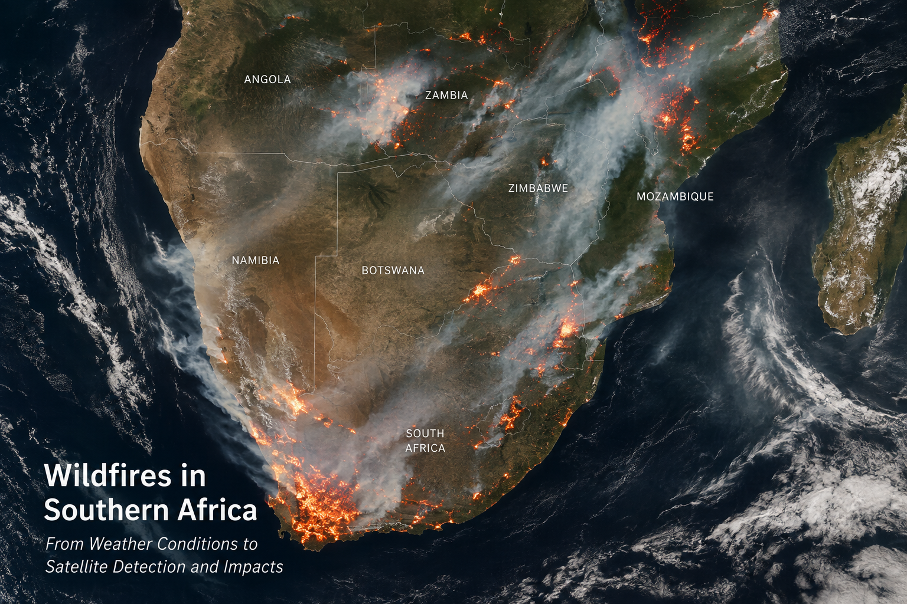
Wildfires in southern Africa: From Weather Conditions to Satellite Detection and Impacts
Image generated using ChatGPT (OpenAI 2026).

Slide 2
Presentation Outline
Why Veld fires matter over southern Africa
Where and when do veld fire occur over southern Africa
Conditions favourable for the development of veld fires in southern Africa
Satellite detection
Western Cape case study
Impacts

Slide 3
Why veld fires matter in southern Africa?
Veld fires are a recurring hazard across Southern Africa.
Fire activity varies strongly with season, climate, vegetation and weather.
Impacts extend beyond the immediate fire area: communities, infrastructure, transport, air quality and ecosystems.

Slide 4
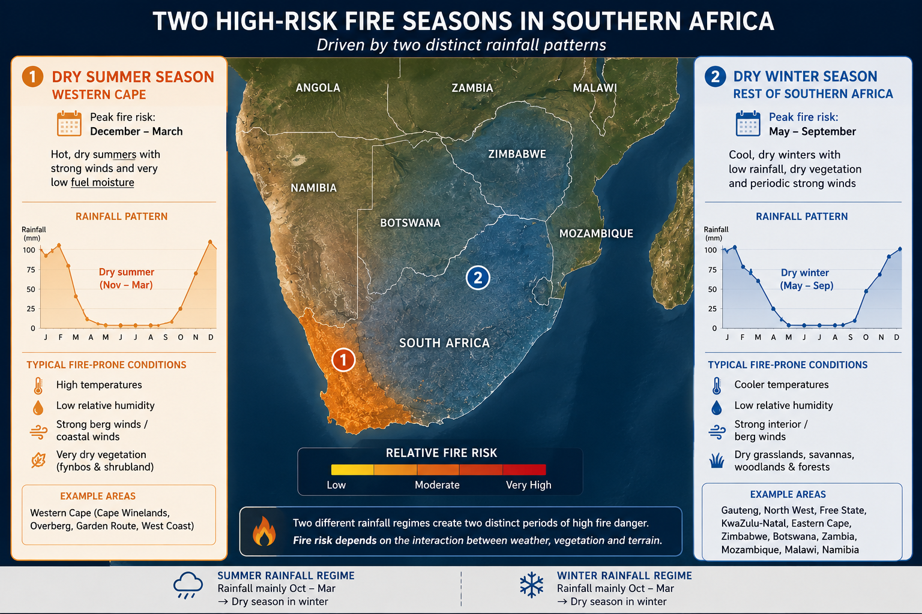
Where and when do they occur?
Figure 1: southern Africa Image generated using ChatGPT (OpenAI 2026).

Slide 5
Typical Conditions favorable for the development of veld fires
Figure 2: southern Africa Image generated using ChatGPT (OpenAI 2026).

Slide 6
Sources of veld fires
Source
Prescribed burning
Accidental burning
Arson
Meteorological ingredients fueling the veld fires
High temperature
Low relative Humidity
High wind speed & direction
Rainfall/antecedent dryness
Environmental ingredients fueling the veld fires
Vegetation
Dry biomass and tall grasses
Invasive Alien vegetation
Interwtwined Canopies

Slide 7
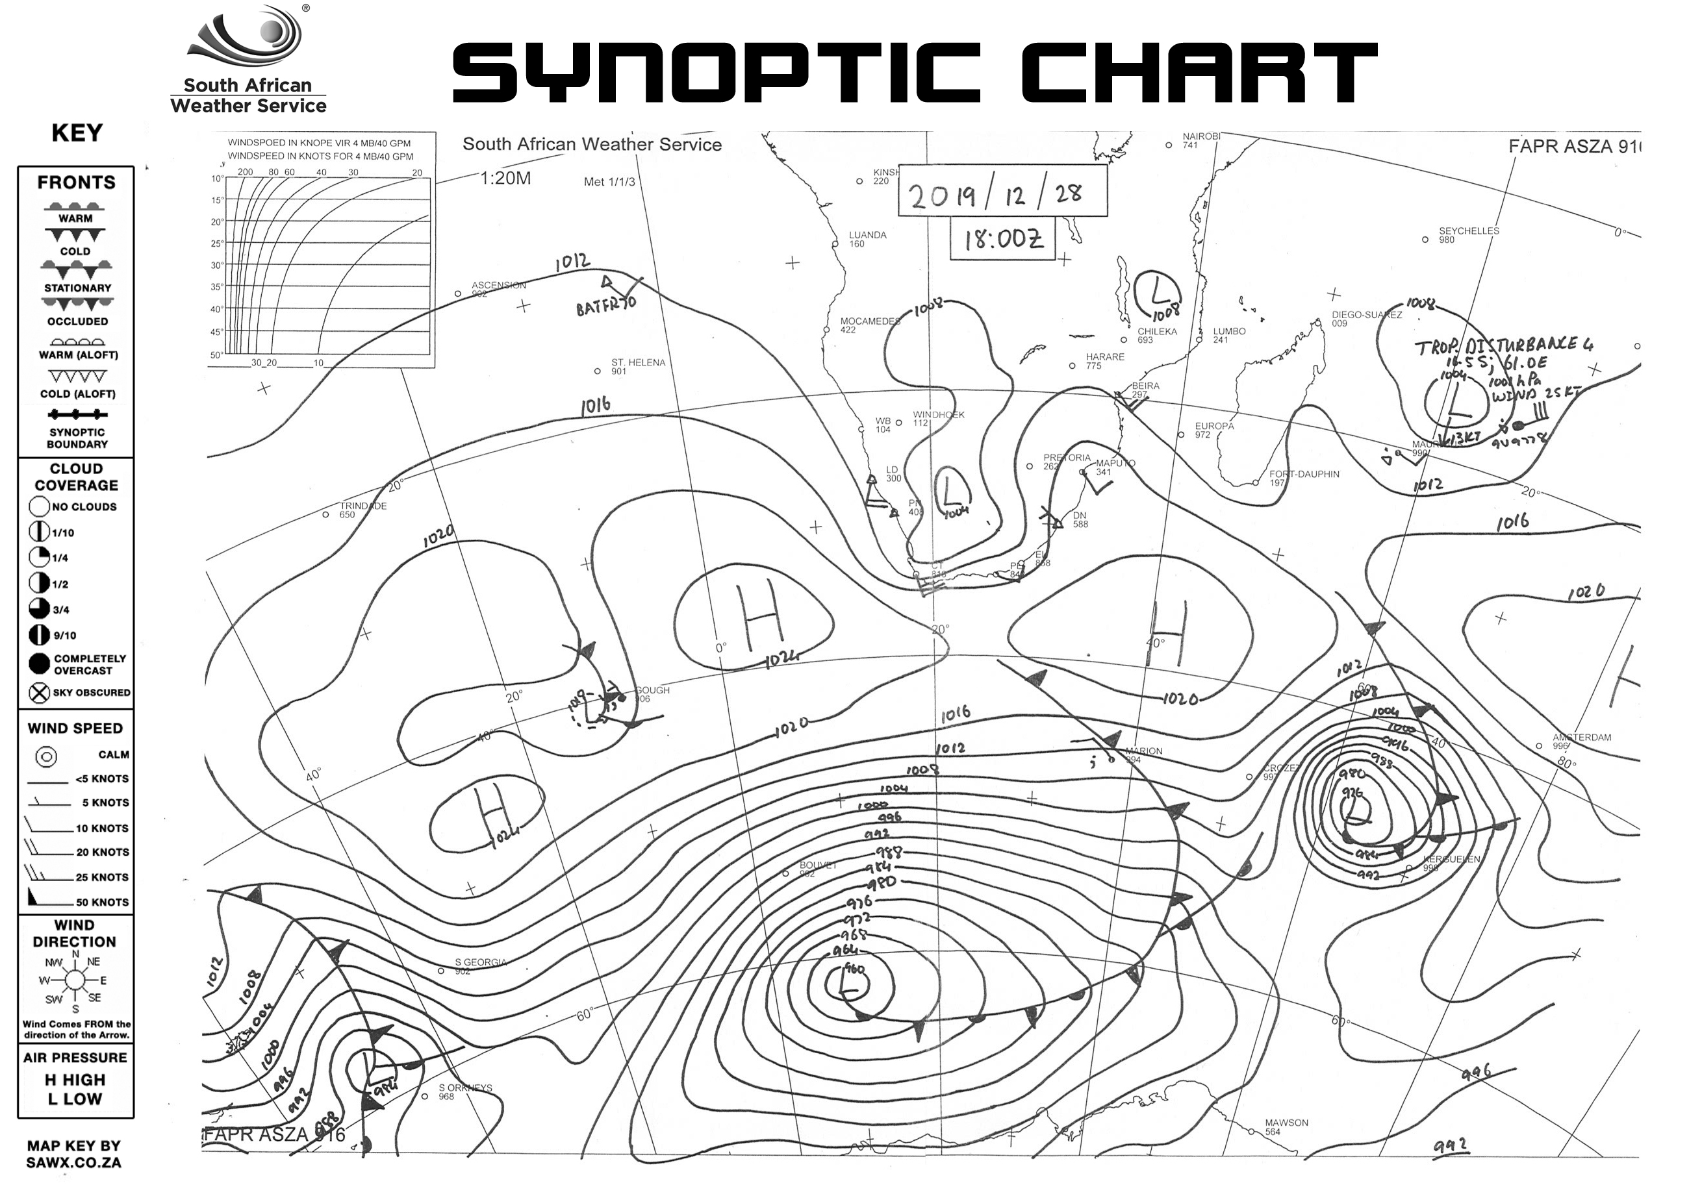
Veld fires: Western Cape Province
How the Cape Doctor Affects Veld Fires
Figure 3: southern Africa Image generated using ChatGPT OpenAI 2026).
Figure 4: Synoptic Chart (SAWS 2019).

Slide 8
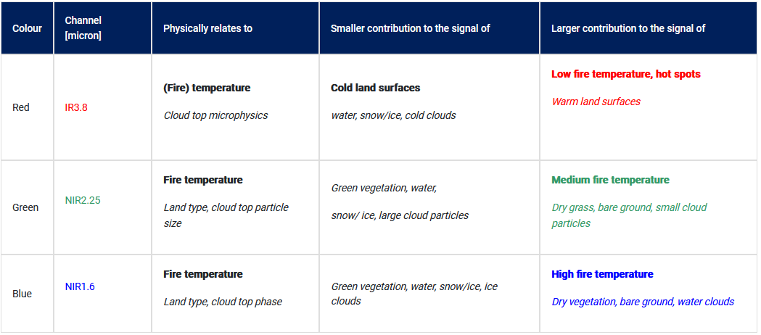
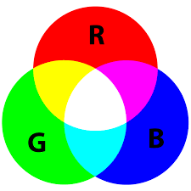
Satellite detection: MTG Fire Temperature
Table 1: MTG Fire temperature RGB recipe (EUMeTrain 2023)
IR3.8 : sensitive to fires that are much smaller than the pixel size
Moderately intense/large fires are detected at both IR3.8 and NIR2.25 channels and appear orange to yellow
Very intense fires are detected by all three bands; hence joint contribution makes them appear white.
Figure 5: RGB (Wikipedia 2026)
Notes:
The term veld fire predominates in Southern Africa and has been increasingly used everywhere in the region

Slide 9
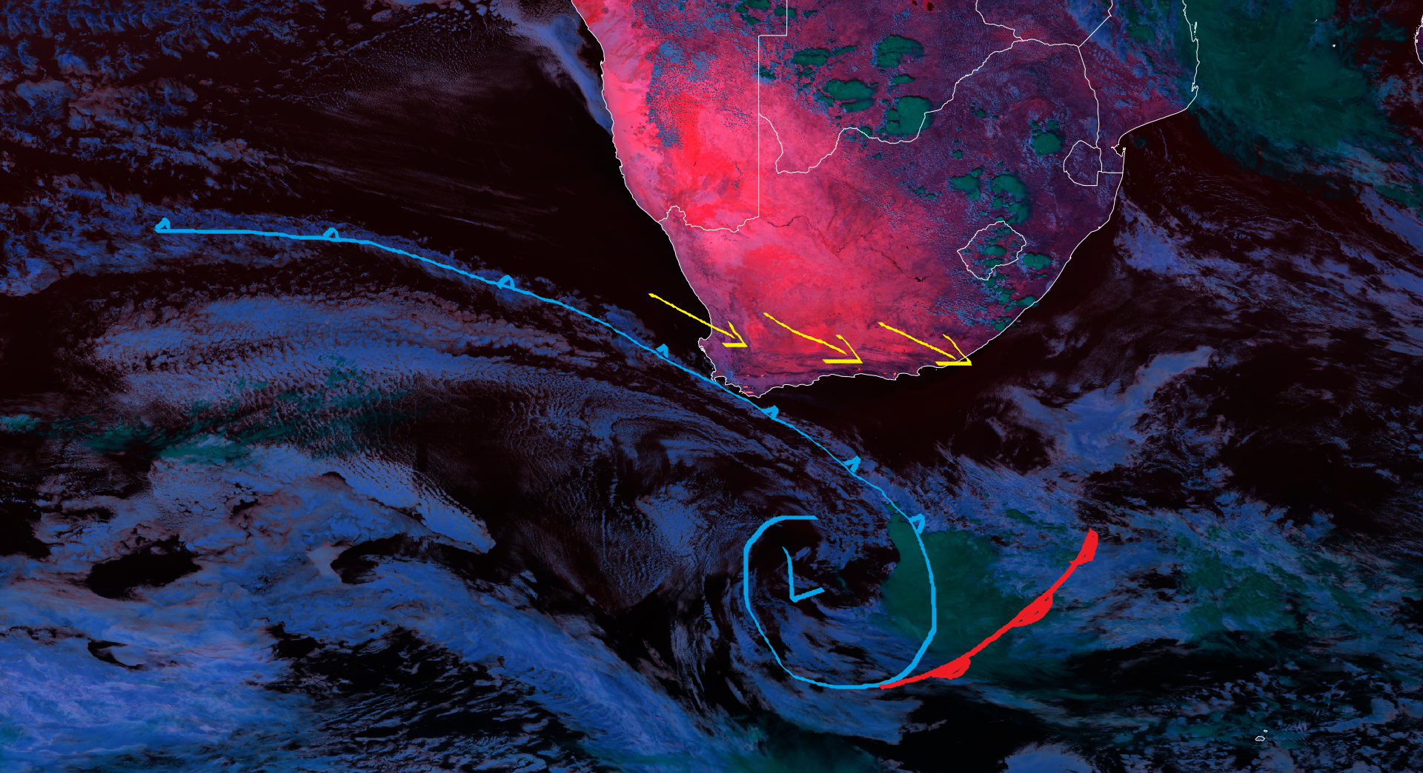
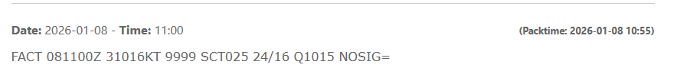
Veld fires: 08 January 2026 Western Cape Province
(SAWS 2026)
Figure 6: Fire Temperature RGB 08 January 2026 (EUMETSAT 2026)

Slide 10
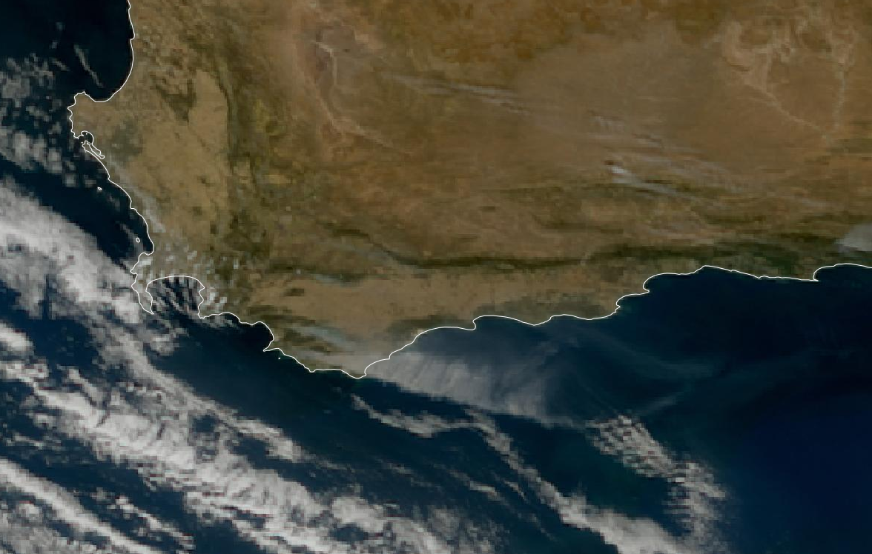
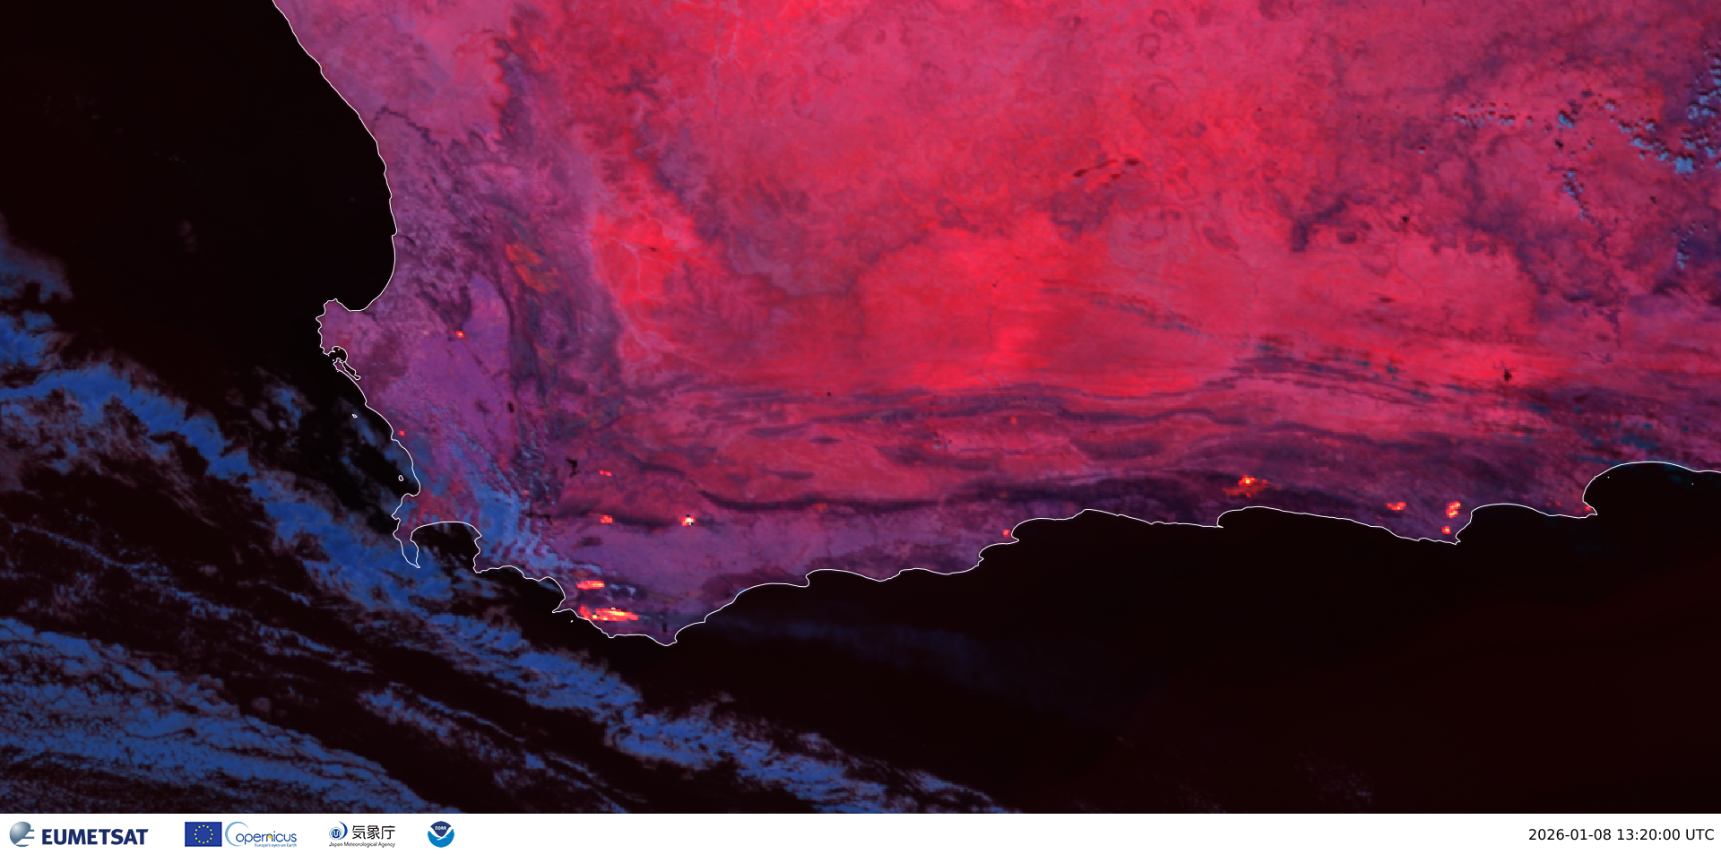
Veld fires: 08 January 2026 Western Cape Province
Figure 7: True Colour RGB 08 January 2026 (EUMETSAT 2026)
Figure 8: Fire Temperature RGB 08 January 2026 (EUMETSAT 2026)

Slide 11
Veld fires: 08 January 2026 Western Cape Province
Figure 9: Fire Temperature RGB 08 January 2026 (EUMETSAT 2026)
Notes:
The term veld fire predominates in Southern Africa and has been increasingly used everywhere in the region

Slide 12
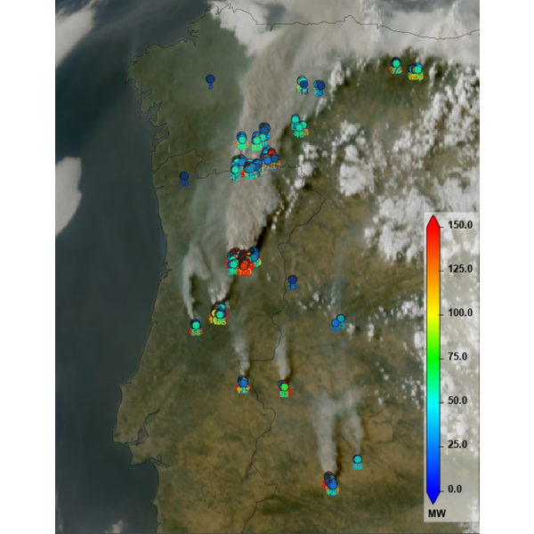
Satellite detection: MTG Fire Radiative Power (FRP) product
FRP estimates the rate at which a detected fire releases energy as electromagnetic radiation, expressed in megawatts (MW).
In simple terms, it tells you how much radiant energy the detected fire is releasing at the time of the satellite observation.
The FRP product is derived every 10 min at the High Resolution of the MTG FCI sensor (1km)
Figure 10: Illustration of FRP product (EUMETSAT 2026)
Figure 6: RGB (Wikipedia 2026)

Slide 13
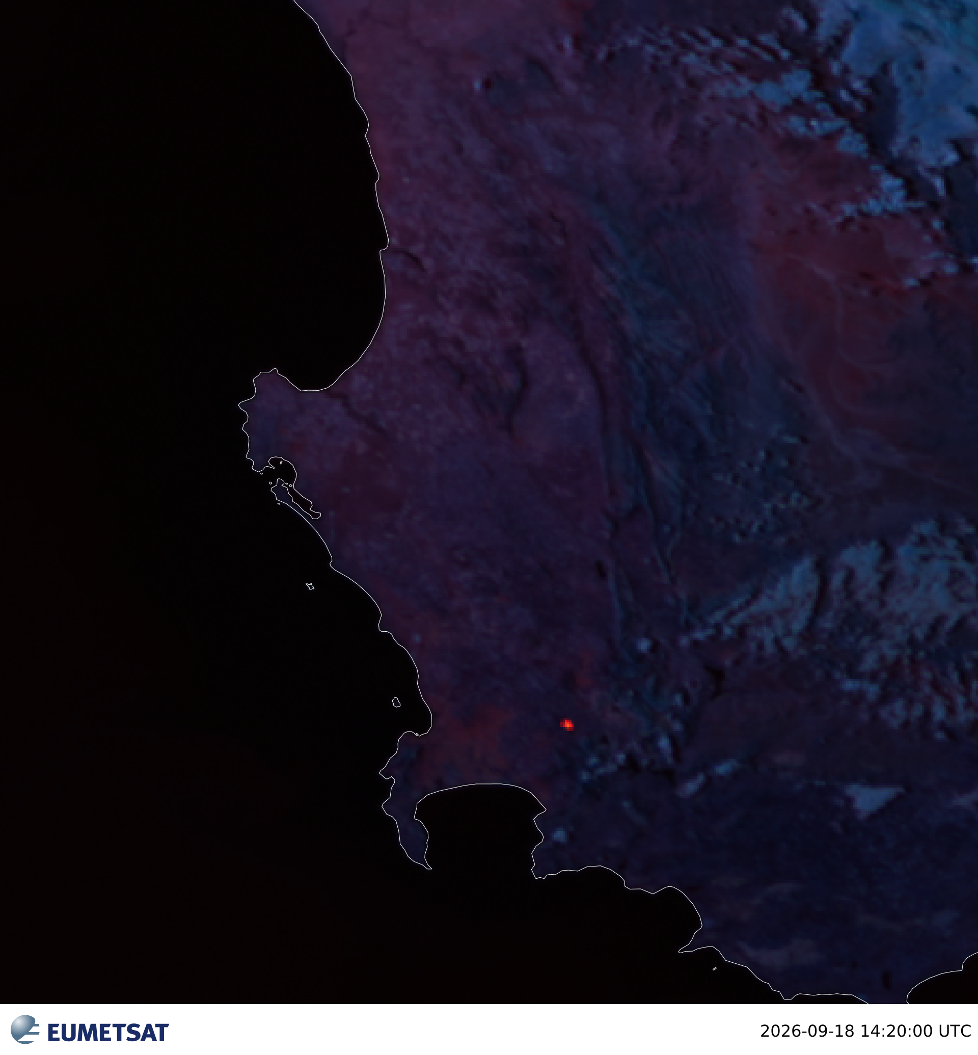
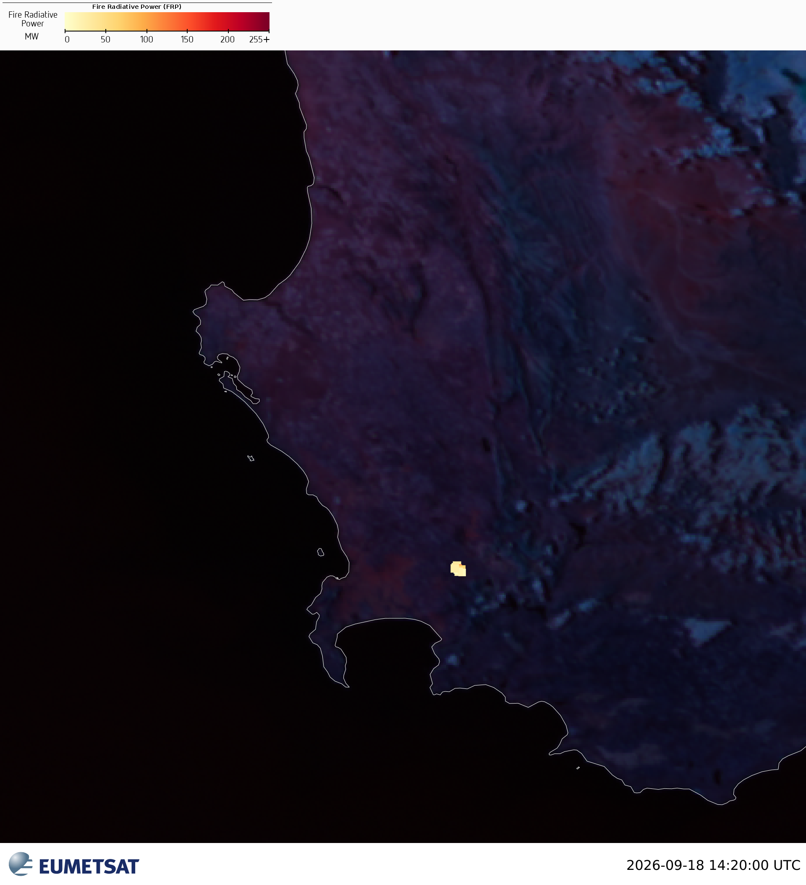
Veld fires: 18 September 2026 Western Cape Province
a
b
Figure 11.a Fire Temperature RGB 14.b Fire Temperature RGB overlaid with FRP (EUMETSAT 2026)
Figure 12: Fire Temperature RGB 08 January 2026 (EUMETSAT 2026)
Notes:
The term veld fire predominates in Southern Africa and has been increasingly used everywhere in the region

Slide 14
Veld fires: 08 January 2026 Western Cape Province
Figure 12: Fire Temperature RGB 08 January 2026 (EUMETSAT 2026)
Notes:
The term veld fire predominates in Southern Africa and has been increasingly used everywhere in the region

Slide 15
Veld fires: Impacts
In general
People
Evacuations
Health impacts
Smoke exposure
Fire crews and local fire fighting associations worked under near-zero visibility to block runaway veld fire threatening several areas.
Environment
Ecosystem damage
Soil degradation
Carbon emissions
08 January 2026 Fire event
Fast-moving blaze damaged homes and structures burning roughly 1,800 hectares with evacuations and road closures in progress.
Transport
Reduced visibility
Road closures
Aviation impacts
Over 100 000 hectares had scorched in the Western Cape, at least 10 homes destroyed in the Mossel Bay/Garden Route area. There were power outages in several areas due to tripped power lines.
Infrastructure
Roads
Power lines
Buildings
Telecommunications

Slide 16

Key take-home messages
Fire danger depends on the interaction between weather conditions, fuel and ignition.
Satellite observations help detect and monitor active fires.
Combining satellite data, weather forecasts and local information supports better situational awareness, subsequently assisting emergency personnel to contain active hazardous fires.

