Slide 1
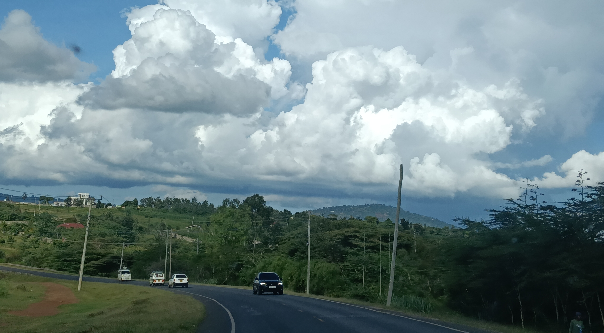
CONVECTION IN THE TROPICS
EVENT WEEK ON TROPICAL METEOROLOGY · 20 OCTOBER 2026
Mirriam Mwende Musyoka ·
Meteorologist, JKIA Met office and Trainer, IMTR Regional Training Centre, Nairobi

Slide 2
OVERVIEW
Deep moist convection is the principal producer of high-impact weather in the tropics
01
02
Seasonal dynamics
Hazards and impacts
How the migrating ITCZ, the monsoonal and bimodal rainfall regimes of equatorial regions, the afternoon-to-evening convective maximum, land–water breeze interactions, the Madden–Julian Oscillation and the Indian Ocean cyclone season together decide when and where convection forms.
Heavy rainfall and flash flooding, lightning, hail, damaging downdraughts and gust fronts, and visibility-reducing phenomena — for communities (loss of life, displacement, damage to infrastructure and agriculture, disruption of surface transport) and for aviation.
03
04
Forecasting and nowcasting
An operational case study
Satellite imagery and derived products, lightning detection, rapidly developing convective systems, storm-cell tracking and extrapolation, convection-permitting NWP, ensemble guidance and post-processing, and observational monitoring from surface networks, radiosondes and AMDAR — and how they are integrated into warning services.
The 6–7 March 2026 floods across East Africa: a high-impact convective episode with a documented forecast, warning, monitoring and impact chain spanning 30 counties in Kenya — and lessons for our own operations and for the warning service.
Convection in the Tropics · EUMeTrain Event Week on Tropical Meteorology 2026
2
Notes:
Signpost the four blocks of the presentation and set the expectation that they are interlinked.

Slide 3
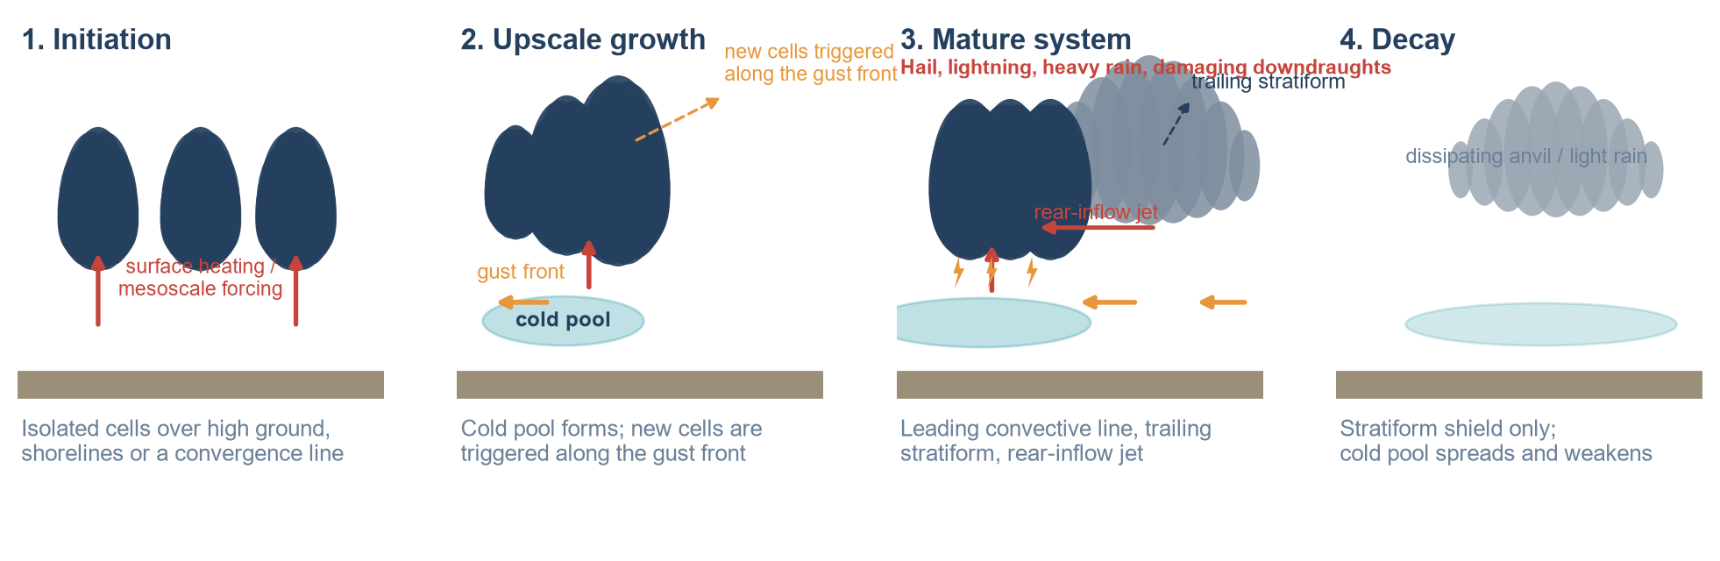
SEASONAL DYNAMICS · 7
Mesoscale convective systems: structure and lifecycle
MCSs are the dominant rain-producing and hazard-producing systems of the tropics. Their lifecycle is predictable in principle — and it is the basis of most severe-weather nowcasting.
Initiation & upscale growth
The mature system
Decay
Surface heating, terrain and convergence lines initiate cells. The cold pool spreads as a gust front, re-triggering new cells along its leading edge.
Leading convective line, trailing stratiform and a rear-inflow jet. This stage delivers the full hazard set: hail, lightning, torrential rain, damaging outflow.
The cold pool outruns and undercuts the inflow; the system weakens to a stratiform shield, leaving an anvil that can persist for hours.
Convection in the Tropics · EUMeTrain Event Week on Tropical Meteorology 2026
10
Notes:
Walk the four stages and note that the mature stage delivers the entire hazard set at once.

Slide 4
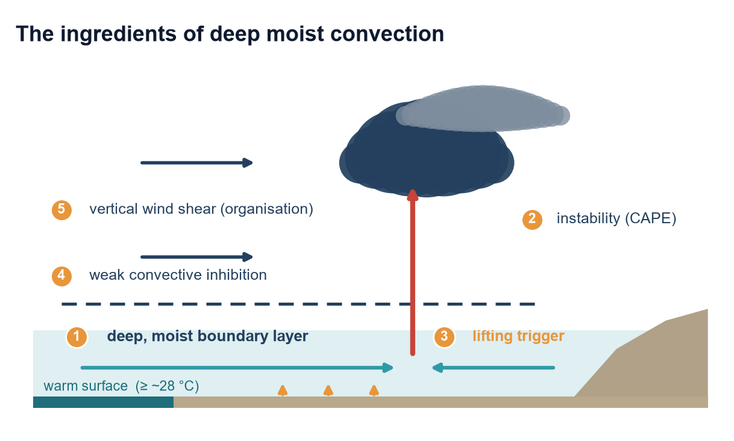

SEASONAL DYNAMICS · 1
The factors required for the development of deep convective systems
The tropics absorb the bulk of the planet's solar energy, so deep convection is the default state — but it still needs five ingredients at the same time and in the same place.
1 · Moisture. A deep, humid boundary layer at high equivalent potential temperature, kept supplied by monsoon flow and the low-level jet.
2 · Instability. Conditional instability: a steep lapse rate and large CAPE, built by strong surface heating over warm, moist low levels.
3 · Lift. A trigger strong enough to release the instability — surface heating, breeze and gust fronts, high ground, ITCZ convergence.
4 · Weak inhibition. A cap shallow enough for the day's heating, or for a passing boundary, to break.
5 · Organisation. Vertical wind shear keeps the updraught and the downdraught apart, so the storm grows, organises and lasts into the night.
CB clouds over Nairobi, 9th April 2025
The five ingredients, and the large-scale setting that decides how often they coincide. Badge numbers match the list on the left.
Convection in the Tropics · EUMeTrain Event Week on Tropical Meteorology 2026
4
Notes:
Set the physical baseline: the tropics are conditionally unstable by default, so convection is the norm and the forecast problem is one of timing, location and organisation.

Slide 5
01
Seasonal dynamics
When and where tropical convection forms
Migration of the ITCZ — the monsoonal bimodal rainfall regime, meridional and zonal
Insolation as a trigger — the afternoon-to-evening convective maximum
Land and sea breeze activity and its role in creating deep convective systems
The role of the MJO in the formation of deep convective systems
The role of Indian Ocean tropical cyclones in deep convective storms
Notes:
Part 1 divider: when and where tropical convection forms.

Slide 6
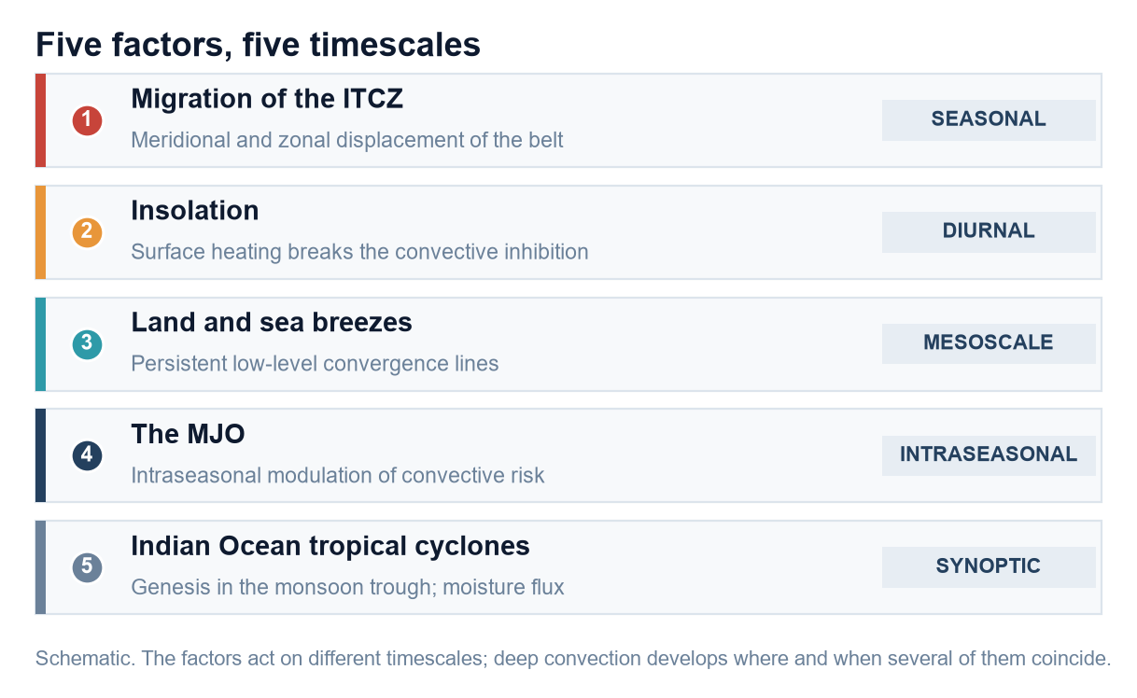
SEASONAL DYNAMICS · 2
Factors that lead to development of deep convective systems in tropical regions
Five factors decide when and where deep convection develops over equatorial East Africa. They act on five different timescales — and each of them is separately forecastable.
1 · Migration of the ITCZ, leading to the monsoonal bimodal rainfall regime — meridional (the seasonal north–south migration, with the belt crossing the equator twice each year) and zonal (east–west displacement through interaction with the Congo air mass).
2 · Insolation as a trigger for deep convective systems, leading to an afternoon-to-evening maximum over land.
3 · Land and sea breeze activity and its role in creating and organising deep convective systems.
4 · The MJO and its role in the formation of deep convective systems.
5 · Tropical cyclones in the Indian Ocean and their role in the development of deep convective storms.
The five factors, and the timescale on which each one acts. Deep convection develops where and when several of them coincide.
Operationally this is the whole problem: because the factors act on different timescales, the forecast question is not whether convection will occur, but which factors will line up first — and where.
Convection in the Tropics · EUMeTrain Event Week on Tropical Meteorology 2026
5
Notes:
Walk the five factors, each on its own timescale, and stress that none of them acts alone: the forecast question is rarely whether convection will occur, but which of these will line up first, and where.

Slide 7
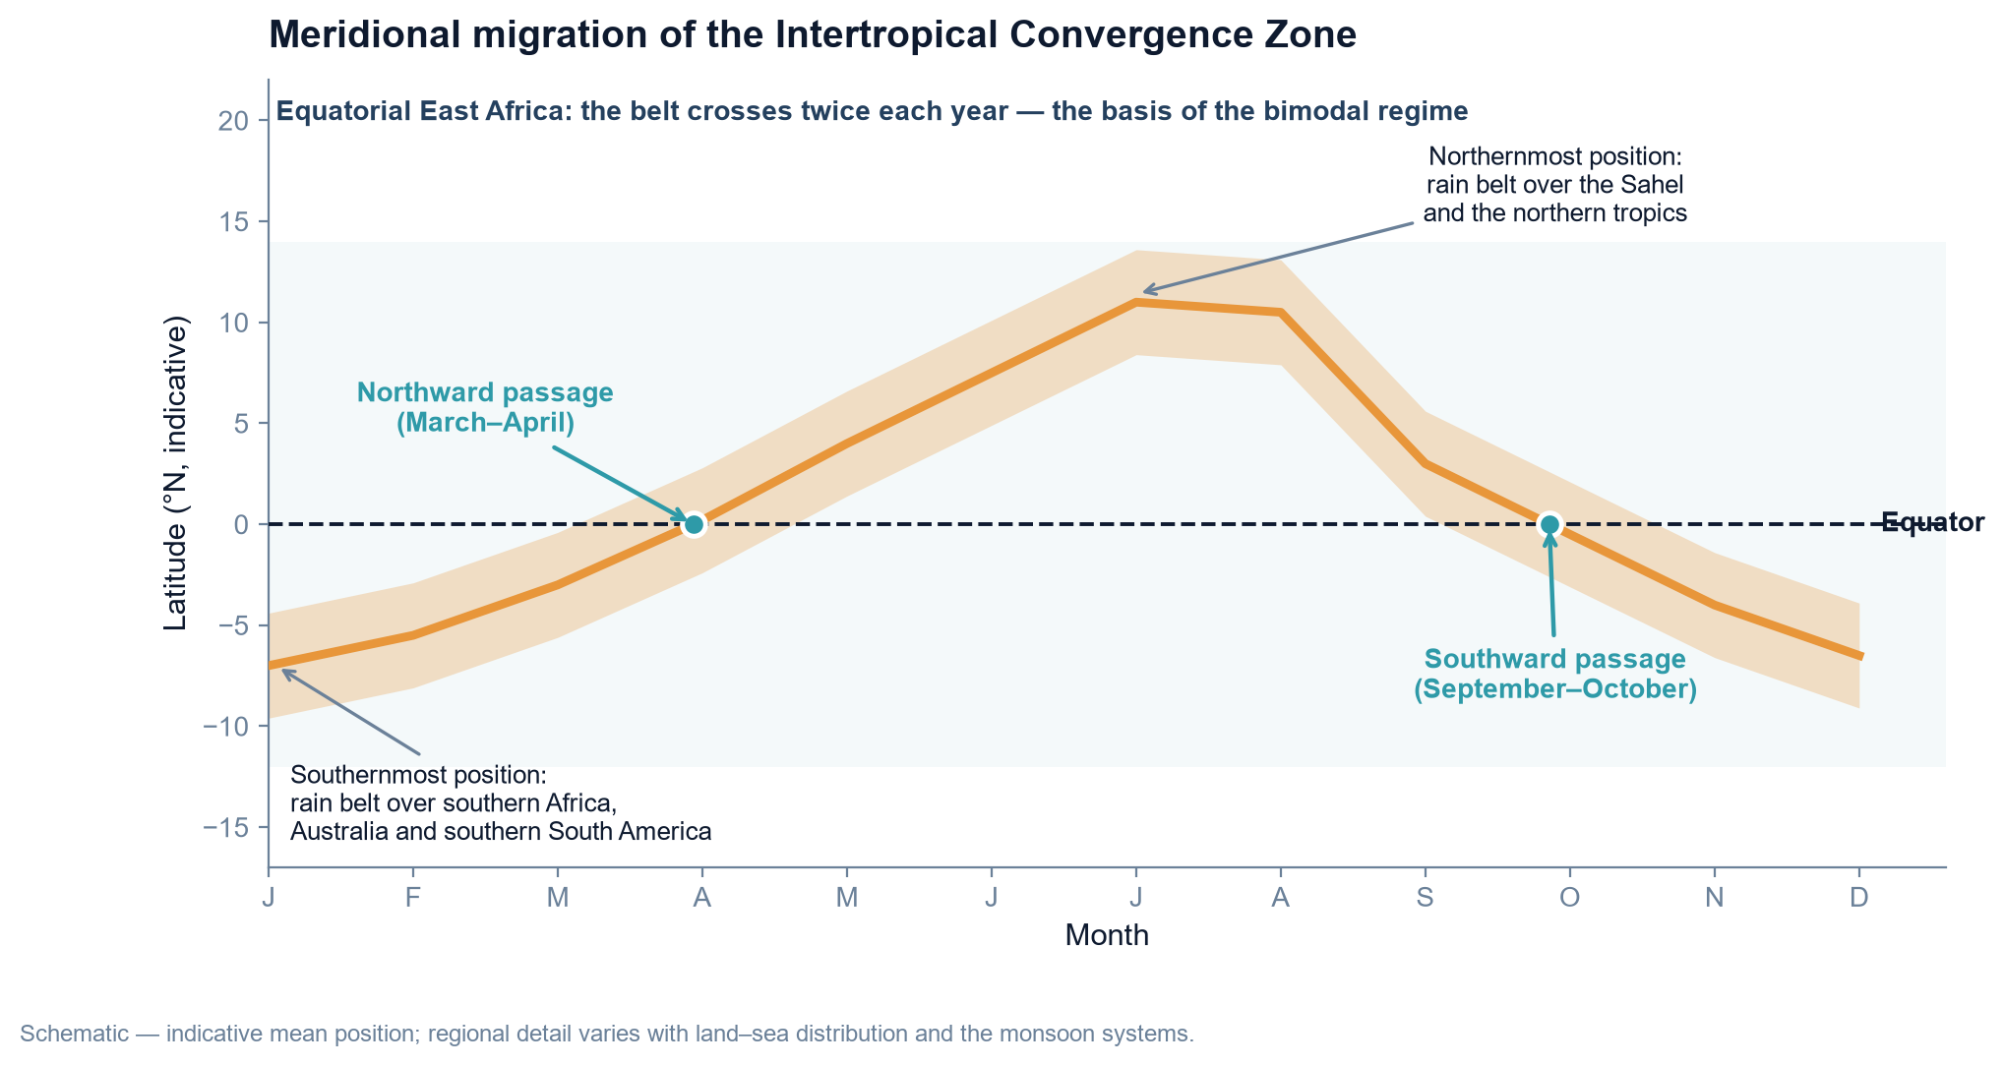
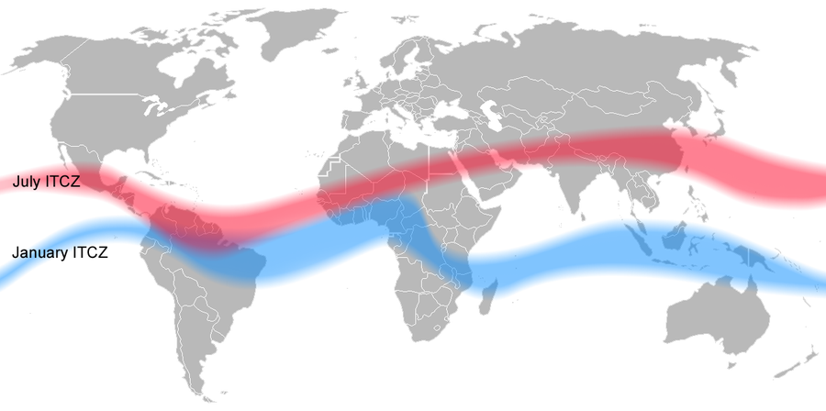
SEASONAL DYNAMICS · 3
Migrating with the sun: the Intertropical Convergence Zone
The ITCZ is the near-equatorial belt where the trade winds of the two hemispheres meet. It is where the largest share of tropical convection is organised — but it is a moving convergence zone, not a fixed line.
Meridional migration follows the seasonal cycle of solar heating: the belt reaches its northernmost position (about 10–15°N over Africa) in July and its southernmost position in January.
Zonal (east–west) migration through interaction with the Congo air mass — and features such as the Congo Air Boundary — adds a second axis of variability over Africa; the double-ITCZ pattern is also visible over the Pacific.
Over equatorial East Africa the belt crosses the equator twice each year — the basis of a bimodal rainfall regime.
Schematic of the meridional migration. Regional detail varies with the land–sea distribution and the monsoon systems.
Observed ITCZ position in January and July (Mats Halldin, public domain).
Convection in the Tropics · EUMeTrain Event Week on Tropical Meteorology 2026
6
Notes:
Stress that the ITCZ is a migration, not a line - meridionally with the sun and zonally through interaction with the Congo air mass - and that the double crossing over equatorial East Africa is what creates the bimodal regime.

Slide 8
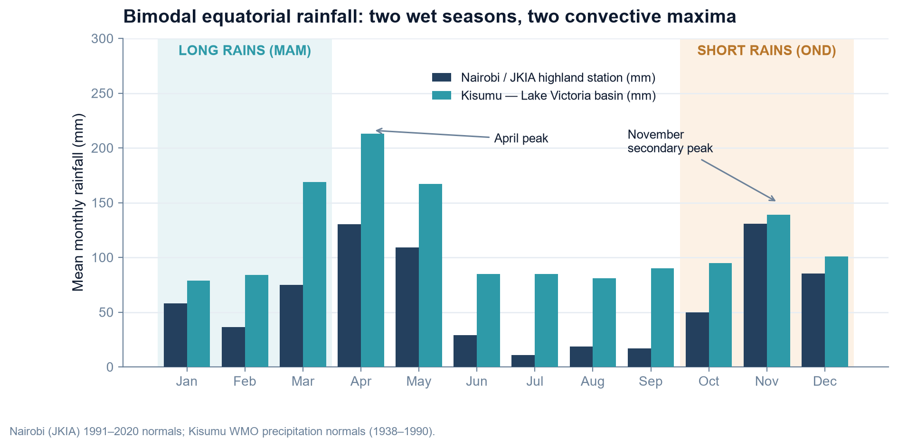
SEASONAL DYNAMICS · 4
The monsoonal bimodal rainfall regime
Where the ITCZ crosses twice, the annual cycle is bimodal: the long rains and the short rains, with dry seasons in between.
Long rains (MAM)
The first passage of the belt northwards. The primary wet season over much of East Africa, and the season in which most of the March–May flood events occur.
Short rains (OND)
The second passage, southwards. Shorter but strongly modulated by the MJO and by Indian Ocean sea-surface temperatures.
Monsoonal contrast
Where the seasonal reversal is strong — the Indian subcontinent, the West African monsoon — a single intense wet season replaces the bimodal pattern.
Nairobi (JKIA) and Kisumu monthly rainfall normals. Sources: Nairobi 1991–2020 normals (Deutscher Wetterdienst / Starlings Roost); Kisumu WMO normals.
Convection in the Tropics · EUMeTrain Event Week on Tropical Meteorology 2026
7
Notes:
Contrast the bimodal equatorial regime with the single-peak monsoonal regime, and point out that the long rains are the season of most flood events.

Slide 9
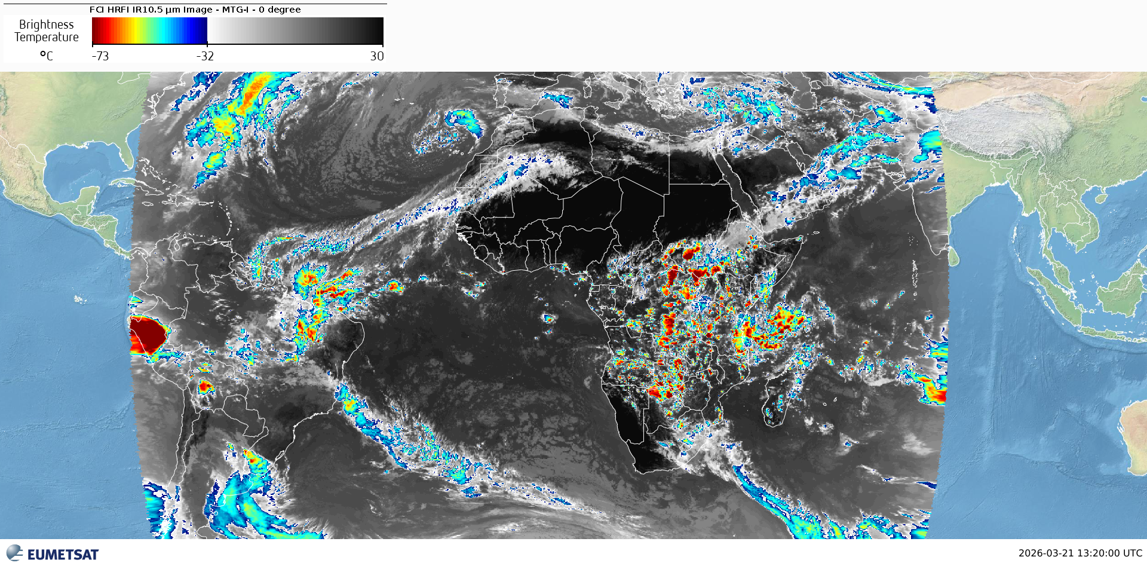
23rd March 2026

Slide 10
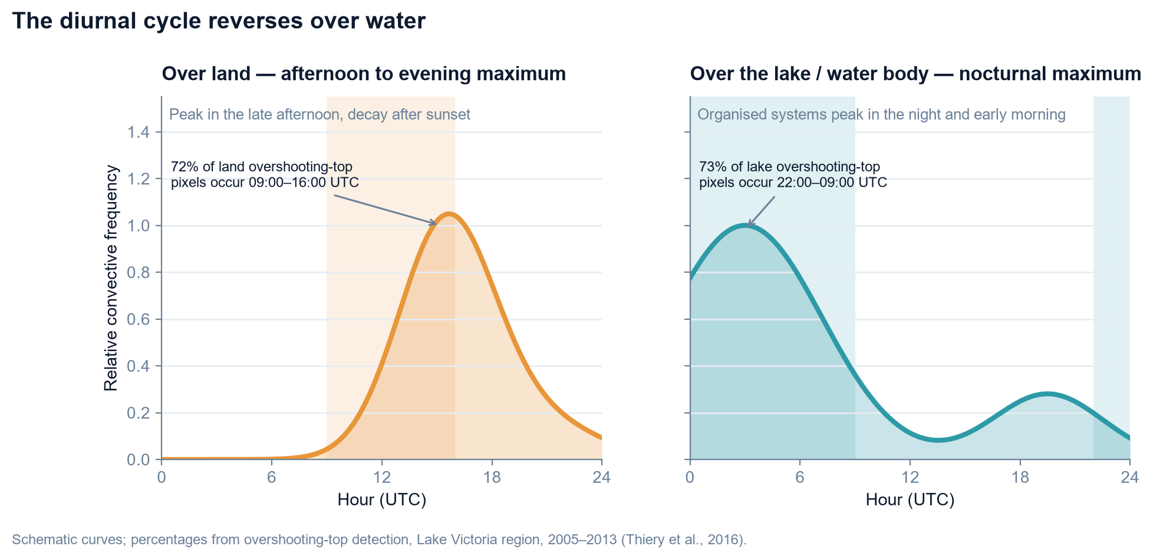
SEASONAL DYNAMICS · 5
Insolation as a trigger: the afternoon-to-evening maximum
The diurnal cycle is the single most predictable element of tropical convection — and the one most often missing from coarse forecast guidance.
Insolation is the trigger. Daytime surface heating deepens the boundary layer and breaks the convective inhibition, so over land the maximum runs from afternoon into the early evening, as the CAPE built during the day is released.
Over large water bodies the cycle reverses: the maximum shifts into the night and early morning. A warm lake loses heat only slowly, so convection over it peaks when the surrounding land has cooled.
Two further mechanisms reinforce the night-time maximum: reduced entrainment of dry air into the updraughts at night, and long-lived mesoscale systems that initiate in the late afternoon and propagate through the night.
Operational consequence: the "quiet" evening and overnight hours are frequently the most dangerous, and the least well staffed.
Idealised diurnal cycle of convection over land compared with a large tropical water body.
Convection in the Tropics · EUMeTrain Event Week on Tropical Meteorology 2026
8
Notes:
The key operational point: the diurnal maximum reverses over water, so the dangerous hours over the lake are the night hours.

Slide 11
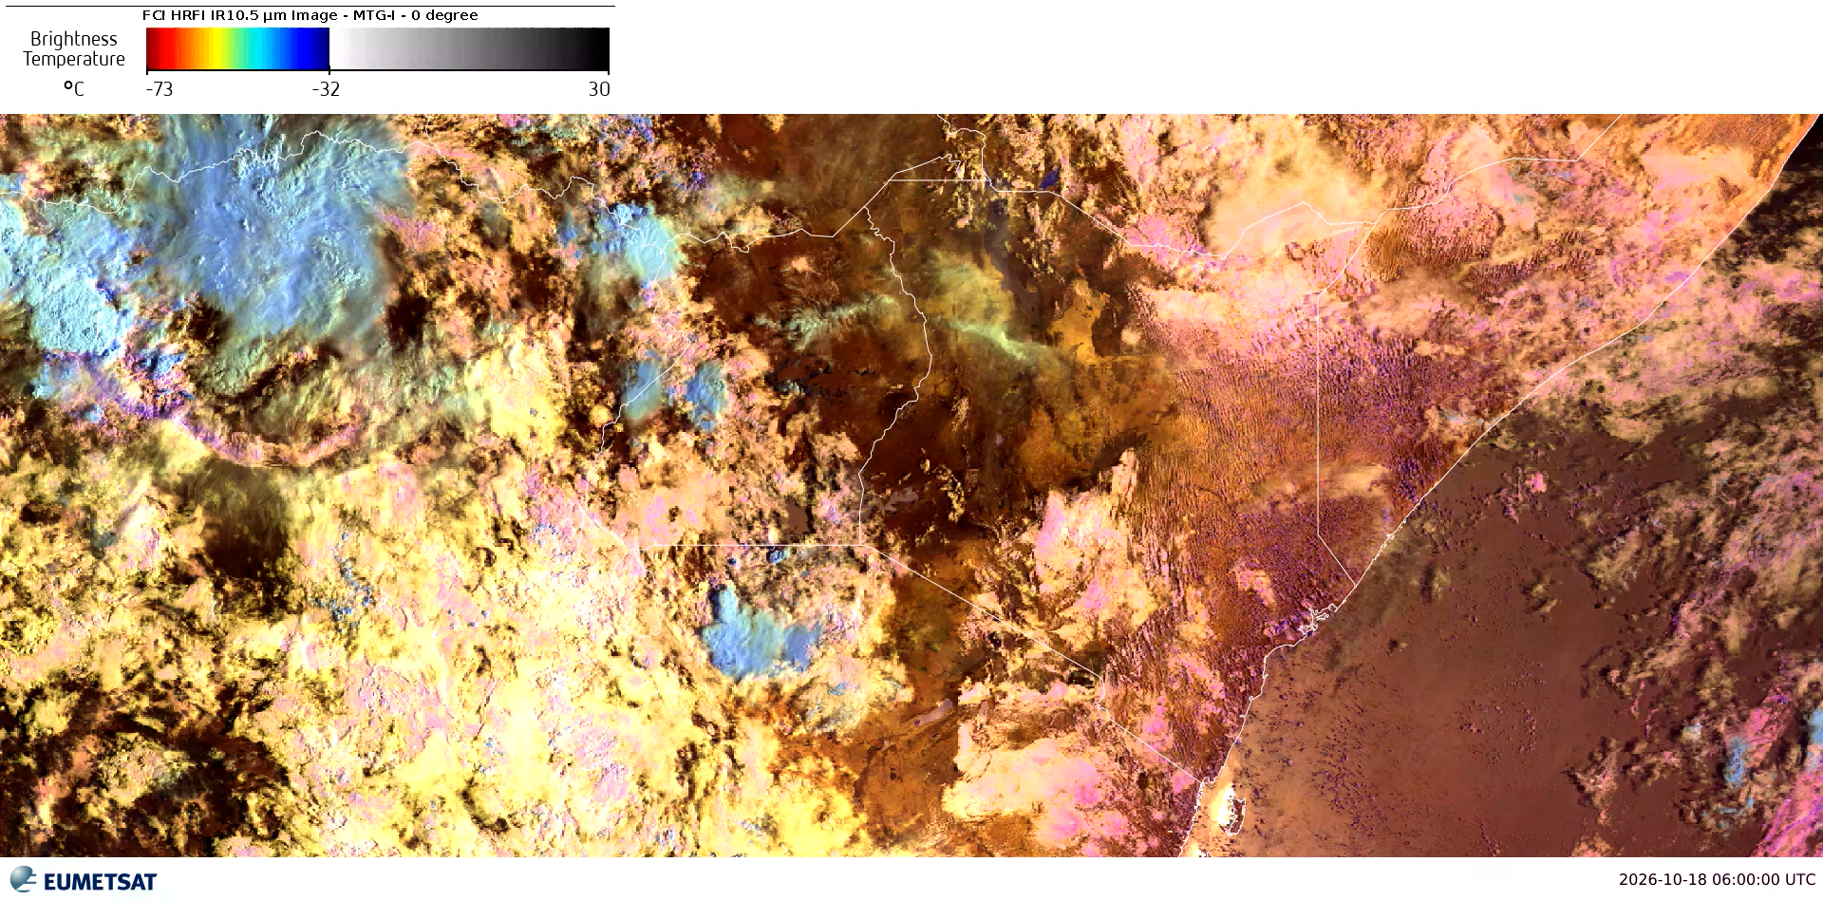

Slide 12
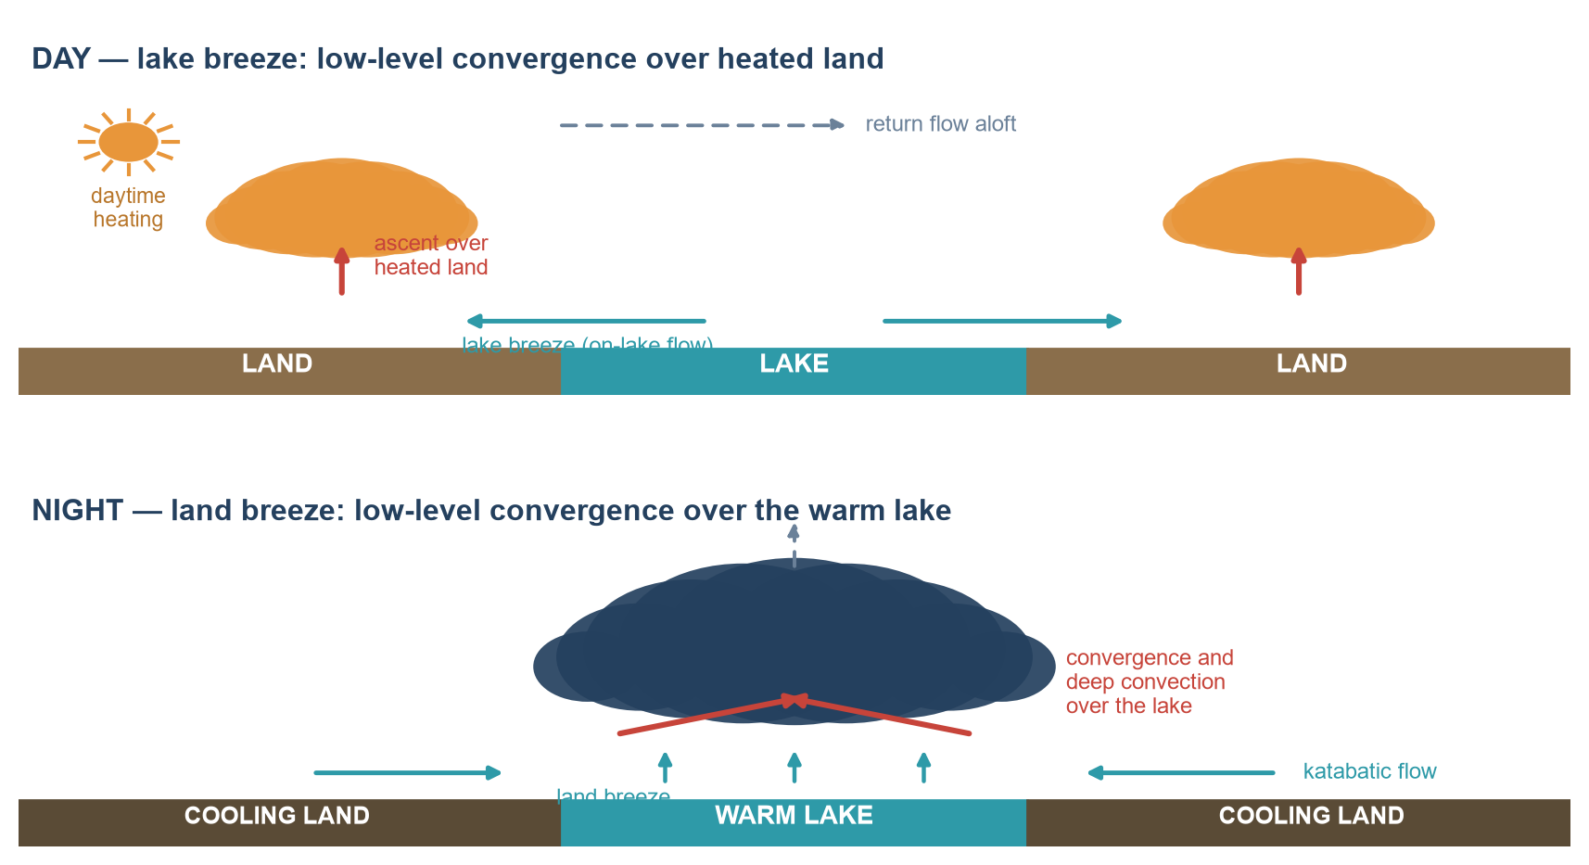
SEASONAL DYNAMICS · 6
Land and sea breeze activity: how they create deep convective systems
Differential heating between land and water drives a diurnal circulation: a lake/sea breeze by day and a land breeze by night.
By day the breeze converges over the heated land, triggering convection along a coastline-parallel line. By night the circulation reverses and converges over the warm water.
These boundaries act as persistent low-level convergence lines: they organise scattered showers into long-lived mesoscale convective systems and repeatedly re-trigger cells along the same axis.
The effect appears over lakes, along coasts and adjacent to any large water body — and it is strongest where the land–water thermal contrast is largest.
Day (lake breeze, convergence over heated land) compared with night (land breeze, convergence over the warm lake).
Convection in the Tropics · EUMeTrain Event Week on Tropical Meteorology 2026
9
Notes:
Explain how a persistent breeze boundary organises scattered showers into a long-lived MCS.

Slide 13
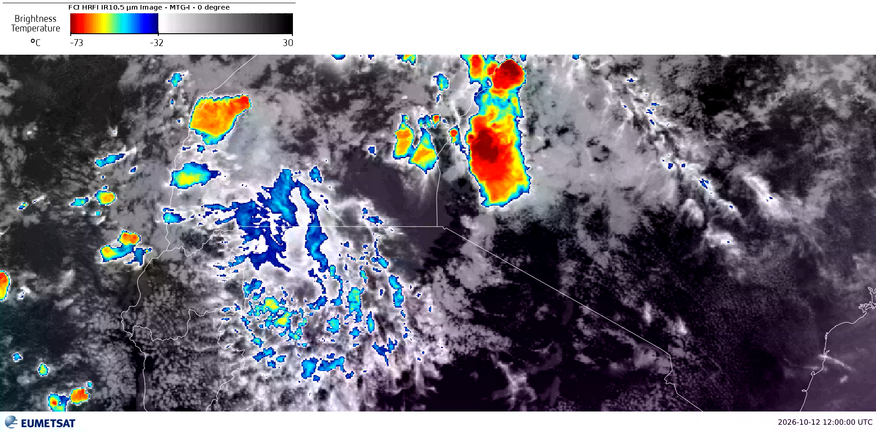

Slide 14

SEASONAL DYNAMICS · 8
A regional hotspot: nocturnal MCSs over Lake Victoria
The clearest illustration of the breeze mechanism — and the deadliest convective hazard in our region.
Nocturnal, and over the water. In the 2019 HIGHWAY campaign the organised systems formed and grew upscale overnight over the lake, while the surrounding land peaked in the afternoon (del Moral Méndez et al., 2025).
The land sets up the night. Cold pools from evening storms on the western highlands strengthen the land breeze; extreme nights differ from ordinary ones by dynamical forcing, not by instability (Glazer et al., 2025).
Two modes carry the hazard. March–May: steep low-level lapse rates give strong downdrafts and damaging straight-line winds. October–December: linear systems with dry mid-levels give severe gusts through evaporative cooling (del Moral Méndez et al., 2025).
The toll stays extreme. Drowning rates of 231 per 100,000 in Tanzanian and 502 per 100,000 in Ugandan lakeside communities, 81% while fishing (Whitworth et al., 2019). On 29 December 2025 five fishers drowned off Dho-Goye, Siaya.
~1,000
Weather-related deaths a year on the lake — the baseline now used, replacing older 3,000–5,000 estimates (Watkiss et al., 2020; Glazer et al., 2025)
200,000
Fishers on the lake, in a fishery worth about US$350 million a year (LVFO, 2022)
>30 m/s
Projected severe wind gusts, with rain peaks above 50 mm/h: mean lake rainfall falls while extremes strengthen (Van de Walle et al., 2021)
Small open boats on Lake Victoria, the only craft most fishers can afford. Photo: Geossegawa / https://commons.wikimedia.org/wiki/File:Men_fishing_on_lake_Victoria_in_Uganda.jpg, CC BY 4.0.
Convection in the Tropics · Mirriam Mwende Musyoka
11
Notes:
Make the mechanism concrete and current: the lake peaks at night while the land peaks in the afternoon, cold pools from the western highlands set up the night-time breeze, and the two wet seasons carry different wind hazards. Then land the cost: about 1,000 weather-related deaths a year, and five fishers lost off Siaya in December 2025.

Slide 15
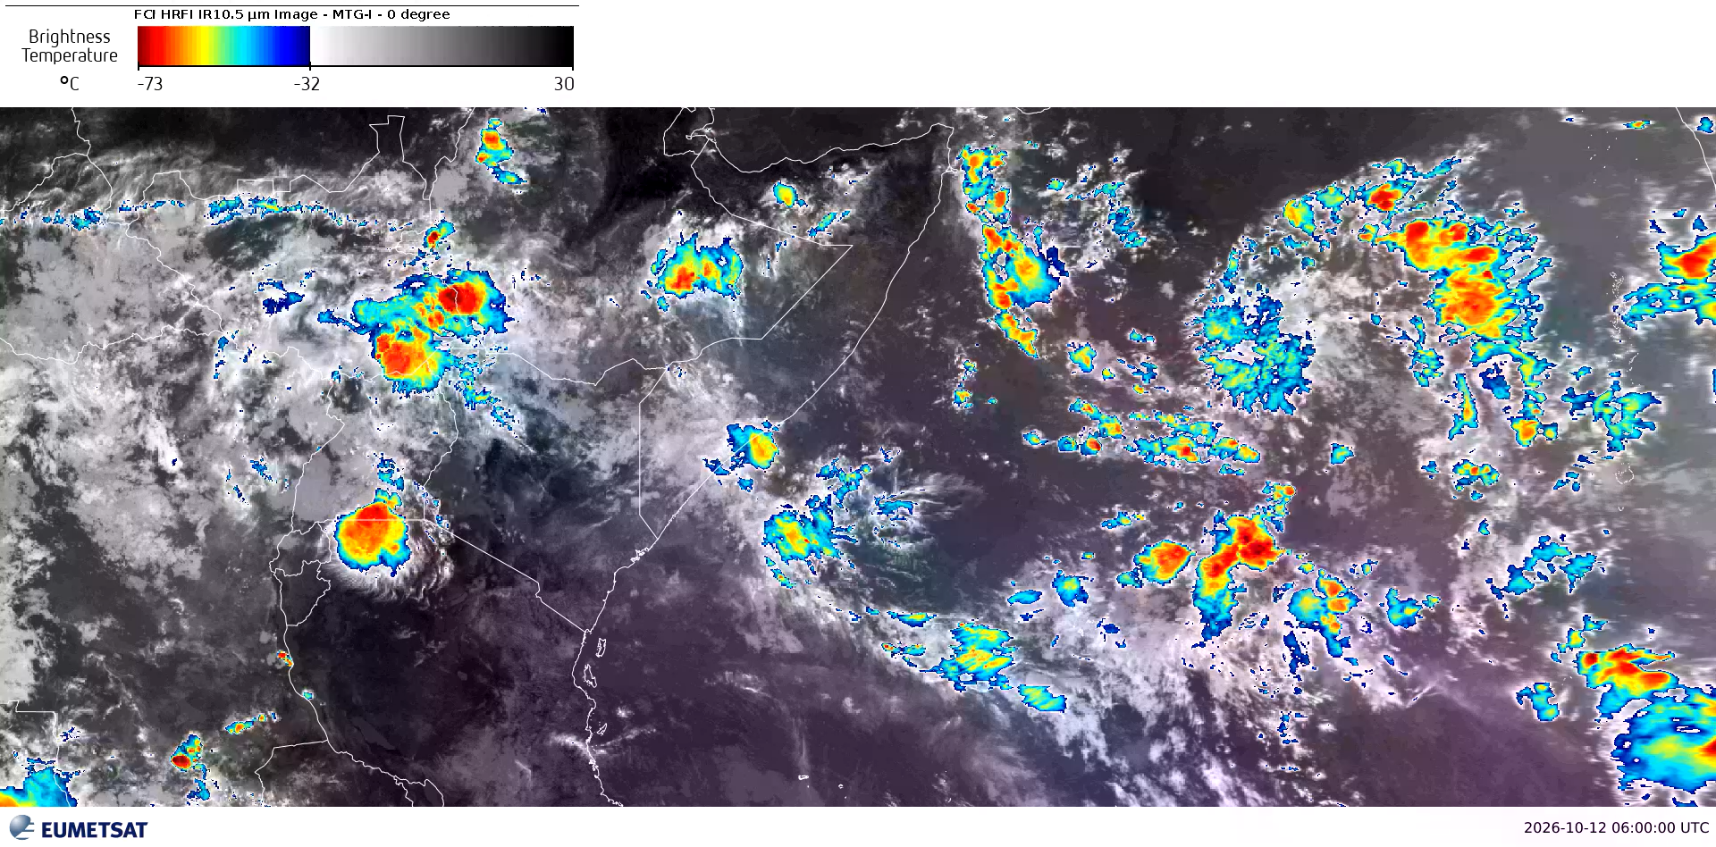

Slide 16
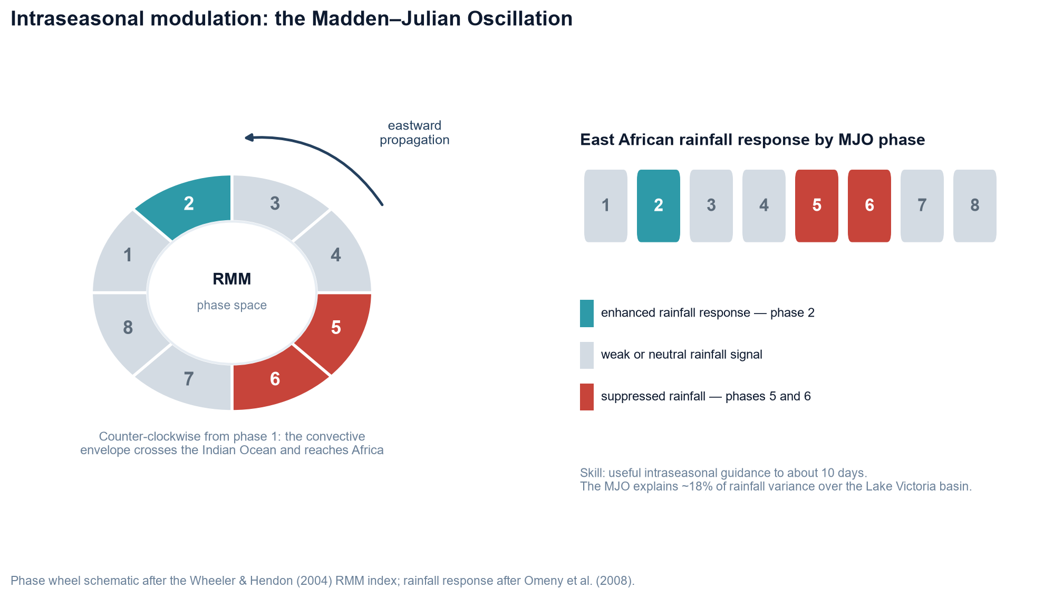
SEASONAL DYNAMICS · 9
The role of the MJO in the formation of deep convective systems
Between the diurnal cycle and the seasonal cycle sits the MJO — the dominant mode of intraseasonal variability, and our best source of convective risk guidance two to three weeks ahead.
A coupled circulation–convection envelope propagating slowly eastwards, tracked operationally in the Wheeler and Hendon real-time multivariate (RMM) phase space, phases 1–8 with amplitude.
East African rainfall is strongly associated with the MJO, especially to the west of the region, around the Lake Victoria basin (Omeny et al., 2008).
Phase 2 coincides with enhanced rainfall, strongly negative OLR anomalies and a westerly/easterly wind configuration at 700 and 200 hPa; phases 5 and 6 are associated with suppressed rainfall.
Skillful rainfall prediction at the intraseasonal scale is possible up to about 10 days; the MJO indices explain roughly 18% of the variance over the Lake Victoria basin, and show little skill over the eastern parts of East Africa.
RMM phase space (after Wheeler and Hendon, 2004) and the East African rainfall response by MJO phase (after Omeny et al., 2008).
Convection in the Tropics · EUMeTrain Event Week on Tropical Meteorology 2026
12
Notes:
Place the MJO as the two-to-three week risk signal, with phases 2 and 5-6 as the enhanced and suppressed phases over East Africa.

Slide 17
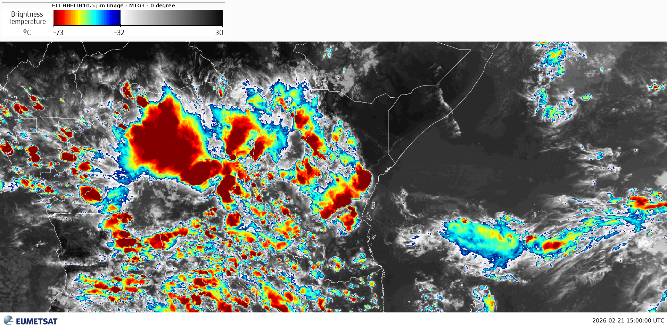
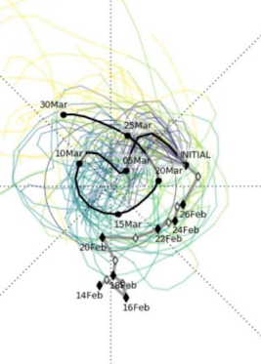

Slide 18
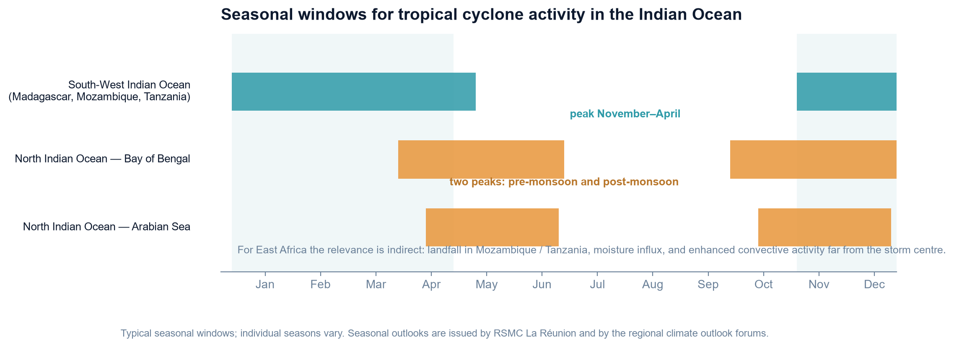
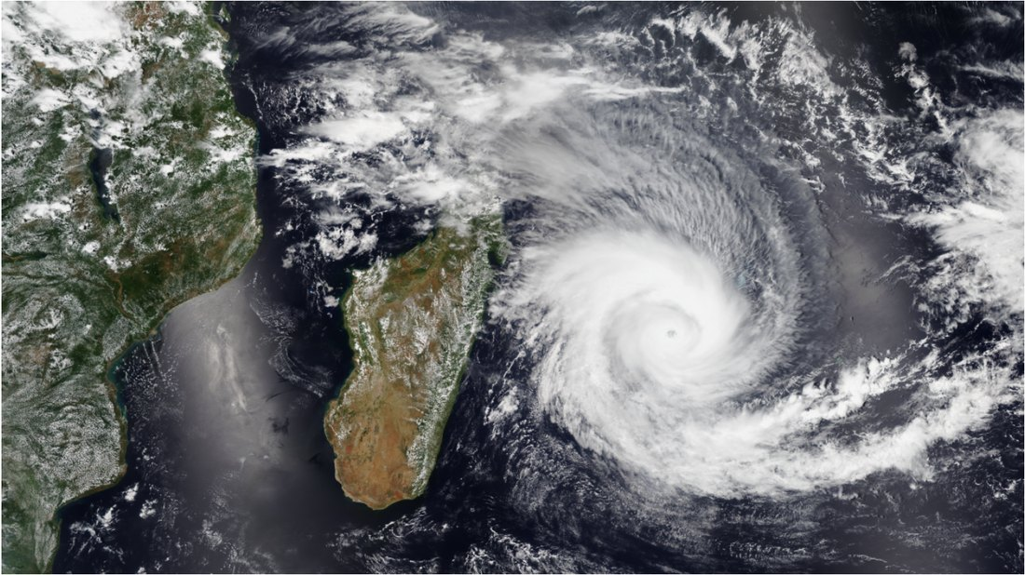
SEASONAL DYNAMICS · 10
The role of Indian Ocean tropical cyclones in deep convective storms
Tropical cyclones are the high-amplitude end of the same spectrum: they form at the poleward edge of the monsoon trough, where low-level convergence, vorticity and warm sea-surface temperatures coincide.
South-west Indian Ocean (RSMC La Réunion): the season runs broadly November to April, peaking in mid-summer. Genesis is concentrated in the monsoon trough over the warmest water.
North Indian Ocean: bimodal, with peaks before and after the south-west monsoon — the Bay of Bengal and the Arabian Sea.
Direct landfall in East Africa is rare, but cyclones and their remnants modulate moisture flux, rainfall and maritime conditions over the region — and disrupt aviation and shipping well away from the storm centre.
Seasonal windows for tropical cyclone activity in the Indian Ocean, adapted from the regional TCAC material.
Why place TCs in the same framework?
Seasonality, genesis location and the resulting hazard all follow from the seasonal migration of the convergence zone and the ocean heat content beneath it.
Tropical Cyclone Batsirai approaching Madagascar, 2 February 2022 (NOAA-20). Public domain.
Convection in the Tropics · EUMeTrain Event Week on Tropical Meteorology 2026
13
Notes:
Show that tropical cyclones belong to the same framework - seasonality, genesis location and hazards all follow the migrating convergence zone.

Slide 19
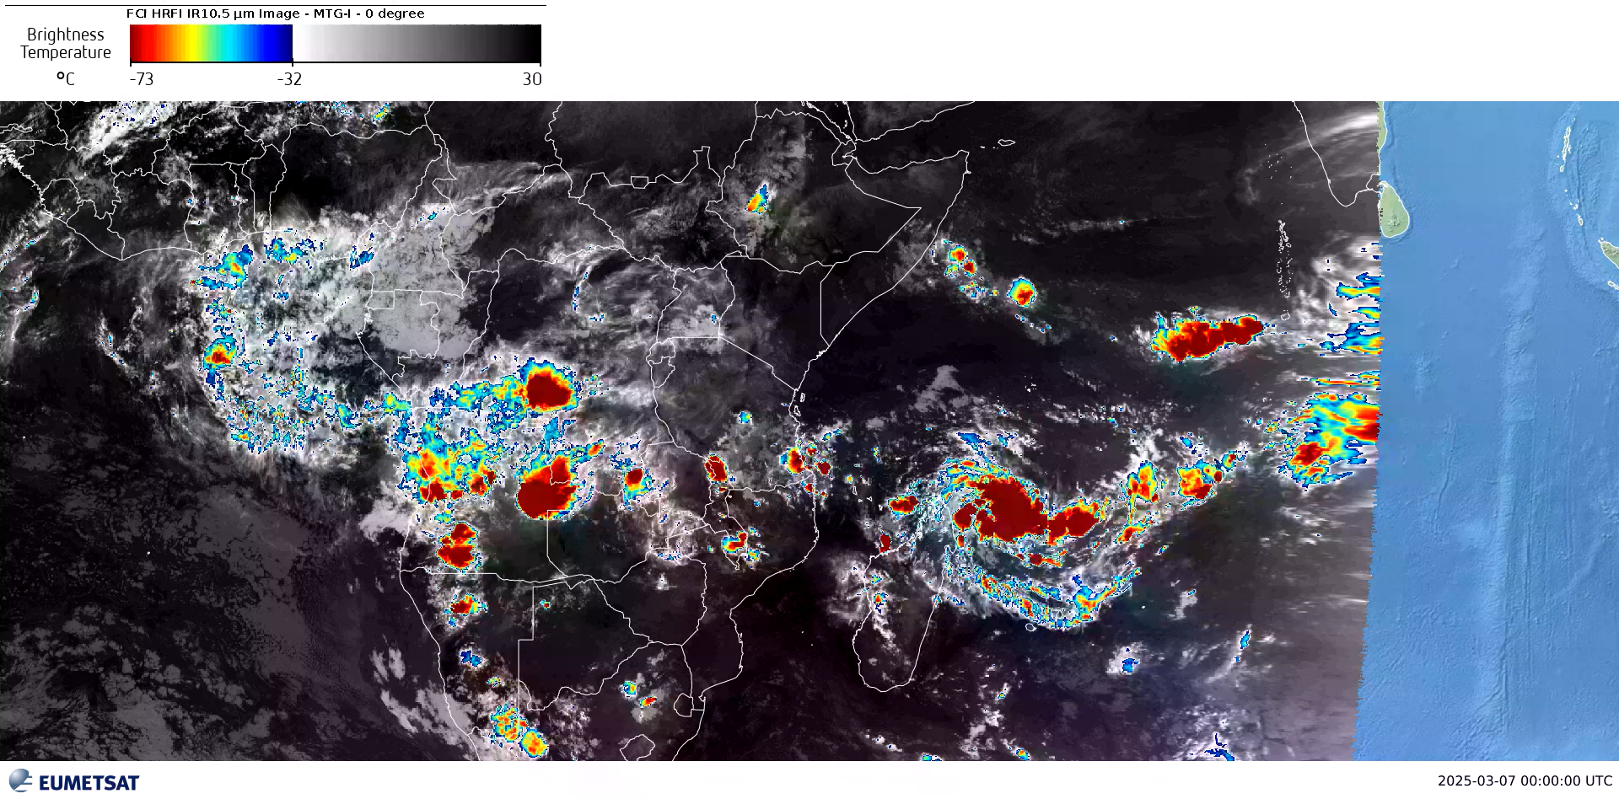
TC JUDE 7-12 MARCH 2025

Slide 20
02
Hazards and Impacts
What these systems do to people, infrastructure and aircraft
Heavy rainfall and flash flooding
Lightning
Hail
Damaging downdraughts and gust fronts
Visibility-reducing phenomena
Impacts: loss of life, displacement, damage to infrastructure and agriculture, disruption of surface transport — and, for aviation, turbulence, icing, hail, wind shear, microbursts, lightning risk to ground operations, holding, diversions and added operating cost
Notes:
Part 2 divider: what these systems do to people, infrastructure and aircraft.

Slide 21
HAZARDS AND IMPACTS · 1
Heavy rainfall and flash flooding
Images removed due to possible copyright issues.
https://watchers.news/2026/03/18/kenya-flood-death-toll-rises-to-71-as-forecasters-warn-of-renewed-heavy-rainfall/
https://global-flood.emergency.copernicus.eu/news/239-floods-and-landslides-in-kenya-ethiopia-and-tanzania-march-2026
Where the water comes from
Human and social impacts
Transport and infrastructure
Organised convection — and especially slow-moving or repeatedly re-developing MCSs — produces rain rates that overwhelm drainage and hillslopes with lead times of minutes to a few hours. Urban catchments respond fastest.
Loss of life by drowning and electrocution; displacement of households; destruction of homes, schools and health facilities; loss of crops, livestock and topsoil; and the disease risk that follows standing, contaminated water.
Flooded and washed-away roads, culverts and bridges, and landslides, isolate communities and delay relief. Runway and apron flooding stops aviation outright — as the case study will show.
Convection in the Tropics · EUMeTrain Event Week on Tropical Meteorology 2026
15
Notes:
Emphasise lead time: urban catchments respond in minutes to a few hours.

Slide 22
HAZARDS AND IMPACTS · 2
Lightning, hail, damaging outflow and visibility loss
Images removed due to possible copyright issues.
https://youtu.be/Mla2eNR3CnQ
https://youtu.be/5HnH9lJ40Qk .
https://www.youtube.com/watch?v=tkRrsHhB8yA
Lightning
Hail
Downdraughts, gust fronts and visibility
Direct strike hazard, electrocution and fire ignition; damage to power distribution and electronics. Flash rate is itself a nowcasting signal — a rapid jump often precedes severe weather at the ground.
Damages crops, roofs, vehicles and aircraft. Large stones require strong, sustained updraughts, so hail is a marker of the most intense systems.
Downbursts produce abrupt, damaging low-level outflow and wind shifts; gust fronts trigger new cells. Heavy rain, blowing dust and post-storm fog all cut visibility and disrupt surface transport.
16
Notes:
Note that flash rate and hail size are both signals of storm intensity, not just hazards in themselves.

Slide 23
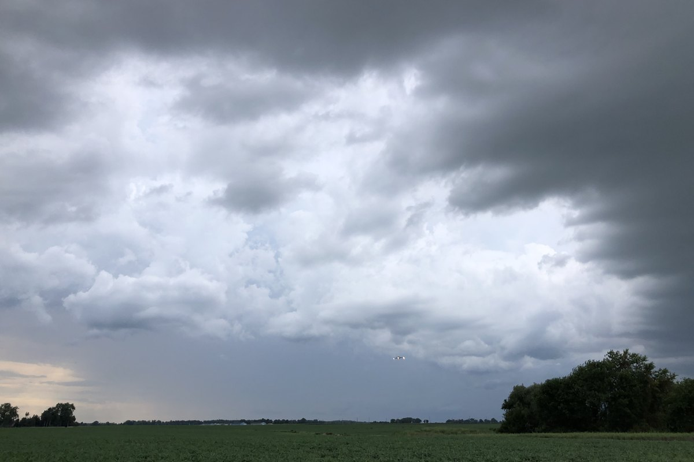
HAZARDS AND IMPACTS · 3
Aviation: the en-route and terminal hazard set
Convective turbulence — severe turbulence in and near towering cumulus and cumulonimbus, particularly at the freezing level and in anvil outflow.
Icing — supercooled water in the strong updraughts of tropical convective cloud, which can be severe at altitude even in the tropics.
Hail — encounterable well outside the visible storm core, carried downwind in the anvil and overhang, so "avoiding the black" is not sufficient.
Lightning — airframe strikes, and a serious risk to ground operations: apron personnel, fuelling and ramp equipment.
Visibility and runway state — heavy rain reduces visibility and braking action; standing water on runways and aprons halts operations.
An aircraft on approach beside the edge of a thunderstorm. Photo: Famartin / https://commons.wikimedia.org/wiki/File:2022-07-18_19_01_26_View_across_a_field_towards_the_edge_of_a_thunderstorm_and_an_aircraft_on_approach_to_nearby_Dover_Air_Force_Base%2C_viewed_from_Delaware_State_Route_8_%28North_Little_Creek_Road%29_near_Quaker_Lane_in_Oak_Grove%2C_Kent_County%2C_Delaware.jpg, CC BY-SA 4.0.
Tropical convection is frequently embedded, fast-growing and close to busy terminal areas — the combination that leaves the least room for tactical avoidance.
Convection in the Tropics · EUMeTrain Event Week on Tropical Meteorology 2026
17
Notes:
Stress that hail and turbulence are encountered outside the visible core, so 'avoiding the black' is not enough.

Slide 24


HAZARDS AND IMPACTS · 4
Low-level wind shear, microbursts and the cost of consequence
On approach and departure
Low-level wind shear and microbursts are the most lethal convective hazard to aviation. A downburst produces an abrupt headwind-to-downdraught-to-tailwind sequence at low level, exactly where there is no height to recover.
On the ground
Lightning risk suspends fuelling and apron work; heavy rain degrades braking action; flooding closes runways, taxiways and access roads.
An airliner on approach. TACA Tegucigalpa. Photo: Jim Drebert / https://commons.wikimedia.org/wiki/File:TACA_Tegucigalpa.jpg, CC BY-SA 3.0.
En-route and the cost
Wind damage from a downburst. CC0.
Track offsets and altitude changes add mileage and fuel. The downstream cost appears as holding, diversions, cancellations, crew duty-time pressure and network-wide knock-on delay.
At JKIA, cells developing over the Nairobi highlands or along the Rift can sit across the approach and departure paths within a single satellite scan.
Convection in the Tropics · EUMeTrain Event Week on Tropical Meteorology 2026
18
Notes:
Wind shear and microbursts are the lethal hazard; the cost consequences (holding, diversion) follow from the safety decision.

Slide 25
03
Forecasting and Nowcasting
The operational toolset, what each tool can and cannot do, and how the tools are combined into warnings
Satellite imagery and products for convective initiation, growth and overshooting tops, and lightning detection for rapidly developing systems — including the EUMETSAT MTG era of 10-minute full-disc and 2.5-minute rapid-scan imagery
Storm-cell tracking and extrapolation nowcasts
High-resolution convection-permitting NWP, ensemble guidance and post-processing
Observational monitoring: surface networks, radiosondes and AMDAR
Integration into early warning services — SIGMET, aerodrome warnings and multi-hazard systems
Notes:
Part 3 divider: the operational toolset and how it is combined.

Slide 26
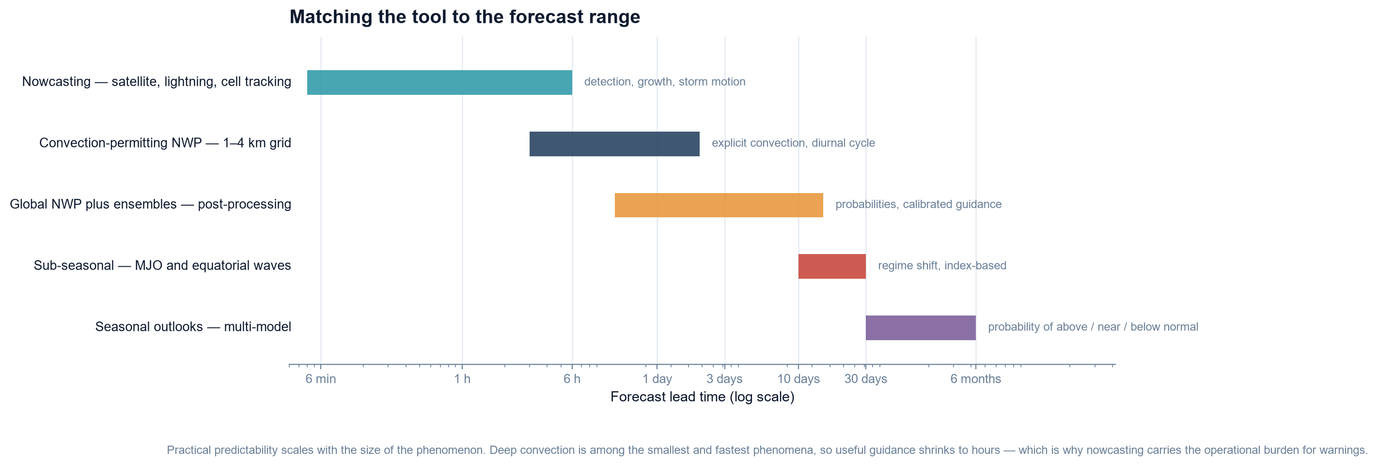
FORECASTING AND NOWCASTING · 1
Matching the tool to the forecast range
No single tool covers all lead times. Nowcasting is the only approach that resolves the storm itself; numerical guidance supplies the environment in which it will form.
Range chart of operational tools against lead time, from minutes to months. After WMO guidance on nowcasting and very short-range forecasting.
The forecaster's job is to blend these ranges, not choose between them: a warning issued on an NWP signal is updated by satellite and lightning observations as the event approaches.
Each step up in range costs accuracy: NWP gives the environment and a probability, nowcasting gives the storm — but only once it exists.
Convection in the Tropics · EUMeTrain Event Week on Tropical Meteorology 2026
20
Notes:
Introduce the range chart: each tool owns a band of lead time, and the forecaster blends them.

Slide 27
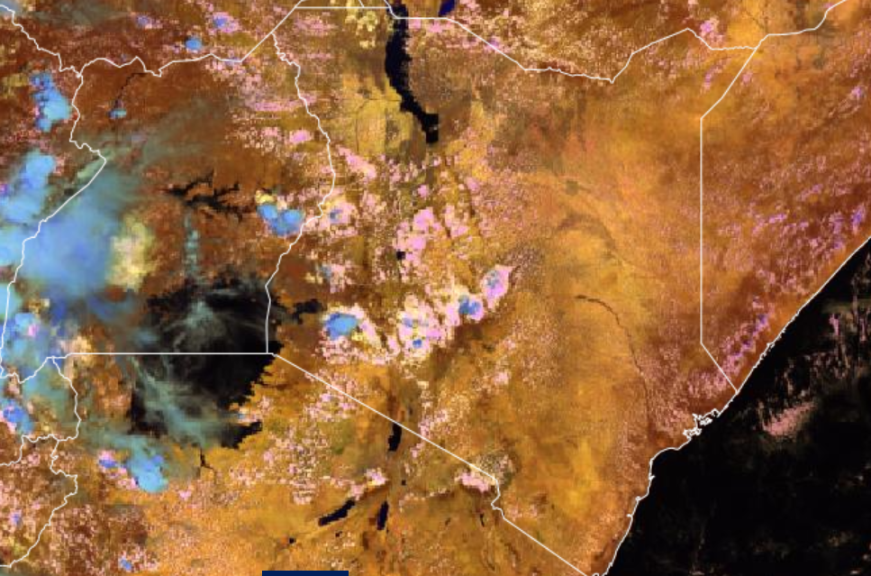
FORECASTING AND NOWCASTING · 2
Satellite imagery: seeing convection initiate, grow and overshoot
Geostationary imagery is the foundation of tropical nowcasting — and Meteosat-12 now returns sixteen channels every ten minutes, day and night.
Sixteen channels, every 10 minutes. FCI spans 0.4–13.3 µm at 0.5 km (visible) and 1 km (infrared): 0.6–2.2 µm for cloud microphysics, 3.8 for fog and fire, 6.3/7.3 for water vapour, 8.7–13.3 for cloud-top temperature.
The infrared is still the nowcasting signal. The 10.5 µm brightness temperature, and the rate at which it falls, marks cloud-top cooling, the first cold pixels and the overshooting top; 0.9 µm shows the low-level moisture feeding it.
RGBs: phase and glaciation. Cloud Phase and Cloud Type separate water from ice and flag glaciation before the first flash; Day, Night and 24-hour Microphysics carry the analysis around the clock, HRV Clouds the fine detail. The Lightning Imager adds total lightning every 30 s on a 2 km grid.
MTG FCI Cloud Phase RGB, 20 Oct 10:50 UTC : Source: EUMETSAT.
RDT — rapidly developing thunderstorms (MSG)
Meteosat-12: the step change
Detects, tracks, characterises and forecasts convective cells from SEVIRI. It needs input refreshed at least every 30 minutes and issues a one-hour forecast in 15-minute steps. It cannot create, dissipate or re-route a cell, and performs better with organised storms than with scattered ones.
16 FCI channels instead of 12, a full disc every 10 minutes instead of 15, 0.5–1 km sampling, and the Lightning Imager operational since 31 October 2024. MTG-I2 followed on 27 August 2026.
Convection in the Tropics · Mirriam Mwende Musyoka
21
Notes:
Satellite is the only system that sees the whole life cycle. On MTG the workhorses are the 10.5 micron infrared for cloud-top cooling, the Cloud Phase and Cloud Type RGBs for glaciation before the first flash, and the Lightning Imager. RDT still runs on MSG and automates the tracking a forecaster would otherwise do by eye.

Slide 28
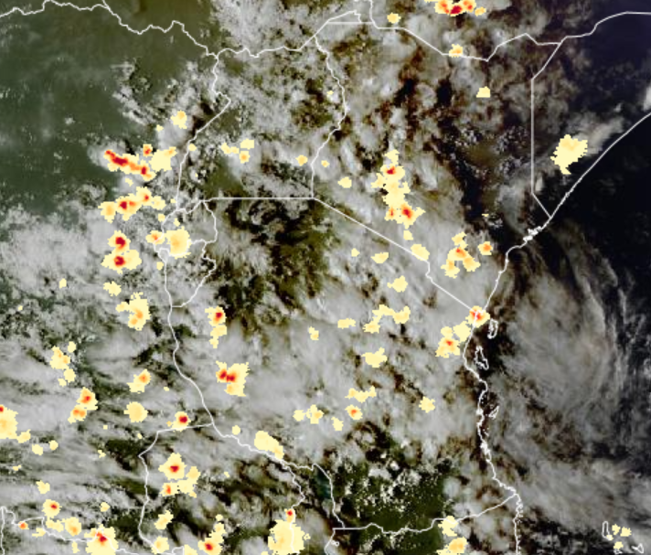
FORECASTING AND NOWCASTING · 3
The MTG Lightning Imager: every flash, cloud and ground
The instrument. Europe's first geostationary optical lightning detector: a wide-band sensor behind four cameras, 1000 frames a second, full disc every 10 minutes. Level 2 gives accumulated flash area, flash count and flash radiance on a 2 km grid in 10–30 s chunks, on EUMETCAST within about a minute.
Total lightning, not just ground strikes. It records the light each flash leaves at cloud top, so it counts the intracloud discharge that ground networks miss — more than three quarters of all lightning. A jump in flash rate typically precedes hail and damaging wind by 10–20 minutes.
The honest limit. Cloud and ground flashes are counted together, never labelled: about 70% detection by day, 95% at night. Attribution and peak current stay with the ground network, so a ramp stand-down still needs both — but LI fills the gaps over the lake and the interior where coverage is thin.
MTG LI flash groups (pale yellow to red) over the FCI cloud image, https://view.eumetsat.int/productviewer?v=default 6 March 2026 15 UTC
.
608 million
>30%
Night peak
flashes across the field of view in 2025, the instrument's first full operational year — more than 30 million of them over Europe.
of that total fell over the Congo Basin, the brightest region in the field of view and probably the most intense lightning hotspot on Earth.
Lightning over Lake Victoria peaks at night while the surrounding shores peak in the afternoon — a diurnal rhythm the forecaster can anticipate, not only observe.
Convection in the Tropics · Mirriam Mwende Musyoka
22
Notes:
The Lightning Imager is the step change: an optical detector in geostationary orbit that sees intracloud as well as cloud-to-ground flashes, every 30 seconds, across the whole of Africa. Sell it as the flash-rate jump, not the strike map - and say plainly that it does not label which flash is which, so attribution still belongs to the ground network.

Slide 29
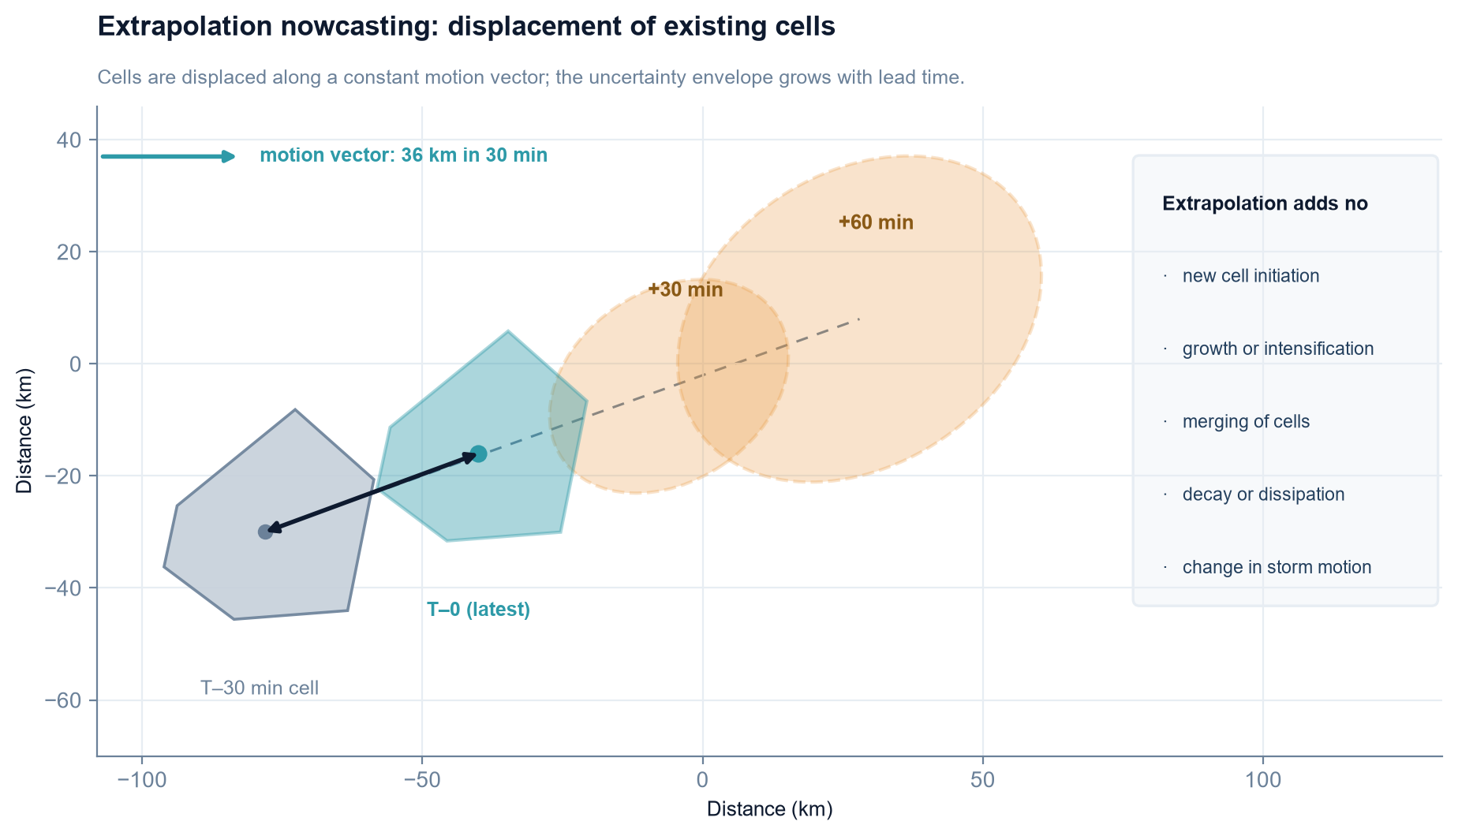
FORECASTING AND NOWCASTING · 4
Storm-cell tracking and extrapolation nowcasts
Extrapolation is the workhorse of 0–2 hour nowcasting: simple, fast, and effective for as long as the system behaves predictably.
Two successive analyses give a motion vector for each cell, or for the whole cloud field. Displacing the latest analysis along that vector produces the forecast field.
Skill is highest for mature, well-organised, fast-moving systems. It decays quickly beyond about two hours, and is zero for a cell that does not yet exist.
Cell-based tracking adds the trends that pure advection ignores — area, cloud-top height and the temperature of the coldest tops — while optical-flow methods estimate a spatially varying motion field rather than one vector for everything.
Blending completes the range: beyond roughly 2–6 hours the nowcast is handed over to the convection-permitting model, and machine-learning nowcasting can now learn growth and decay as well as displacement.
The limitation is structural, not a matter of tuning. A warning built only on extrapolation is a warning about what has already happened.
Displacement of existing cells along a constant motion vector, with the forecast uncertainty envelope growing with lead time.
Convection in the Tropics · EUMeTrain Event Week on Tropical Meteorology 2026
23
Notes:
Make the limitation of extrapolation explicit: it forecasts what already exists and nothing else.

Slide 30
FORECASTING AND NOWCASTING · 5
Convection-permitting numerical weather prediction
Grid spacings of roughly 1–4 km turn convection from a parameterisation into a resolved process — and that changes what the model can say.
Convection is resolved explicitly by the model dynamics instead of being estimated by a parameterisation scheme. That removes a large part of the uncertainty in the timing, intensity and amount of rainfall.
What it adds: initiation tied to surface heating, terrain and boundary-layer convergence; cold pools and gust fronts; upscale growth into organised systems and their propagation through the night; and a far more realistic distribution of rainfall intensity.
What it demands: an accurate initial state (satellite, lightning and aircraft data assimilated into the analysis), a realistic land surface and land–water contrast, boundary conditions from a global model, and the computing to run the domain.
What it still cannot do: guarantee the timing and location of the first convective cell. Double penalties, displacement and phase errors remain — expect the environment to be right and the storm to be late or in the wrong place.
Operational examples include ICON-D2, AROME and the UK 1–2 km configurations; comparable setups run in research and pre-operational mode over Africa.
Resolved, not parameterised
The cloud in the forecast is produced by the model's own equations of motion — not by a statistical scheme that describes the average of a grid box.
The diurnal cycle appears
Convection-permitting models reproduce the afternoon-to-evening maximum over land and the nocturnal maximum over water — the two features a coarse model smooths away.
Cost and spin-up
A limited-area model needs boundary conditions and spin-up time; running it frequently enough for a warning service is a resourcing decision, not a scientific one.
Convection in the Tropics · EUMeTrain Event Week on Tropical Meteorology 2026
24
Notes:
Convection-permitting models resolve rather than parameterise convection - and still cannot promise the first cell.

Slide 31
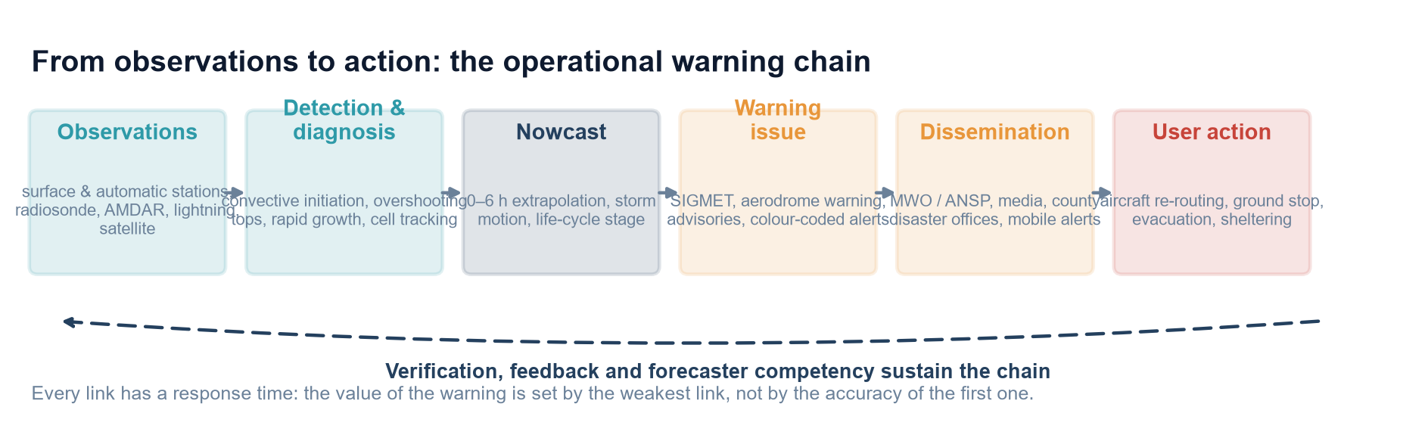
FORECASTING AND NOWCASTING · 8
From observation to action: integrating the tools into warning services
The tools are only useful if they terminate in a warning a user can act on — and in a verification loop that improves the next one.
Aviation products. SIGMET for en-route thunderstorms, severe turbulence, icing and volcanic ash; aerodrome warnings for thunderstorms, squalls, hail, wind shear and heavy precipitation; aerodrome forecasts with TEMPO and PROB groups; and low-level wind shear warnings — all issued within the ICAO Annex 3 and PANS-MET (Doc 10157) framework.
Public warnings. Colour-coded advisories and warnings issued against agreed rainfall thresholds, with a defined lead time and a confidence statement.
Multi-hazard integration. Rainfall warnings linked to hydrological and flash-flood alerts, and shared with disaster management, health and transport authorities so that one forecast reaches every user who needs it.
Dissemination. A single authoritative channel, consistent terminology and a clear statement of uncertainty — duplicated or contradictory messages destroy credibility.
Verification and feedback. Every warning checked against what actually happened, with the impact data recorded. This is the only step that makes the service better.
The operational warning chain. Every link must work, and the loop is closed by verification and feedback.
A warning that is never verified cannot be improved. Record the impact data alongside the warning, and use both to improve the next forecast.
Convection in the Tropics · EUMeTrain Event Week on Tropical Meteorology 2026
27
Notes:
The warning chain is the harvest of all the earlier slides; stress verification and feedback as part of the operational loop.

Slide 32
04
An Operational Case Study
The 6–7 March 2026 floods across East Africa — forecast, warning, monitoring and impact
Seasonal setting: the long rains and the northward passage of the ITCZ
The event: a national episode, from the central highlands and Nairobi to the Lake Victoria basin
Forecast and warning: KMD advisories from 25 February to 3 April 2026
Monitoring: satellite, lightning, surface networks
Impacts across Kenya: loss of life, displacement, transport, agriculture and aviation
Lessons for operations and for the warning service
Notes:
Part 4 divider: the case study, framed nationally rather than as a single-city event.

Slide 33

CASE STUDY · 1
The event: 6–7 March 2026, East Africa
Seasonal setting. The event fell within the long rains (March–May), as the ITCZ makes its northward passage — the primary wet season over Kenya, and the season in which most of the March–May flood events occur.
Antecedent warning. From 25 February 2026 the Kenya Meteorological Department advised that rainfall exceeding 20 mm within 24 hours was expected in some areas — naming the central highlands and the Lake Victoria basin — with flash-flood and reduced-visibility risk; on 3 March it warned that heavy rains would persist.
The trigger day. Heavy rainfall on 6 March 2026 over the central highlands, the Nairobi area and the Lake Victoria basin.
The event. During the night of 6–7 March the Nairobi River burst its banks and floodwaters inundated roads across the city — an overnight urban flash flood, while the same regime was producing flooding in the lake basin and across the highlands.
A national episode, not a city one. Twenty-three deaths were recorded in Nairobi on 7 March, and 71 vehicles were swept away there; JKIA flights were diverted to Mombasa. By early April the episode had affected 30 counties, with at least 110 deaths and at least 34,765 people displaced nationwide.
25 Feb
First KMD advisory: more than 20 mm in 24 hours expected in some areas, with flash-flood and reduced-visibility risk
6–7 Mar
The night the Nairobi River burst its banks and roads across the city were inundated
Lake Victoria. Bett Duncan / https://commons.wikimedia.org/wiki/File:Boat_at_Lake_Victoria_shoreline.jpg, CC BY-SA 4.0.
30
counties affected by the same episode, from the highlands to the lake basin
112
deaths confirmed nationwide by 3 April 2026, with at least 34,765 people displaced
Convection in the Tropics · EUMeTrain Event Week on Tropical Meteorology 2026
29
Notes:
Set the event within the seasonal framework, show that the advisory came ten days ahead, and make the national footprint explicit: 30 counties, 112 deaths and more than 34,000 people displaced.

Slide 34
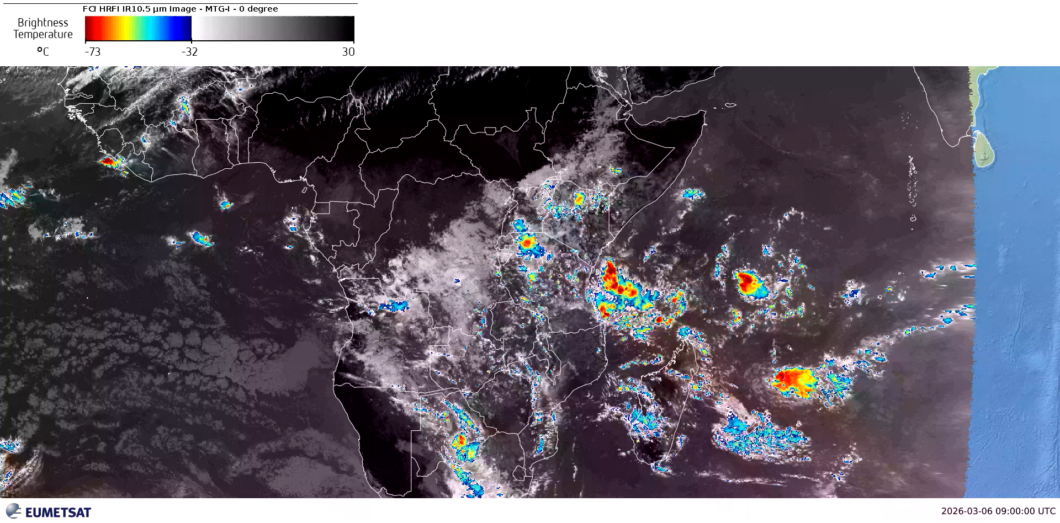

Slide 35
Removed due to possible copyright issues.

Slide 36
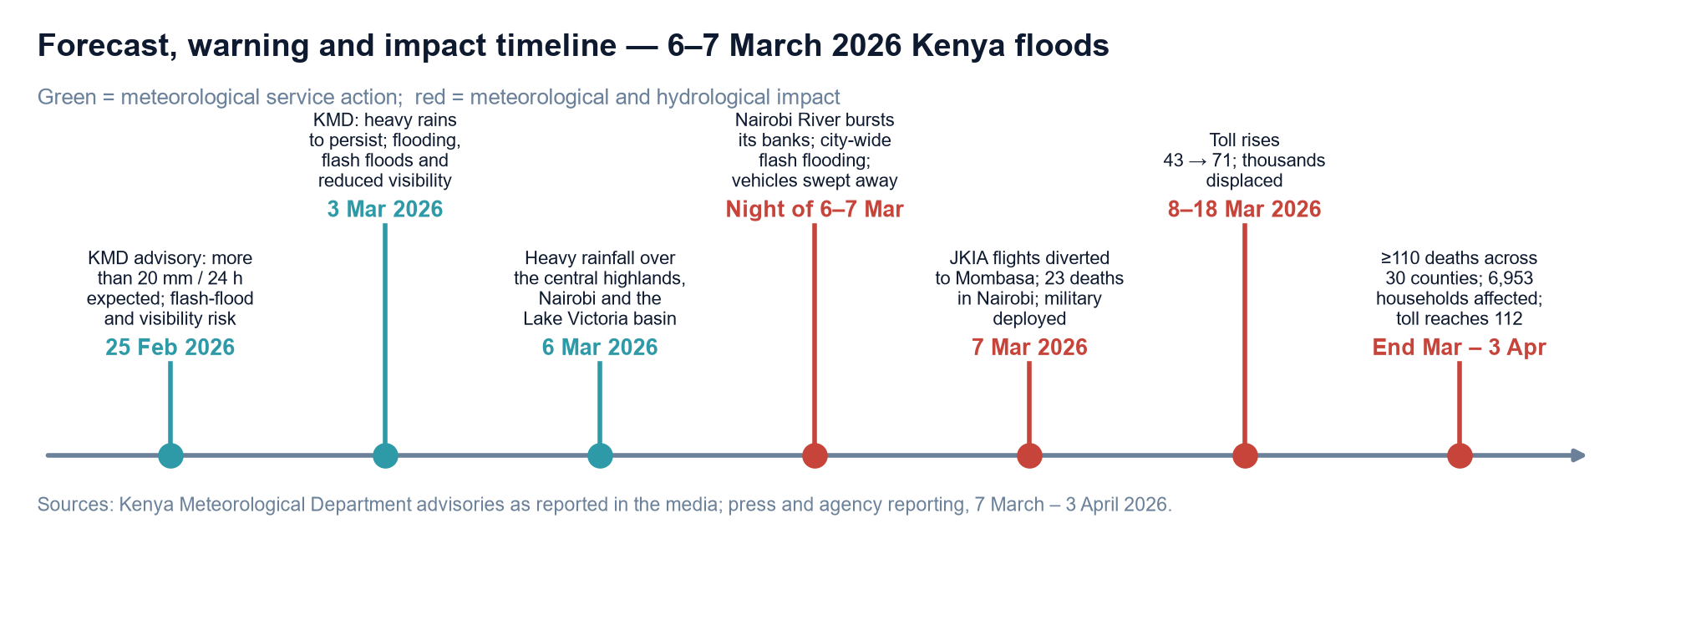
CASE STUDY · 2
The forecast and warning timeline
Forecast, warning and impact timeline for the 6–7 March 2026 floods across Kenya. Sources: KMD advisories as reported in the press, and agency reporting from 7 March to 3 April 2026.
Every link of the chain is visible in this event: a seasonal-scale advisory ten days ahead, a persistence forecast three days ahead, the impact during the night of 6–7 March, and the impact reporting that followed for the next four weeks.
30
Convection in the Tropics · EUMeTrain Event Week on Tropical Meteorology 2026
Notes:
Walk the timeline from the 25 February advisory to the final toll on 3 April.

Slide 37


