Slide 1
NWC SAF LI prototypes in the European Weather Cloud (EWC)
Adelina Mihai, NMA RO

Slide 2
Agenda
Usefull links
LiStack Prototype
LiJump Prototype
NWC SAF Products in the EWC: Local Systems Integration

Slide 3
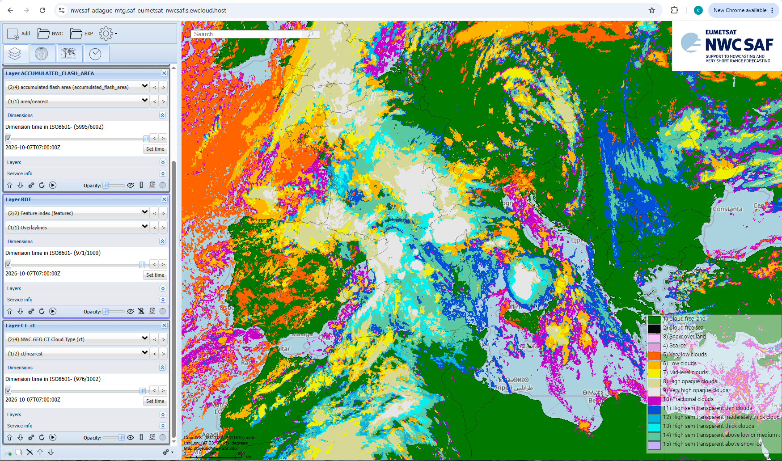
Which area, according to the Cloud Type (CT) layer, would you expect to be the most prone to lightning activity?

Slide 4
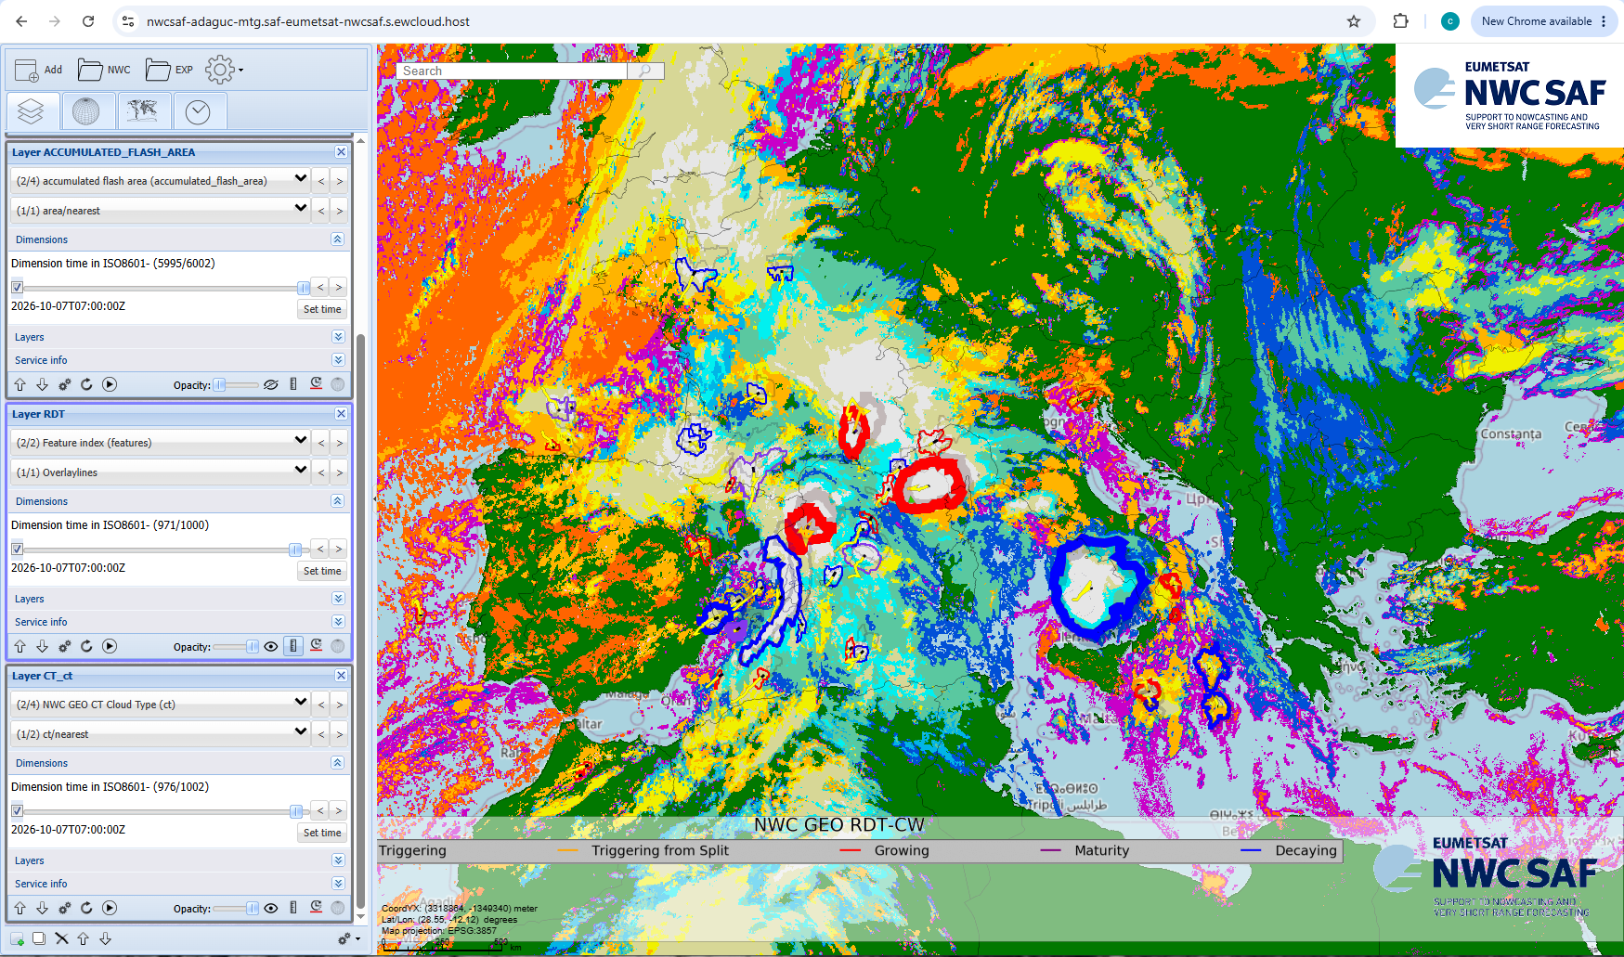

Which area, according to the Cloud Type (CT) and Rapid Developing Thunderstorms (RDT) layers, would you expect to be the most prone to lightning activity?
5
1
3
Join at
slido.com
#2790695
2
4
6

Slide 5
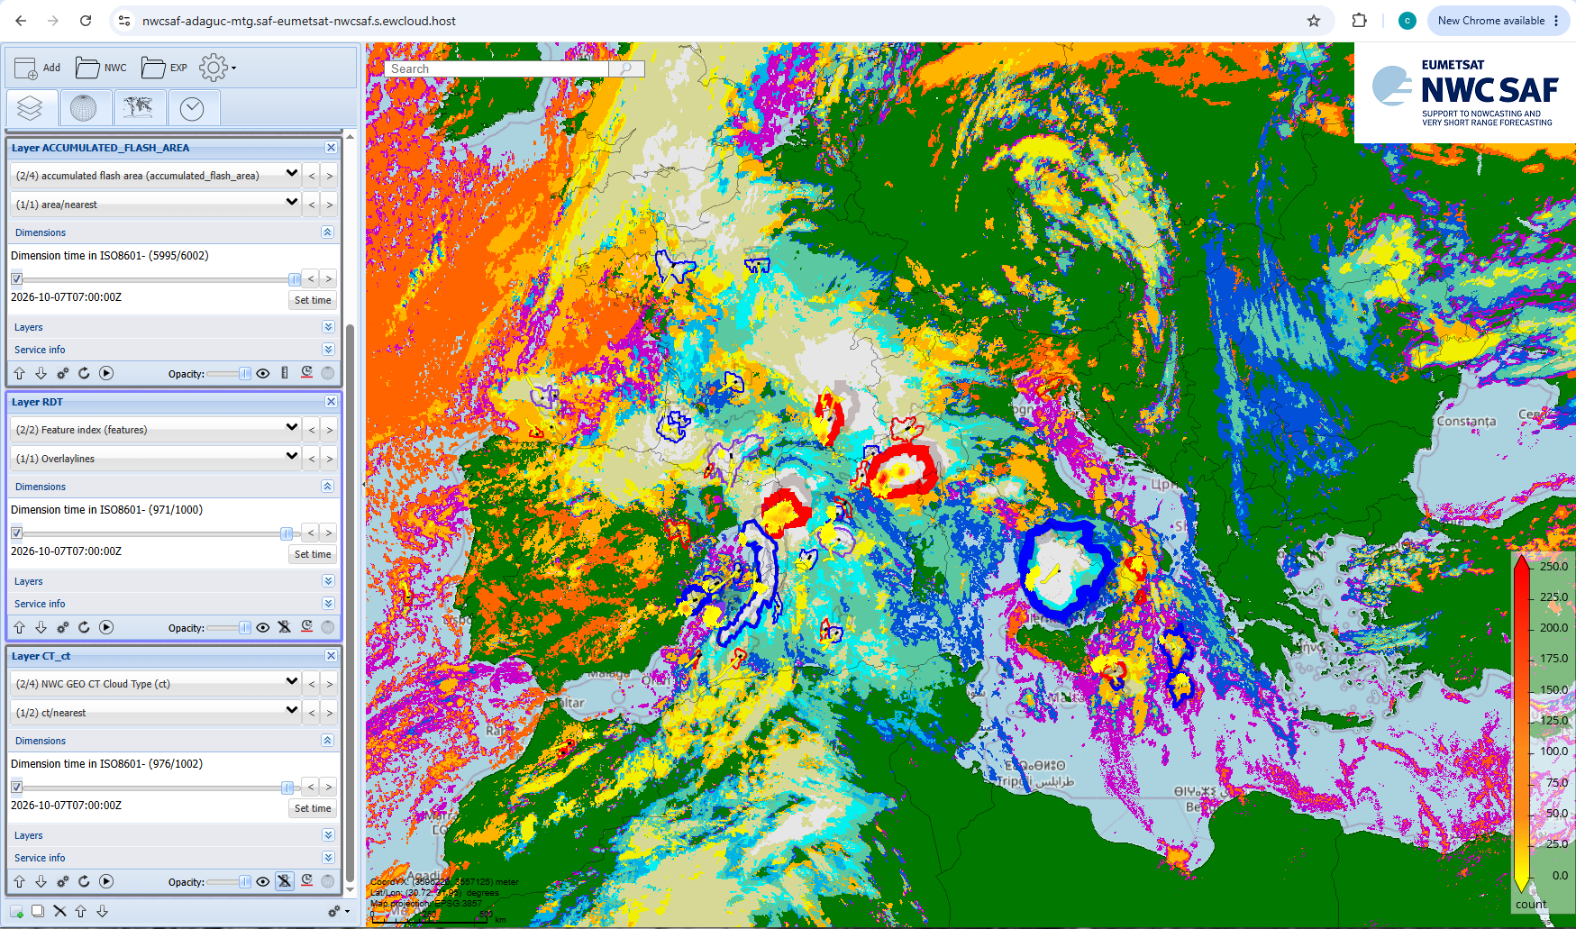

Slide 6
5
1
3
2
4
6

Slide 7
Usefull links
Production of NWC SAF products in the EWC, connected to ​two WMS servers (https://adaguc.nwcsaf.eumetsat.ewcloud.host/;
https://nwcsaf-adaguc-mtg.saf-eumetsat-nwcsaf.s.ewcloud.host/):​
​
based on ADAGUC (https://adaguc.knmi.nl/)​;
not fully operational (24/7)​;
open to the whole world;
subject to change do to the migration to the new EWC infrastructure.

Slide 8
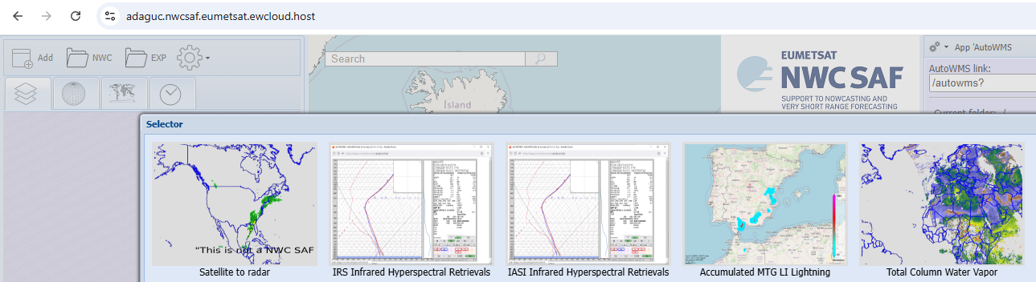
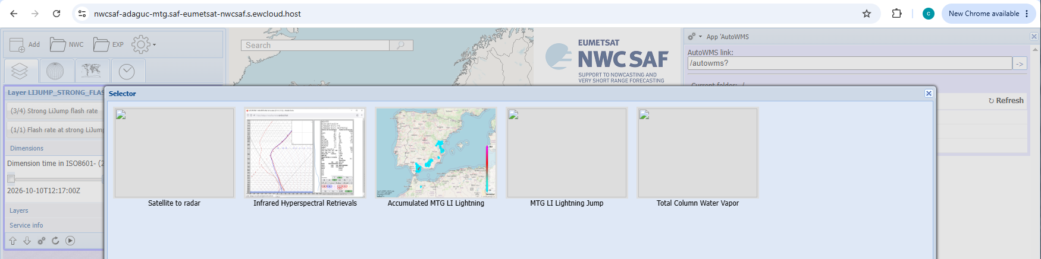
Usefull links
https://adaguc.nwcsaf.eumetsat.ewcloud.host/
https://nwcsaf-adaguc-mtg.saf-eumetsat-nwcsaf.s.ewcloud.host/
NWC/GEO v2021.2
NWC/PPS Cloud products
LiStack & others prototypes
NWC/GEO-I v2025.1 (cloud, precipitation, convection and aviation products)
LiStack & LiJump prototypes

Slide 9
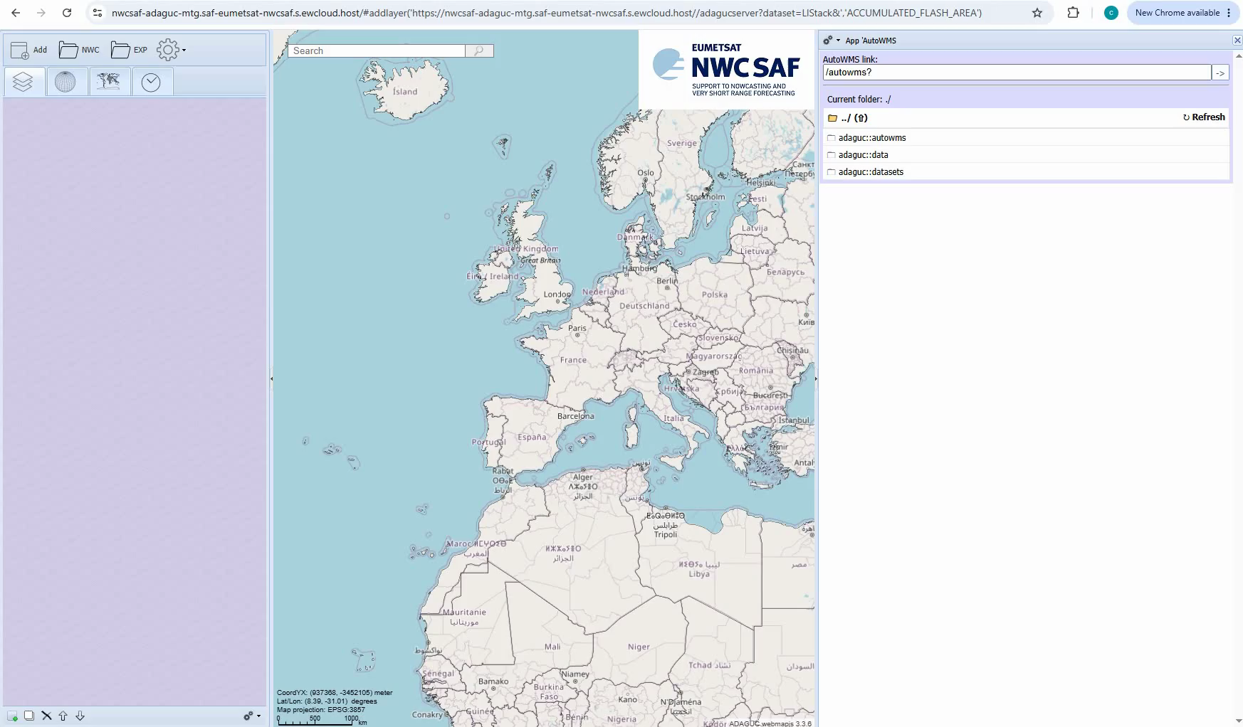
LiStack prototype

Slide 10
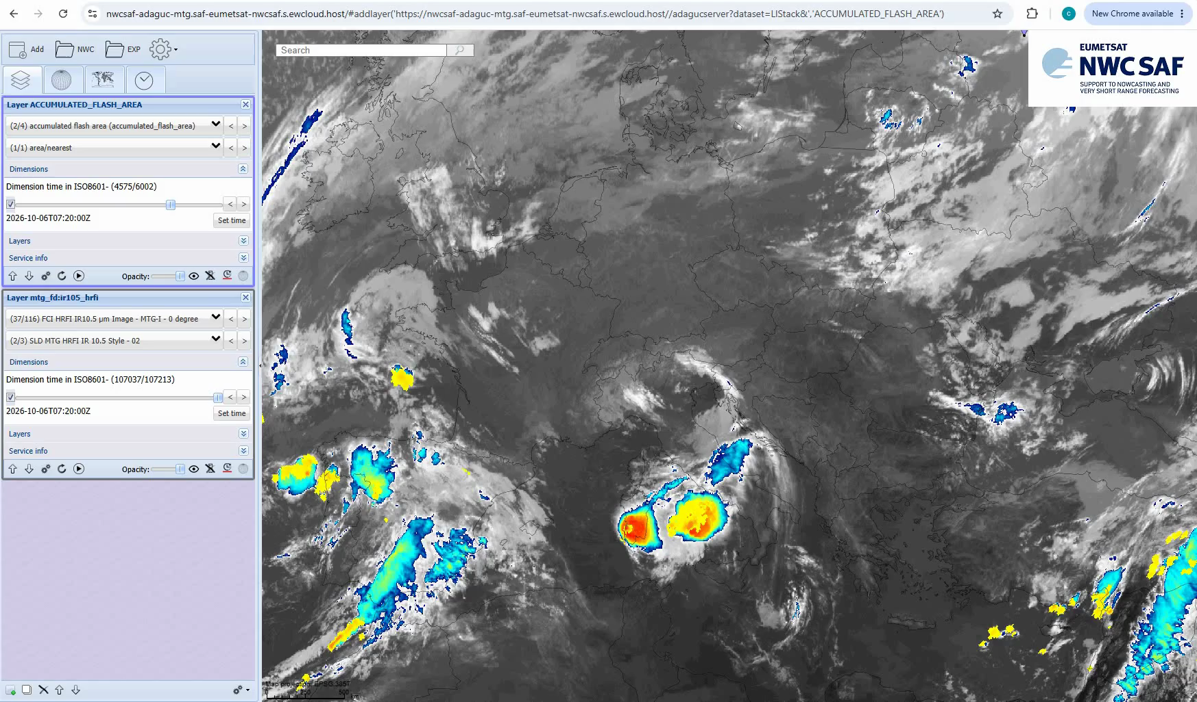
LiStack prototype

Slide 11
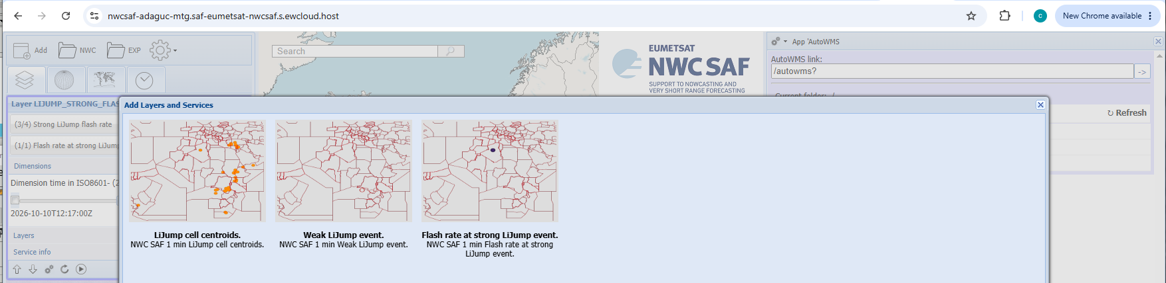
LiJump prototype

Slide 12
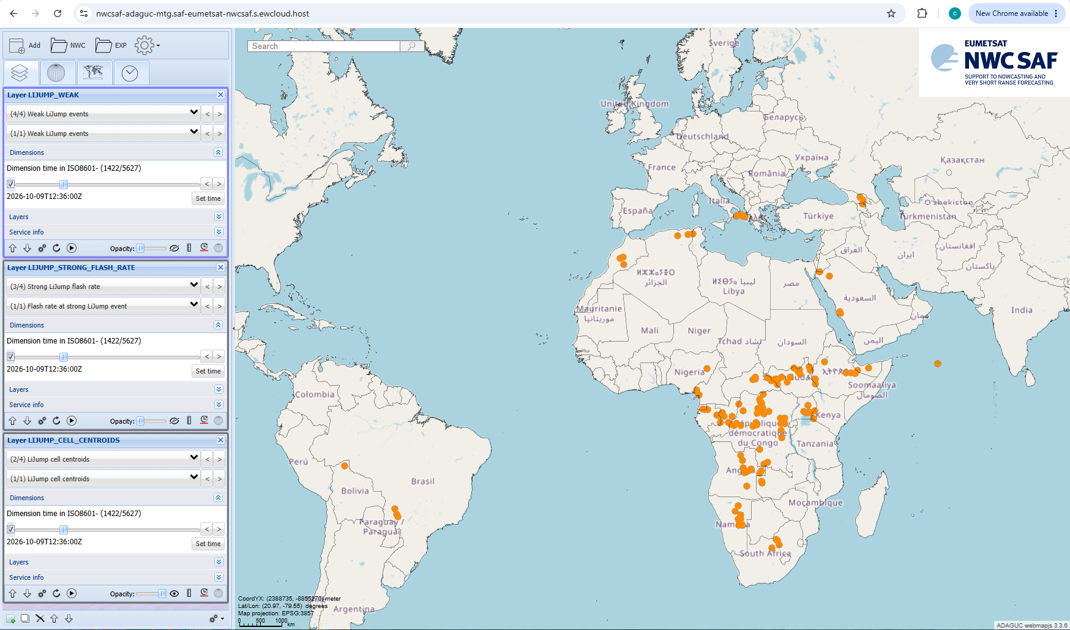
LiJump prototype - LiJump cell centroids

Slide 13
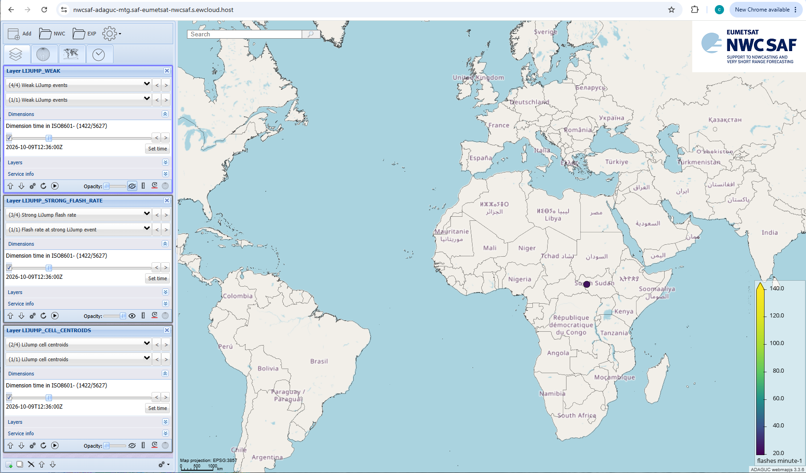
LiJump prototype - Strong LiJump flash rate

Slide 14
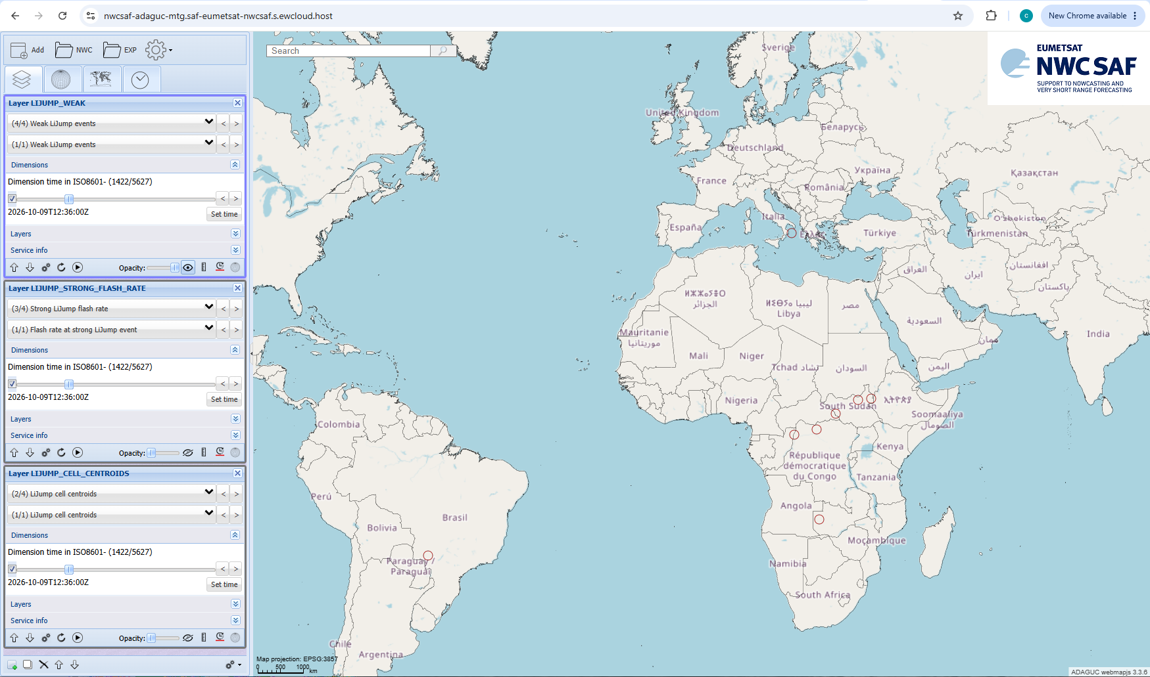
LiJump prototype - Weak Lijump events

Slide 15
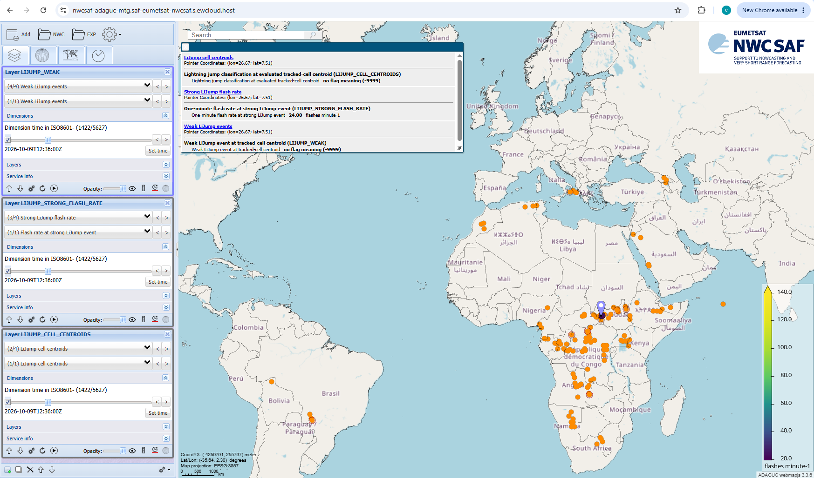
LiJump prototype

Slide 16
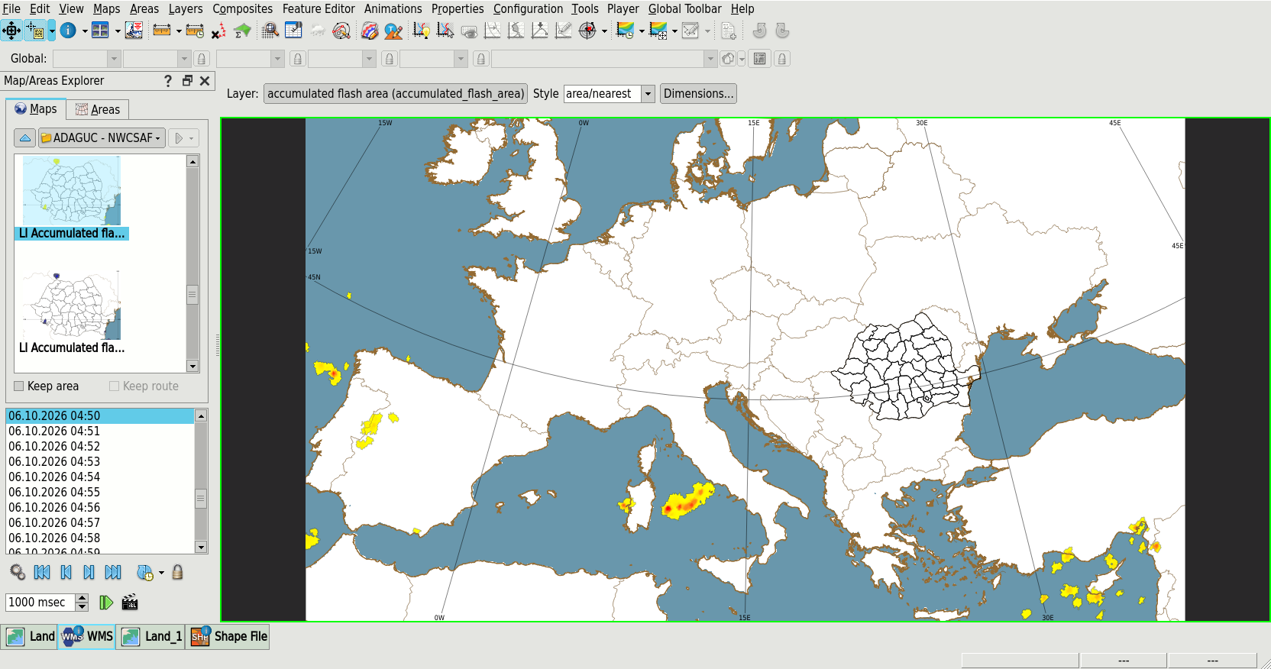
NWC SAF Products in the EWC: Local Systems Integration
IBL Visual Weather

Slide 17
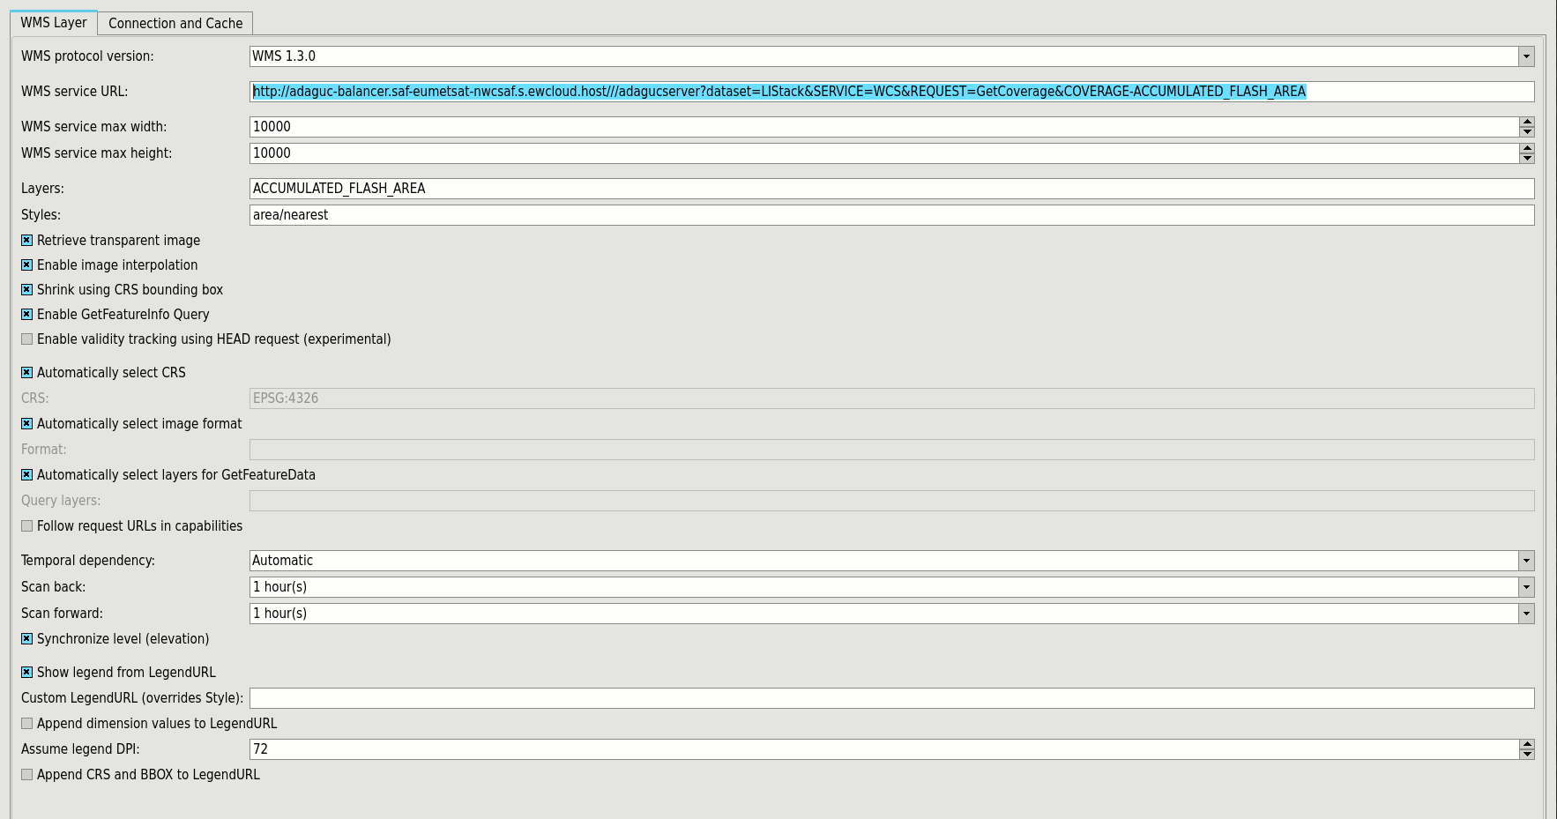
NWC SAF Products in the EWC: Local Systems Integration

Slide 18
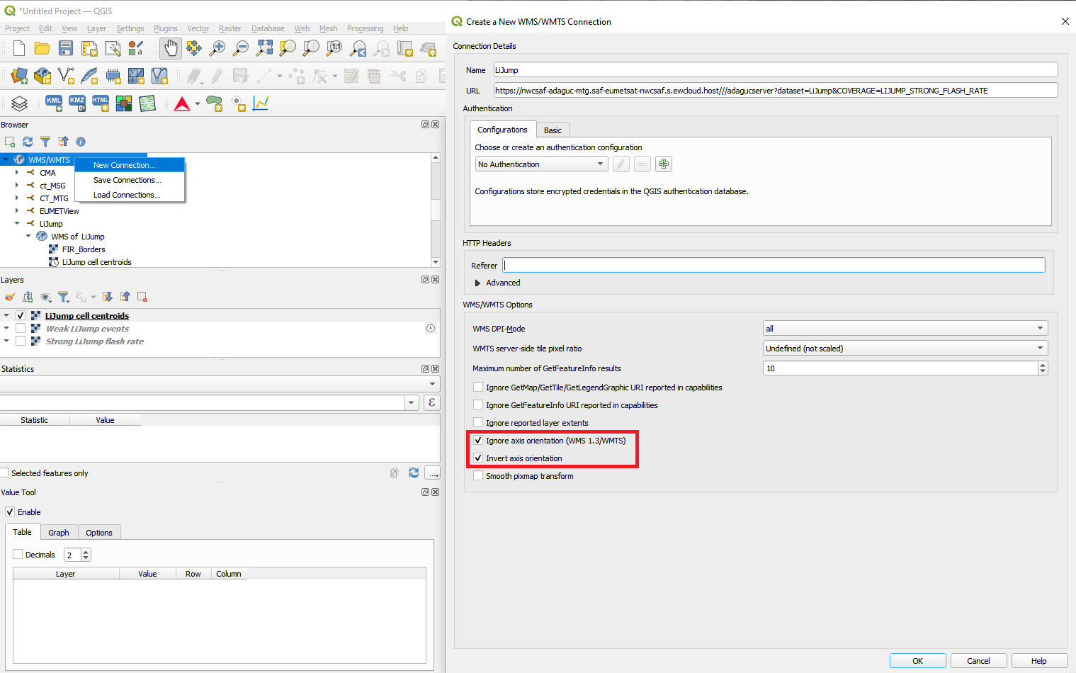
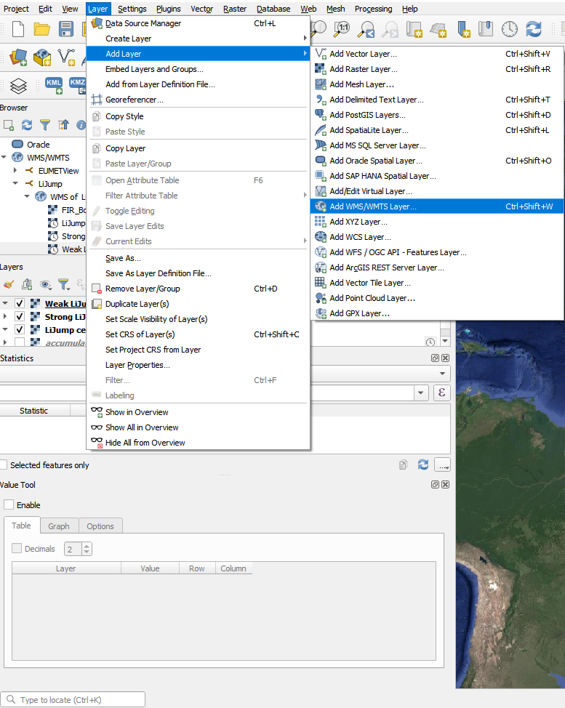
NWC SAF Products in the EWC: Local Systems Integration
QGIS

Slide 19
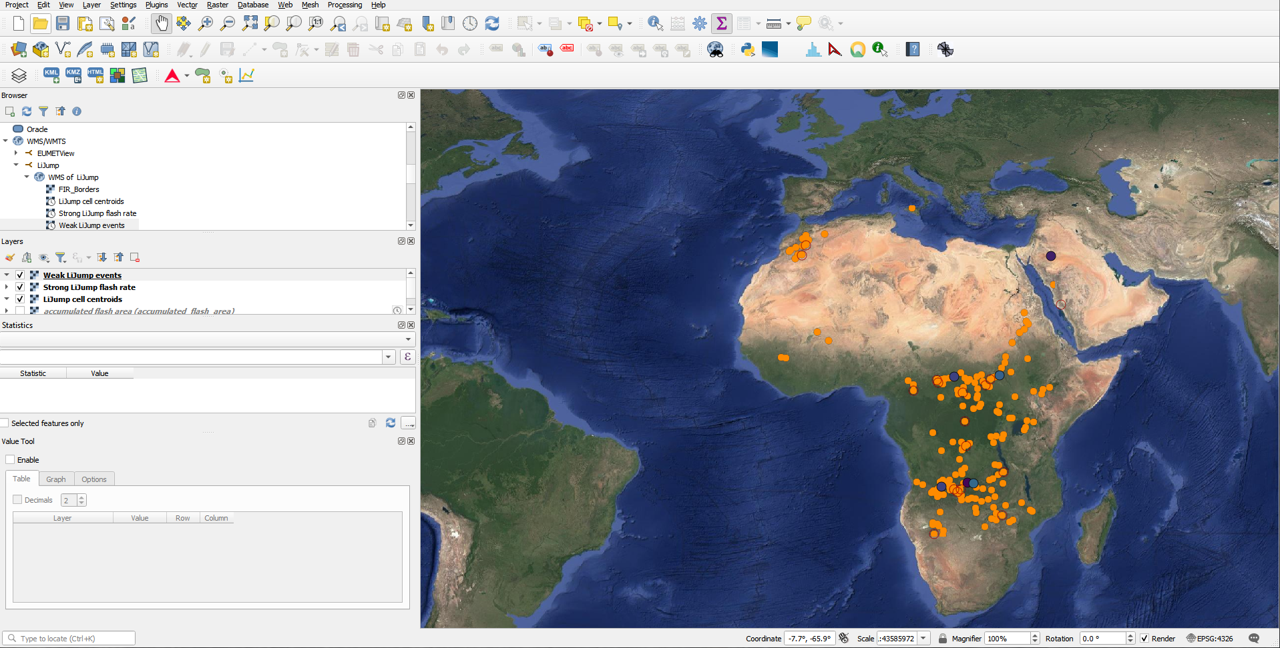
NWC SAF Products in the EWC: Local Systems Integration

Slide 20
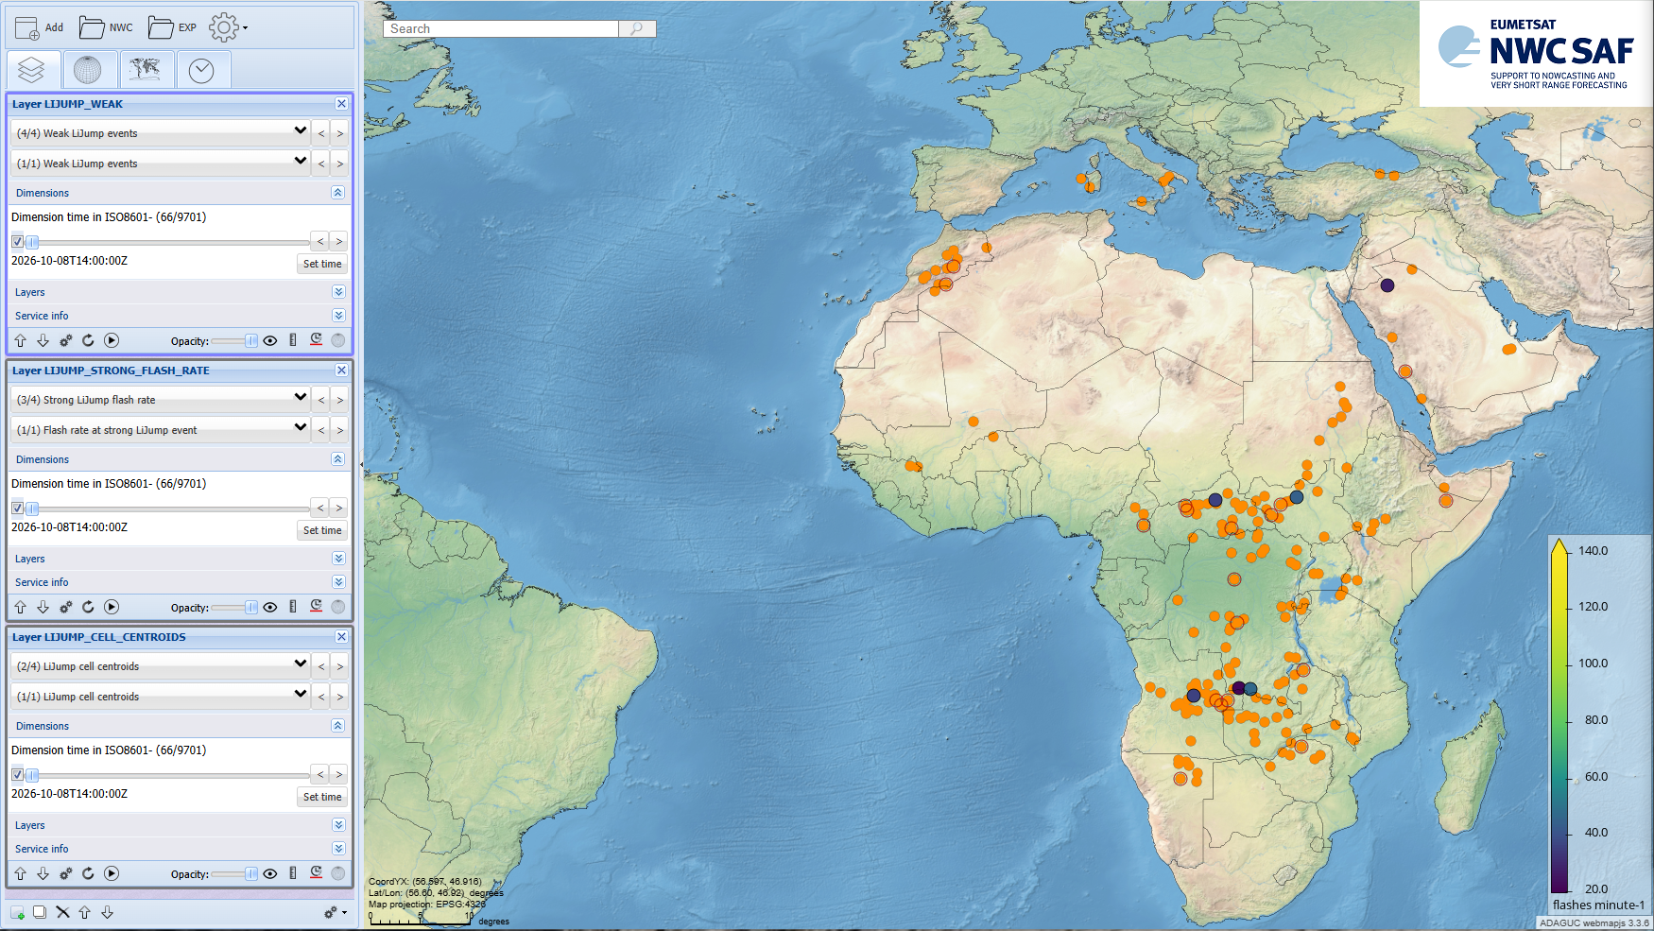
NWC SAF Products in the EWC: Local Systems Integration

Slide 21
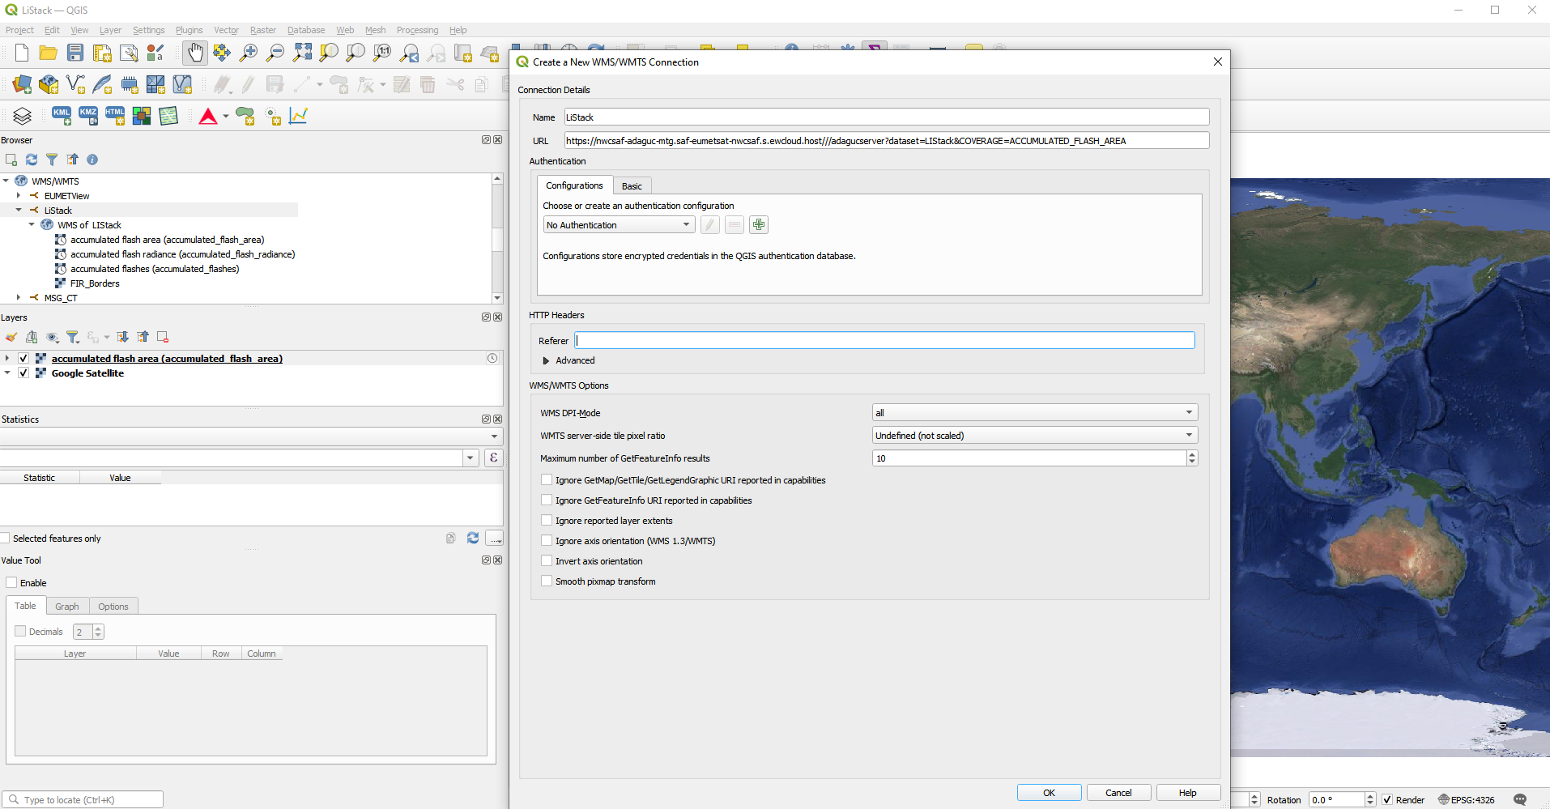
NWC SAF Products in the EWC: Local Systems Integration

Slide 22
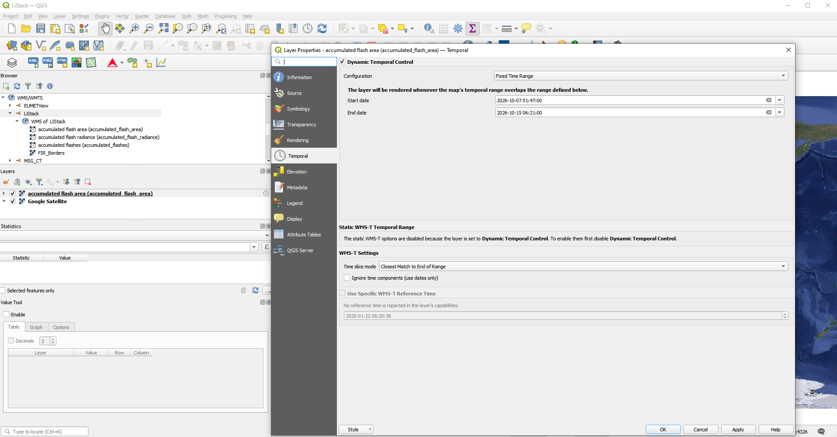
NWC SAF Products in the EWC: Local Systems Integration

Slide 23
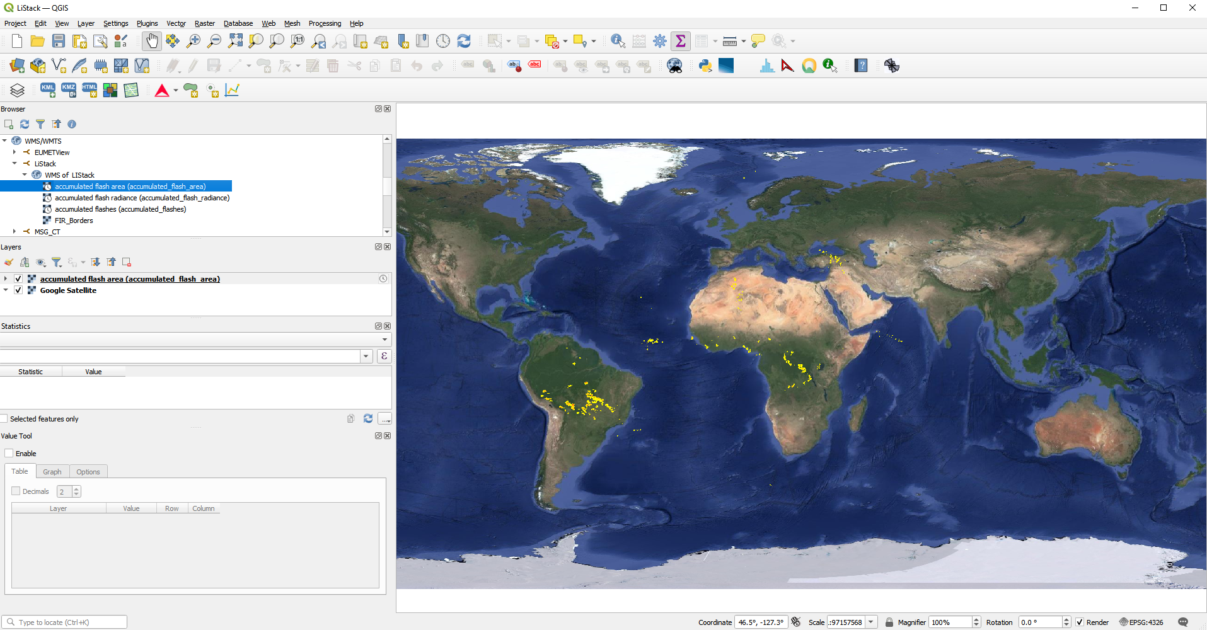
NWC SAF Products in the EWC: Local Systems Integration

Slide 24
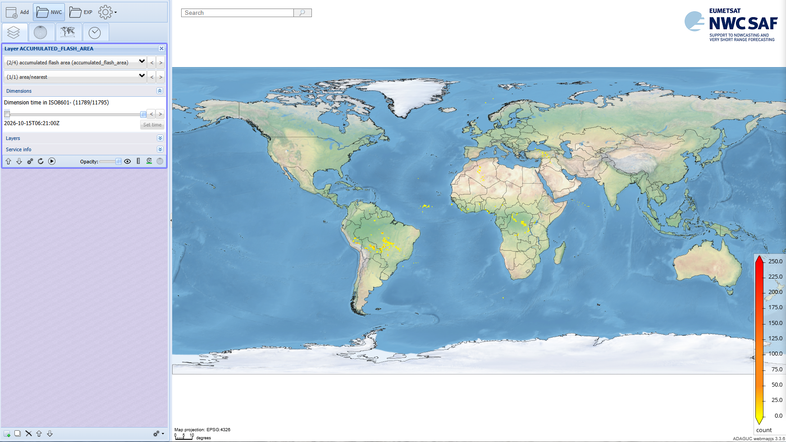
NWC SAF Products in the EWC: Local Systems Integration

Slide 25
Thank you!
Questions are welcome.

