Slide 1

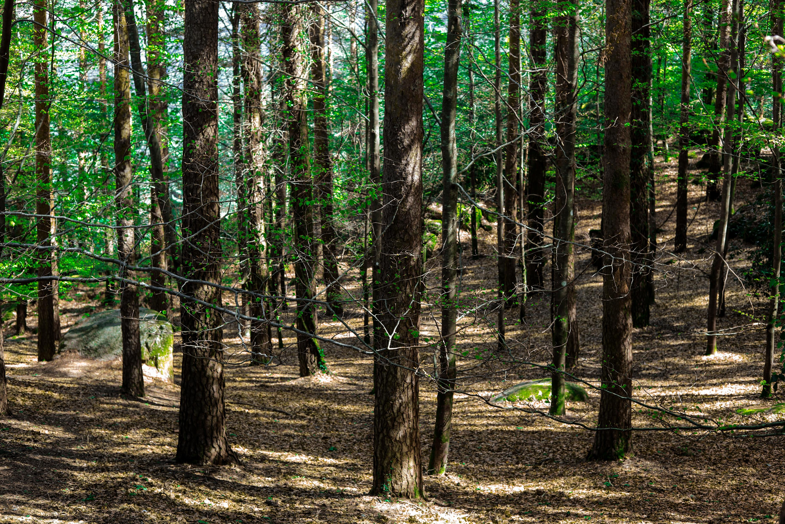


SIFOR | Portuguese Rural Fire Information System
PLIS | Interoperability Platform
GeoSIFOR | WebGIS Application
Pedro Venâncio (AGIF, Portugal) 2026-06-03

Slide 2

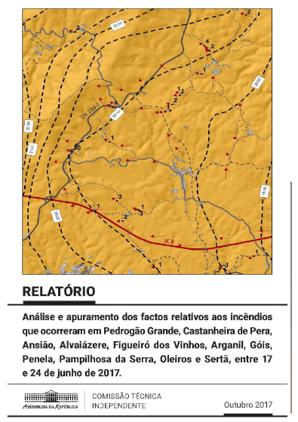
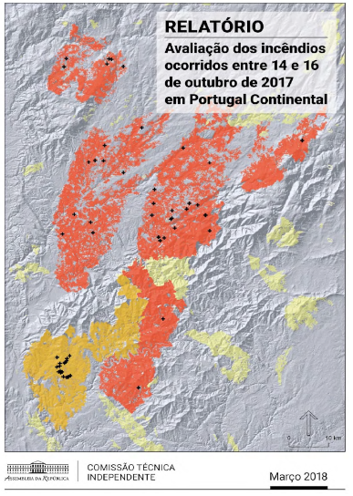
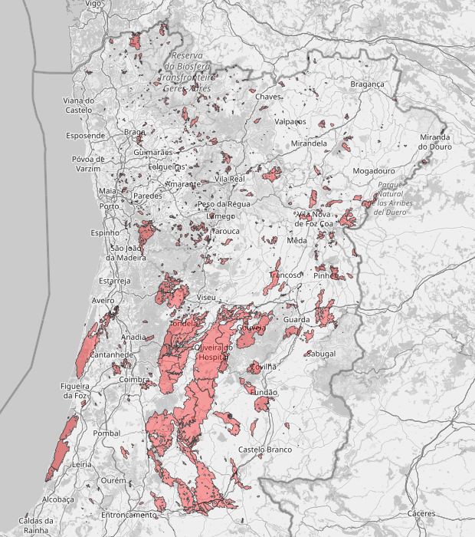
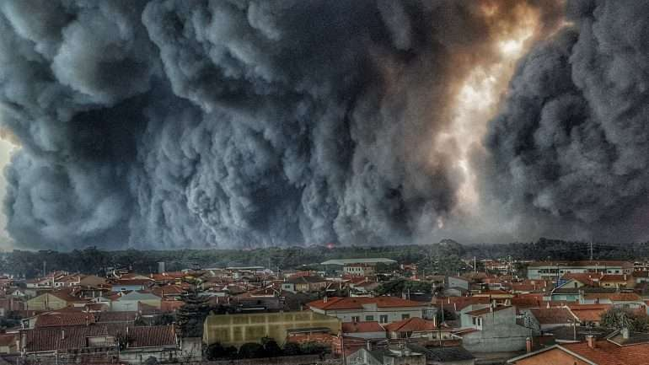

Integrated Rural Fire Management System (SGIFR)
SGIFR was established in 2021, replacing the National Forest Fire Defense System (2006);
It is mainly based on the conclusions and recommendations of Independent Technical Commissions of 2017 mega-fires (june and october);
Some of the constraints identified were the lack of interoperability of information systems and the lack of data sharing between the entities.
Rural Fire Information System

Slide 3
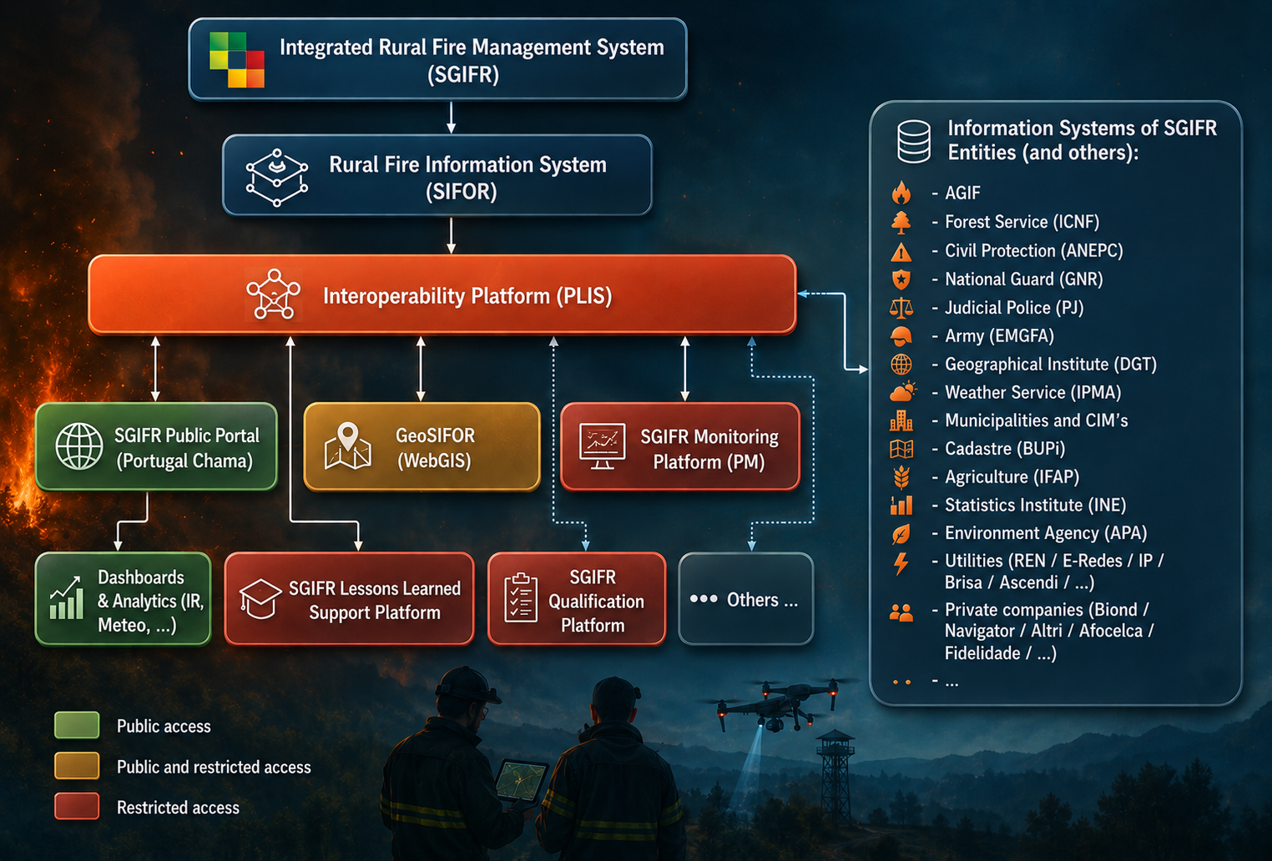
Rural Fire Information System (SIFOR)
Rural Fire Information System

Slide 4
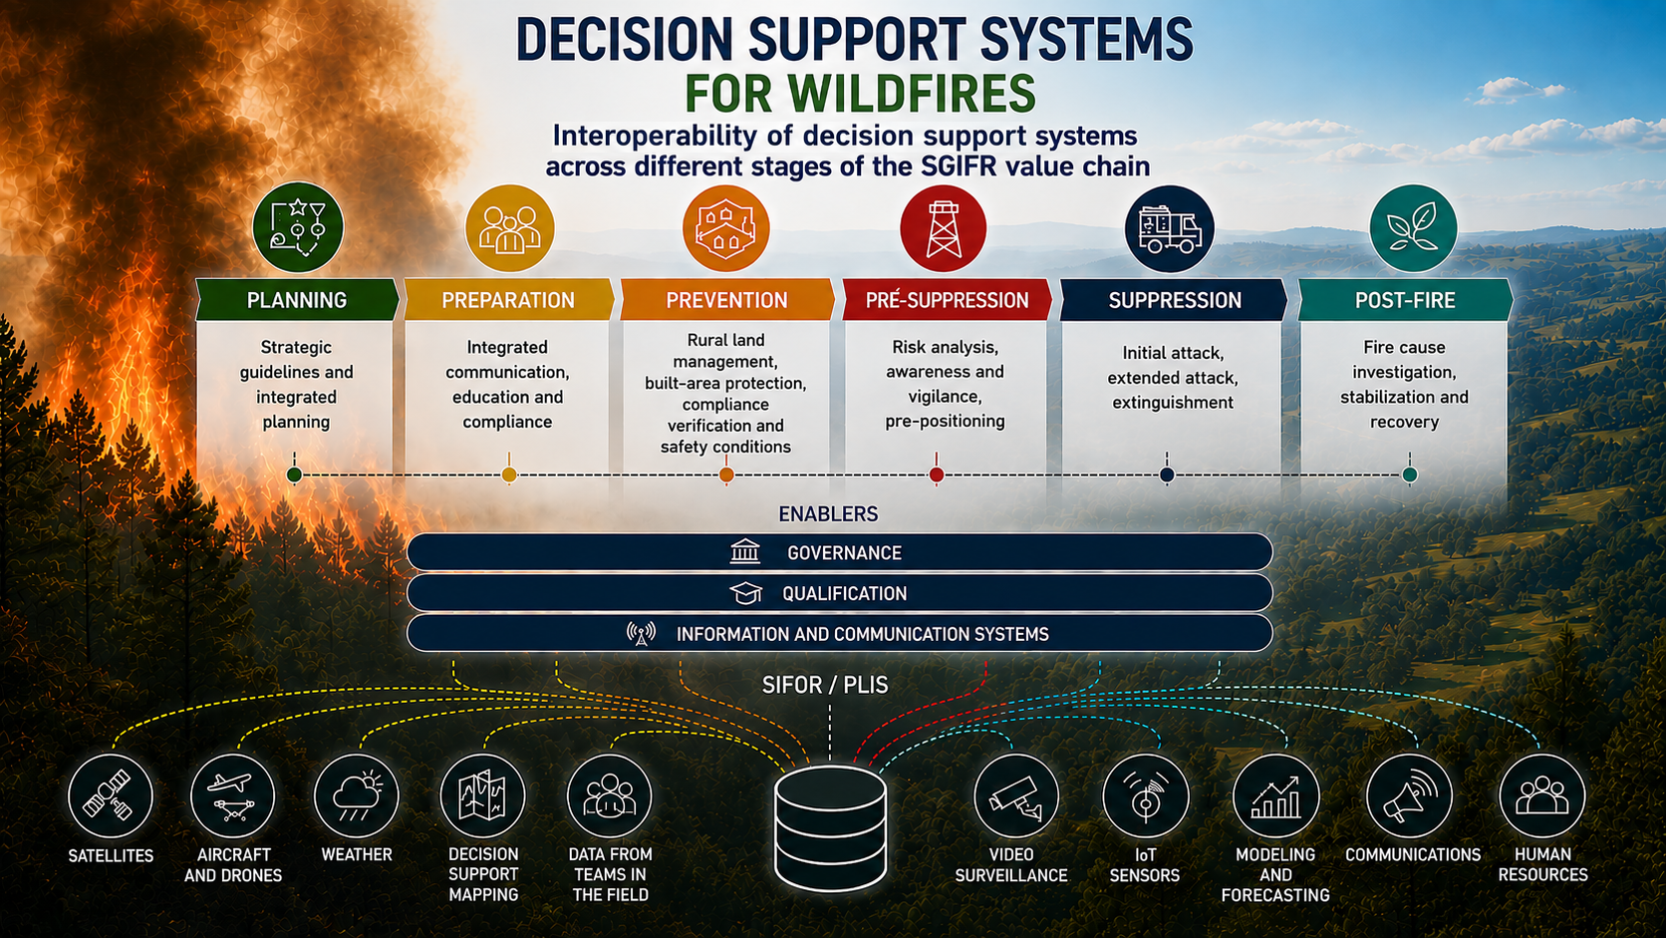

Slide 5
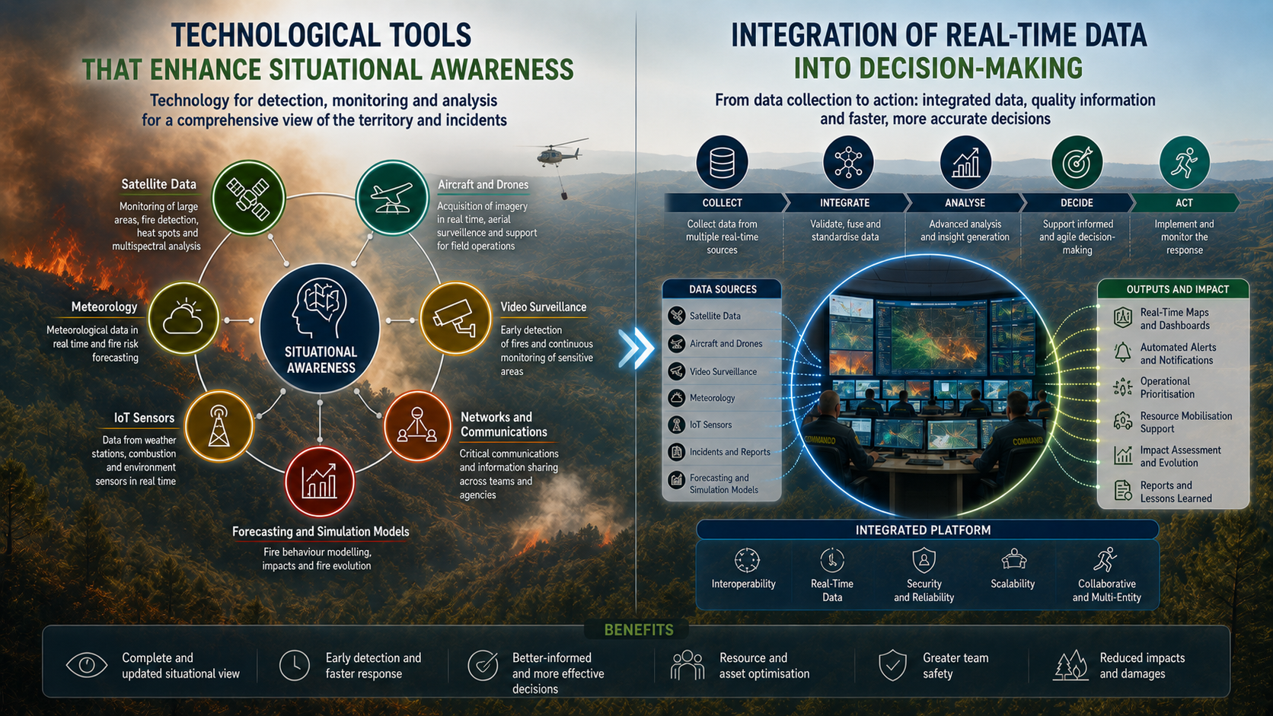

Slide 6



















Entities Involved in SIFOR
Planning, Strategic Coordination and Evaluation
Civil Protection
Forest Service
Weather Service
National Geographic Institute
Law enforcement Agencies
Army / Geographic Institute
Municipalities
Communications Regulator
Agriculture Entities
Land Registry
Private entities (Utilities / Forest and Agriculture)
Environmental Agency

Slide 7









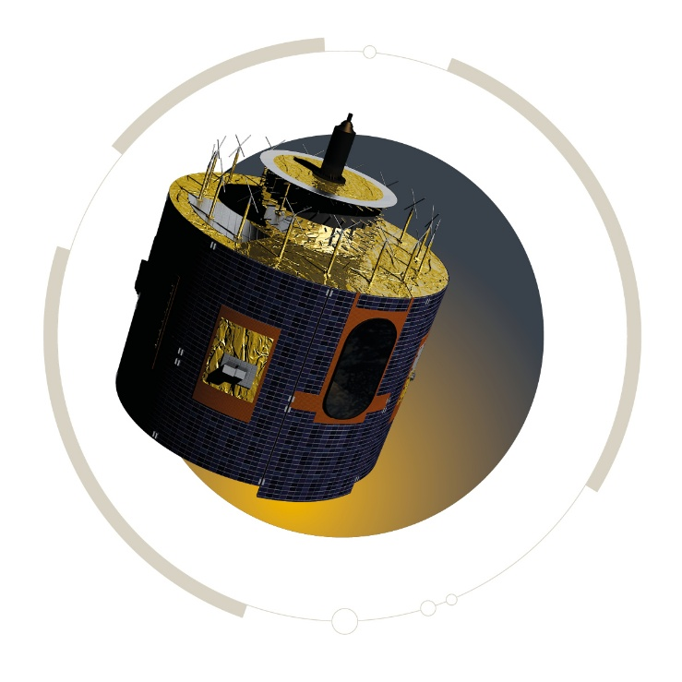
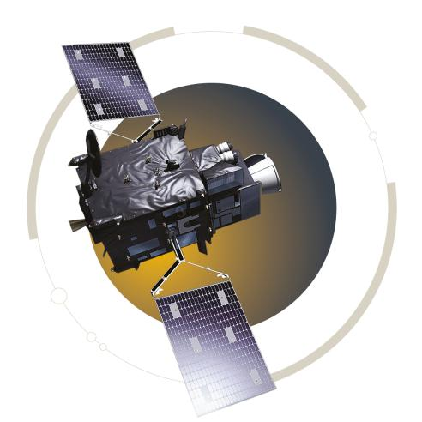
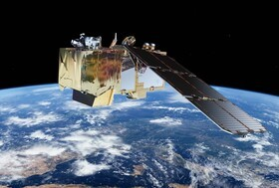
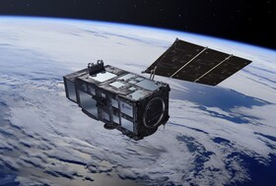
Entities Involved in SIFOR (International Data Providers)

Slide 8
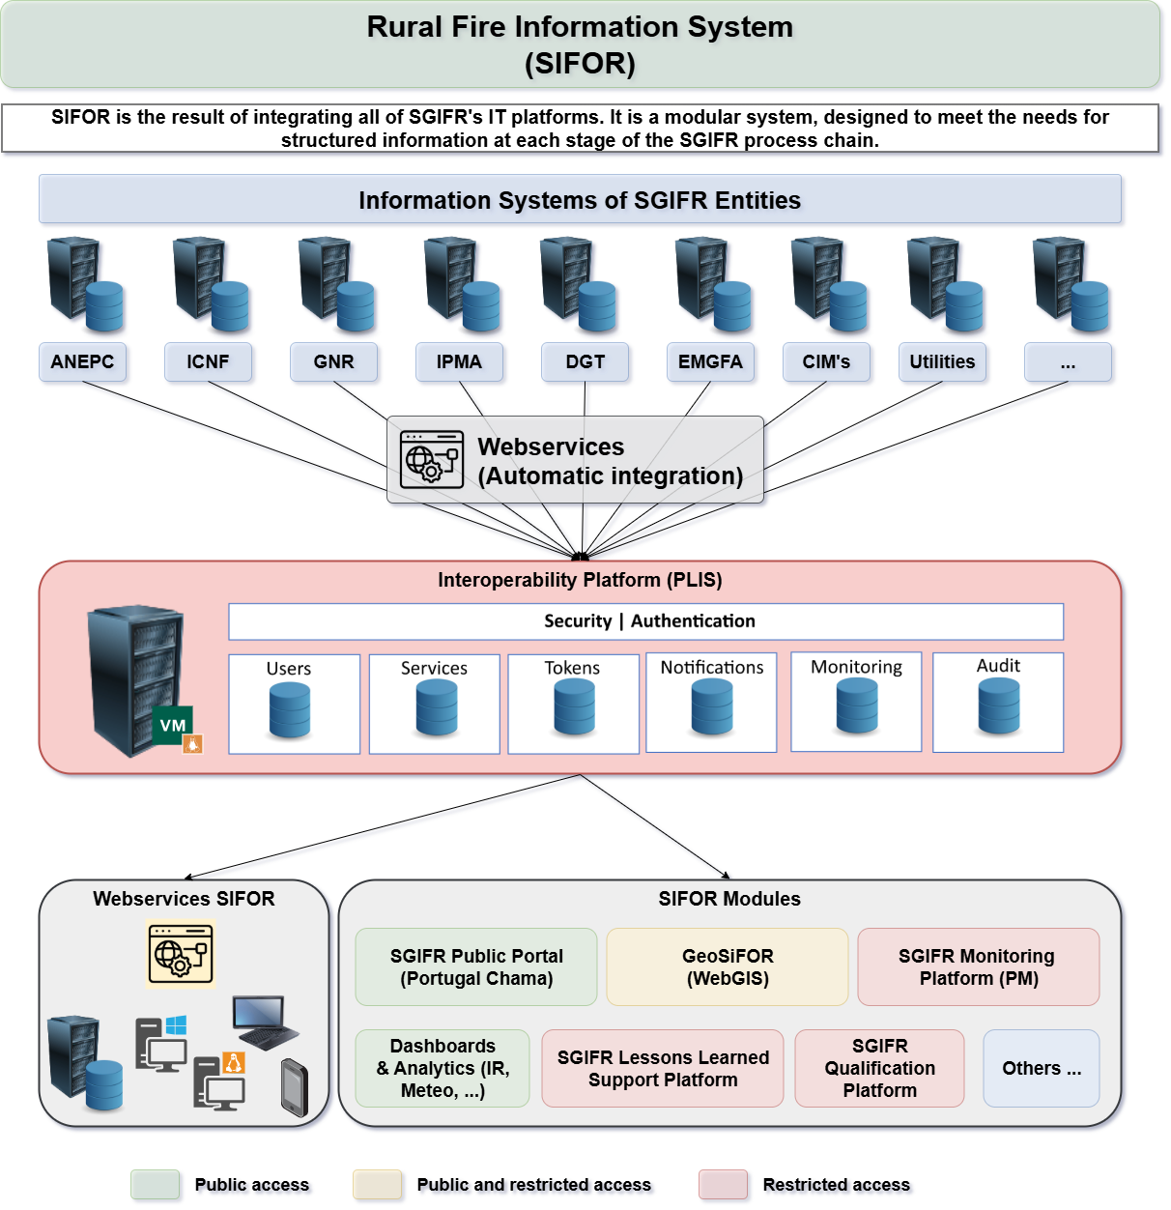


How it works
WMS
WMTS
WFS
WCS
Map Service
Feature Service
Image Service
Alphanumeric
(non geographic)
JSON
GeoJSON
XML
…
Rural Fire Information System

Slide 9

Public Portal (Communication and Awareness Information)
https://www.sgifr.gov.pt
Rural Fire Information System

Slide 10
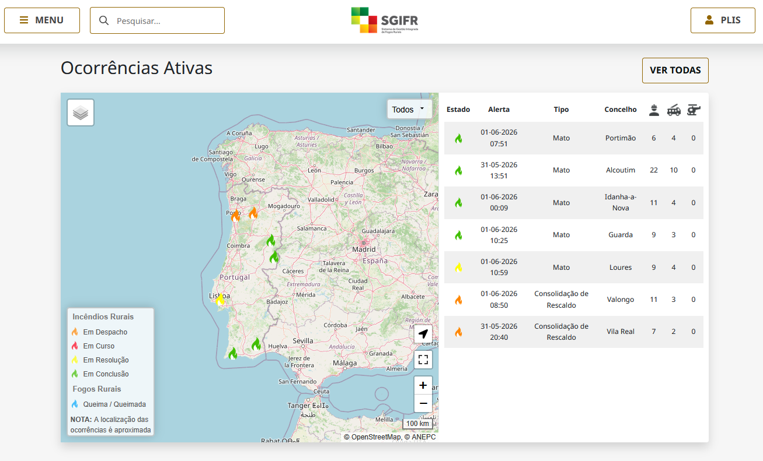
Public Portal (Communication and Awareness Information)
https://www.sgifr.gov.pt
Rural Fire Information System

Slide 11
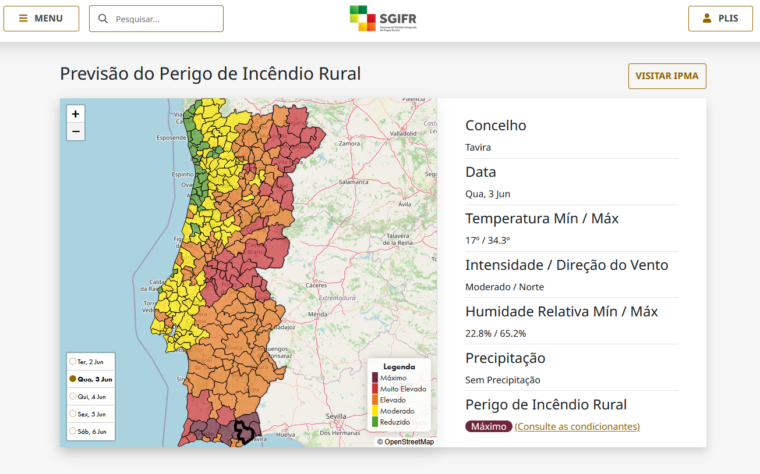
Public Portal (Communication and Awareness Information)
https://www.sgifr.gov.pt
Rural Fire Information System

Slide 12
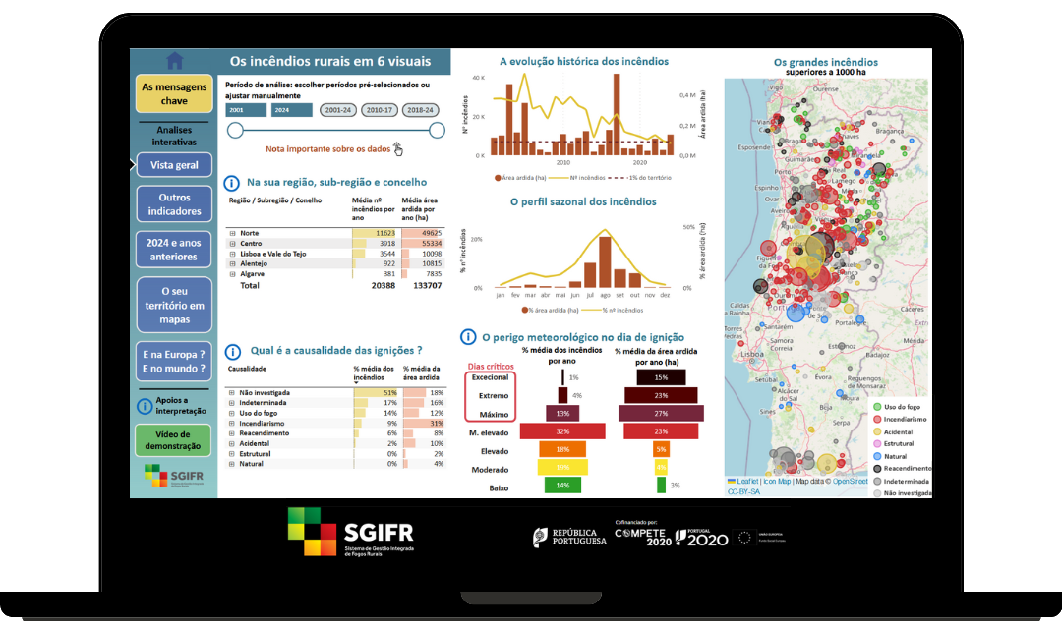
Public Portal (Technical Information)
https://www.sgifr.gov.pt
Rural Fire Information System

Slide 13
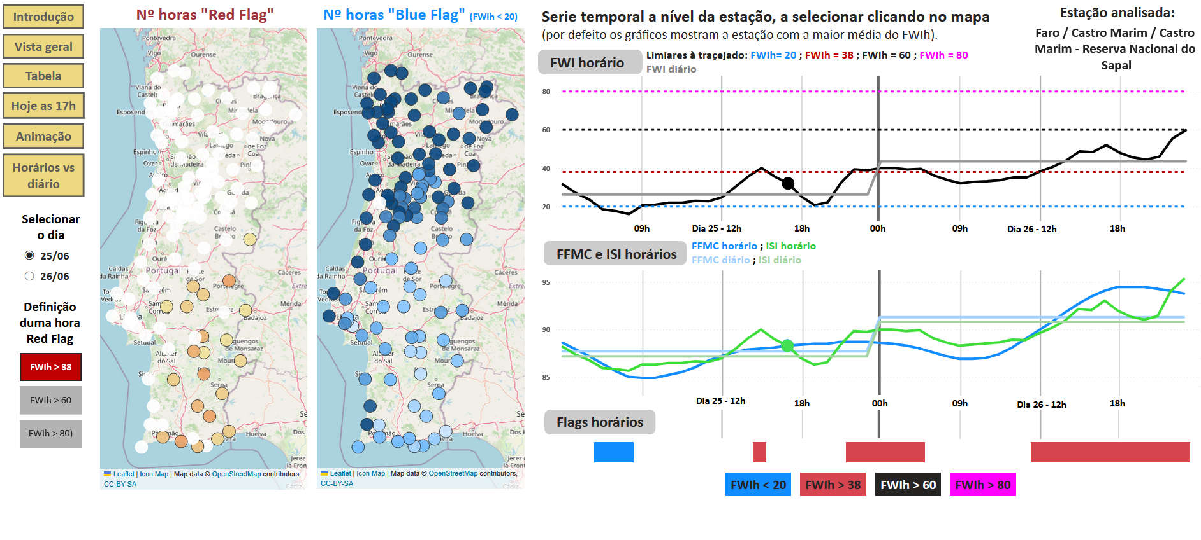
Public Portal (Technical Information)
https://www.sgifr.gov.pt/aplicacoes-analises-sgifr
Rural Fire Information System

Slide 14
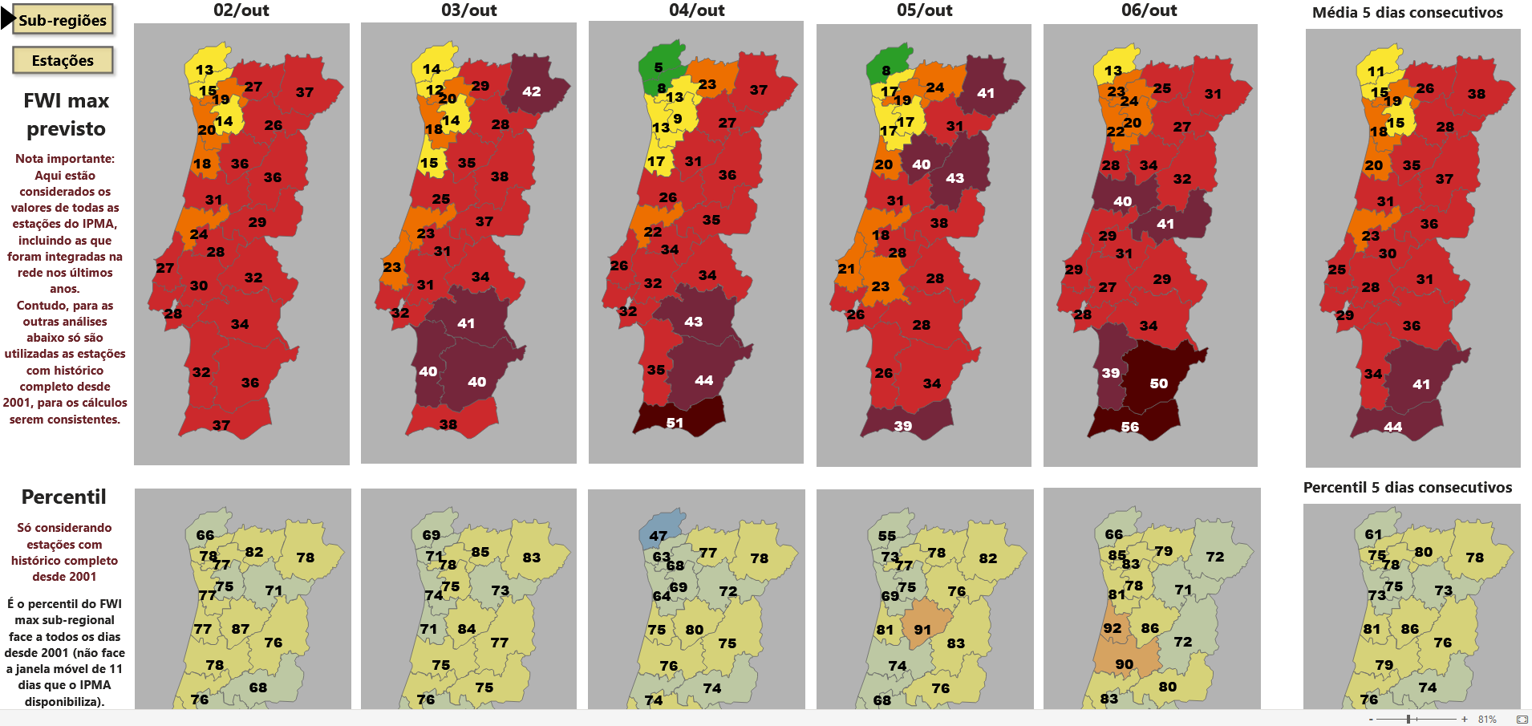
Public Portal (Technical Information)
https://www.sgifr.gov.pt/aplicacoes-analises-sgifr
Rural Fire Information System

Slide 15
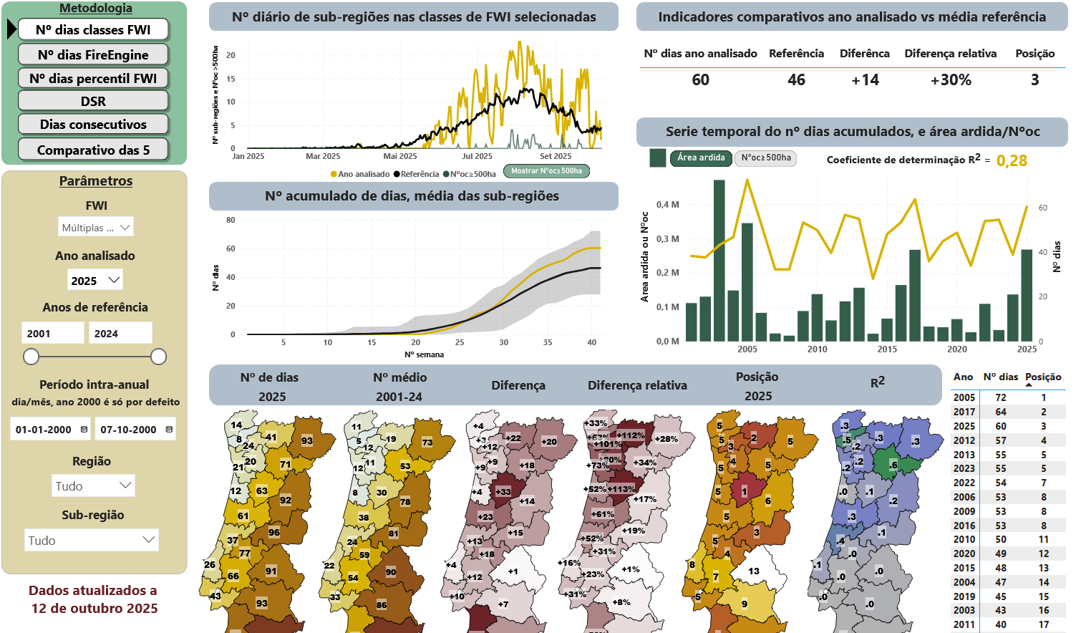
Public Portal (Technical Information)
https://www.sgifr.gov.pt/aplicacoes-analises-sgifr
Rural Fire Information System

Slide 16
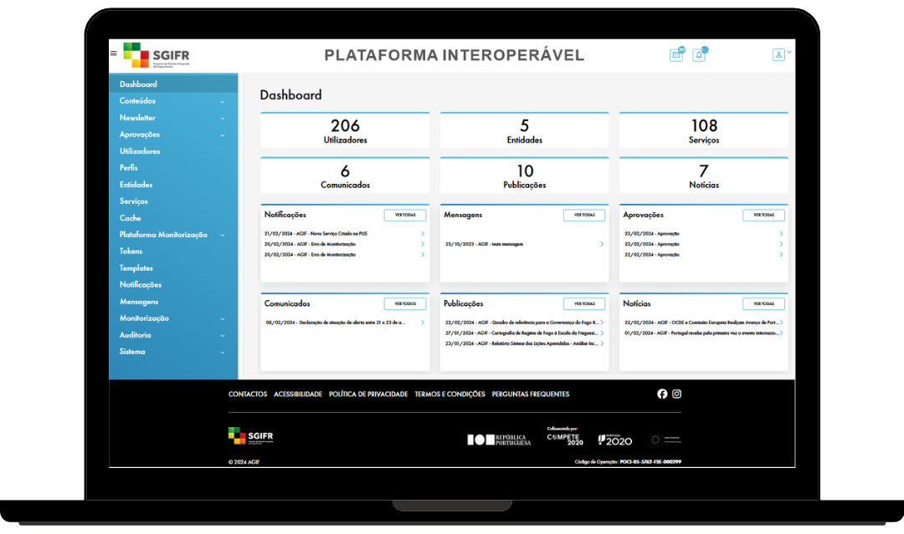
Interoperability Platform (PLIS)
https://plis.sgifr.gov.pt
Rural Fire Information System

Slide 17
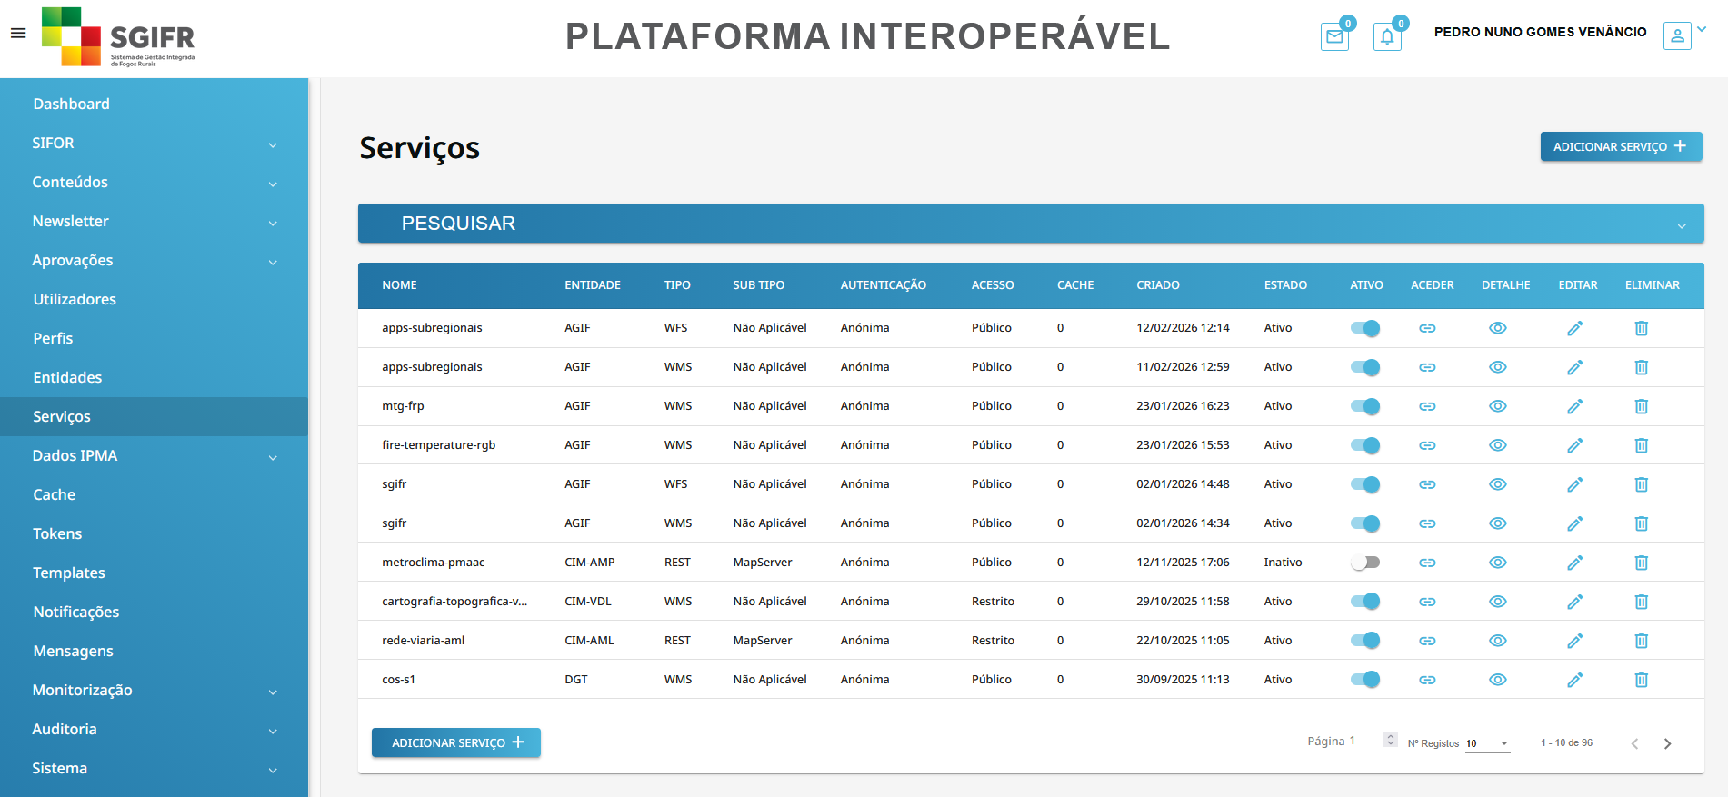
Interoperability Platform (PLIS)
https://plis.sgifr.gov.pt
Rural Fire Information System

Slide 18
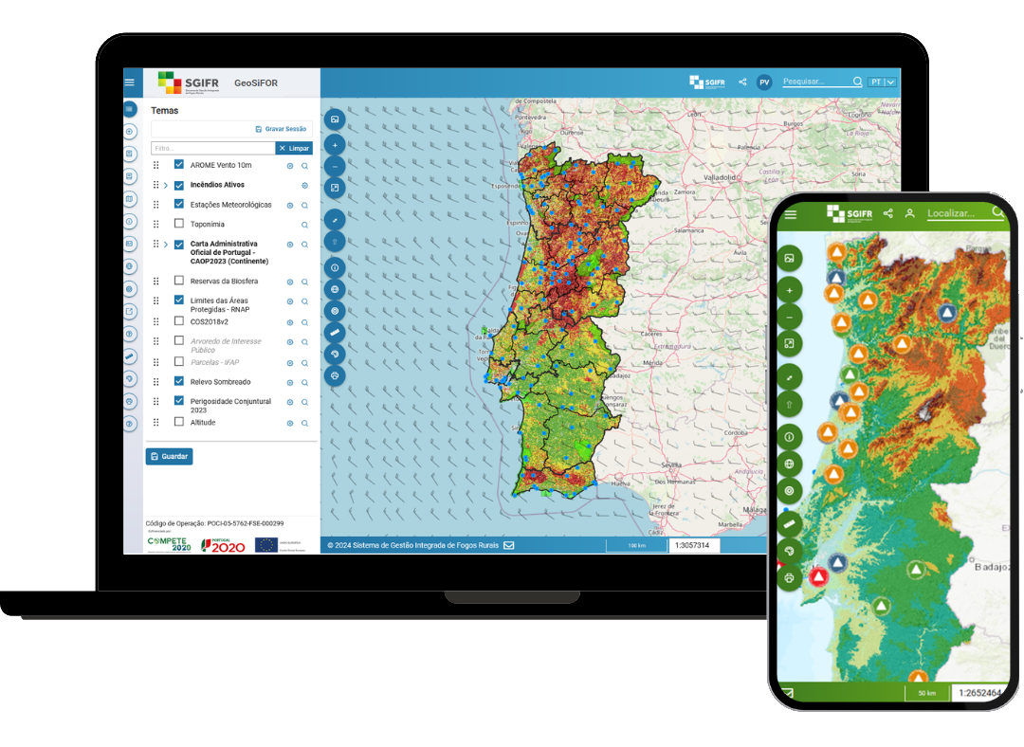
WebGIS App (GeoSiFOR)
Rural Fire Information System
https://geosifor.sgifr.gov.pt

Slide 19
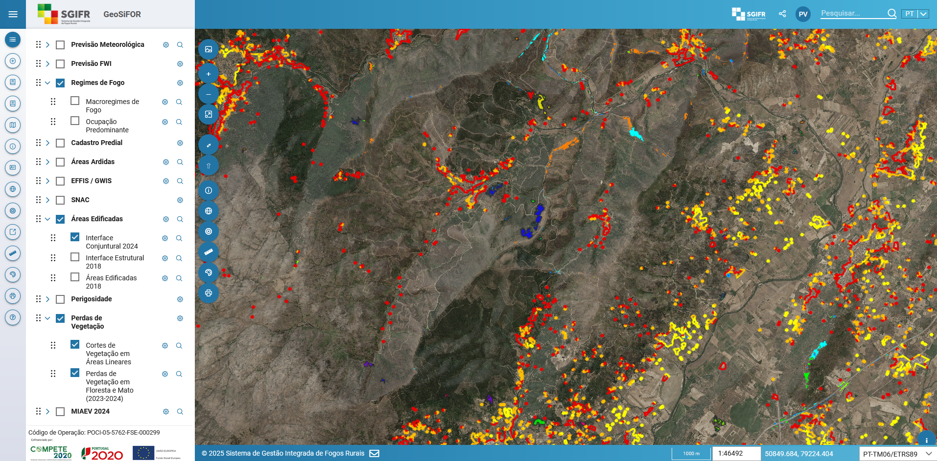
WebGIS App (GeoSiFOR)
https://geosifor.sgifr.gov.pt
Rural Fire Information System

Slide 20
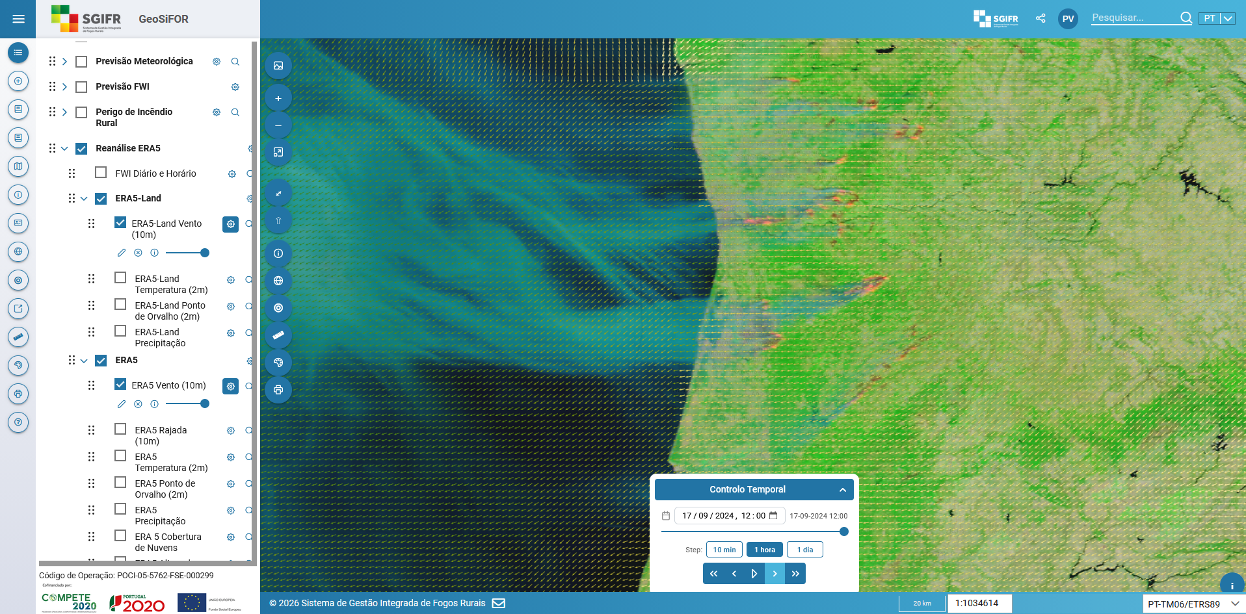
WebGIS App (GeoSiFOR)
MODIS | ERA5
(2024-09-17 11:00 UTC)
https://geosifor.sgifr.gov.pt
Rural Fire Information System

Slide 21
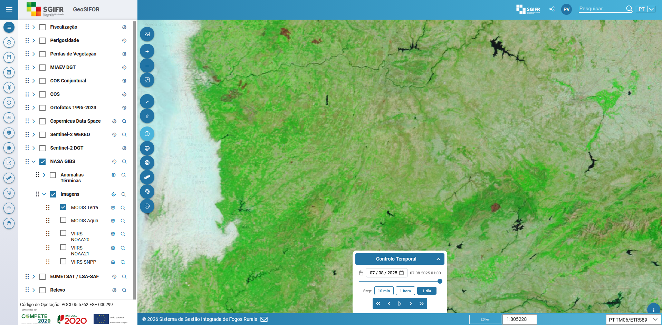
WebGIS App (GeoSiFOR)
MODIS
(2024-08-07)
https://geosifor.sgifr.gov.pt
Rural Fire Information System

Slide 22
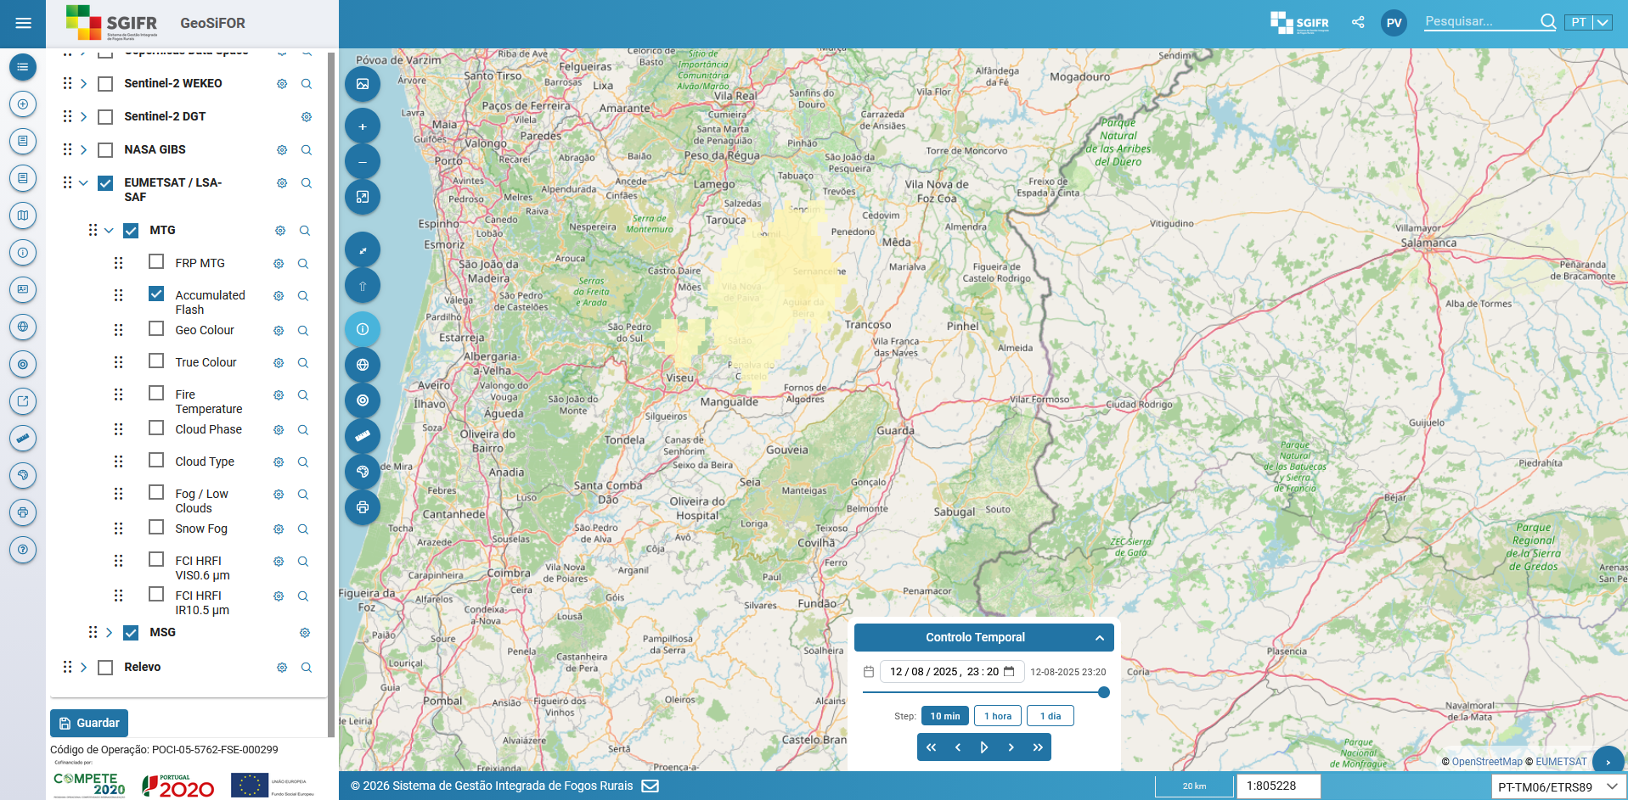
WebGIS App (GeoSiFOR)
Lightning - Sátão Fire
Meteosat Third Generation (2025-08-12 22:20 UTC)
DEA IPMA: 2025-08-12 22:21 UTC
Fire Alert: 2025-08-12 23:03 UTC
https://geosifor.sgifr.gov.pt
Rural Fire Information System

Slide 23
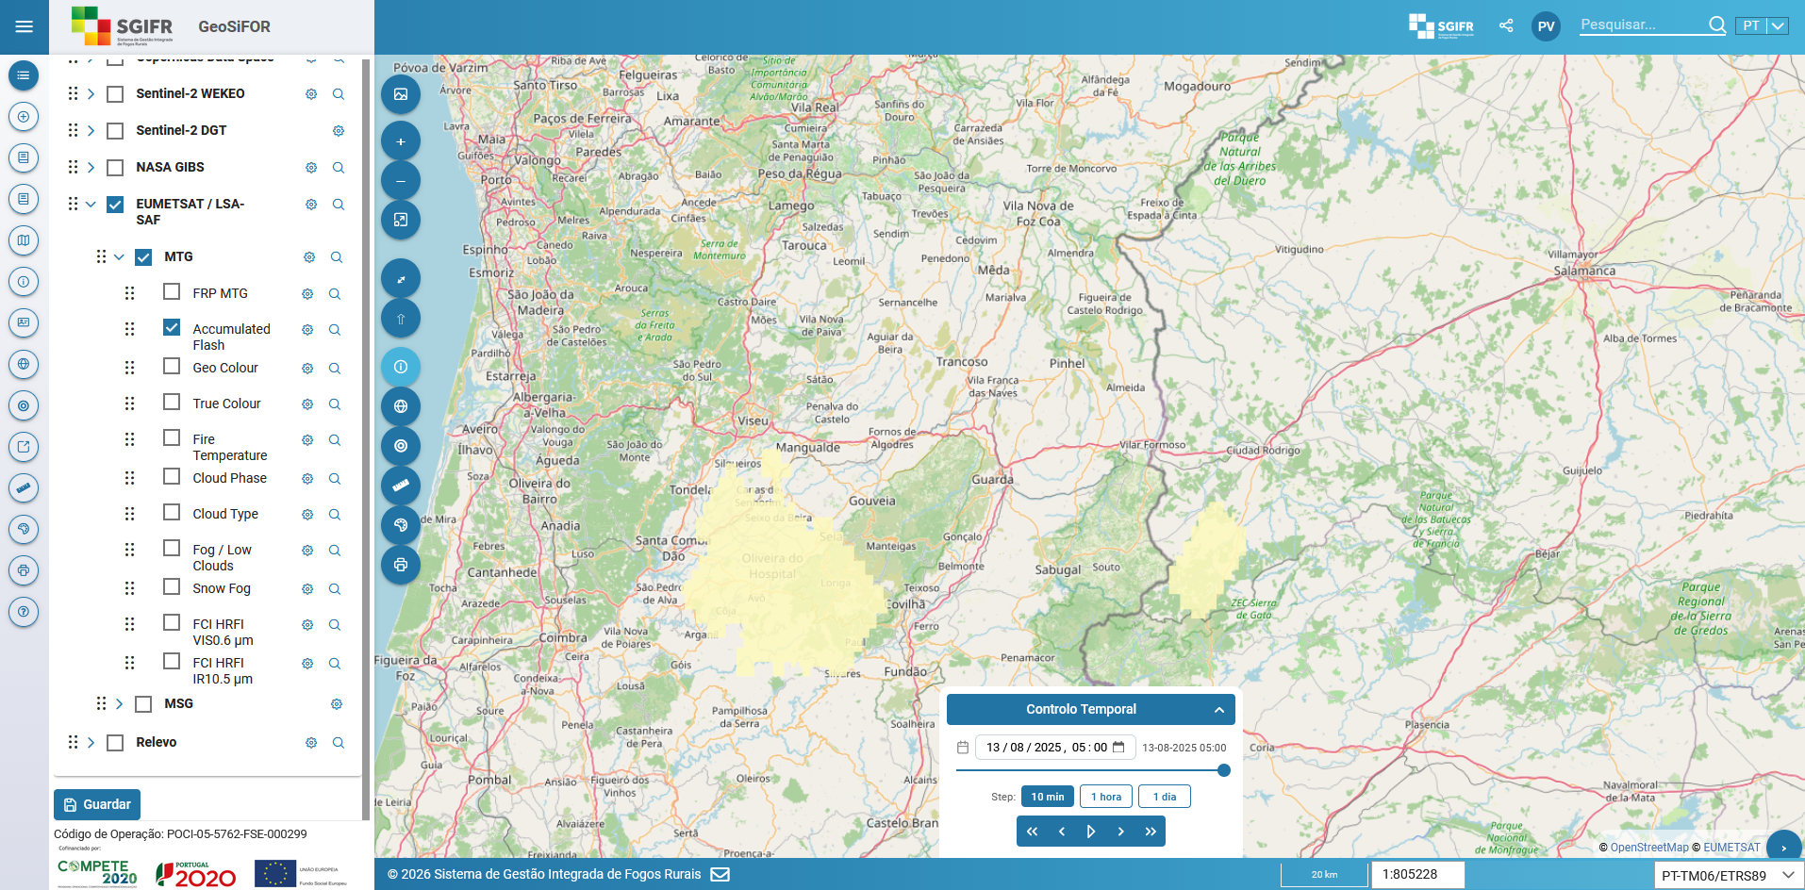
WebGIS App (GeoSiFOR)
Lightning - Piódão Fire
Meteosat Third Generation (2025-08-13 04:00 UTC)
DEA IPMA: 2025-08-13 04:05 UTC
Fire Alert: 2025-08-13 04:08 UTC
https://geosifor.sgifr.gov.pt
Rural Fire Information System

Slide 24
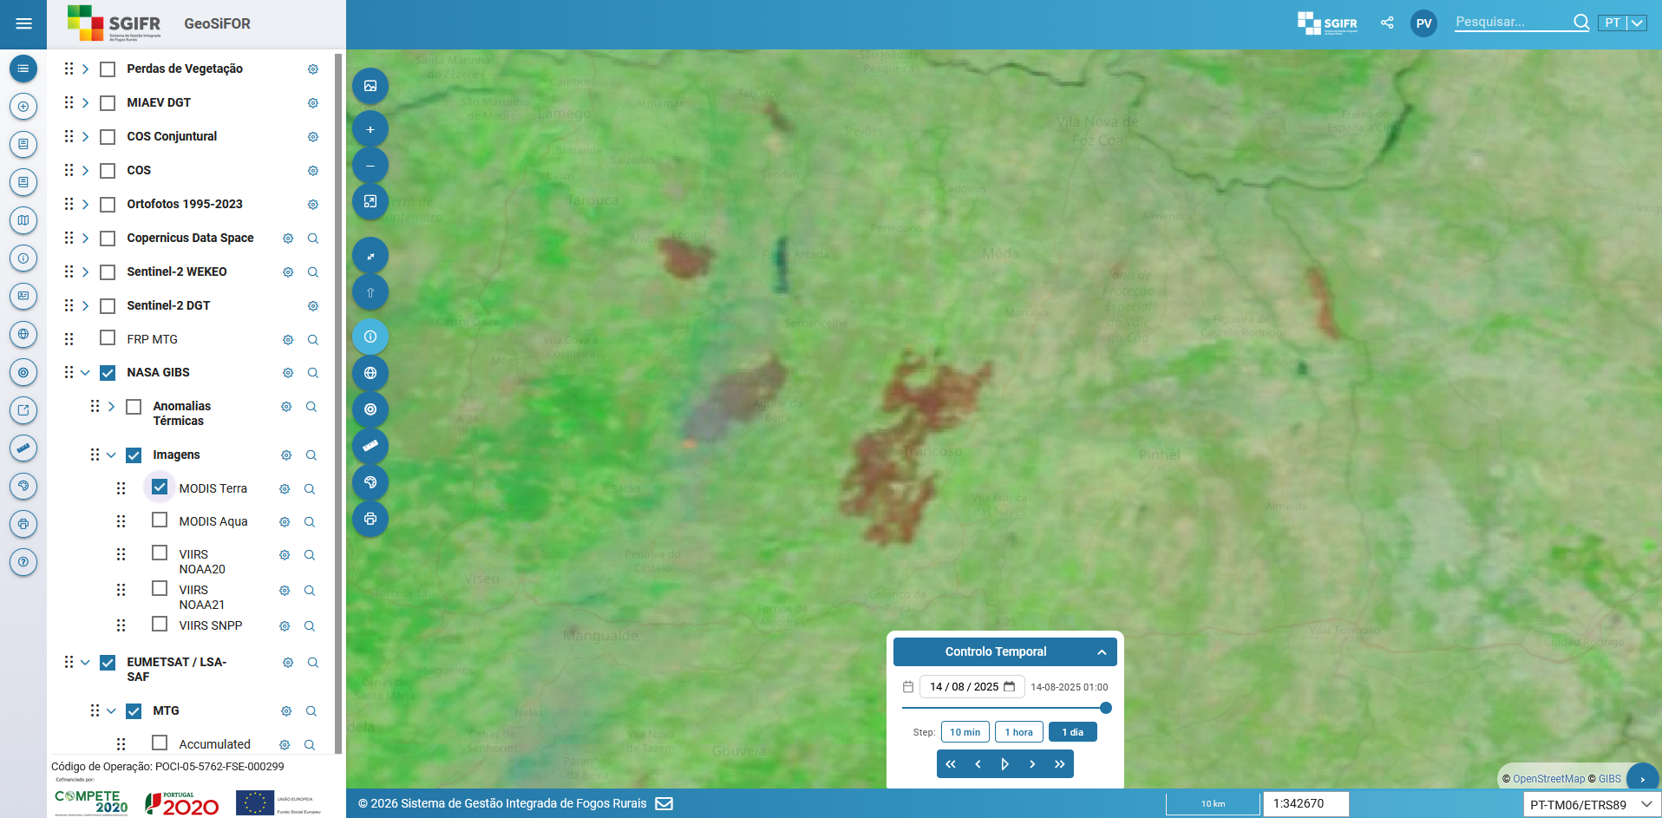
WebGIS App (GeoSiFOR)
MODIS Terra
(2025-08-14)
https://geosifor.sgifr.gov.pt
Rural Fire Information System

Slide 25
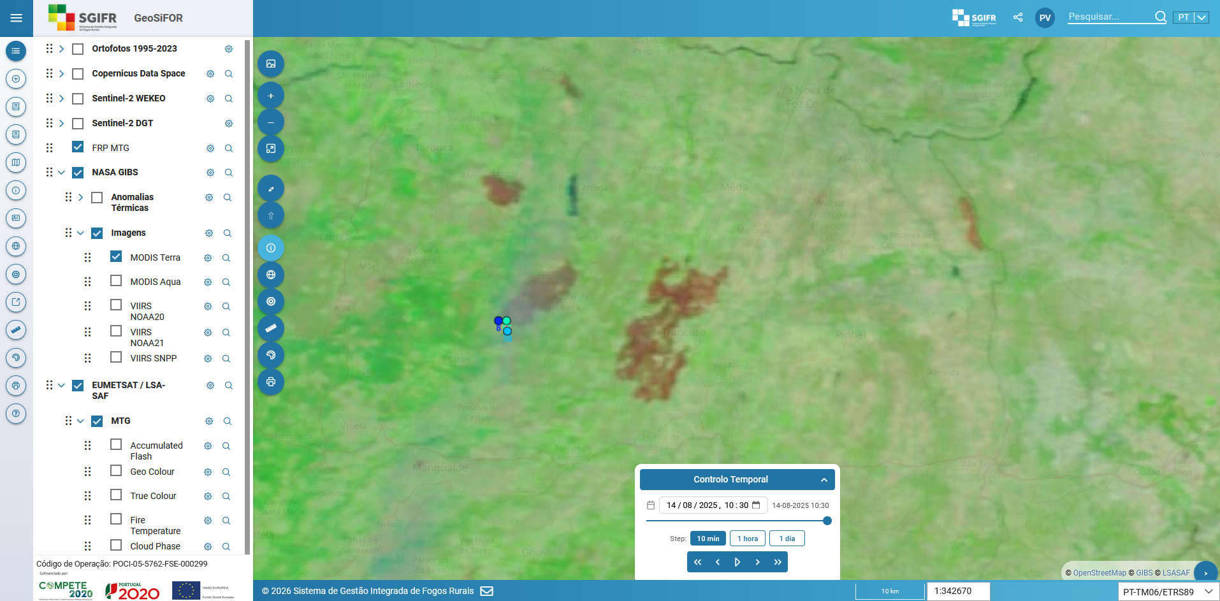
WebGIS App (GeoSiFOR)
MODIS Terra | MTG
(2025-08-14 09:30 UTC)
https://geosifor.sgifr.gov.pt
Rural Fire Information System

Slide 26
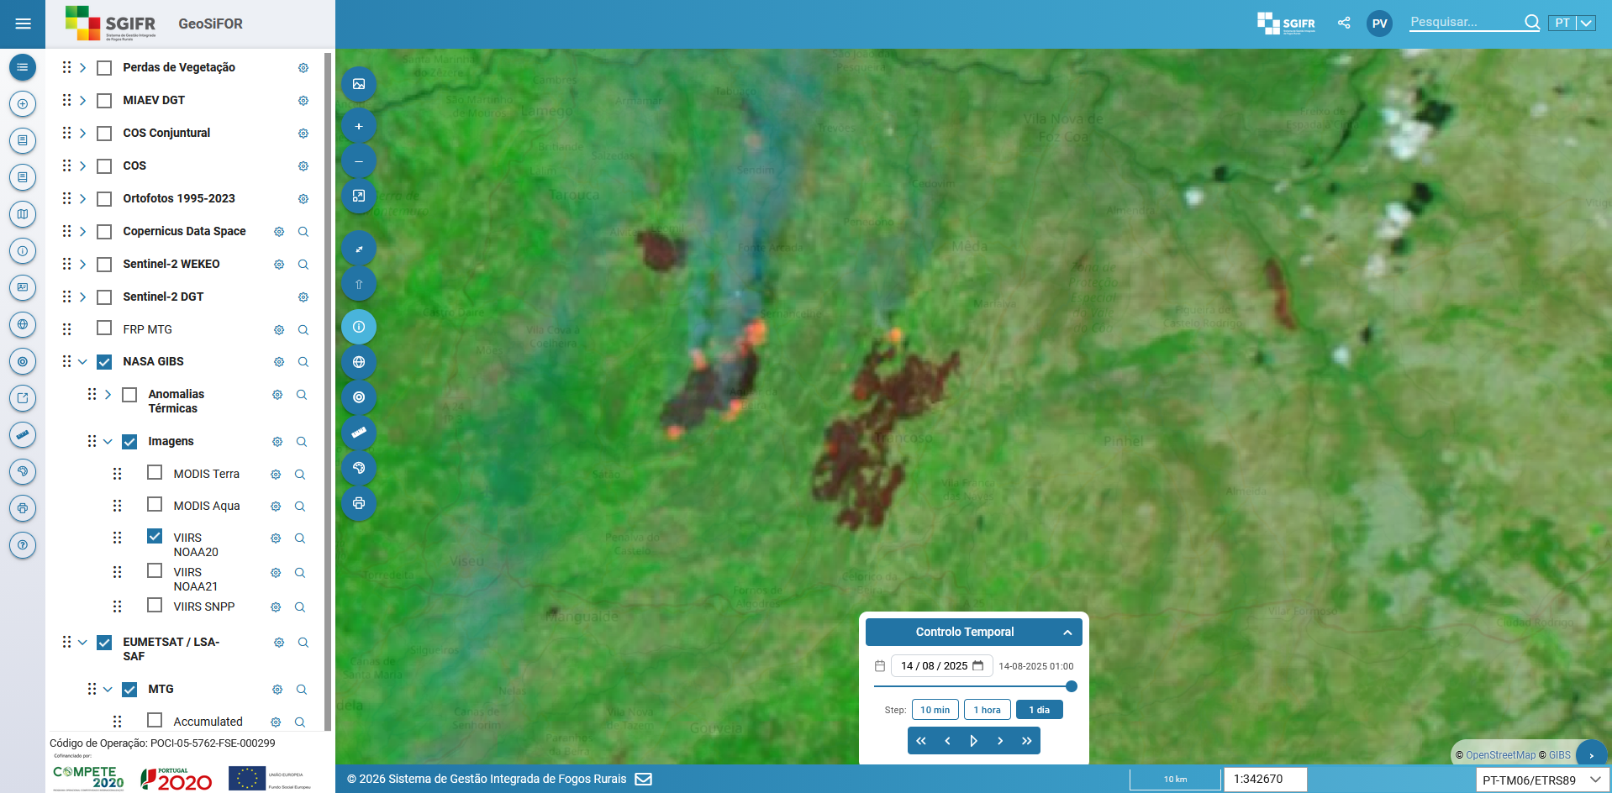
WebGIS App (GeoSiFOR)
VIIRS NOAA20
(2025-08-14)
https://geosifor.sgifr.gov.pt
Rural Fire Information System

Slide 27
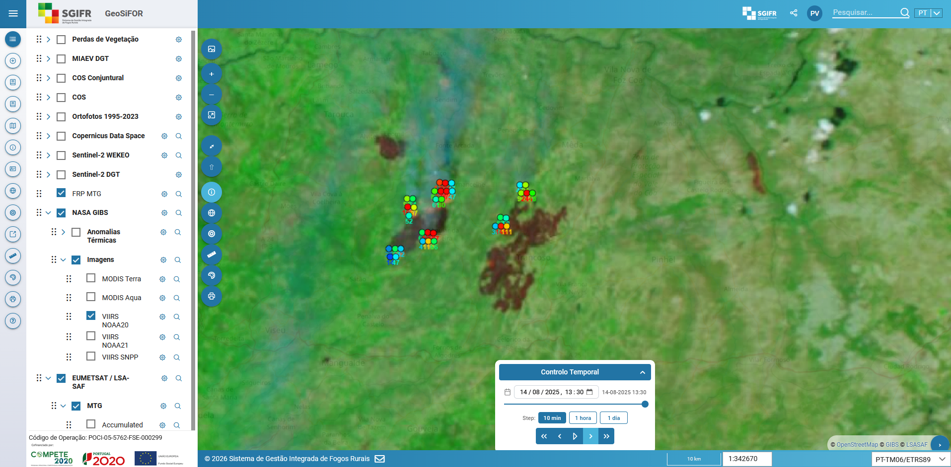
WebGIS App (GeoSiFOR)
VIIRS NOAA20 | MTG
(2025-08-14 12:30 UTC)
https://geosifor.sgifr.gov.pt
Rural Fire Information System

Slide 28
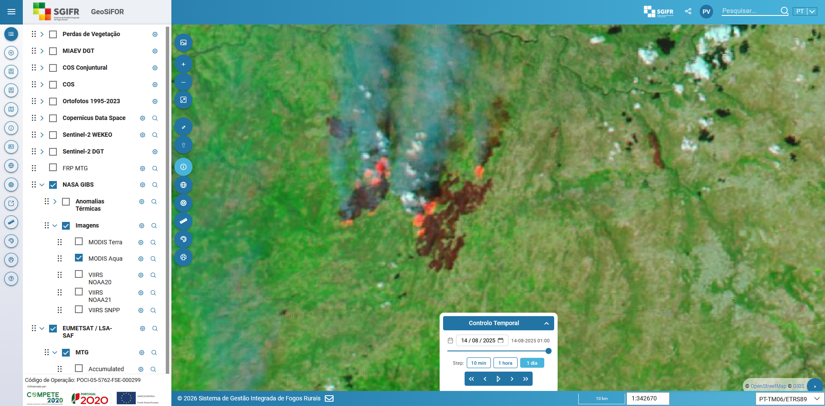
WebGIS App (GeoSiFOR)
MODIS Aqua
(2025-08-14)
https://geosifor.sgifr.gov.pt
Rural Fire Information System

Slide 29
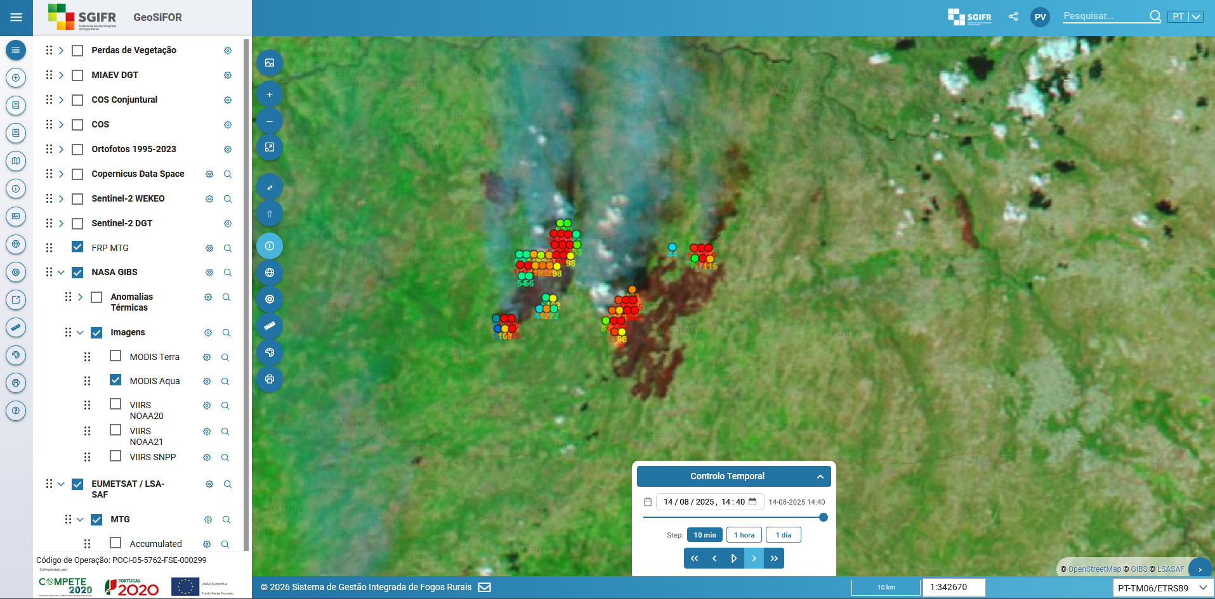
WebGIS App (GeoSiFOR)
MODIS Aqua | MTG
(2025-08-14 13:40 UTC)
https://geosifor.sgifr.gov.pt
Rural Fire Information System

Slide 30
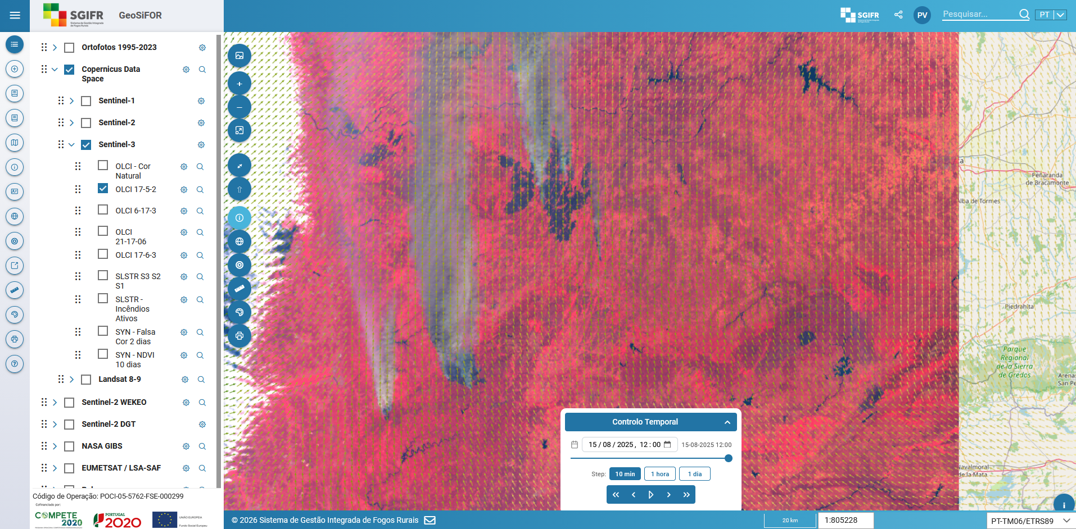
WebGIS App (GeoSiFOR)
Sentinel-3 | ERA5-Land (2025-08-15 11:00 UTC)
https://geosifor.sgifr.gov.pt
Rural Fire Information System

Slide 31
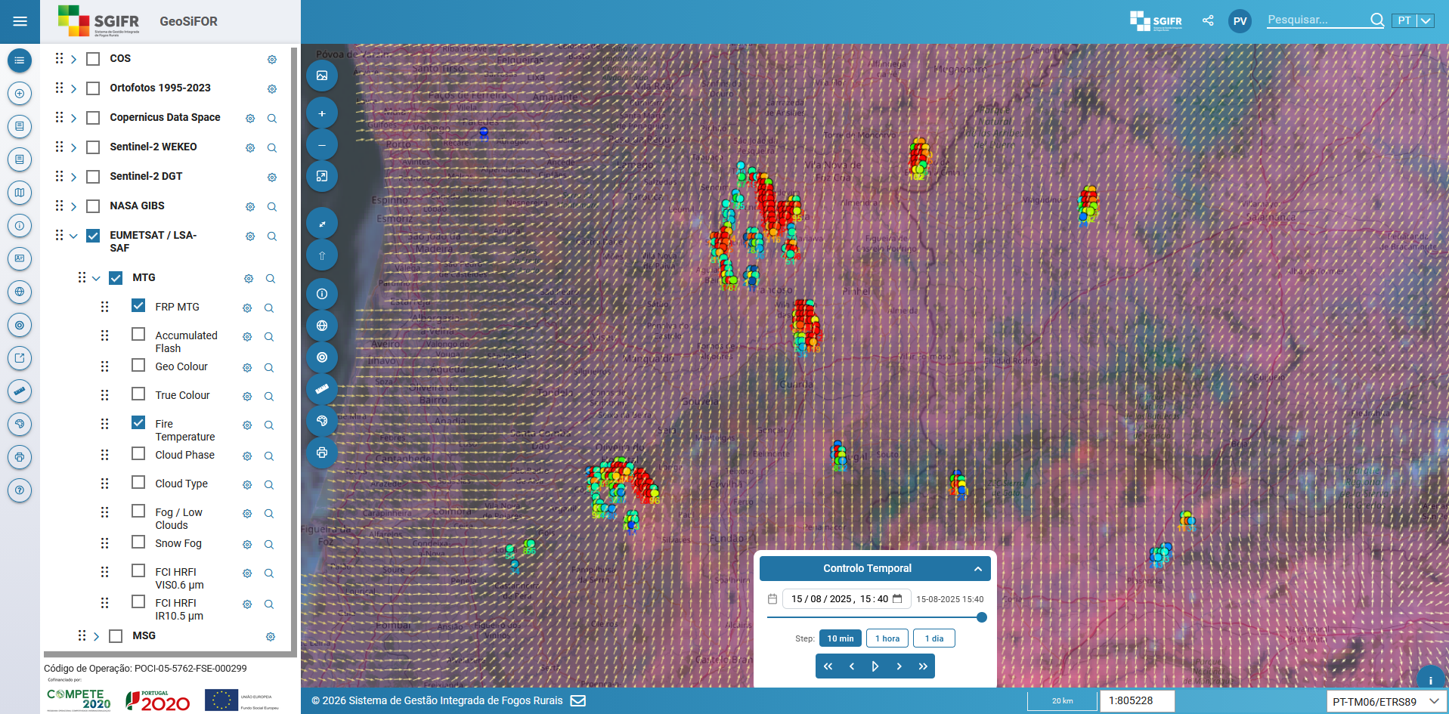
WebGIS App (GeoSiFOR)
Meteosat Third Generation (2025-08-15 14:40 UTC)
https://geosifor.sgifr.gov.pt
Rural Fire Information System

Slide 32
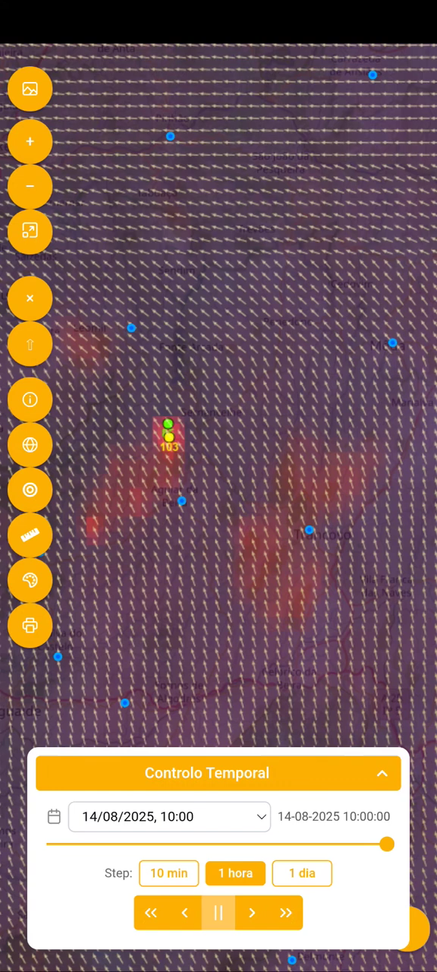
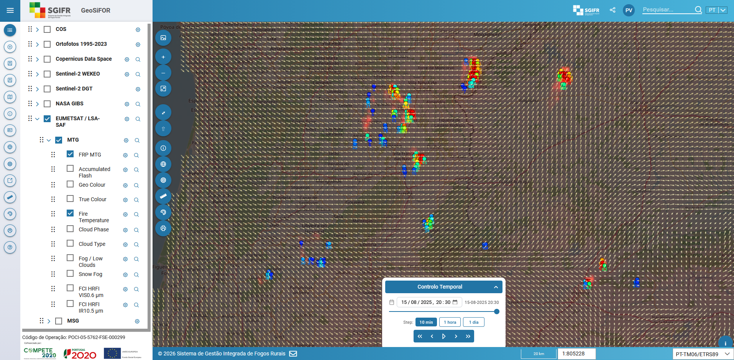
WebGIS App (GeoSiFOR)
Meteosat Third Generation (2025-08-15 19:30 UTC)
https://geosifor.sgifr.gov.pt
Rural Fire Information System

Slide 33
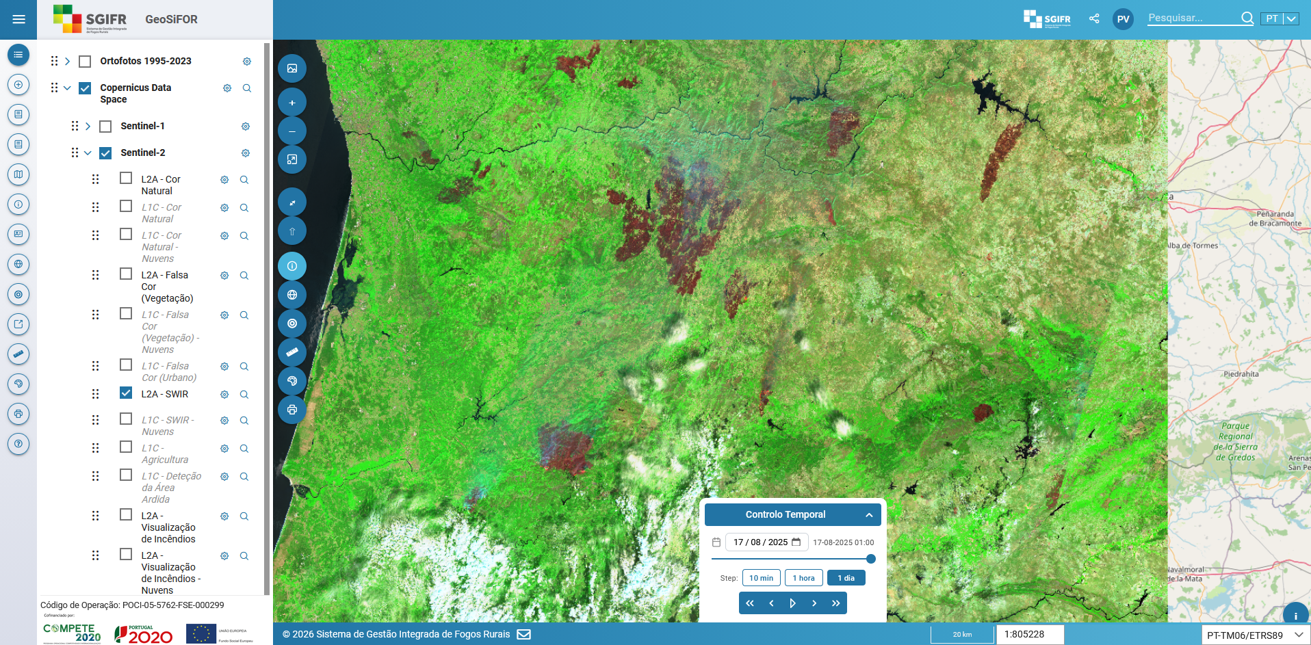
WebGIS App (GeoSiFOR)
Sentinel-2 2025-08-16
https://geosifor.sgifr.gov.pt
Rural Fire Information System

Slide 34
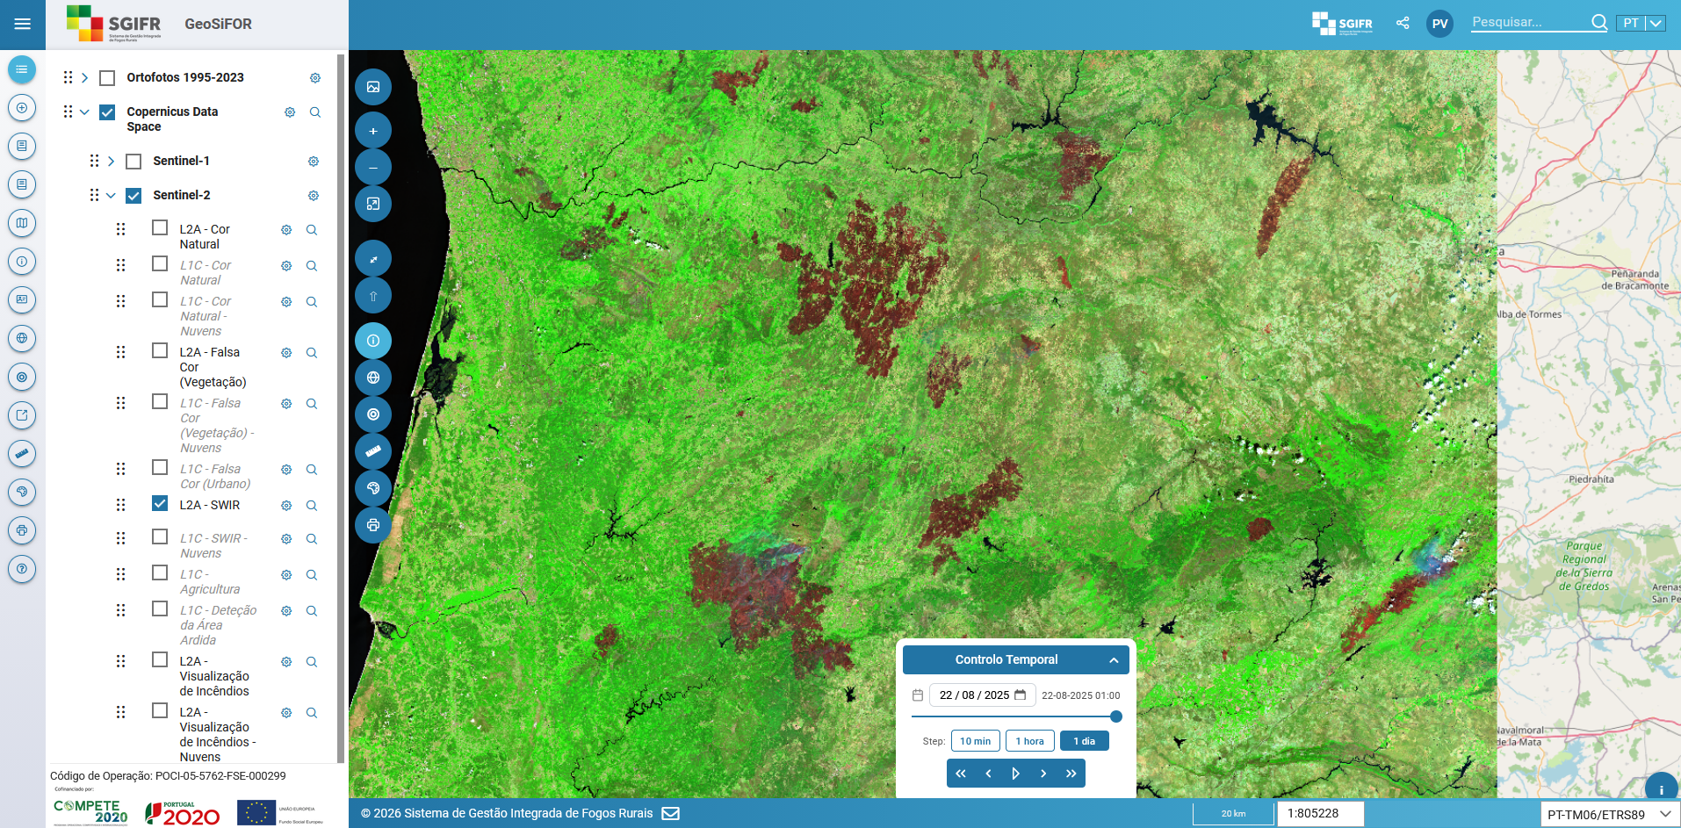
WebGIS App (GeoSiFOR)
Sentinel-2 2025-08-21
https://geosifor.sgifr.gov.pt
Rural Fire Information System

Slide 35
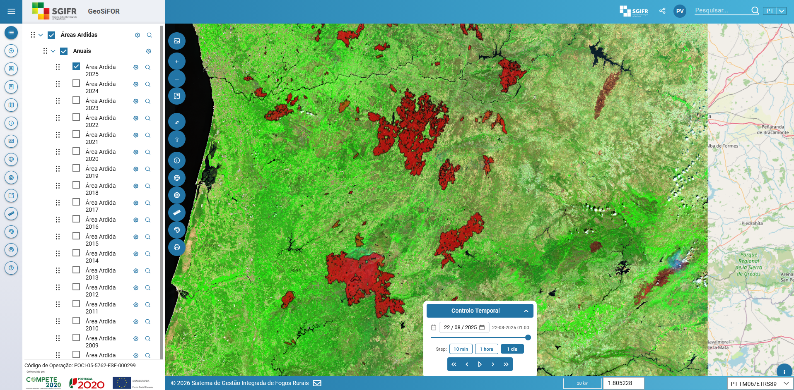
WebGIS App (GeoSiFOR)
Burned Areas
(Forest Service - ICNF)
https://geosifor.sgifr.gov.pt
Rural Fire Information System

Slide 36
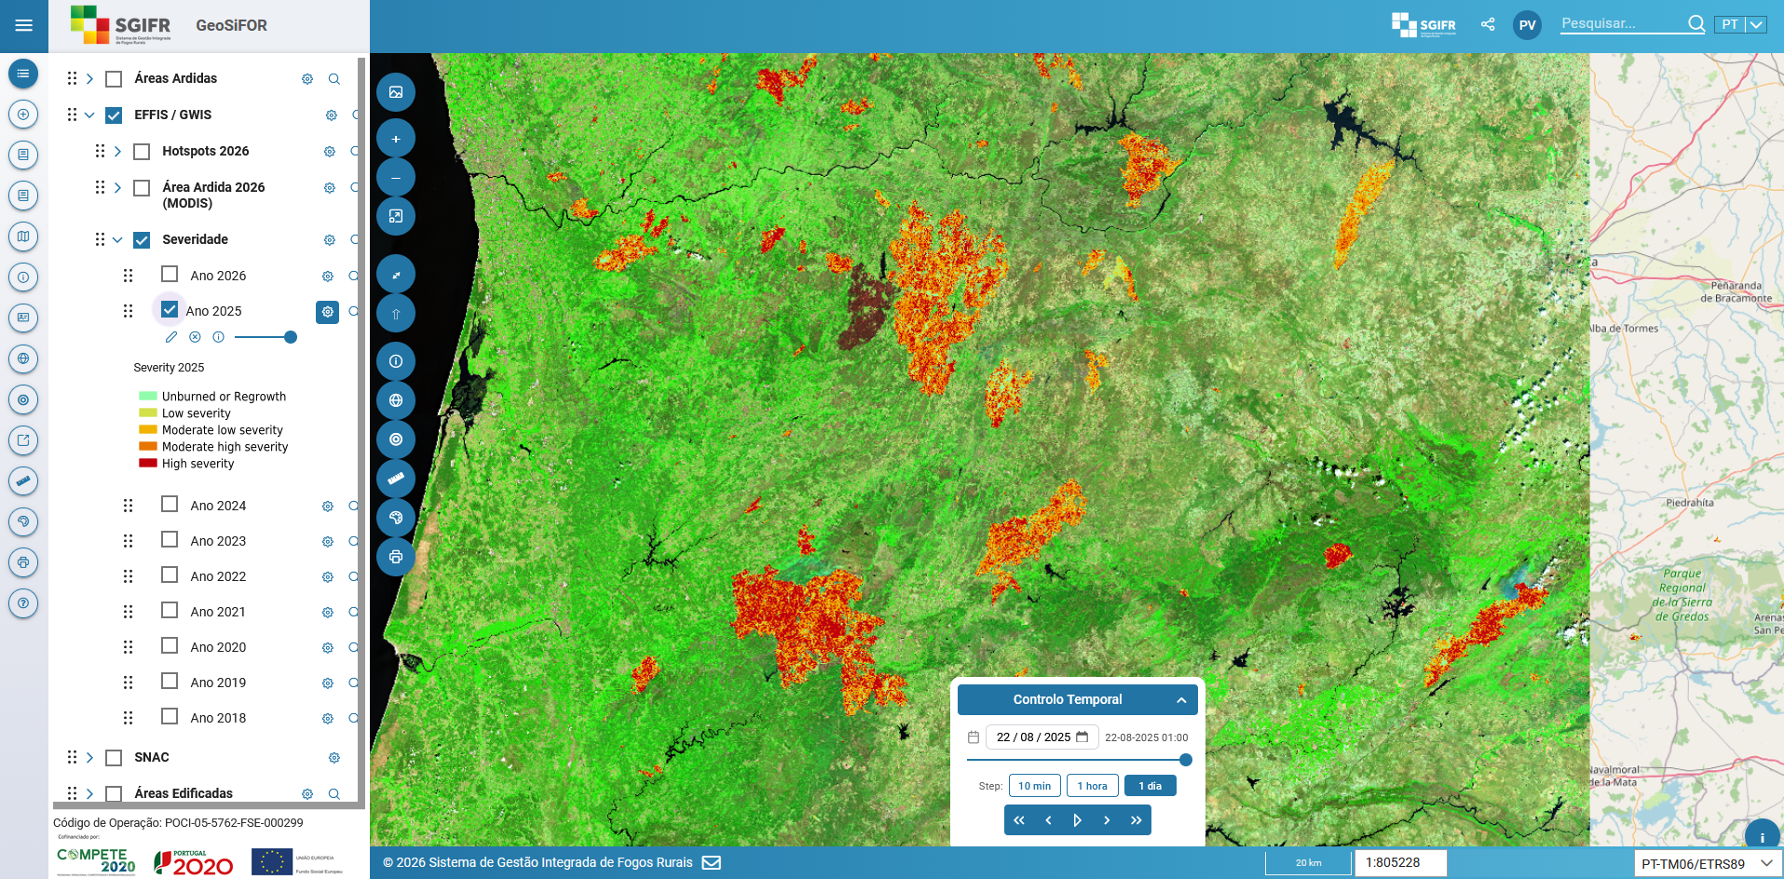
WebGIS App (GeoSiFOR)
Fire Severity
(EFFIS)
https://geosifor.sgifr.gov.pt
Rural Fire Information System

Slide 37
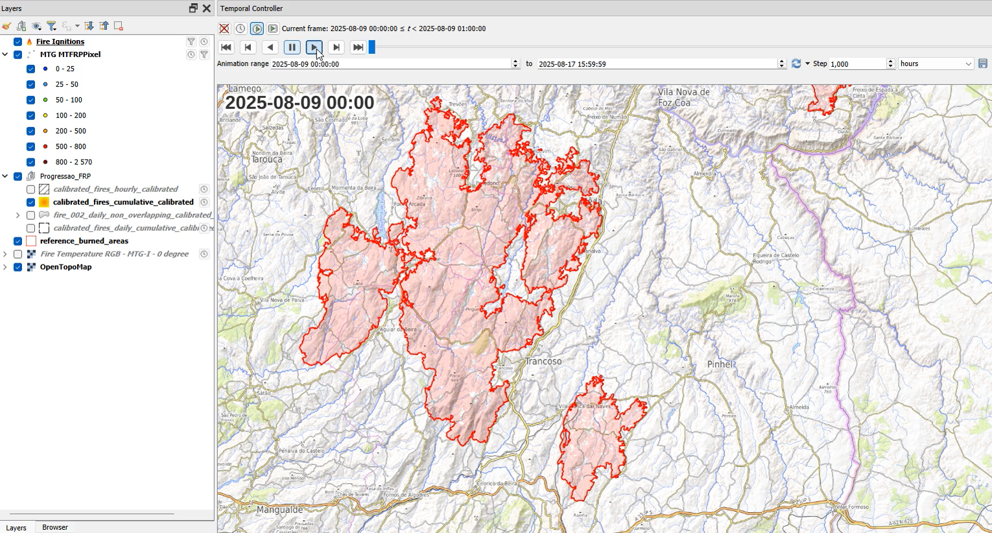
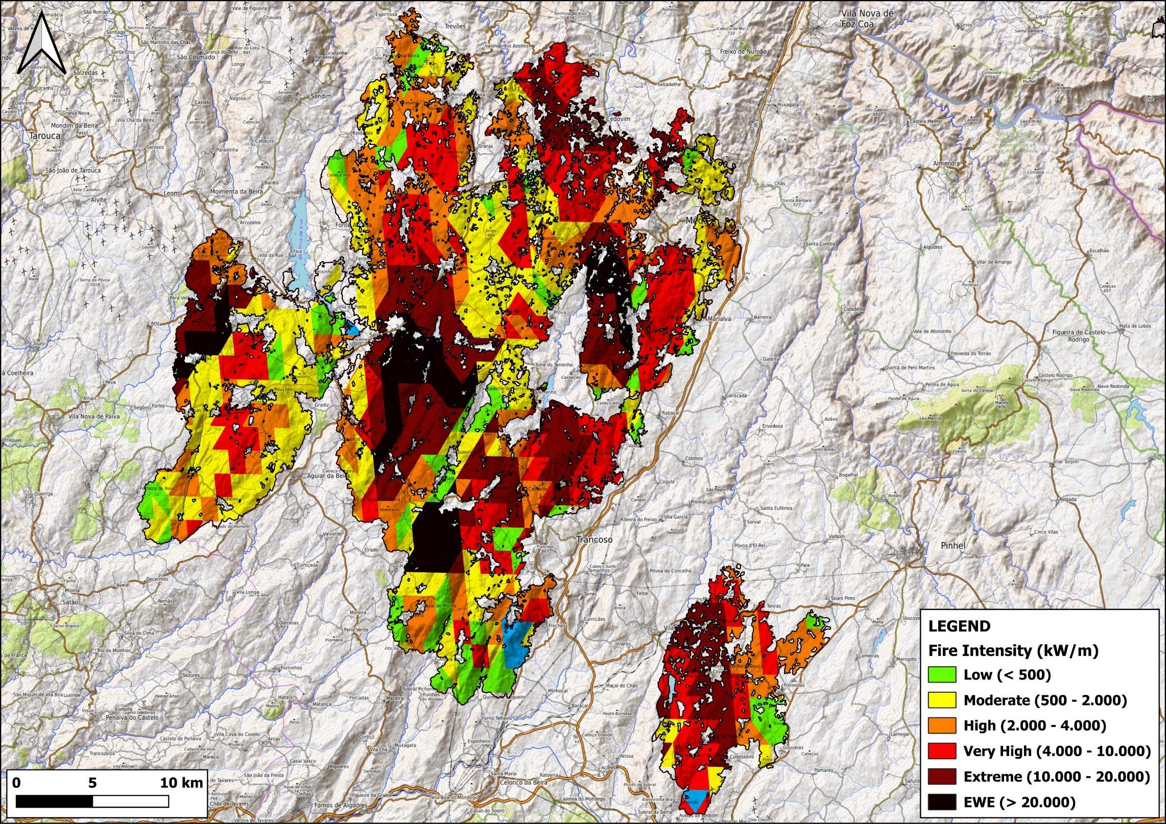
Lessons Learned
https://github.com/PedroVenancio/mtg-frp-fire-progression
Hourly reconstruction of Trancoso-Sátão fire complex and Guarda fire
(~78k hectares, august 2025) - Meteosat Third Generation
Rural Fire Information System

Slide 38
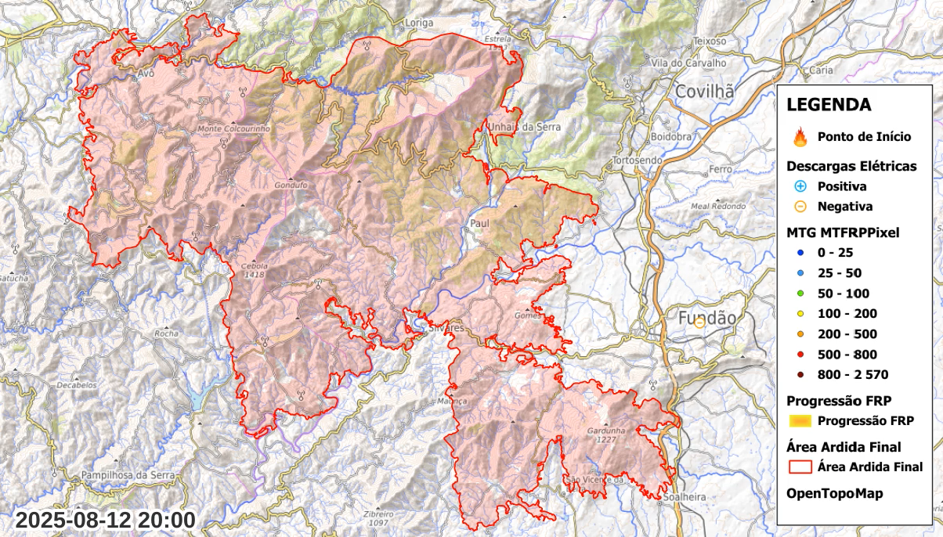
Lessons Learned
https://github.com/PedroVenancio/mtg-frp-fire-progression
Hourly reconstruction of Piódão fire (>65k hectares, august 2025)
Meteosat Third Generation
Rural Fire Information System

Slide 39
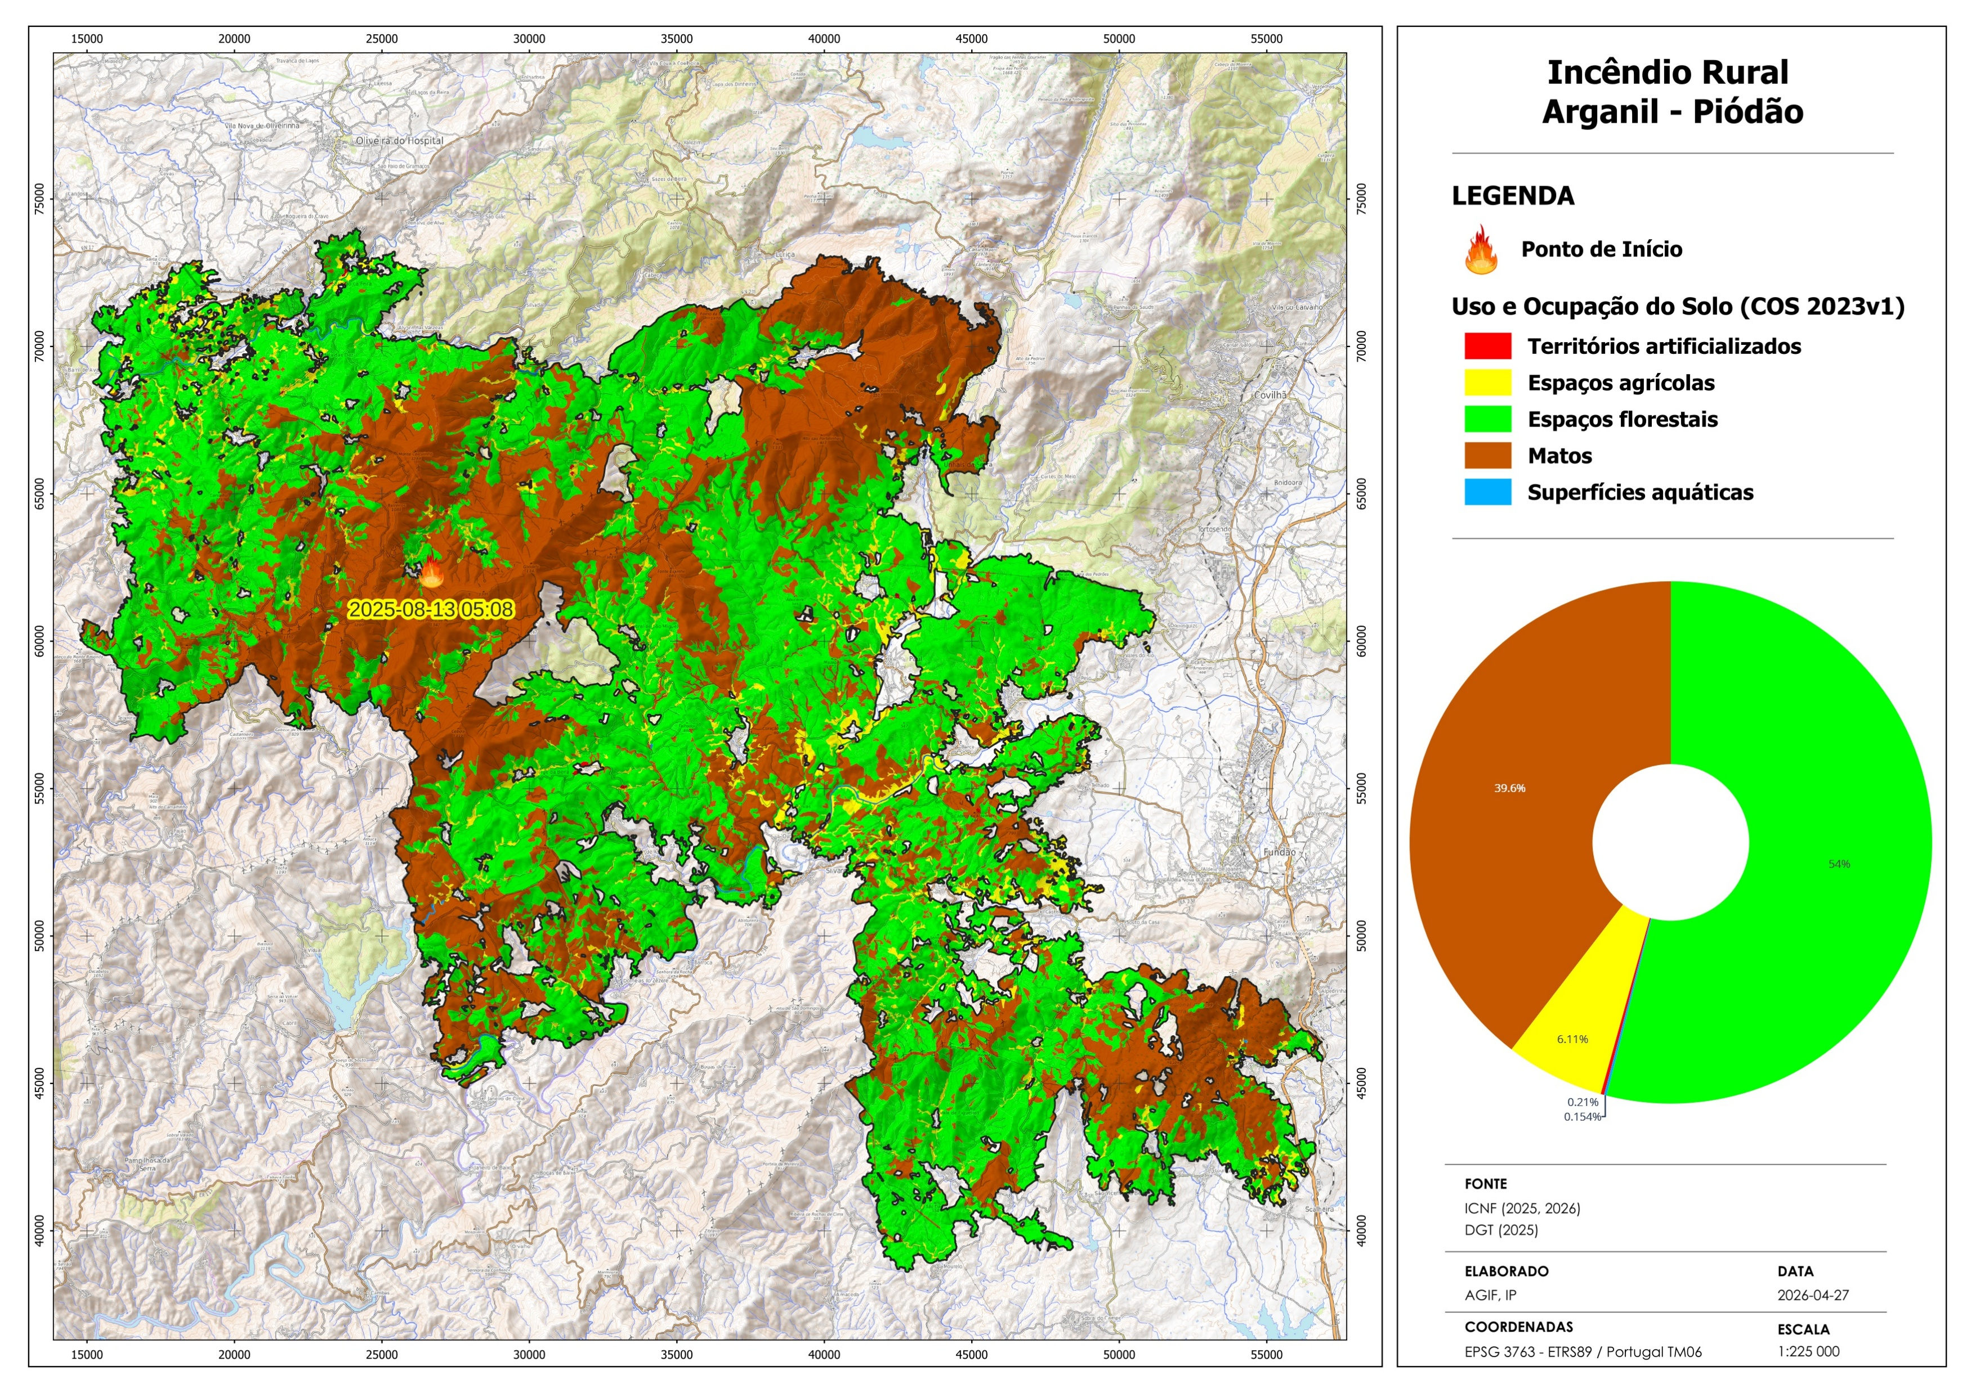
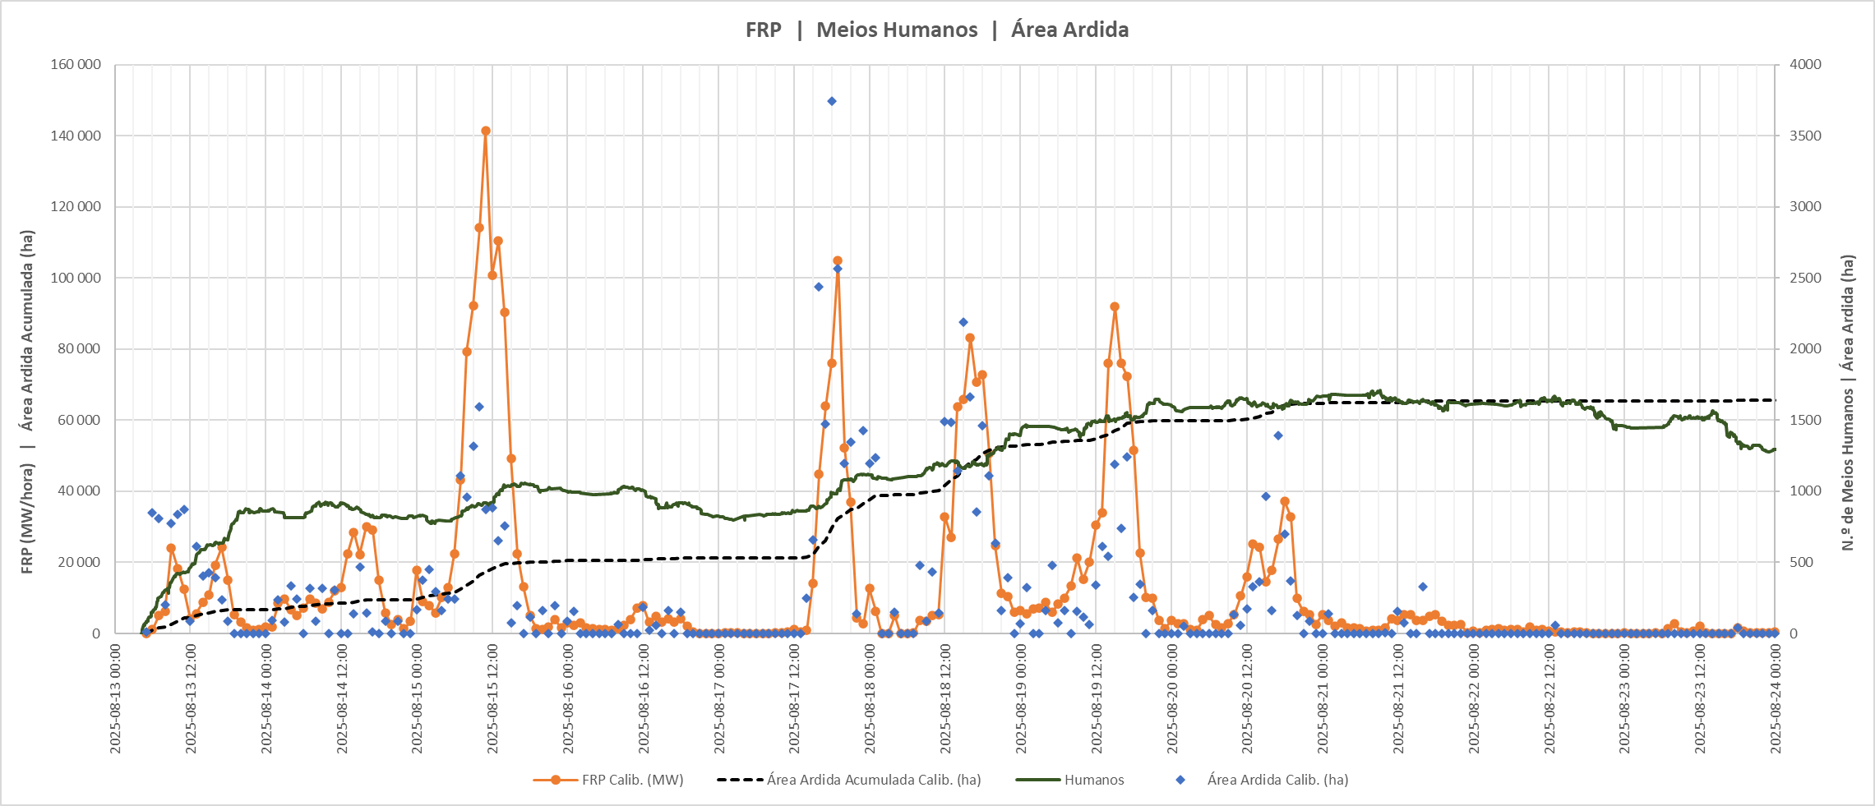
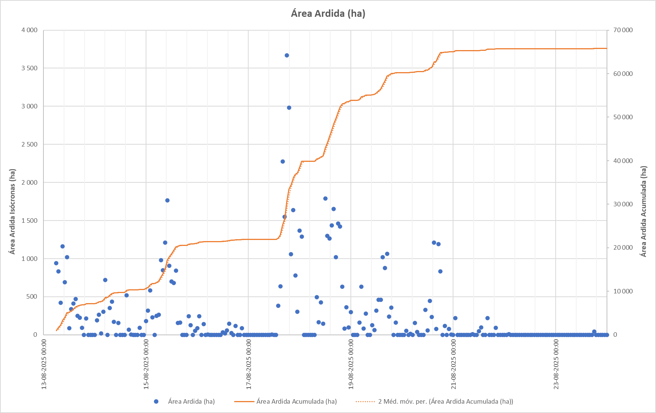
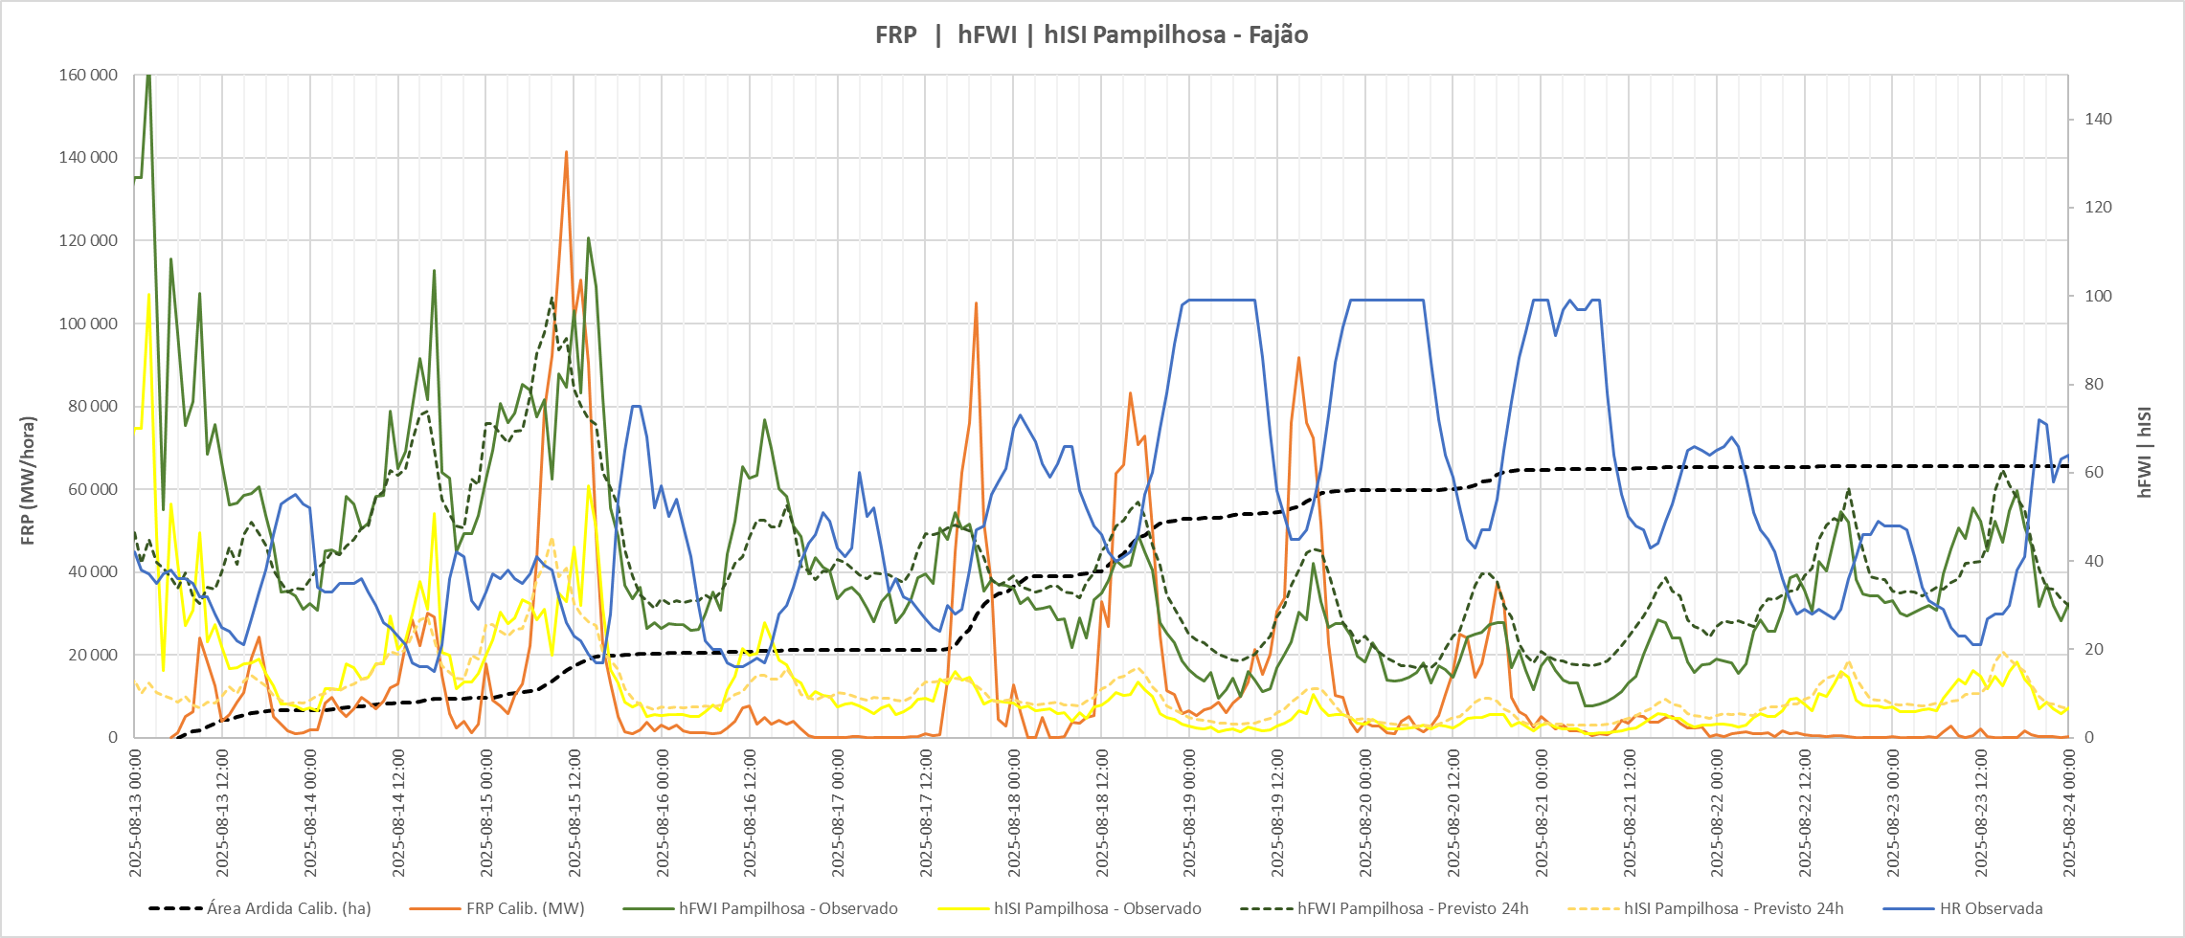
Lessons Learned
https://github.com/PedroVenancio/mtg-frp-fire-progression
Rural Fire Information System

Slide 40


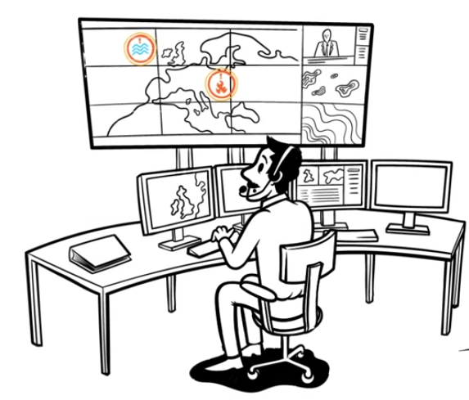
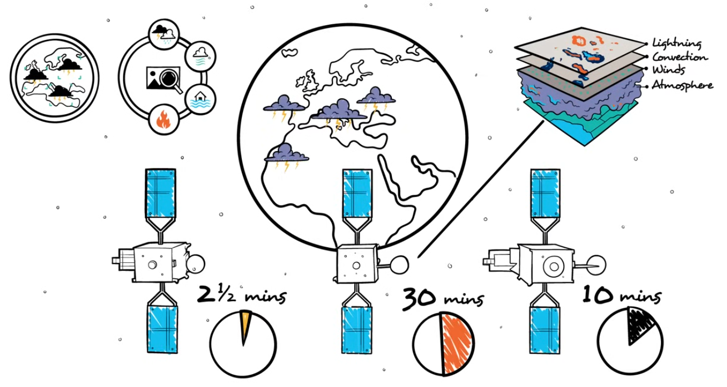


MTG-Imager 2
MTG-Sounder 1
MTG-Imager 1
Rural Fire Information System

Slide 41


GeoSIFOR WebGIS
Demo
https://geosifor.sgifr.gov.pt

Slide 42

Thank you very much!
Obrigado!

