Slide 1

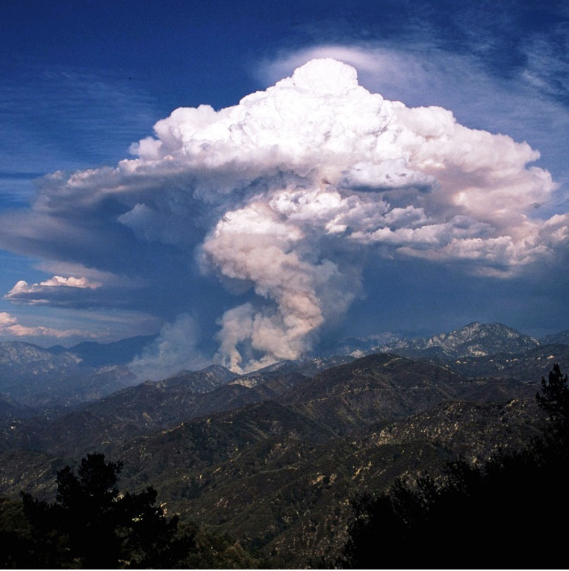

How do Pyro-Cb clouds appear
in satellite imagery?
Mária Putsay, EUMeTrain, retired from Hungarian Meteorological Service
Ildikó Szenyán, HungaroMet
EUMeTrain Event Week on Forest Fire, online presentation, 3 June 2026
Angeles National Forest, California, United States © JeremyaGreene

Slide 2
Outlines
Pyrocumulus / pyrocumulonimbus – How do the form? Why are they dangerous?
Identification in satellite imagery
It forms above fire (animated sat images, e.g. True color images)
Looks like a cumulus or Cb (e.g. sandwich image, shape, cloud top temperature)
Highly polluted by smoke particles (using microphysical RGBs)
Lightning activity
Summary

Slide 3
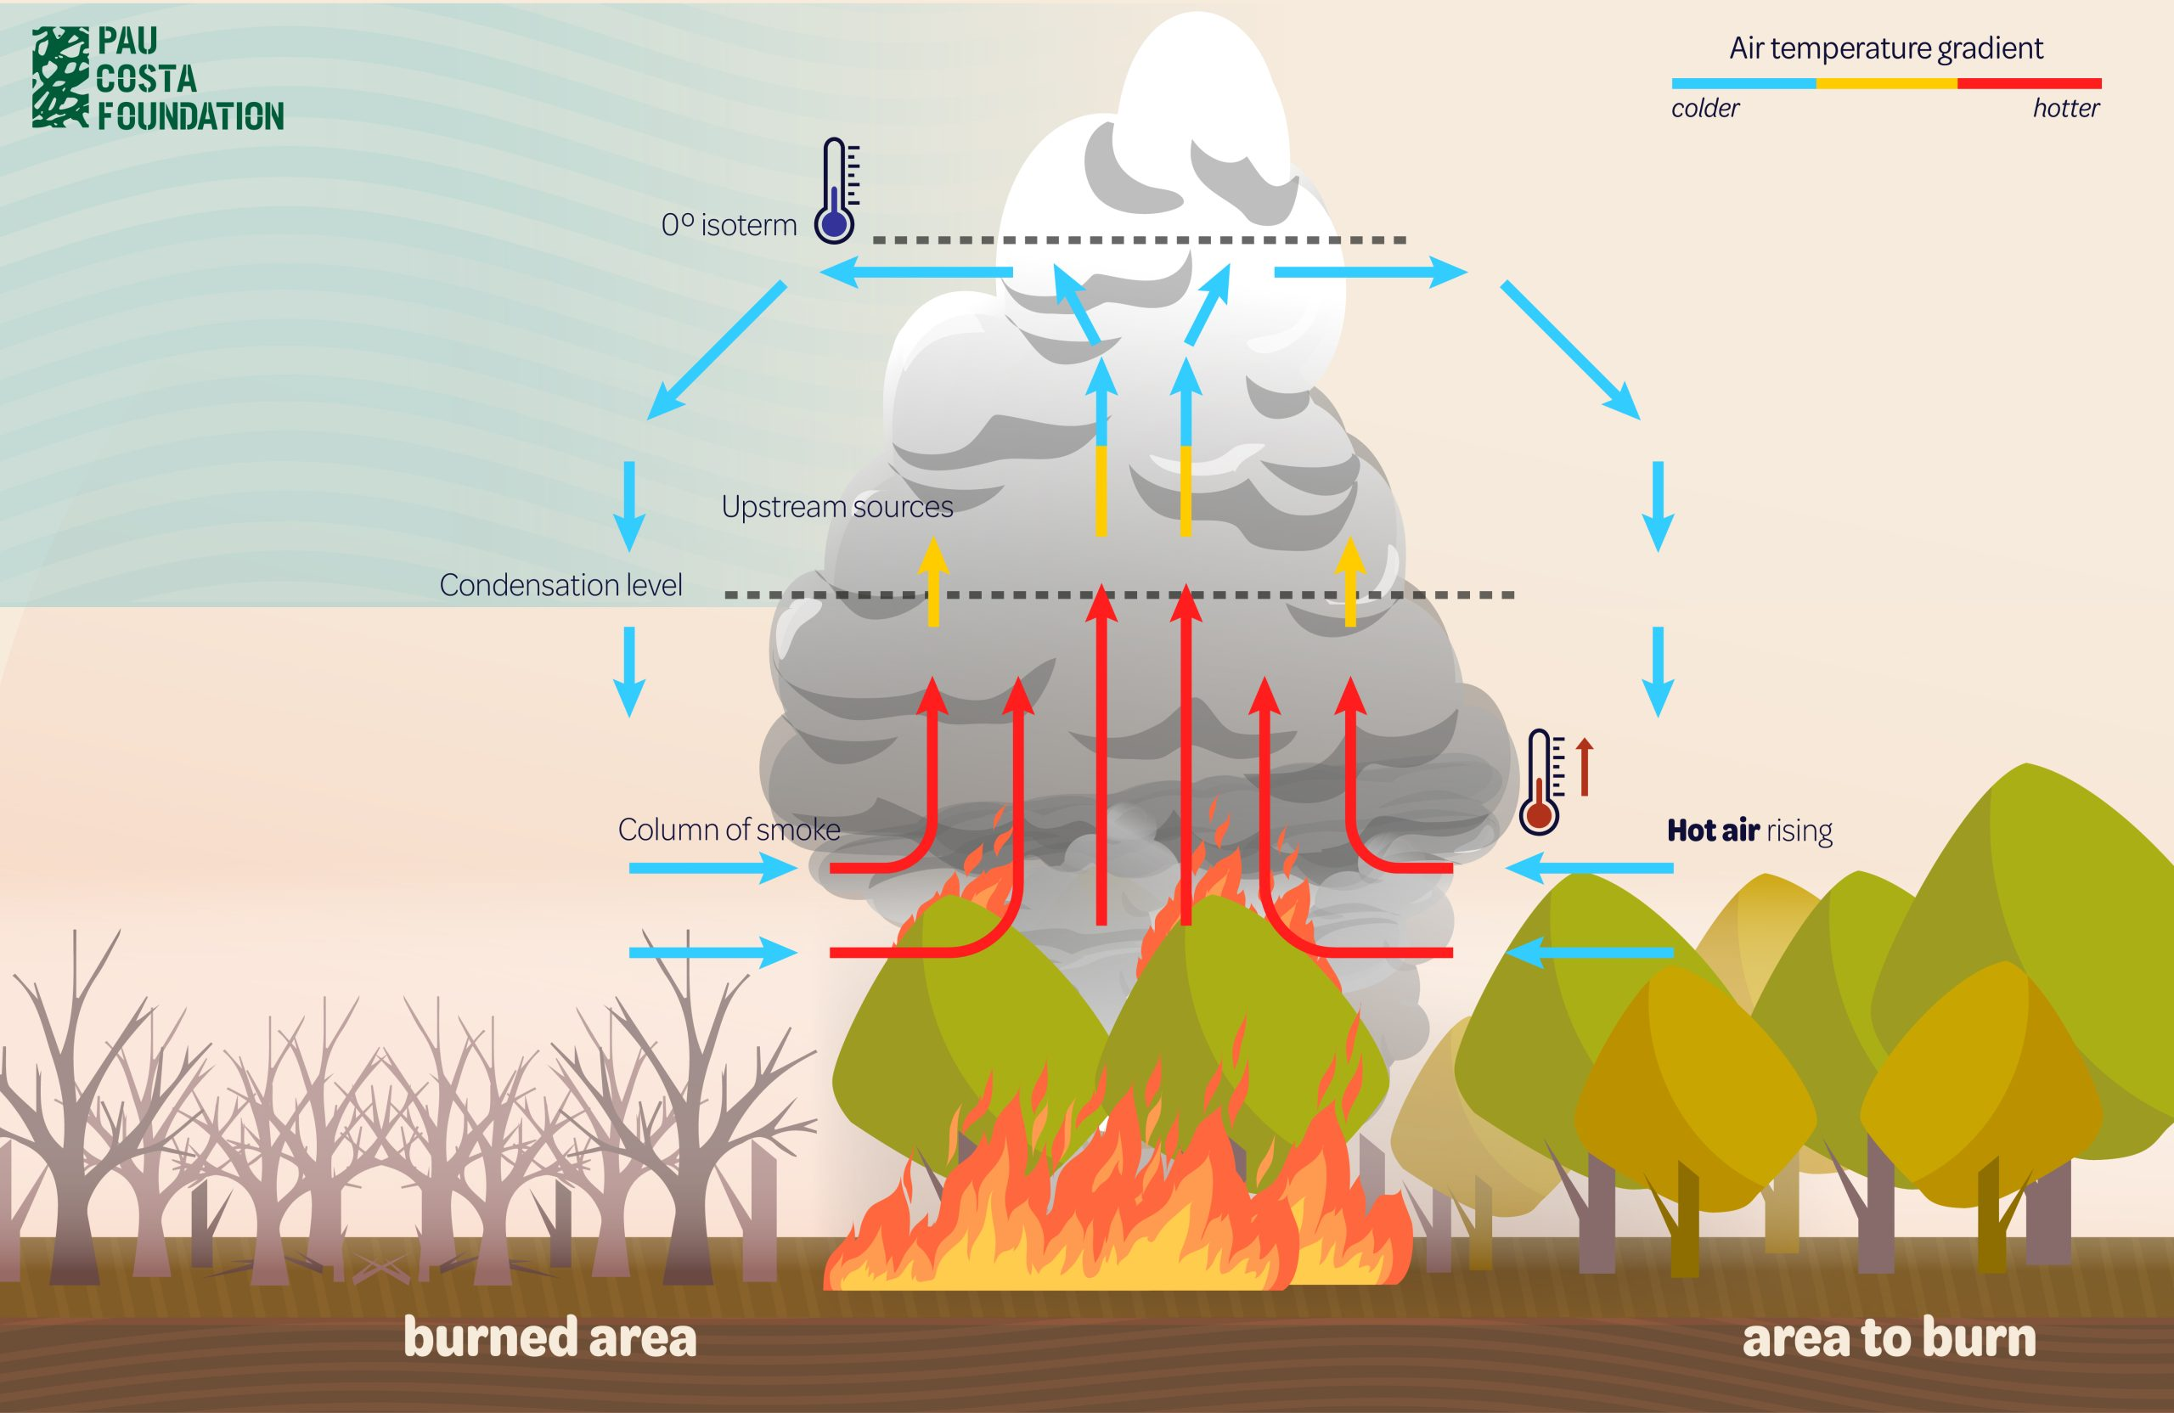
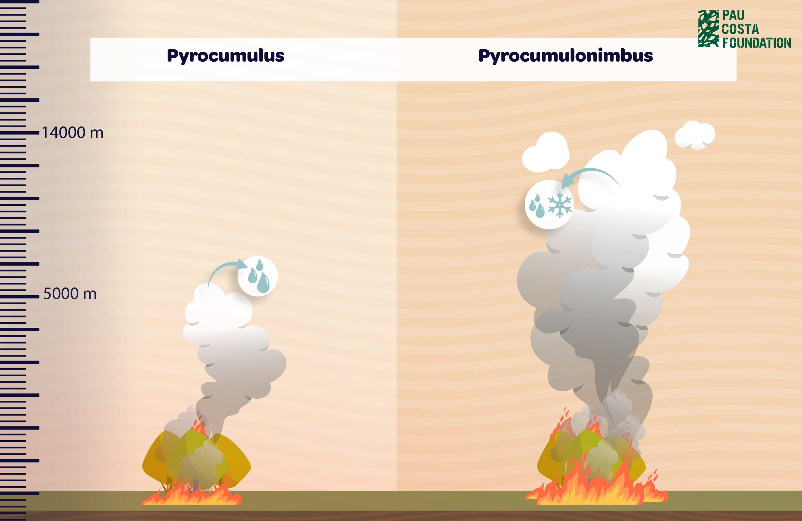
Convective clouds (pyrocumulus, pyrocumulunimbus) may form over wildfire.
These clouds created by the extreme heat of wildfires.
Lift is provided by the fire.
“Extra” moisture is also provided; evaporating from burning vegetation.
Some of these clouds (pyrocumulus) can turn into pyrocumulonimbus (pyro-Cb) reaching considerable vertical development.
https://www.paucostafoundation.org/en/pyrocumulus-and-pyrocumulonimbus-the-clouds-of-wildfires/

Slide 4
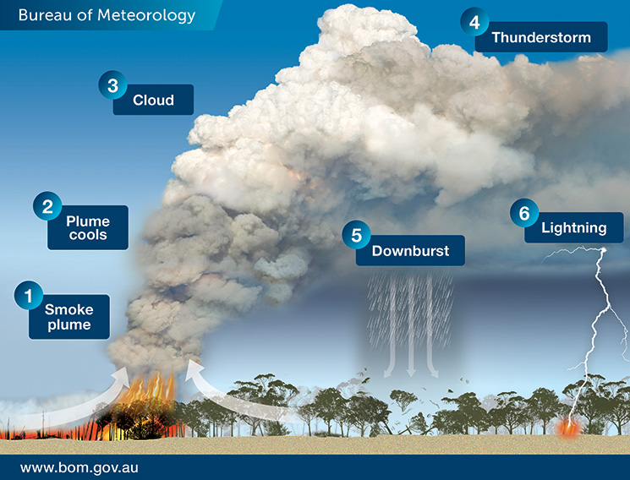
Why are pyro-Cb dangerous?
Pyro-Cb clouds often produce
lightning strokes, which can start new fires, (aerosol effect)
extreme low-level winds, which may increase fire-spread.
The downdraft may generate at the surface extremely strong wind gusts up to 240 km/h that can uproot and break several trees, and produce erratic and unpredictable winds.
Wind increases fire-spread.
Wind intensifies the fire by providing oxygen.
Wind can also transport embers or flames further away causing secondary fires far from the original source.
Dry storm --- no rain to extinguish the fire
The cloud is polluted by smoke --- tiny cloud elements -- not much rain forms (if any) --- the rain often evaporates before reaching the surface

Slide 5
Case studies
Focusing on images taken by of geo satellites
Pyro-Cbs can be identified in satellite imagery by
Animation showing that it formed above the fire,
The usual features helping to identify a Cb cloud: shape, low cloud top temperature, possible cloud top features
Their color in the microphysical RGBs
Lightning data.

Slide 6
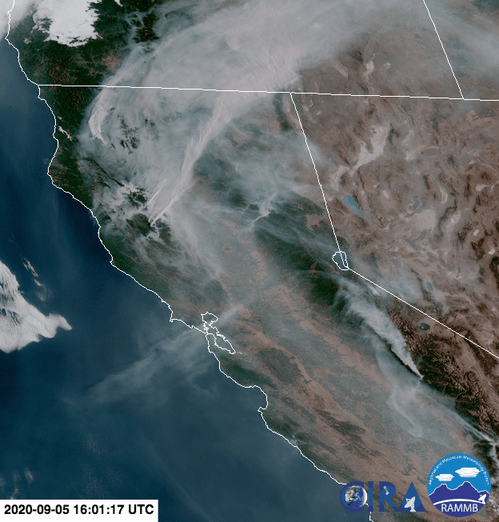
Animation of the formation of a pyrocumulonimbus above the 2020 Creek Fire in California
GOES-17 ABI True Color RGB
05 September 2020 16:00 UTC - 06 September 01:00 UTC
Smoke is well seen
Smoke - cloud --- different color, different structure
Minimum of cloud top temperature at 23:50 UTC:
218 K, -55 °C
https://en.wikipedia.org/wiki/Cumulonimbus_flammagenitus#/media/File:2020_Creek_Fire_pyrocumulonimbus_cloud_formation.gif

Slide 7
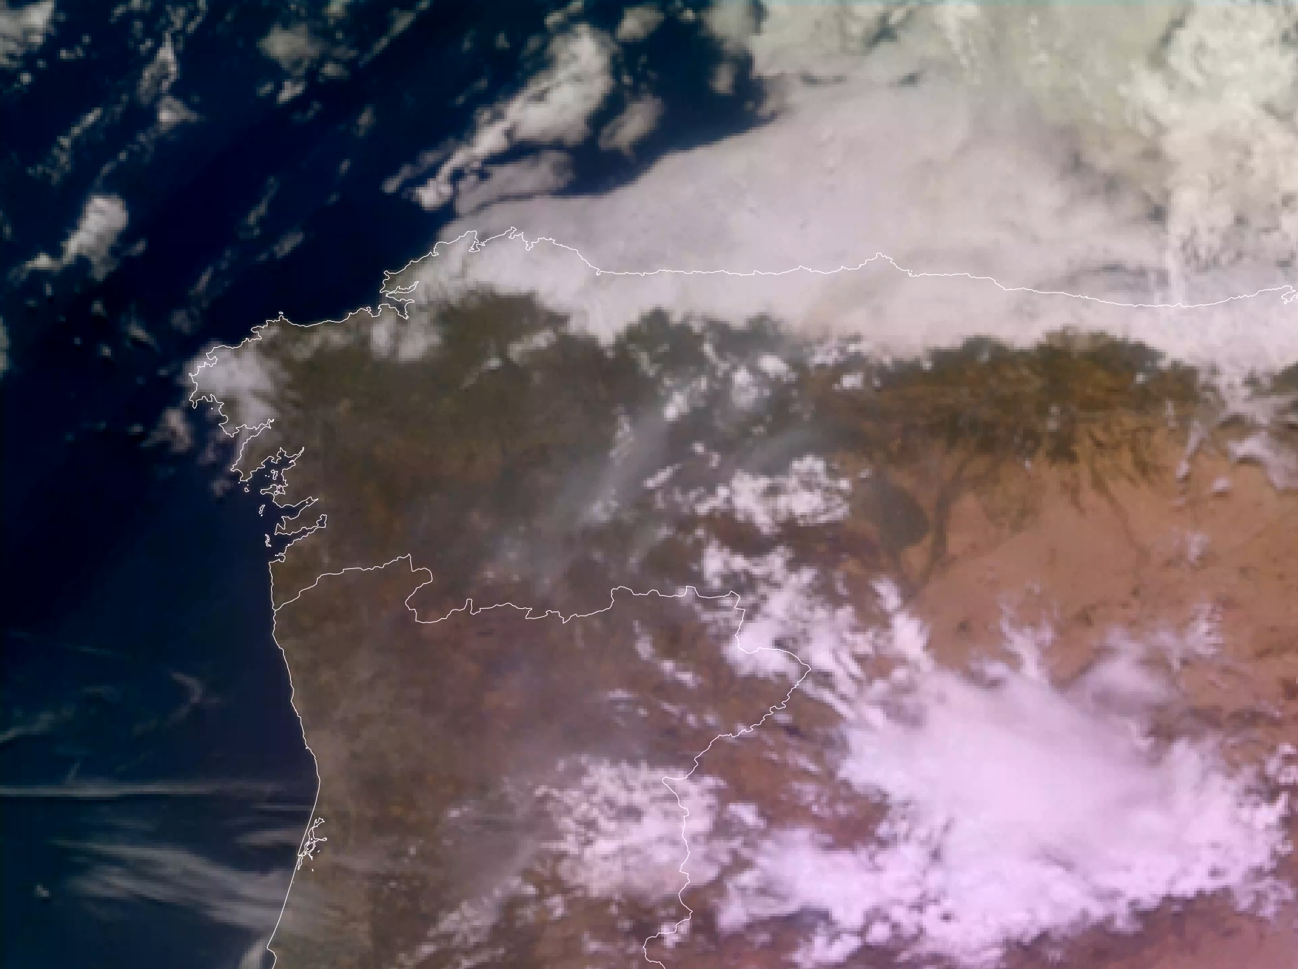
Animation
Met-12 FCI True Color RGB
13 August 2025, 12:00-15:00 UTC
Smoke plumes and clouds
Is there any pyro-Cb in the image?
Not easy
We need additional information
Click on the image to see the animation!
Note: “Flames RGB” animation will be even better ---
True Color RGB overlaid with fire hotspots,
under development at EUMETSAT

Slide 8
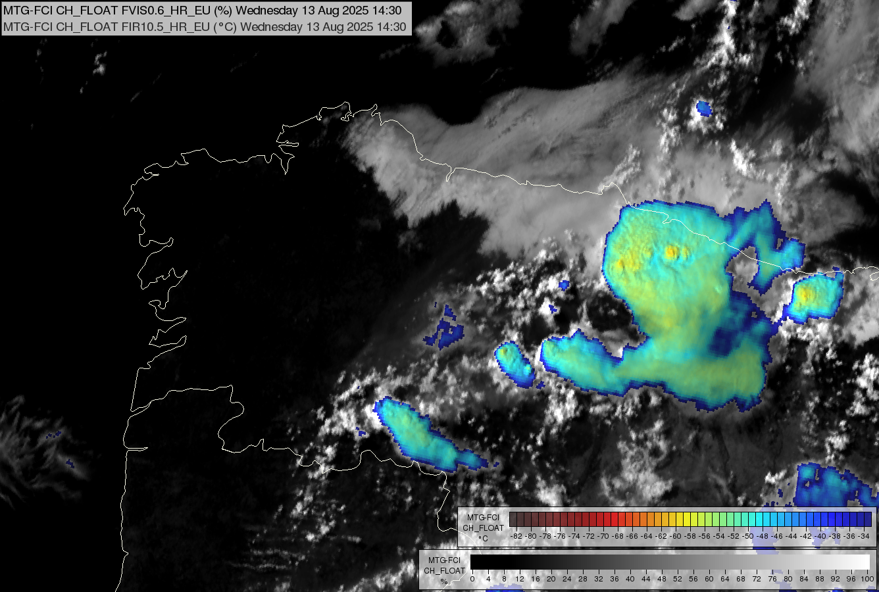
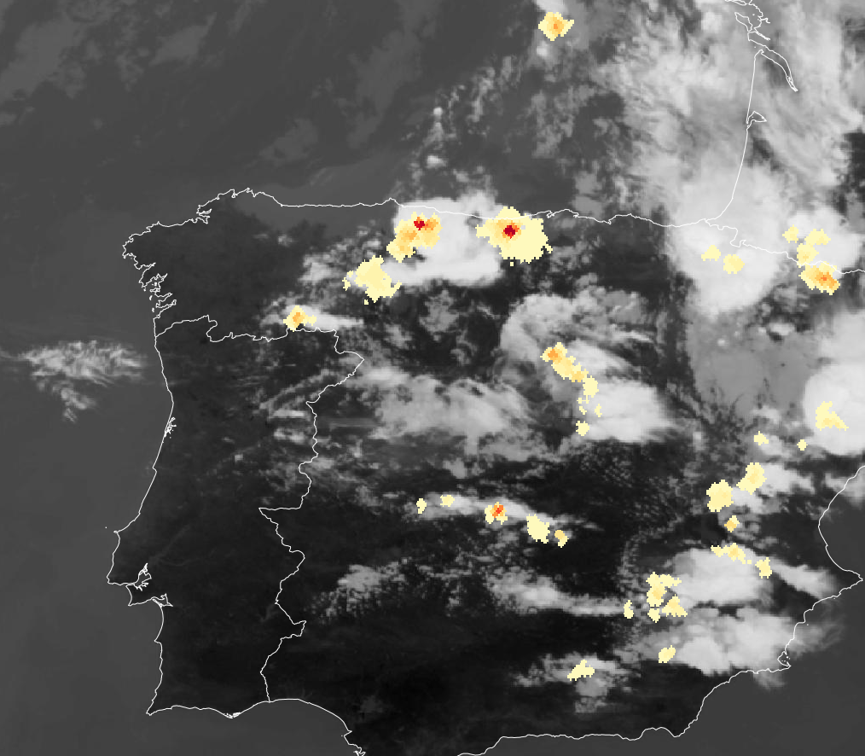

Sandwich (VIS0.6&IR10.5)
IR10.5 + lightning (accumulated flash area)
Alak cloud top temp lightning
Lowest cloud top temperatures are between -50 and -60 °C.
14:30 UTC

Slide 9
Satellite (in visible and infrared spectra) sees only the cloud top of a thick cloud.
The ice crystals on the top of an ice cloud are usually large.
However, in some exceptional cases they might be typically small, like
Cloud highly polluted by smoke or dust or volcanic ash
High lee cloud
Severe convection – extreme strong updraft
Early spring convective clouds
The fire injects large amounts of smoke in a pyro cloud.
The number of the condensation nuclei is very high.
Consequently, extremely small cloud particles are forming in these clouds.
Convective clouds with small particles on their tops have typical color in some RGBs.
RGBs using microphysical channels –
      These data are sensitive to cloud top microphysics -- cloud top phase, cloud top (mean) particle size.

Slide 10
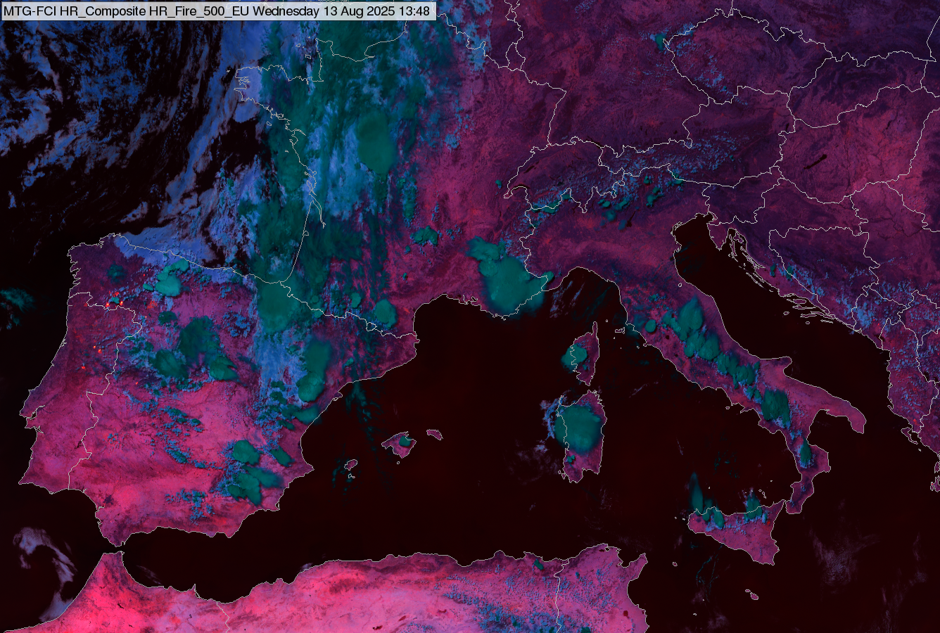
FCI Fire Temperature RGB
13 August 2025, 13:40 UTC
The pyrocumulus and pyro-Cb ice clouds appear lighter green than the “usual” ice clouds, because of the smaller cloud top particles. (distinct color)
Typical colors of clouds
– thick water cloud
– thick ice cloud
(large ice crystals)
– thick ice clouds
(small ice crystals)
– thick ice clouds
(extremely small ice crystals)
Typical colors of cloud-free surface
– active fire
with different intensity
– sea
– vegetated land
– hot, arid land
Color beam | Channel | Range |  |  | Gamma
Red | IR3.8 | 273 | 333 | K | 0.4
Green | NIR2.2 | 0 | 100 | % | 1
Blue | NIR1.6 | 0 | 75 | % | 1
All three components are microphysical channels, sensitive to cloud top microphysics.

Slide 11
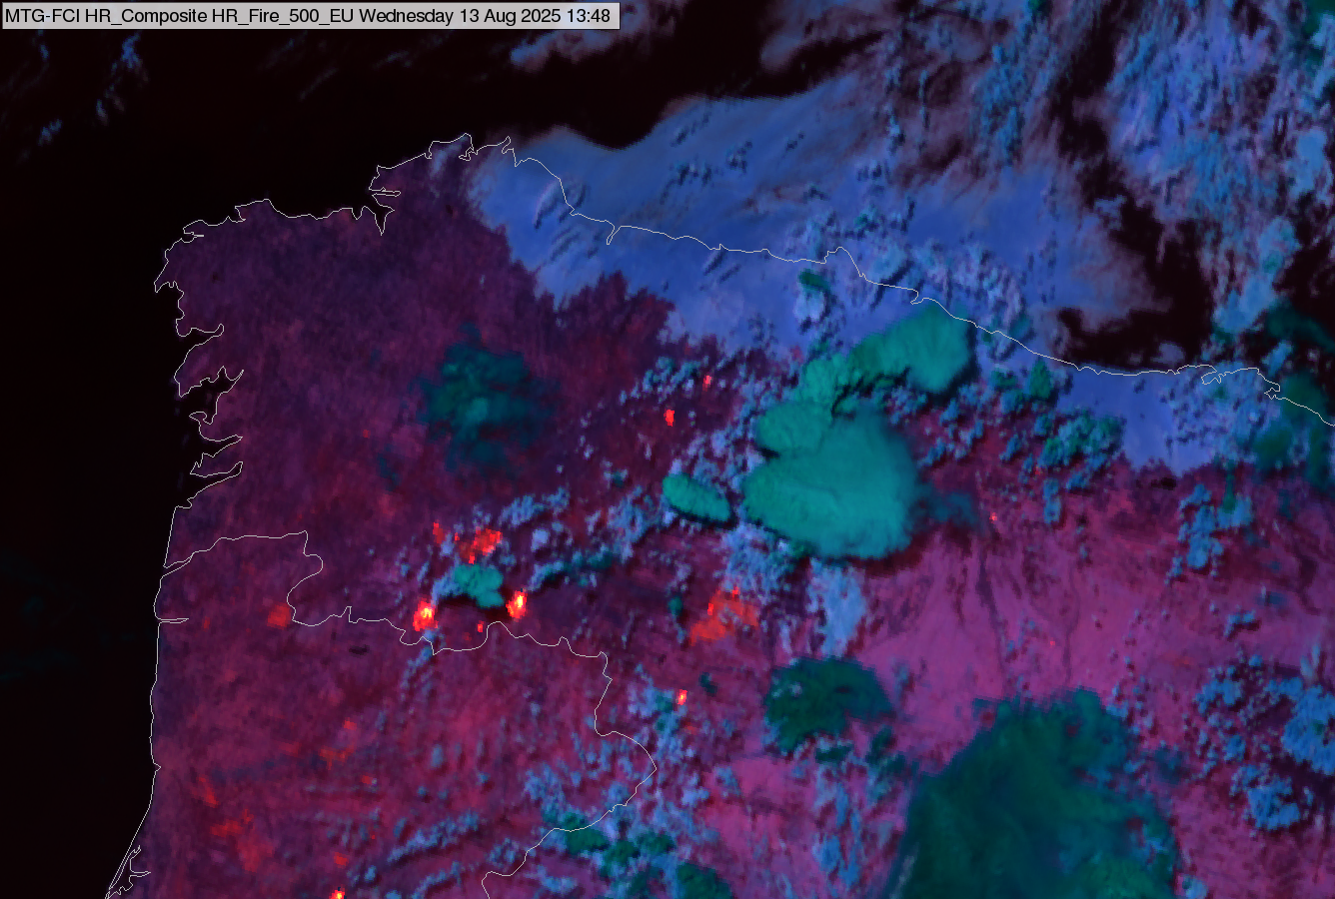
FCI Fire Temperature RGB
13 August 2025, 13:40 UTC
Typical colors of clouds
– thick water cloud
– thick ice cloud
(large ice crystals)
– thick ice clouds
(small ice crystals)
– thick ice clouds
(extremely small ice crystals)
Typical colors of cloud-free surface
– active fire
with different intensity
– sea
– vegetated land
– hot, arid land
Color beam | Channel | Range |  |  | Gamma
Red | IR3.8 | 273 | 333 | K | 0.4
Green | NIR2.2 | 0 | 100 | % | 1
Blue | NIR1.6 | 0 | 75 | % | 1

Slide 12
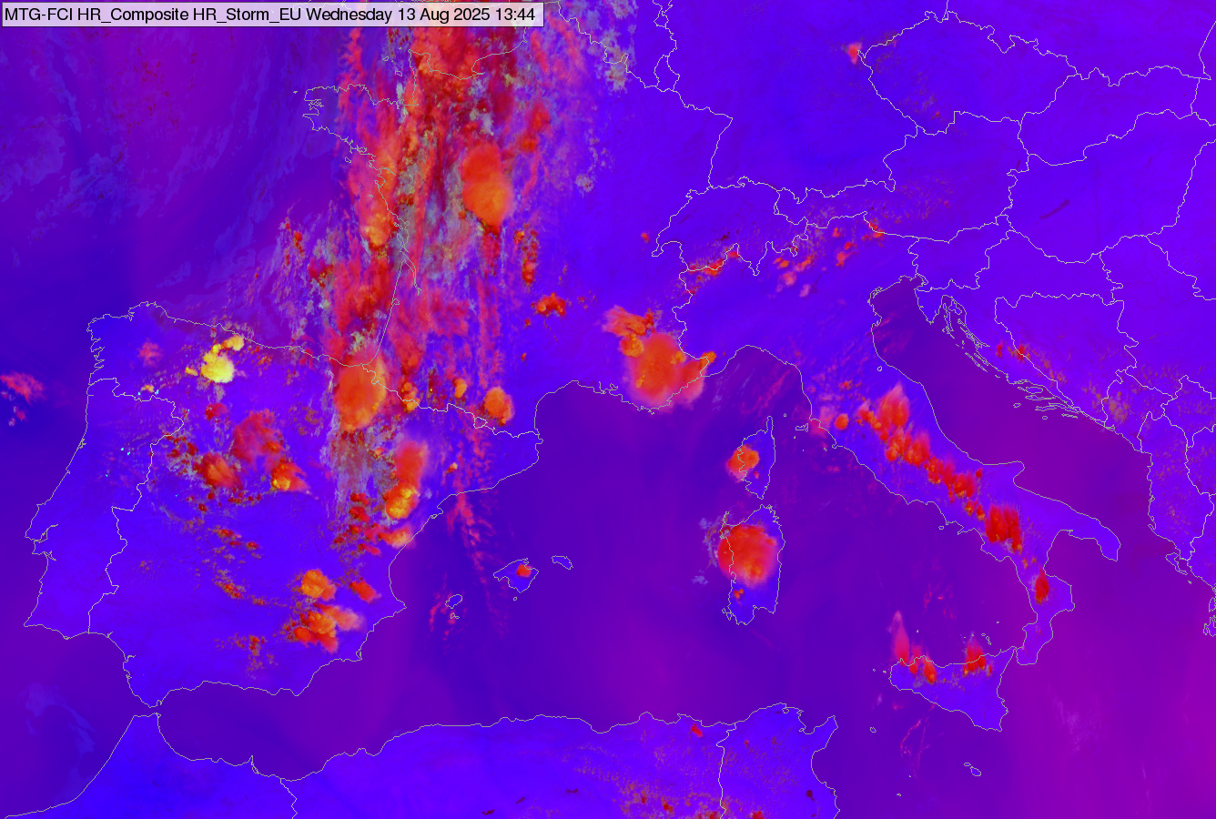
FCI Severe Storms RGB
(alternative name: Convection RGB)
13 August 2025, 13:40 UTC
High, thick ice clouds covered by he very small ice crystals appear yellow instead of red. -- Distinct color
Typical colors
– thick high ice clouds with large ice crystals
– thick high ice clouds with small ice crystals
– thin high ice clouds
– intense active fire
– background, cloud free or higher-level water clouds
Color beam | Channel | Range |  |  | Gamma
Red | WV6.3 - WV7.3 | -33.9 | 6.4 | K | 1
Green | IR3.8 – IR10.5 | 5 | 70 | K | 0.5
Blue | NIR1.6 – VIS0.6 | -70 | 20 | % | 1
The “yellowness” depends on the cloud top temperature as well not only on the cloud top particle size.
Convective clouds with cold cloud base (e.g. early spring convective clouds) can appear yellow without small ice crystals on their top.
The green component is sensitive to cloud top microphysics.

Slide 13
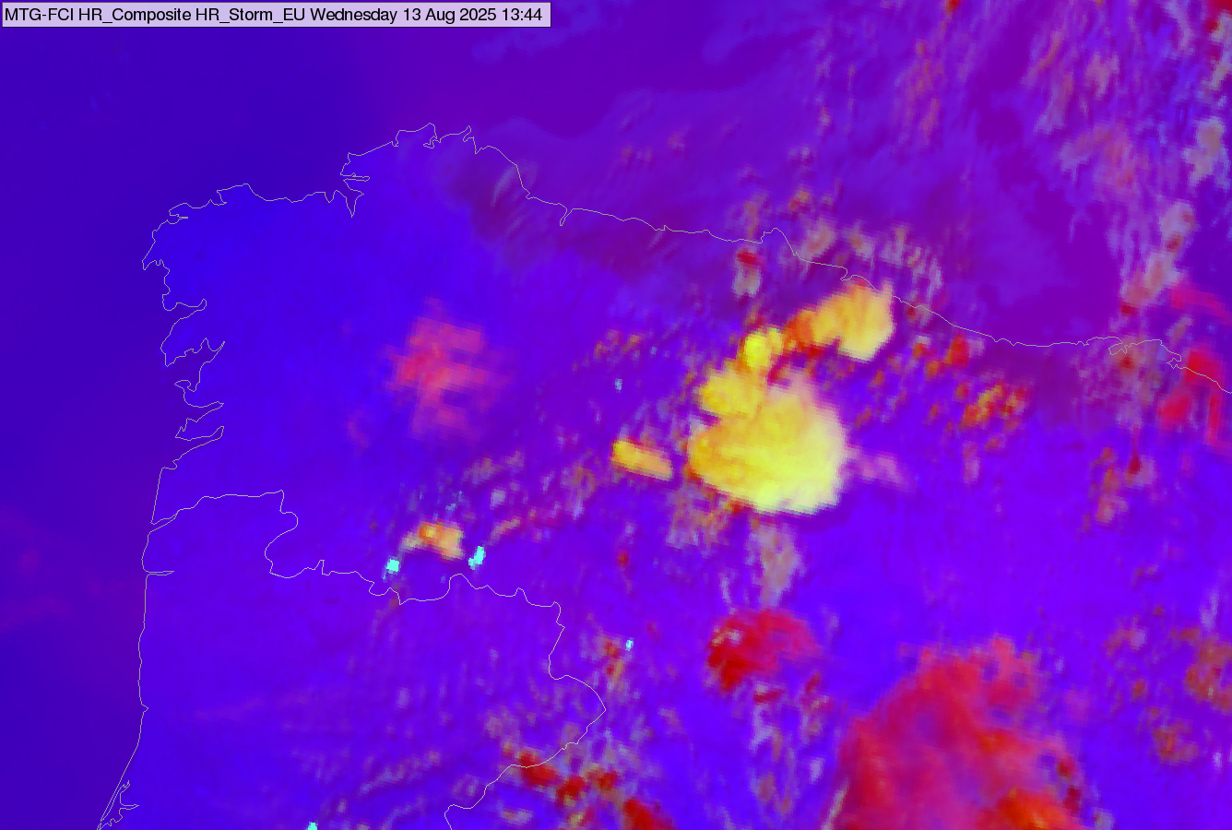
FCI Severe Storms RGB
13 August 2025, 13:40 UTC
Typical colors
– thick high ice clouds with large ice crystals
– thick high ice clouds with small ice crystals
– thin high ice clouds
– intense active fire
– background, cloud free or higher-level water clouds
Color beam | Channel | Range |  |  | Gamma
Red | WV6.3 - WV7.3 | -33.9 | 6.4 | K | 1
Green | IR3.8 – IR10.5 | 5 | 70 | K | 0.5
Blue | NIR1.6 – VIS0.6 | -70 | 20 | % | 1
Severe Storms RGB also confirms the presence of the very small ice crystals on the cloud tops (they appear yellow instead of red).

Slide 14
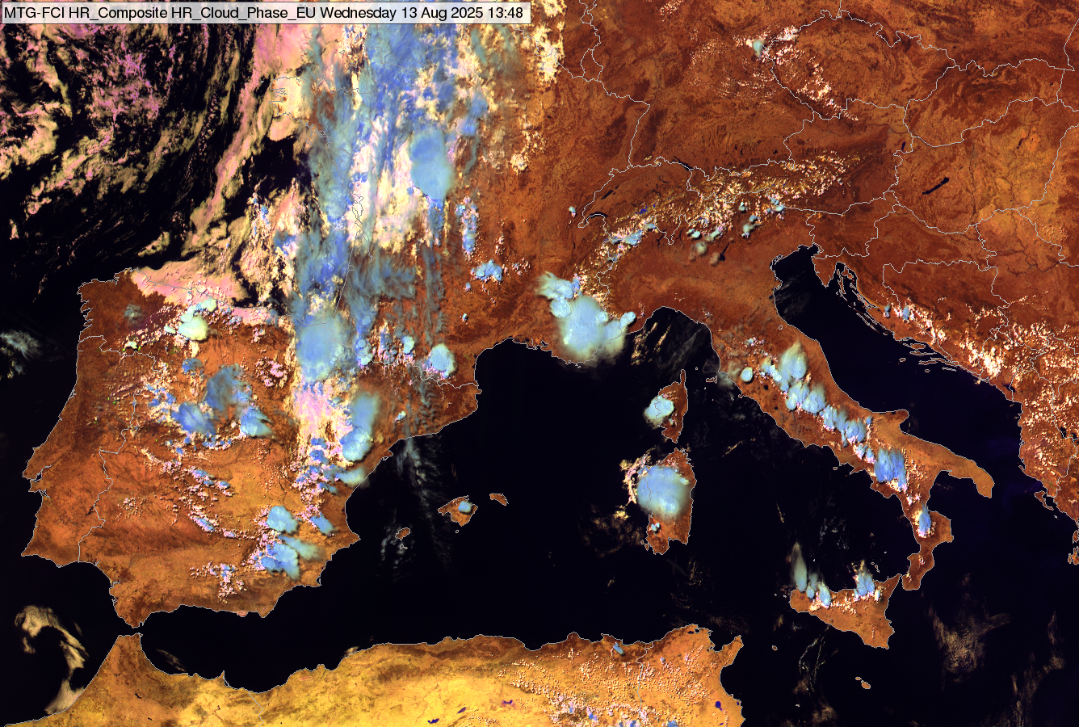
FCI Cloud Phase RGB
13 August 2025, 13:40 UTC
High thick ice clouds covered by small ice crystals appear light bluish/greenish cyan or light yellow instead of blue. Distinct color
Typical colors of clouds
- thick ice clouds (large ice crystals)
- thick ice clouds
(small ice crystals)
- thick ice clouds
(extremely small ice crystals)
– thin ice clouds
– thick water cloud (different droplet size)
Typical colors of cloud-free surfaces
– land
– sea
– intense fire
Color beam | Channel | Range |  |  | Gamma
Red | NIR1.6 | 0 | 50 | % | 1
Green | NIR2.2 | 0 | 50 | % | 1
Blue | VIS0.6 | 0 | 100 | % | 1
Thick, high ice clouds covered by small ice crystals appears similar to water clouds.
The smaller the cloud top particles the more similar to water clouds.
The red and green components are sensitive to cloud top microphysics.

Slide 15
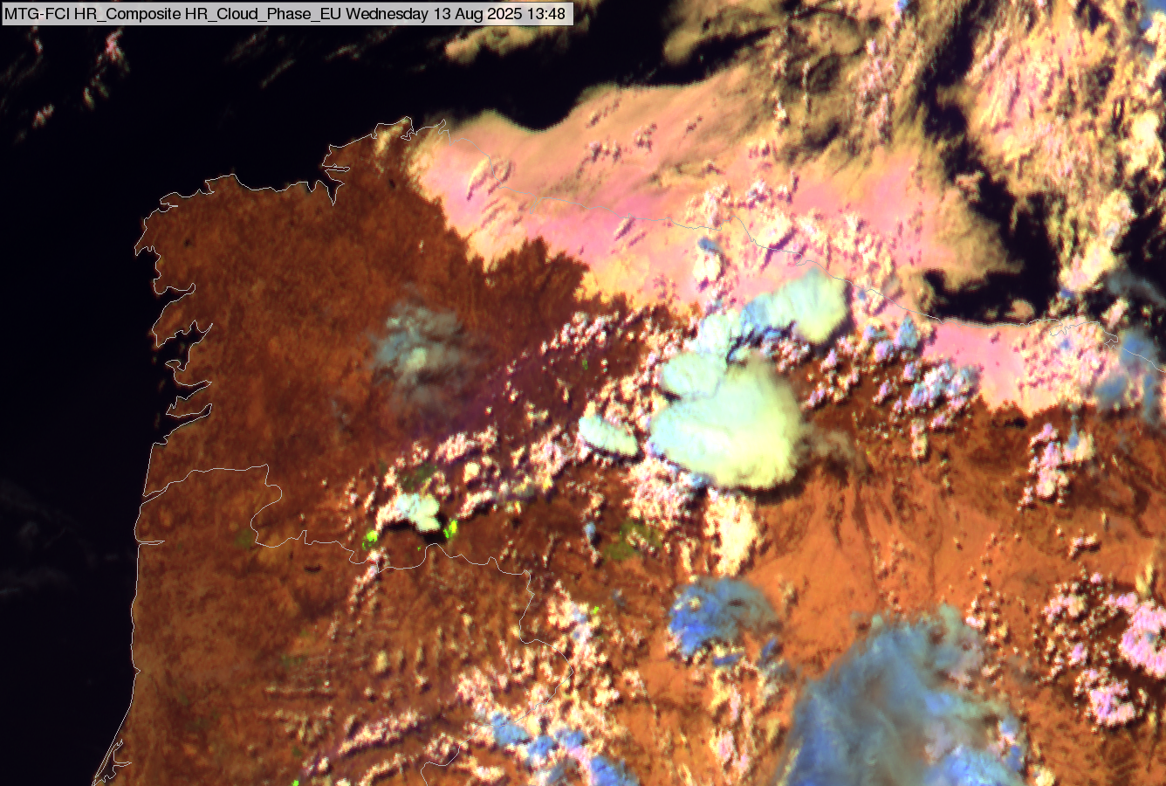
FCI Cloud Phase RGB
13 August 2025, 13:40 UTC
Typical colors of clouds
- thick ice clouds (large ice crystals)
- thick ice clouds
(small ice crystals)
- thick ice clouds
(extremely small ice crystals)
– thin ice clouds
– thick water cloud (different droplet size)
Typical colors of cloud-free surfaces
– land
– sea
– intense fire
Color beam | Channel | Range |  |  | Gamma
Red | NIR1.6 | 0 | 50 | % | 1
Green | NIR2.2 | 0 | 50 | % | 1
Blue | VIS0.6 | 0 | 100 | % | 1

Slide 16
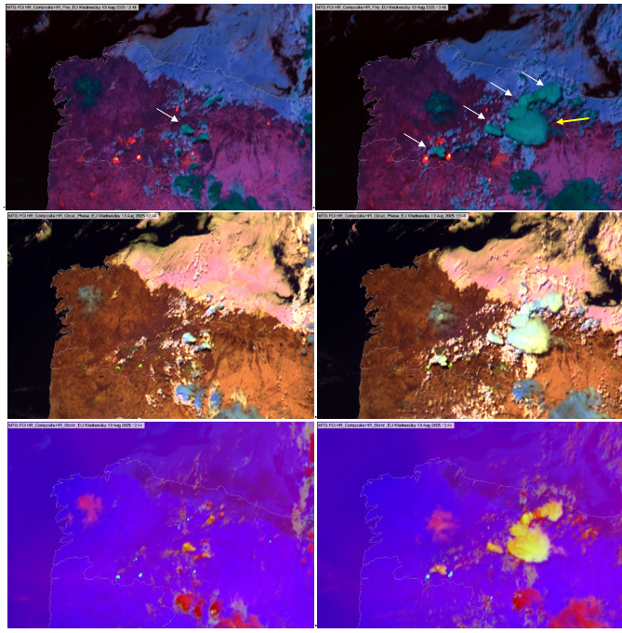
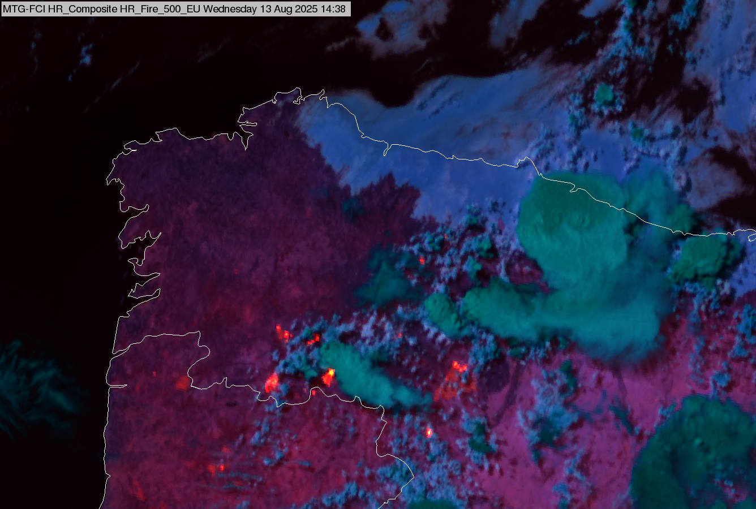
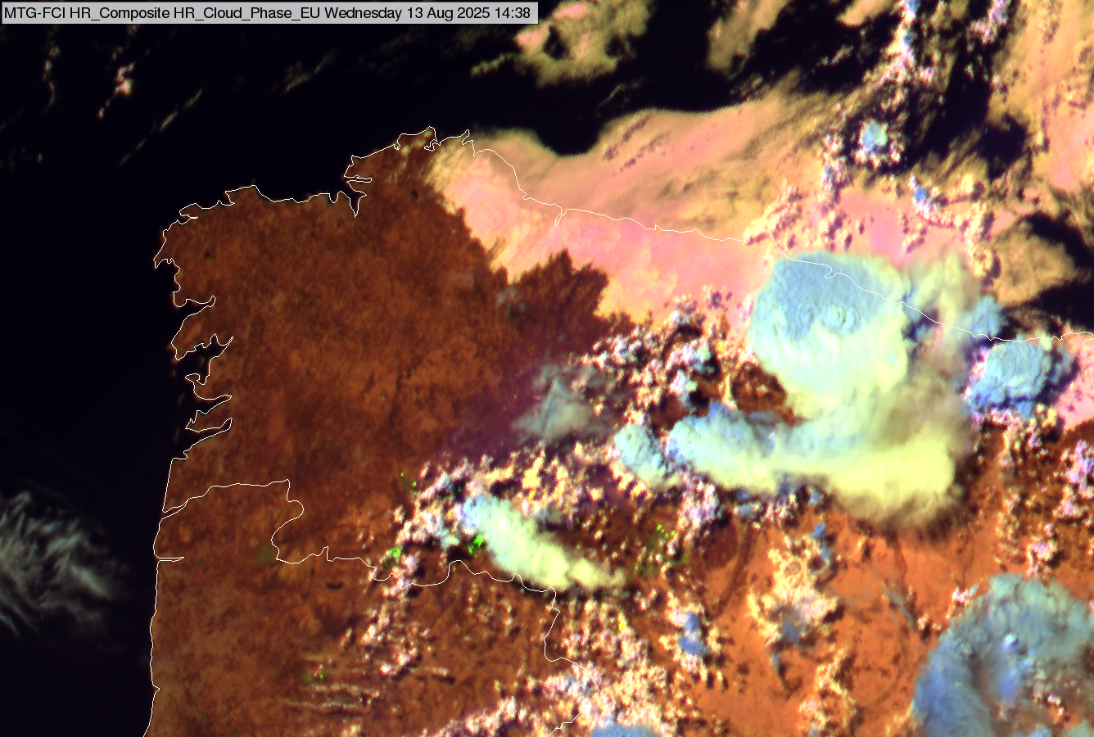
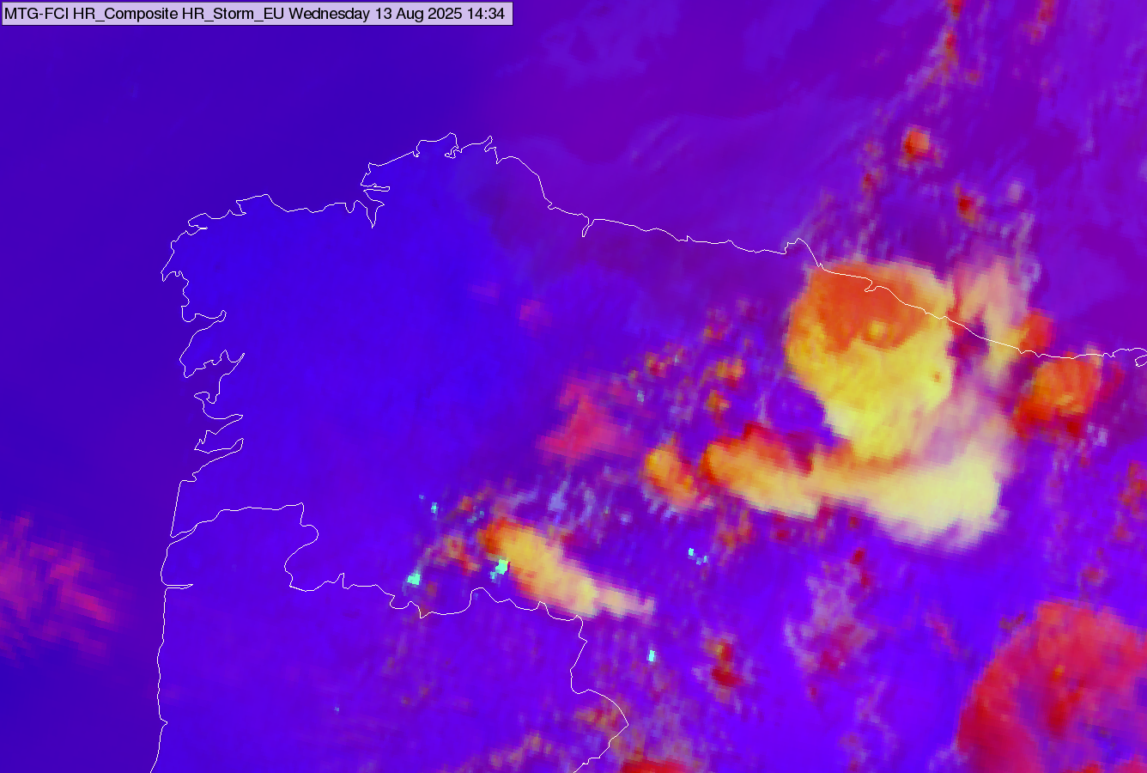
12:40 UTC
13:40 UTC
14:30 UTC
FCI images
13 August 2025
Fire Temperature RGB
Cloud Phase RGB
Severe Storms RGB

Slide 17
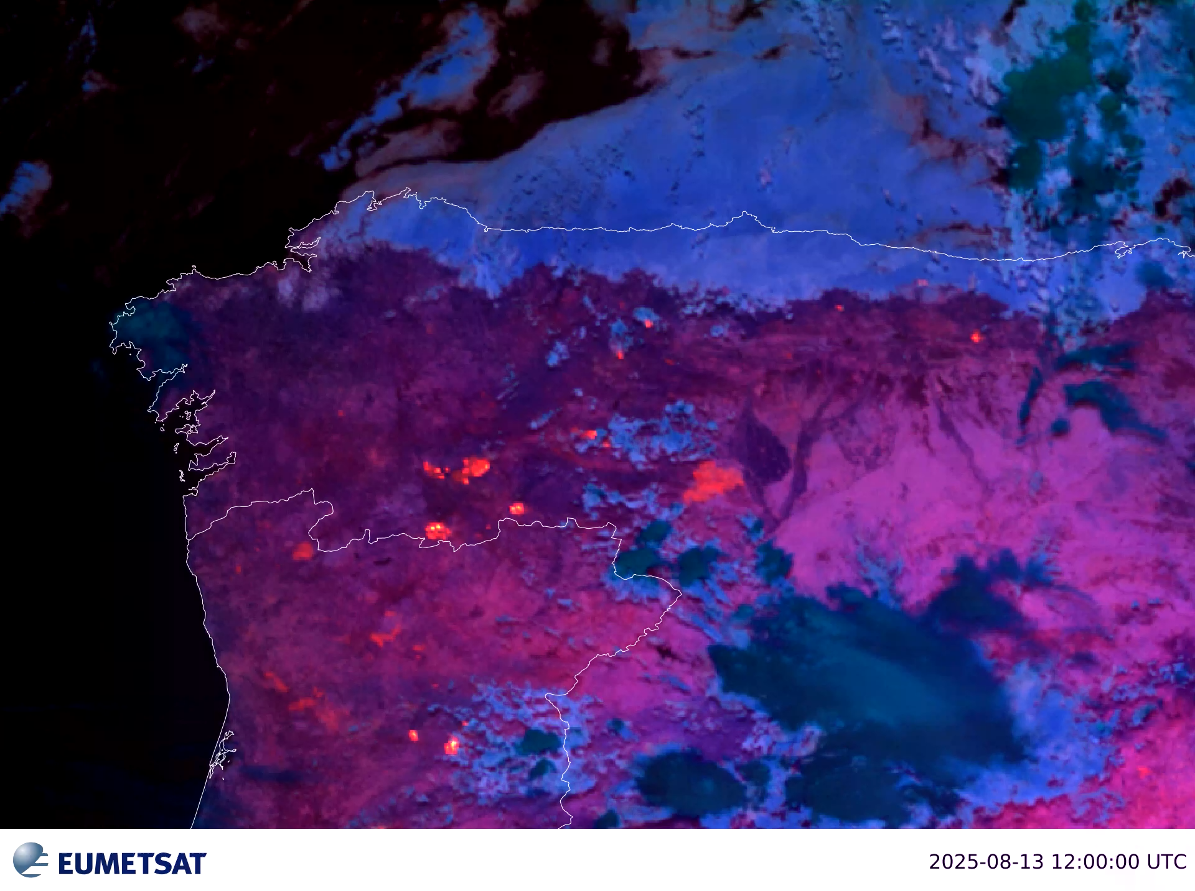
Animation
Met-12 FCI Fire Temperature RGB
13 August 2025, 12:00-15:00 UTC
Click on the image to see the animation!

Slide 18

Animation
Met-12 FCI Fire Temperature RGB
LI lightning data (transparent)
13 August 2025, 12:00-15:00 UTC
Click on the image to see the animation!

Slide 19
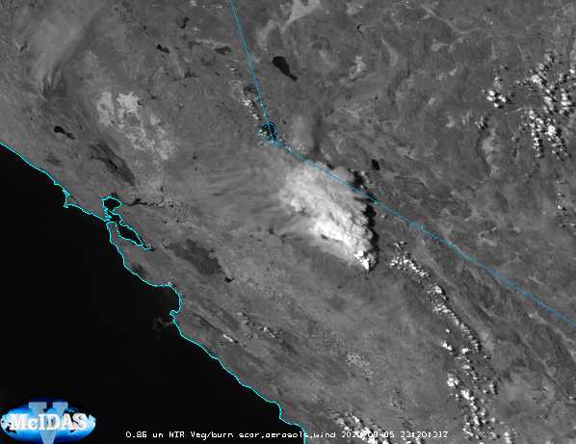
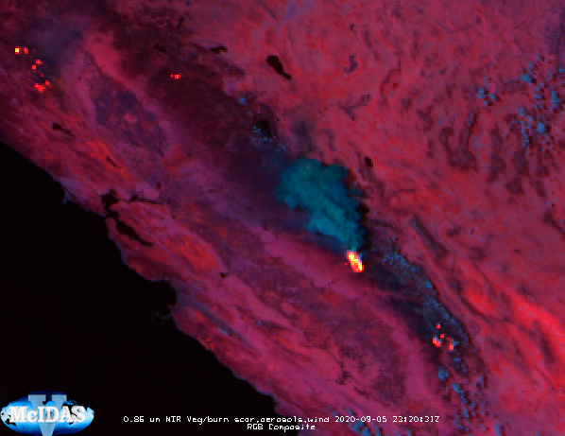
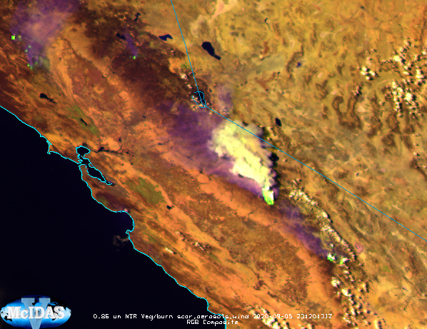
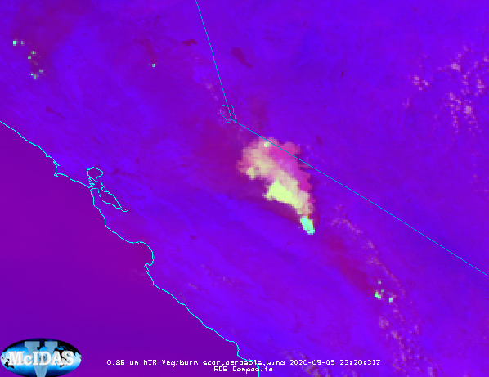
NIR0.8
Fire Temperature RGB
2020 Creek Fire in California
GOES-17 ABI images
05 September 2020 23:20 UTC
Cloud Phase RGB
Severe Storms RGB

Slide 20
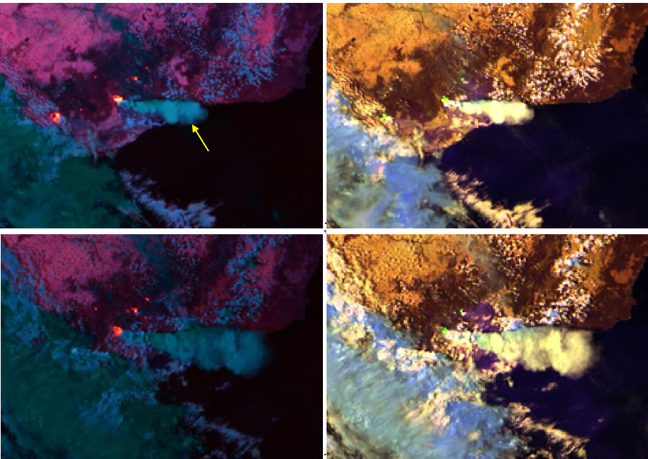
Victoria, Australia
Himawari-8 AHI images
3 March 2019
Fire Temperature RGB
Cloud Phase RGB
04:00UTC
05:30UTC
Their colors are similar as the color of water clouds.

Slide 21
Summary
Identification of pyro-Cb clouds in satellite imagery
It forms above fire (study animated satellite images, e.g. True Color RGB images, or Flames RGB images)
Highly polluted by smoke particles (using microphysical RGBs)
  Fire Temperature RGB
  Cloud Phase RGB
  Severe Storms RGB
Looks like a Cb (e.g. sandwich image, shape, cloud top temperature)
Lightning activity
Highly polluted --- cloud top microphysics --- during day
  High ice clouds highly polluted by smoke appear in distinct color than ‘usual’ high ice clouds
  In case of Fire Temperature and Cloud Phase RGBs the pyro-Cb clouds appear similar to water cloud. The smaller the cloud top ice crystals, the more similar to water clouds.
  Best to visualize all three RGBs.
Note
Pyro-Cb clouds can form above volcano (at large eruption), nuclear explosion, ....

Slide 22
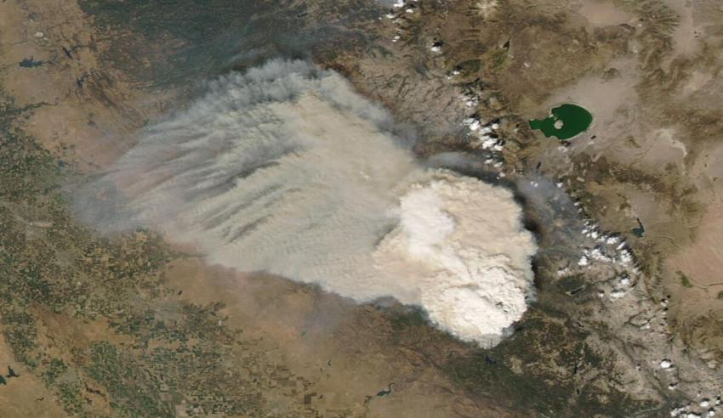
Thank you for the attention!
Quick Guide to the Fire Temperature RGB (Eumetrain):
  https://eumetrain.org/sites/default/files/2021-05/FireTemperatureRGB.pdf
Quick guide to the Cloud Phase RGB
  https://eumetrain.org/sites/default/files/2023-01/CloudPhaseRGB.pdf
Quick guide to the Severe Storms RGB
  https://eumetrain.org/sites/default/files/2025-06/severe_storm_QG.pdf
Extended guide to the Cloud Phase RGB
https://eumetrain.org/resources/extended-guide-cloud-phase-rgb
Quick Guide to the new microphysical channel (NIR2.25) on EUMeTrain webpage:
  https://eumetrain.org/sites/default/files/2020-05/NIR225QG.pdf
Aqua MODIS image shows a pyro-Cb cloud emerging from the Creek Fire.
5 September, 2020
Image: NASA Worldview.

