Slide 1

Data access and analysis of Metop-A/B/C Level 3 trace gas products relevant for fires
Julian Meyer-Arnek (DLR)
Jupyter Notebook available at
https://github.com/julianmeyerarnek/FireWeek

Slide 2

Overview
Wild fires are a global problem with massive effects on local, regional and global air quality.
Major wild fires are visible from space:
Not only by visual instruments such as Sentinel-2,
but also by atmosphere-sensing spectral missions (Metop-C).
This presentation focuses on the 2025-wildfires on the Iberian Peninsula and focuses on
  Getting and accessing atmosphere data (discovery and access),
  Perform data analysis
using Jupyter Notebooks.

Slide 3




Let’s dive into it.
These layers are touched...
Science (Wild Fires / Air Chemistry)
Slido.com: 2601092
Trace Gas Retrieval
from Space
Data Access and Management
Jupyter Notebook

Slide 4
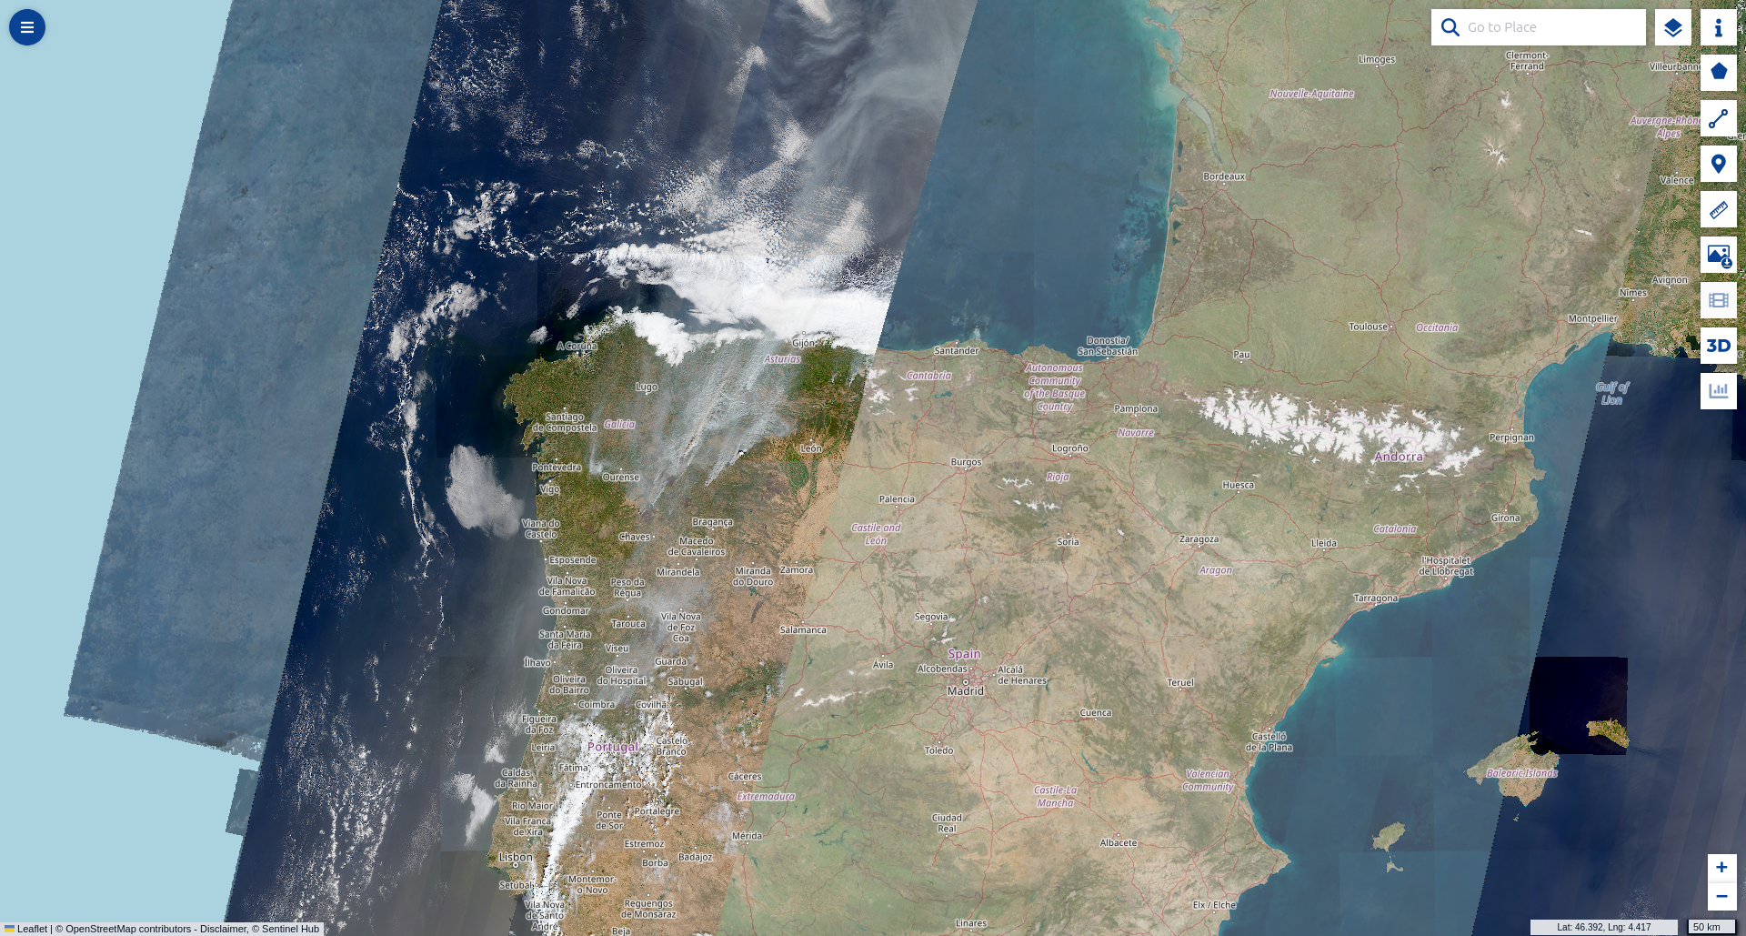
Focusing Wildfires on the Iberian Peninsula
Copernicus Data Space, Sentinel 2, 16.08.2025

Slide 5
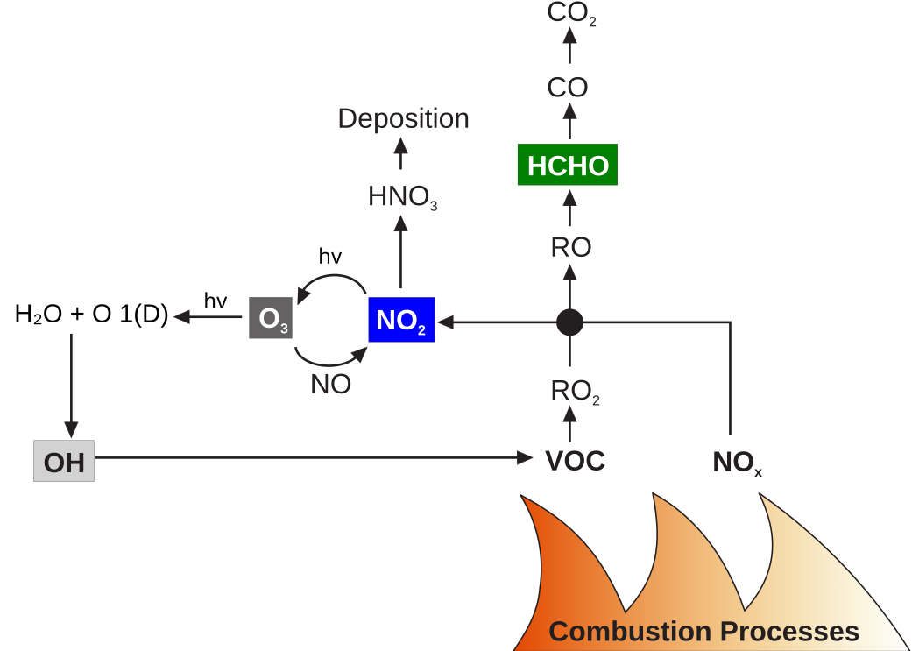

Slide 6
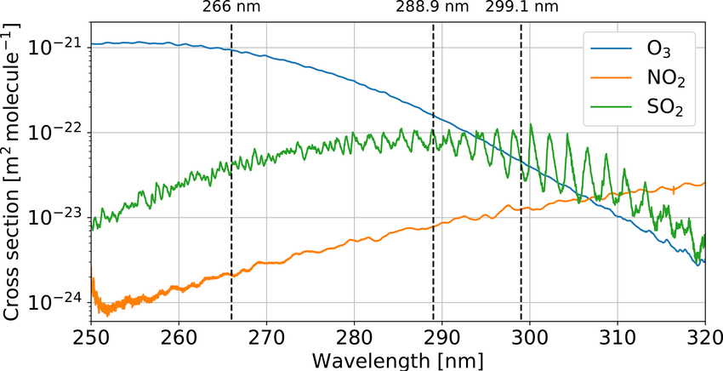
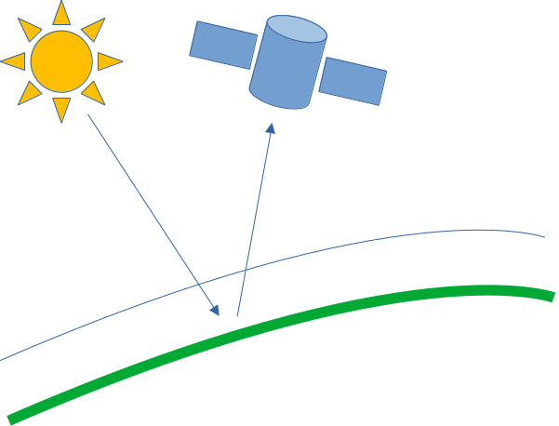
How to retrieve trace gas amounts

Slide 7
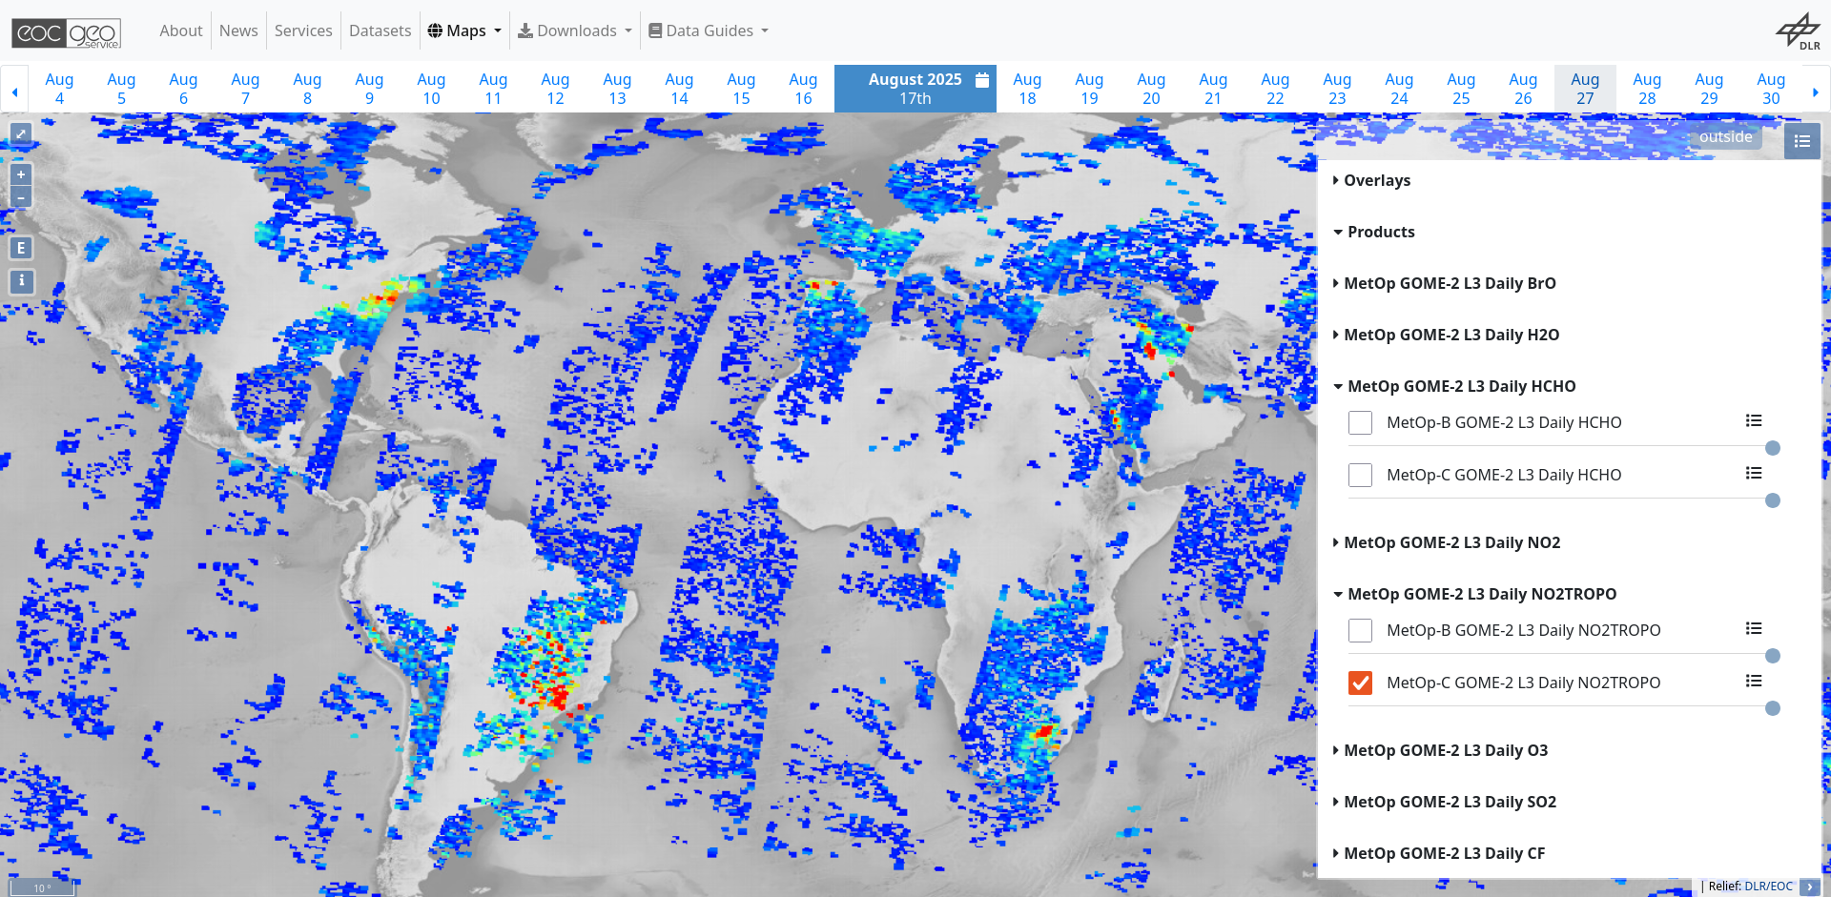
https://geoservice.dlr.de/web/maps/metop:gome2:l3:daily

Slide 8
https://geoservice.dlr.de/web/maps/metop:gome2:l3:daily

Slide 9
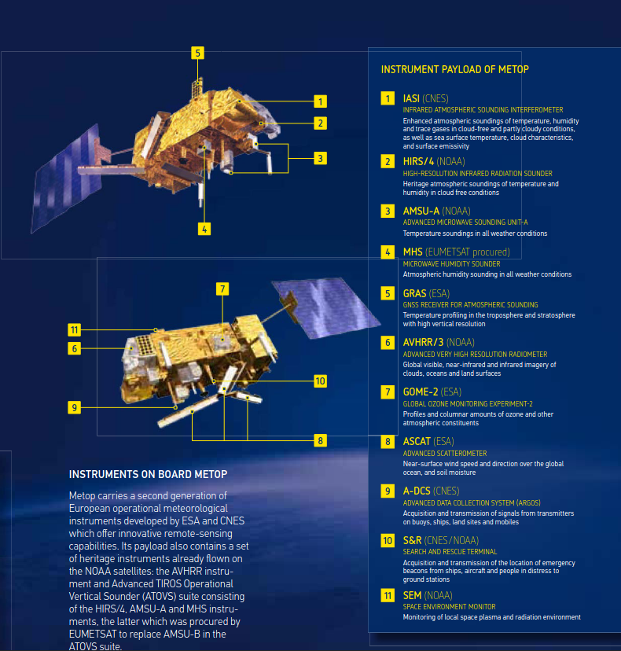
Metop – Satellites:
Orbit:
sun-synchronous polar orbit,
morning orbit 09:30 local time descending node
Inclination: 98.7° to the Equator
Altitude: 800 - 850 km
GOME-2: 40 x 80 km² pixel size
Long Time Series: 3 Satellites
Metop-A, Metop-B, Metop-C 2007 - 2032
Source: EUMETSAT, https://www.eumetsat.int/media/15002

Slide 10

Let’s dive into it.
These layers are touched...
Science (Wild Fires / Air Chemistry)
Data Access and Management
Slido.com: 4089103
Jupyter Notebooks
Jupyter Notebook

Slide 11
Jupyter Notebook
Development environment for Python, R, Rust, …
Linux: Start by typing „jupyter-lab“ in your terminal
Jupyter Lab may run locally on your desktop.

Slide 12
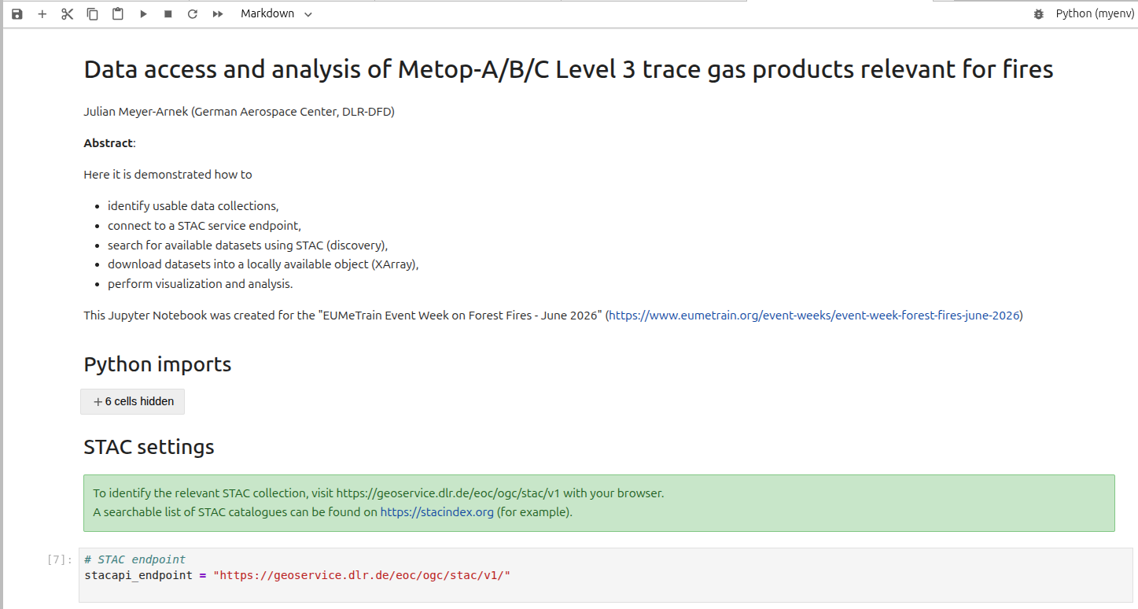

Slide 13

Let’s dive into it.
These layers are touched...
Science (Wild Fires / Air Chemistry)
Data Access and Management
Slido.com: 3525232
STAC
Jupyter Notebook

Slide 14
STAC – SpatioTemporal Asset Catalog
Metadata
Data
Collection
  Items
    Asset 1
    Asset 2
    Asset 3

Slide 15
STAC – SpatioTemporal Asset Catalog
Metadata
Data
Collection
  Items
    Asset 1
    Asset 2
    Asset 3
NetCDF dataset
GeoTIFF dataset
(Cloud optimized)
Auxilliary dataset(s)
1. Discover STAC Items

Slide 16
STAC – SpatioTemporal Asset Catalog
Metadata
Data
Collection
  Items
    Asset 1
    Asset 2
    Asset 3
NetCDF dataset
GeoTIFF dataset
(Cloud optimized)
Auxilliary dataset(s)
1. Discover STAC Items

Slide 17
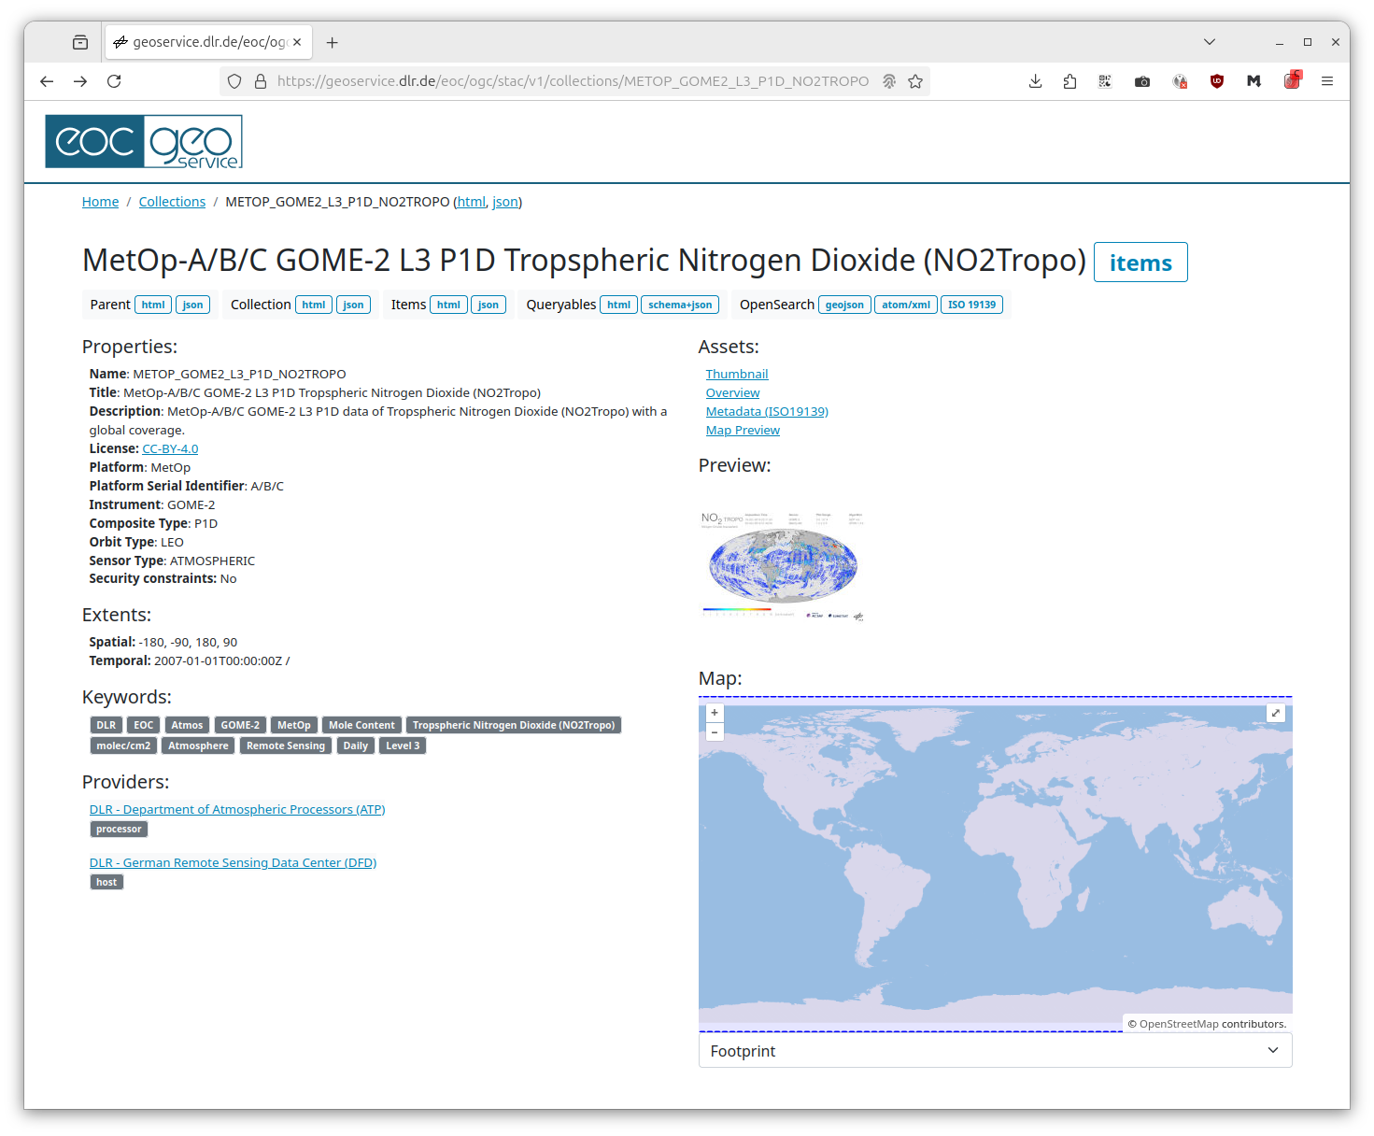
STAC – SpatioTemporal Asset Catalog
Metadata
Data
Collection
  Items
    Asset 1
    Asset 2
    Asset 3
NetCDF dataset
GeoTIFF dataset
(Cloud optimized)
Auxilliary dataset(s)
1. Discover STAC Items

Slide 18
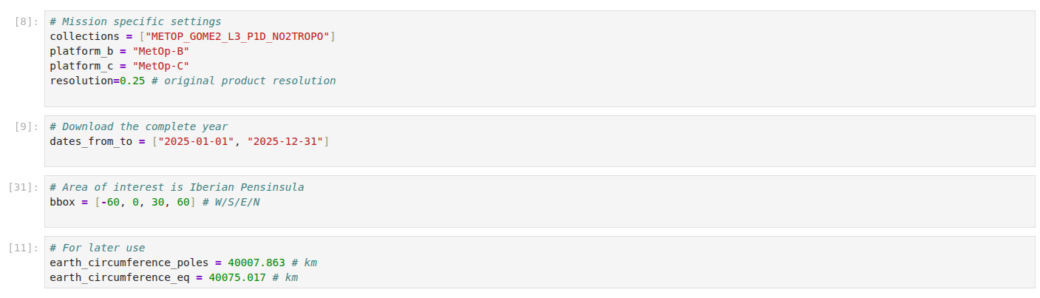
STAC – SpatioTemporal Asset Catalog
Metadata
Data
Collection
  Items
    Asset 1
    Asset 2
    Asset 3
NetCDF dataset
GeoTIFF dataset
(Cloud optimized)
Auxilliary dataset(s)
1. Discover STAC Items

Slide 19
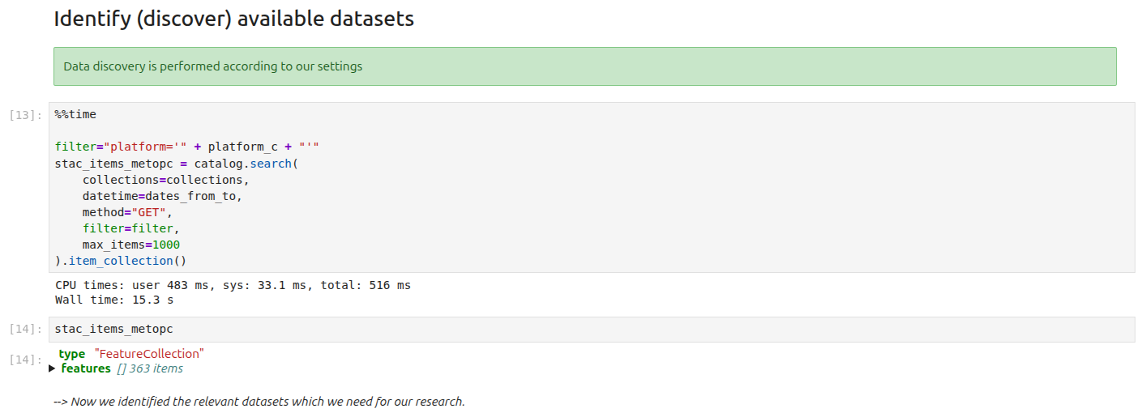
STAC – SpatioTemporal Asset Catalog
Metadata
Data
Collection
  Items
    Asset 1
    Asset 2
    Asset 3
NetCDF dataset
GeoTIFF dataset
(Cloud optimized)
Auxilliary dataset(s)
1. Discover STAC Items

Slide 20
STAC – SpatioTemporal Asset Catalog
Metadata
Data
Collection
  Items
    Asset 1
    Asset 2
    Asset 3
NetCDF dataset
GeoTIFF dataset
(Cloud optimized)
Auxilliary dataset(s)
1. Discover STAC Items
2. Download corresponding data into local data cube

Slide 21
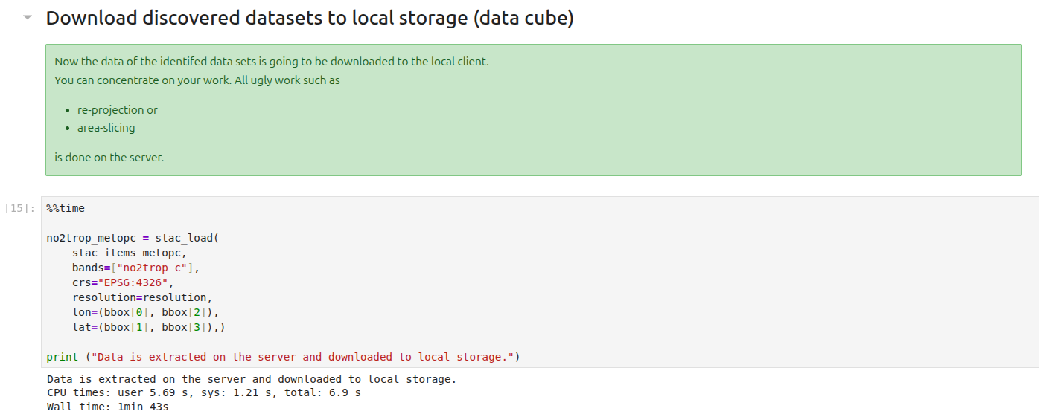
STAC – SpatioTemporal Asset Catalog
Metadata
Data
Collection
  Items
    Asset 1
    Asset 2
    Asset 3
NetCDF dataset
GeoTIFF dataset
(Cloud optimized)
Auxilliary dataset(s)
1. Discover STAC Items
2. Download corresponding data into local data cube

Slide 22
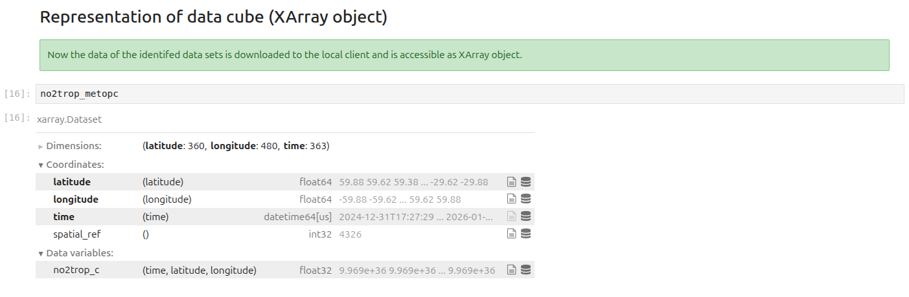
STAC – SpatioTemporal Asset Catalog
Collection
  Items
    Asset 1
    Asset 2
    Asset 3
NetCDF dataset
GeoTIFF dataset
(Cloud optimized)
Auxilliary dataset(s)
1. Discover STAC Items
2. Download corresponding data into local data cube

Slide 23
STAC – SpatioTemporal Asset Catalog
Collection
  Items
    Asset 1
    Asset 2
    Asset 3
NetCDF dataset
GeoTIFF dataset
(Cloud optimized)
Auxilliary dataset(s)
1. Discover STAC Items
2. Download corresponding data into local data cube
3. Analyze data

Slide 24
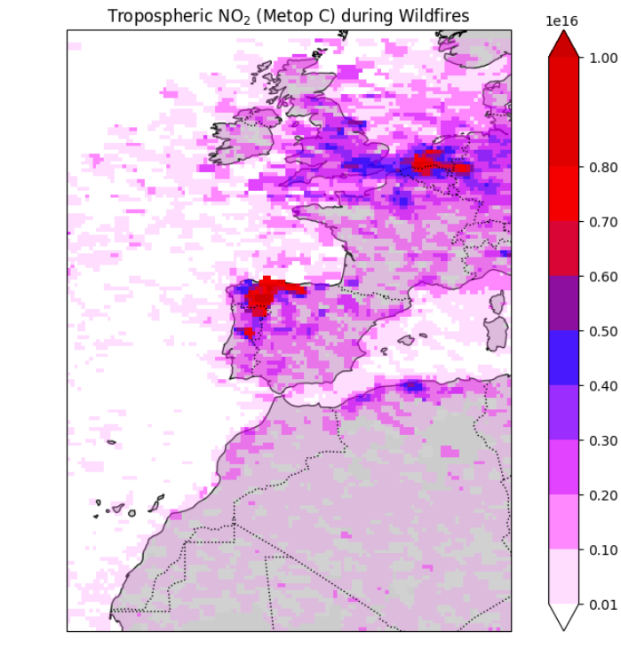
molecules/cm²

Slide 25
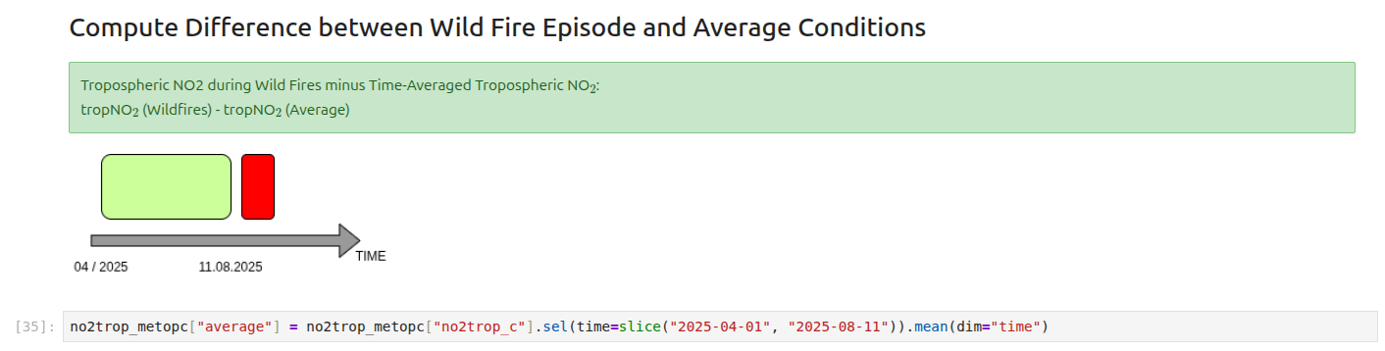

Slide 26
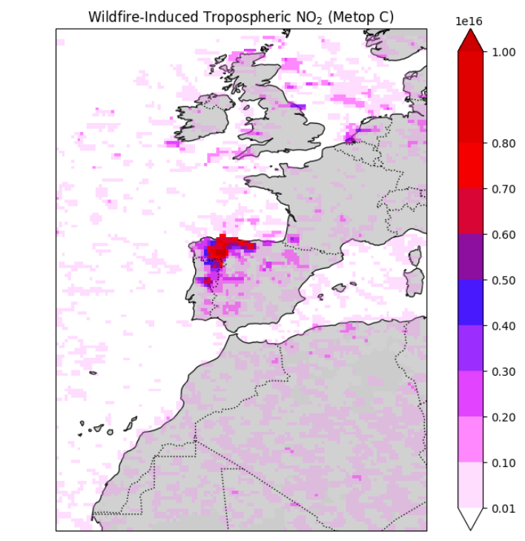

Slide 27

We are finished.
These layers were touched.
Science (Wild Fires / Air Chemistry)
Data Access and Management
Slido.com: 1502593
Did you like it?
Jupyter Notebook

Slide 28
High Resolution Mission:
Sentinel 5P

Slide 29
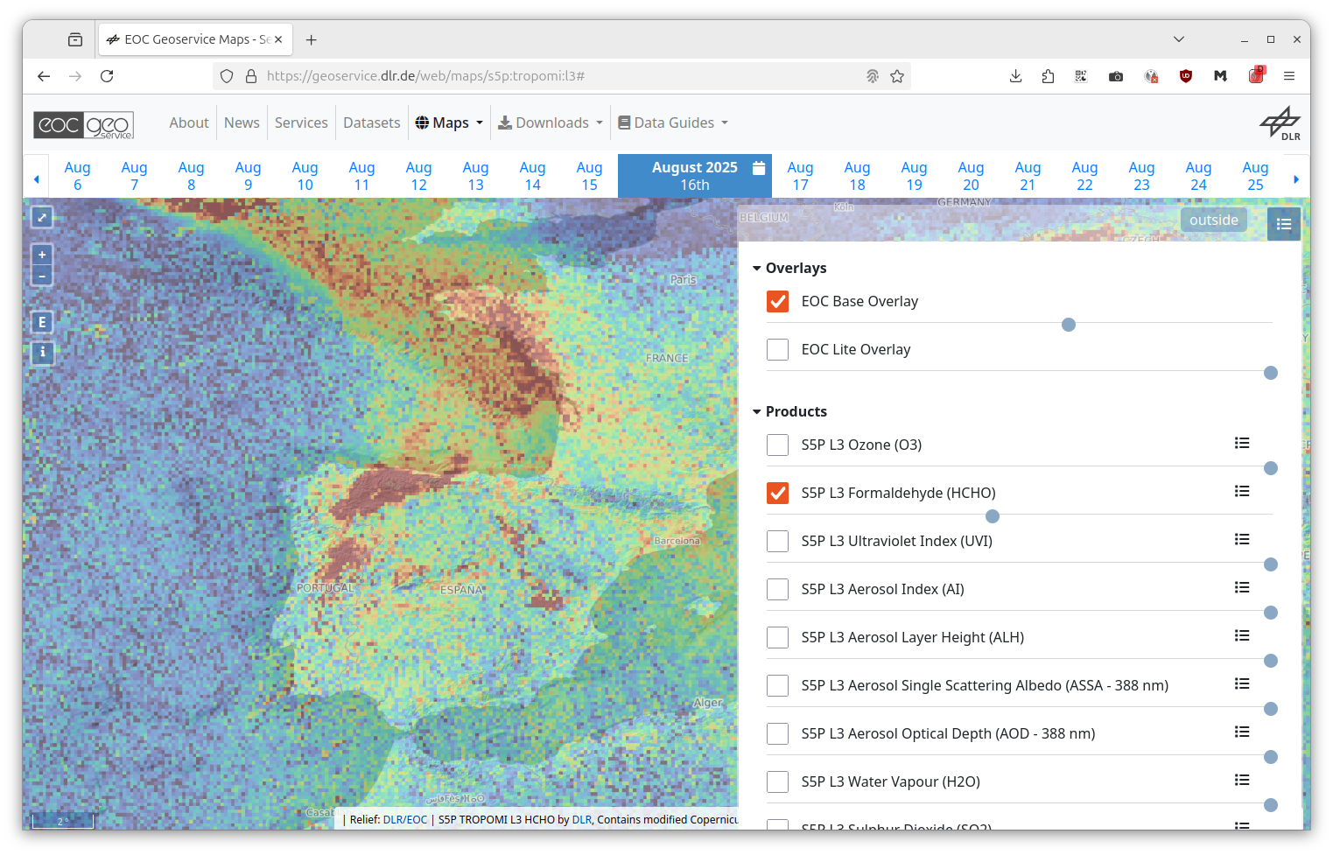
Sentinel 5P
Spatial Resolution: 3.5 x 7 km²
Temporal Resolution Level 3: 1 day
Currently the best available polar orbiting trace gas observing instrument.
Products are also accessible via STAC at EOC Geoservice.

Slide 30
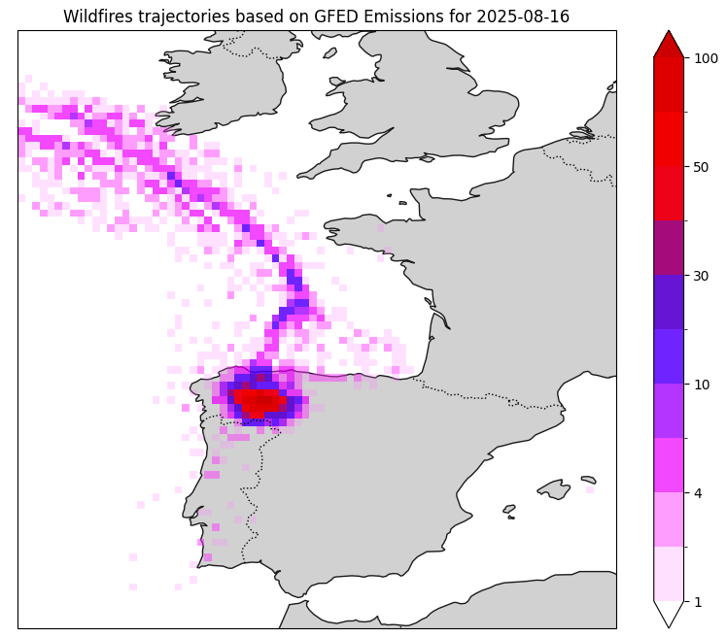

Slide 31
Impressum
Topic: Data access and analysis of Metop-A/B/C Level 3 trace gas products relevant for fires
Date: 2026-06-03
Author: Julian.Meyer-Arnek@DLR.de
Institute: DFD
Credits: All images „DLR (CC BY-NC-ND 3.0)“,
if not stated differently

