Slide 1

Vegetation from space:
processing satellite products with Jupyter Notebooks
Boštjan Muri, Ahac Pazlar, Mateja Iršič Žibert, Tjaša Kovačević and¸the LSA SAF team
EUMeTrain‘s Event Week on Forest Fires, 1-3 June 2026
Notes:
1

Slide 2
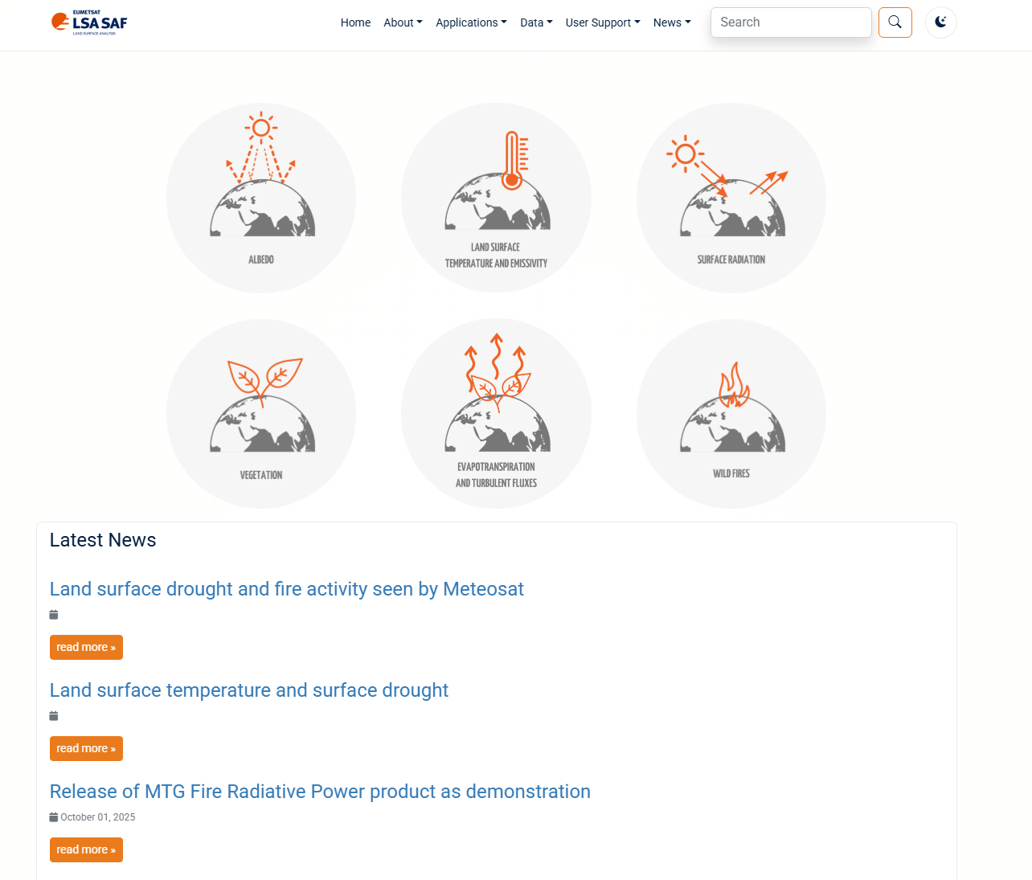
Outline
LSA SAF products
Vegetation from space
Fires from space
Jupyter Notebook Examples
lsa-saf.eumetsat.int

Slide 3
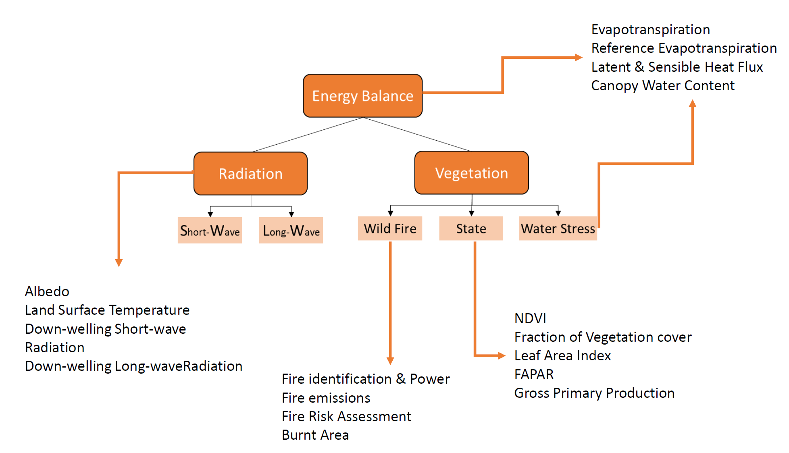
Scheme of the LSA-SAF products
lsa-saf.eumetsat.int
Notes:
3

Slide 4
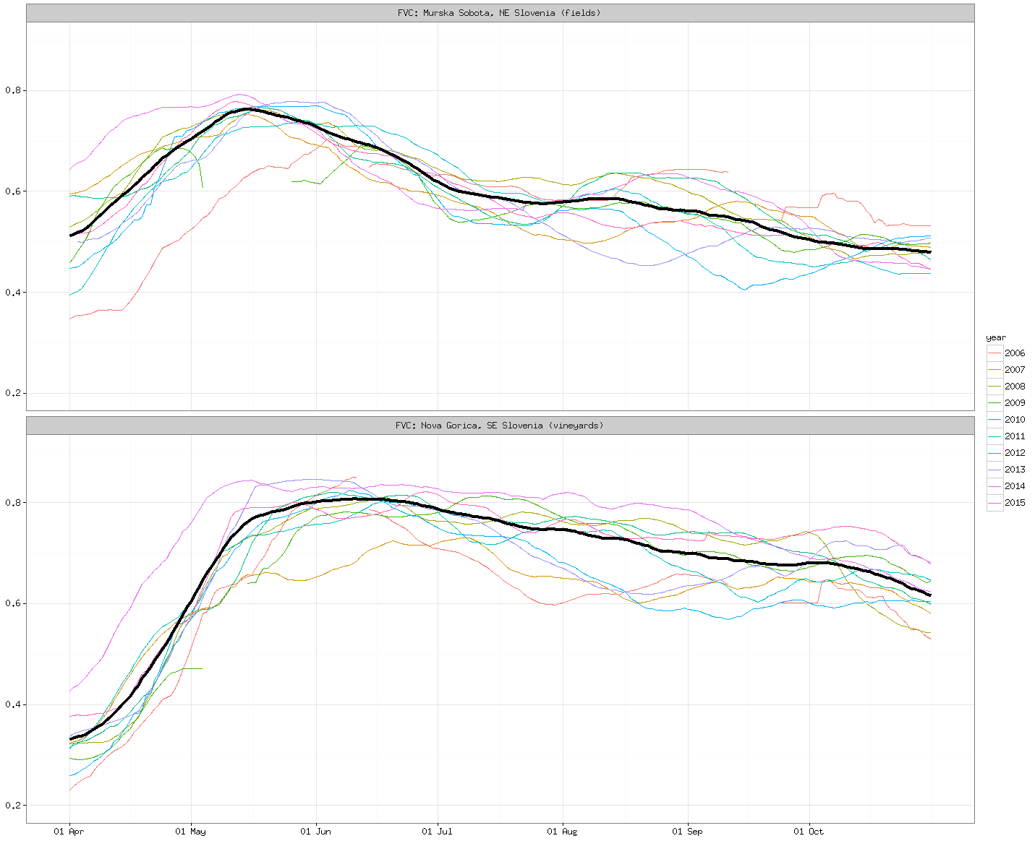
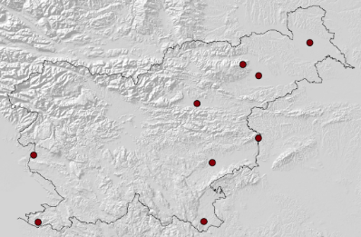
Vegetation: FVC, LAI & fAPAR
SEVIRI/METOP VEGETATION INDICES (daily / multi-day temporal frequency):
Fraction of vegetation cover (FVC)
Leaf Area Index (LAI)
Fraction of Photosynthetically Active Radiation (fAPAR)
FVC for vegetative season
for locations in
Slovenia / SE Europe
Deviations from the reference (black) for different years (in colors)

Slide 5
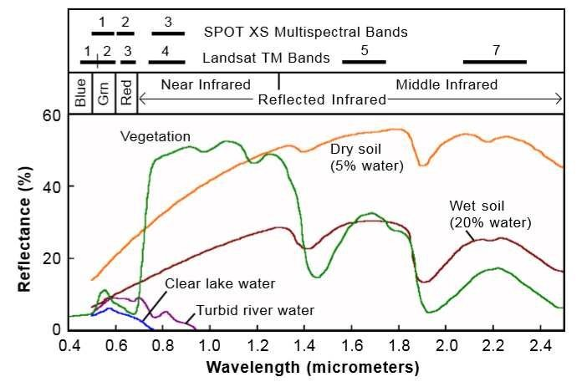
Spectral Fingerprint

Slide 6
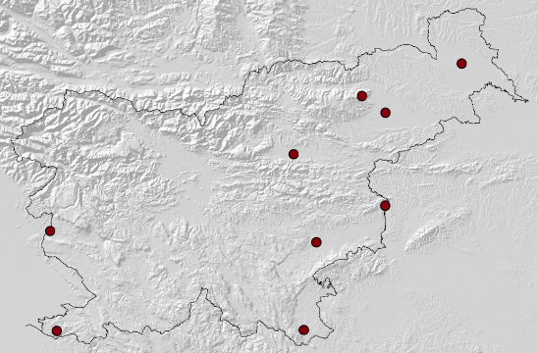
LSA SAF Vegetation Products
At ARSO we rely on LSA SAF satellite products for drought and vegetation monitoring. LSA SAF products focus on the use of EUMETSAT satellites.
MSG/METOP VEGETATION INDICES (daily / multi-day temporal frequency):
Fraction of vegetation cover (FVC)
Leaf Area Index (LAI)
Fraction of Photosynthetically Active Radiation (fAPAR)
LSA SAF FVC index
Reference based on long-term
average vegetation (2004–2018).
Murska Sobota (NE Slovenia, fields)
Very dry years: 2007, 2012 and 2013 (summer values below reference)
Nova Goria (SW Slovenia, vineyards)
Very dry years: 2006, 2007, 2012 and 2013
A very moist year with high precipitation: 2014 (values well above reference)
Fields
Vineyards

Slide 7
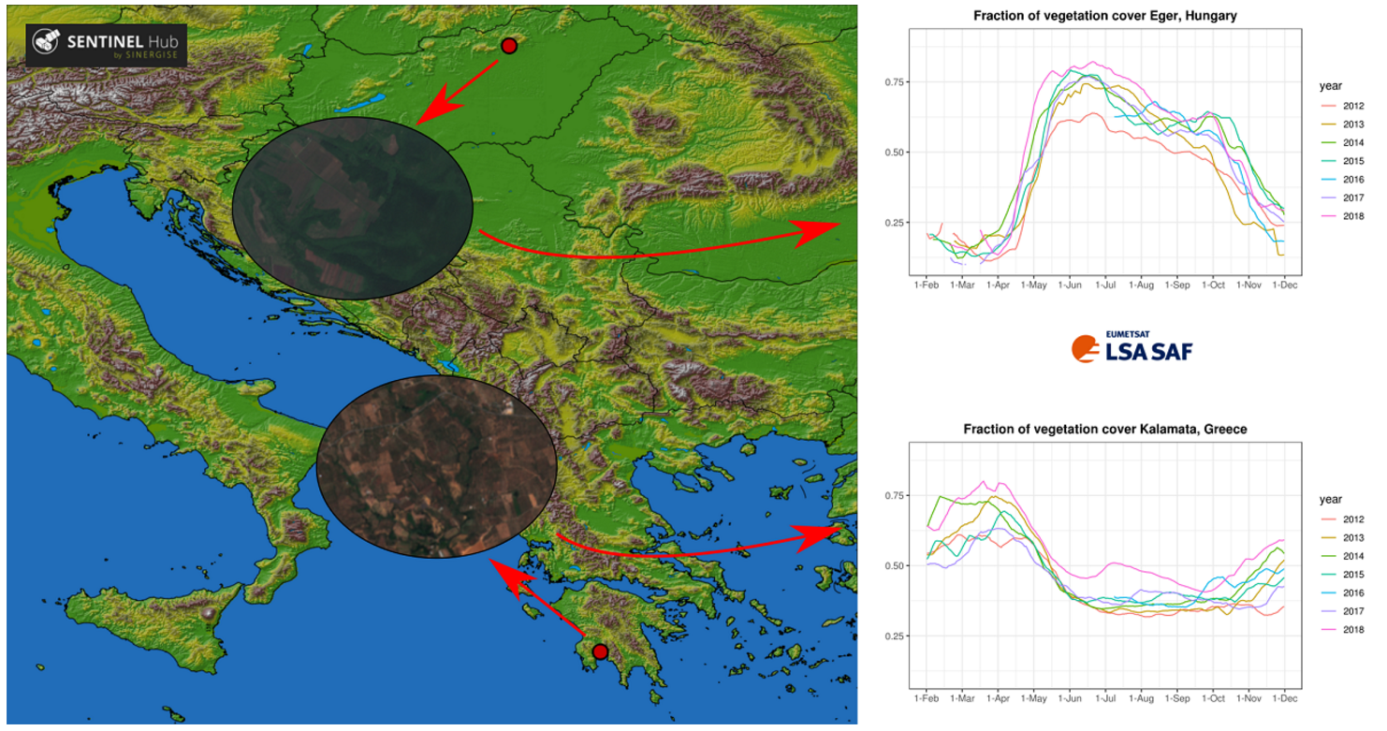
Vegetation Response Variability
Vegetation signal from space (LSA SAF FVC from MSG) depends on various factors, such as growing season, water availability and vegetation type.
Vegetation is at its greenest in late spring and early summer in Eger, Hungary (mixed vegetation types; continental climate).
Kalamata, Greece (olive groves; Mediterranean climate): vegetation is green in spring and brown in summer.
The two locations are located in different climate regions, which results in a large difference between vegetative season in Hungary and Greece.

Slide 8
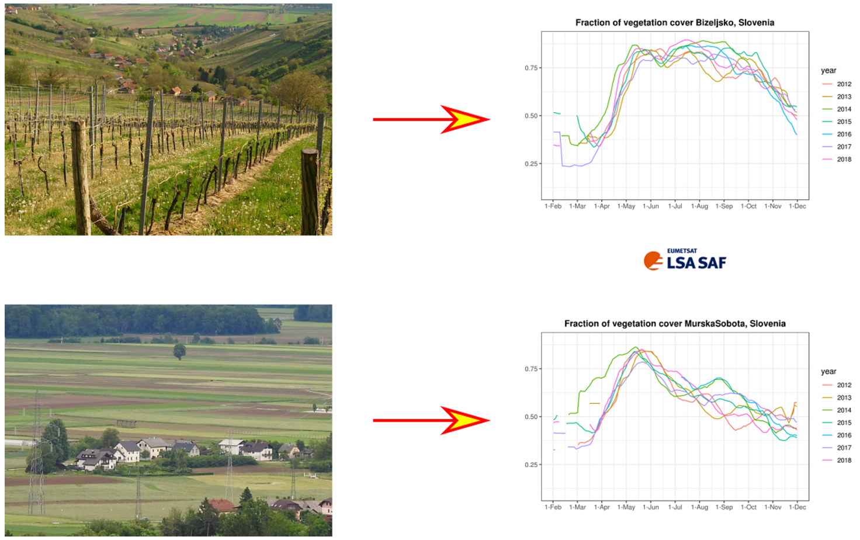
How do land and climate type affect vegetation signal from space?
LSA SAF FVC (from MSG) yearly evolution at two locations in Slovenia close to each other with a similar climate: Bizeljsko (mostly vineyards and forests) and Murska Sobota (crops).
Vegetation stays very green from late spring until the end of summer in Bizeljsko, whereas there is a peak of FVC in the late spring with decreasing FVC values later in Murska Sobota.
Year-to-year FVC variability is a function of available water in the growing season and the types of crops that are grown on the cultivated land.
Different land types cause differences in their respective satellite signals.

Slide 9
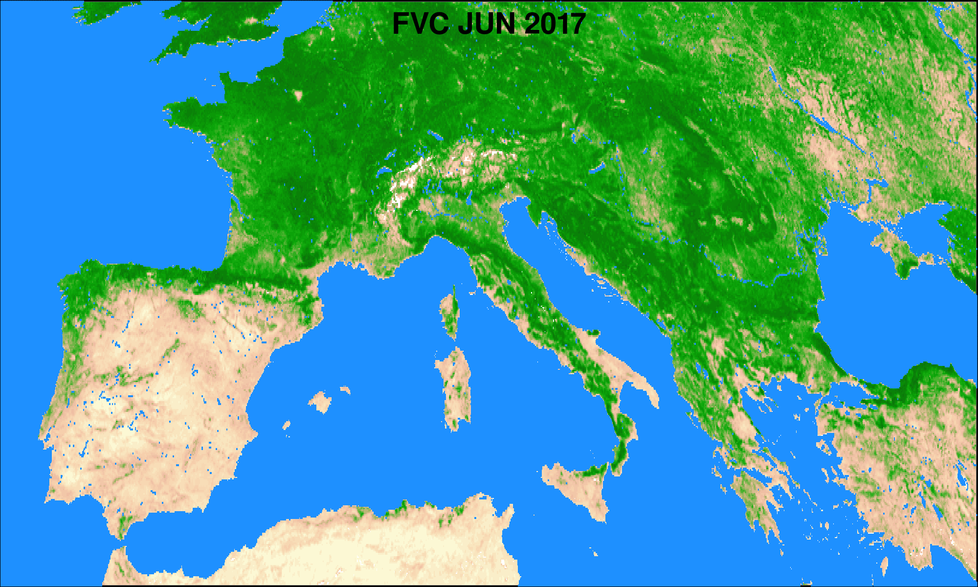
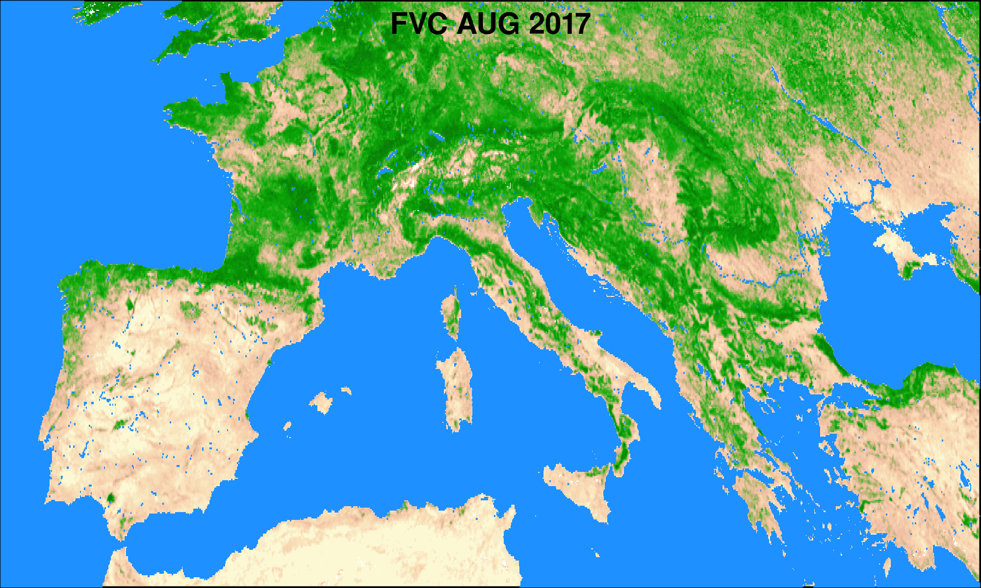

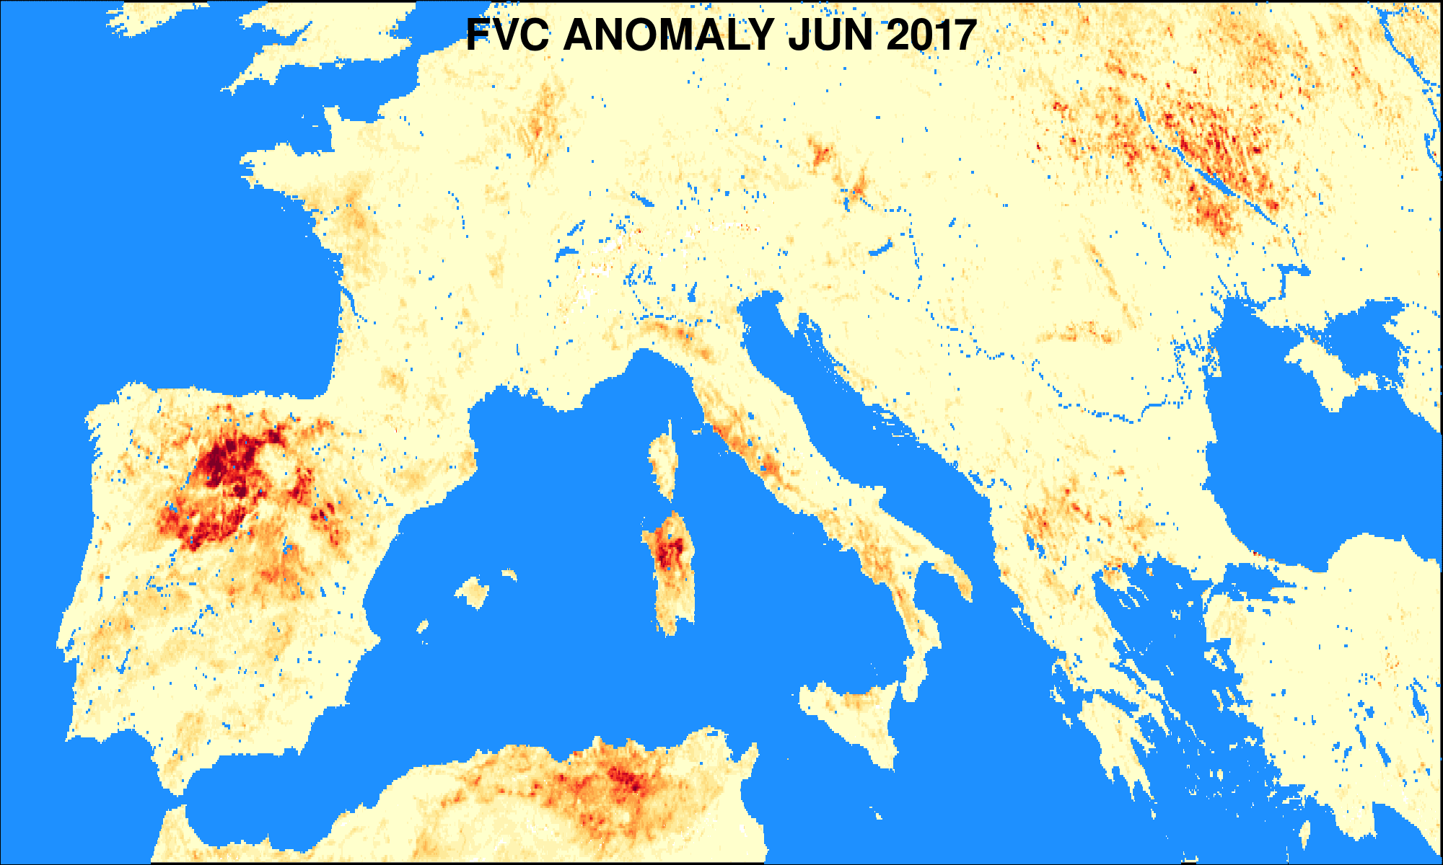
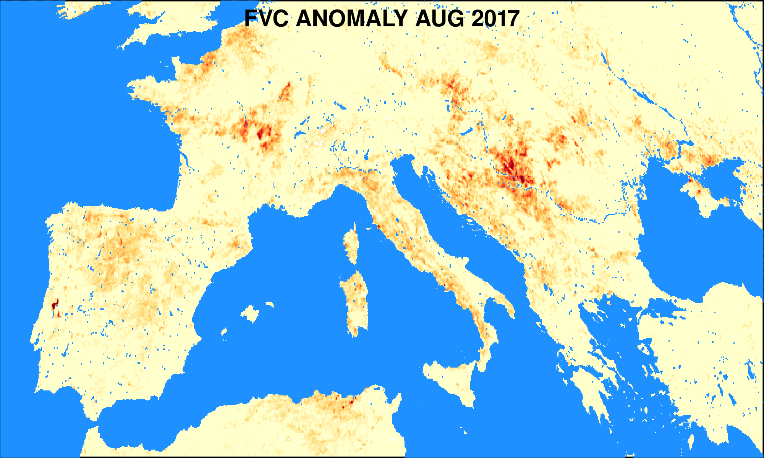

Fraction of Vegetation Cover: Locating Drought Impacted Areas
FVC and its negative anomaly (difference from average value) are displayed on the left.
Droughts: Iberia, Italy, France (middle/late summer) and the Balkans (late summer).
Areas of burnt forest in Portugal caused by massive forest wildfires encircled in black.

Slide 10
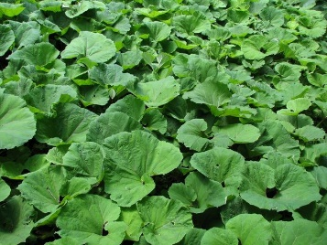
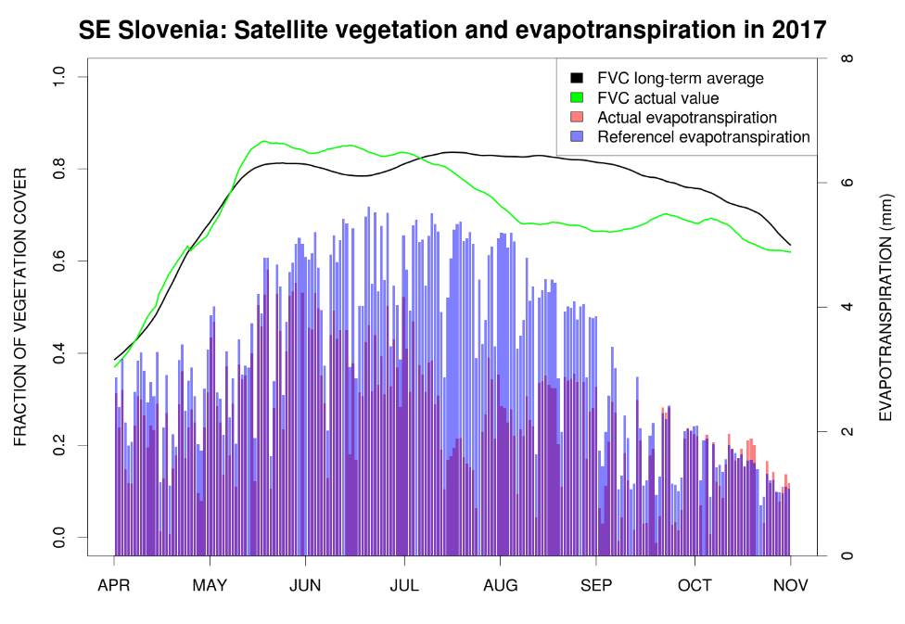
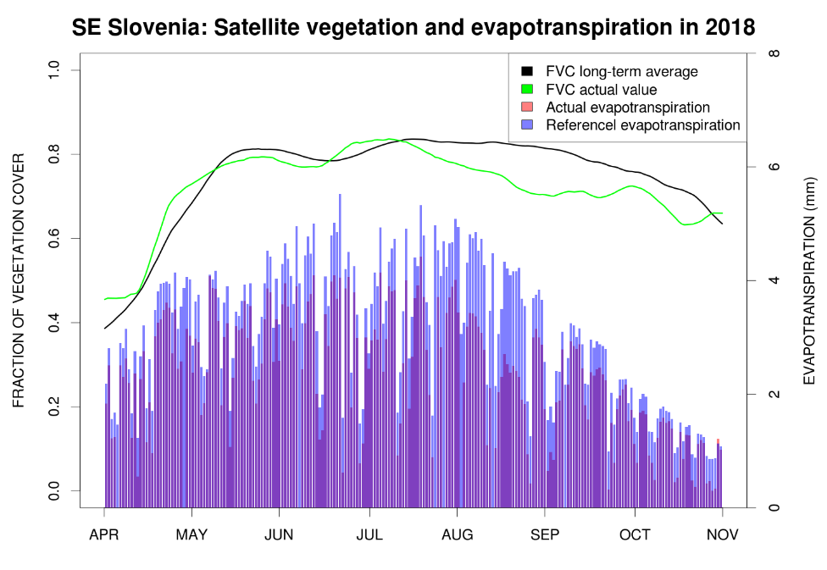
Actual and Reference Evapotranspiration
SEVIRI/MSG:
30 min / 3 km sub-satellite point
Daily composites
Actual ET: Energy Balance by cover type within each pixel using SEVIRI down-welling radiation, Albedo, Vegetation, LST, ….
Reference ET: Evapotranspiration of reference non-stressed surface driven by DSSF.
Large difference/ration between actual and reference evapotranspiration signals drought.

Slide 11
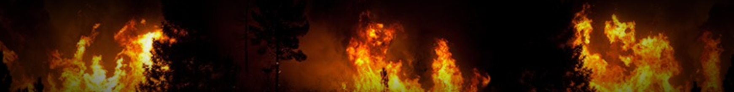
Fires from space:
processing satellite products with Jupyter Notebooks
Boštjan Muri, Ahac Pazlar, Mateja Iršič Žibert, Tjaša Kovačević and the LSA SAF team
EUMeTrain‘s Event Week on Forest Fires, 1-3 June 2026
Notes:
11

Slide 12
Scheme of the LSA-SAF products
lsa-saf.eumetsat.int
Notes:
12

Slide 13
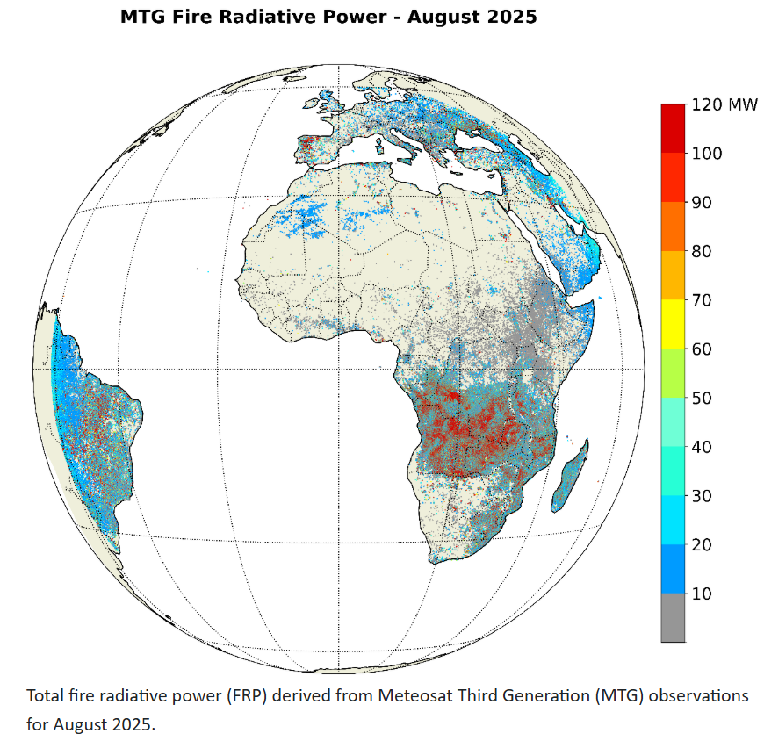
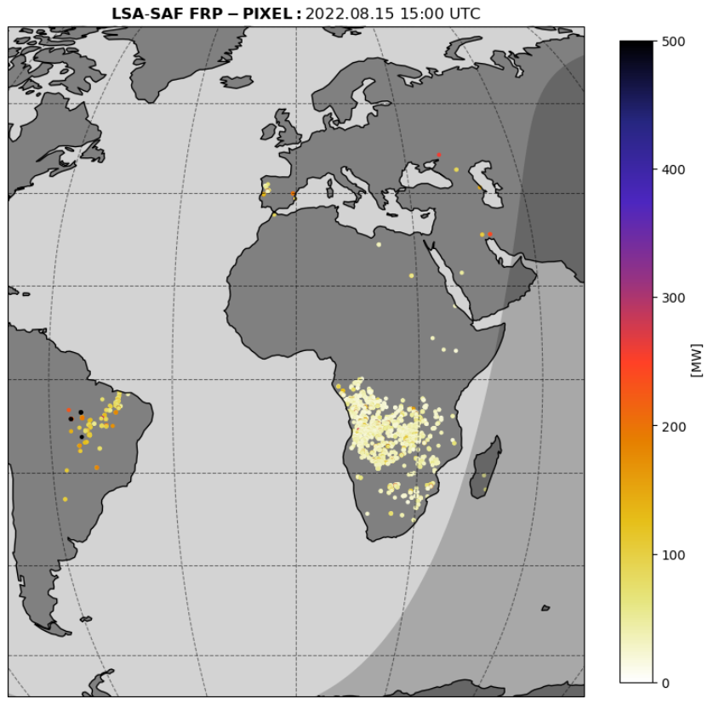
Fire Radiative Power – Pixel
Fire Radiative Power (FRP) estimates based on
  Location, FRP, uncertainty (MW)
  Fire detection confidence, Effective pixel area for each individual detected fire
MTG Fire Radiative Power – Pixel (MTFRPPIXEL)
Spatial resolution: 1 km
Timeliness: Up to 45 minutes, typically around 20 minutes
Temporal frequency: Every 10 minutes
LSA-509 – currently demonstration product
MSG Fire Radiative Power – Pixel (FRPPixel)
Spatial resolution: 3 km
Temporal frequency: Every 15 minutes
LSA-502 (operational)

Slide 14
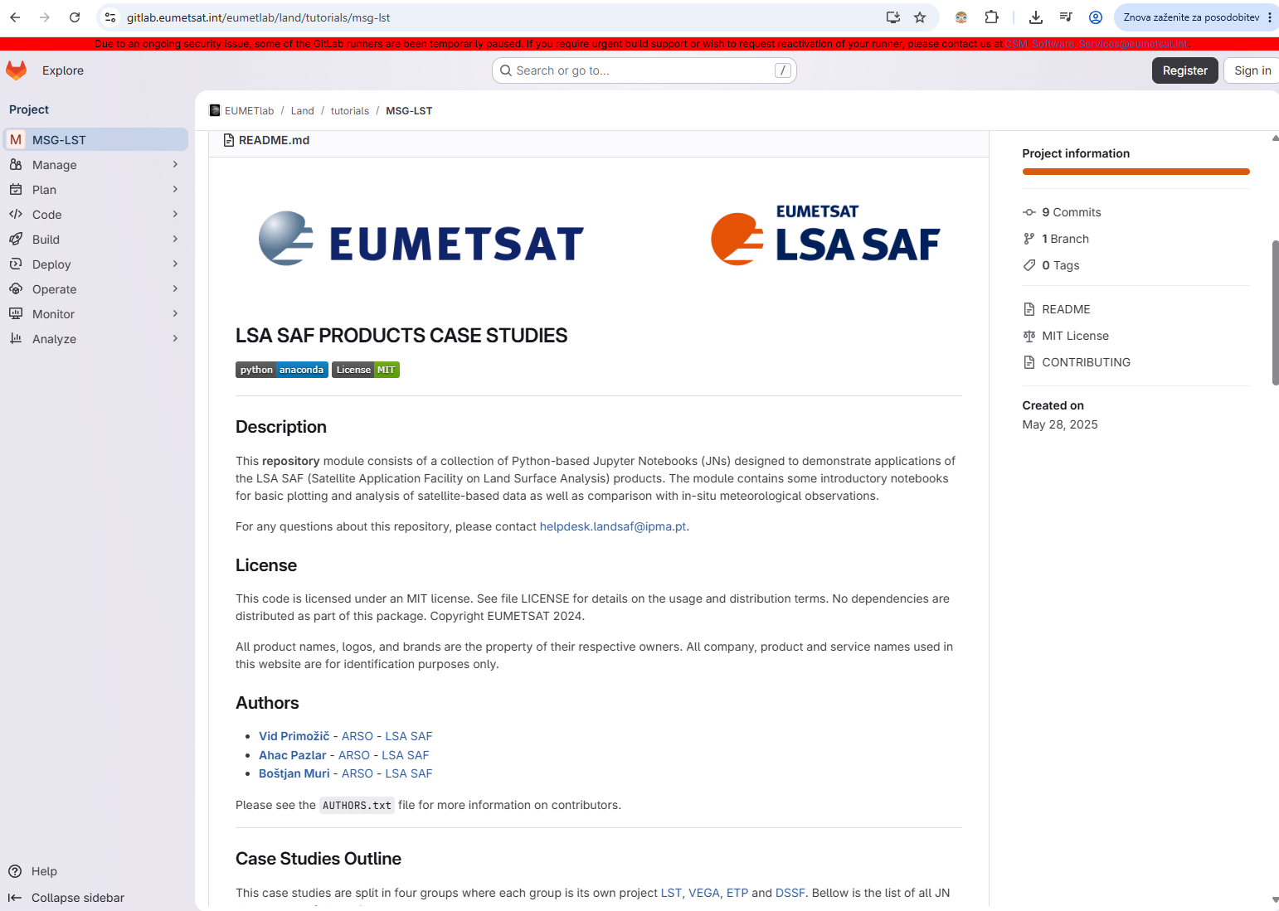
Jupyter Notebooks
Combining code, visuals, and text
Run code in small steps, inspect outputs instantly, and experiment with data
Reproducibility and sharing
Ideal for learning, demonstrating concepts
How to run Jupyter Notebooks?
Local machine
JupyterHub
Google Colab

Slide 15
Jupyter Notebooks
A suite of Jupyter Notebooks focusing on land surface temperature, vegetation, evapotranspiration and shortwave radiation.
Vegetation Jupyter Notebooks
FVC anomalies: Calculation of Fractional Vegetation Cover anomaly from LSA SAF ETFVC
Overview of the products: Demonstration of MSG Based LSA SAF Vegetation Products
Vegetation and fires: Analyzing Effects of Wildfires on Vegetation Using LSA SAF MDFVC and MSG-FRP Pixel Products
gitlab.eumetsat.int/eumetlab/land/tutorials
gitlab.com/helpdesk.landsaf/lsasaf_data_access/-/tree/main/tutorials/MSG?ref_type=heads

Slide 16
Jupyter Notebook Tutorial on Fires
LSA SAF Fire Radiative Power - Utilising MSG and MTG data
Basic facts on the LSA SAF FRPPixel (MSG)
Product number: LSA-502
Spatial resolution: 3km at nadir
Spatial coverage: MSG-Disk
Time steps: 15 min
Data availability: from 2016
Basic facts on the LSA SAF FRPPixel (MTG)
Product number: LSA-509
Spatial resolution: 1km at nadir
Spatial coverage: MTG-Disk
Time steps: 10 min
Data availability: Demonstrational from 1 Oct 2025
Statistical comparisons clearly show that the FCI sensor is more sensitive to smaller fires, with a higher number of detections, especially near the edges of the satellite disc.
gitlab.com/helpdesk.landsaf/lsasaf_data_access/-/tree/main/tutorials?ref_type=heads

Slide 17
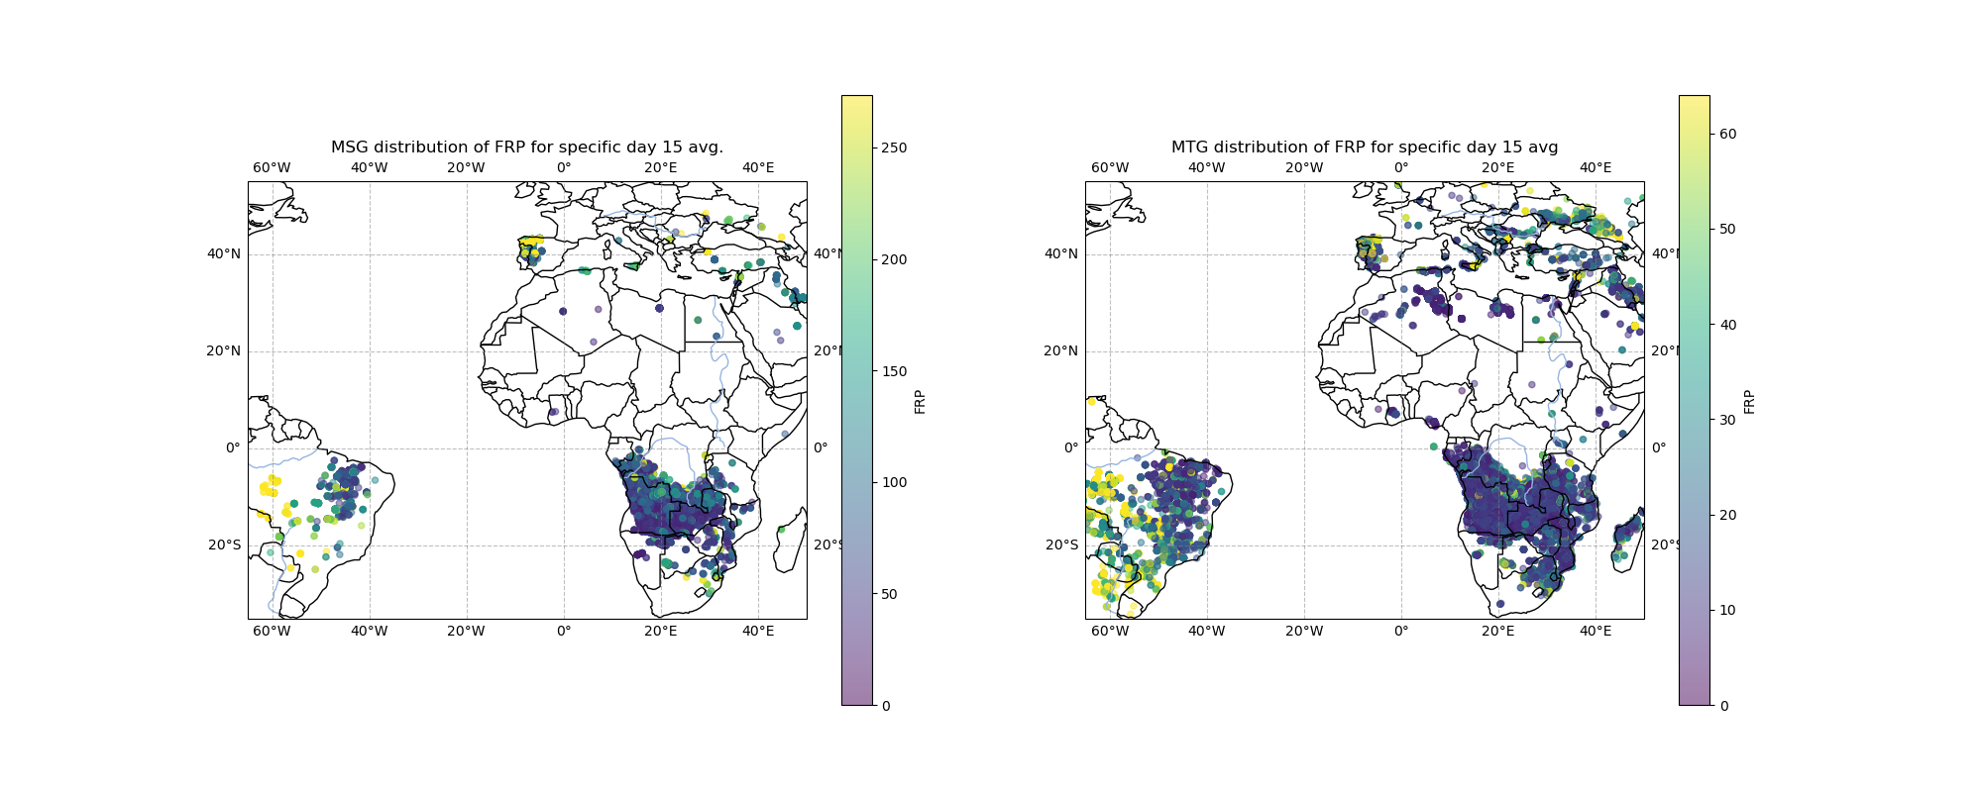
Daily FRP values for 15 August 2025

Slide 18
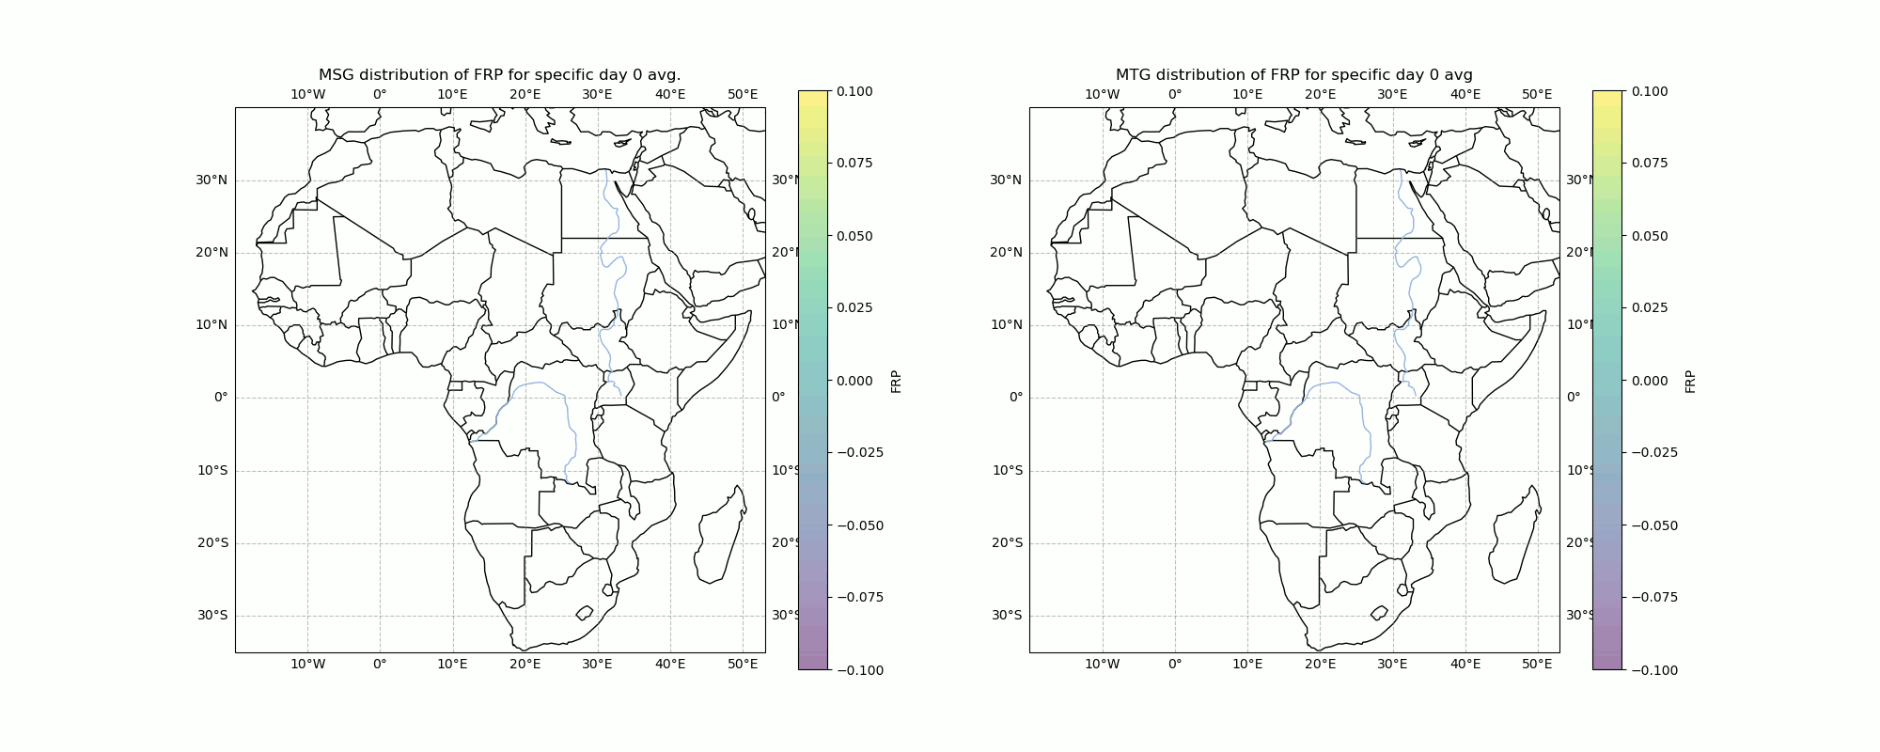
FRP animation for August 2025

Slide 19
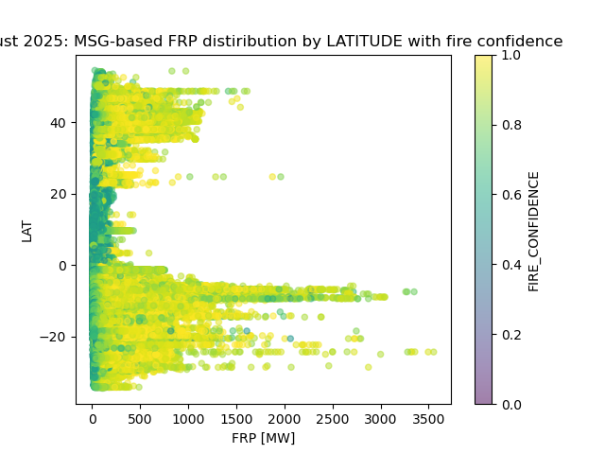
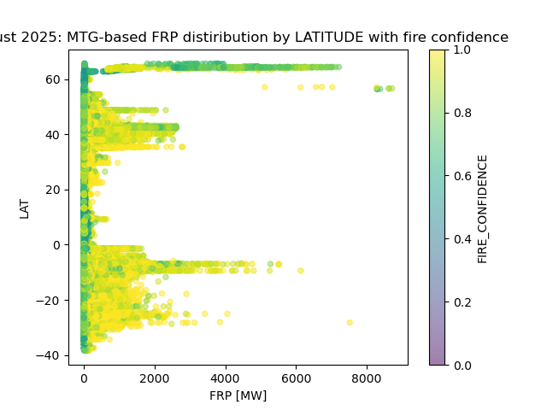
Analysing FRP distribution (MSG vs MTG)
Peaks of fire activity
mid-latitudes of the Northern Hemisphere
Southern Africa and South America – some of the highest FRP values
Thanks to the finer spatial and temporal resolution of MTG, the maximum FRP values are higher compared to MSG.

Slide 20
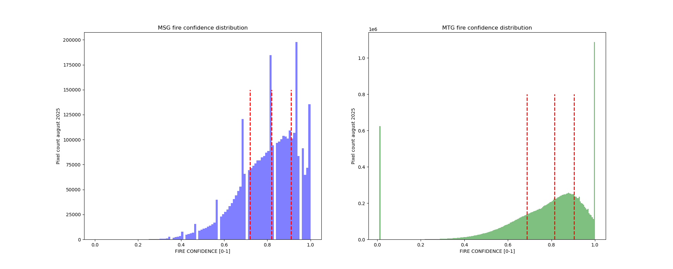
Analysing FRP distribution (MSG vs MTG)
The fire activity is analysed by latitude using the August 2025 FRPPixel datasets for both MSG and MTG satellites, covering the full disc area.
MTG captures more detail but is also more prone to false or uncertain detections (e.g. sun glints).

Slide 21
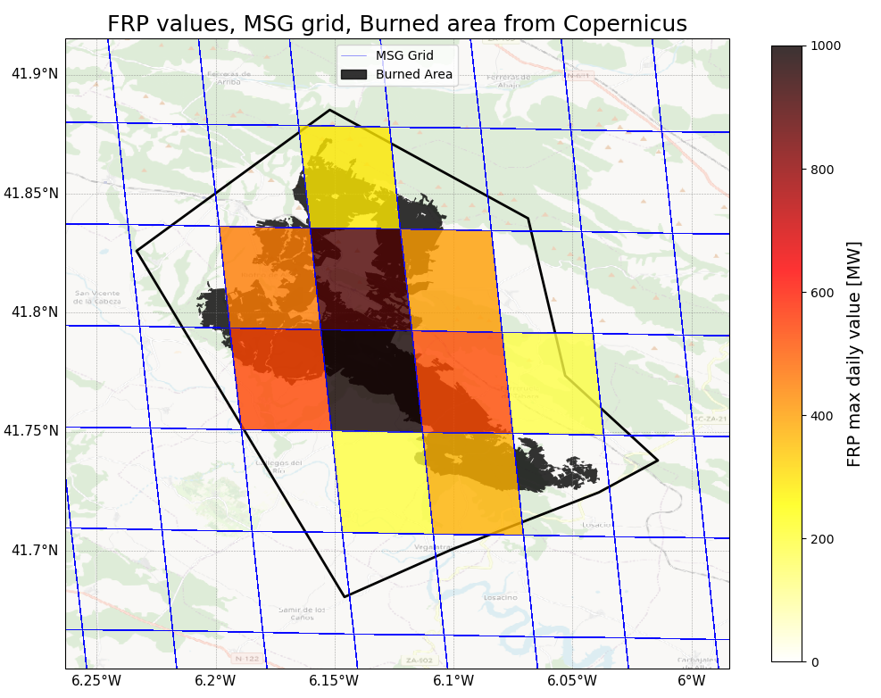
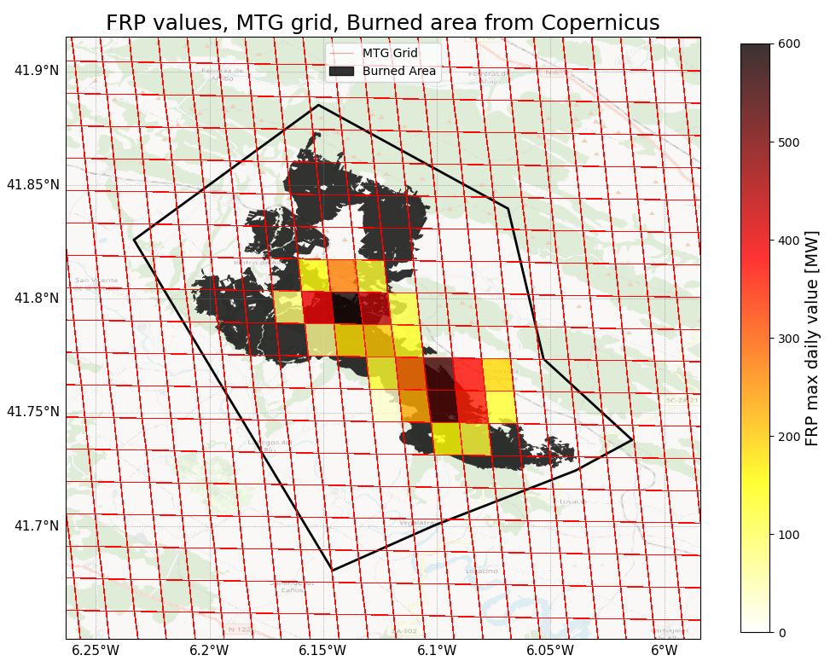





Spain – Fire Monitoring, 12. August 2025
MSG (left) and MTG (right): Fire Radiative Power over Ferreuela region, Spain
Fire monitoring over Europe August 2025
Fire monitoring over Europe August 2025
Fire monitoring over Europe August 2025
Jupiter notebooks with more than 10 examples for MTG (FRP)
Jupiter notebooks with more than 10 examples for MTG (FRP)
Jupiter notebooks with more than 10 examples for MTG (FRP)
Comparring MSG (left) vs MTG (right) over Ferreuela region, 12 Aug 2025. ​
Comparring MSG (left) vs MTG (right) over Ferreuela region, 12 Aug 2025. ​
Comparring MSG (left) vs MTG (right) over Ferreuela region, 12 Aug 2025. ​

Slide 22
Thank you for your attention!
bostjan.muri@gov.si
lsa-saf.eumetsat.int/en
SEEMET Regional Training Course, Trogir, Croatia, 13-17 April 2026

