Slide 1
Possible ways to visualize IRS L2 data
Zsofia Kocsis, Kalman Csirmaz
HungaroMet Hungarian Meteorological Service
kocsis.zs@met.hu

Slide 2

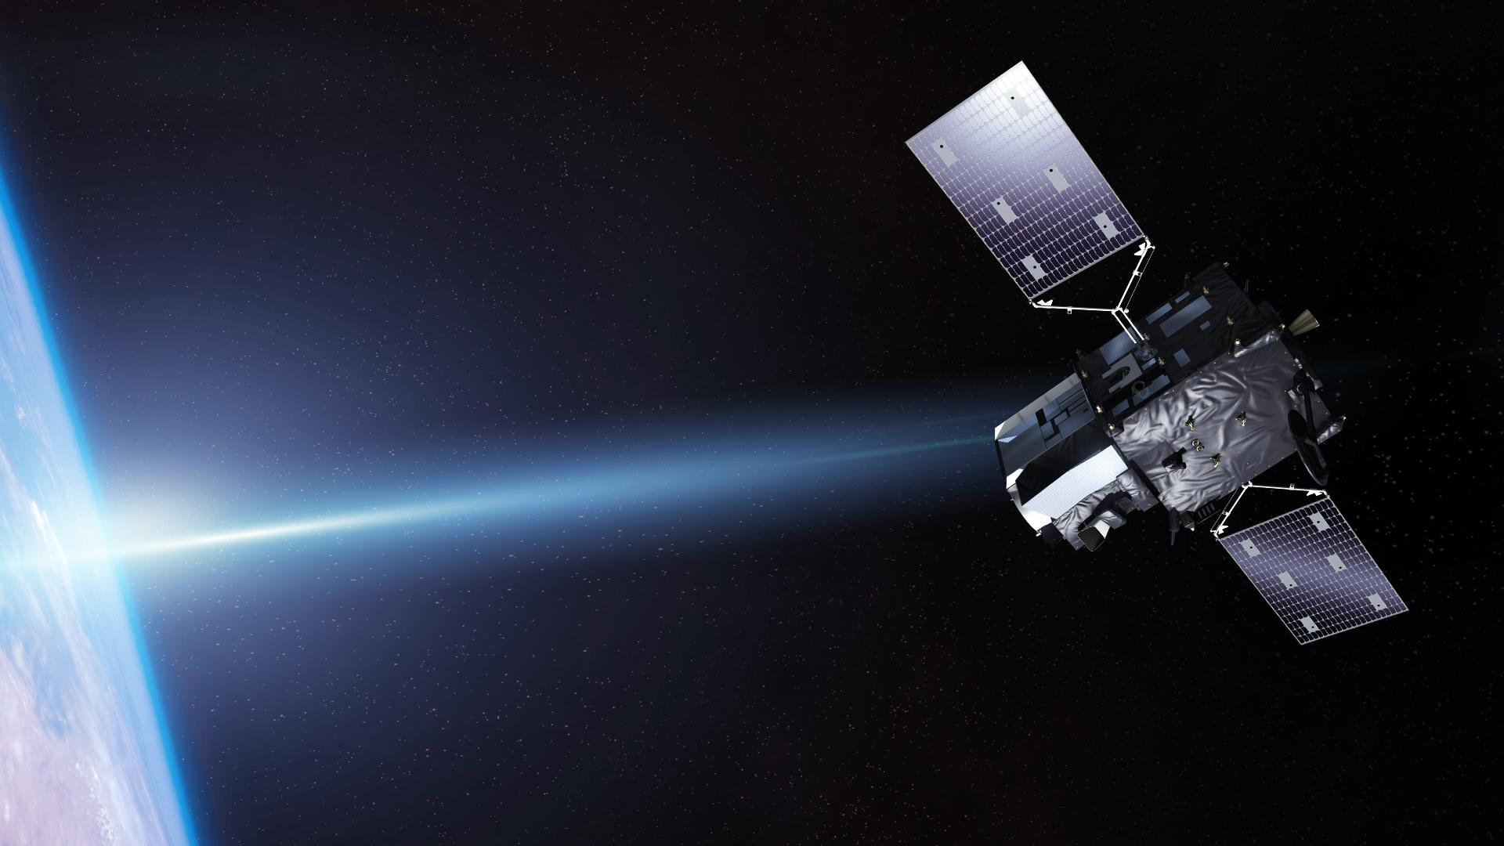
Introduction
Credit: ESA, EUMETSAT
MTG-S successfuly launched 1st July 2025
Two instruments: IRS and UVN
IRS – Infrared Sounder:
First European GEO sounder
Data over Europe every 30 minutes
Nowcasting

Slide 3
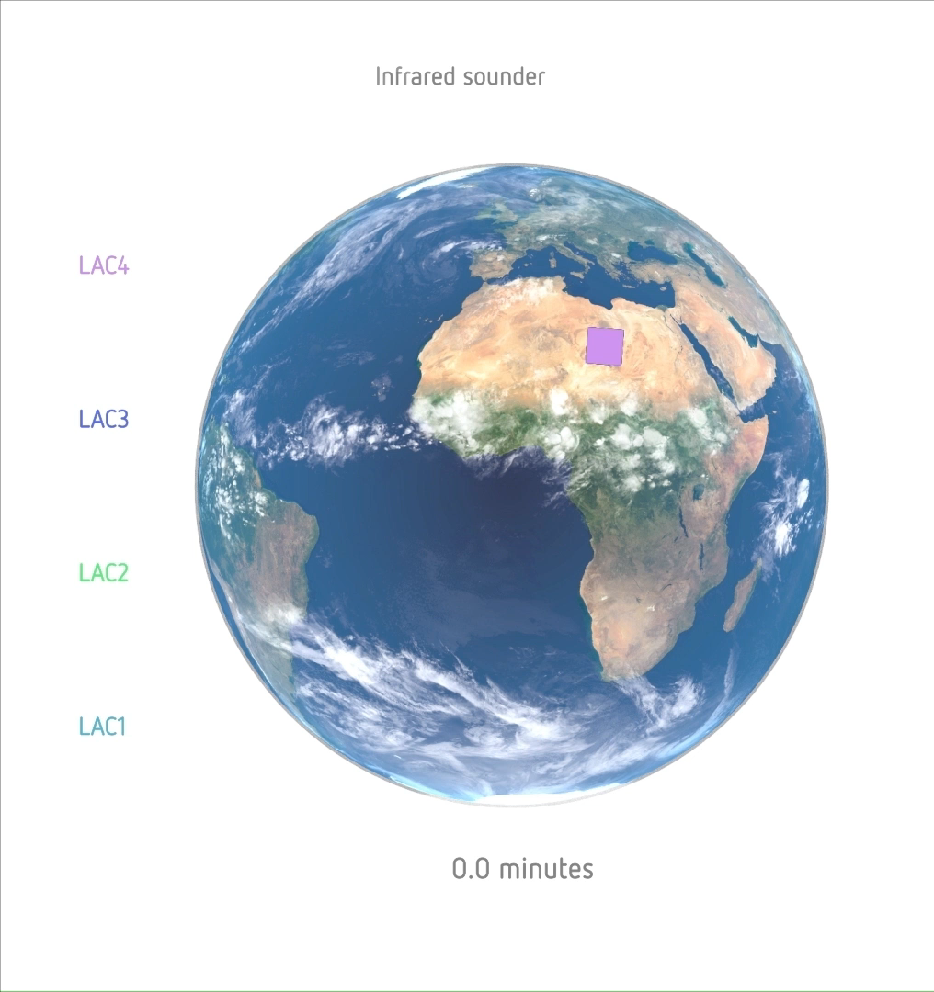
IRS measurements
Scanning in 'stop and stare' mode: IRS images an area - a dwell - of the Earth covered by the field of view, collecting in ~10 seconds 160x160 interferograms.
The Earth disc has been divided into four regions of interest called LACs (Local Area Coverage).
LAC4 covering Europe is scanned every 30 minutes.
No full disk concept.
Credit: EUMETSAT

Slide 4
IRS L2 data
Atmospheric and surface variables using the PWLR (Piece-Wise Linear Regression) statistical method in all-sky conditions
in NetCDF format
The most relevant variables for nowcasting include:
3D variables:
T and humidity profiles (101 levels)
T (40 levels) and Td (30 levels) profile error estimates
2D variables:
Surface T, Humidity and error estimate
Cloud information (status, height)
Calculated parameters (SBCAPE, MUCAPE, MLCAPE,CIN, LI, KI,…)

Slide 5
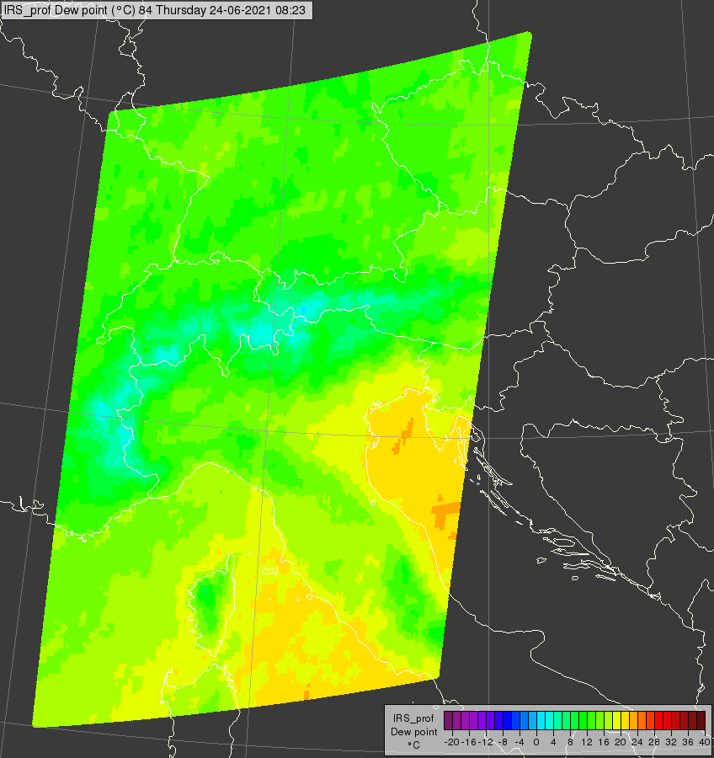
Visualization of field variables
IRS L2 will be processed and distributed in dwells
Each dwell contains 160x160 pixels (10 seconds)
LAC4 consists of 73 dwells
Example of one dwell, 2m Dew point, 24.06.2021. 08:23:10-20 UTC

Slide 6
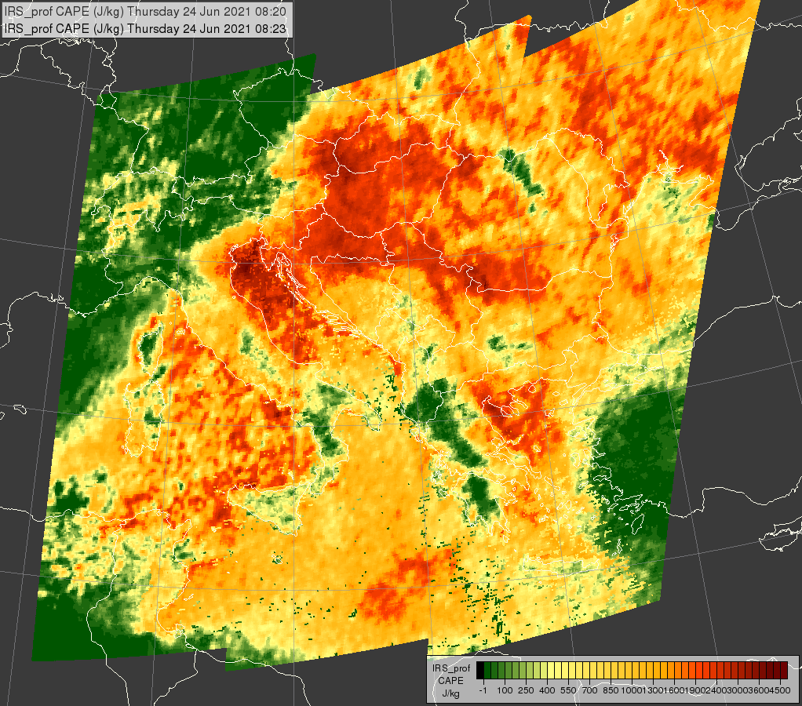
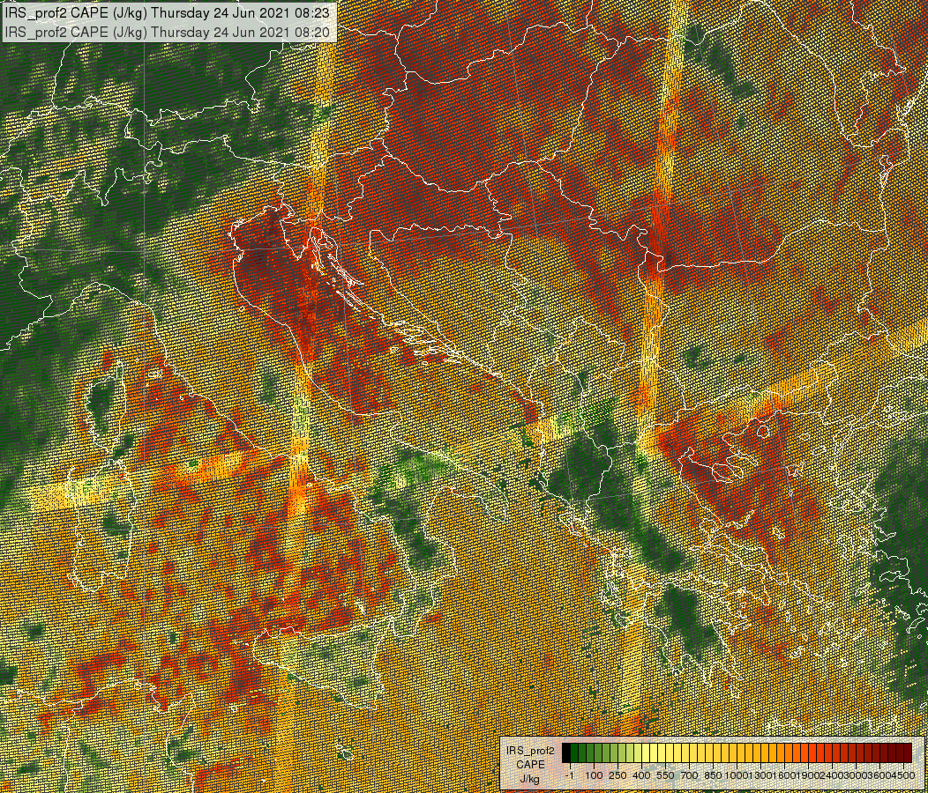
6 dwells together
Adjacent dwells partially overlap along their edges -> boundaries may be visible at the edges of the dwell images
Example of overlaping dwells, SBCAPE, 24.06.2021. 08:20-23 UTC.

Slide 7
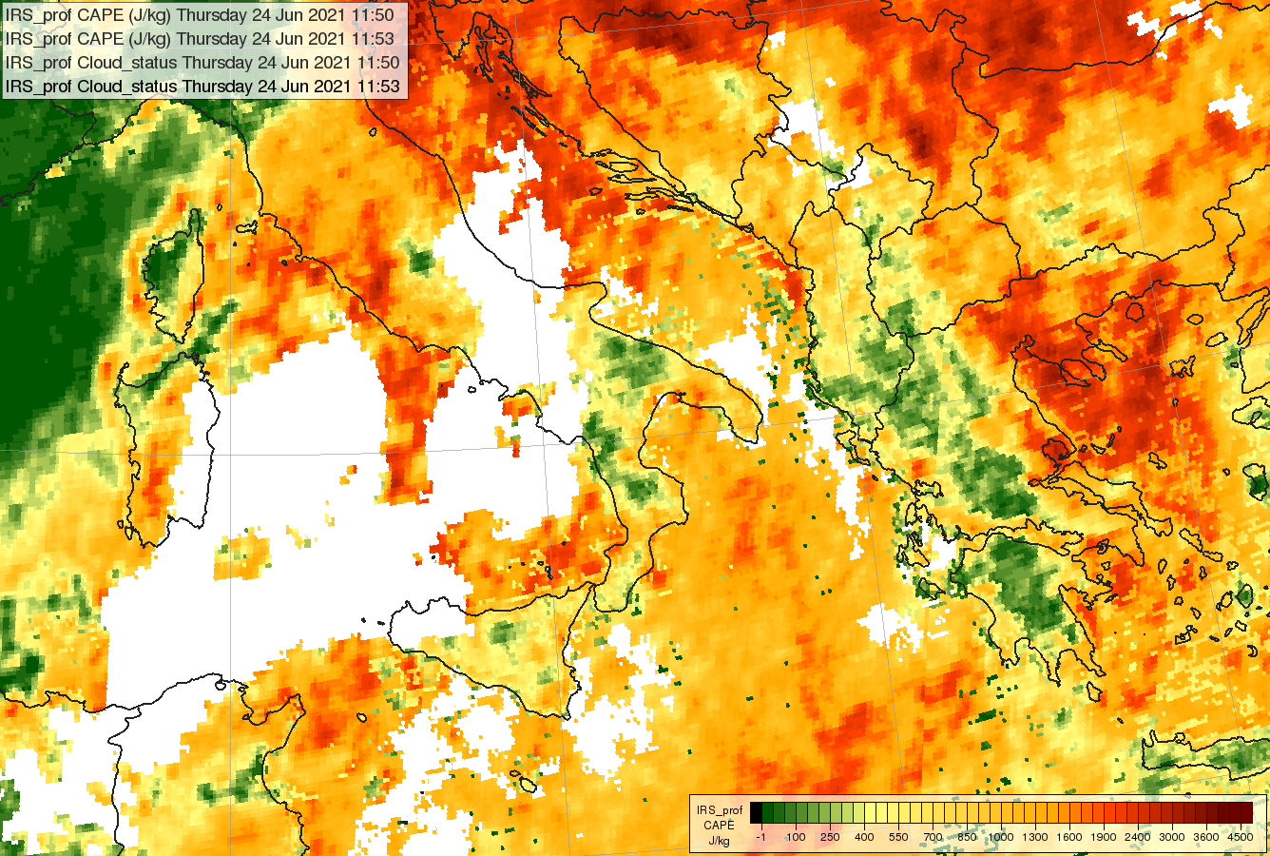
What about the clouds?
Example of cloudy areas completely masked.

Slide 8
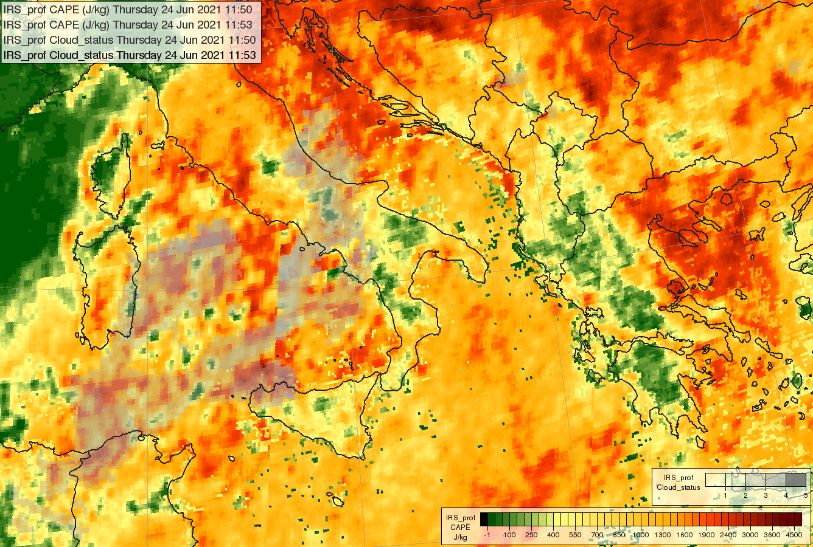
What about the clouds?
Example of cloudy areas shaded according to cloud contamination.

Slide 9
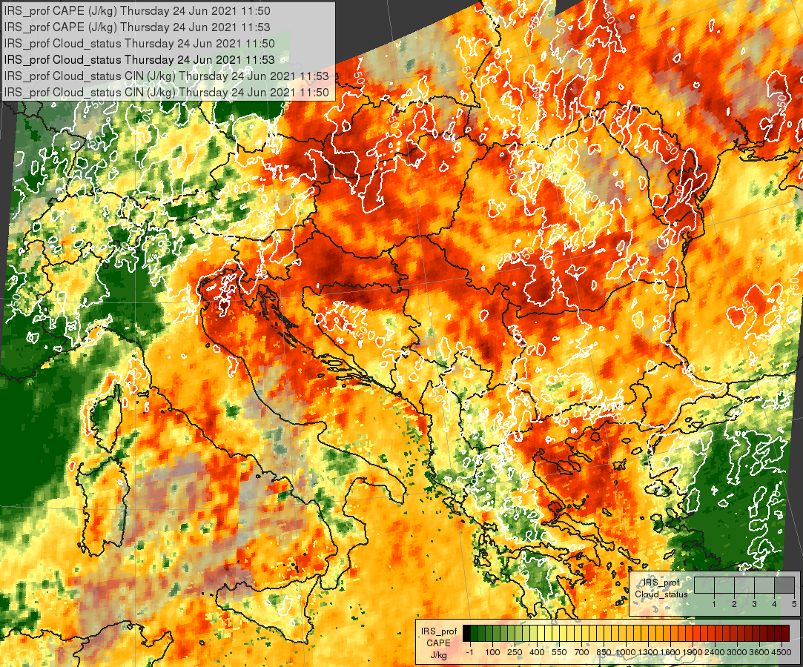
Overlaying several fields
SBCAPE with CIN and cloud contamination

Slide 10
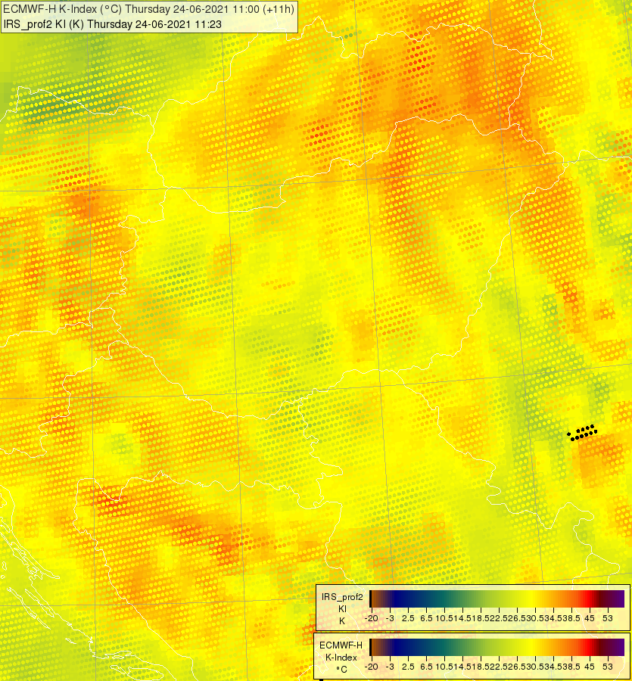
Visualization of variables with NWP data
IRS K-Index overlaid on top of ECMWF K-Index

Slide 11
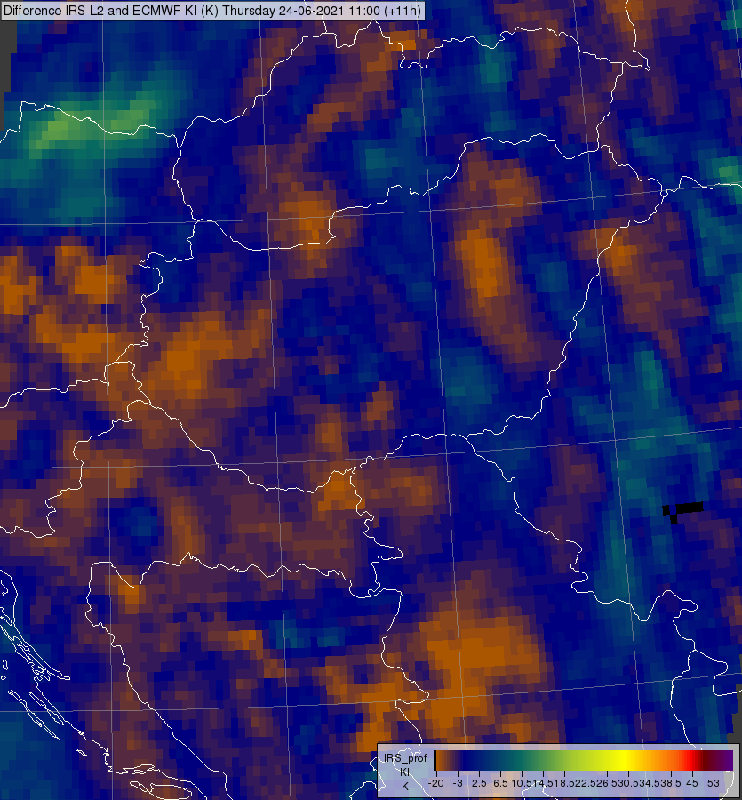
Visualization of variables with NWP data
Difference between IRS and ECMWF K-Index

Slide 12
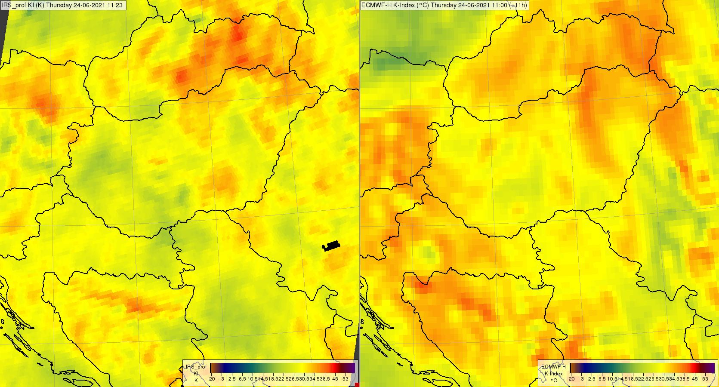
Visualization of variables with NWP data
IRS K-Index 24.06.2021. 11:23 UTC (left) ECMWF K-Index valid at 11 UTC (right)

Slide 13
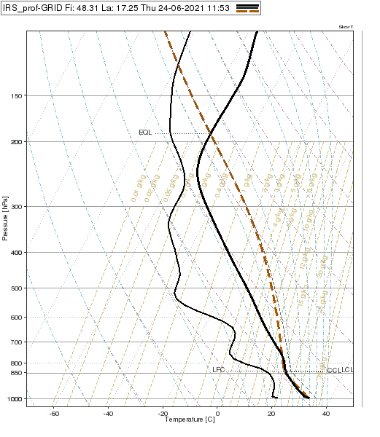
Visualization of 3D variables
Example of a Skew-t diagram

Slide 14
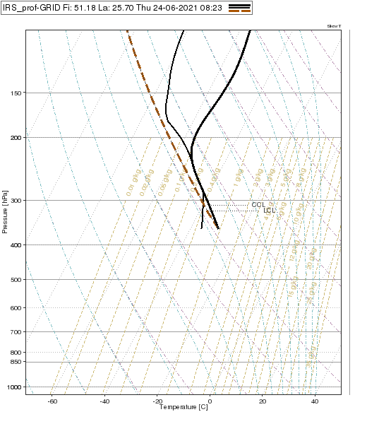
Visualization of 3D variables
Example of a masked profile below clouds

Slide 15
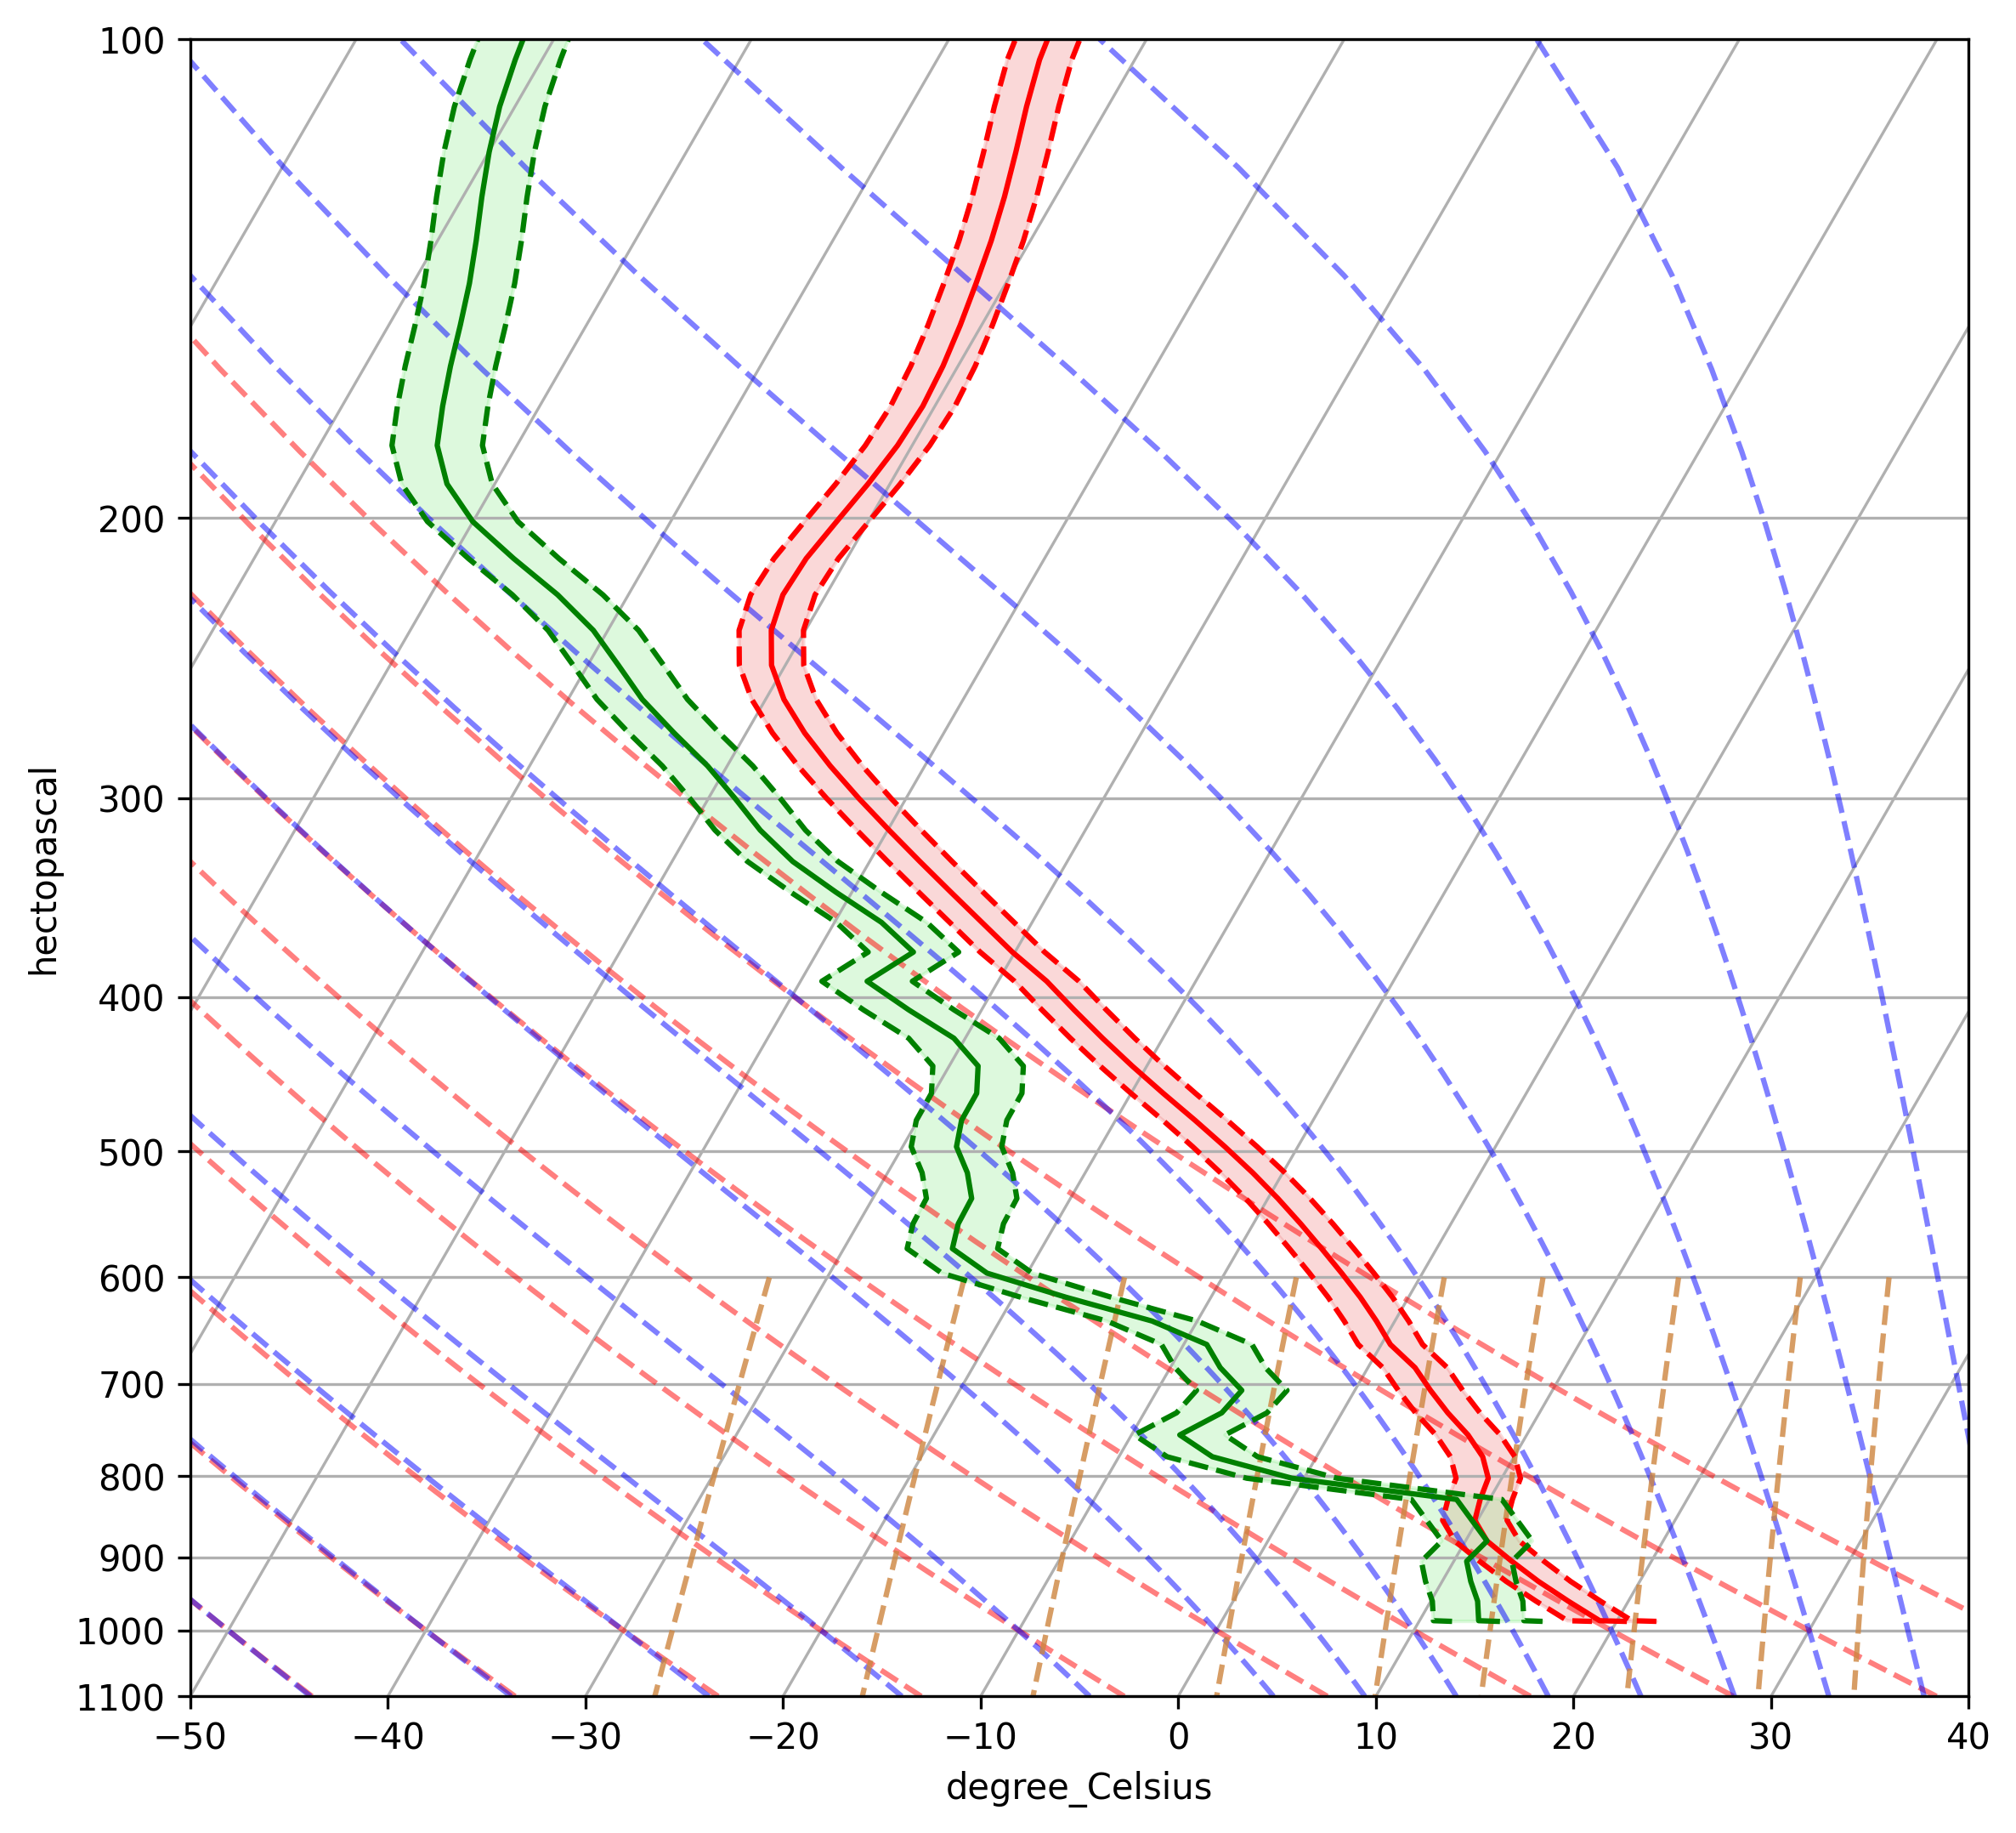
Visualization of 3D variables
Example of including costant error

Slide 16
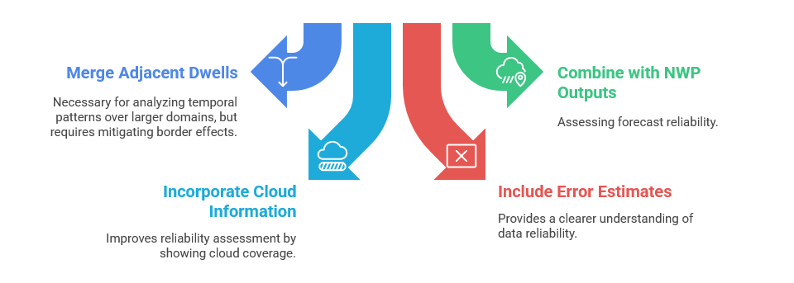
Conclusions

Slide 17
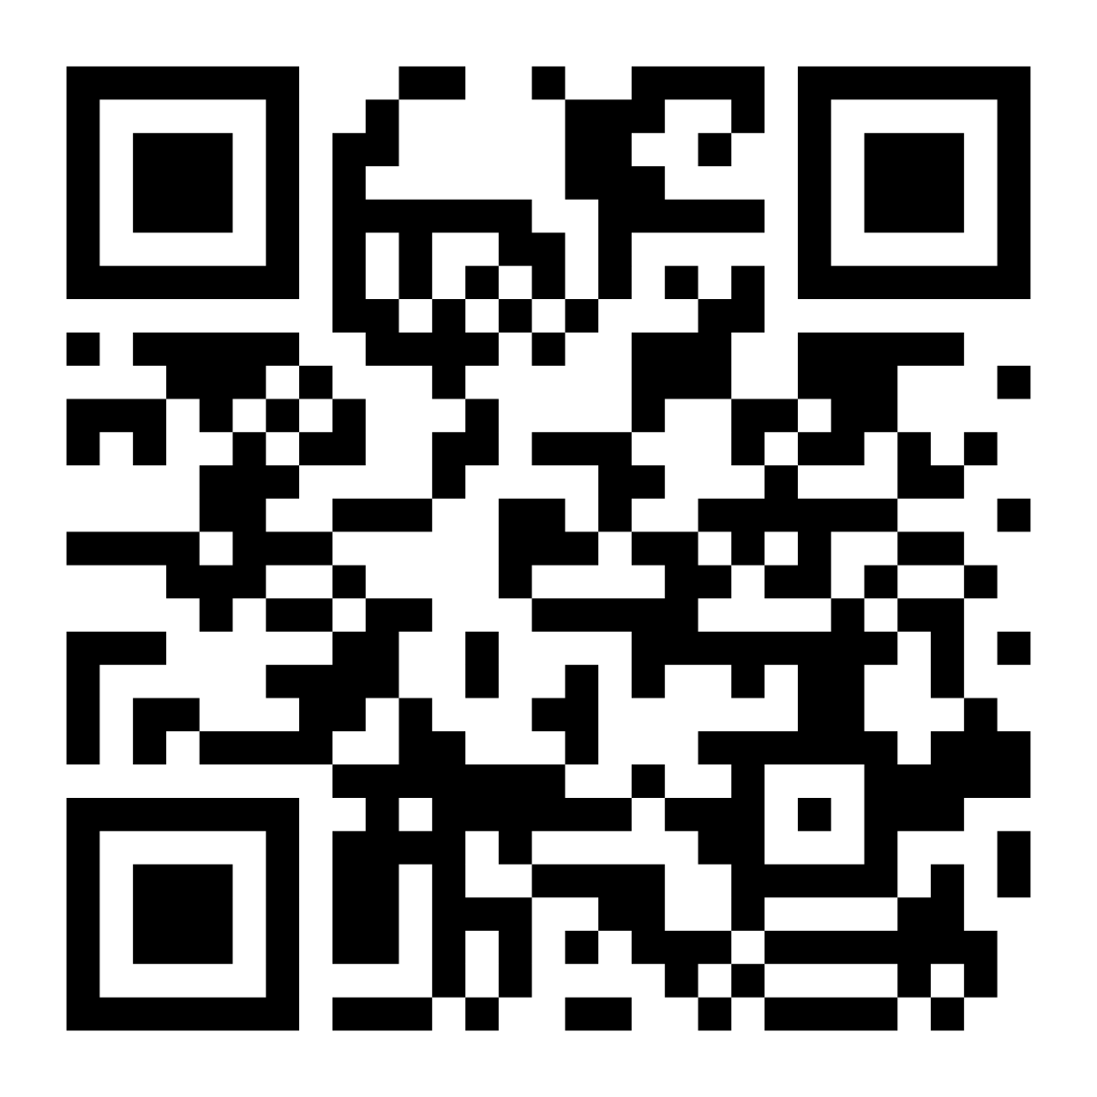
Thank you for your attention! Questions?
Feel free to fill out our questionnaire regarding visualization of IRS L2 test data.

