Slide 1
Assimilation of MTG data at ECMWF
Current usage and future plans
Chris Burrows
Thanks to:
Philippe Lopez (LI)
Ethel Villeneuve (FCI radiances)
Francis Warrick (FCI AMVs)
EUMeTrain MTG Event Week

Slide 2
Introduction
ECMWF has assimilated radiance and wind data from SEVIRI for many years. So FCI provides continuity, with improvements.
We also use hyperspectral IR data from IASI etc. So the assimilation of IRS will be based on this.
Lightning data assimilation is a much more original activity, but the plan is to assimilate data from LI.
An area of active development is the assimilation of visible data from FCI.

Slide 3
Contents.
FCI radiances
FCI Atmospheric Motion Vectors (AMVs)
LI Lightning data
IRS

Slide 4
MTG-I FCI radiances (All Sky Radiance, ASR product) Thanks to Ethel Villeneuve

Slide 5
Meteosat-12 FCI Allsky Radiances (ASR) product
Regridded and averaged product using FCI L1c 16x16 pixels (resolution ~32 km (IR) at nadir).
1 ASR every 10 minutes.
Contains averaged brightness temperature for all channels and cloud information for each pixel used.
BT for each sky situation (clear-sky, all-sky, presence of low, mid or high clouds).
ESAS update seminar: Assimilation of MTG-I observations

Slide 6
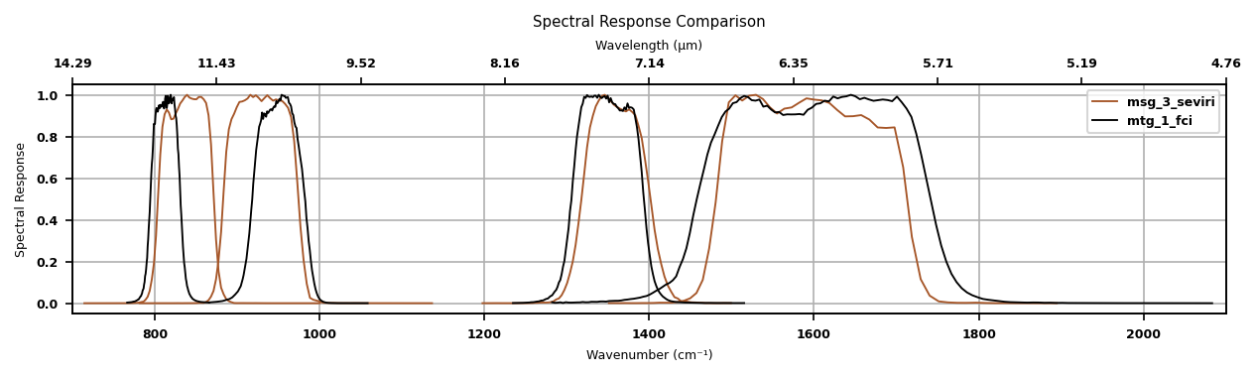
Transition from SEVIRI to FCI
Used data based on what is used for the current SEVIRIs
Central wavelength (bandwidth) in microns of each (used) channel from MSG-SEVIRI and MTG-FCI
- Clear-sky brightness temperature, only FoR where the statistics are computed with more than 70% of the pixels (WV) and more than 95% of the pixels (Window) to ensure significant statistics used.
- 1 observation per hour.
- Thinning to 75 km.
- Observation errors based on those of SEVIRI.
Channel | MSG-SEVIRI | MTG-FCI
WV upper-tropo | 6.25 (0.9) | 6.3 (1.0)
WV mid-tropo | 7.35 (0.5) | 7.35 (0.5)
Window | 10.8 (1.0) | 10.5 (0.7)
ESAS update seminar: Assimilation of MTG-I observations

Slide 7
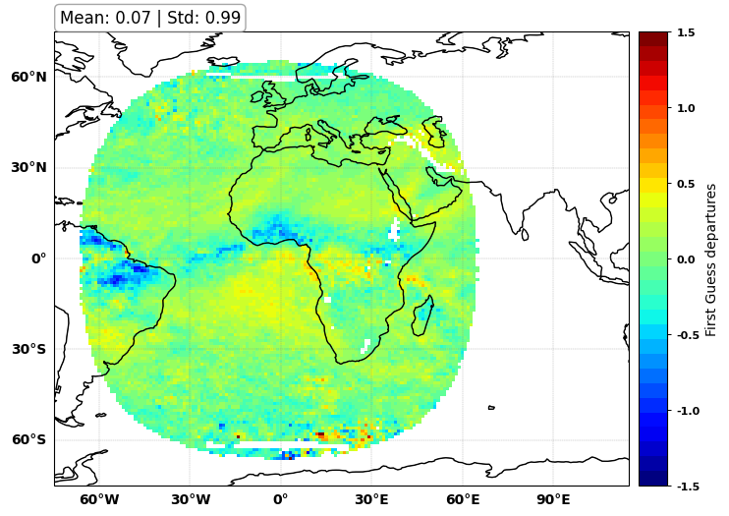
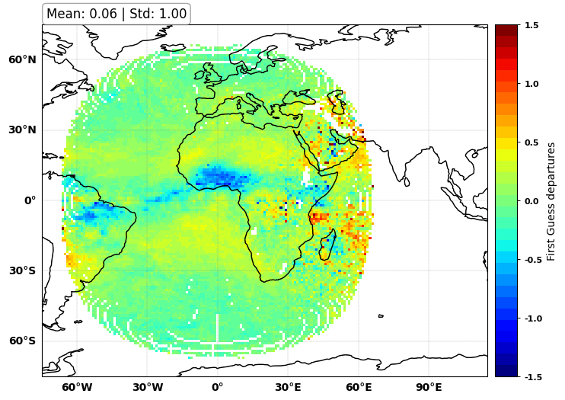
MTG-FCI TO REPLACE MSG-SEVIRI: assimilation
Transitioning from MET-10 SEVIRI to MET-12 FCI:
L2 products declared operational in November 2025.
Keep monitoring to ensure the product quality is stable and as expected / SEVIRI remains the operational Meteosat 0° imager.
Assimilation experiments with pre-operational datasets.
Assessment of observation errors, assessment of impact when FCI replaces SEVIRI (same thinning, same data selection).
Similar quality and impact on forecasts
MET-12 FCI
MET-10 SEVIRI
Mean first guess departures, water vapour channel 6.3 (6.2) μm
MTG-FCI (left) and MSG-SEVIRI (right) – 20250308 to 20250508

Slide 8
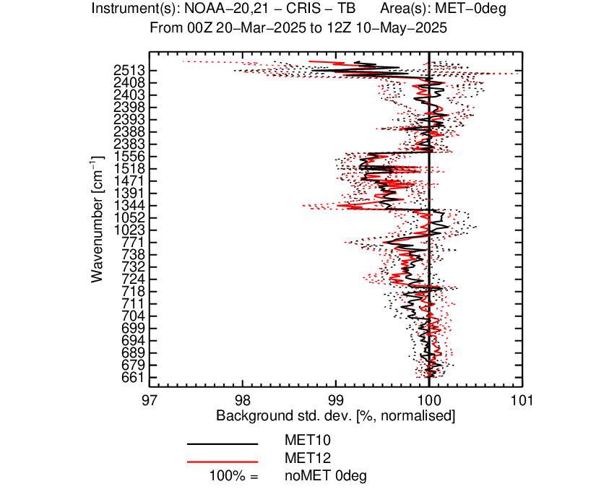
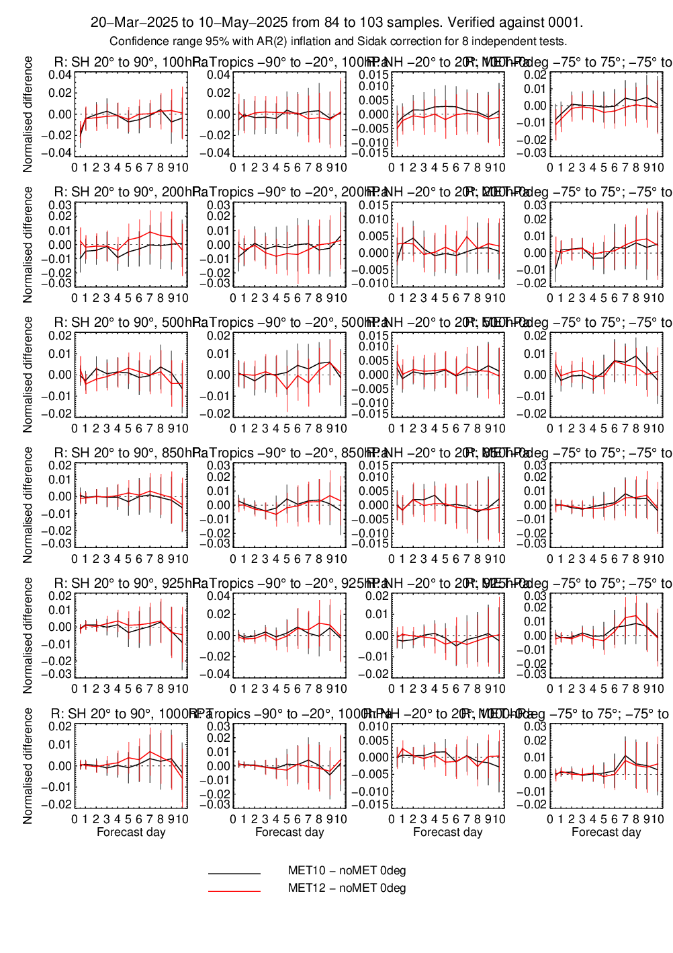
Assimilation performances in the IFS
Both the verification against independent observations and the forecast scores show similar impact when MTG-FCI replaces SEVIRI as the Meteosat 0° satellite.
The impact of FCI may improve in the future with the operational release of the Level-2 product (planned for September 2025) and further optimisation in the IFS, such as refined observation errors and inter-channel correlation for the two water vapour channels.
ESAS update seminar: Assimilation of MTG-I observations

Slide 9
MTG-FCI ASR radiances in IFS. Timeline.
24 Sept. 2024: Test of pre-operational products
04 March 2025: Monitoring of pre-operational ASR in IFS
11 Nov. 2025: Level-2 products declared operational
MTG-FCI assimilated operationally in IFS to replace MSG-3 SEVIRI
20 Nov. 2025:

Slide 10
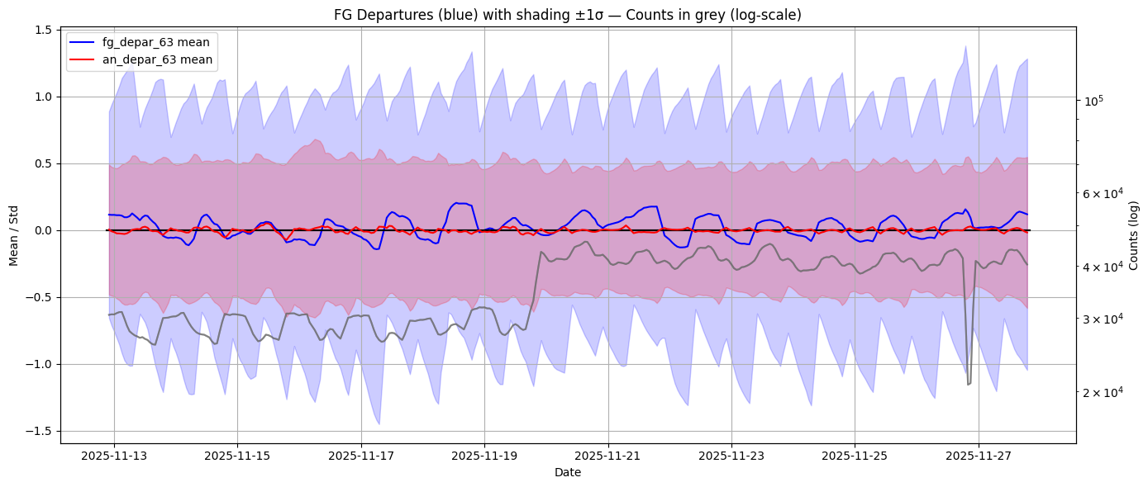
Data events – Geostationary satellites | FCI radiances
Meteosat-12 FCI ASR active
Meteosat-10 ASR passive
Meteosat-12 FCI ASR pre-operational product have been passively monitored in operations since March 2025.
EUMETSAT declared the FCI Level-2 products operational on 11 November.
20 November: FCI ASR products activated in operations to replace Meteosat-10 SEVIRI as the Meteosat 0° mission 🥳
Meteosat-10 remains in passive monitoring while it is still disseminated as parallel back-up to MET12-FCI.
No significant impact on forecasts in the IFS as FCI is pretty similar to SEVIRI previously used.
September
October
November
December
FCI
SEVIRI
Departures statistics: SEVIRI WV 6.2μm until 20 Nov. and FCI WV 6.3μm from 20 Nov. onwards
02/24

Slide 11
MTG-I FCI Winds (Atmospheric Motion Vector, AMV product) Thanks to Francis Warrick

Slide 12
Meteosat Second Generation vs Meteosat Third Generation Overview of Differences in the AMV Wind Product
 | MSG | MTG
Number of Images in Sequence | 4 | 3
Image Time Separation | 15 minutes | 10 minutes
Target Size | 24 pixels | 16 pixels
Pixel Size | Thermal: 3km Visible: 1km | Thermal: 2km Visible: 1km
Height Assignment Method | CLA | OCA
Channels | Infrared Window 10.8 Water Vapour 6.3 Water Vapour 7.3 Visible 0.8 | Infrared Window 10.5 Water Vapour 6.3 Water Vapour 7.3 Visible 0.8 Infrared 3.8
Notes:
4 IMAGES TO 3 and no averaging, just one vector and one subvector for quality control, this plus image separation plus target size change means it’s now quite a different scale of tracking.

Slide 13
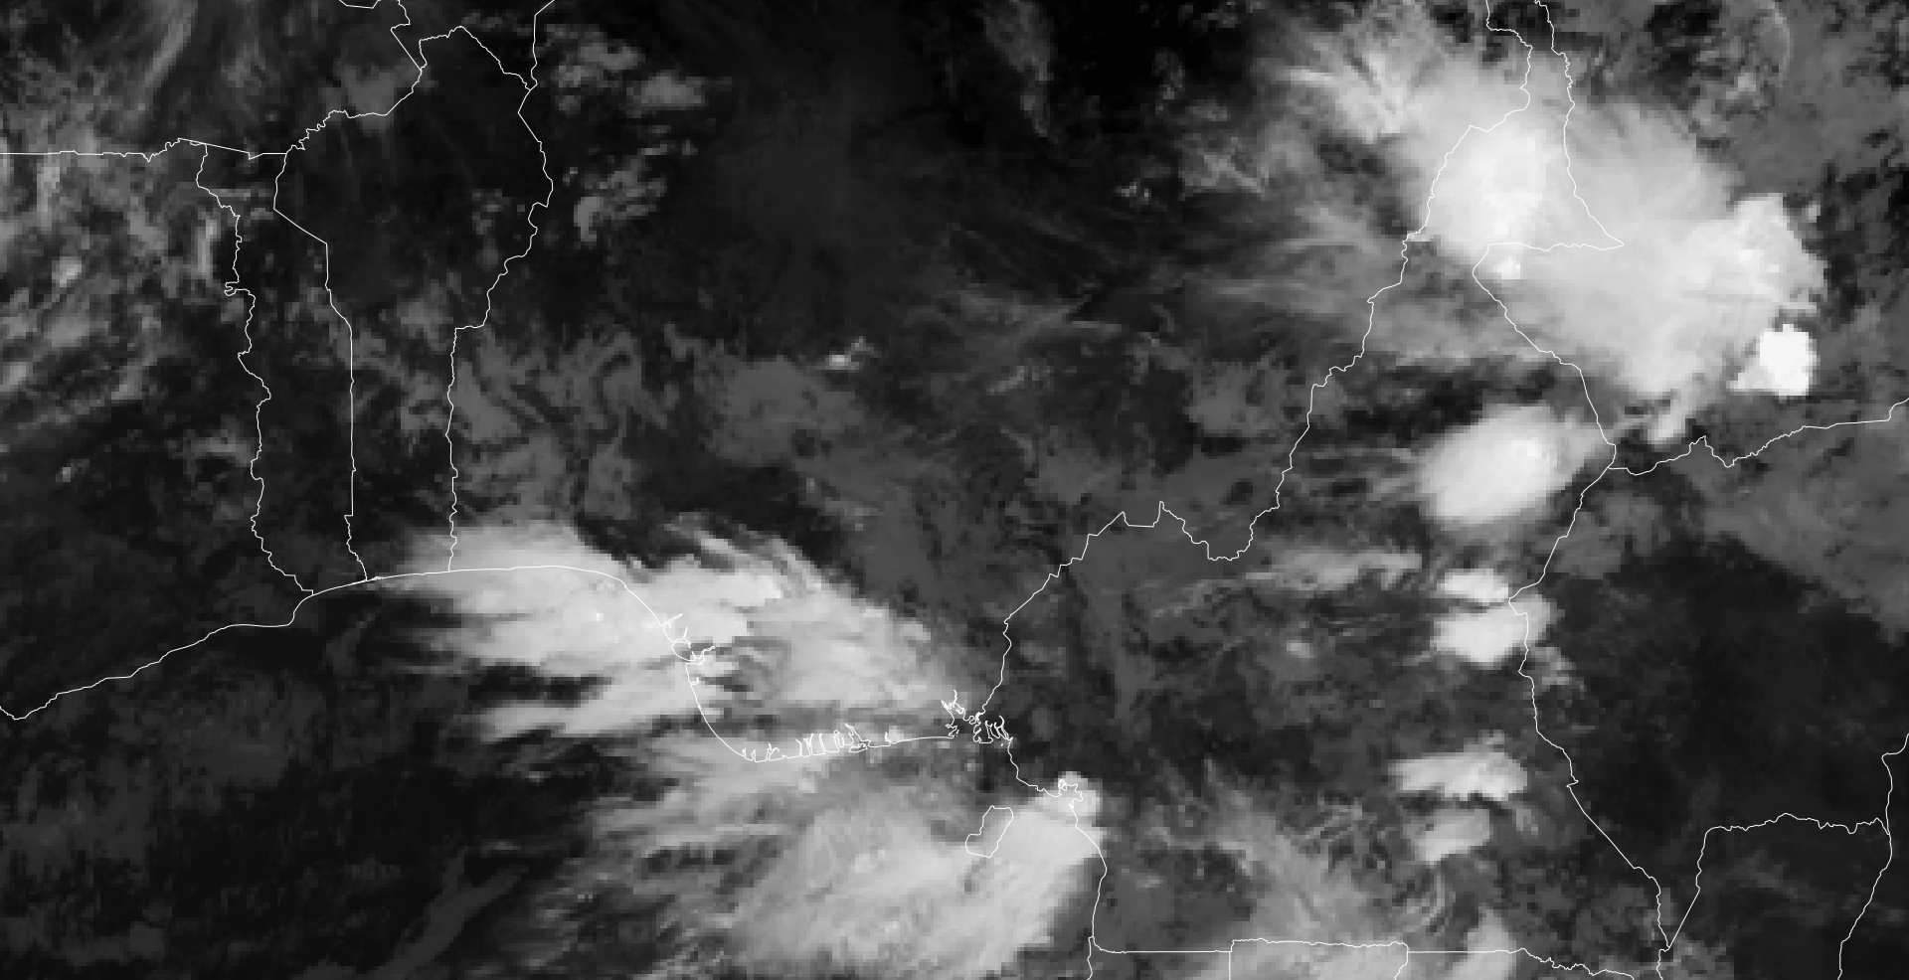
0830 UTC 3/7/25

Slide 14
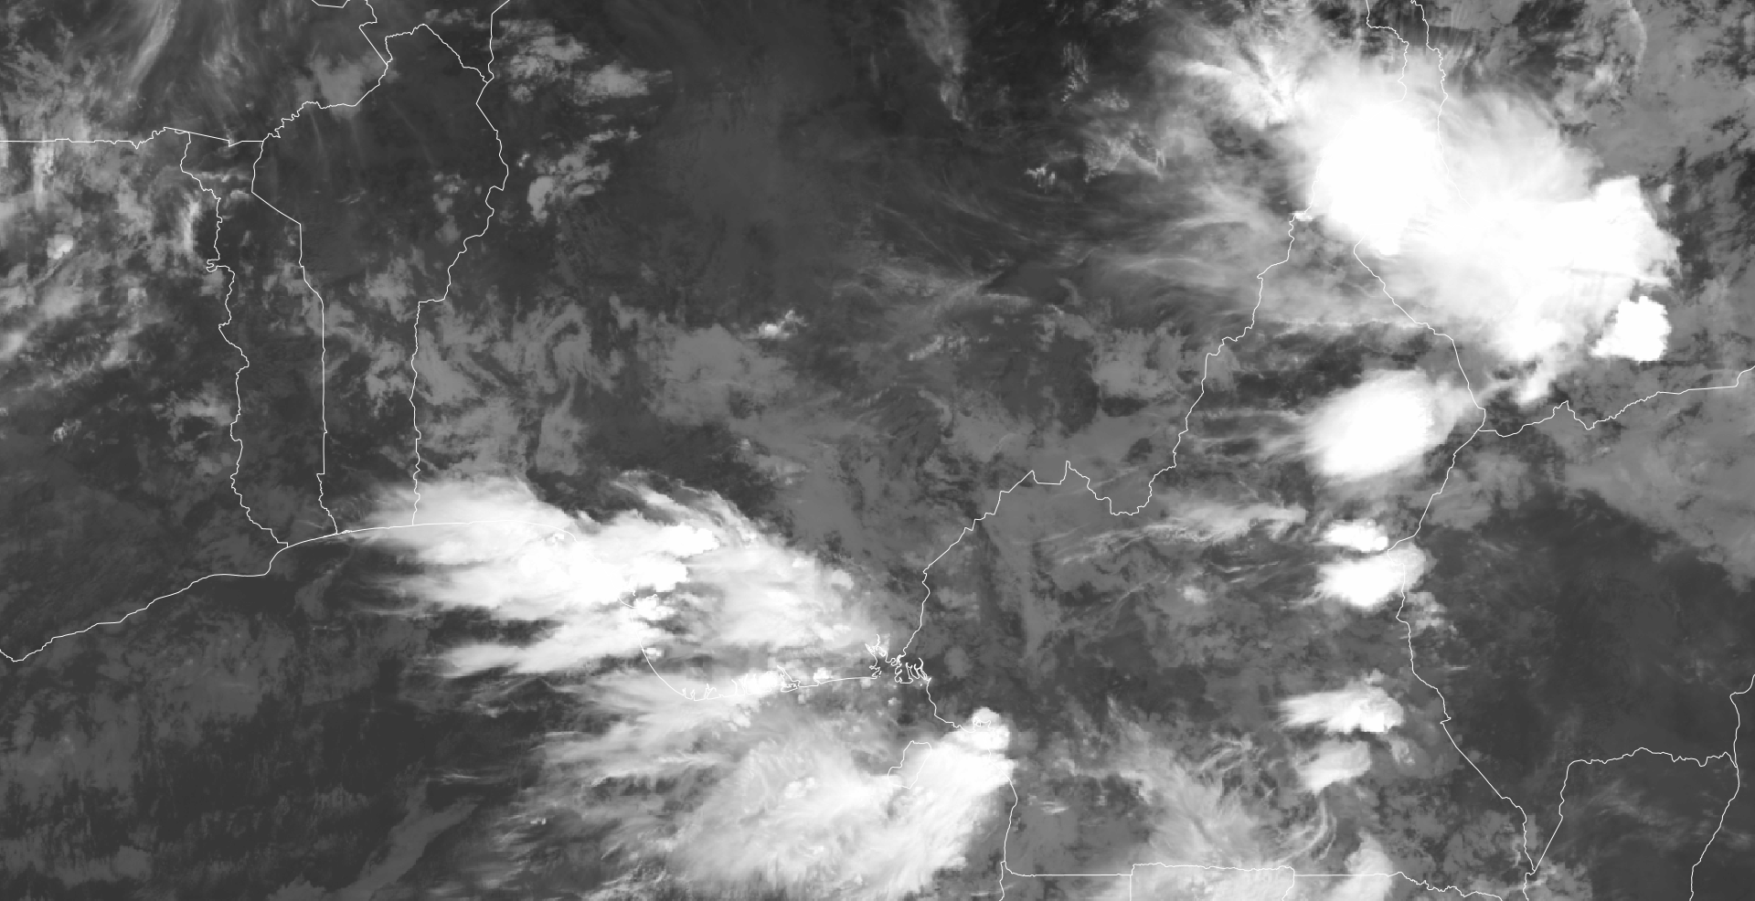
0830 UTC 3/7/25

Slide 15
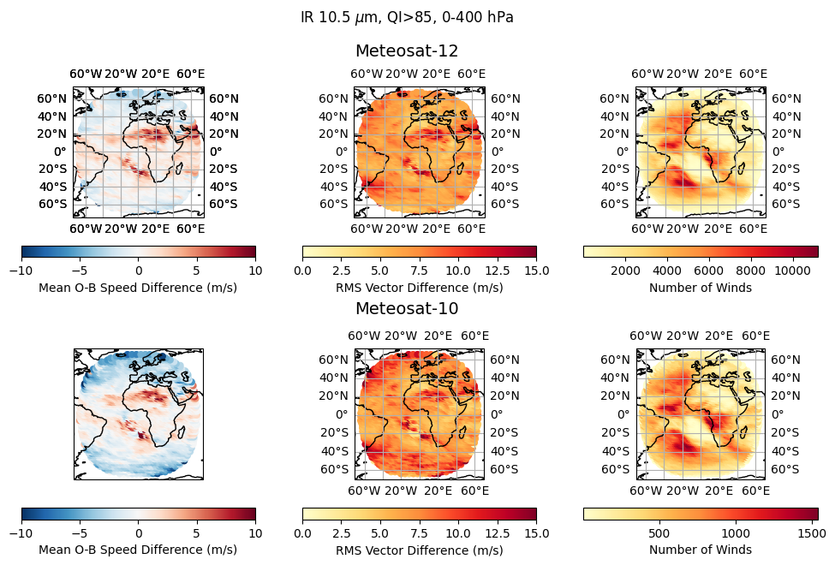
AMVs from Meteosat Third Generation
Reductions in O-Bs in extratropics, possibly linked to OCA
Notes:
Point out clearly that top row is MTG, bottom row is MSG

Slide 16
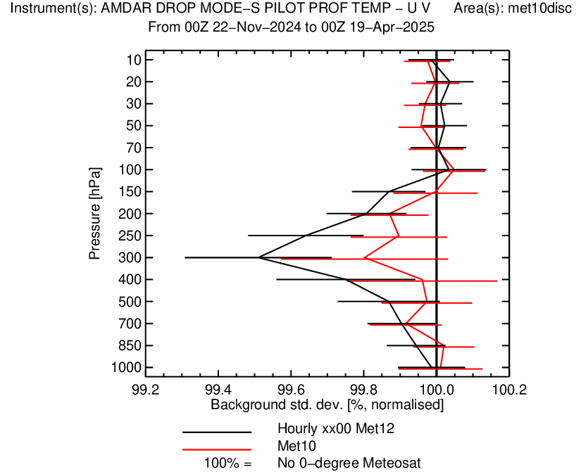
Winds from FCI: Atmospheric Motion Vectors
Quality (from background departures) similar to MSG AMVs, average wind speed slightly higher
Data volume increase ~8x due to smaller pixel size and more frequent imagery, but also the derivation scheme has changed to look for smaller cloud features
FCI AMVs available half-hourly, but hourly assimilation gave better results, likely that temporal error correlations too strong at half-hourly
Quality control kept the same as MSG, including 200km spatial thinning, rejecting over land between 500hPa and the surface.
Research ongoing to see whether revised quality control can get a benefit from this channel’s AMVs
Data received since November 2024, monitored since March 2025, assimilation began in June 2025.

Slide 17
MTG-I LI Lightning data Thanks to Philippe Lopez

Slide 18
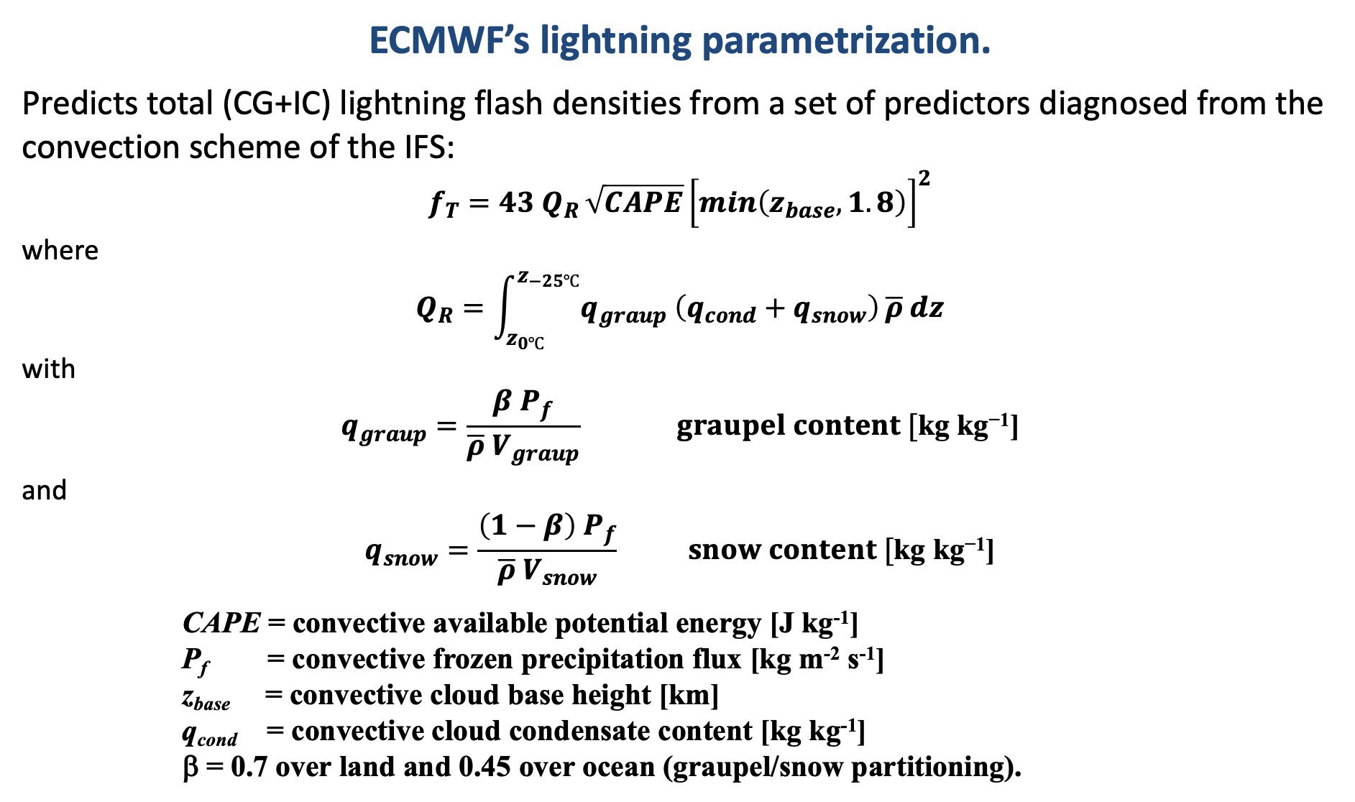
ECMWF’s lightning parametrization.
Predicts total (CG+IC) lightning flash densities from a set of predictors diagnosed from the convection scheme of the IFS:
$$f_{T}=43{ Q}_{R }\sqrt{CAPE}{\left[\min_{}\left(z_{base}, 1.8\right)\right]}^{2}$$
where
$$Q_{R}=\int_{z_{0℃}}^{z_{−25℃}}{q_{graup} \left(q_{cond}+q_{snow}\right)}\overline{ρ} dz$$
with
$$q_{graup}=\frac{{β P}_{f}}{\overline{ρ}{ V}_{graup}} graupel content [\text{kg} \text{kg}\text{−1}\text{]}$$
and
$$q_{snow}=\frac{{\left(1−β\right) P}_{f}}{\overline{ρ}{ V}_{snow}} snow content [\text{kg} \text{kg}\text{−1}\text{]}$$
CAPE = convective available potential energy [J kg⁻¹]
P_{f} = convective frozen precipitation flux [kg m⁻² s⁻¹]
z_{base} = convective cloud base height [km]
q_{cond} = convective cloud condensate content [kg kg⁻¹]
β = 0.7 over land and 0.45 over ocean (graupel/snow partitioning).
Proxy for charging rate
(collisions btw. hydrometeors)
graupel fall velocity set to 3.0 m s⁻¹
snow fall velocity set to 0.5 m s⁻¹
Proxy for updraft strength
Proxy for updraft width
Lopez 2016, MWR

Slide 19
Assimilation method (for both MTG LI and GOES GLM).
Method:
- Direct global 4D-Var DA (like all other observations already assimilated in ECMWF’s IFS).
- 6 or 12-hour assimilation window (every 6 or 12 hours, respectively).
- In-house quality control of MTG LI and GOES GLM data is applied before assimilation.
- Flash detection efficiency is assumed to vary between 70 and 88% (day/night).
- Parallax correction is applied to each flash geolocation.
- Optional bias correction.
Quantity to be assimilated:
- Observed lightning flash densities as derived from L2 flash data.
- Simulated lightning flash densities from IFS using Lopez (2016).
- Averaged over 6 hours (to reduce effects of non-linearities).
- Log transform applied before assimilation (obs – model departures closer to Gaussian).
All code developments will be available in the next operational version of IFS (early 2026).

Slide 20
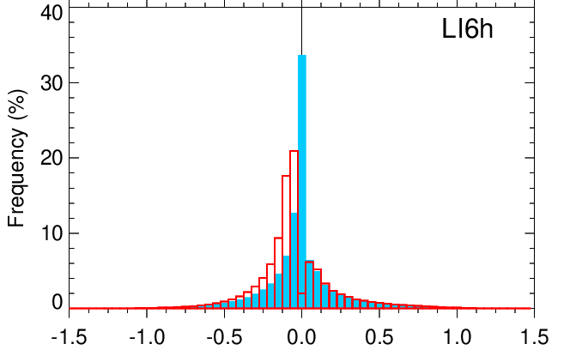
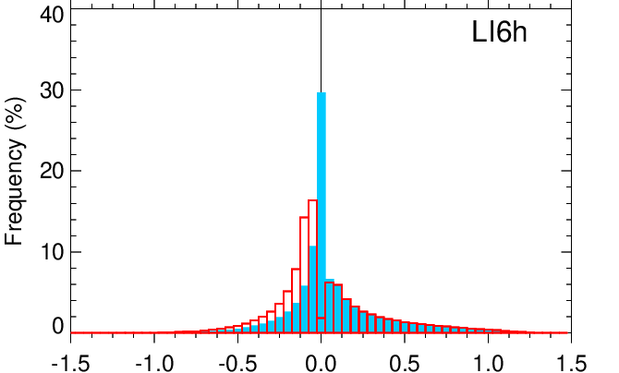
Lightning statistics before and after assimilation.
Histograms of observation−model lightning departures from a 4D-Var (28-km) experiment Period: 1 April - 2 August 2025 (lightning assimilated on top of all other available obs types).
GOES-19 GLM
MTG-I1 LI
obs < model
obs > model
obs < model
obs > model
Obs − Background (before assimilation)
Obs − Analysis (after assimilation)
Lightning departures:
After the assimilation, lightning from the model gets closer to observations.
Still an asymmetry, because the sensitivity booster is designed to make the model state
more unstable when needed, but not necessarily all the way to lightning generation.

Slide 21
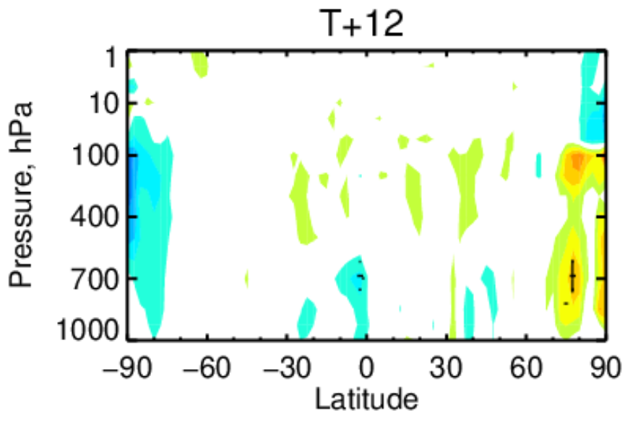
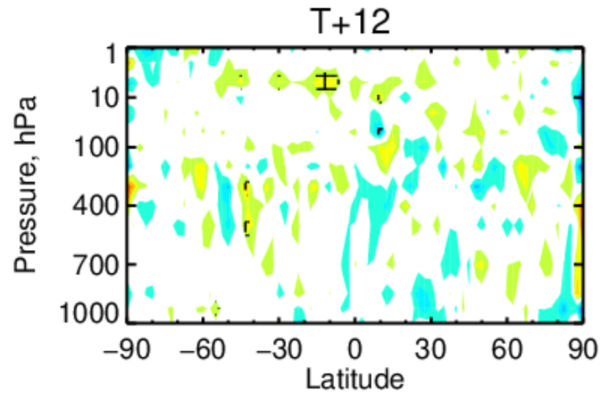
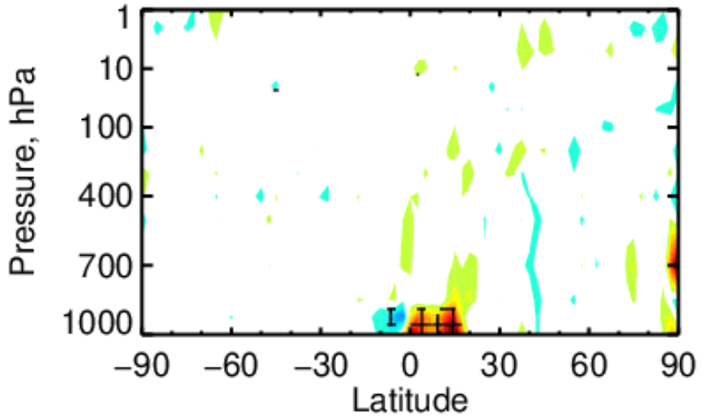
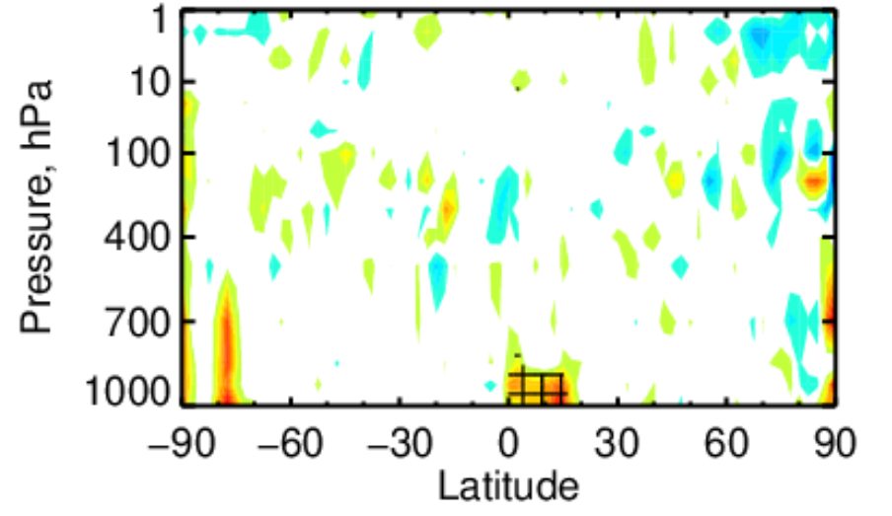

Geostationary satellite lightning assimilation: Preliminary experimentation.
12h forecast RMSE differences due to 4D-Var assimilation of GOES-16/18 GLM & MTG-I1 LI (8 Jul – 17 Aug 2024):
0.04
☹️
Geopotential
Wind vector
0.02
4D-Var using all available obs types
(28-km resol).
Zonal mean cross-sections of impact on RMSE.
0.00
Temperature
Relative Humidity
-0.02
-0.04
🙂
→ No sign of any major degradation (and still a lot of room for improvements).

Slide 22
Summary & Plans
Everything is in place for the global assimilation of geostationary satellite lightning data in
ECMWF’s 4D-Var system.
The plan is to get the assimilation of lightning data from MTG LI and GOES GLM ready for
operational implementation in early 2026.
Ongoing work to maximize impact on weather prediction:
- Tuning of the lightning sensitivity booster (zero-gradient issue in 4D-Var);
- Adjusting error statistics (esp. for observations);
- Optimizing the averaging period applied to lightning flash densities (6, 3 or 1 hour?);
- Assessing the relevance of including a bias correction.
Longer term:
- Prepare for future lightning instruments on board MTG-I2 (2026) and MTG-I3 (2032?).

Slide 23
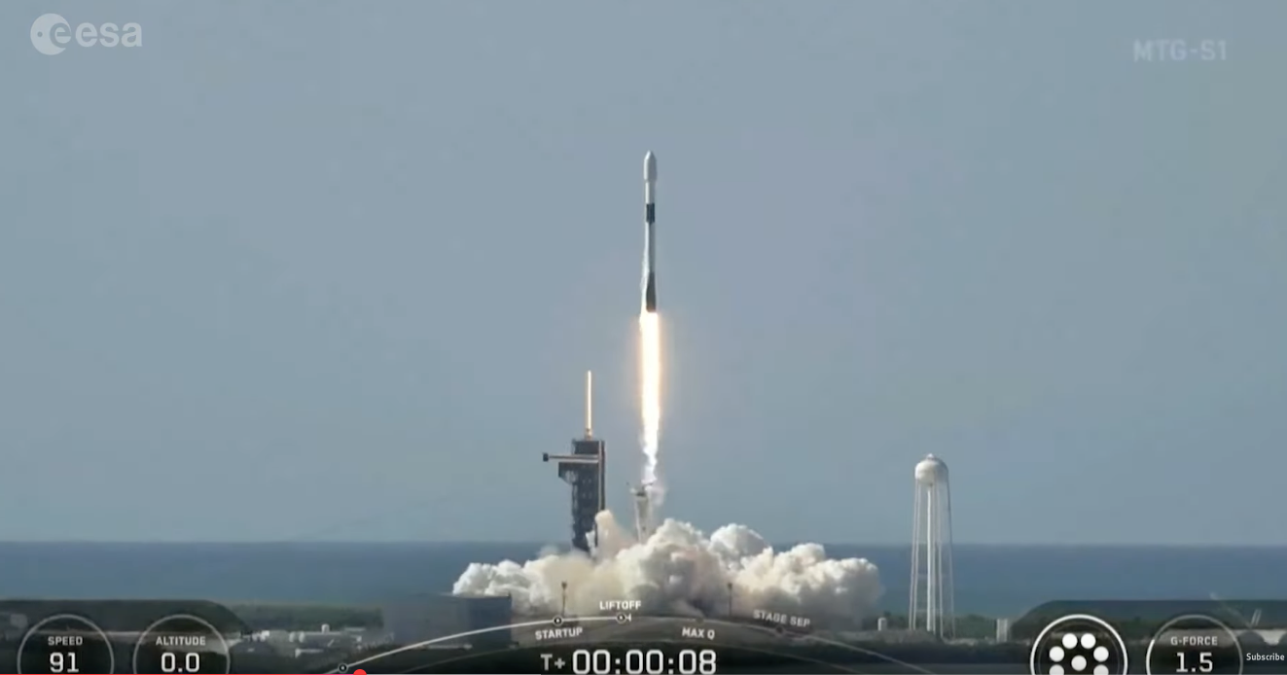

MTG-S IRS

Slide 24
Data provision
We would like to assimilate radiances, but the observations will be provided in real time as a truncated set of principal component scores.
This is a lossy compression. So, we cannot fully recover the original radiances.
To a first approximation this is ok, so we will assimilate “reconstructed radiances” from the PC scores using standard methods.
There will be approximately 340,000,000,000 radiance observations produced per day (!!!).
For context, ECMWF assimilates around 50,000,000 observations per day in total. So we will only be assimilating a small subset of the observations that are produced by the satellite.

Slide 25
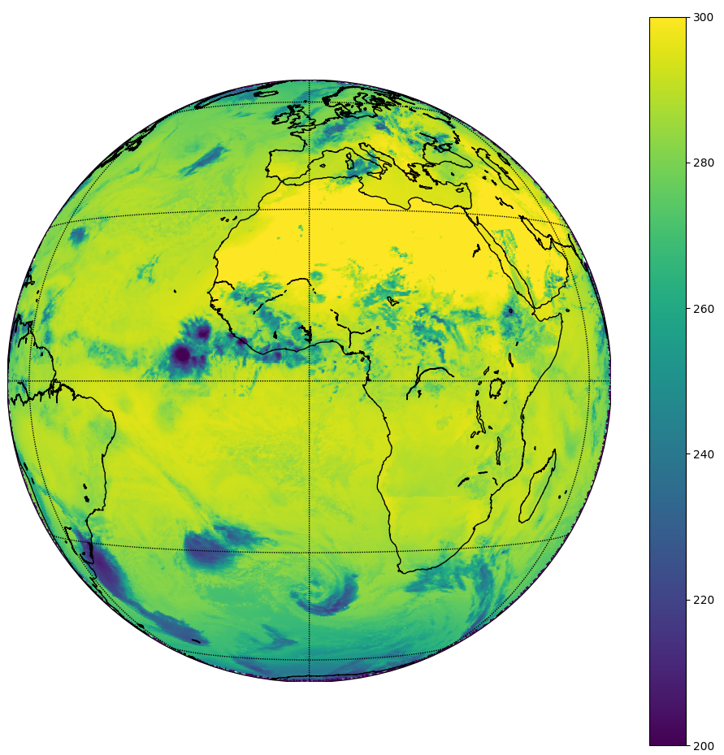
Test data set has been super helpful
All indications are that the instrument is operating very well. ☺
Good technical progress in preparation for the provision of real IRS data has been possible thanks to the test datasets.
Looking forward to getting real data.

Slide 26
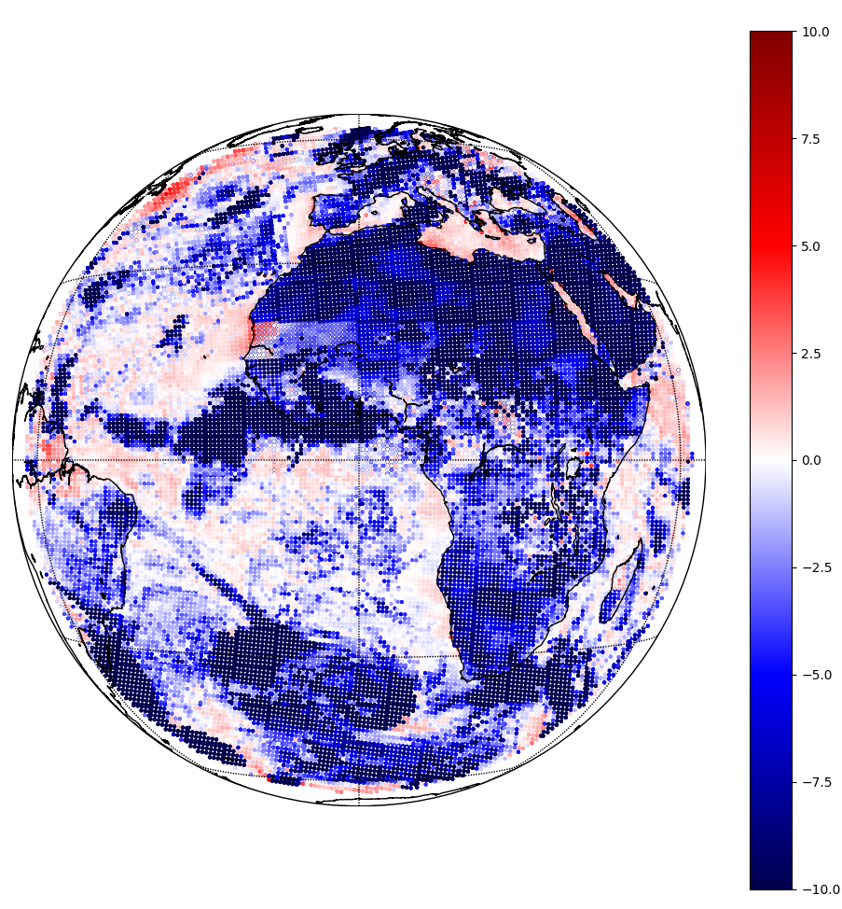
An initial methodology has been prepared in anticipation of the real data
Use IRSPP software to reconstruct radiances, apodise them and convert to BUFR.
Do conservative spatial thinning. (1 pixel in 100 retained currently).
Base channel selection and cloud detection parameters and QC on what is done already for CrIS.
Use RTTOV to simulate the radiances.
This plot shows Obs minus Model for the test data, having gone through an offline global assimilation experiment.
So, we are close to being ready for when real data arrive.

Slide 27
Finally, a preview of our plans to assimilate visible observations. Thanks to Cristina Lupu

Slide 28
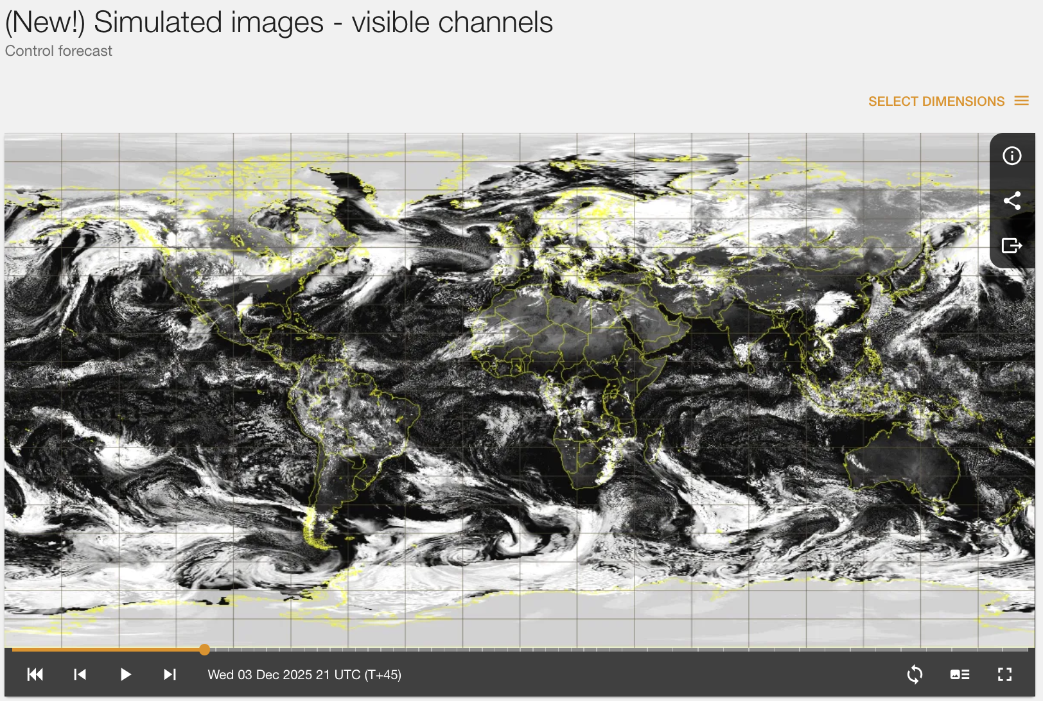
We can simulate visible reflectances using RTTOV/MFASIS The assimilation of these observations is a key research area
https://charts.ecmwf.int/products/medium-simulated-vis/

Slide 29
Summary
MTG data is already an important component of our observation usage in global NWP.
It will become even more important when IRS data become available.
NWP assimilation capabilities often lag behind detector the cutting edge of detector technology, so for example, we are still not operationally using visible radiances. But progress is being made here, and in other aspects of exploiting under-used channels etc.
Cutting edge work is being done to prepare to assimilate lightning observations from LI.

