Slide 1
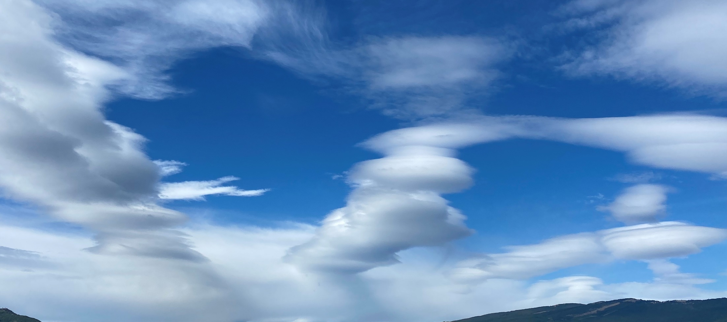
Challenges in aviation weather forecasting: the example of mountain waves
marco.stoll@meteoswiss.ch

Slide 2
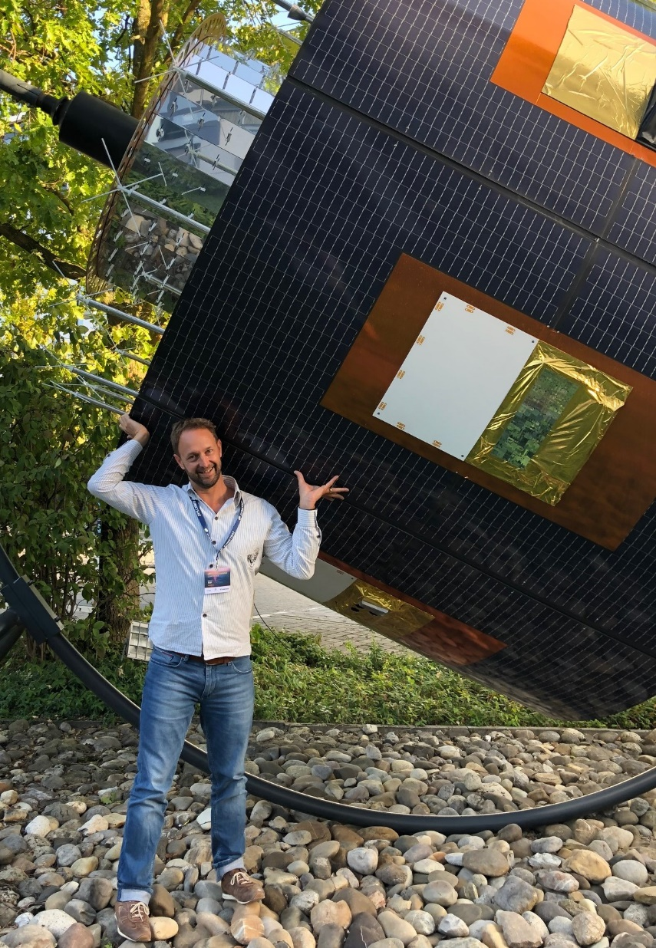
prepare slido.com
on your browser or your mobile phone for the intro quiz!
CODE: 1380185
Marco Stoll
Forecaster @ MeteoSwiss since 2005 Aviation and Public Weather Service

Slide 3
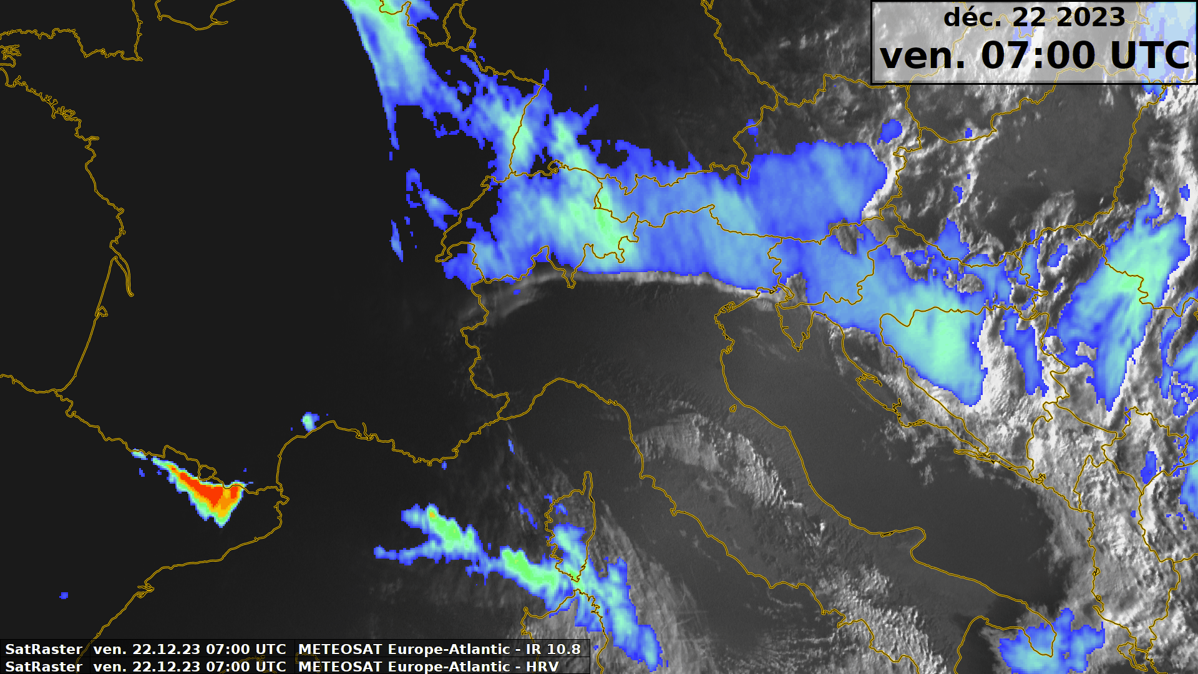
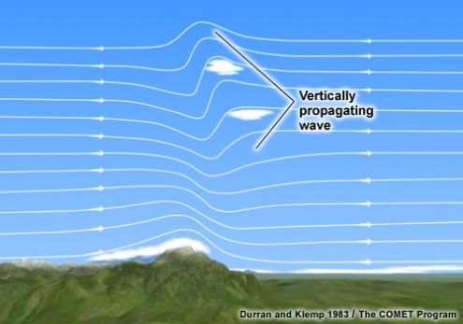
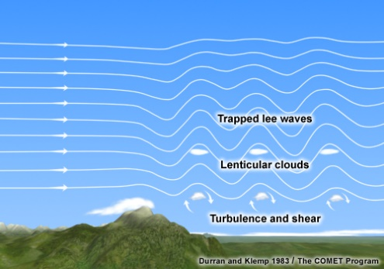
warm-up quiz code 1380185

Slide 4
warm-up quiz code 1380185
Where do we see TRAPPED LEE WAVES?
A
E
F
D
B
C

Slide 5
warm-up quiz code 1380185
Where do we see VERTICALLY PROPAGATING WAVES?
A
E
F
D
B
C

Slide 6
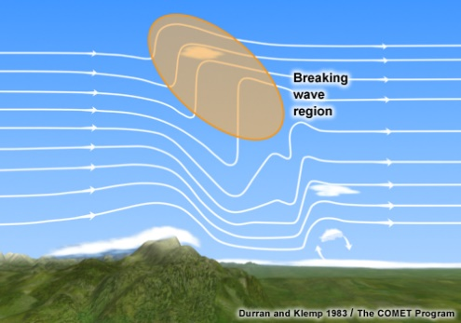
warm-up quiz code 1380185
Where do we see BREAKING WAVES?
A
E
F
D
B
C

Slide 7
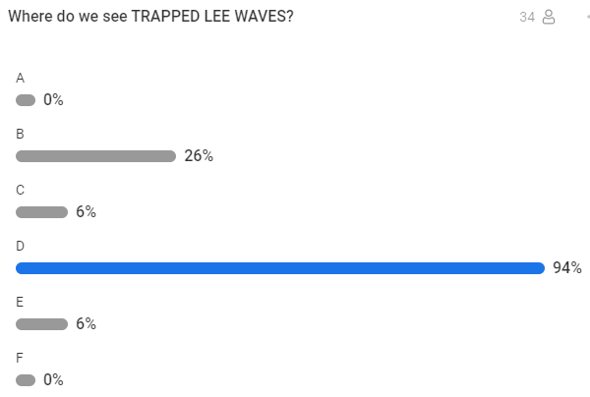
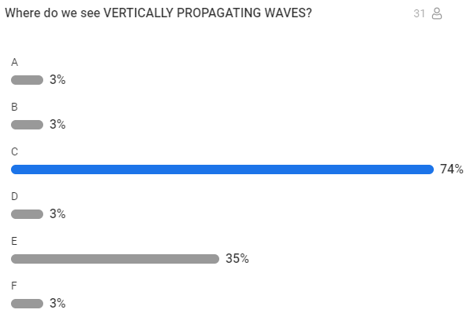
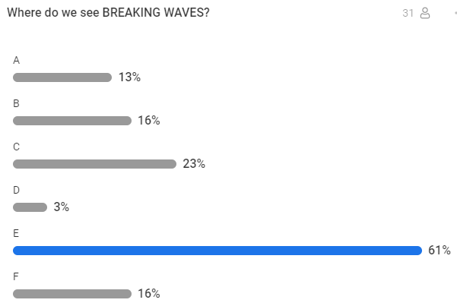
post-event slido quiz results

Slide 8
problems in aviation forecasting/warning
are there significant mountain waves?
what type of wave does form in the flow?
how strong are the up- and downdrafts?
is there a chance/risk of wave breaking to occur?

Slide 9
content of this talk
«types» of turbulence and translation into SIGMETs
the 22 dec 2023 case
synoptic overview
satellite & radar imagery
upstream sounding analysis
NWP cross sections
conclusions & outlook
questions, discussion

Slide 10
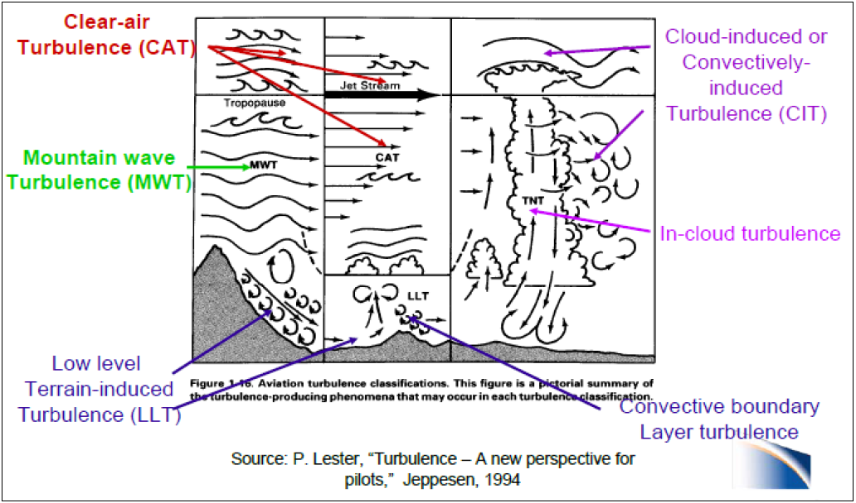
mountain waves vs turbulence
Einführung ins Thema
wave breaking, → CAT event!
resp. Axel Barleben, DWD, modified

Slide 11
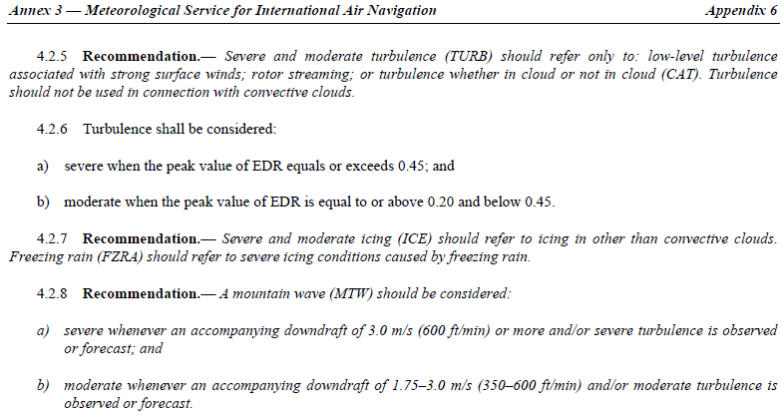
mountain waves vs turbulence
Einführung ins Thema
wave breaking, → CAT event!
TURBULENCE intensity → Eddy Dissipation Rate, EDR
MOUNTAIN WAVE Intensity → vertical speed, w (m/s)
resp. Axel Barleben, DWD, modified

Slide 12
mountain waves vs turbulence
Vertically stacked SIGMET structure:
wave breaking regime near tropopause, treated as an «ON/OFF feature»
(vertically propagating) mountain waves, laminar, significantly exceeding ICAO threshold of 3 ms⁻¹ for vertical speed
near surface mechanical turbulence: gusty downslope wind storm, rotors, vortex shedding, strong shear at the interface between Foehn flow and the cold pool underneath (CH/AT/DE use 10m gust speed > 70 KT at exposed mountain stations as agreed threshold)
Einführung ins Thema
SEV TURB FL360/420
wave breaking → CAT event
SEV MTW FL120/380
SEV TURB SFC/FL140

Slide 13
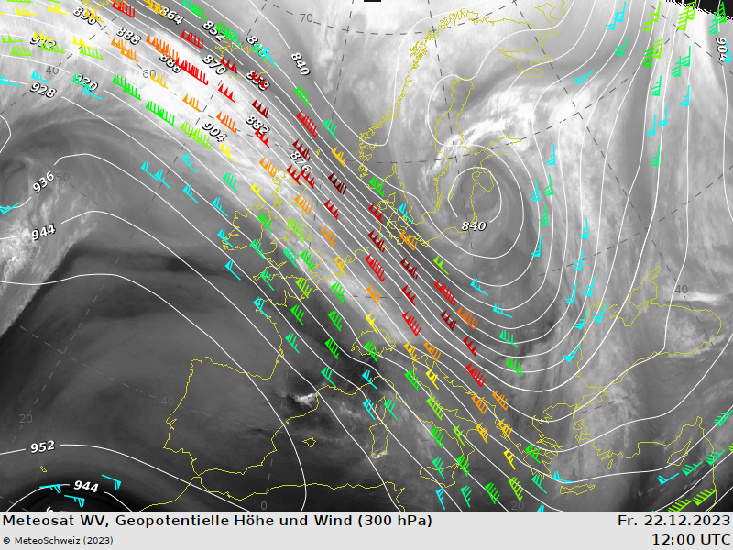
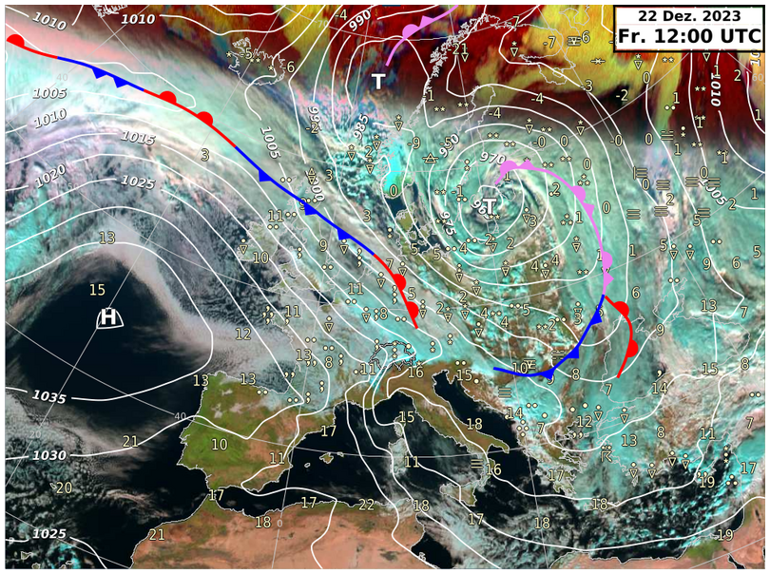
22 Dec 2023 – synoptic overview

Slide 14
22 Dec 2023 – HRV/IR10.8 sandwich

Slide 15
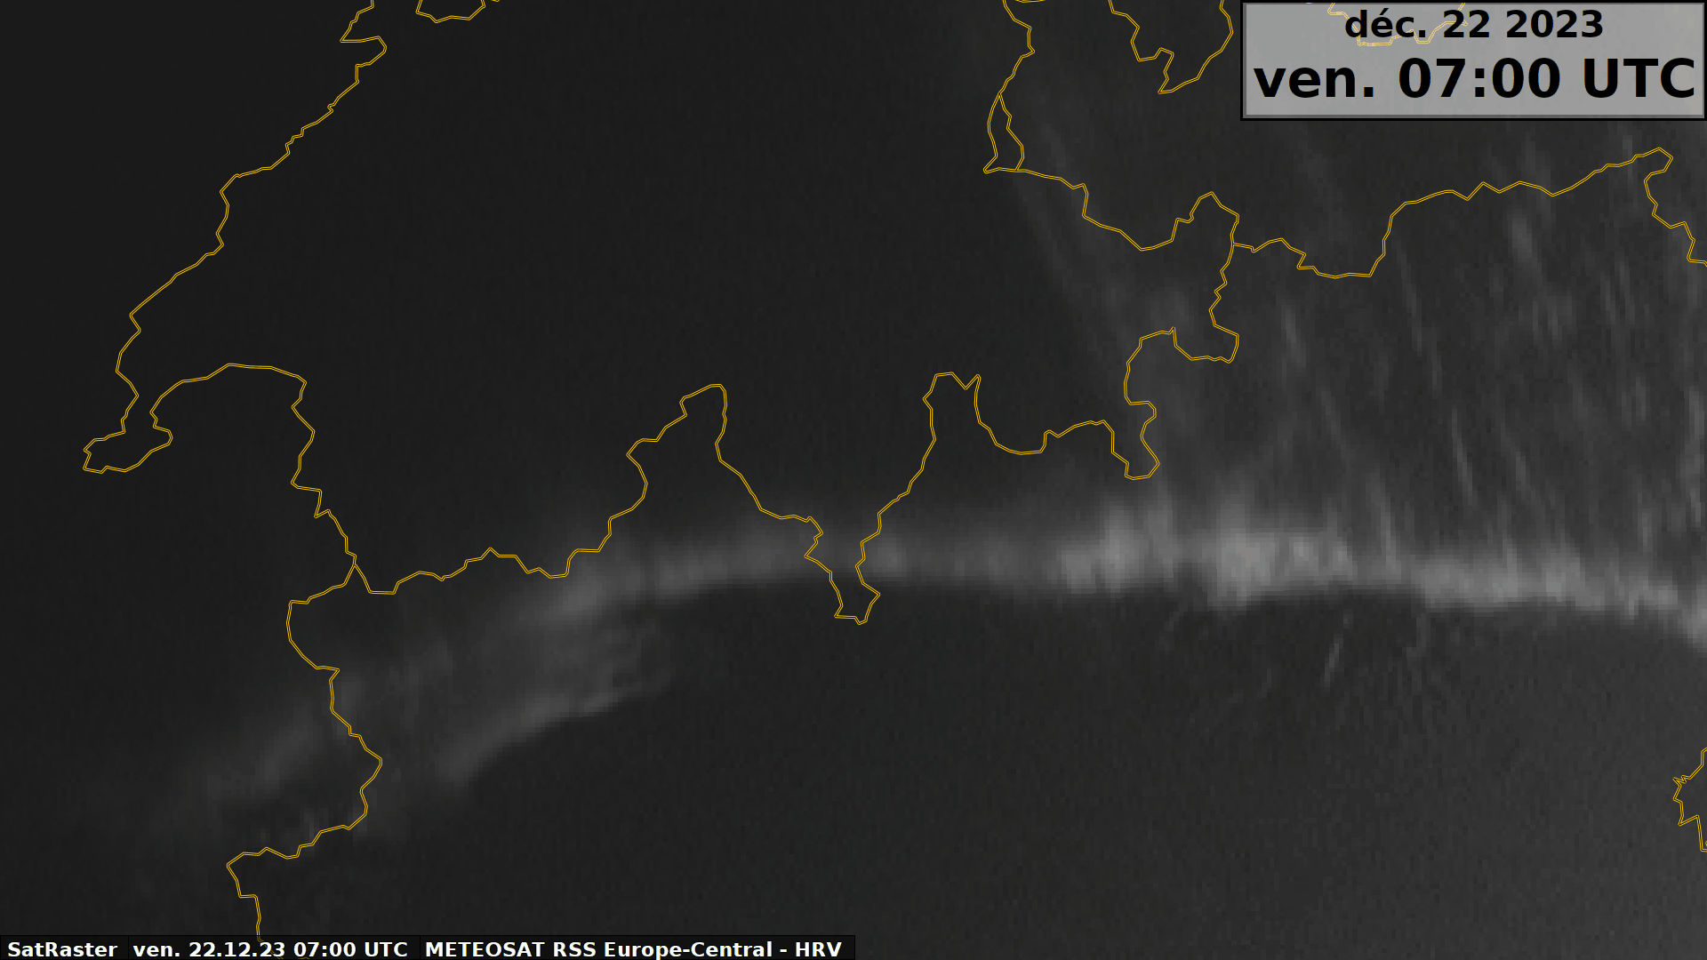
22 Dec 2023 – HRV animation

Slide 16
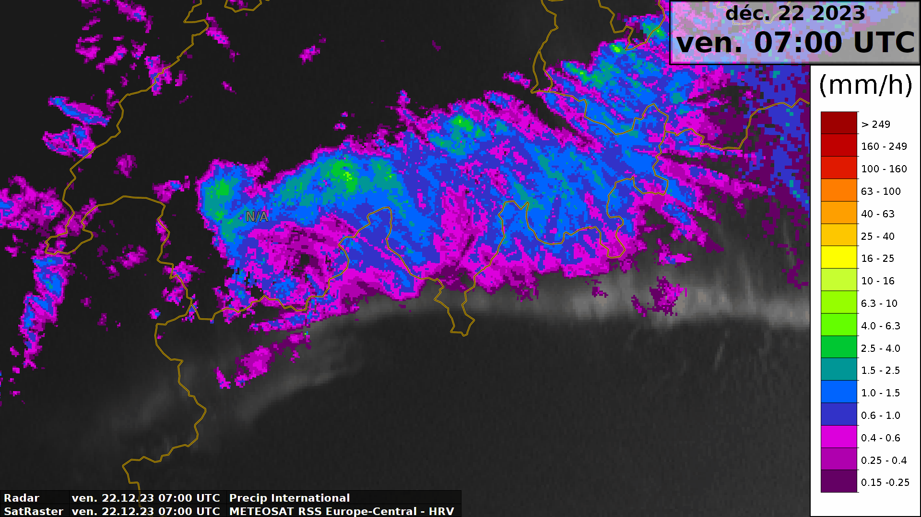
22 Dec 2023 – HRV/MeteoSwiss radar
Lugano view north

Slide 17
22 Dec 2023 – Lugano view north
Lugano, view north into the descending branch of the mountain wave
«stationary rainbow» visible in light precip spilled over the Alpine arc
«Foehn wall» clouds over the main Alpine crest, evaporating close to as well as south of Lugano area (highly reflective as before in HRV)

Slide 18
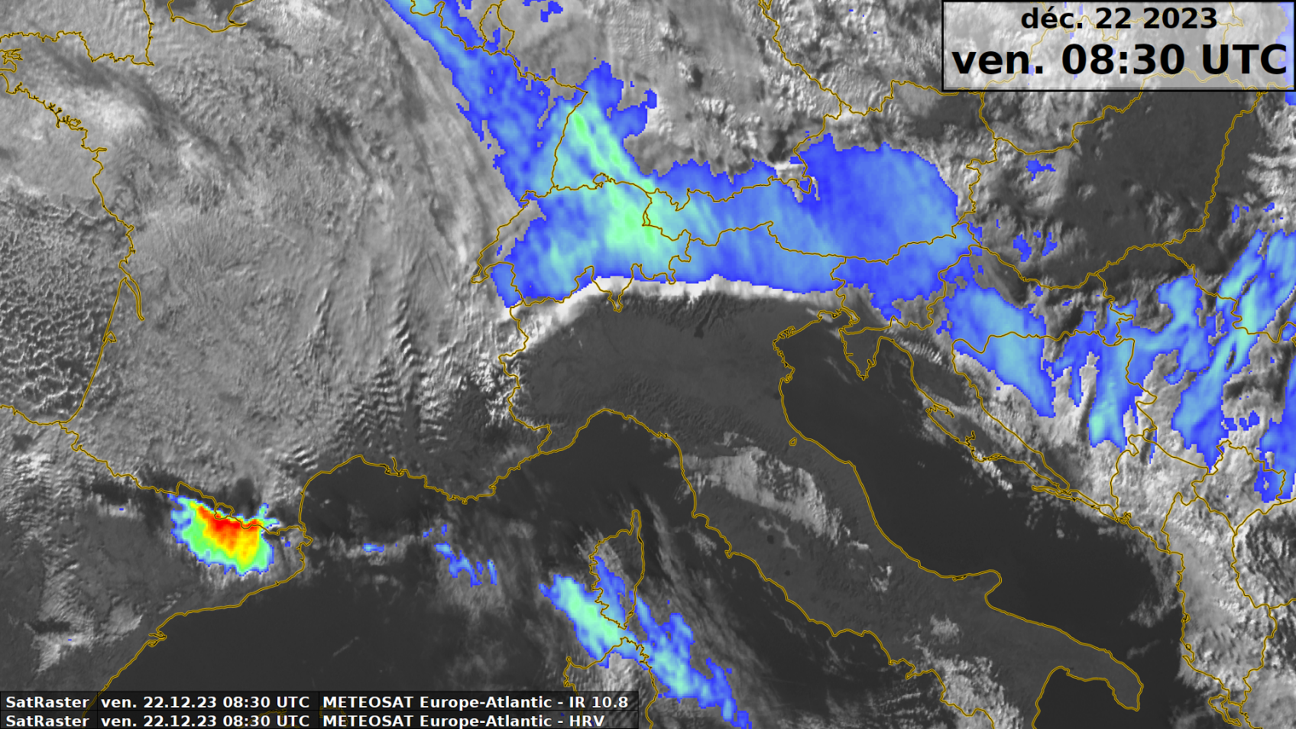
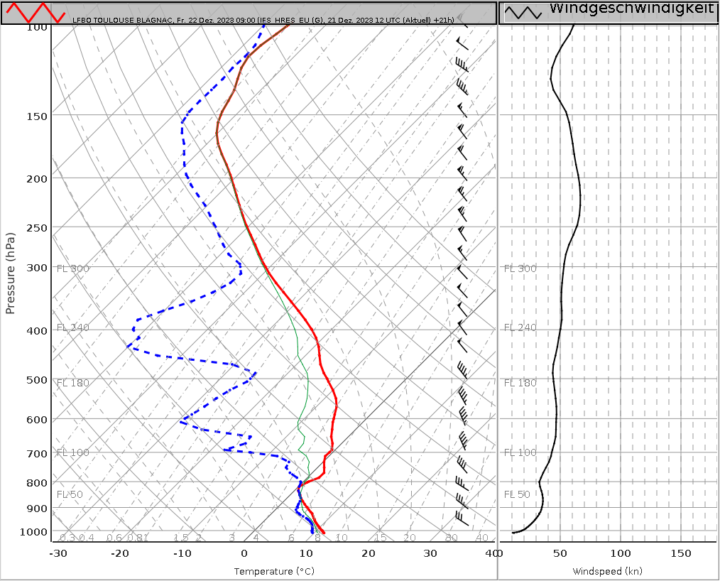
upstream sounding analysis
Toulouse

Slide 19
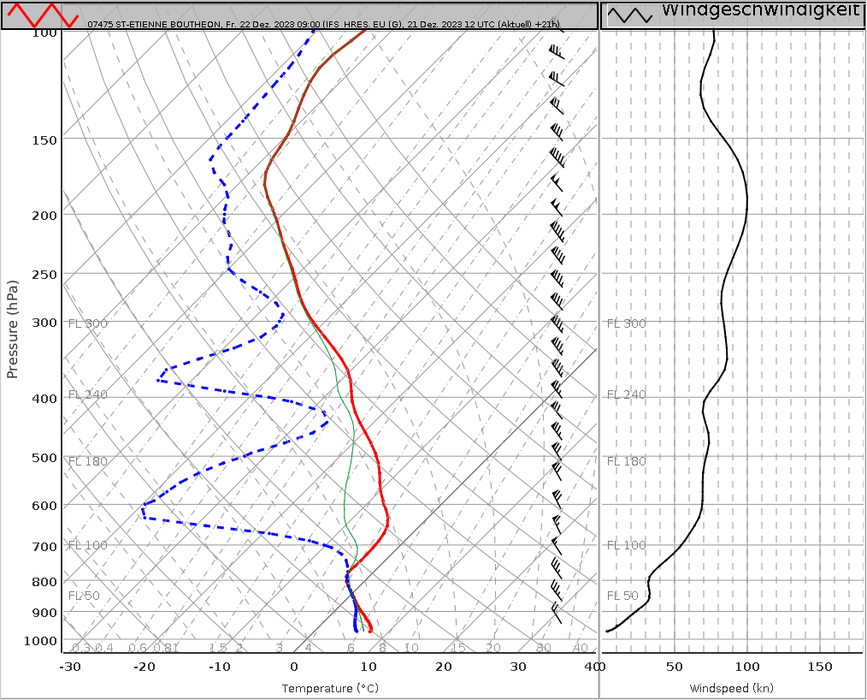
upstream sounding analysis
St. Etienne

Slide 20
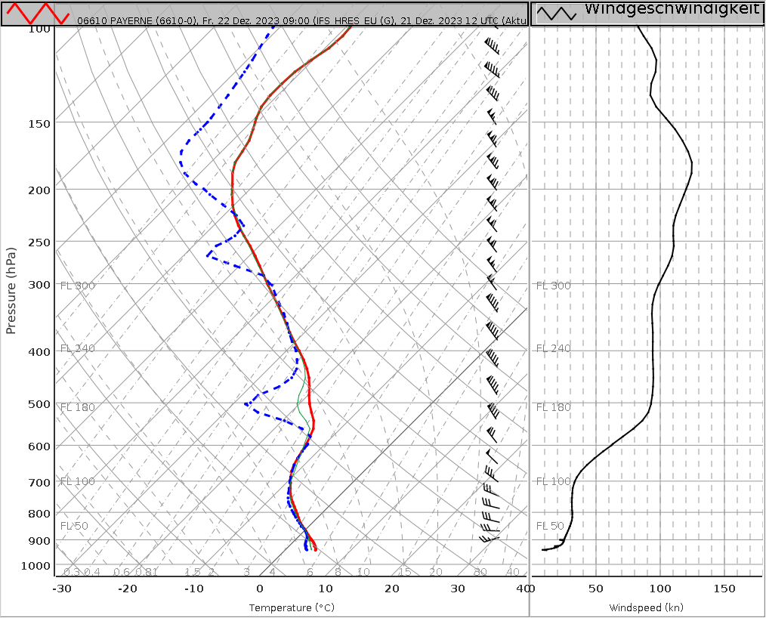
upstream sounding analysis
Payerne

Slide 21
NWP cross sections: ICON-CH1 CTRL
Payerne
St. Etienne

Slide 22
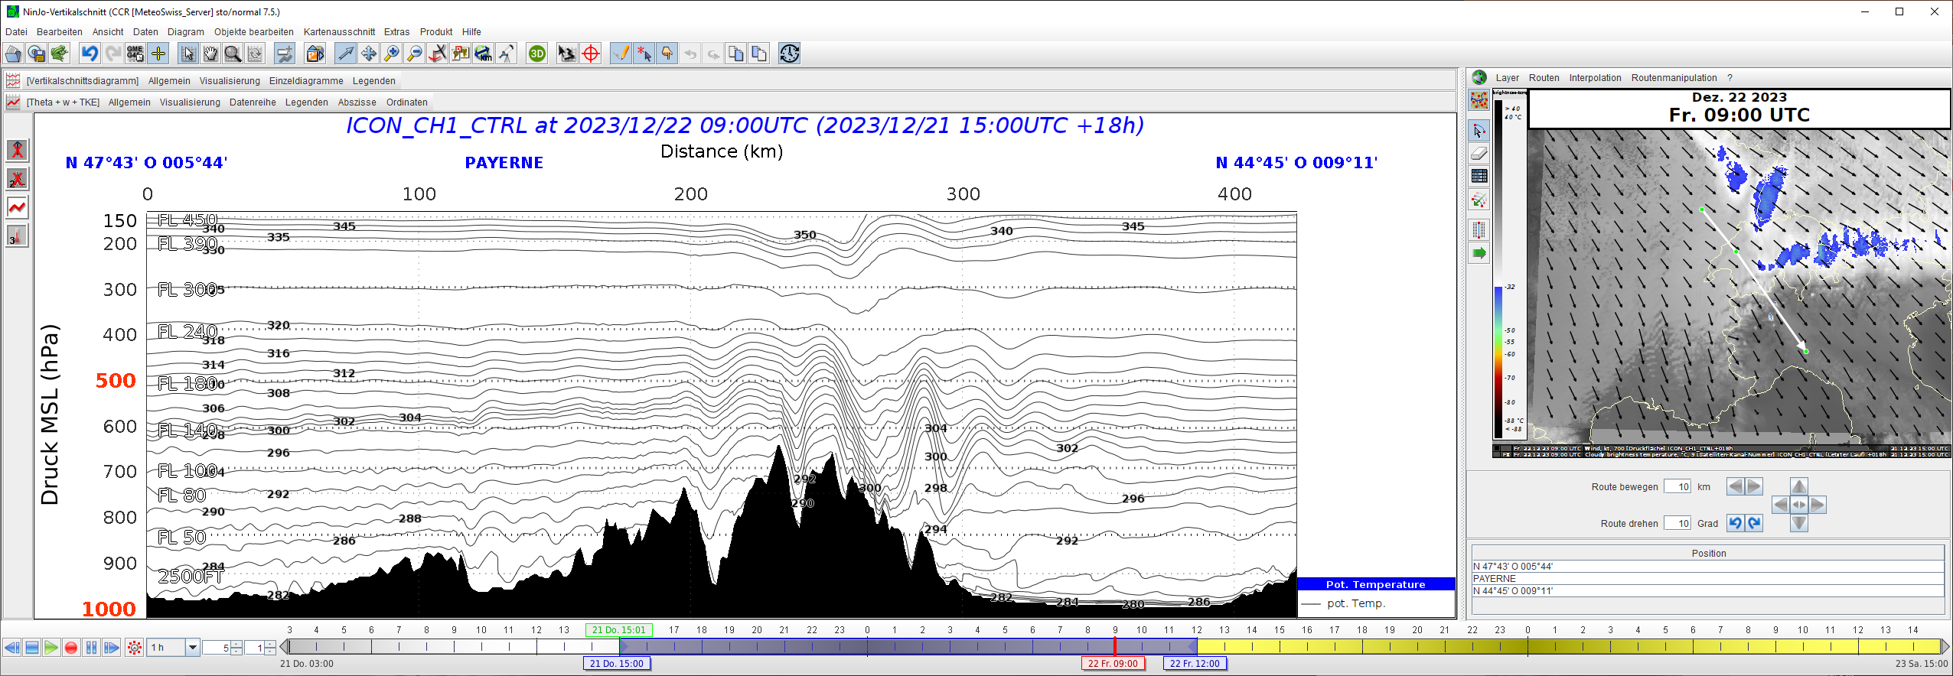
ICON cross section Payerne - Alps
Jura
Alps
N-Italy

Slide 23
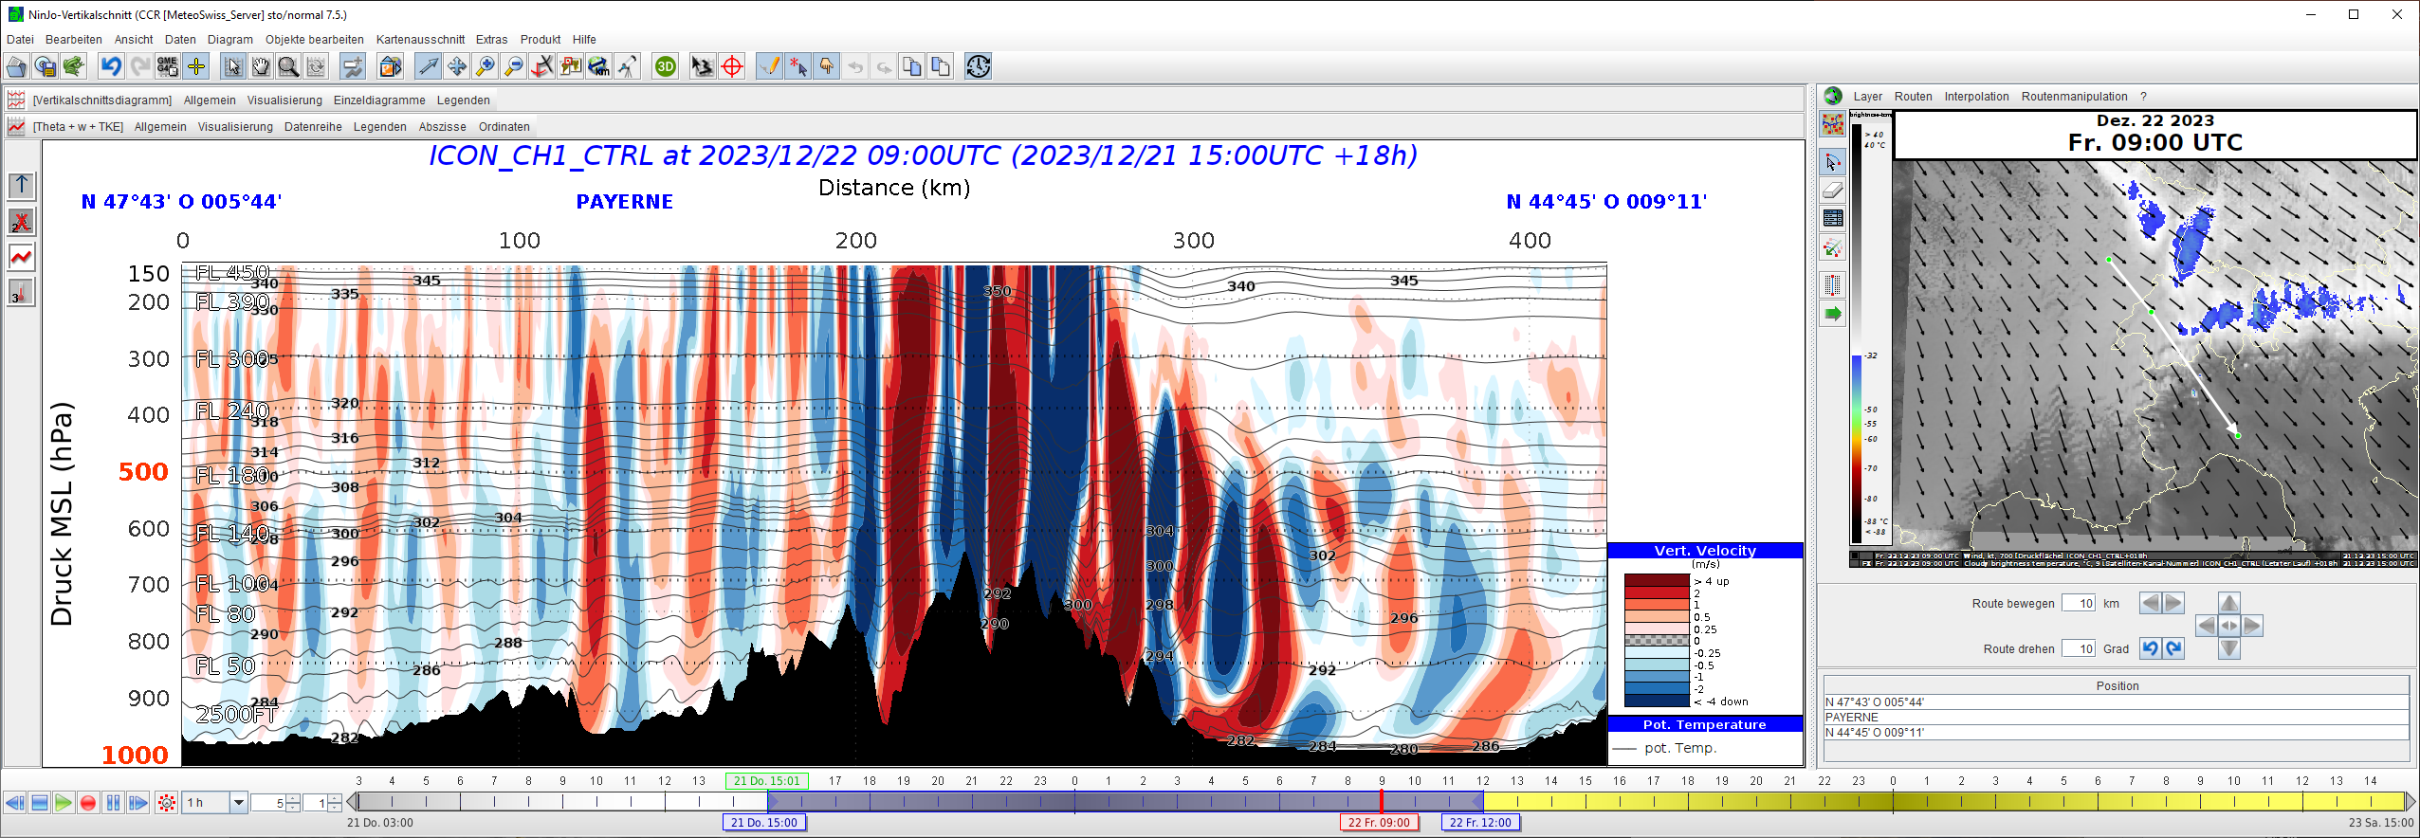
ICON cross section Payerne - Alps
Jura
Alps
N-Italy

Slide 24
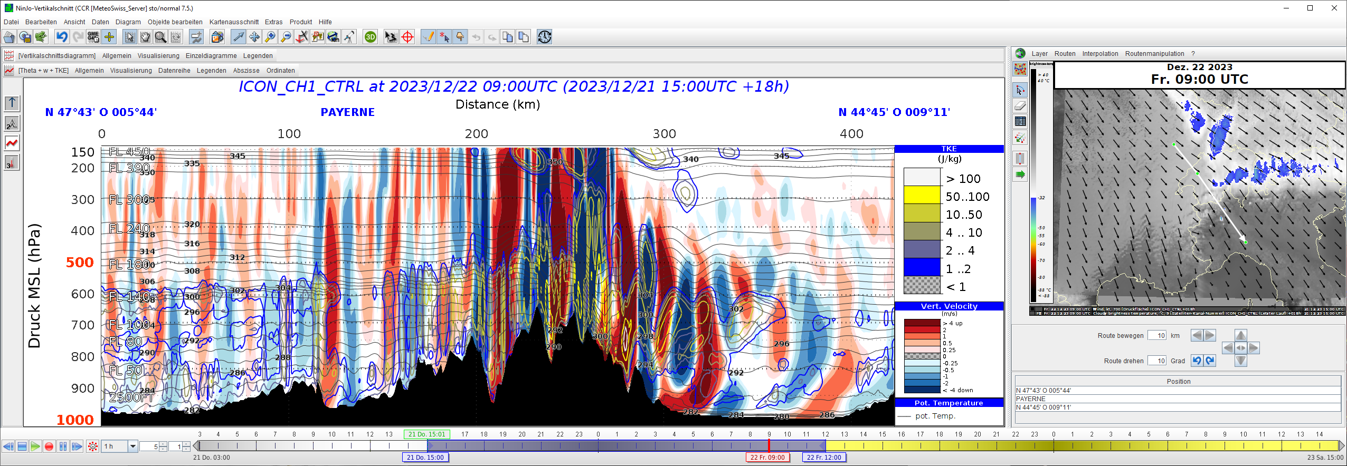
ICON cross section Payerne - Alps
experimental!
Jura
Alps
N-Italy
Turbulent Kinetic Energy TKE vs Barleben A. et al. (2020): A Novel Approach for Satellite-Eddy Dissipation Rate EDR, ICON: Based Turbulence Nowcasting for Aviation. Remote Sensing

Slide 25
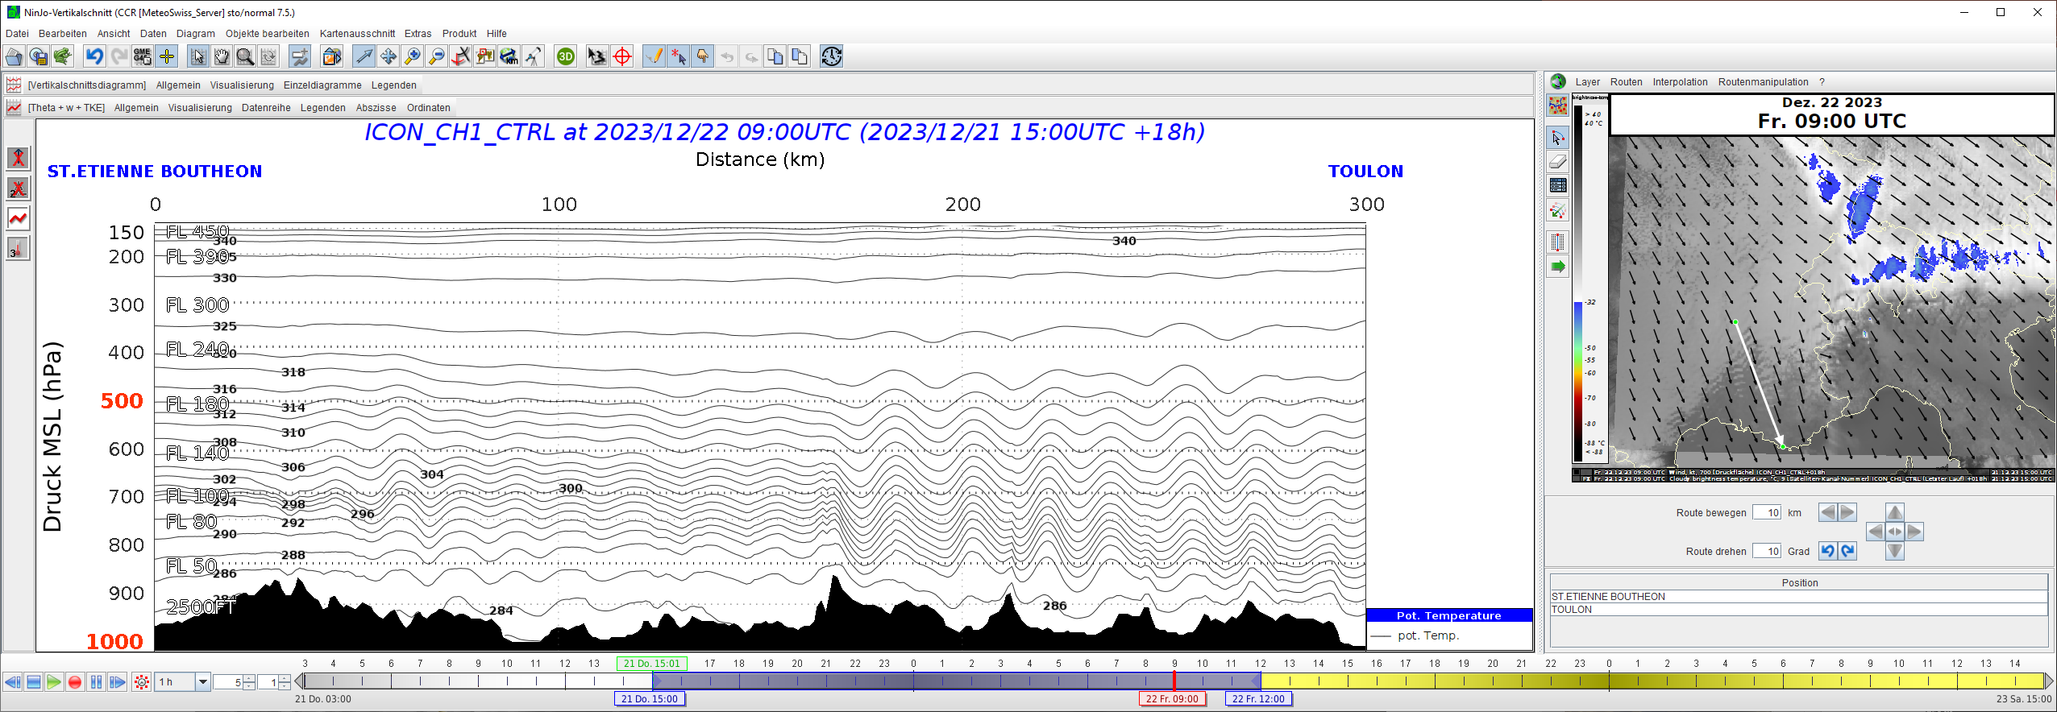
ICON cross section St. Etienne - Toulon
Cevennes
Rhône V.
M. Ventoux … S. Vict.

Slide 26
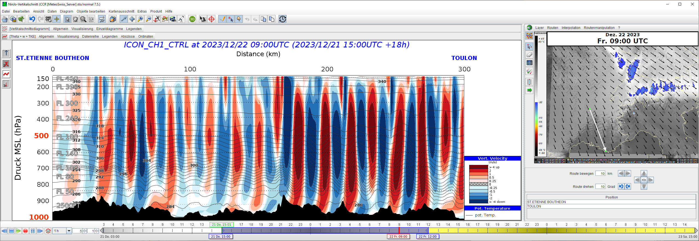
ICON cross section St. Etienne - Toulon
Cevennes
Rhône V.
M. Ventoux … S. Vict.

Slide 27
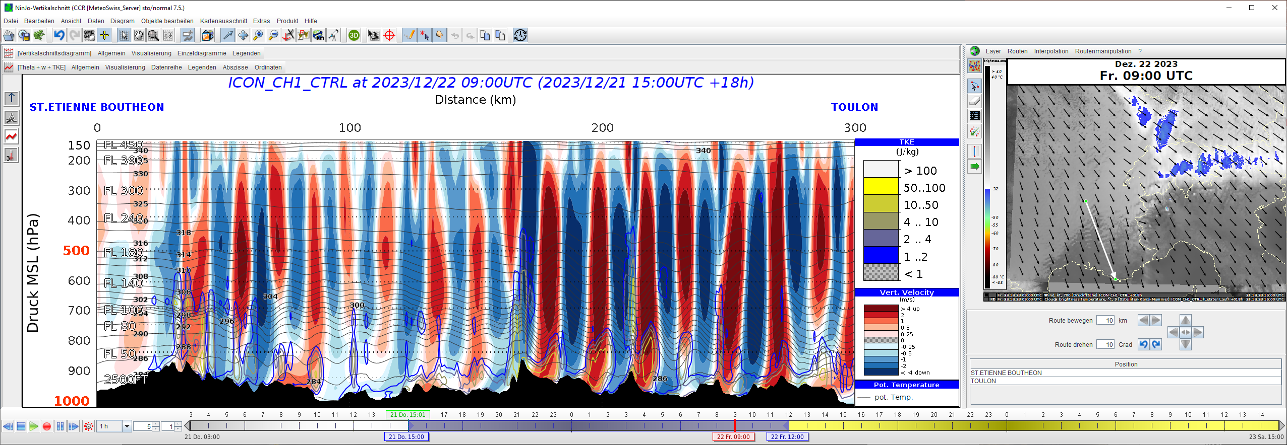
ICON cross section St. Etienne - Toulon
experimental!
Cevennes
Rhône V.
M. Ventoux … S. Vict.
Turbulent Kinetic Energy TKE vs Barleben A. et al. (2020): A Novel Approach for Satellite-Eddy Dissipation Rate EDR, ICON: Based Turbulence Nowcasting for Aviation. Remote Sensing

Slide 28
conclusions
qualitative diagnosis & forecasting of mountain waves OK
synoptic situation, strength & orientation of flow vs orographic barrier
satellite appearance
signatures in NWP model output (vertical speed maps or cross sections)
quantification of mountain wave intensity, vertical speed ~ OK (?)
wave breaking diagnosis & forecasting CHALLENGE!
how good are the models …?
how to extract this process out of the model data best?

Slide 29
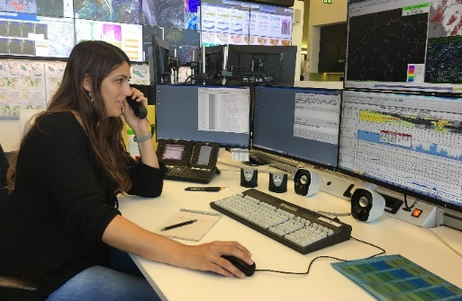
outlook: automation of the process based on probabilistic high res. NWP model?
mesoscale NWP model probabilistic, ~ ICON-CH1E w,TKE output ~10’ intervals
probabilities for event>threshold in time/space
«events» 4D objects (2D polygons)
products, services automatisch, or as «1st guess heads-up»
SIGMET SEV MTW
P_{w>wkrit}(x,y,z,t)
P_{TKE>TKEkrit}(x,y,z,t)
SIGMET SEV TURB
forecaster: interpret & understand data know and explain what happens in nature monitor functioning and improve the system

Slide 30
THANK YOU VERY MUCH FOR YOUR ATTENTION
my personal questions:
minimum mesoscale model resolution to properly resolve wave dynamics?
minimum model output frequency to detect transient wave breaking?
how good are mesoscale models in representing wave parameters?
do you have automated wave/wave breaking diagnostic in your service?
image credit: Andreas Walker

