Slide 1
Improved NWCSAF products with MTG-I
Pilar Rípodas
NWC SAF team
Eumetrain event week on MTG-I
27 September 2023

Slide 2
Are you a current user of the NWC SAF?
ⓘ Start presenting to display the poll results on this slide.

Slide 3
Outline of the presentation
Introduction to the NWC SAF
Objective of the NWC SAF and products portfolio
Current software versions
User Services
NWC SAF MTG-I Day 1 software and products
Objective
Products and improvements with respect to MSG
Examples with MTGTD-488 FCI Dataset
Short online workshop after MTG Day-1 software is released
Future NWCSAF SW releases
Improvement of current products
New products from LI and IRS sensors
Conclusions

Slide 4
NWC SAF concept
To ensure the optimum use of meteorological satellite data in Nowcasting and Very Short Range Forecasting
The NWC SAF develops and maintains software Packages (for GEOstationary and POLAR Satellites) freely distributed to registered users to generate satellite derived products with a direct application in Nowcasting
User support
Training
nwc-saf.eumetsat.int

Slide 5
Current NWC SAF software packages
Geostationary satellites
NWC SAF GEO v2021.2
MSG 0 degree/primary Service
MSG Rapid Scan Service
MSG IODC
Himawari 8/9
GOES-16,GOES-17, GOES-18
Polar satellites
NWC SAF PPS v2021.3
Metop
NOAA
NPP
JPSS
EOS
FY-3D

Slide 6
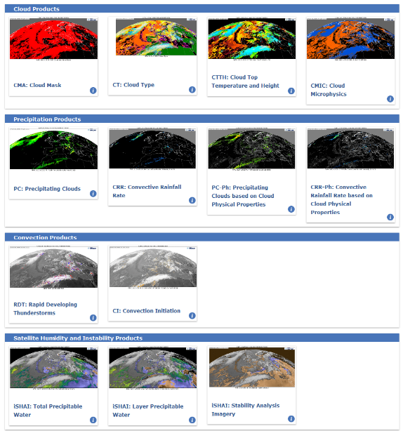
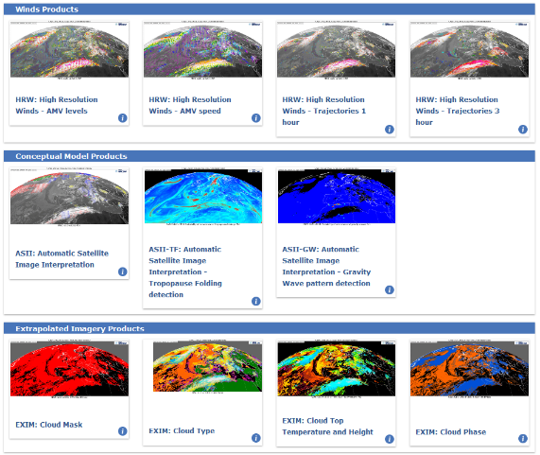
NWC SAF GEO Products
Available in NRT in nwc-saf.eumetsat.int

Slide 7
NWC SAF services. (nwc-saf.eumetsat.int)
From the web site:
Access to the NRT NWCSAF GEO and PPS product images (Reference Systems)
Access to GEO product images archive
Description of the products. Guide for forecasters and Aviation guide
Some general information and documentation
For registered users: Download of NWCSAF software packages and other tools, user support via a ticketing system, access to a broader information and documentation
Participating in and/or organizing training activities, Testbeds, Workshops and conferences to explain, promote and ease the use of the NWC SAF products

Slide 8
NWC SAF MTG-I Day 1
NWC SAF software package available from the first day MTG-I1 is operational:
Ensures continuation of current NWCSAF/GEO products with MSG
Will benefit in Europe/Africa from the enhanced MTG-I spatial & temporal resolution: products will show more details and can be updated with higher frequency.
Some products make use of new channels in MTG-I/FCI, thanks to the experience gained with Himawari/AHI & GOES/ABI sensors
Inclusion of MTG-LI as input data in RDT-CW product
New ASII-ICE product (demonstrational)
Updated NetCDF output formats, for an easier processing by other tools

Slide 9
NWC SAF MTG-I Day 1
The software is ready
Waiting for the delivery of NRT FCI well calibrated data
To test the end-to-end operability of the NWC SAF MTG day-1 software
To fine tune the different NWCSAF algorithms to real data.
To validate the NWC SAF products and ensure they fulfill the requirements
After these steps, the software will be delivered to users at the beginning of 2024 as
NWC SAF GEO-I v2024.
Exploitation of MTG-I full capabilities planned for the following releases

Slide 10
MTGTD-488 FCI L1C Commissioning Data for SAFs
Data Package provided 17 July 2023. 38 hours: 26 June 2023 20:00 to 28 June 2023 09:50
FCI data package MTGTD-488:
Is the result of a very preliminary processing of FCI data and it is not properly validated and has a number of known limitations
To facilitate the integration of the SAF processing chains with the MTG System and to test interfaces and processing timeliness. Not suitable for scientific results
We can:
Test the operability of the software
Get a first impression of what the software can do with MTG data

Slide 11
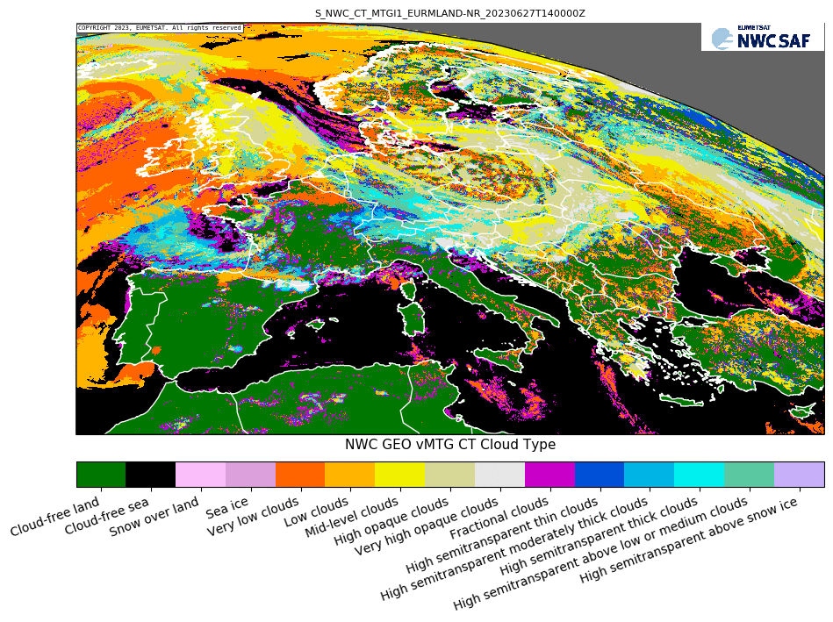
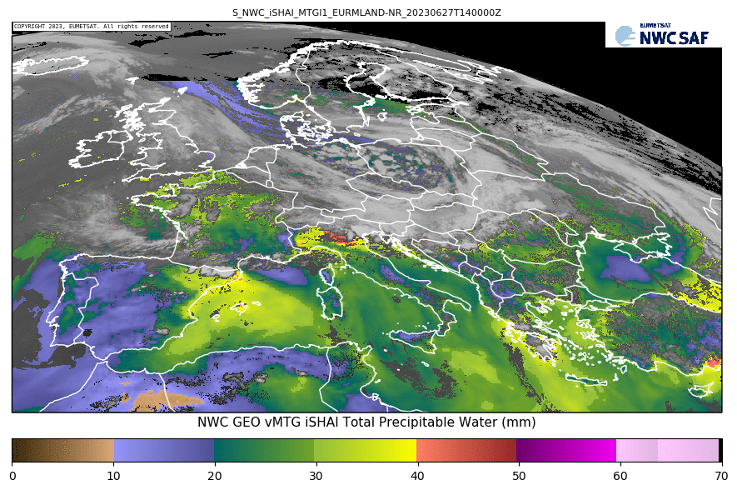
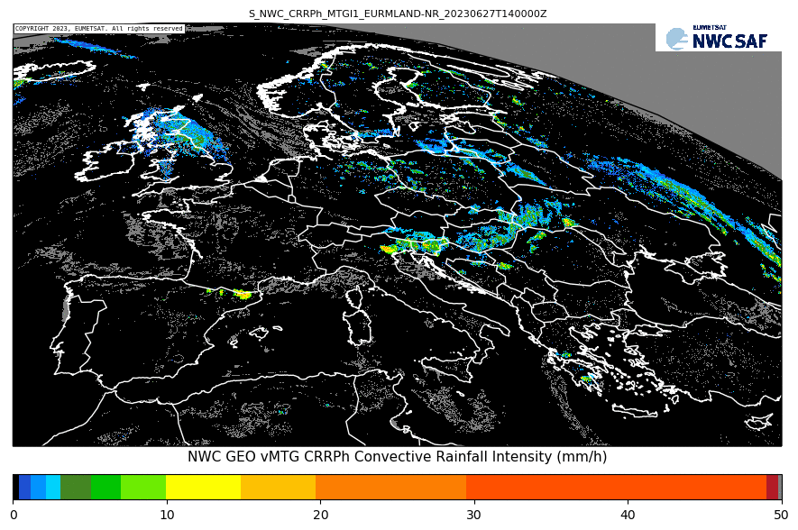
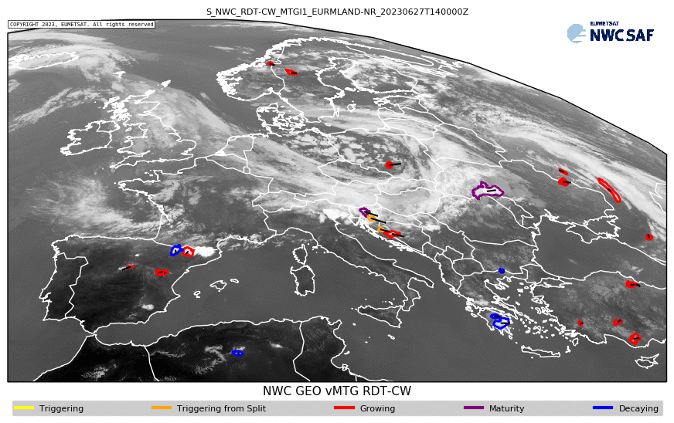
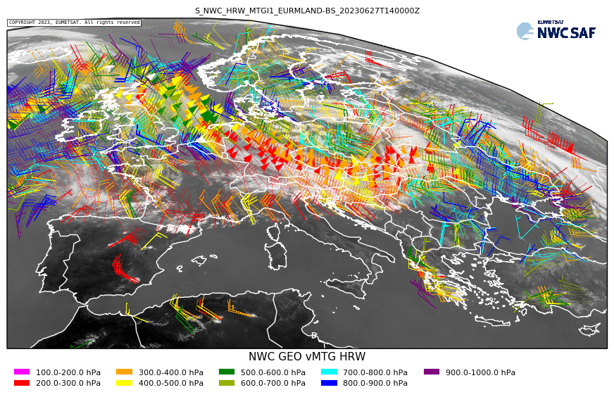
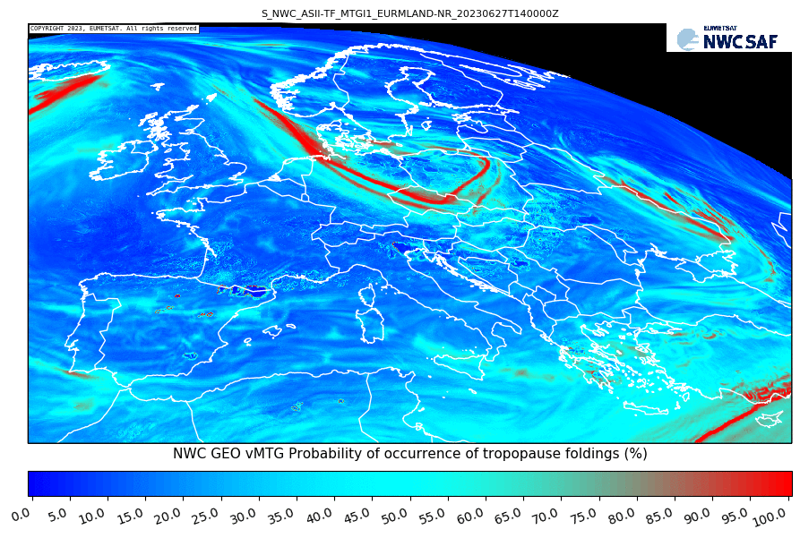
EUR-MLAND examples 27 June 2023 14:00 UTC
(Provisional data MTGTD-488)

Slide 12
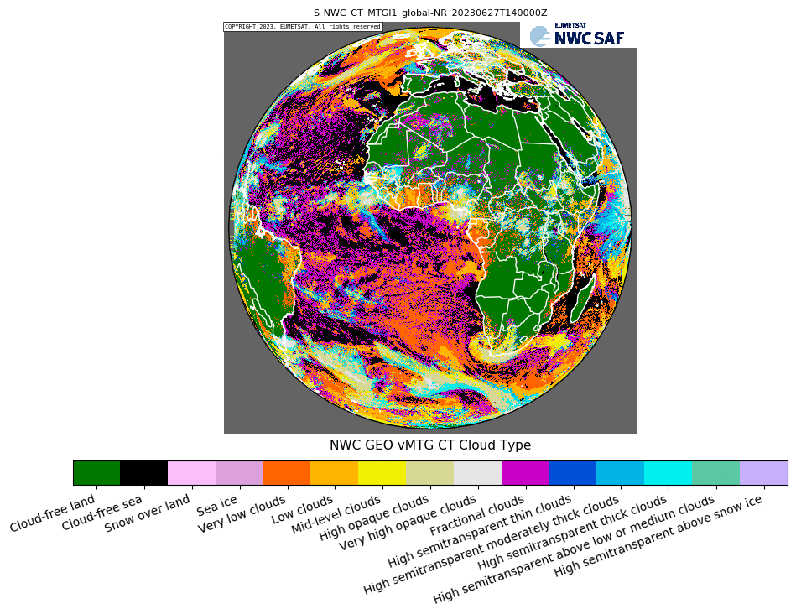
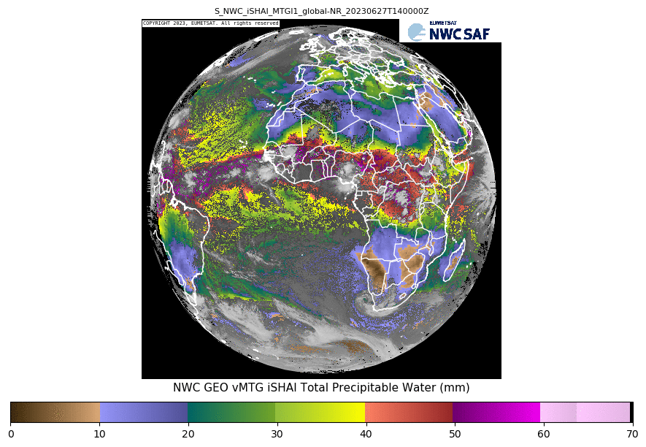
Full disk examples 27 June 2023 14:00 UTC
(Provisional data MTGTD-488)

Slide 13
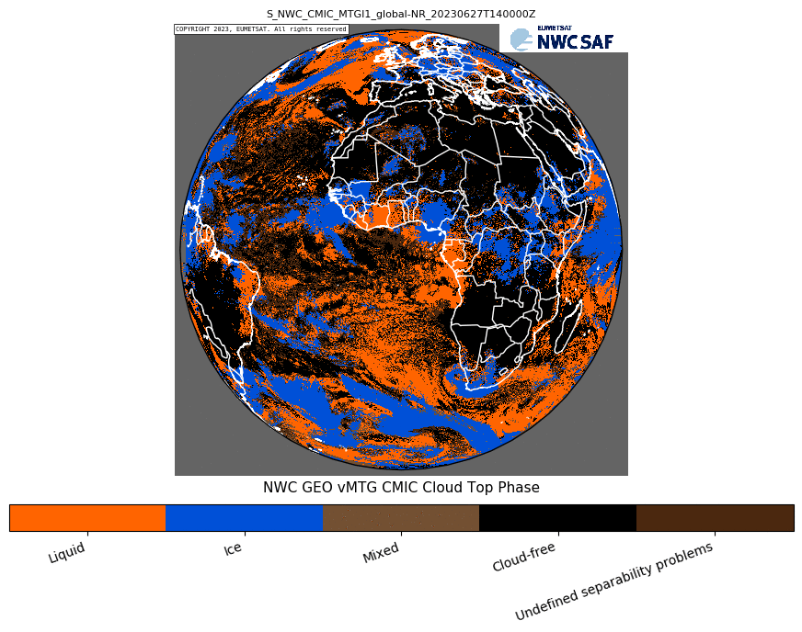
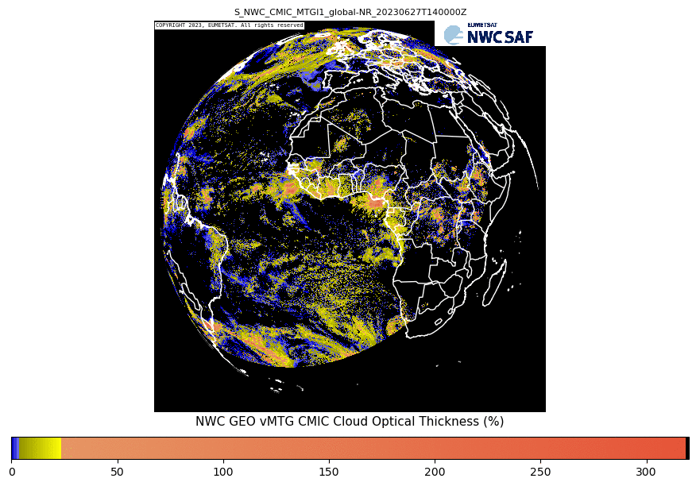
Full disk examples 27 June 2023 14:00 UTC
(Provisional data MTGTD-488)

Slide 14
MTG CT 27 June 2023 13:00 – 16:50 UTC
(Provisional data MTGTD-488)

Slide 15
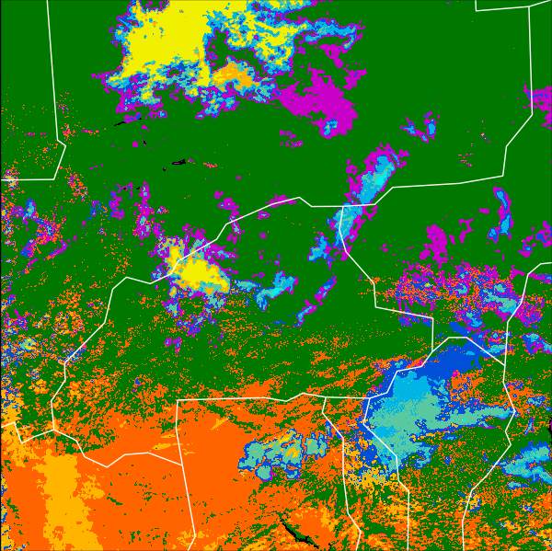
MTG 27 June 2023 13:00 – 16:50 UTC (Provisional data MTGTD-488)
CT (Cloud Type) CRR (Convective Rainfall Rate mm/h)

Slide 16
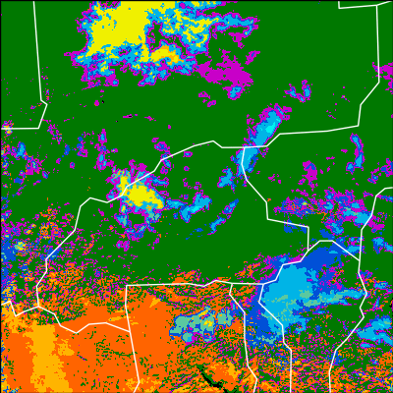
27 June 2023 13:00 – 16:50 UTC
MTGI1 CT (Provisional data MTGTD-488) MSG3 CT

Slide 17
27 June 2023 13:00 – 14:50 UTC
MTGI1 (Provisional data MTGTD-488) MSG3
In particular in the first stages of Convection Development
MTG provides more frequent and more detailed information
In
CT
CMIC-
COT

Slide 18
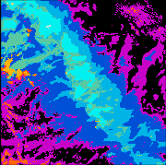
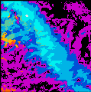
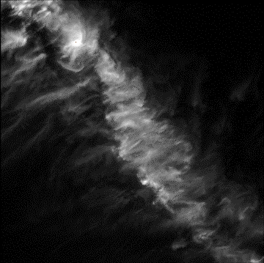
Channel 1.38 µm in MTGI1: improves detection of cirrus
(Provisional data MTGTD-488 for MTG)
MTG CT
MSG CT
MTG 1.38 µm
360x360 1.38 µm pixels
centered at lat 5.4°lon -12.2°
27 June 2023 16:00 UTC

Slide 19
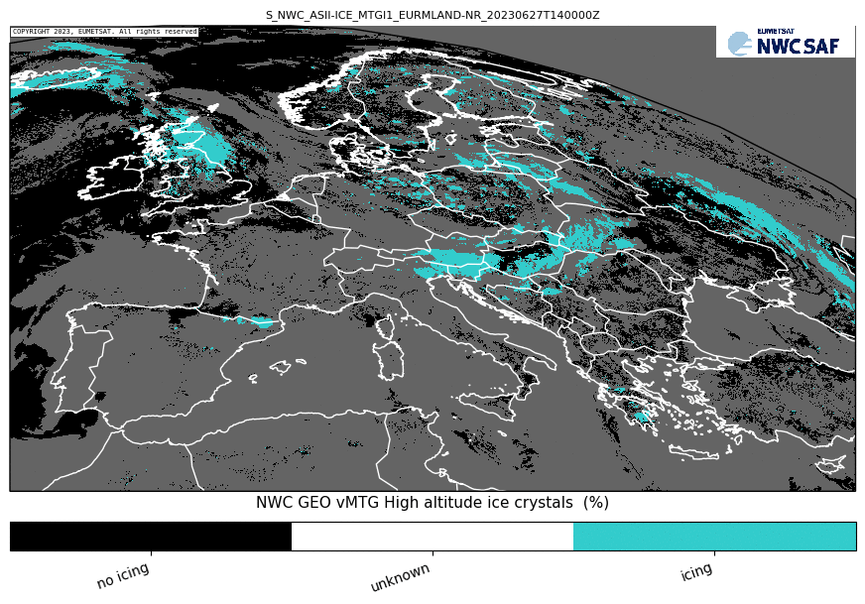
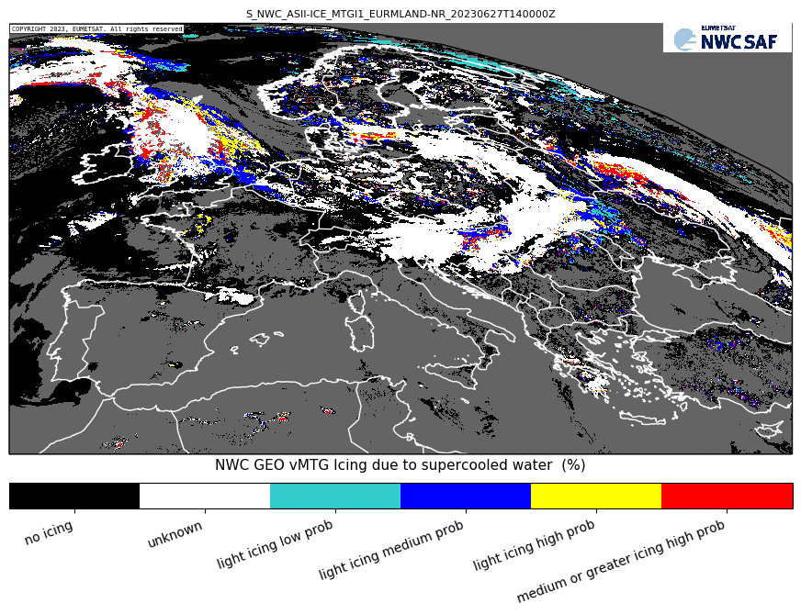
New ASII-ICE product (by ZAMG)
27 June 2023 14:00 UTC
(Provisional data MTGTD-488)
Detection of in-flight icing, comprising:
➔ High-altitude ice crystals (HAIC) detection, as defined in
de Laat, A., Defer, E., Delanoë, J., Dezitter, F., Gounou, A., Grandin, A., Guignard, A., Meirink, J. F., Moisselin, J.-M., Parol, F. (2017): Analysis of geostationary satellite-derived cloud parameters associated with environments with high ice water content. Atmos. Meas. Tech., 10, 1359-1371 (https://doi.org/10.5194/amt-10-1359-2017).
Icing potential based on supercooled water droplet detection, as defined in
Smith, W. L. Jr., P. Minnis, C. Fleeger, D. Spangenberg, R. Palikonda, L. Nguyen (2012): Determining the flight icing threat to aircraft with single-layer cloud parameters derived from operational satellite date. J. Appl. Meteor. Climatol., 51, 1794–1810 (https://doi.org/10.1175/JAMC-D-12-057.1).
Main application: Aviation community
To be released as demonstrational; to become operational in later releases
nwc-saf.eumetsat.int

Slide 20
New NetCDF format
27 June 2023 13:10 – 16:40 UTC
(Provisional data MTGTD-488)
Starting in vMTG day-1, allows to ingest directly NWCSAF/GEO outputs to common tools like Panoply, McIDAS V, ADAGUC, WCT.
(for previous versions we provide a converter from NWCSAF outputs to appropriate formats)
ADAGUC example of NWCSAF software outputs: geolocalized, zoomable, several products visible simultaneously (f.ex. CRRPh, RDT)

Slide 21
Planned Workshop
After the release of NWC SAF MTG Day-1 as NWC SAF GEO-I v2024
Short and online
Content:
Installation
Configuration
Main technical differences with previous version
Guidelines to plot the products

Slide 22
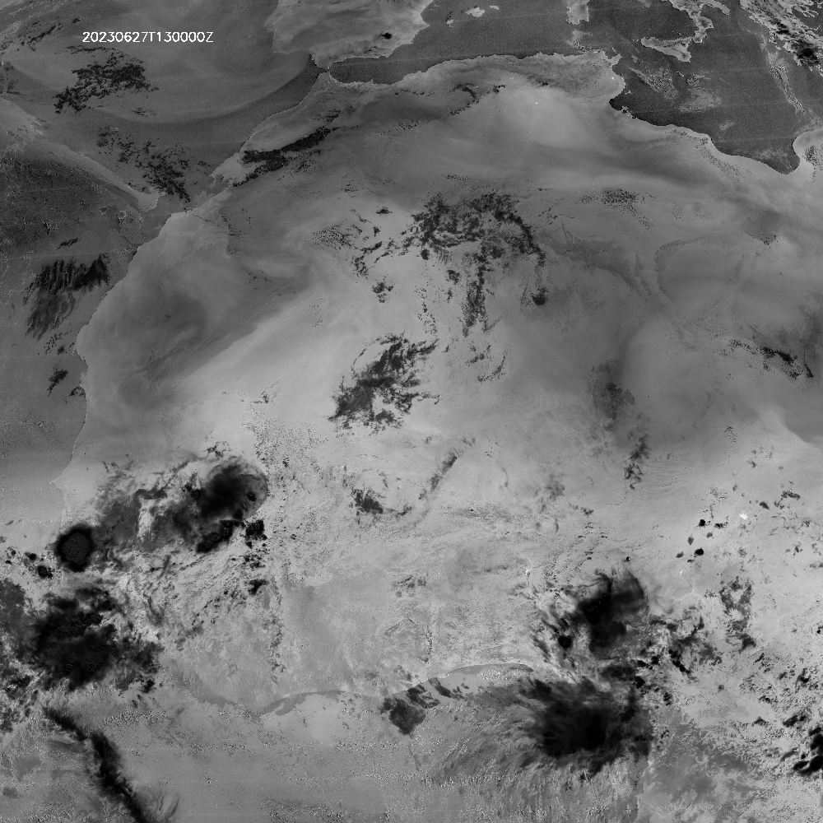
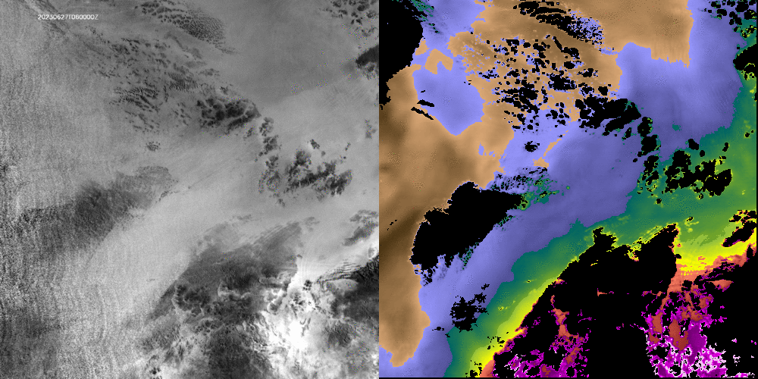
Channel 0.9 µm in MTGI1
(Provisional data MTGTD-488)
Left: Ratio of VIS09 and VIS08 proxy of TPW. Implemented through the difference of the logarithms.
Right: NWC SAF MTGI/FCI TPW iSHAI product from WV and IR channels
General pattern very similar.
Ratio of VIS09 and VIS08 can provide more detailed information (daytime).
2023-06-27 from 06:00Z 18:50Z
NWC SAF is also financing a scientific study to develop an algorithm for total water content from 0.9 and 0.8 channels.
Scientist: Jan El Kassar (FUB).
Prototype can be ready beginning 2024
FCI (log(VIS08)-Log(VIS09)) scaled in range [0, 0.8]
iSHAI TPW (mm)
(Processed on 1x1 FOR)
Image cortesy of Miguel Ángel Martínez (AEMET)

Slide 23
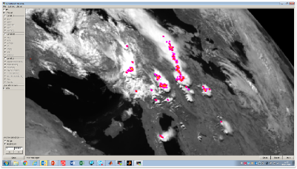
New products in future software releases
New Lightning products (by NMA/Romania)
LiStack
Accumulation of EUMETSAT L2 LI gridded products in the user´s defined time period and region (with option of parallax correction).
To monitor the lightning activity.
Released around end 2024 in a dedicated release.
LiJump
Lightning jump detection (Image like product).
Released at a later stage around 2026.
Simulated MTG LI L2 AFA accumulated product
B. Viticchie, EUMETSAT

Slide 24
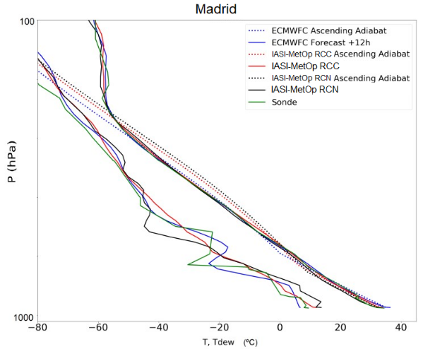
New software package NWC/GEO-S
NWC/GEO-S – New products from MTG-S/IRS instrument (by AEMET) First infrared hyperspectral sounder in a geostationary satellite for Europe
qIRS: Tool to manage MTG-S/IRS data: calculates radiances/BTs for channels &
combinations with physical meaning
sSHAI: Atmospheric vertical profiles retrievals (T,q,ozone) and derived stability indices. Integration of surface based measurements to the retrievals will be explored.
sSHAI_ES: Stability indices derived from EUMETSAT Secretariat L2 vertical profiles.
Delivered as Day-2 products in a dedicated NWC/GEO-S software package We aim to integrate GEO-I and GEO-S software packages for synergies of FCI,LI,IRS instruments
15 June 2015 12:00 UTC, Madrid
Comparison of protoptype retrievals with ECMWF forecast and radiosonde
N. Peinado-Galán, AEMET

Slide 25
Conclusions
NWC SAF software for MTG is technically ready. Final algorithm tuning and validation of the products against the requirements to be done when calibrated FCI data is available.
Software to be released to users when MTG-I1 is operational, as NWC SAF GEO-I v2024
Main improvements come from the higher spatial and temporal resolution
Online Workshop planned after software release
Full exploitation of MTG capabilities in future releases:
Improvements in current products
New products from new sensors

Slide 26
More information in nwc-saf.eumetsat.int
You can contact us at
pripodasa@aemet.es
safnwchd@aemet.es
Thank you very much for your attention!

