Slide 1
Cloud Phase RGB
a new RGB to monitor cloud top microphysics
Mária Putsay
EUMeTrain trainer, retired from the Hungarian Meteorological Service
MTG-I Event Week, EUMeTrain, 27 October 2023

Slide 2
Outlines
Introduction
Physical background
Main application areas
General cloud analysis
Monitoring convection
Mature phase
Developing phase
Summary

Slide 3
Introduction
New microphysical channel - NIR2.2
Aim: improved information on cloud top microphysics
Phase and “effective size” of the cloud top particles
Cloud top microphysics -- Why is it interesting?
General cloud analysis – differentiate ice and water clouds
Monitoring convection
Developing phase
Mature phase
…
Has it added value compared to the RGBs invented from SEVIRI data?
Apart higher temporal and spatial resolution – from the point of view of cloud top microphysics
Proxy data VIIRS, Himawari/AHI ….

Slide 4
Outlines
Introduction
Physical background
Main application areas
General cloud analysis
Monitoring convection
Mature phase
Developing phase
Summary

Slide 5
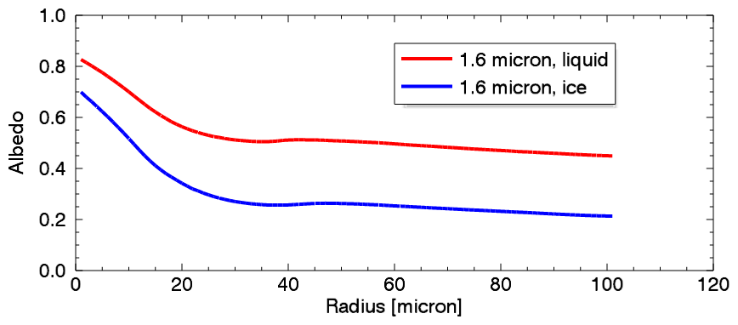
Simulated albedo of opaque clouds
(Ralf Bennartz, University of Wisconsin–Madison)
Albedo – radius of cloud top particles
+ Typical range of
cloud top particles of water clouds
are smaller
than those of ice clouds.
NIR1.6 is good for separation opaque ice and water clouds, with some exceptions
NIR2.25 alone is NOT good for separating phase
good for separating opaque clouds with small/large particles
The NIR2.2 albedo is sensitive to the cloud top particle size in a broader interval than the NIR1.6 albedo.

Slide 6
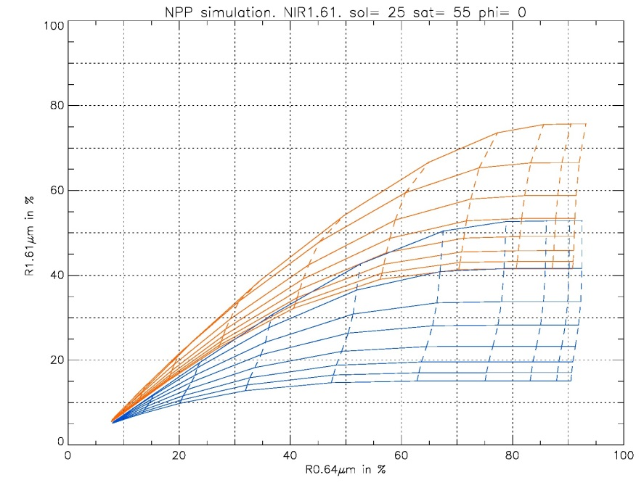
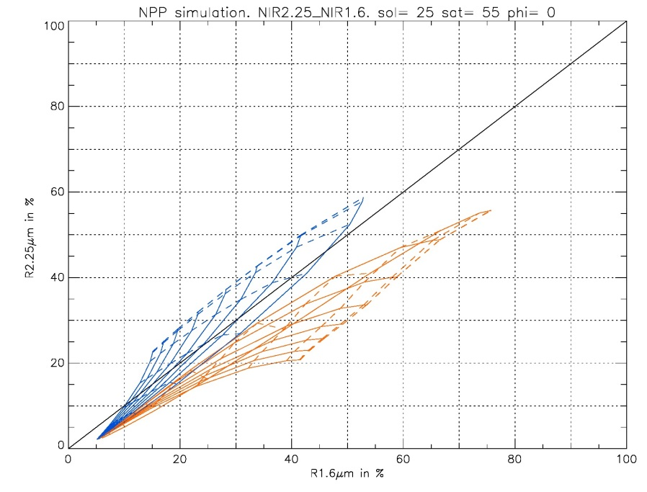
Common use of NIR1.6 and NIR2.25 channels
Simulated reflectivity values over dark background depending on optical depth and cloud top effective particle size as parameters
blue: ice clouds
brown: water clouds
NIR1.6 and VIS0.64
NIR2.25 and NIR1.6
R1.6 µm
R2.25 µm
R0.64 µm
R1.6 µm
Overlap between the curves of water and ice clouds
No overlap → using this channel pair the phase retrieval will be more perfect
G.Kerdraon, H. Le Gléau, M.-P. Raoul
Météo-France, CMS, Lannion France
Notes:
These graphs refer to channel pairs.
The automatic cloud phase retrieval is based on this channel pair with SEVIRI data, and with FCI data.
Reflectivity of water and ice clouds were simulated as a function of optical depth and cloud top effective particle size.
These simulated reflectivity pairs are shown for this channel pair.
Brown curve-set corresponds to water clouds.
Blue curve-set corresponds to ice clouds.
If the observed reflectivity value pair is on the overlap region …
These graph is the base of cloud top properties retrieval from SEVIRI data

Slide 7
Cloud Phase RGB
(invented by Jochen Kerkmann, EUMETSAT)
Only daytime
Beam Channel Information on
Red NIR1.6 cloud top microphysics (mainly phase)
Green NIR2.25 cloud top microphysics (mainly particle size)
Blue VIS0.67 cloud optical thickness
NIR1.6 and NIR2.25 complement each other
recipe for VIIRS
The Cloud Phase RGB can distinguish more perfectly the thick ice and water clouds than the present SEVIRI RGB do.
Cloud Phase RGB is sensitive to the cloud top particle size as well.
Color beam | Channel | Range
Red | NIR1.6 | 0-50 %
Green | NIR2.25 | 0-50 %
Blue | VIS0.67 | 0-100 %
No temperature information

Slide 8
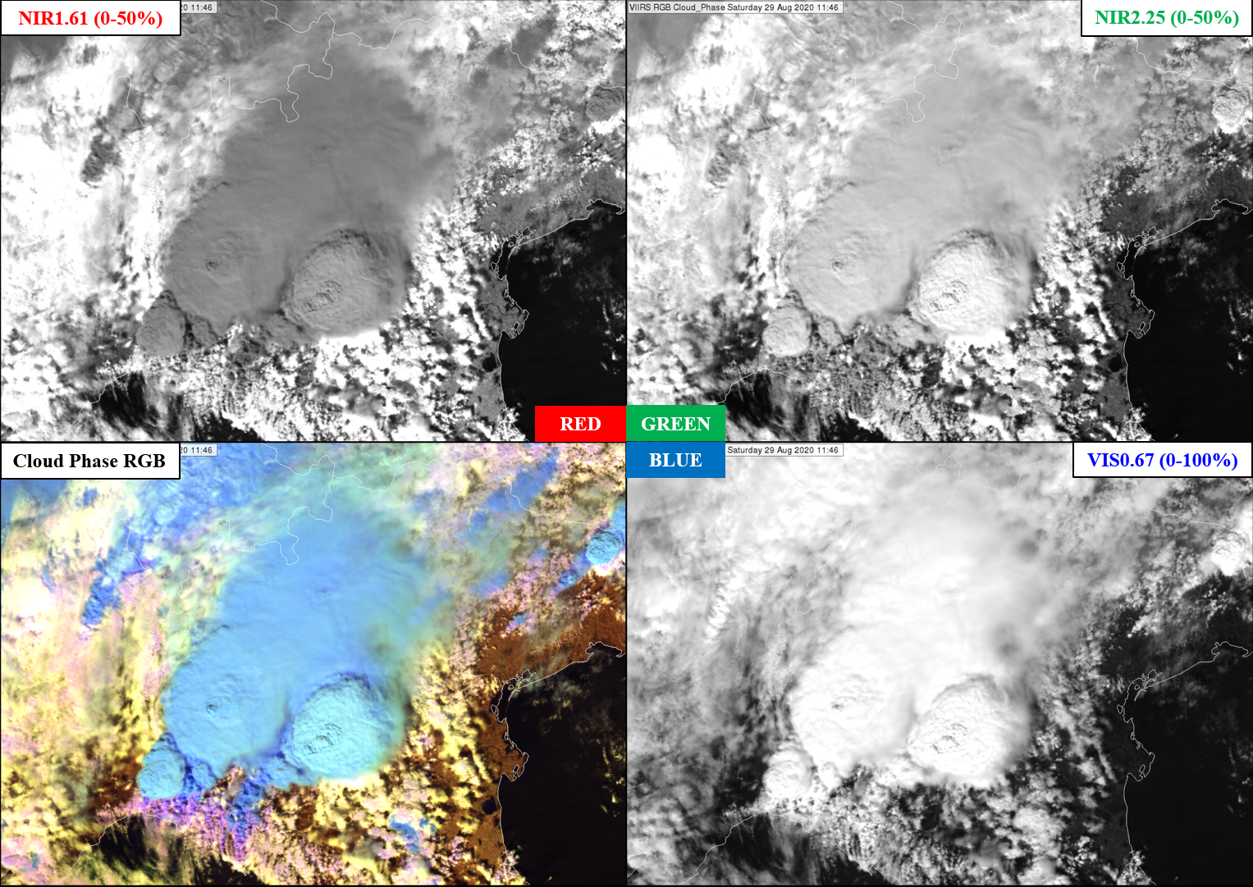
VIIRS Cloud Phase RGB and its components,
northern Italy,
29 August 2020, 11:46 UTC

Slide 9
Typical colors of VIIRS Cloud Phase RGB
Thick ice cloud, large particles
Thick ice cloud, small particles
Thin ice cloud, extremely small ice crystals
Medium thin ice cloud over sea
Very thin ice cloud over sea
Thin ice cloud over land
Thin ice cloud over water cloud
Thick water cloud with extreme large particles or thick mixed phase cloud
The color of the thin ice clouds depends on several factors
Thin water cloud over sea
Thick water cloud, large droplets
Thick water cloud, medium size droplets
Thick water cloud, small droplets
Sea Sandy desert Land with less/more green vegetation Snow

Slide 10
Outlines
Introduction
Physical background
Main application areas
General cloud analysis
Monitoring convection
Mature phase
Developing phase
Summary

Slide 11
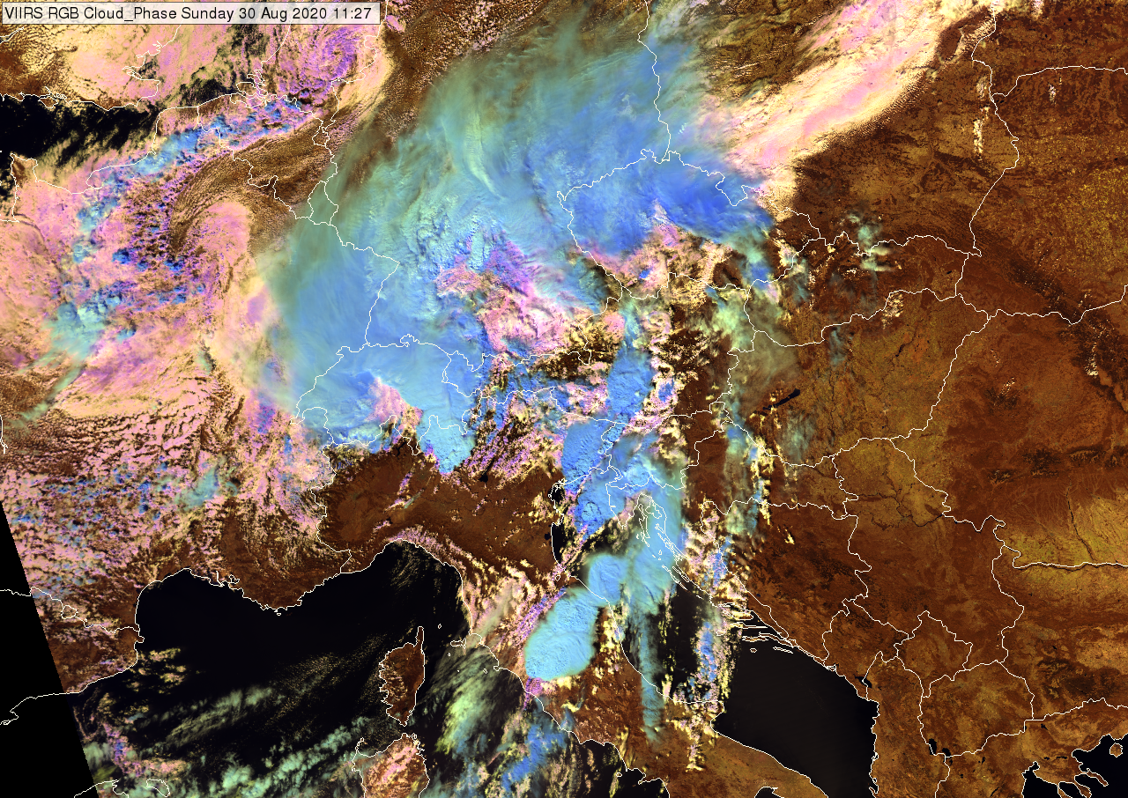
Application
General Cloud analysis
VIIRS Cloud Phase RGB
30 August 2020, 11:27 UTC
Good color contrast between
thick clouds and the surface features
Thick ice and water clouds
Several color shades with good contrast
for thick ice clouds covered by small /large ice crystals
for thick water clouds covered by small /large droplets
Thin ice clouds appear in different color shades than thick ice clouds.
Very thin clouds are (almost) not seen.

Slide 12
Outlines
Introduction
Physical background
Main application areas
General cloud analysis
Monitoring convection
Mature phase
Developing phase
Summary

Slide 13
Most important color shades at monitoring mature convection.
Typical colors of VIIRS Cloud Phase RGB
Thick ice cloud, large particles
Thick ice cloud, small particles
Thin ice cloud, extremely small ice crystals
Medium thin ice cloud over sea
Very thin ice cloud over sea
Thin ice cloud over land
Thin ice cloud over water cloud
Thick water cloud with extreme large particles or thick mixed phase cloud
The color of the thin ice clouds depends on several factors
Thin water cloud over sea
Thick water cloud, large droplets
Thick water cloud, medium size droplets
Thick water cloud, small droplets
Sea Sandy desert Land with less/more green vegetation Snow

Slide 14
For analysing mature storms on satellite imagery we use:
Sandwich image
image containing information on cloud top microphysics,
image containing info on the environment,
…
Cloud top microphysics
In case of mid-latitude continental convective clouds:
Small ice crystals on (or above) the top of a convective cloud –
Indicator of (possibly) strong updraft - possibly severity
Strong updrafts often bring small ice particles up to the cloud top. The water particles formed at the cloud base have not much time to become larger by coagulation before freezing.
Small ice crystals may belong to an above anvil cirrus cloud as well –
Pileus / ice plume / jumping cirrus – indicators of strong updraft
However:
Small particles on the top of a convective cloud do NOT necessarily indicate strong updraft, they can form due to other processes, as well.
Continental convective cloud with cold cloud base has usually small ice crystals on the top – without strong updraft
Highly polluted convective cloud (like pyro Cb) has usually small ice crystals on the top – without strong updraft
There are some (non-convective) ice cloud types which typically consist of small ice crystals, like high-level lee clouds or highly polluted cirrus clouds (e.g. dust)

Slide 15
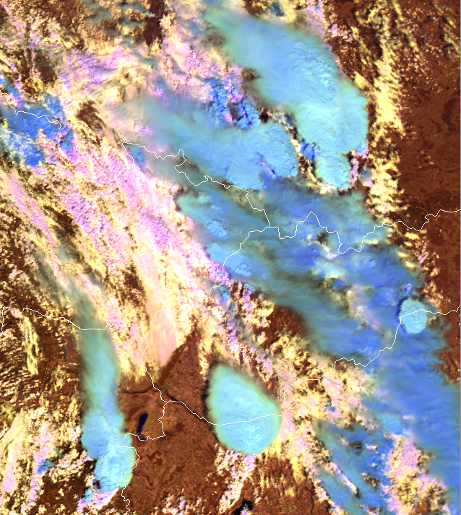
VIIRS Cloud Phase RGB
9 July 2021, 11:59 UTC
If you have only this information …
Please annotate which convective clouds/systems indicate possibly strong updrafts.
Notes:
If you have only this information …

Slide 16
VIIRS Cloud Phase RGB
9 July 2021, 11:59 UTC
ESWDB reports
10-16 UTC
Notes:
These appear most brighter cyan – these are covered by the smallest ice crystals. This indicate that the updraft within them might be strong.
Three of them really caused severe weather according to the ESWDB reports.
Looking at SEVIRI animation the cell on the Hungarian Slovakian border dissipated rather fast.

Slide 17
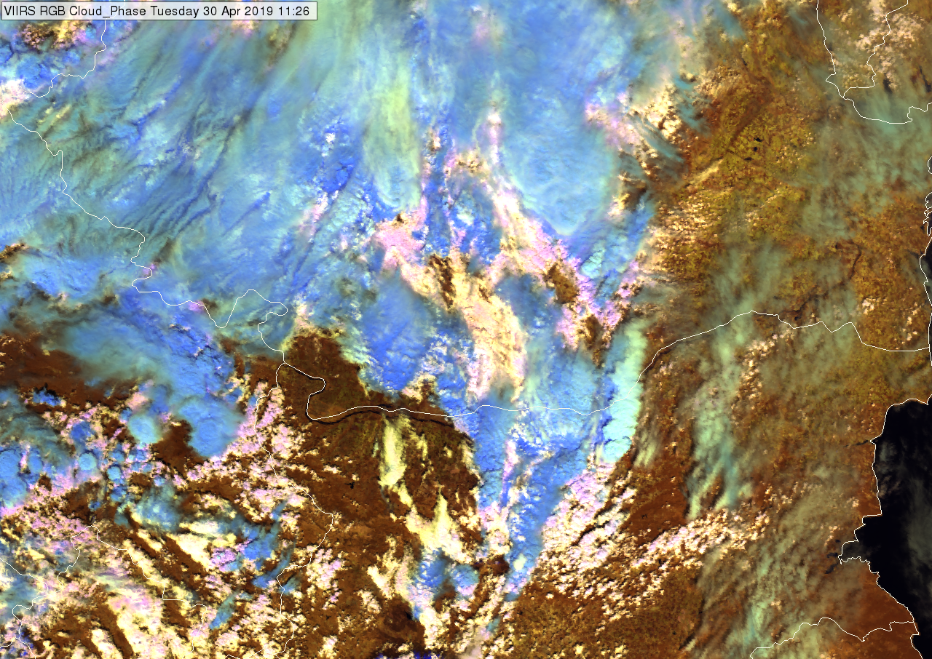
30 April 2019, 11:26 UTC
Romania, Bulgaria
Severe storm, large hail
Cloud Phase RGB
(NIR1.6, NIR2.25, VIS0.6)
Bright cyan - small ice crystals on the top of the thunderstorm
Medium blue - large ice crystals on the top of the thunderstorm

Slide 18
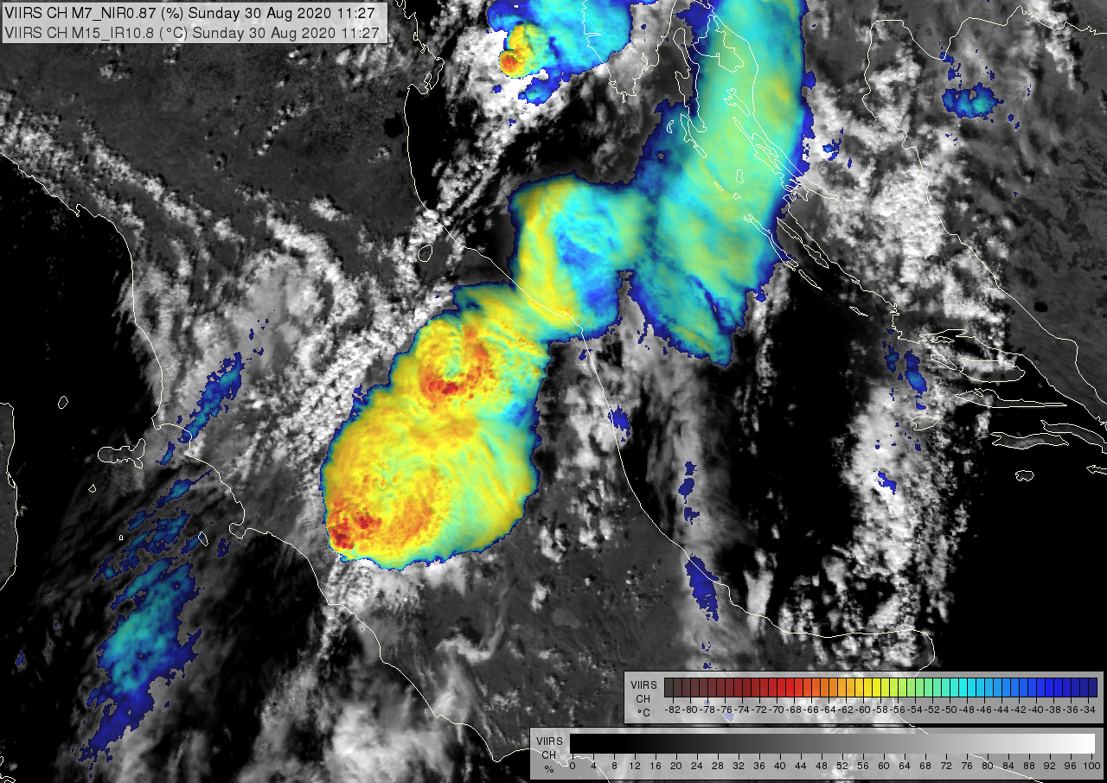
VIIRS Sandwich
image
30 August 2020, 11:27UTC
tornado was reported in central Italy
New cell is developing.
It breaks through a cloud.

Slide 19
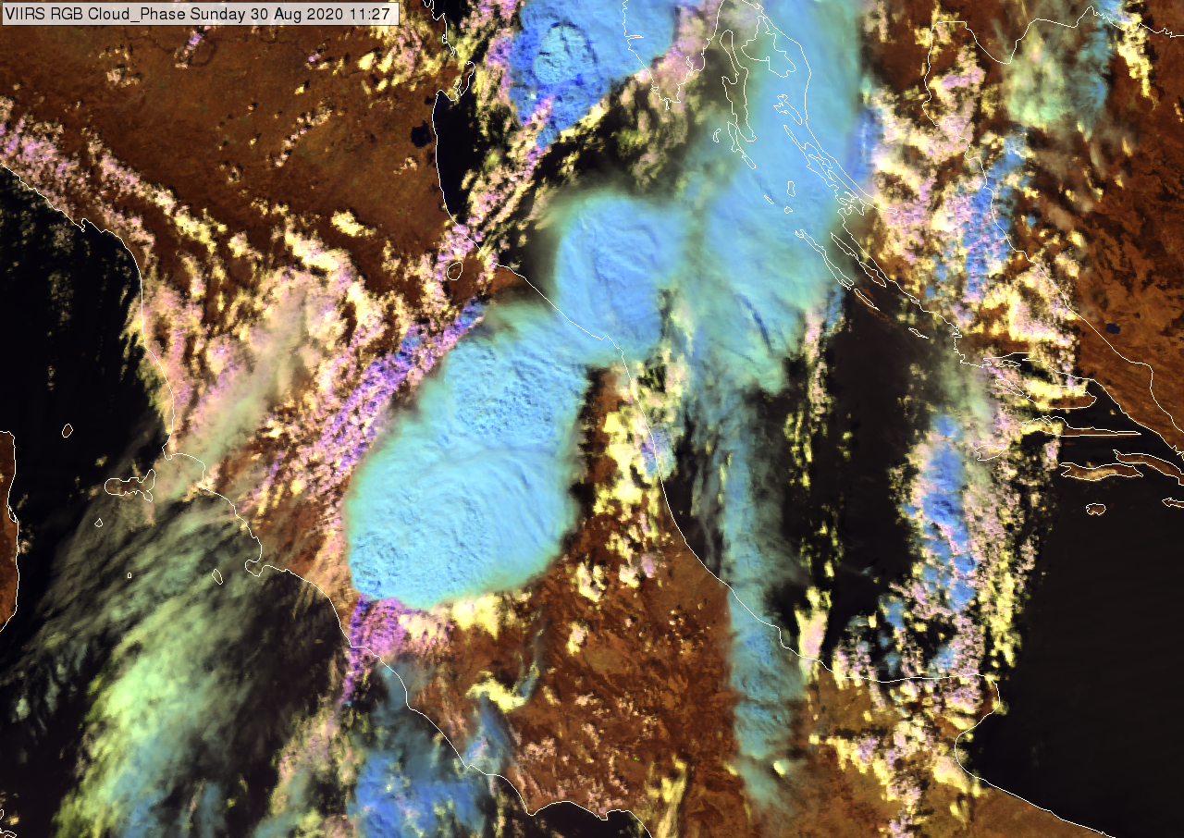
VIIRS Cloud Phase RGB
(NIR1.6, NIR2.25, VIS0.6)
30 August 2020, 11:27UTC
High color contrast between thick ice clouds covered by large and small ice crystals in Cloud Phase RGB
Is this color contrast seen in a SEVIRI RGB as well?
Notes:
Is this color contrast seen in a SEVIRI RGB as well?

Slide 20
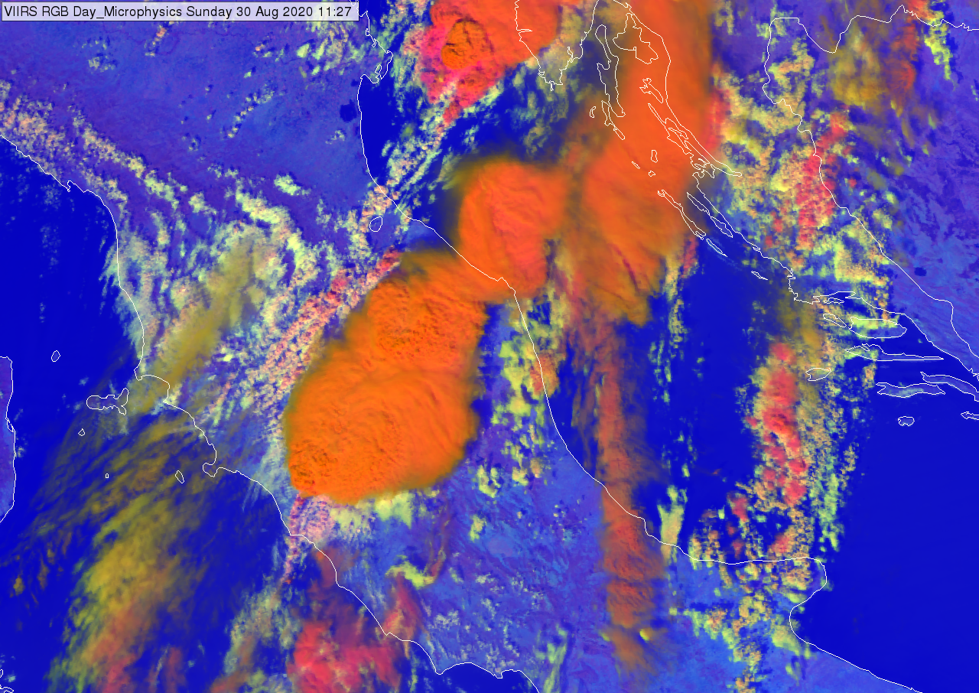
VIIRS
Day Microphysics RGB (with NIR1.6)
(NIR0.87, NIR1.6, IR10.8)
30 August 2020, 11:27UTC
Red – thick ice cloud covered by large ice crystals
Orange – thick ice cloud covered by small ice crystals
Note:
We compare Cloud Phase RGB with SEVIRI Day Microphysics RGB, because with SEVIRI data this is the RGB with reflects the cloud top microphysics.
It can be created either with NIR1.6 or IR3.9 channel on green. Here we show it with NIR1.6 because for ice clouds it works similarly (or better) as with IR3.9.
Based on several tests we found that
the new Cloud Phase RGB (which uses the NIR1.6 and NIR2.2 microphysical channels together) usually has better color contrast between thick ice clouds covered by small and large ice crystals, than the Day Microphysics RGB (which created only with NIR1.6 or with IR3.9).
Both RGBs showed color contrast between thick ice clouds covered by small /large ice crystals.
Cloud Phase RGB with better color contrast.
Notes:
We compare Cloud Phase RGB with SEVIRI Day Microphysics RGB, because with SEVIRI data this is the RGB with reflects the cloud top microphysics.
It can be created either with NIR1.6 or IR3.9 channelon green. Here I show it with NIR1.6 because for ice clouds it works similarly or better as with IR3.9. With SEVIRI data the convection RGB is also used for monitoring convection. However, it reflect a combined effect of cloud top temperature and particle size.

Slide 21
Outlines
Introduction
Physical background
Main application areas
General cloud analysis
Monitoring convection
Mature phase
Developing phase
Summary

Slide 22
Most important color shades at monitoring convection initiation.
glaciation on the top of towering cumulus clouds
Thick ice cloud, large particles
Thick ice cloud, small particles
initiation of new cells
Thick water cloud with extreme large particles or thick mixed phase cloud
Thick water cloud, large droplets
Thick water cloud, medium size droplets
Thick water cloud, small droplets
Sea Sandy desert Land with less/more green vegetation

Slide 23
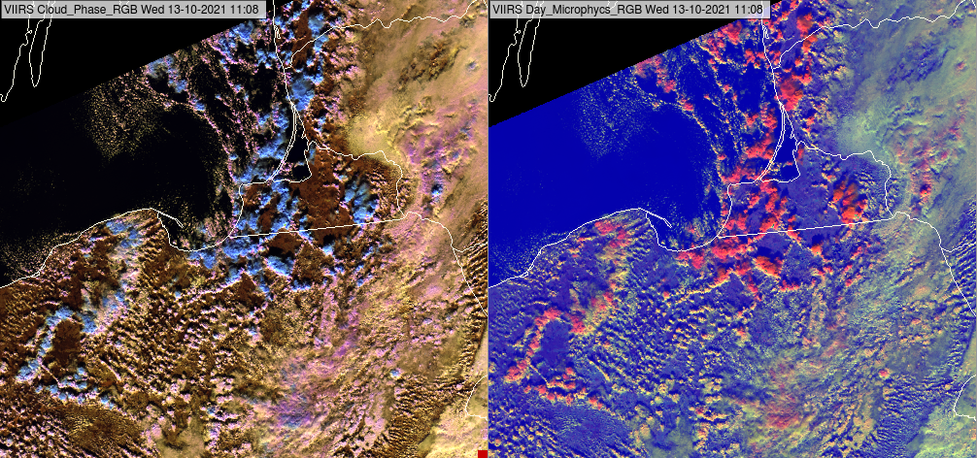
Isolated cumulus clouds
VIIRS Cloud Phase RGB
Glaciation of the top of towering cumulus clouds is well seen
Good color contrast between
cumulus clouds and surface
Water clouds and ice clouds
blue against pale yellow or pink.

Slide 24
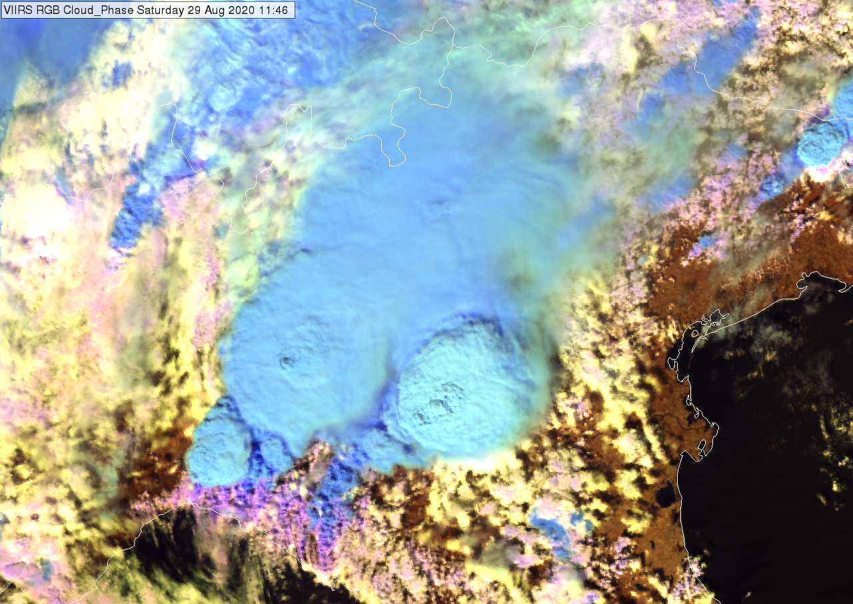
29 August 2020, 11:46 UTC
Cloud Phase RGB
(NIR1.6, NIR2.25, VIS0.6)
Multicell system
Color contrast between thick water clouds with extremely large droplets, and thick ice clouds
pink, magenta
against
blue

Slide 25
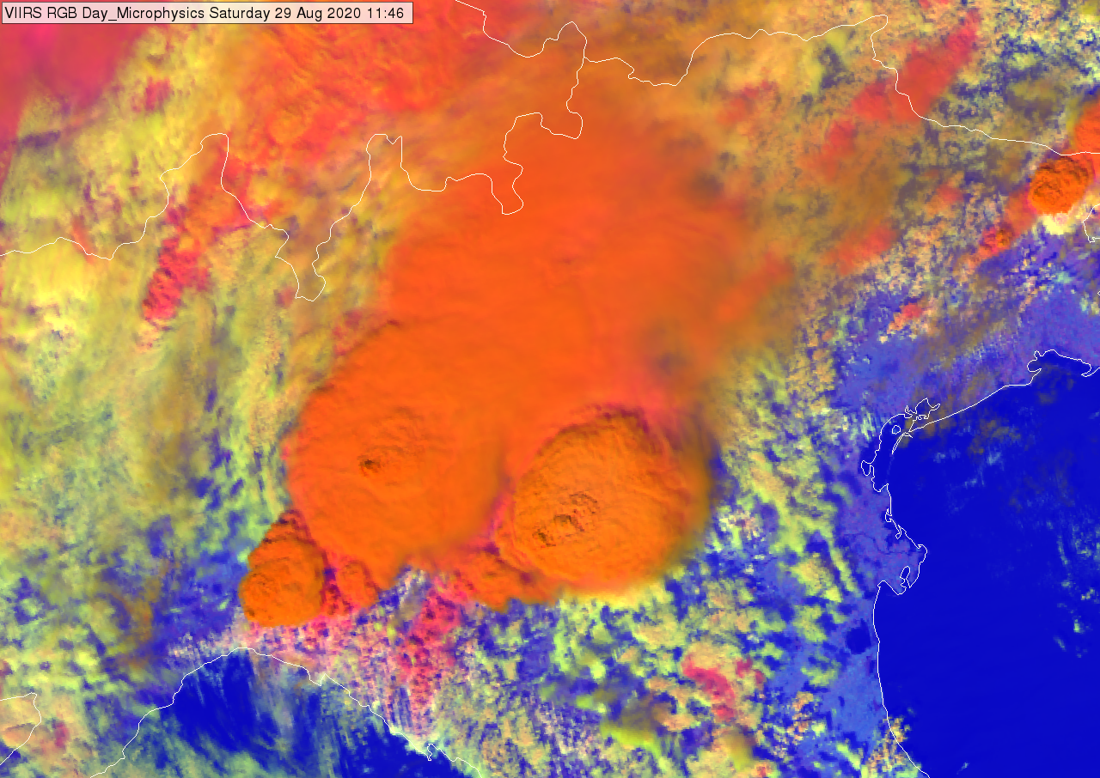
29 August 2020, 11:46 UTC
Day Microphysics RGB
with NIR1.6
(NIR0.87, NIR1.6, IR10.8)
Multicell system
Color contrast between thick water clouds with extremely large droplets, and thick ice clouds
pink against red

Slide 26
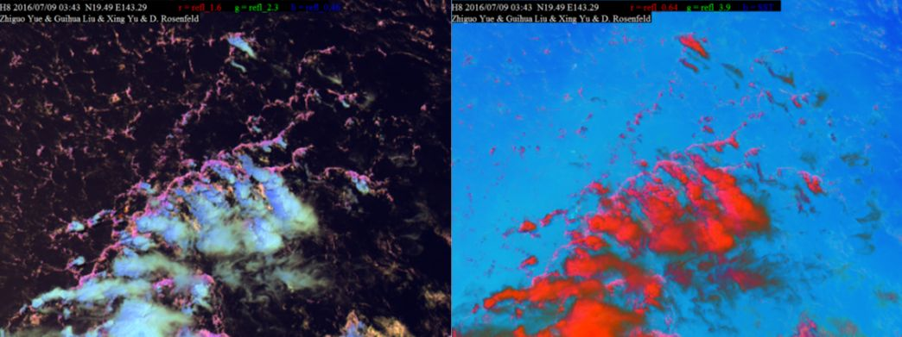
Deep convective clouds with outflow boundaries over the Philippine Sea in the Pacific Ocean.
The water clouds along the outflow boundary consist of large droplets, as cloud drops over pristine ocean are typically large.
09 July 2016 at 03:43 UTC
Himawari/AHI
Cloud Phase RGB
Day Microphysics RGB (with IR3.85)
Thick and thin ice clouds – bluish, greenish
Thick water clouds with large droplets - pink or magenta.
Ice clouds - red
water clouds with large droplets - pink
In the Cloud Phase RGB the color contrast between thick ice and water clouds is much higher than in the Day Microphysics RGB.
(Image from Daniel Rosenfeld, Hebrew University of Jerusalem, Israel)
Added value!

Slide 27
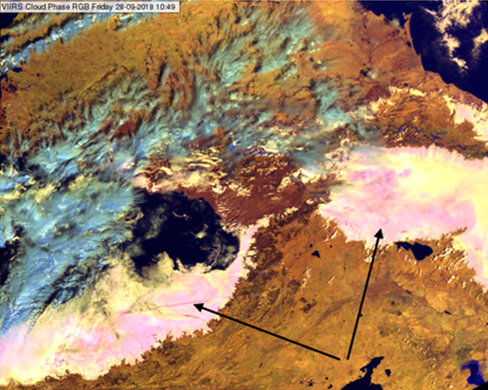
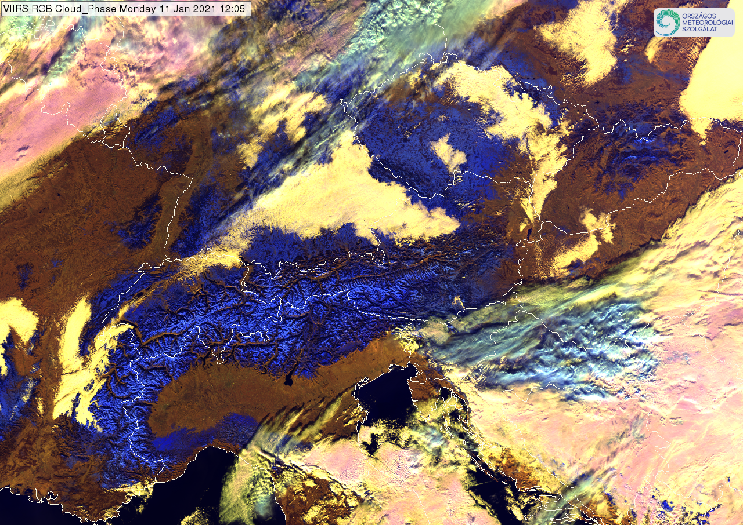
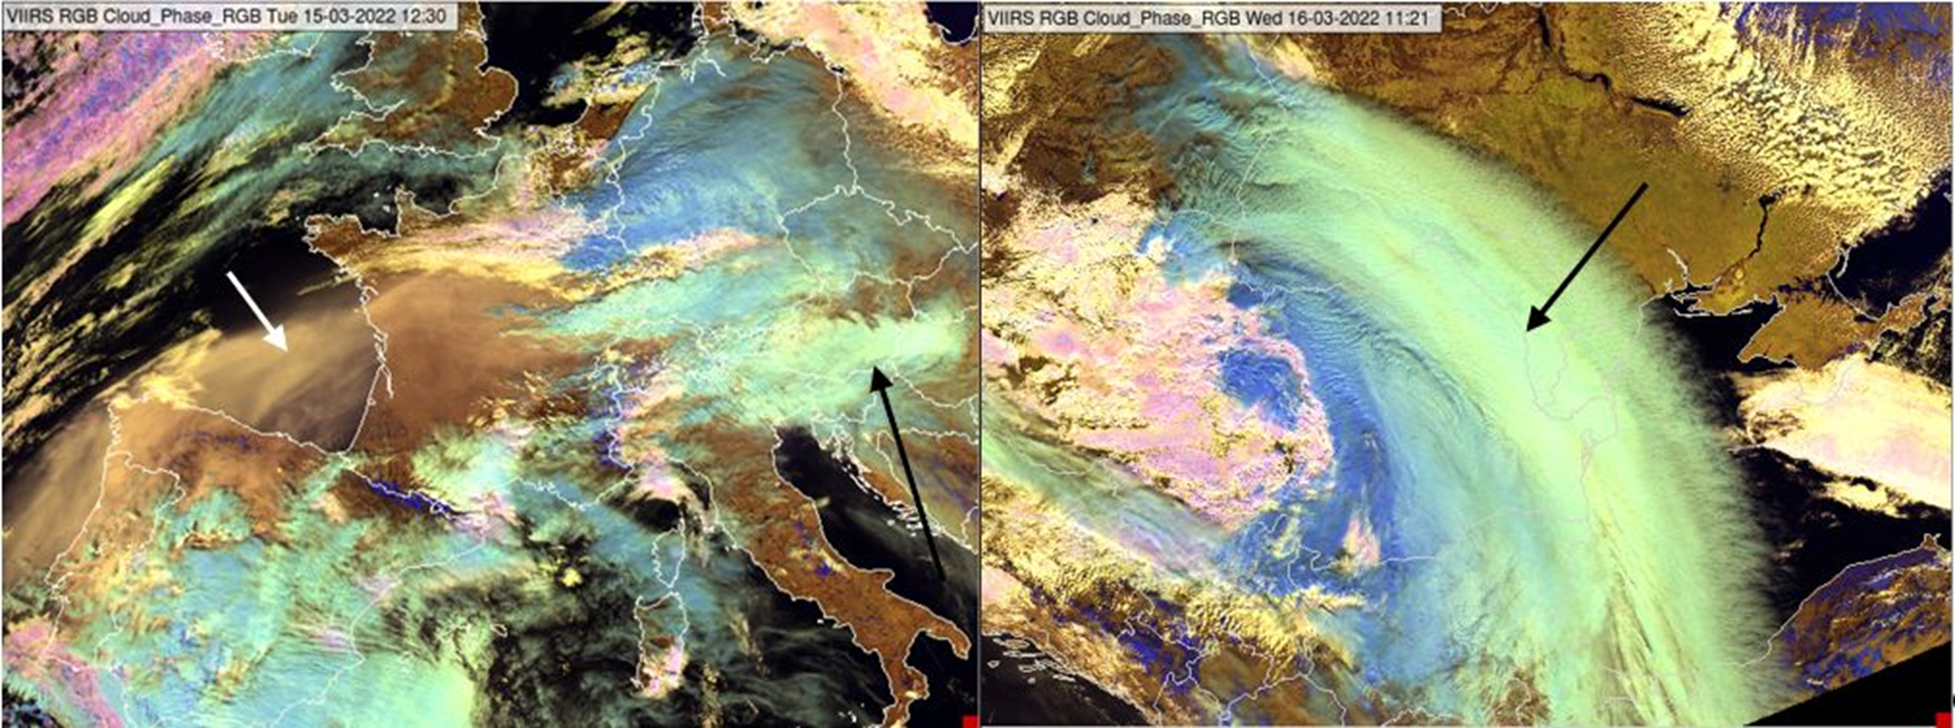
Some other areas of applications
Monitoring of fog/low cloud
Monitoring snow
Studying aerosol- cloud interaction

Slide 28
Outlines
Introduction
Physical background
Main application areas
General cloud analysis
Monitoring convection
Mature phase
Developing phase
Summary

Slide 29
Summary
Cloud Phase RGB reflects well the cloud top microphysics of thick clouds.
It is useful for monitoring convection both in developing and mature phase.
For the real FCI data further tests are needed.

Slide 30
Useful links
Quick Guide to the Cloud Phase RGB: https://www.eumetrain.org/sites/default/files/2023-01/CloudPhaseRGB.pdf
Quick Guide to the new microphysical channel, NIR2.25: https://eumetrain.org/sites/default/files/2020-05/NIR225QG.pdf
Extended guide to the Cloud Phase RGB https://resources.eumetrain.org/data/7/726/index.htm
RGB Color Guide on the EUMeTrain webpage: https://eumetrain.org/index.php/rgb-color-guide
Presentation of Daniel Rosenfeld: New capabilities with high resolution cloud micro-structure facilitated by MTG 2.3 µm channel https://eumetrain.org/index.php/resources/new-capabilities-high-resolution-cloud-micro-structure-facilitated-mtg-23-um-channel
Presentation at a CWG workshop: Mária Putsay: New RGB for convection monitoring based on newly available channels in MTG
Case studies in the EUMETSAT Image Library: https://www.eumetsat.int/forecasting-revolution-its-way
https://www.eumetsat.int/studying-convective-situation-europe-viirs-images https://www.eumetsat.int/contrail-shadows-over-stratus https://www.eumetsat.int/ship-trails-industrial-plumes ...
Case study on the EUMeTrain webpage: https://eumetrain.org/resources/snow-spain-january-2021-viirs-cloud-phase-rgb-imagery
Product Tutorial on Sandwich product https://eumetrain.org/index.php/resources/sandwich-products-satellite-imagery-visualisation-technique

Slide 31
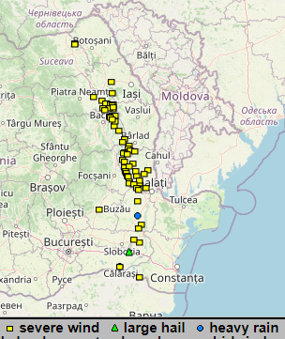
preliminary
3
MTG FCI
Cloud Phase RGB animation
6.8.2023, 10:10 – 14:40 UTC
Thank you for the attention!
https://www.eumetsat.int/forecasting-revolution-its-way
Notes:
Promising that Cloud Phase RGB with FCI data will work similarly as we experienced with proxy data.

