Slide 1
Estimating rainfall from the bottom-up: the SM2RAIN-derived rainfall product
Luca Ciabatta and the Hydrology Group of IRPI-CNR (Italy)

Slide 2
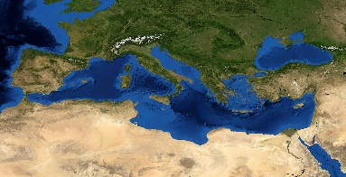
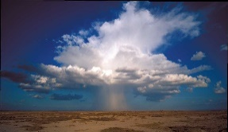


Outline
RATIONALE
SM2RAIN ALGORITHM
HSAF PRODUCT
SOME APPLICATIONS

Slide 3
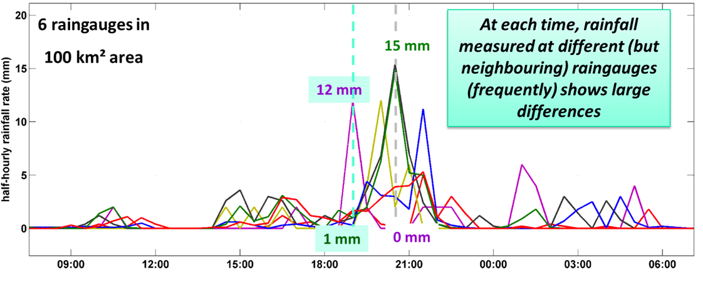
Rationale
The retrieval approach used in state-of-the-art precipitation products (e.g., GPM) is (mainly) based on a “top-down” approach providing an estimate of the
INSTANTANEOUS RAINFALL RATE at the satellite overpass
At least, 10 passes per day are needed for obtaining satisfactory performance in estimating 1-day rainfall
Ciabatta, L. et al. (2017) Journal of Hydrology 545, 436-450

Slide 4
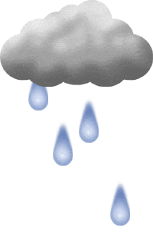
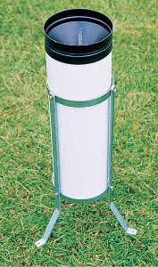

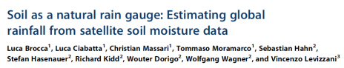
SM2RAIN Algorithm
HOW DO WE MEASURE RAINFALL?
We “measure” the water level in the gauge for getting rainfall
We “measure” the water level in the soil
(SOIL MOISTURE) for getting rainfall
RAIN GAUGE
SM2RAIN

Slide 5
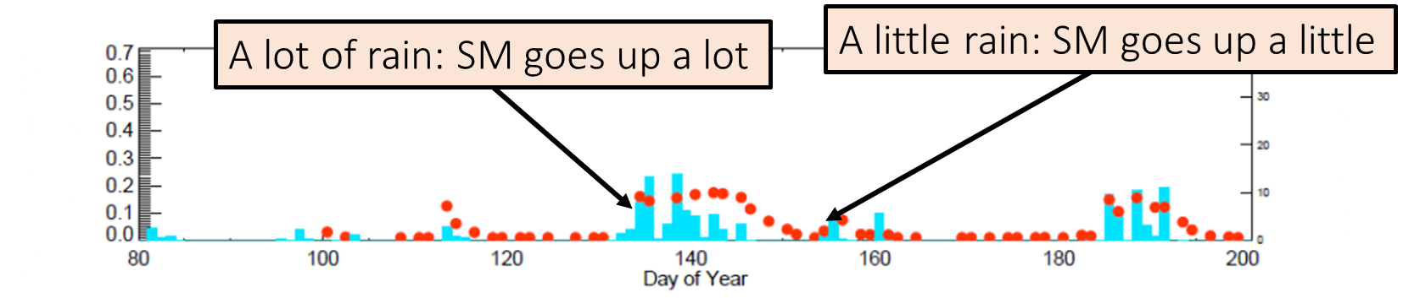
SM2RAIN Algorithm
e(t):
evapotranspiration
p(t):
rainfall
Soil moisture
Precipitation
r(t):
surface runoff
relative soil moisture
SOIL LAYER
surface runoff
drainage
precipitation
g(t):
drainage= deep percolation
+ subsurface runoff
Z*ds(t)/dt=p(t)-r(t)-e(t)-g(t)
soil water capacity
= soil depth X porosity
evapotranspiration
During rainfall, surface runoff and evapotranspiration are assumed to be negligible
g(t)=as(t)^{b} r(t)=0 e(t)=0
p(t)=Z*ds(t)/dt+as(t)^{b}

Slide 6
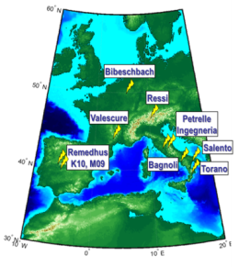
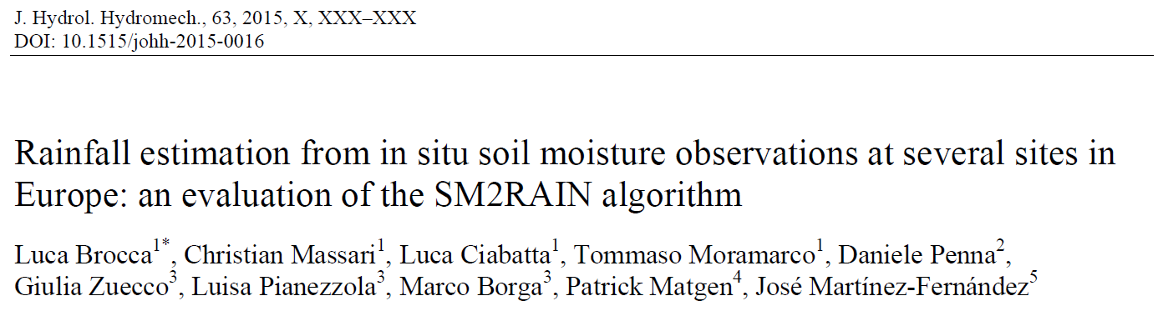
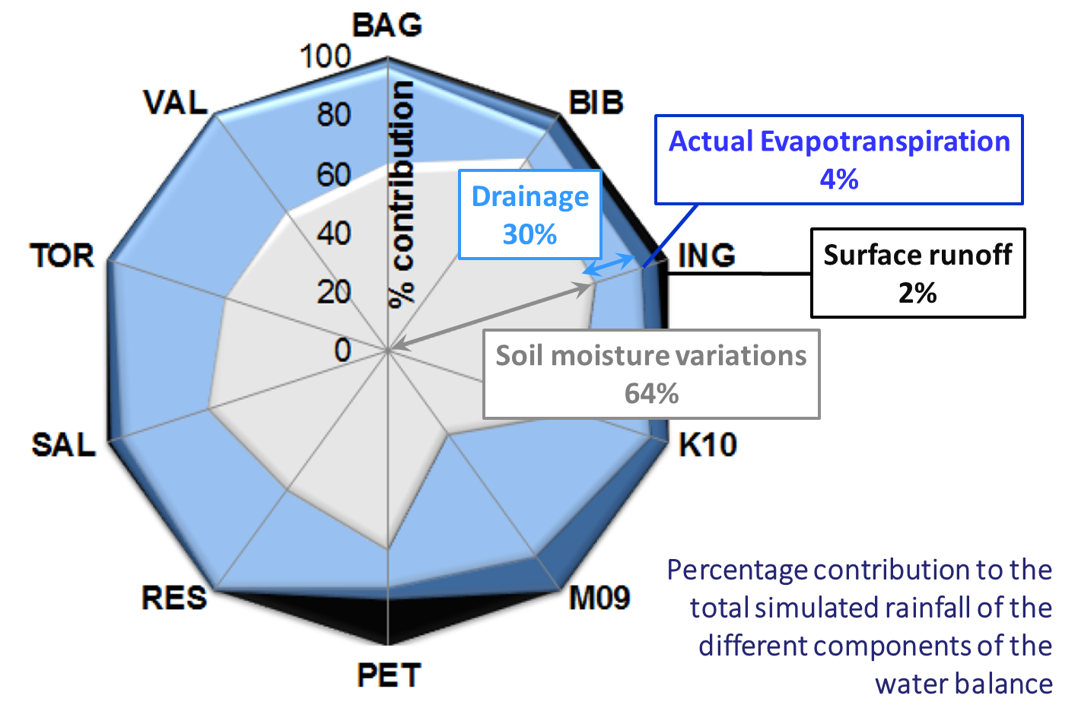
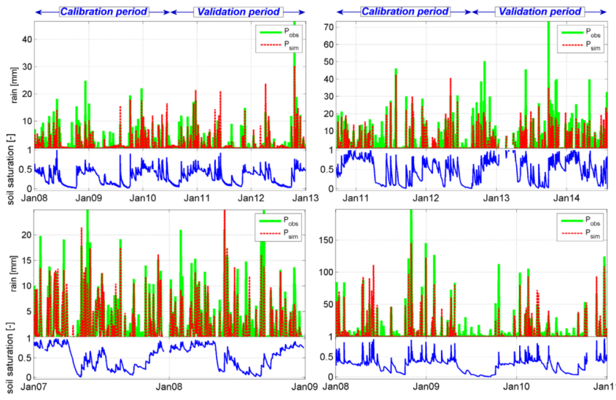
SM2RAIN Algorithm
SM Variations
Drainage
Actual Evap
Surface Runoff
In situ soil moisture observations

Slide 7
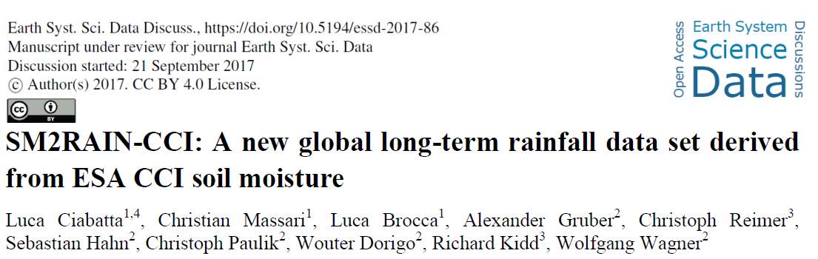
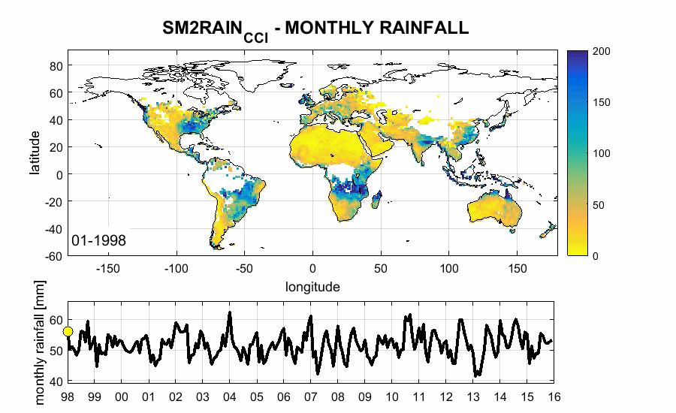
SM2RAIN Algorithm
Long-term dataset - Visiting scientist activity under ESA CCI Soil Moisture project
18 years of global rainfall estimates
http://doi.org/10.5281/zenodo.1305021

Slide 8
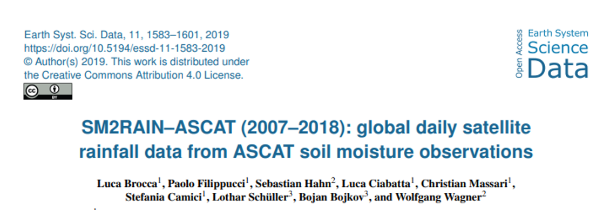
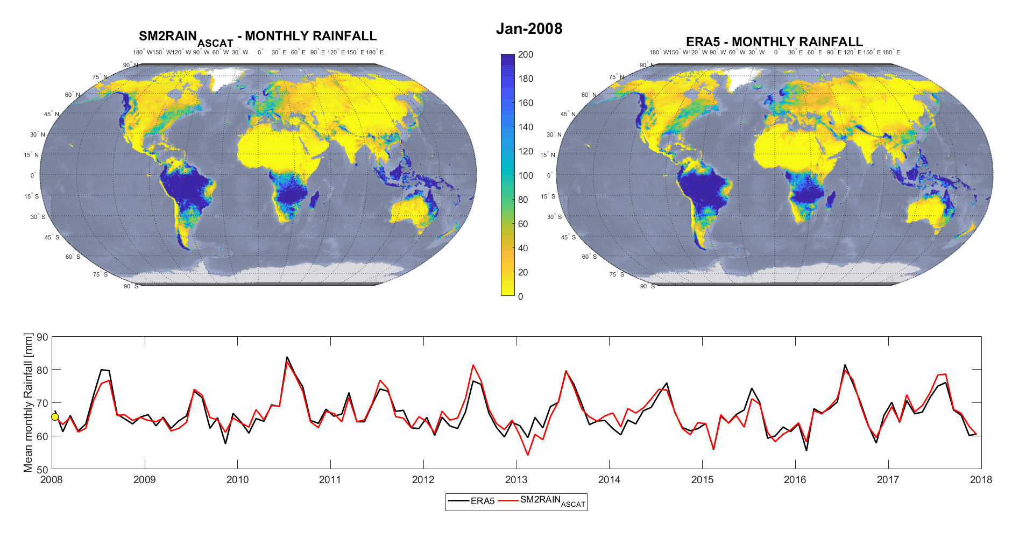
SM2RAIN Algorithm
Based only on ASCAT SM data Freely available at Zenodo
https://doi.org/10.5281/zenodo.3405563

Slide 9
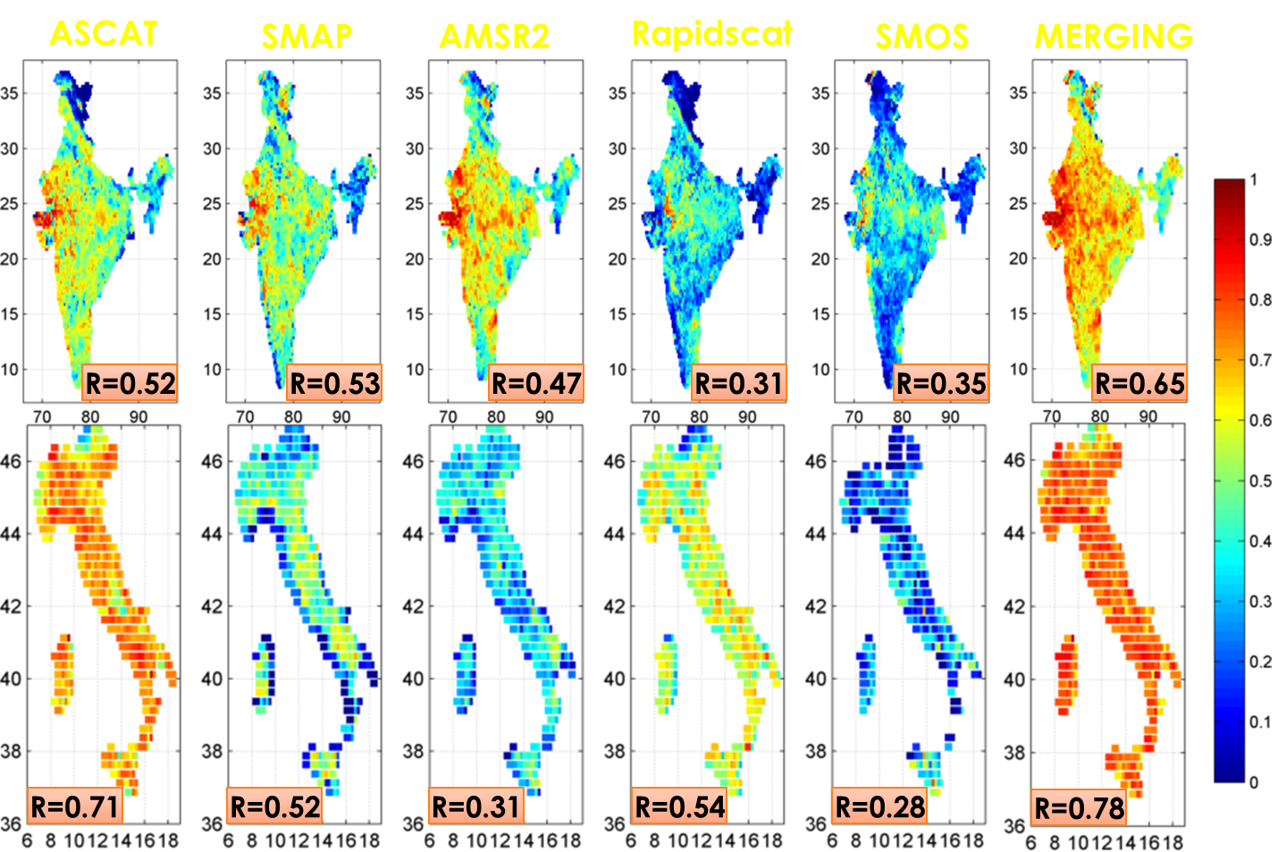
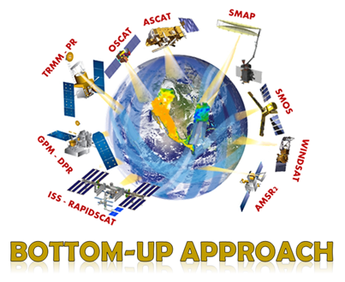
SM2RAIN Algorithm
ASCAT
SMAP
AMSR2
Rapidscat
SMOS
MERGING
SM2RAIN to multiple satellite SM missions
RED is good ☺ → High correlations against ground observations

Slide 10
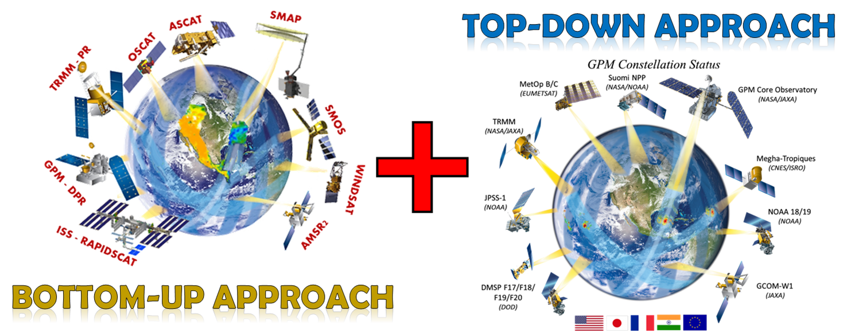
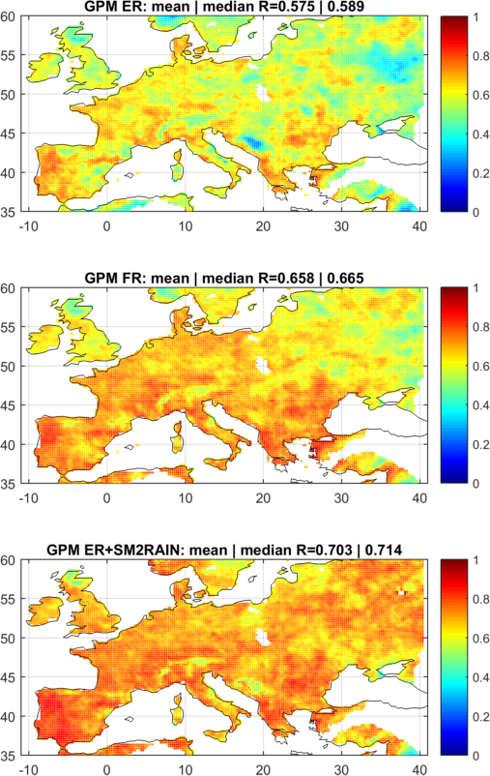
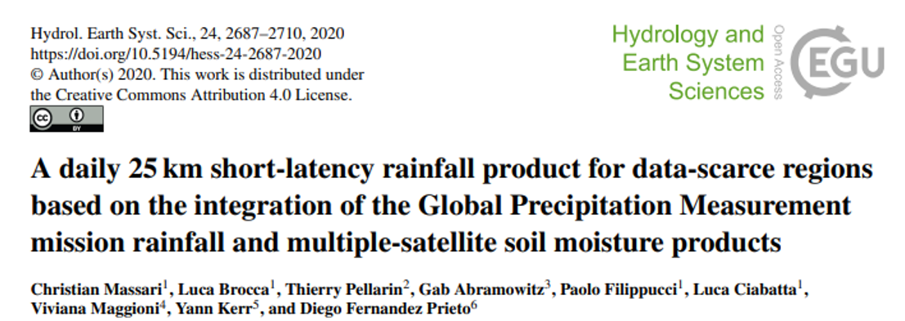
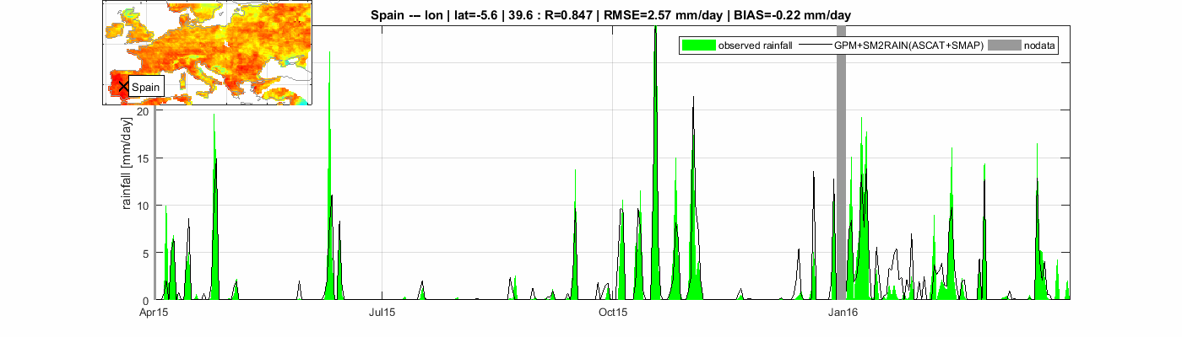
SM2RAIN Algorithm

Slide 11
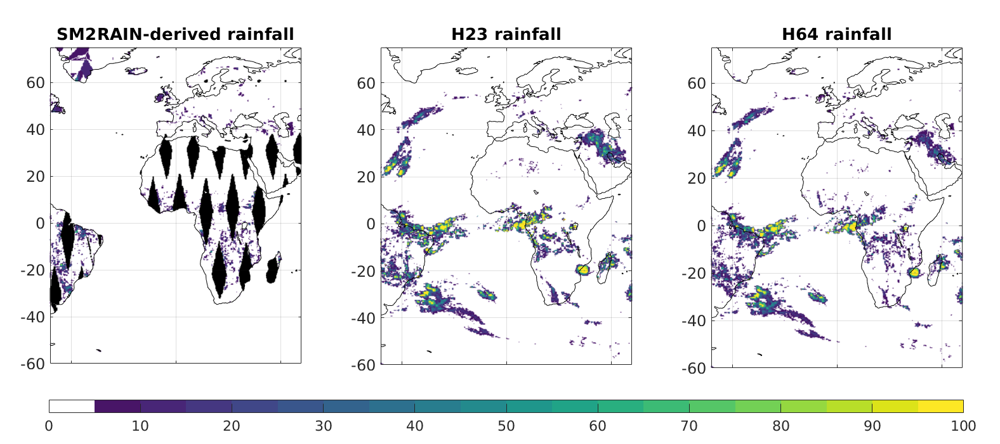
H SAF Product
The soil moisture-precipitation integrated product
P-AC-SM2RAIN (H64)

Slide 12
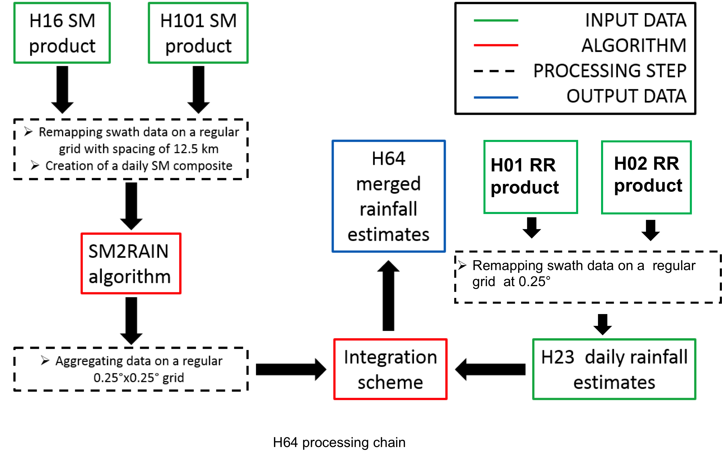
H SAF Product

Slide 13
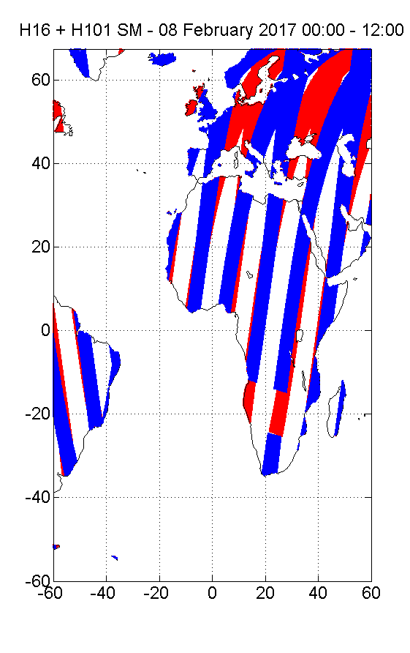
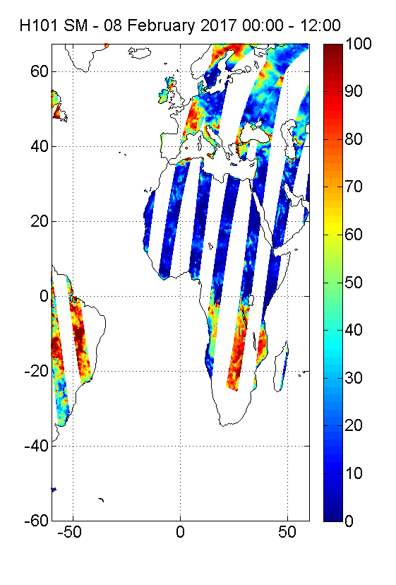
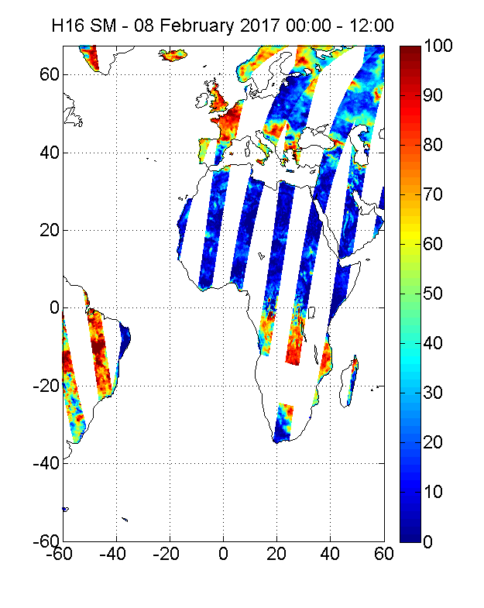
H SAF Product
H101
Swath Format
Daily composite
Daily SM maps
from H16 and H101
H16
Swath Format
Daily composite

Slide 14
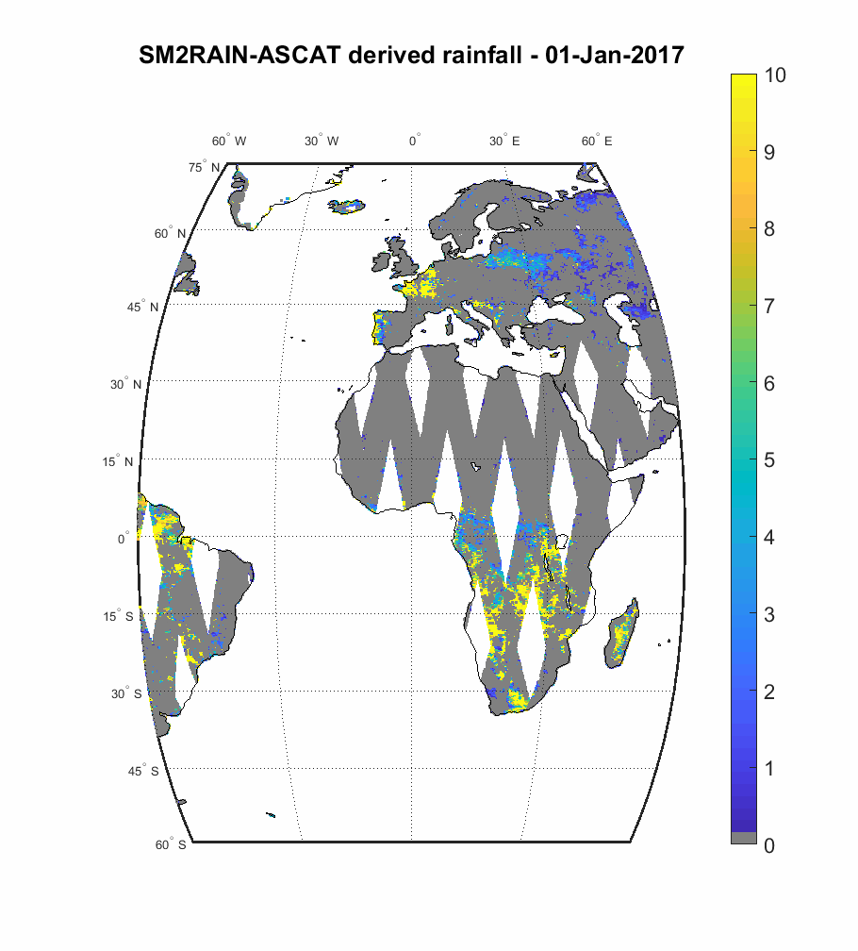
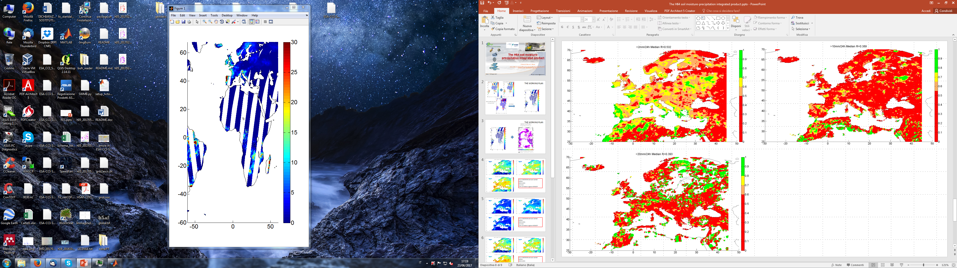
H SAF Product
Daily SM maps
from H16 and H101
SM2RAIN
Daily SM derived
rainfall maps (SM2RAIN_HSAF)
SM2RAIN parameters calibrated through the use of H113 CDR product considering ERA5 rainfall as benchmark during the period 2007-2017
SM2RAIN

Slide 15
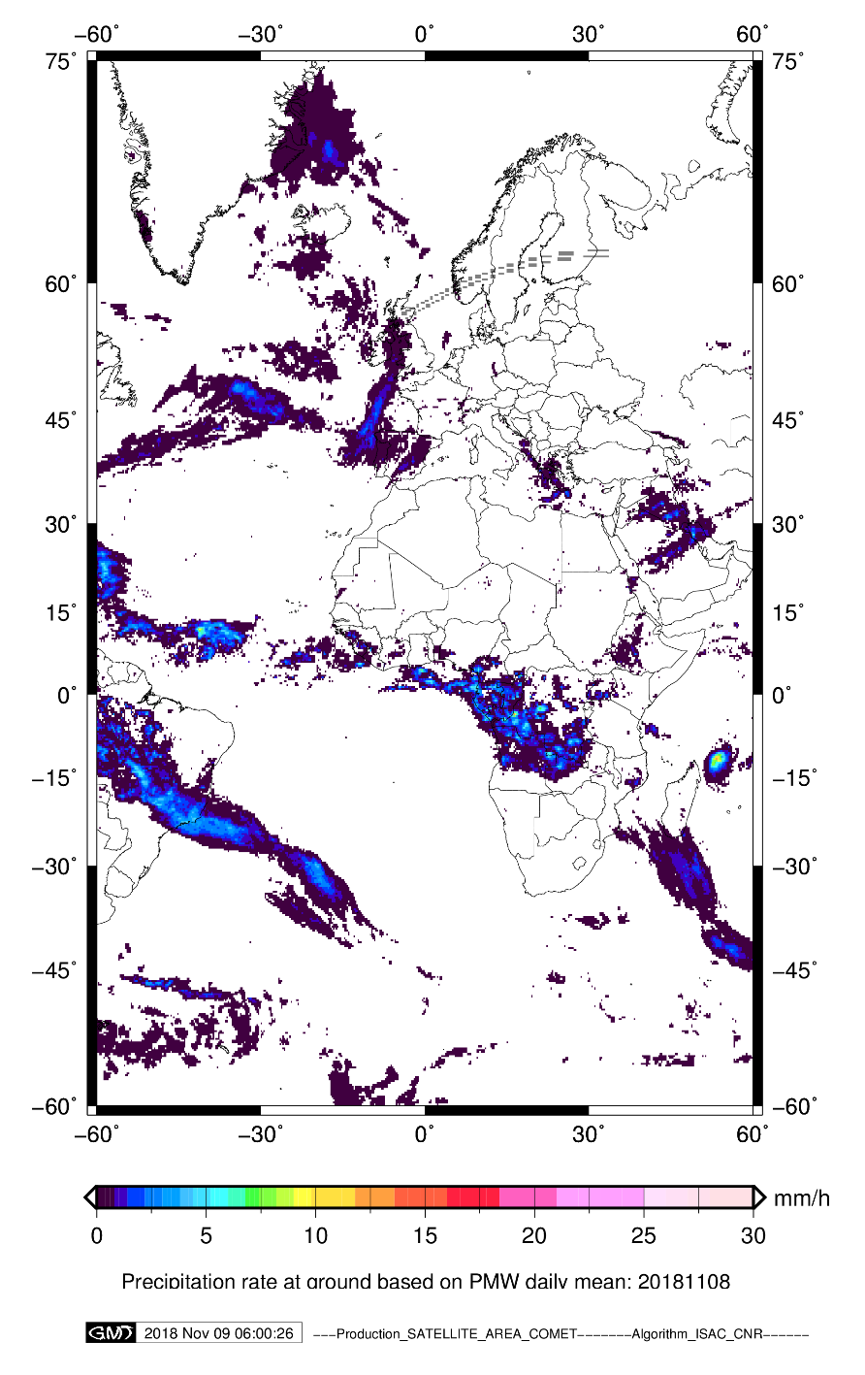
H SAF Product
SM2RAIN derived
rainfall
Regridding
over H23 grid
Integration with H23
H64
The integration id performed only over land
If SM2RAIN-derived rainfall is missing, only H23 is used and viceversa

Slide 16
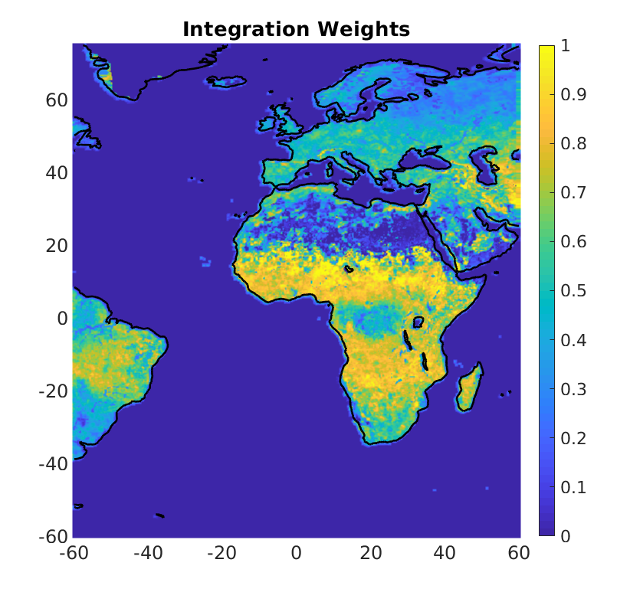
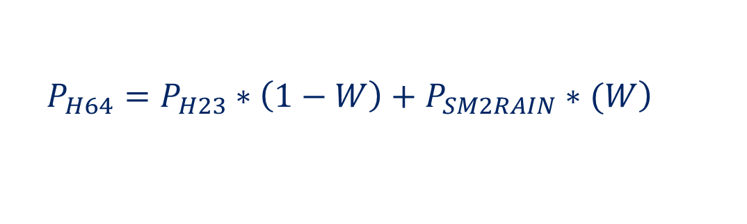
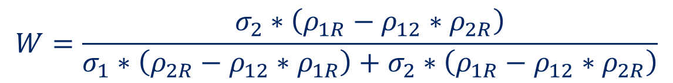
H SAF Product
$$\left.P_{H64}=P_{H23}∗\left(1−W\right)+P_{SM2RAIN}∗(W\right)$$
$$W=\frac{σ_{2}∗\left(ρ_{1R}−ρ_{12}∗ρ_{2R}\right)}{σ_{1}∗\left(ρ_{2R}−ρ_{12}∗ρ_{1R}\right)+σ_{2}∗\left(ρ_{1R}−ρ_{12}∗ρ_{2R}\right)}$$

Slide 17
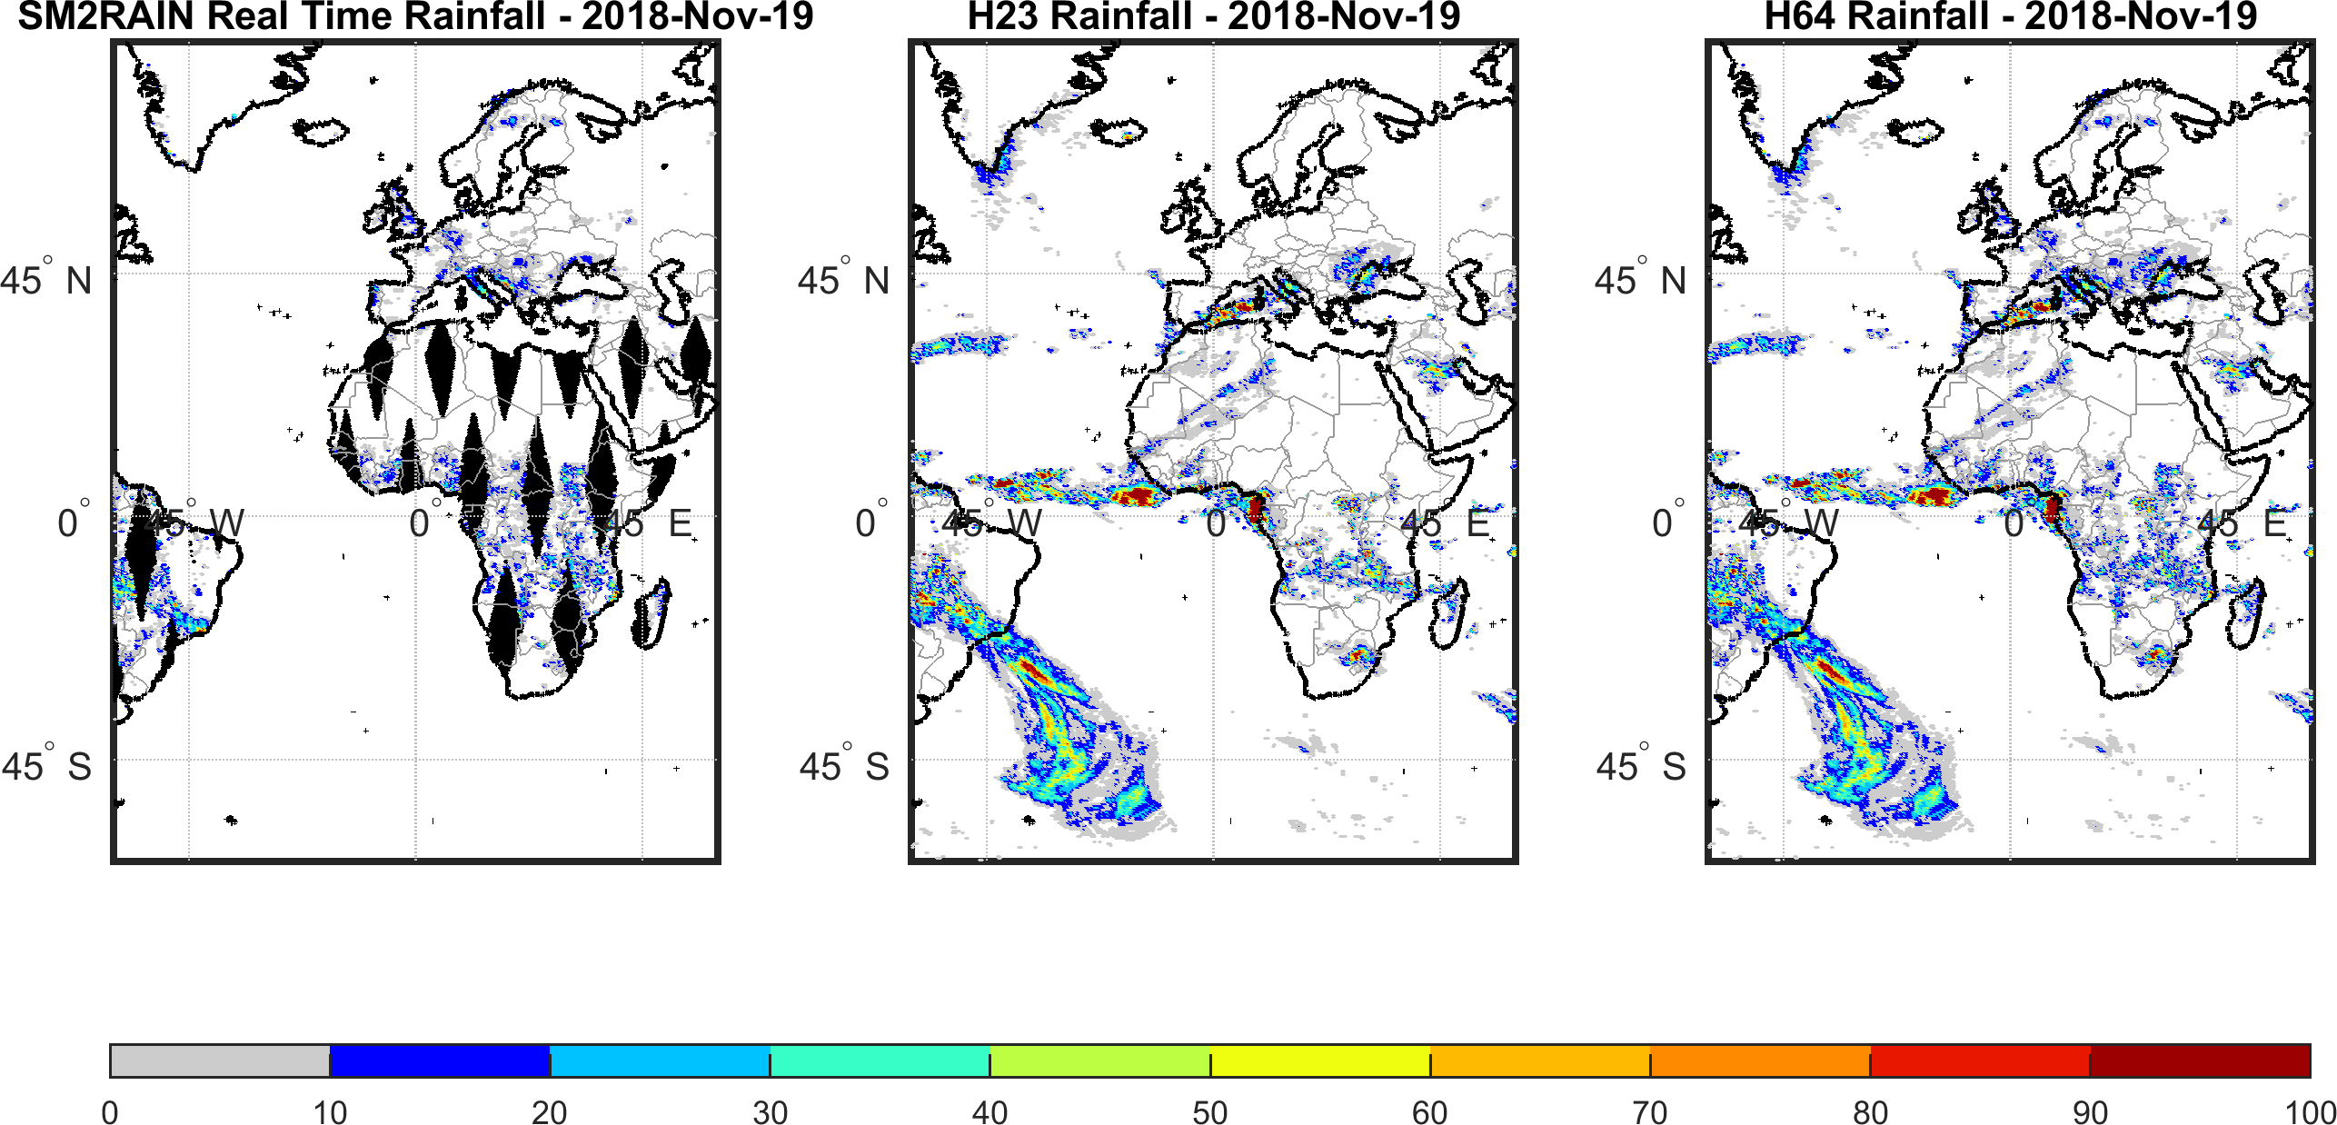
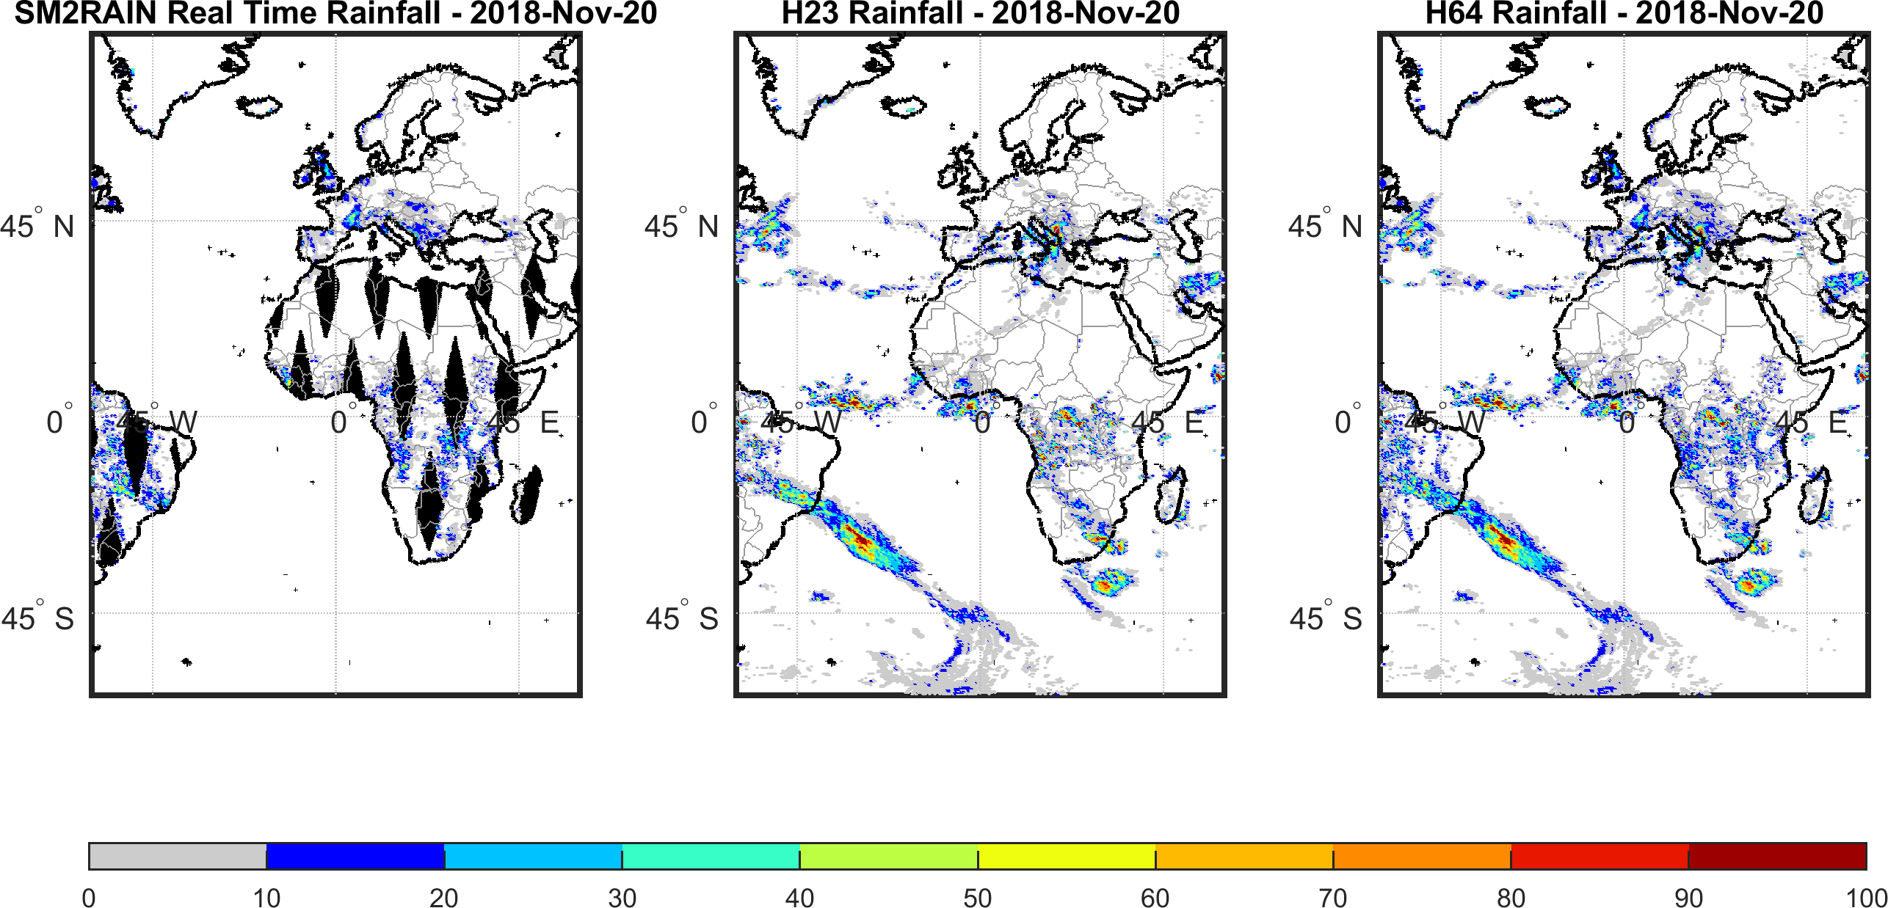
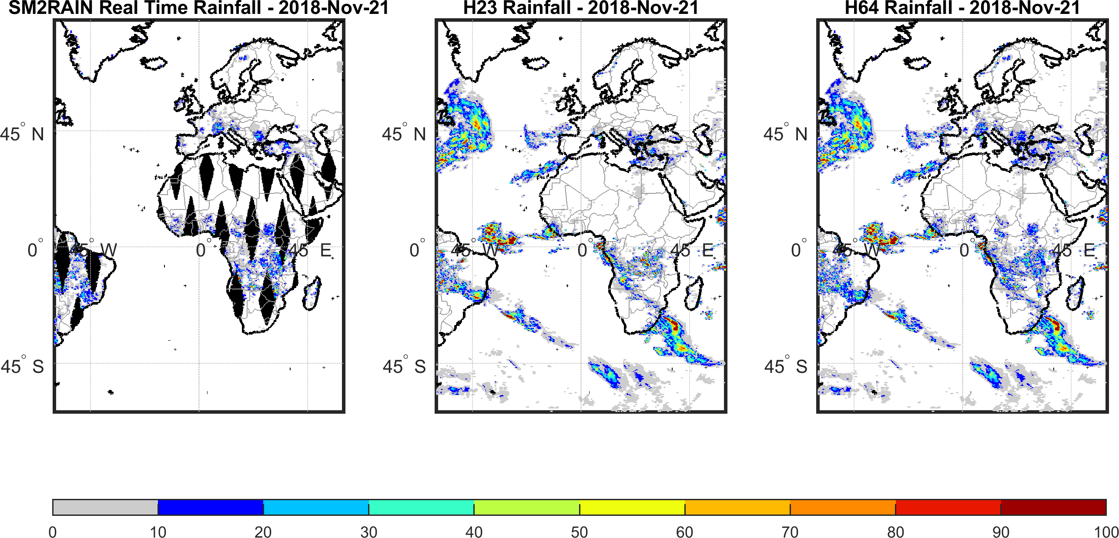
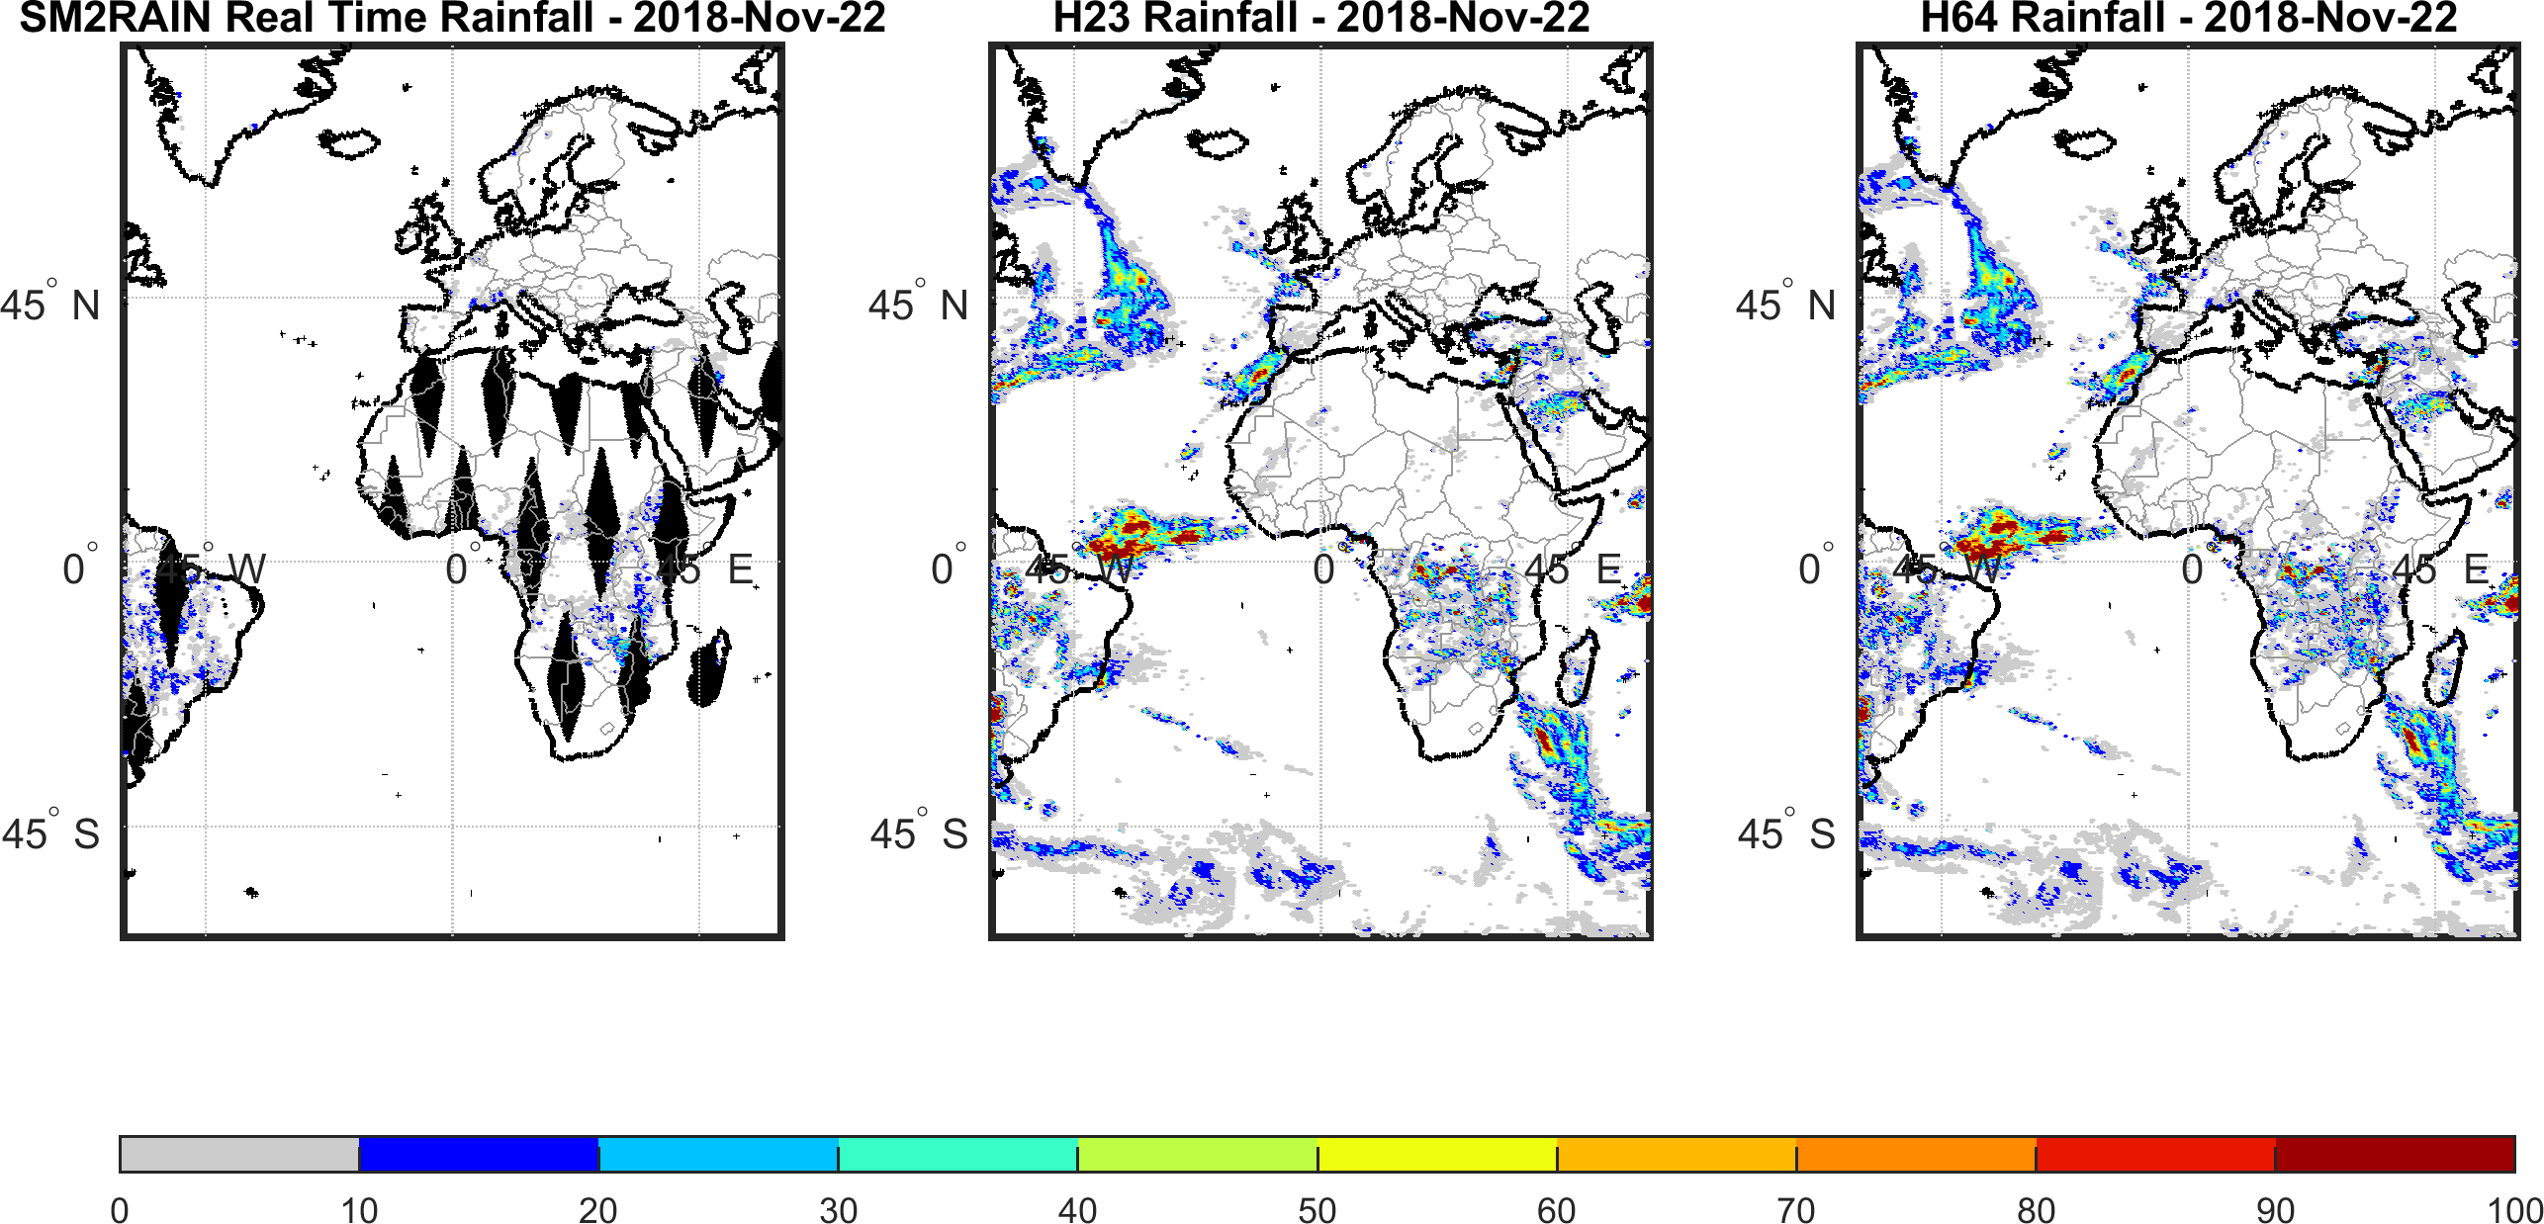
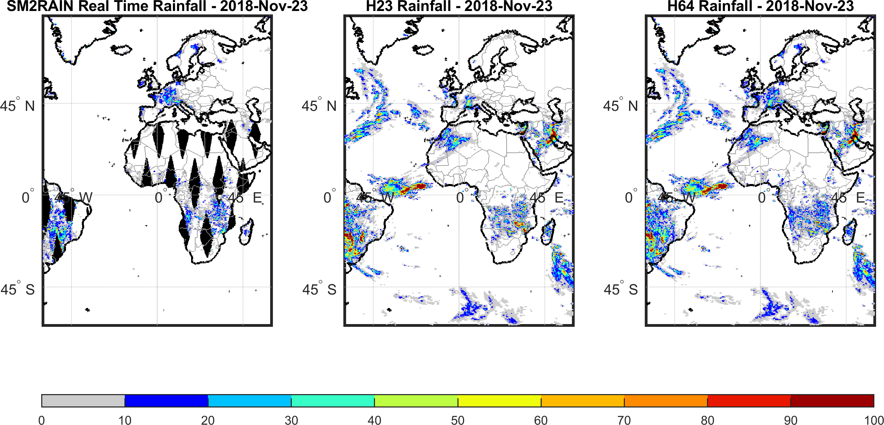
H SAF Product
P-AC-SM2RAIN (H64)
main features:
Daily temporal resolution;
0.25° spatial resolution;
Offline product (1 day latency);
Format netCDF;
Availability since 2019

Slide 18
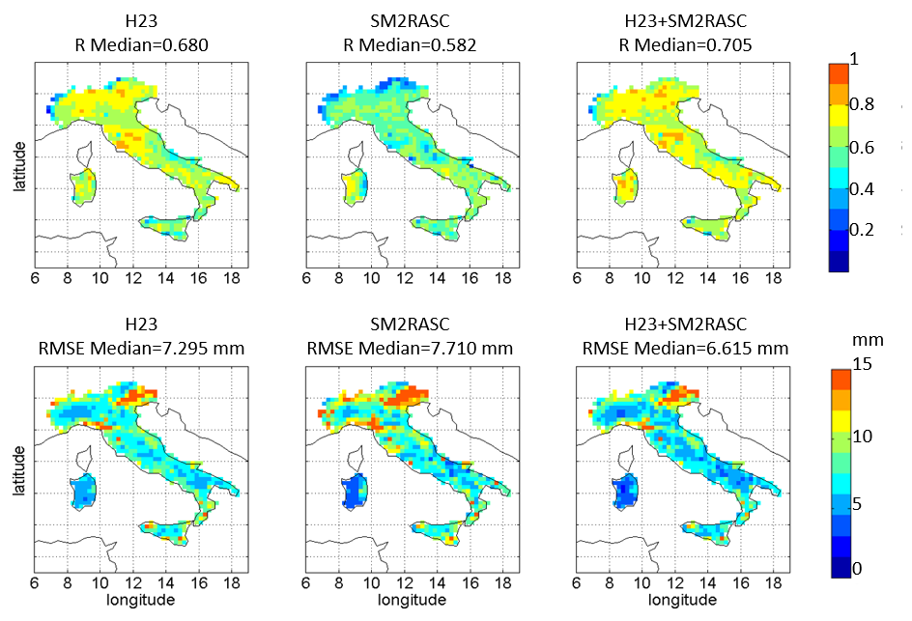
H SAF Product
Correlation maps
2011-2014

Slide 19
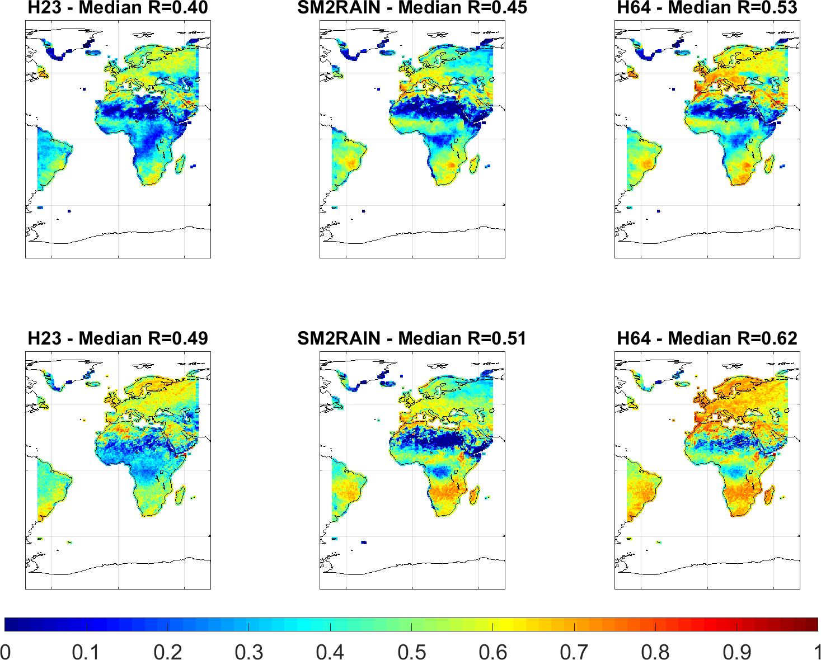
H SAF Product
Correlation maps
2011-2014
VS GPCC
VS ERA5

Slide 20
H SAF Product
SM2RAIN-derived products portfolio
Product ID | Product Acronym | Product Type | Coverage | Spatial resolution | Temporal Resolution
H64 | P-AC-SM2RAIN | Precipitation/Soil Moisture integrated product | Extended H SAF area (LAT 60°S – 75°N, LON 60°W – 60°E) | 0.25° | Daily
H75 | P-AC-SCA-SM2R | Soil Moisture-based product (SM2RAIN) for EPS-SG SCA | Global | 6.25 km | Daily
H79 | P-AC-SM2R-PMW-G | Precipitation/Soil Moisture integrated product | Global | 0.25° | Daily
H84 | P-AC-SM2R-PMW-G-L | Gauge adjusted Precipitation/Soil Moisture integrated product | Global | 0.25° | Daily
H87 | P-AC-SM2R-DR | SM2RAIN-only rainfall product | Global | 0.1° | Daily

Slide 21
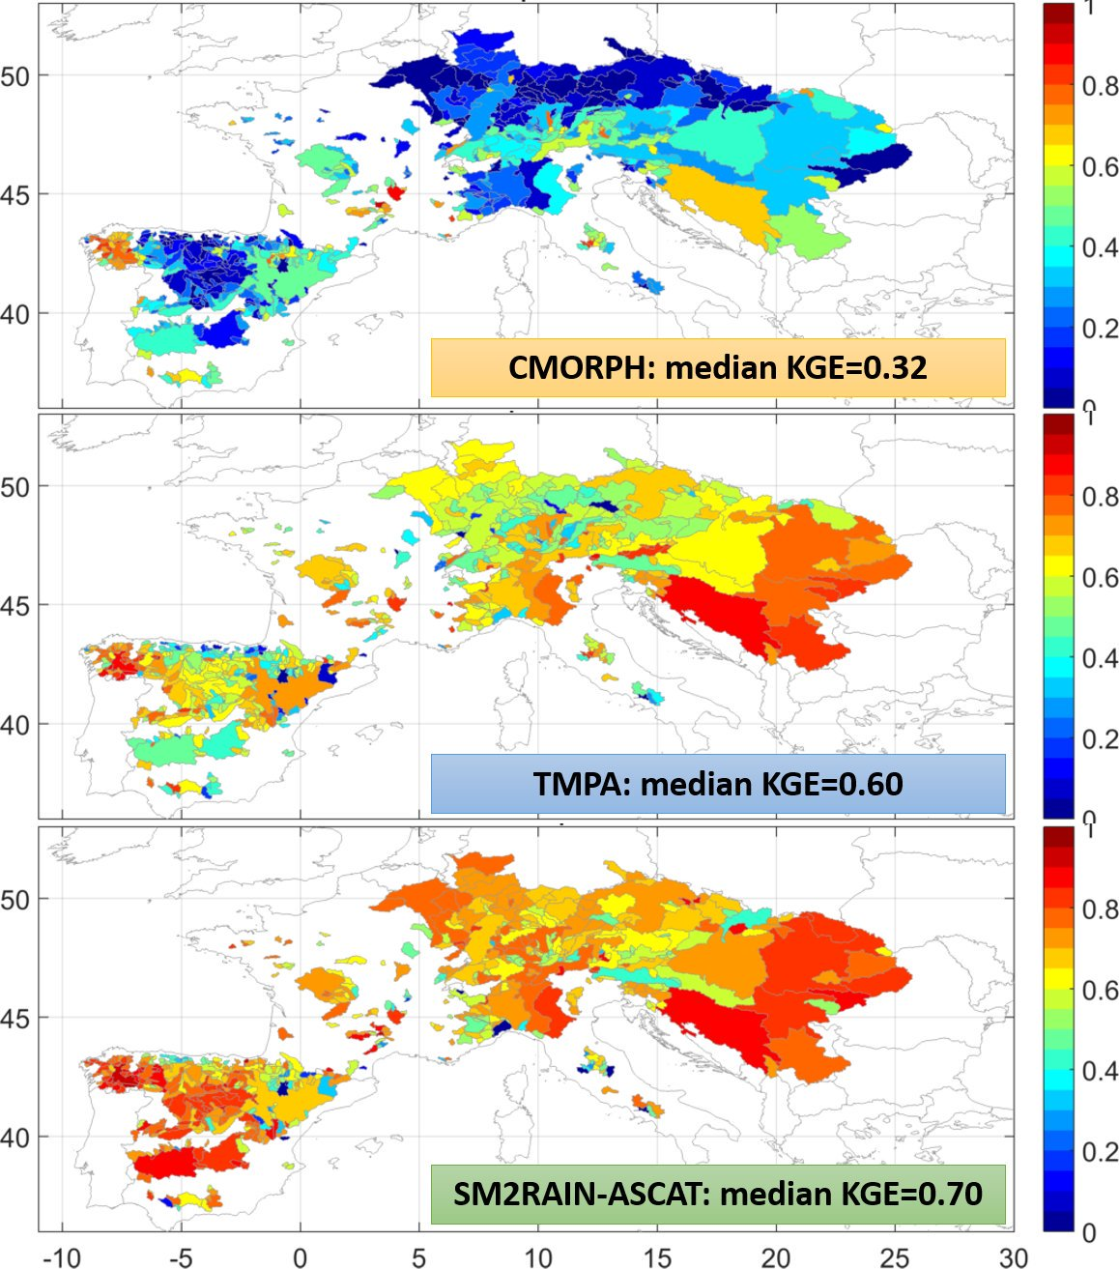
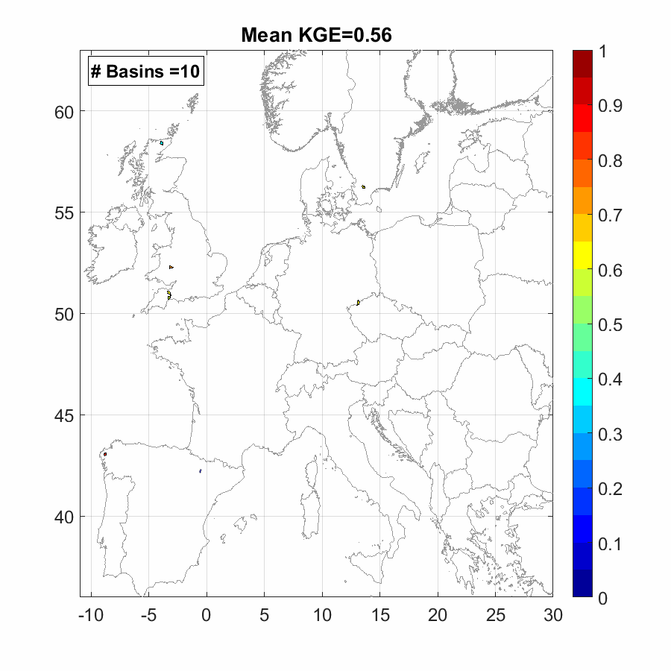
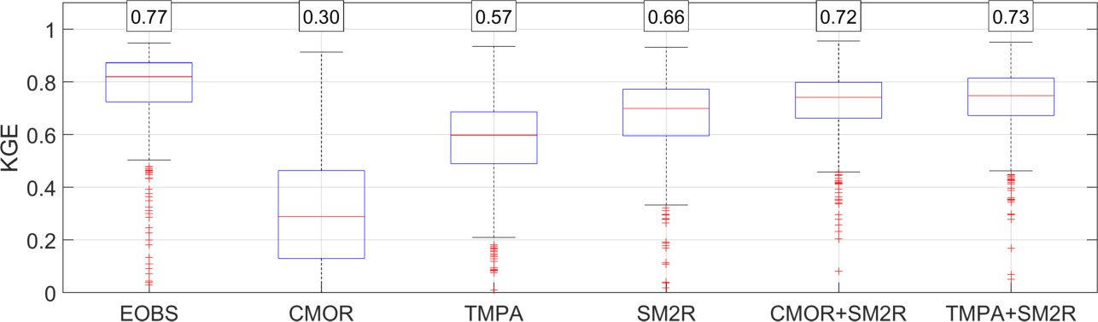
Some Applications
RED is good ☺ → High performance in terms of flood estimation against streamflow observations (through hydrological modelling)
Camici, S. et al (2018)
Journal of Hydrology
563, 950-961
Simulation of floods over 600 basins throughout Europe
Don’t miss the presentation by Christian Massari on Thursday at 9 UTC!!
See also Massari et al. (2014, ADWR); Ciabatta et al. (2016, JAG); Abera et al. (2017, HESS); Massari et al. (2018, RS)

Slide 22
Some Applications
Brunetti, M. et al (2018)
Remote Sensing of Environment 210, 65-75
TARGET
SM2RAIN-ASCAT+
CMORPH
Don’t miss my presentation on Friday at 9 UTC!!
TMPA
CMORPH
IN SITU
SM2RAIN-ASCAT
SM2RAIN-ASCAT integrated with CMORPH performs the best benefiting from the better accuracy of SM2RAIN-ASCAT and the high temporal resolution (hourly) of CMORPH
POD
PERSIANN
POFD

Slide 23
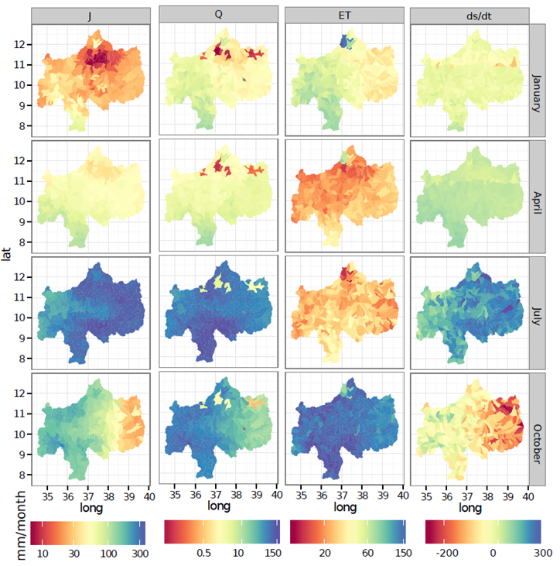
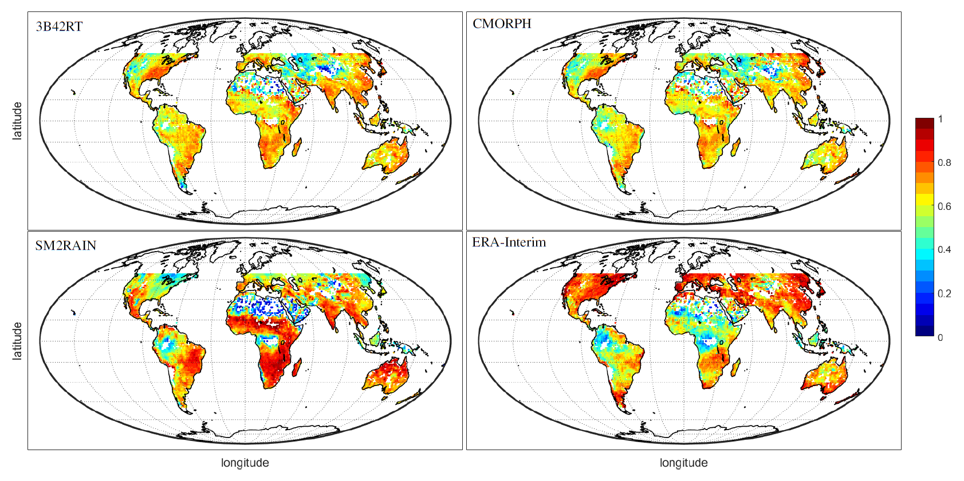
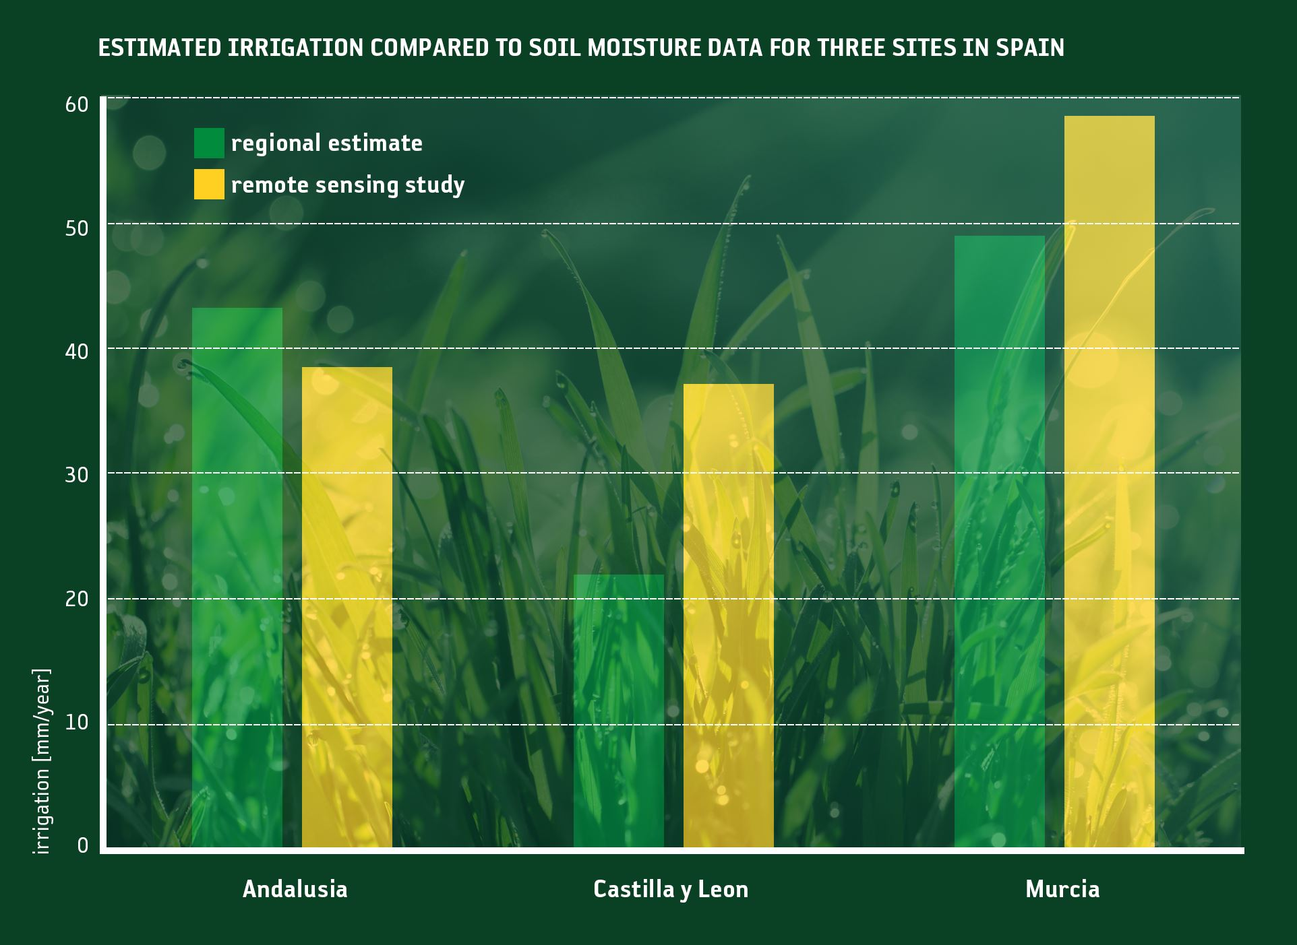
Some Applications
CROP MODELLING
WATER RESOURCES MANAGEMENT
VALIDATION OF SATELLITE PRODUCTS
IRRIGATION

Slide 24
Thank you for your attention
For further information about SM2RAIN just contact us:
luca.ciabatta@irpi.cnr.it
idrologia@irpi.cnr.it

