Slide 1
CONVECTION WEEK 2019
20th to 24th May 2019
H-SAF precipitation products
Davide Melfi
Italian Air Force Met Service - COMet
H-SAF Project Management

Slide 2
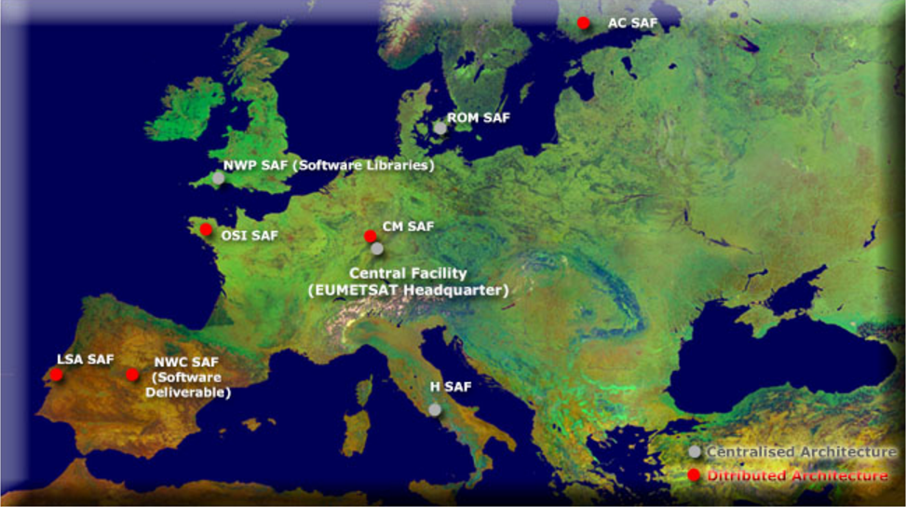













SAF NETWORK
The Satellite Application Facilities (SAFs) are a distributed network of thematic application facilities responsible for necessary research, development, and operational activities not carried out by the central facility. The SAFs are located within the National Meteorological Services (NMS) of EUMETSAT Member States, or other agreed entities linked to a user community.
Slide 2

Slide 3
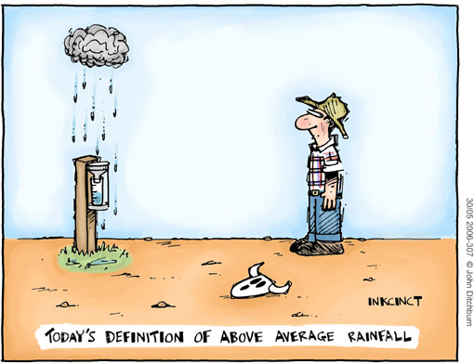
H-SAF Objectives
Civil Protection,
Risk Management,
Hydrological applications,
Nowcasting,
Hydrology and water management,
Climate,
NWP
to provide satellite-derived products from existing and future satellites with sufficient time and space resolution to satisfy the needs of operational hydrology; identified products:
    precipitation (liquid, solid, rate, accumulated);
    soil moisture (at large-scale, at local-scale, at surface, in the roots region);
    snow parameters (detection, cover, melting conditions, water equivalent);
to perform independent validation of the usefulness of the new products for fighting against floods, landslides, avalanches, and evaluating water resources; the activity includes:
  downscaling/upscaling modelling from observed/retrieved fields to basin level;
  fusion of satellite-derived measurements with data from radar and rain gauge networks;
  assimilation of satellite-derived products in hydrological models;
  assessment of the impact of the new satellite-derived products on hydrological applications.
Slide 3

Slide 4
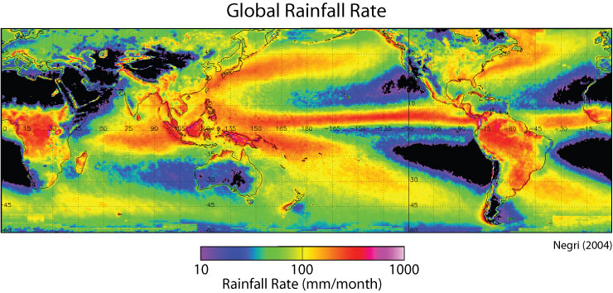
Why?
Meteorological satellite provide a unique opportunity for monitoring the precipitation for regions where ground measurement is limited and consistent with the accuracy required by hydrologists.
Slide 4

Slide 5
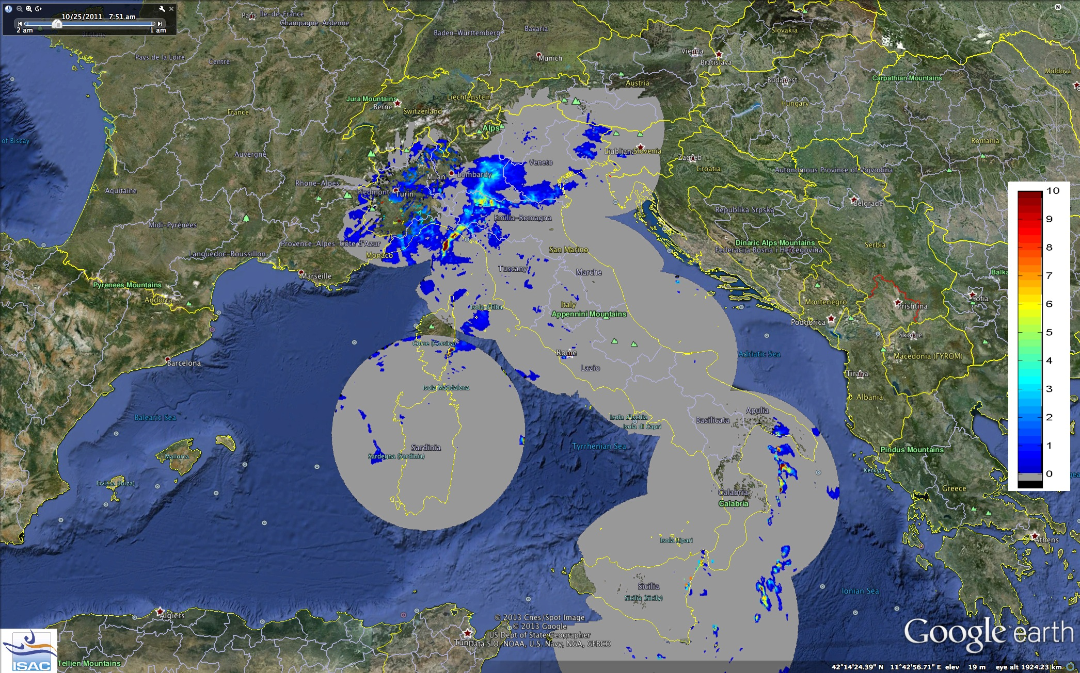
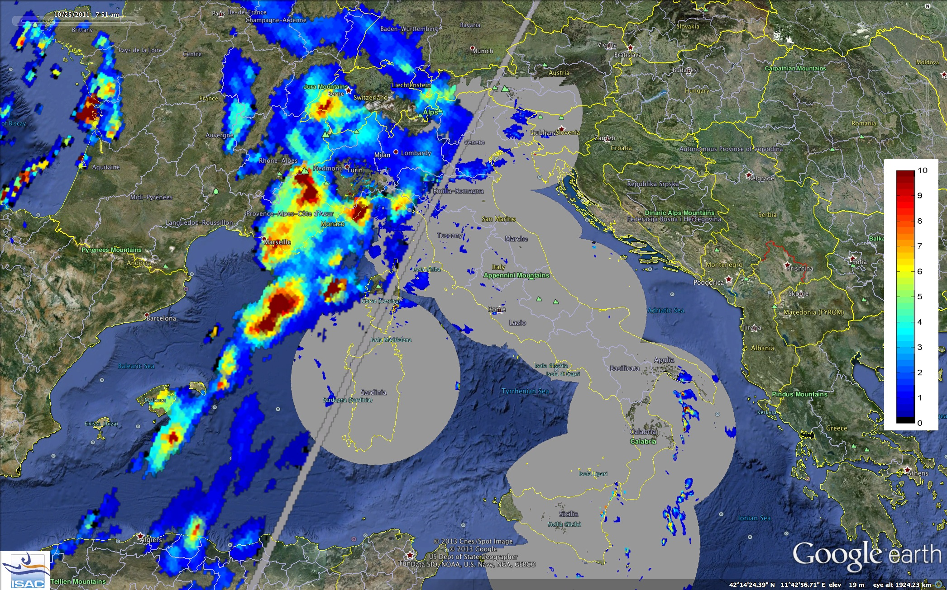
Heavy Precipitation Events Monitoring: Italian Radar Network Mosaic (DPC)
Why from Space?
25 October 2011 – 05:50 UTC
Cinque Terre Flood
Remote sensing rainfall rate retrieval
SSMIS overpass at 5:50 UTC

Slide 6
H-SAF Operational Products
Key Points
Products are provided in NRT
Their timeliness is compliant with the needs of operational users: some products are provided within 15 minutes from last received image
Operational provision:
    24/7 service
    Full operational support
Long term perspective (up to 2032)
High accessibility: EUMETCast dissemination, ftp direct download, orders

Slide 7
H-SAF precipitation products: basic principles
  1) Exploitation of all PMW radiometers (conically and cross-track scanning) offering the most complete set of satellite based observations to retrieve surface precipitation due to the ability of MW radiation to penetrate precipitating clouds and interact with its liquid and iced hydrometeors;
  Higher confidence in:
  Identification of different types of precipitation (deep convective, convective, stratiform)
  Convective precipitation;
  Stratiform and warm rain over ocean
  Stratiform rain over land in specific environmental conditions (contrast between surface and cloud)
  Less confidence in:
  Orographic precipitation (with warm-topped clouds);
  Light precipitation at high latitudes;
  Snowfall and/or with presence of snow/ice at the ground;
  Warm rain over land (no confidence);
Combination of LEO MW estimates and GEO IR observations for near-real time precipitation monitoring and hydrological applications to benefit from physical robustness of MW and space/time resolution of IR. At very high latitudes only LEO MW observations can be used.
Exploit Physical Robustness of LEO MW:
Exploit Space/Time Resolution of GEO IR
Slide 7

Slide 8
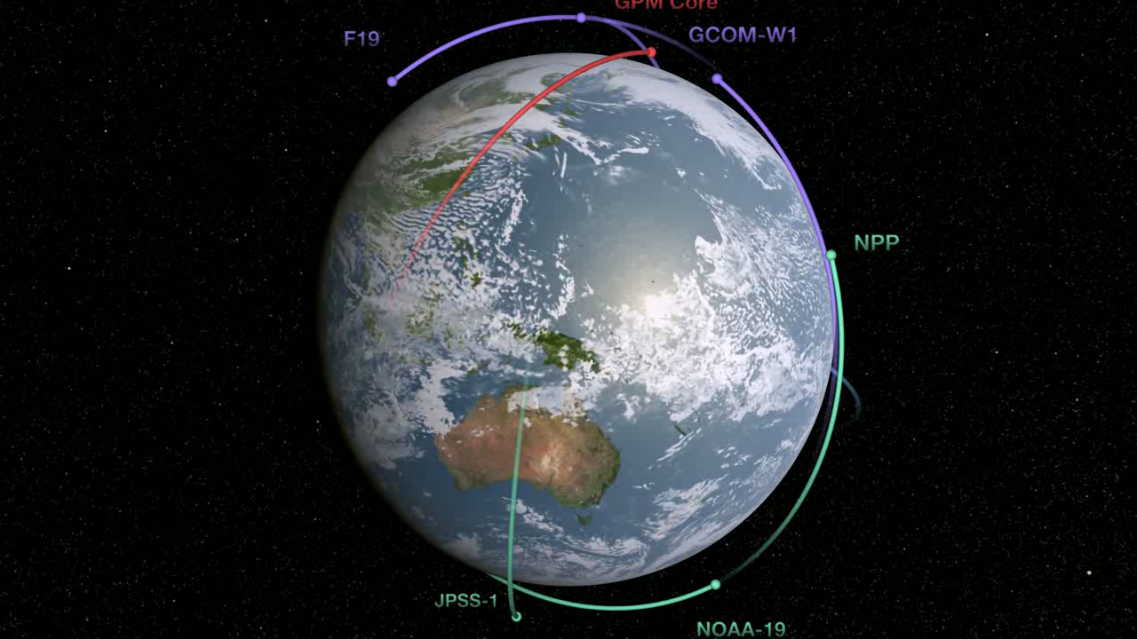
Slide 8

Slide 9
Passive Microwave Sensor Characteristics
Constellation microwave sensor channel coverage
Mean Spatial Resolution (km)
V – Vertical Polarization H – Horizontal Polarization
Channel | 6 GHz | 10 GHz | 19 GHz | 23 GHz | 31/36 GHz | 50-60 GHz | 89/91 GHz | 150/166 GHz | 183/190 GHz
SSMIS |  |  | 19.35 V/H | 22.235 V | 37.0 V/H | 50.3-63.28 V/H | 91.65 V/H | 150 H | 183.31H
MHS |  |  |  |  |  |  | 89 | 157 | 183.311 190.311
AMSU-A |  |  |  | 23.8 | 31.4 | 50.2-58 | 89
AMSR-2 | 6.925 V/H | 10.65 V/H | 18.7 V/H | 23.8 V/H | 36.5 V/H |  | 89.0 V/H
GMI |  | 10.65 V/H | 18.70 V/H | 23.80 V | 36.50 V/H |  | 89.0 V/H | 165.5 V/H | 183.31 V
ATMS |  |  |  | 23.8 | 31.4 | 50.3-57.29 | 87-91 | 164-167 | 183.31
Channel | 6 GHz | 10 GHz | 19 GHz | 23 GHz | 31/36 GHz | 50-60 GHz | 89/91 GHz | 150/166 GHz | 183 GHz
SSMIS |  |  | 59 | 59 | 36 | 22 | 14 | 14 | 14
MHS |  |  |  |  |  |  | 17 | 17 | 17
AMSU-A |  |  |  | 48 | 48 |  | 48
AMSR-2 | 56 | 38 | 21 | 24 | 12 |  | 5
GMI |  | 26 | 15 | 12 | 11 |  | 6 | 6 | 6
ATMS |  |  |  | 74 | 74 | 32 | 16 | 16 | 16
Slide 9

Slide 10
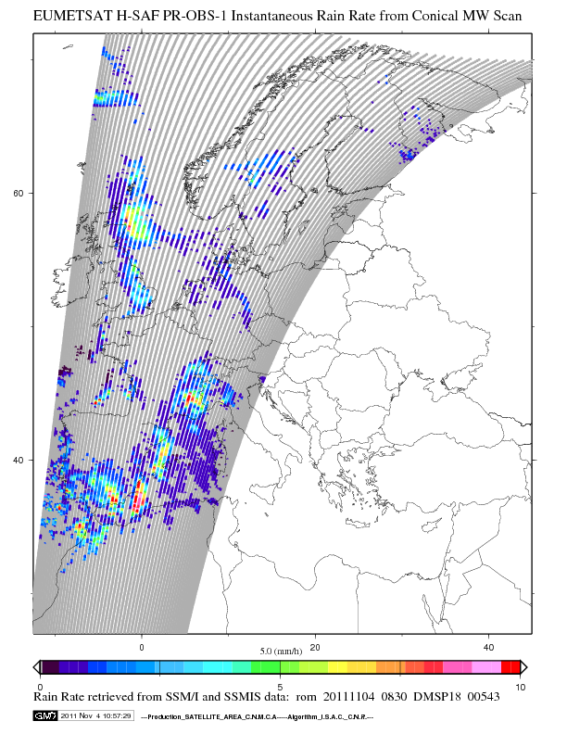
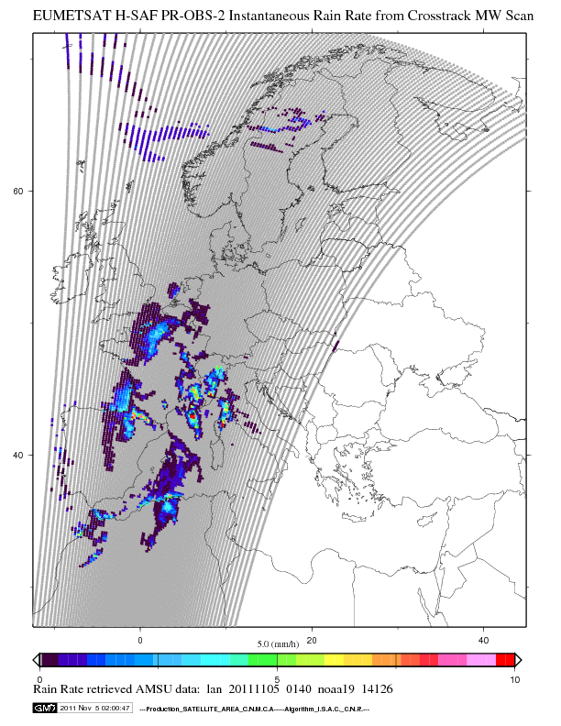
Satellite Rainfall Estimation from MicroWave instruments
It is essential to achieve consistency and accuracy of passive microwave precipitation retrievals from the different sensors orbiting around the globe
CNR-ISAC Italy: Algorithm Theoretical Basic Document for “H01 Precipitation rate at ground by MW conical scanners” .
CNR-ISAC Italy: Algorithm Theoretical Basic Document for “H02 Precipitation rate at ground by MW cross-track scanners
Slide 11
Notes:
Advanced Microwave Sounding Unit (AMSU A)
Microwave Humidity Sounder (MHS)
Special Sensor Microwave/Imager (SSM/I) and Special Sensor Microwave Imager Sounder (SSMIS)

Slide 11
H-SAF Operational Products
Precipitation Products
H01 P-IN-SSMIS | Precipitation rate at ground by MW conical scanners | Operational
H02A/B P-IN-MHS | Precipitation rate at ground by MW cross-track scanners | Operational
H03B P-IN-SEVIRI | Precipitation rate at ground by GEO/IR supported by LEO/MW | Operational
H15A P-IN-SEVIRI-CO | Blended SEVIRI Convection area / LEO MW Convective Precipitation | Pre-operational
H05B P-AC-SEVIRI | Accumulated precipitation at ground by blended MW and IR | Operational

Slide 12
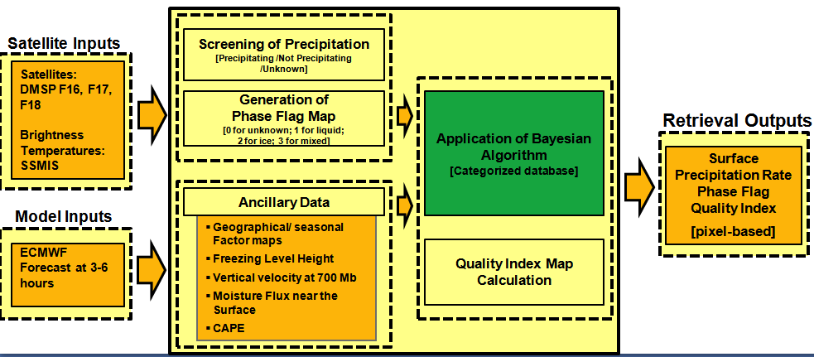
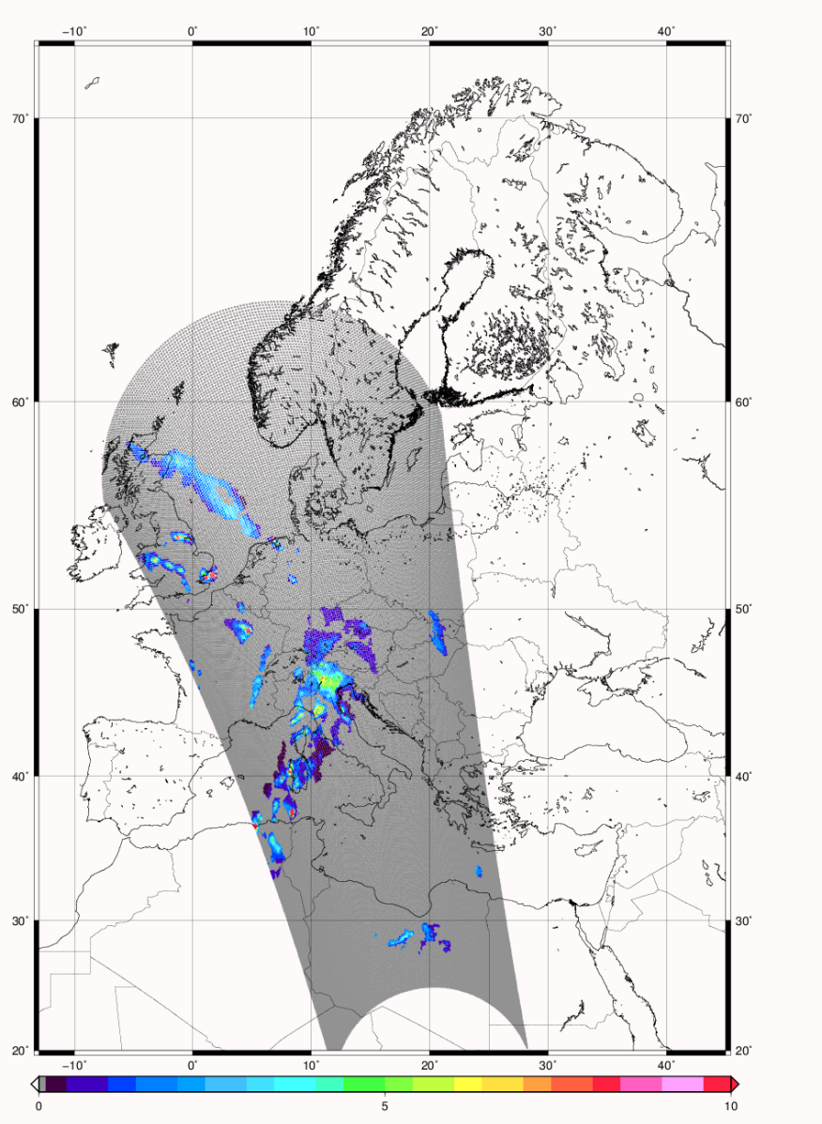
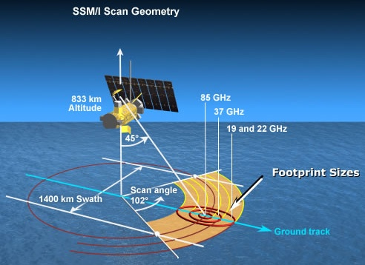
H-SAF Operational Products: examples
P-IN-SSMIS / H01 new. rel.
Cloud Dynamics and Radiation Database (CDRD)
Bayesian Algorithm for conical scanners
(Sanò et al., TGRS, 2013, Casella et al., TGRS, 2013; Smith et al., Mugnai et al., NHESS, 2013)
LIGURIA FLOOD
25/10/2011
SSMIS 18:39 UTC
SSMIS scan geometry
Use of MW conical scanners (Tb) (DMSP-SSMIS);
Physically-based Bayesian technique;
A synthetic a-priori database built from cloud model generated microphysical profiles coupled to RTE model;
Use of dynamical-thermodynamical-hydrological (DTH) model-derived variables to reduce ambiguity problem of retrieval solution; DTH variables from ECMWF forecast/analysis are used as additional input;
Precipitation phase and Quality index evaluation.
Proc. Time: < 4 min (Full disk area), Hor. Res.: ≅15 km
Slide 12
Notes:
New Precipitation Detection Algorithm over Arid Surface

Slide 13
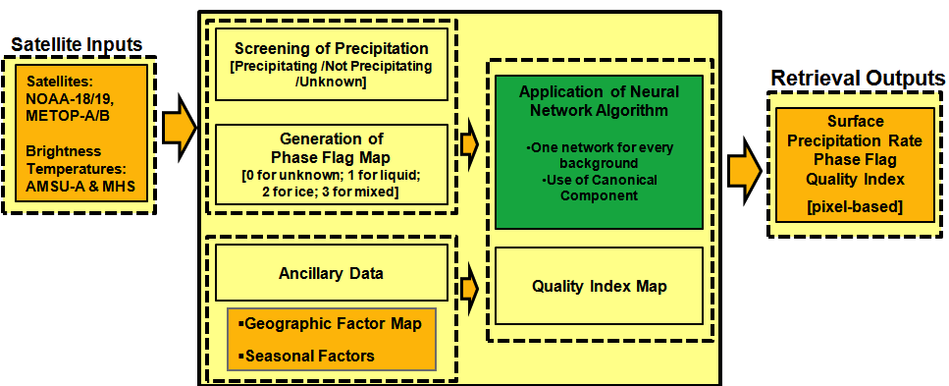
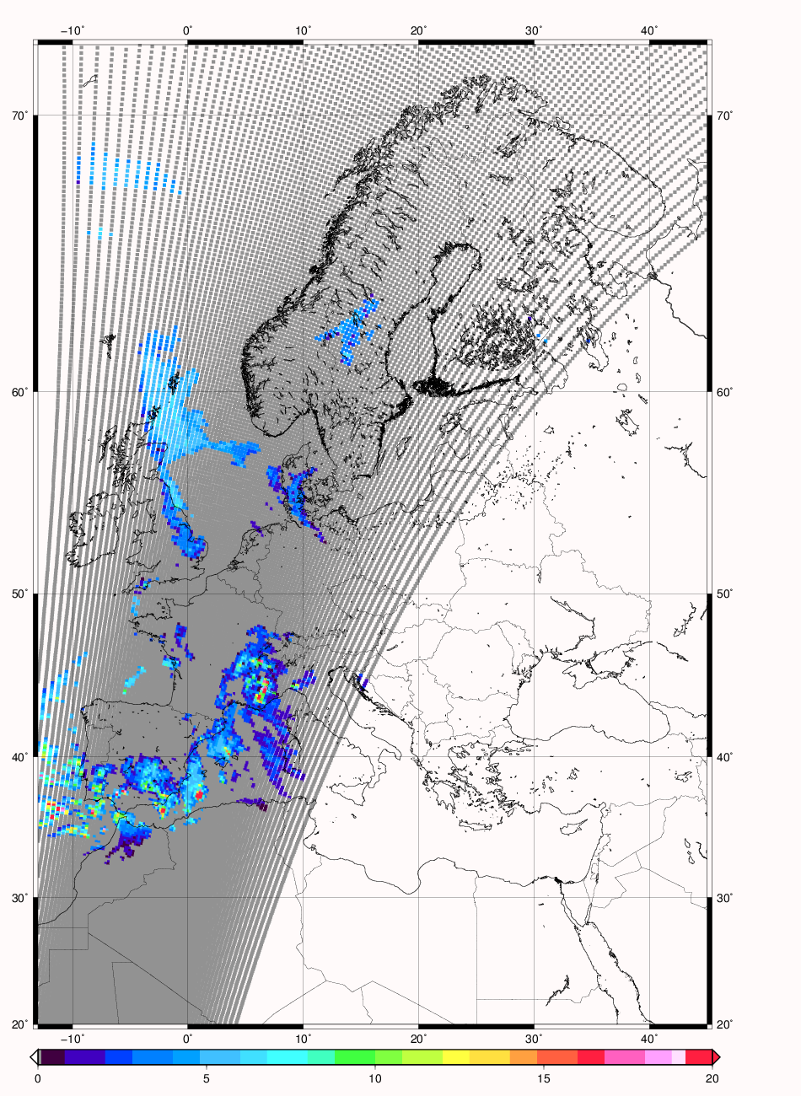
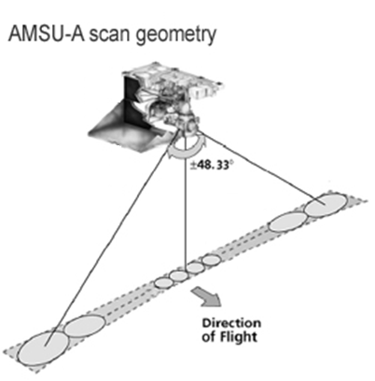
H-SAF Operational Products: examples
P-IN-MHS / H02 new. rel.
PMW Neural-net Precipitation Retrieval (PNPR) Algorithm for cross-track scanners
(Mugnai et al., NHESS, 2013b, Sanò et al., AMTD, 2014)
AMSU-A scan geometry
GENOA FLOOD
4/11/2011
PNPR AMSU/MHS 9:50 UTC
Use of MW cross-track scanners (Tb) (NOAA and MetOp);
Training database built from same cloud resolving simulations as CDRD;
New optimal Artificial Neural Network (ANN) algorithm, one ANN for all surface backgrounds;
The Full Disk Algorithm uses two ANNs (ANN-A for European Area, ANN-B for African Area) trained by the two Databases.
Correction of MetOp-A channel [AMSU-A Channel 7 (54 GHz)] using a specific ANN.
Input: AMSU-A/MHS channels, additional channel derived variables;
Geographycal inputs (i.e., latitude, season, topography) used as additional input;
Precipitation phase and Quality index evaluation
Proc. Time: < 1 min (Full disk area), Hor. Res.: ≅16-50 km
Slide 13

Slide 14
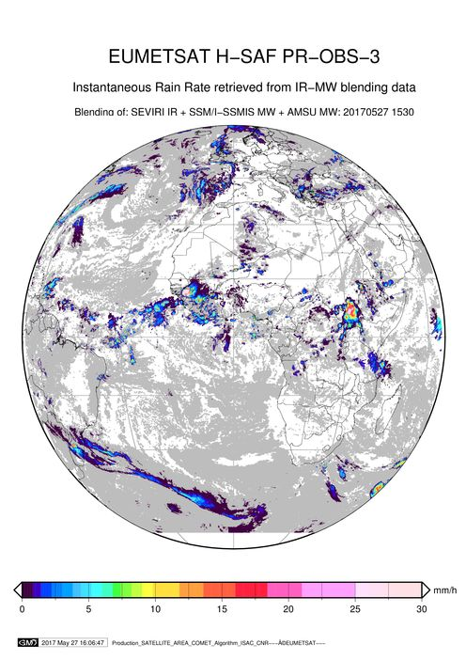
H-SAF Operational Products:
examples
P-IN-SEVIRI/H03: Multi-platform algorithm: BLENDING Technique
The “Rapid Update” tecnique allows to compute instantaneous rain intensities at the ground at the geostationary time-space scale (Turk et al. 2000, Torricella et al. 2007).
It is based on a blended MW-IR technique that correlates, by means of the statistical probability matching, brightness temperatures measured by the IR geostationary sensors and PMW-estimated precipitation rates at the ground.

Slide 15
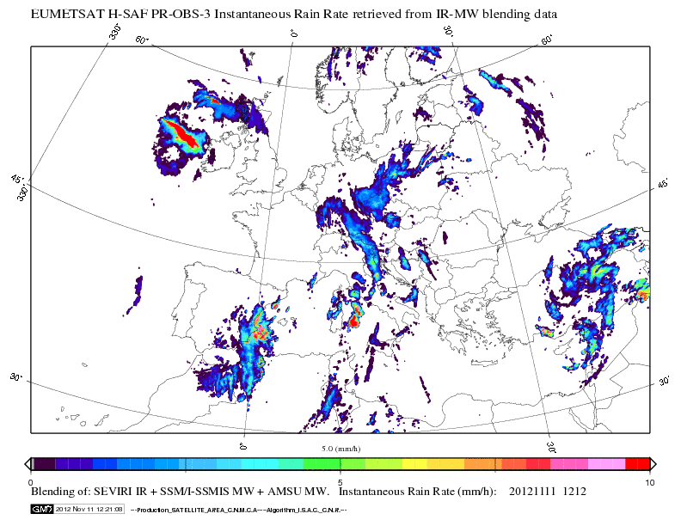
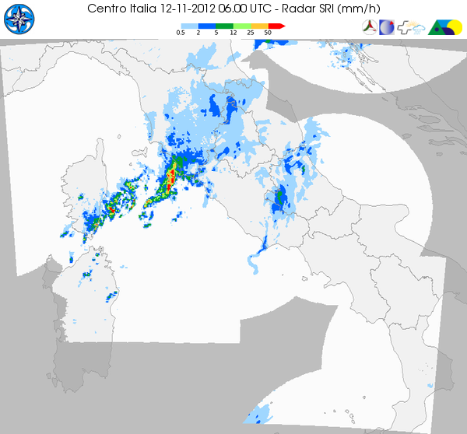
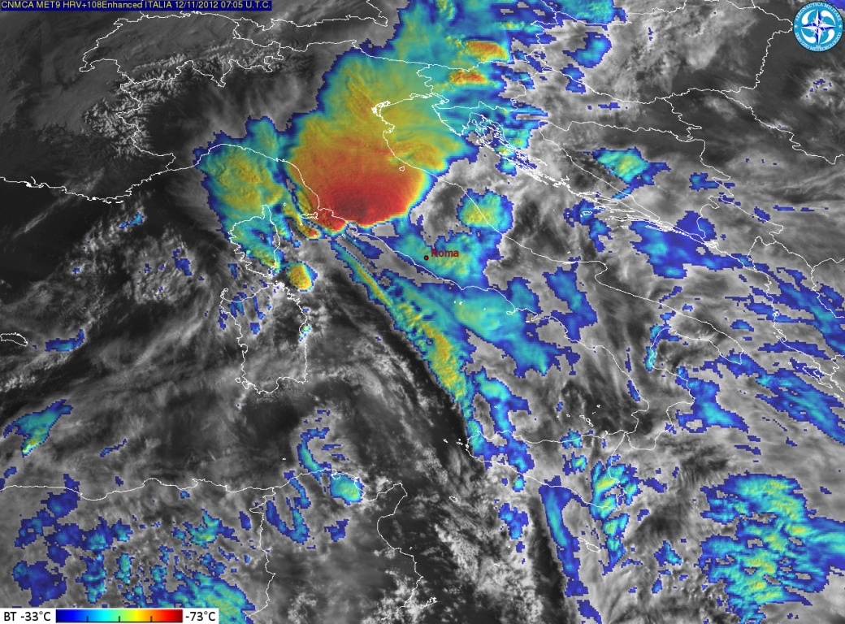
Case studies
Case study: Flood event in
Grosseto (Italy)

Slide 16
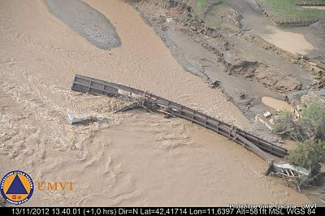
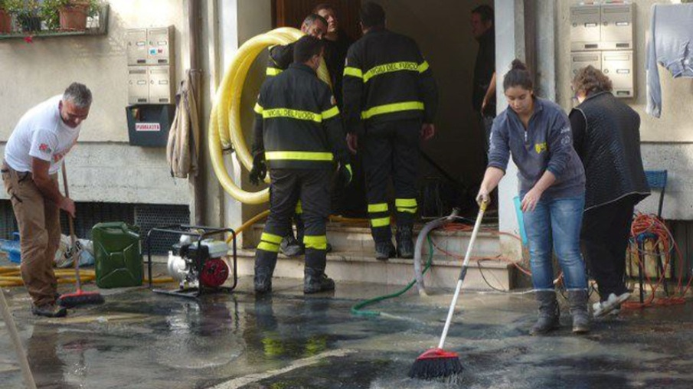
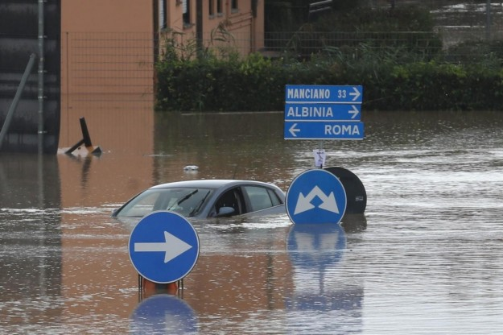
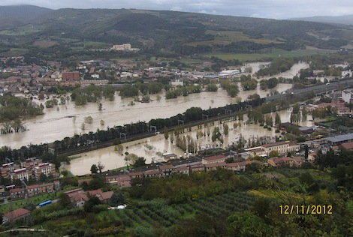
Case study: 11-12 november 2012
Grosseto
http://oiswww.eumetsat.org/WEBOPS/iotm/iotm/20121112_flood/20121112_flood.html
Slide 16

Slide 17
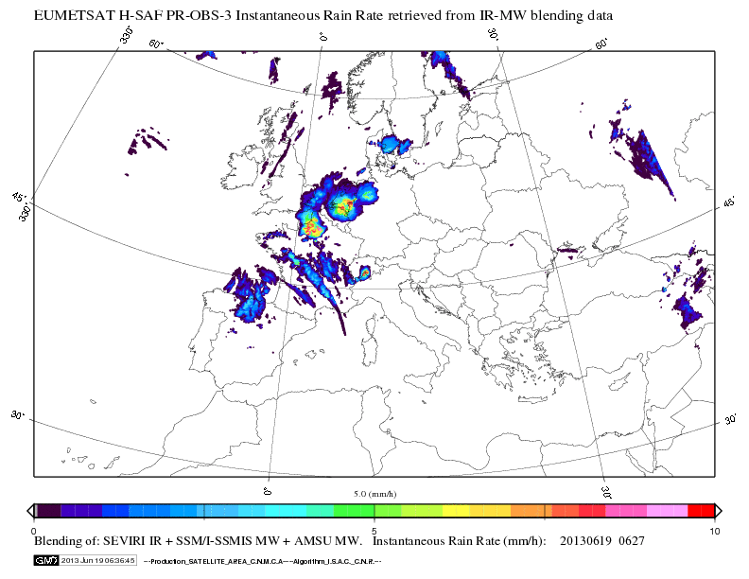
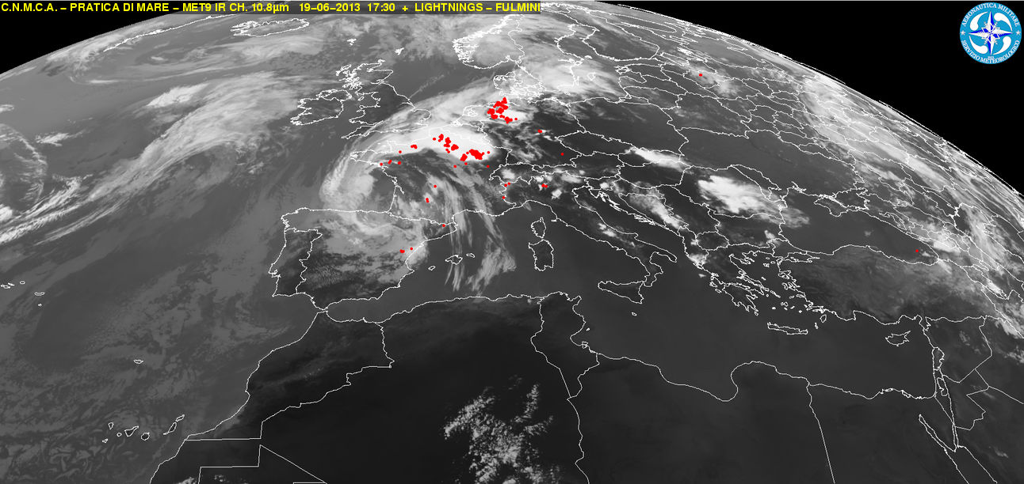
Case studies
Case study: extreme precipitation event,
Germany

Slide 18
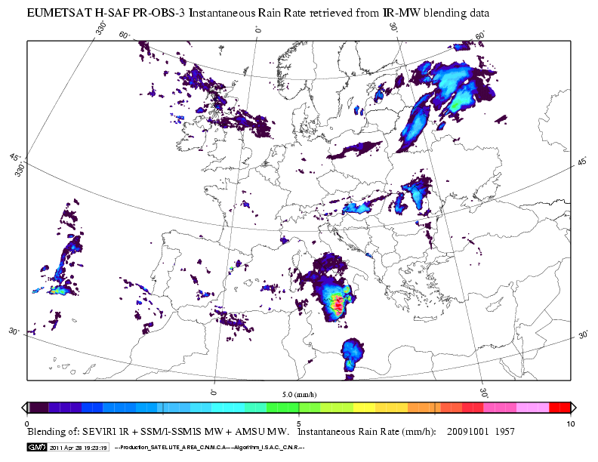
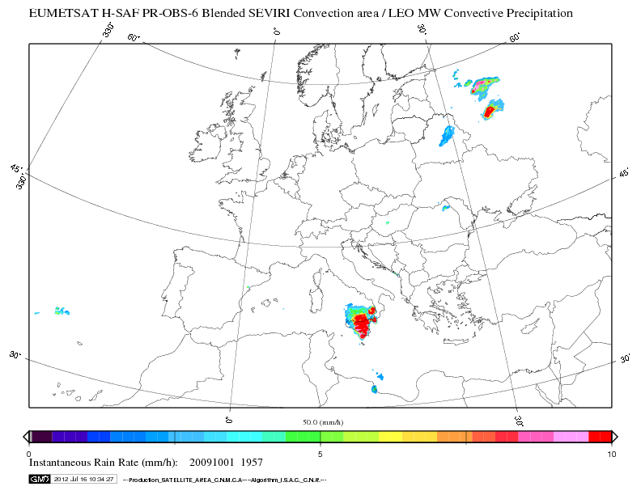
H-SAF Operational Products:
examples
P-IN-SEVIRI-CO / H15:
BLENDING Technique
+ NEFODINA
Convective Precipitation
Slide 18

Slide 19
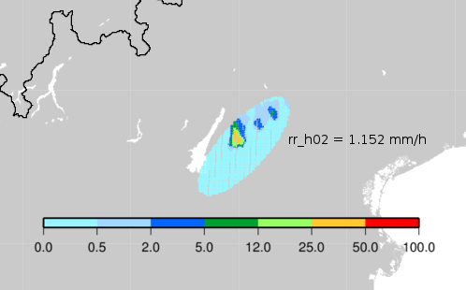
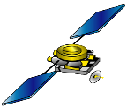

The Satellite “Beam filling” Problem
Comparison between precipitation retrieval by microwave sensor on polar satellite (AMSU) and radar.
5th June 2011
Intrinsic Underestimation
Slide 19

Slide 20
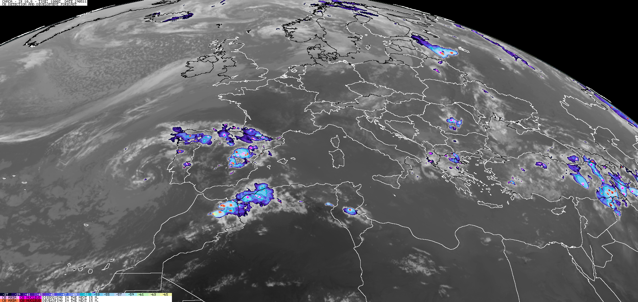
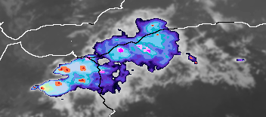
NEFODINA software
http://nefodina.meteoam.it
With red shades are indicated the cloud top of the detected convective cell in growing phase
With pink shades are indicated the cloud top of the detected convective cell in decreasing phase.
Slide 20
Notes:
The dark red and dark pink colors are used to indicate the most intensive convective regions.

Slide 21
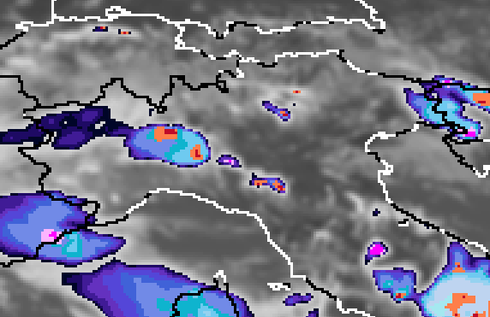
5th June 2011
NEFODINA software
Rain redistribution based on convective cell’s area
Slide 21

Slide 22
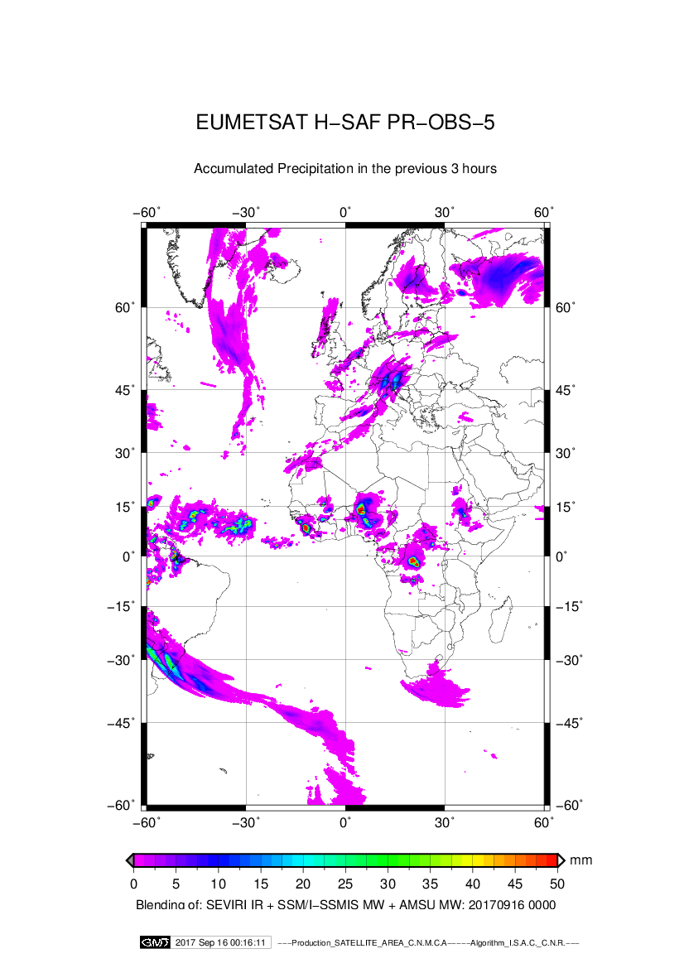
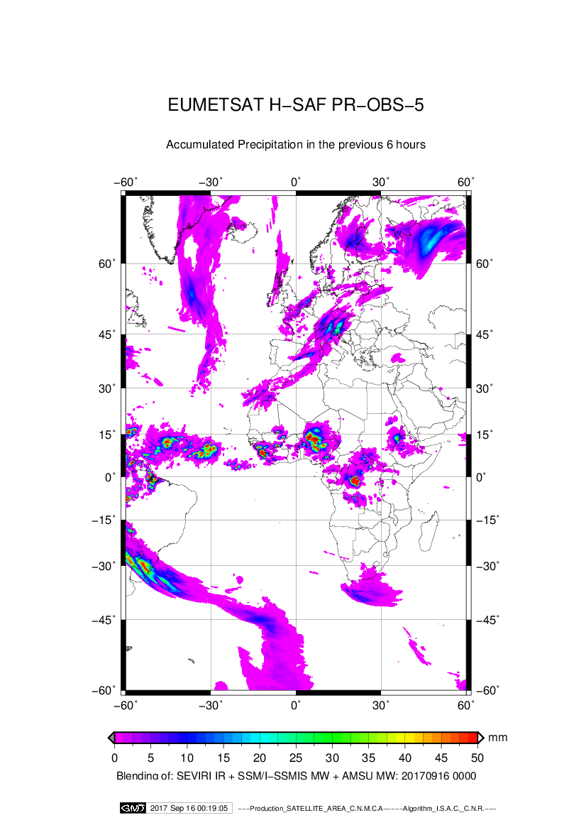
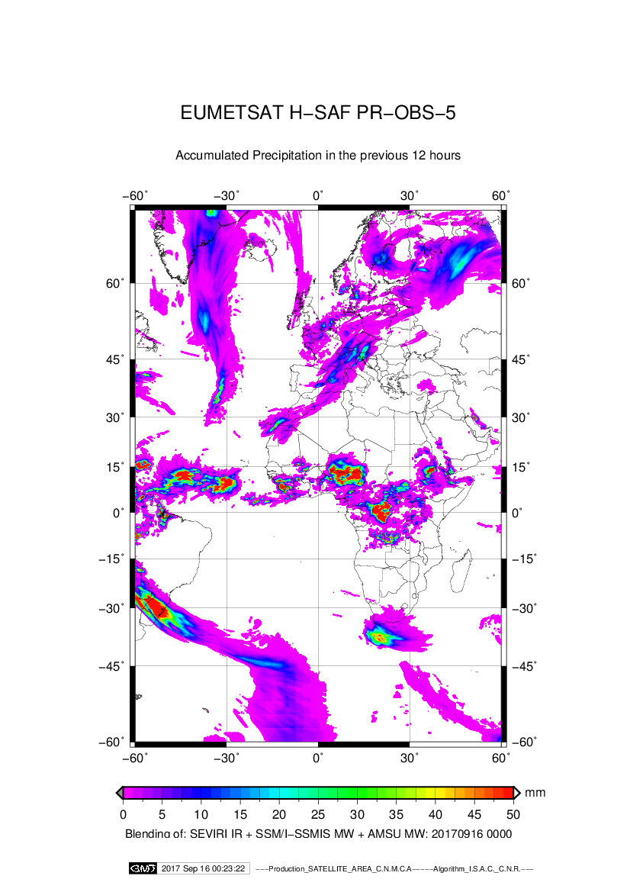
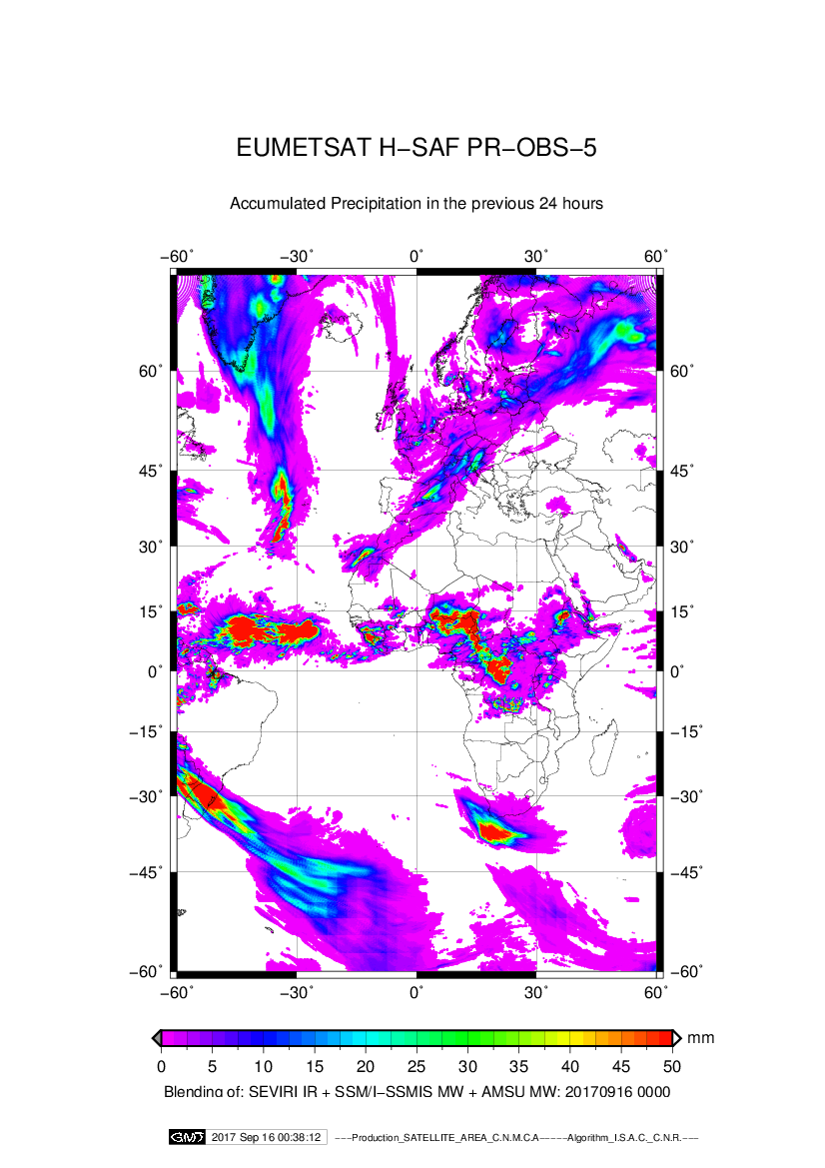
H-SAF Operational Products:
examples
P-AC-G-SEVIRI / H05
Accumulated Precipitation
Slide 22

Slide 23
Auxiliary Products
New MW based auxiliary Products
H-AUX17 | Precipitation rate at ground by MW conical scanners (AMSR2) | Algorithms assessed. Available via ftp
H-AUX20 | Rainfall intensity from GMI (GPM - Microwave Imager)
H-AUX23 | Gridded daily mean precipitation based on PMW instantaneous precipitation rate estimates

Slide 24
In development products
New MW based Products
H18 P-IN-ATMS | Precipitation rate at ground by MW cross-track scanners (Suomi NPP ATMS) | Under review
H67 P-DM-PMW-IC | Gridded 24h mean precipitation based on intercalibrated PMW precipitation rate estimates | In development

Slide 25
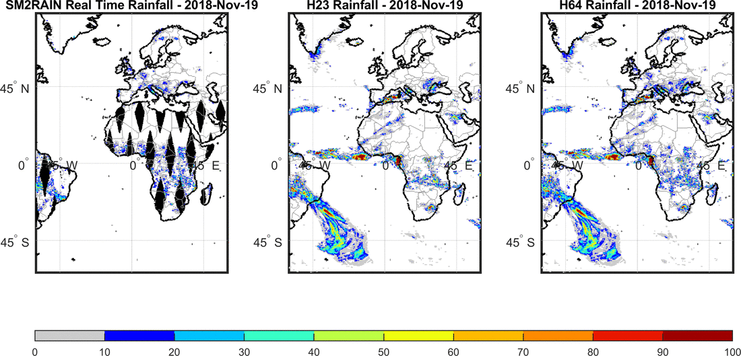
In development products
Integration of Precipitation/Soil Moisture Products
H64 P-AC-SM2RAIN | Precipitation/Soil Moisture integrated product | Algorithm assessed Expected Operations end of 2019

Slide 26
In development Products
Indian Ocean Data Coverage (IODC) Products
H63 P-IN-SEVIRI_E | Precipitation rate at ground by GEO/IR supported by LEO/MW | Algorithm assessed Expected Operations in Q1 2020
H90 P-AC-SEVIRI_E | Accumulated precipitation at ground by blended MW and IR
Notes:
Indian Ocean Data Coverage (IODC)

Slide 27
In development Products
MTG-based Products
H40 P-IN-FCI | Precipitation rate at ground by GEO/IR supported by LEO/MW and MTG FCI | Algorithms assessed Expected Operations in CDOP4
H42 P-AC-FCI | Accumulated precipitation at ground by blended MW and IR and MTG FCI
H50 P-IN-LI | Rainfall intensity from MTG LI
EPS-SG based products
H70 P-IN-MWS | Precipitation Rate at ground by EPS-SG MWS | Expected operations in CDOP-4
H71 P-IN-MWI | Precipitation Rate at ground by EPS-SG MWI

Slide 28

Quality Monitoring Program
Quality Monitoring Programme provides a continuous assessment of the products quality and performances by evaluating statistical scores and case study analysis on the base of comparison between satellite products and ground data

Slide 29
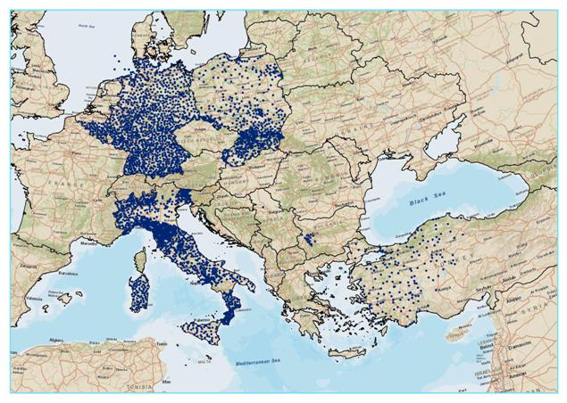
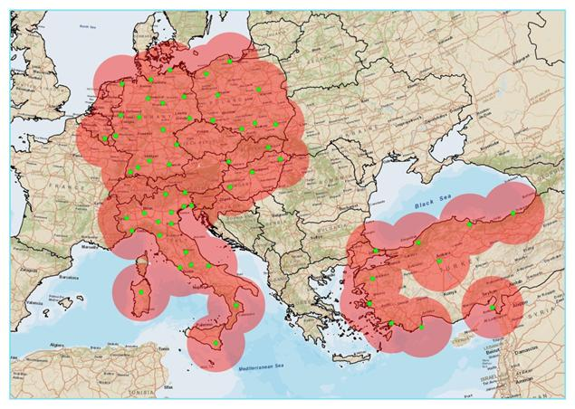
Quality Monitoring Program
The Quality Monitoring Cluster is composed of experts from the National Meteorological and Hydrological Institutes of 8 European countries under the coordination of the Italian Civil Protection Department (DPC). The PPVG uses ground measurement for validation: for precipitation products, for example, rain gauge and radar data are used.
Country (Acronyms) | Institutes
Belgium (BE) | IRM
Bulgaria (BG) | NIMH
Germany (DE) | BfG
Hungary (HU) | OMSZ
Italy (IT-DPC, IT-UNIFE) | DPC, UniFe
Poland (PL) | IMWM
Slovakia (SK) | SHMU
Turkey (TU) | ITU, METU, TSMS
Country | Total number of gauges * | Average minimum distance (km)
Belgium | 89** | 11.2
Germany | 1300 | 17
Italy | 2600 | 9.5
Poland | 330-475 | 13.3
Turkey | 193*** | 27
* the number of rain gauges could vary from day to day due to operational efficiency within a maximum range of 10-15%. ** only in the Wallonia Region *** only covering the western part of Anatolia
59 C-band Radars
29

Slide 30
Quality Monitoring Programme
Validation Methodology
GROUND DATA
TIME-SPATIAL MATCHING
Quality check and filtering
Spatial interpolation (GRISO)
Ground data
upscaling to satellite grid
(gaussian weighting)
STATISTICAL (CONTINUOUS AND MULTI-CATEGORICAL) SCORES
Precipitation classes:
[RR ≥ 1.0 (mm/h)]
[RR ≥ 5.0 (mm/h)]]
[RR ≥ 10.0 (mm/h)]
Surface types:
Sea
Land
Coast
Overall
Time intervals:
Month
Season
Year
Full-period
Precipitation phase
Liquid
Solid
Mixed
All
This comparison methodology is performed by the Unique Common Code (UCC) common to all participating countries
C-code
30
Notes:
Fractional Standard Error (%)
FSE
0 to ∞
0
FSE = [RMSE / <obs>] *100%

Slide 31
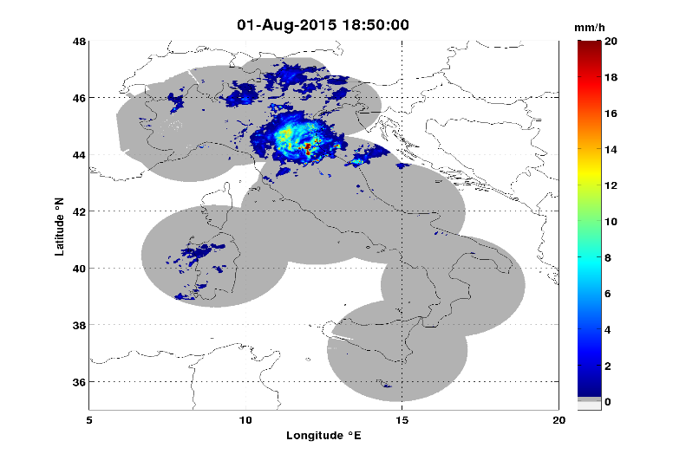
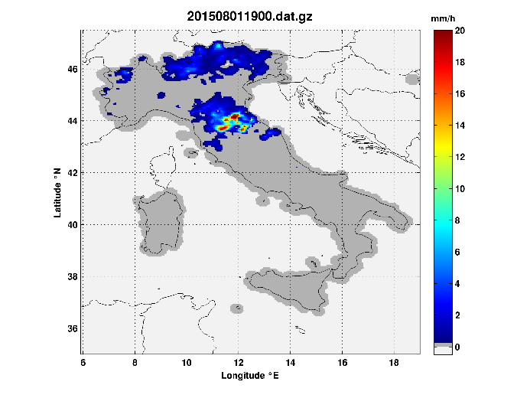
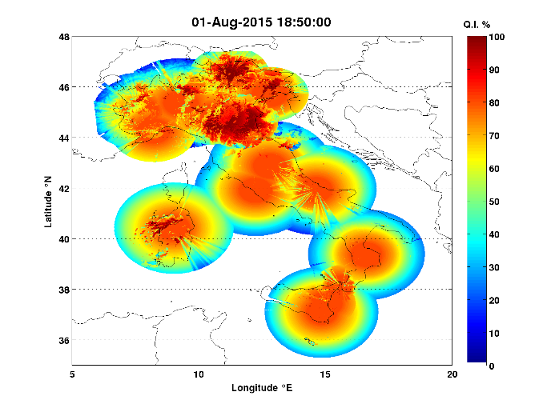
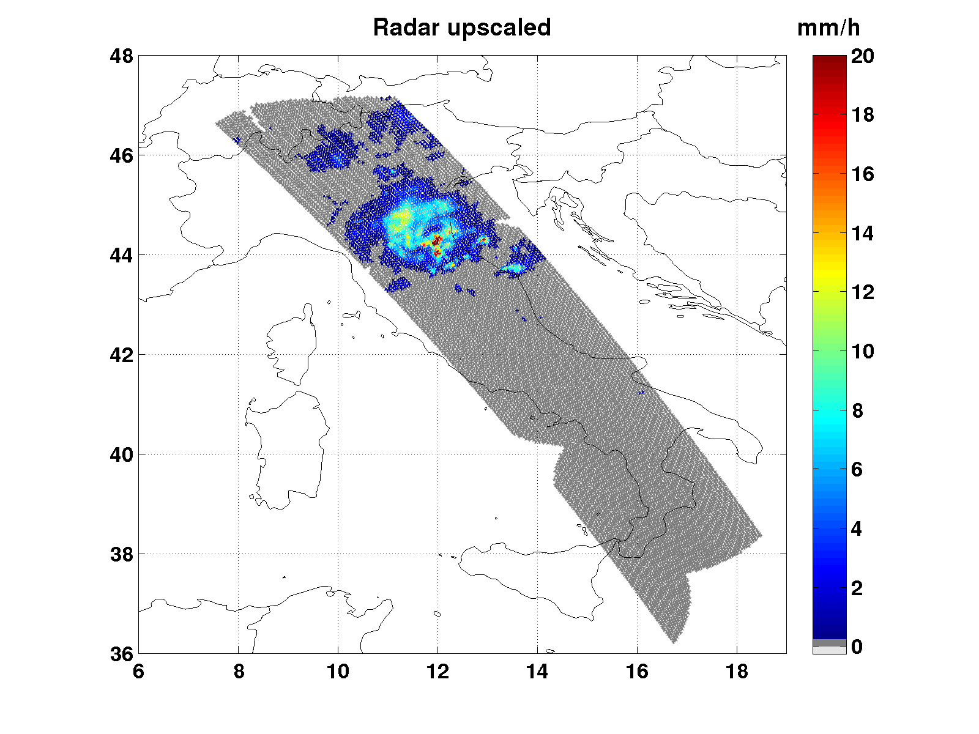
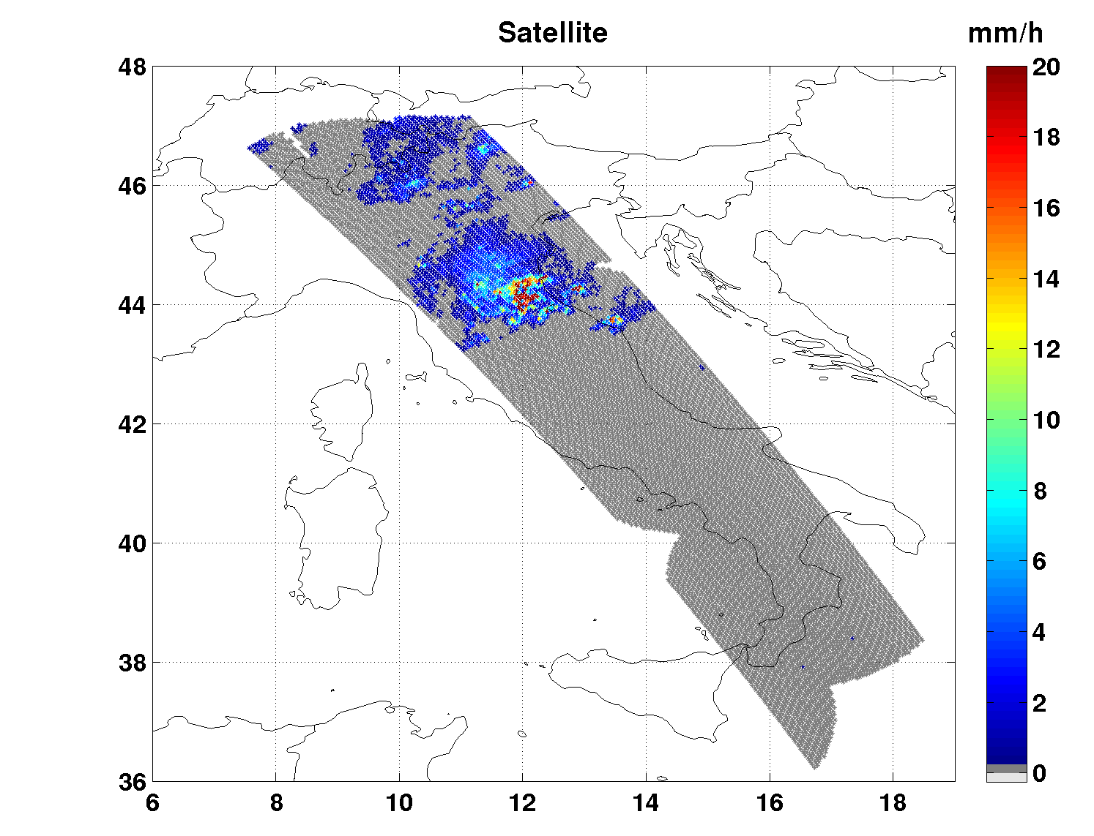
Quality Monitoring Programme
Validation Methodology
SRI
1h interpolated Raingauge
Q.I.
Ground data (Radar, Raingauge and relative quality index) are quality-checked and filtered.
Only High-Quality Radar Data are upscaled to satellite grid.
Pixel-based comparison
Satellite product (overpass)
on Radar coverage

Slide 32
Hydrovalidation Programme
Objectives and tasks
Impact studies and hydrological validation
Product interfacing and utilization improvement
Hydrological validation of Products
Development of tools to assimilate soil moisture and snow
cover products to hydrological models
Product data assessments and model calibration
Tools (methods) for product correction
/blended products
Sensitivity analysis – influence of each product on final output data
Case studies
Perform the analysis of possible product utility for hydrological tasks

Slide 33
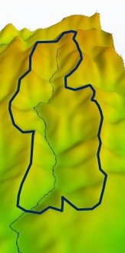
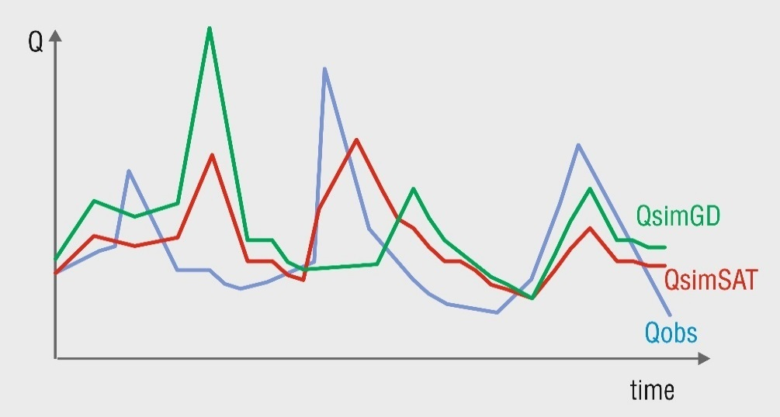
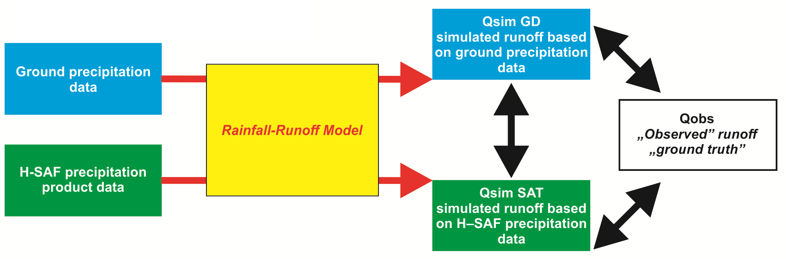
Hydrovalidation Programme
The Hydrological Validation
Indirect comparison, end user point of view
Assessment of model
assessment
of products

Slide 34
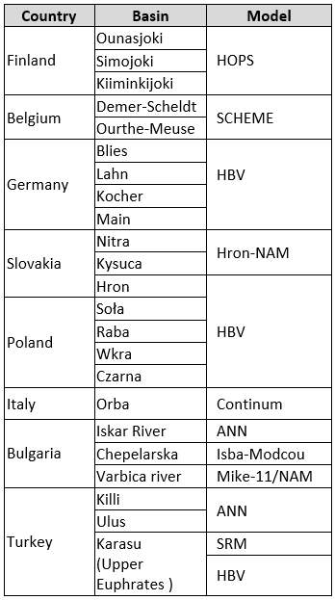
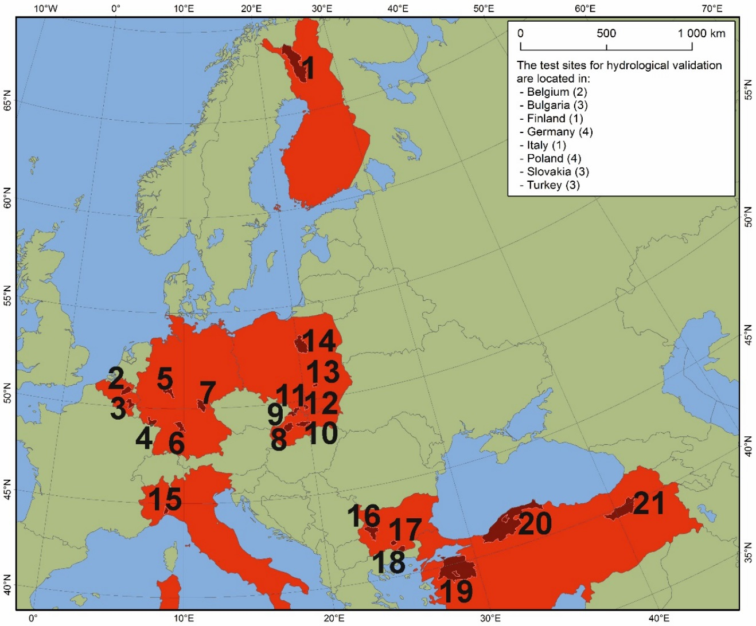
Hydrovalidation Programme
Test sites and models
Ounasjoki (no 1), Demer-Scheldt (no 2), Ourthe-Meuse (no 3), Blies (4), Lahn (5), Kocher (6), Main (7), Nitra (8), Kysuca (9), Hron (10), Soła (11), Raba (12), Czarna and Lagowianka (13), Wkra (14), Orba (no 15), Iskar River (no 16) , Chepelarska (no 17), Varbica river (no 18), Killi subbasin in Susurluk Basin (19), Ulus subbasin in Western Black Sea Basin (20), Upper Euphrates (21, Karasu)

Slide 35
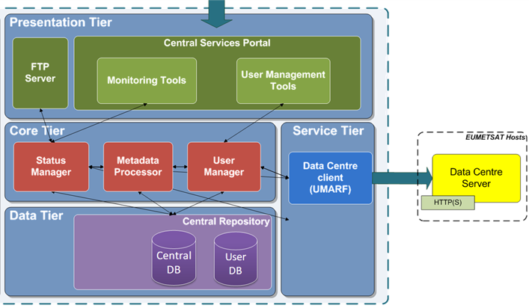
Central Services - Dissemination
Dissemination of products foresees use of both EUMETSAT Data Delivery Service (EUMETCast) and ftp dedicated server by H-SAF Central Facilities
35

Slide 36
Central Services - Archiving
H-SAF Products are centrally collected by NRT ingestion from peripherals to Central Site at CoMET.
NRT availability requirement guaranteed to end users
Products are maintained in two different storage areas:
On-line archive: Latest 60 days of production constantly available (24 / 7). Immediate access to selected items, for registered users.
Off-line archive : Entire production since the beginning of H-SAF operations. Items available through Order Management system, made available on demand in a FTP area for a limited temporal window
36

Slide 37
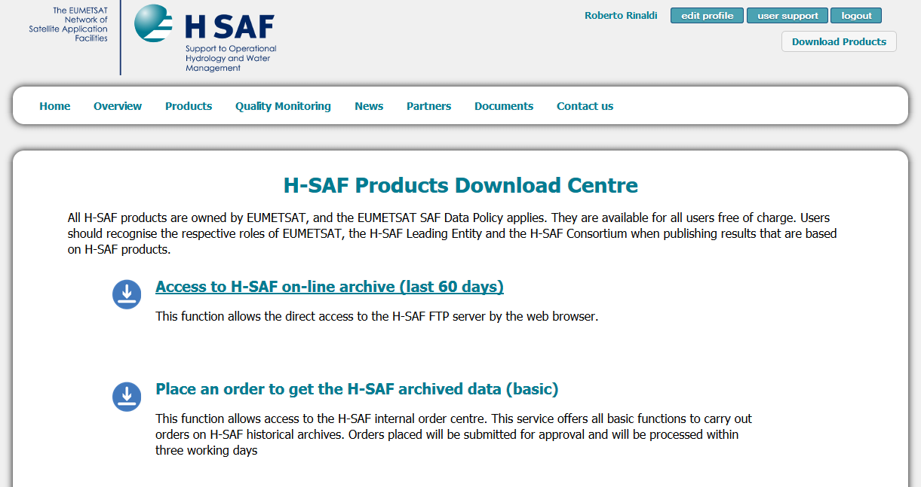
H-SAF User Services
The single account allows a direct access to the FTP content

Slide 38

User Services – Website
Institutional point of access to the programme
hsaf.meteoam.it / h-saf.eumetsat.int
38

Slide 39

User Services – user community
Trend in user registration
Category of users
Slide 39

Slide 40

H SAF and HEPEX workshop
ECMWF | Reading | 25-28 November 2019
https://www.ecmwf.int/en/learning/workshops/satellite-inspired-hydrology-for-an-uncertain-future

Slide 41









Thanks to …
Francesco Zauli¹, Davide Melfi¹,
Dietrich Stefano², Panegrossi Giulia², Sanò Paolo², Anna Cinzia Marra²,
Luca Brocca³, Luca Ciabatta³, Christian Massari³,
Puca Silvia⁴ , Marco Petracca⁴, Stefano Sebastianelli⁵
and all the H-SAF team
1 - Centro Operativo per la Meteorologia (COMet)
2 - Istituto di Scienze dell'Atmosfera e del Clima (ISAC) / Consiglio Nazionale delle Ricerche (CNR), Roma
3 - Istituto di ricerca per la protezione idrogeologica (IRPI) / Consiglio Nazionale delle Ricerche (CNR), Perugia
4 - Dipartimento della Protezione Civile (DPC)/Presidenza del Consiglio dei Ministri
5 - Geo-k
… and you for your attention!
davide.melfi@aeronautica.difesa.it
Slide 41

