Slide 1

A severe hail event in June 2018
Jana Čampa, Blaž Šter
ARSO, Slovenian Environment Agency, Ljubljana

Slide 2
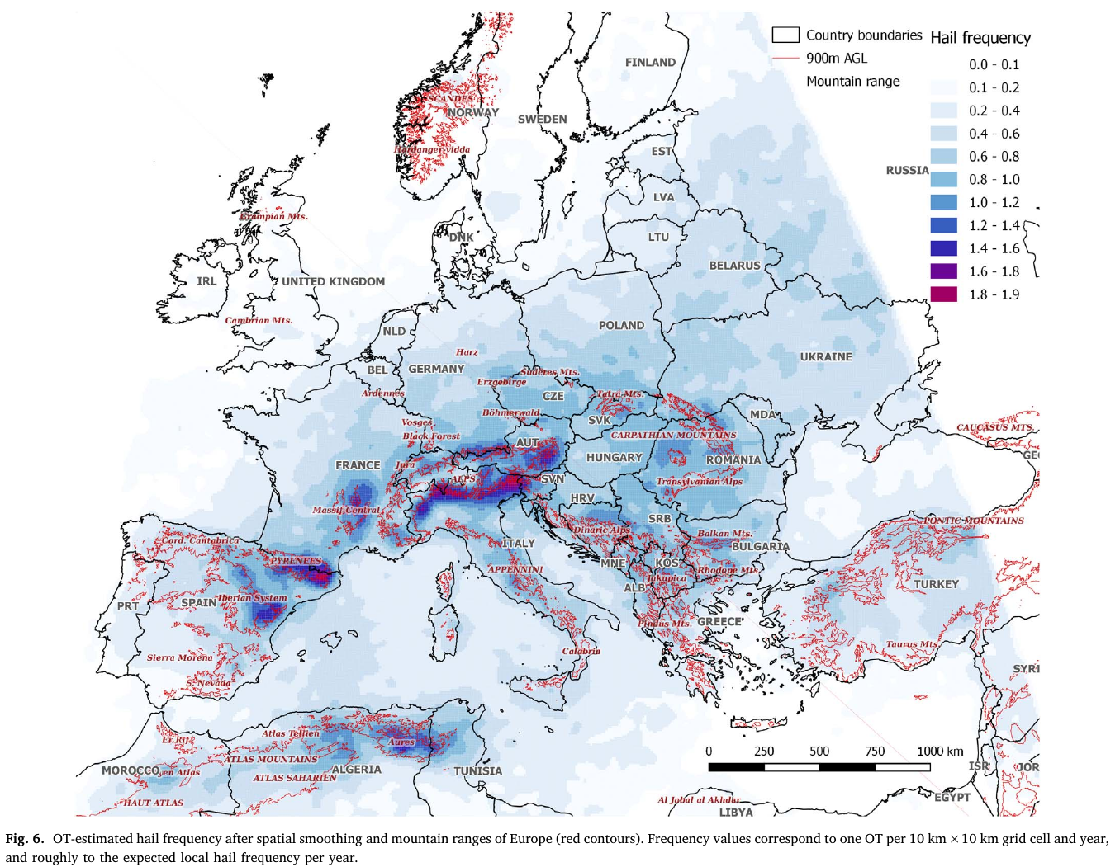
Convection Climatology
Hail frequency maxima along the Alpine flanks, however more severe events
are only initiated over orography
but develop further over a
flater terrain
Punge et al., 2017

Slide 3
Convective season 2018
Very early begin
Estofex issued 15 level 2 warnings in May
In Slovenia only 3 days without convection in May

Slide 4
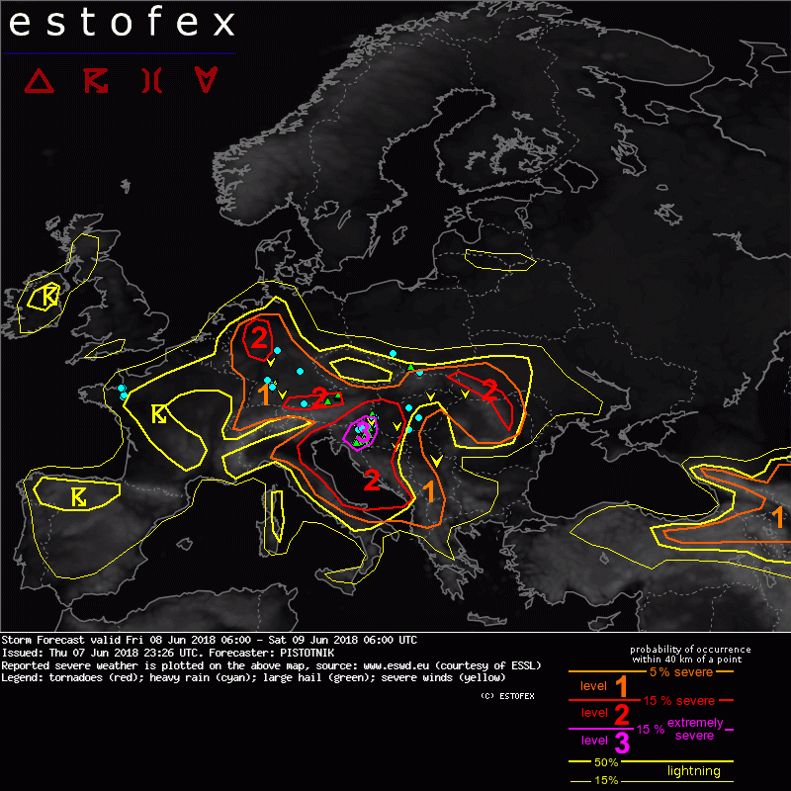
Convective season 2018
Very early begin
Estofex issued 15 level 2 warnings in May
In Slovenia only 3 days without convection in May
Only one level 3 warning issued in the summer
-> 8.6.2018
©ESTOFEX

Slide 5
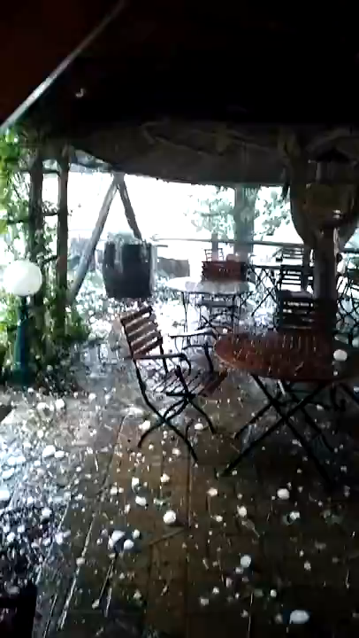
The storm
© Unknown

Slide 6
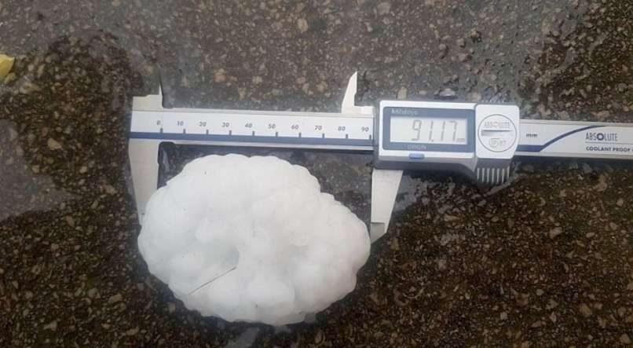
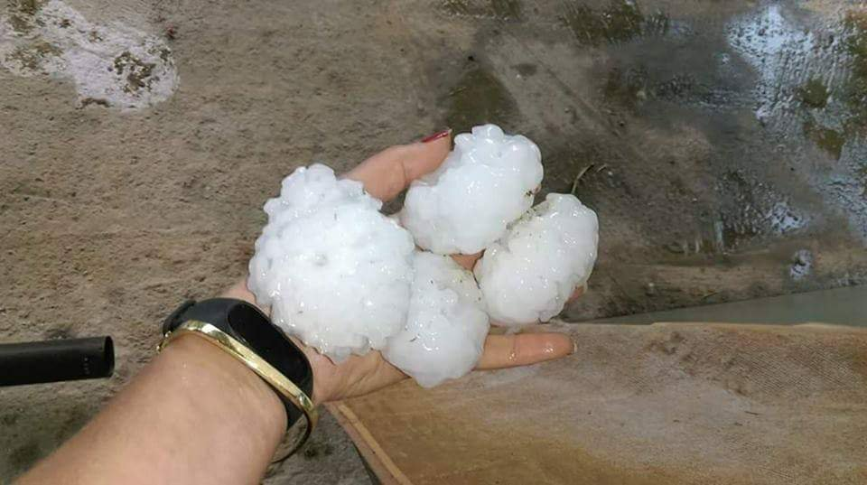
The storm
Duration 15 min
Passed a swath of 10x4 km
Average hailstone size 8 cm, max. size 12 cm
Damage > 20 M € (rural area)
> 1300 buildings damaged, all crops in the region lost
©ReCo
©Crometeohr

Slide 7
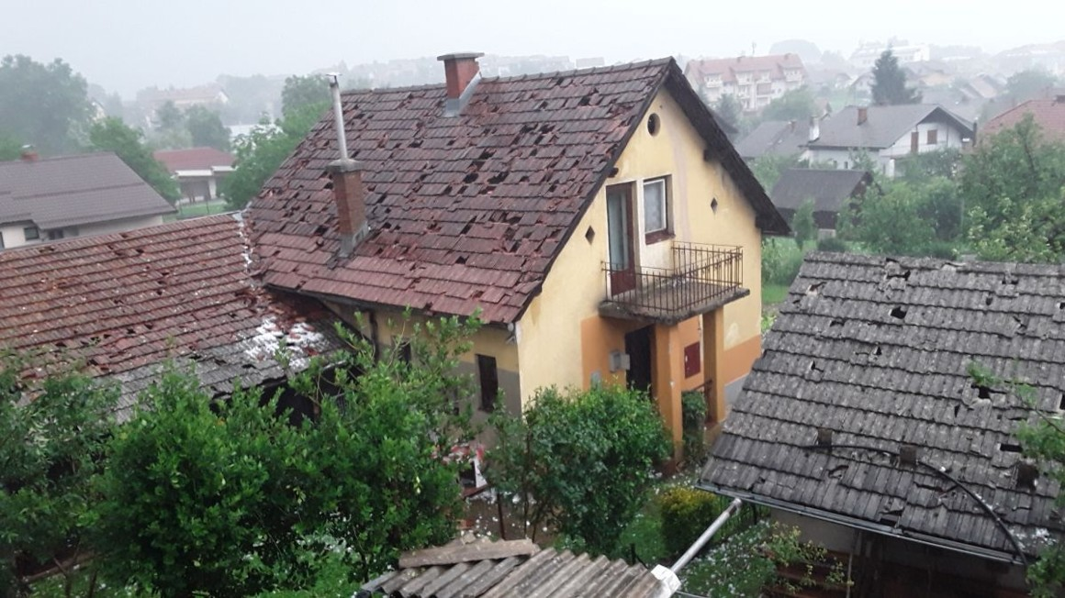

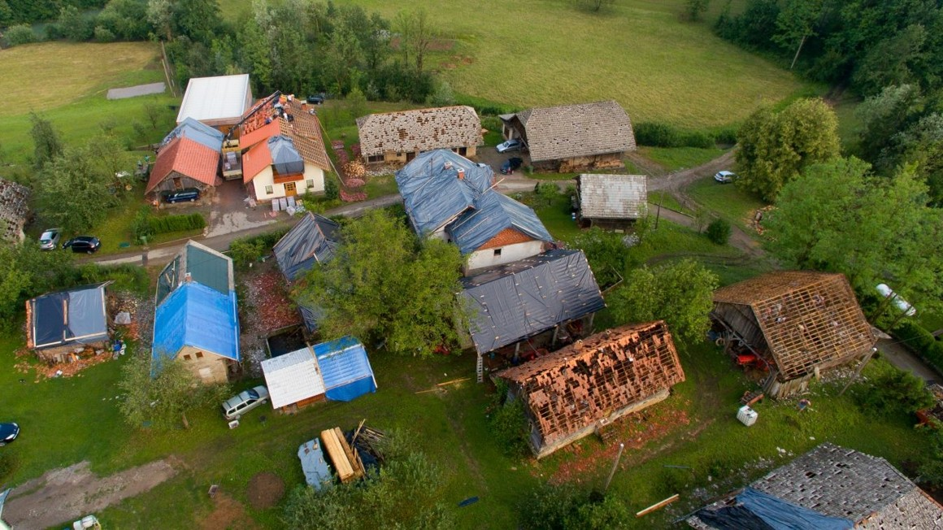
The aftermath
©I.Todorovski
© Unknown
©Bobo

Slide 8
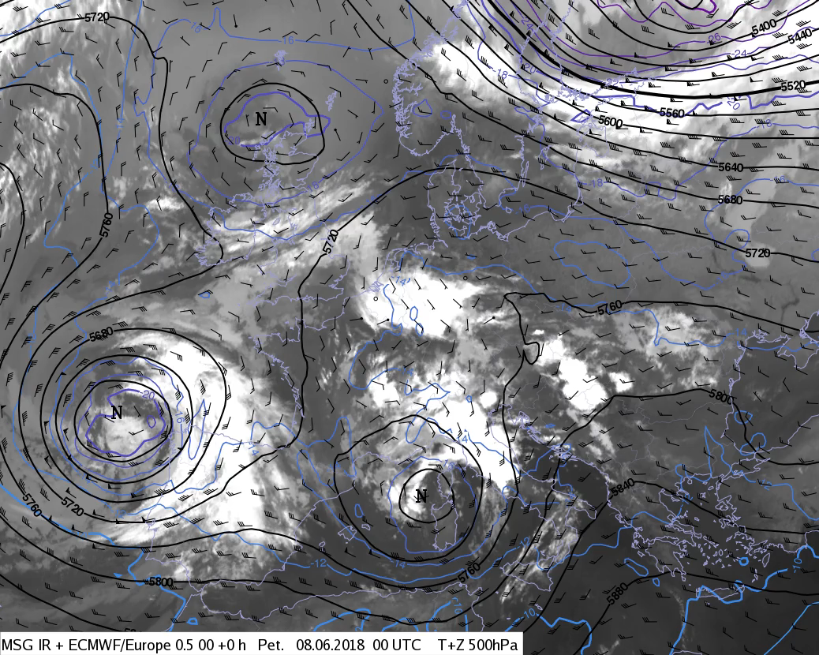
Synoptic situation
Geopotential, temperature and wind at 500 hPa, IR image
Cut-off low, only weak signal at the surface, no clear fronts,
continuous convection along its eastern flank

Slide 9
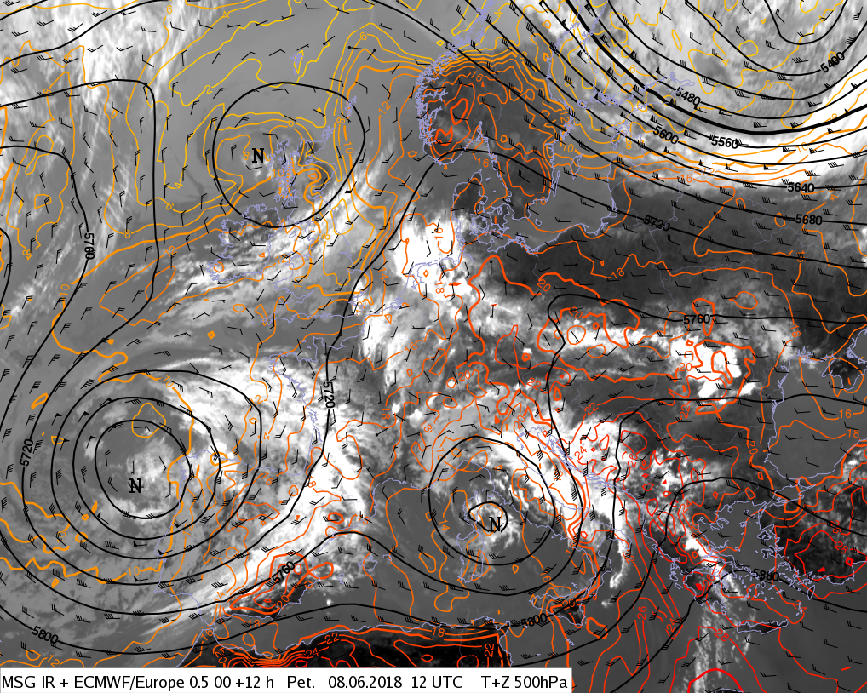
Synoptic situation
Gepotential and wind at 500 hPa, temperature at 925 hPa, IR image
Advection of warm dry air and steep lapse rates (elevated mixed layer)

Slide 10
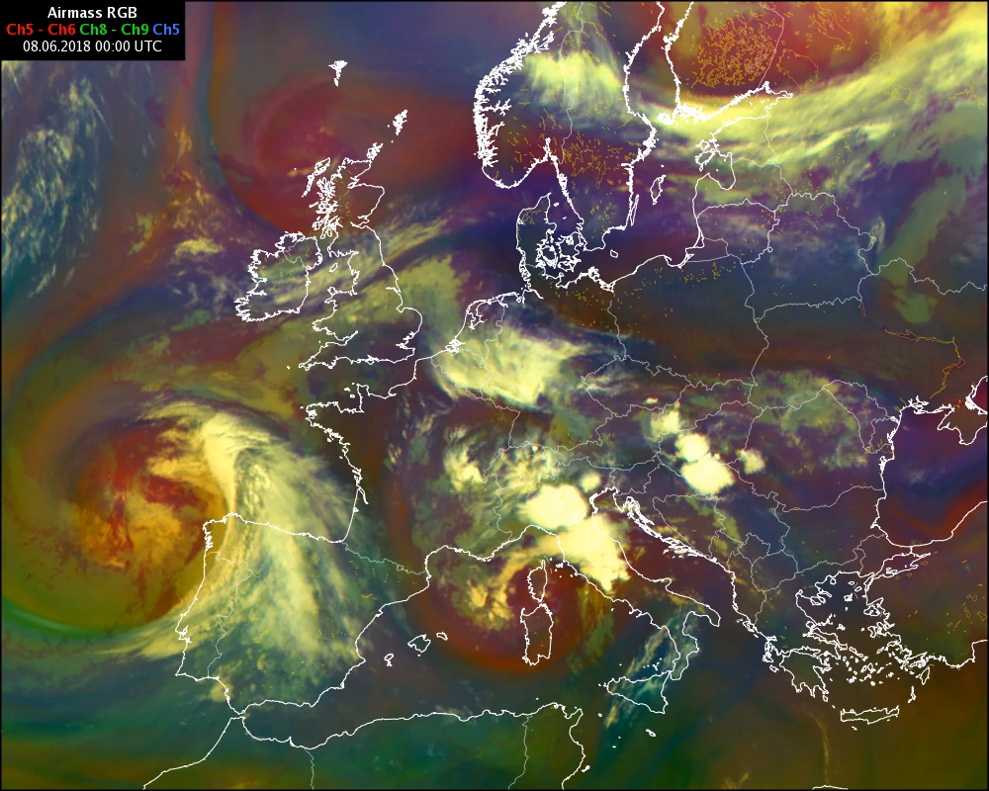
Synoptic situation
Upper-level PV anomaly

Slide 11
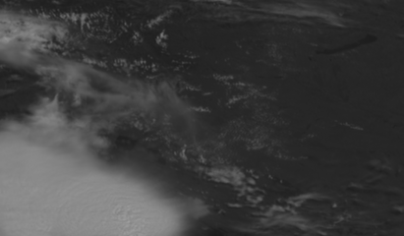
Convective development
Seviri HRV Image
Location of Črnomelj that was struck by the largest hailstones

Slide 12
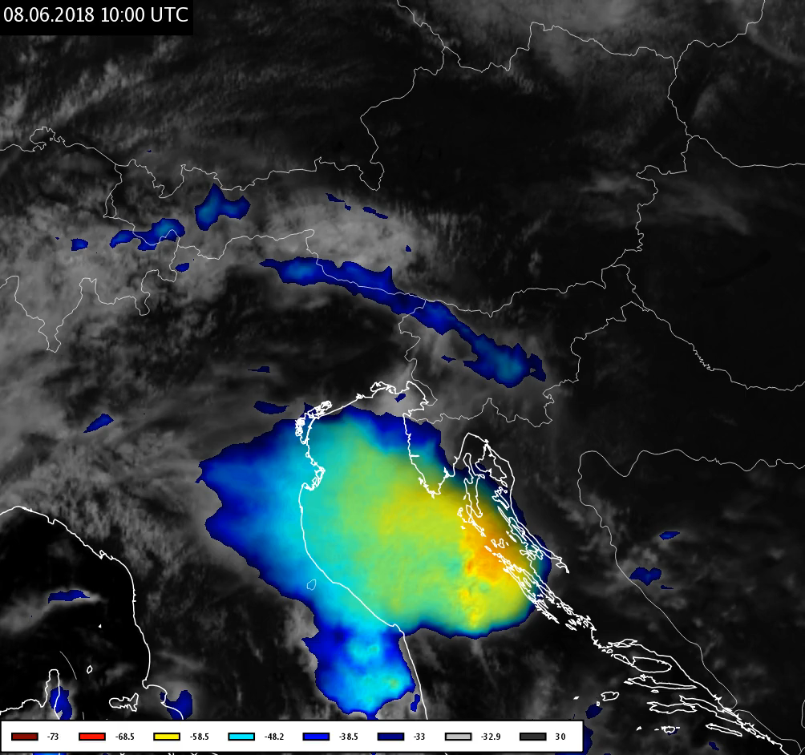
Convective development
Črnomelj

Slide 13
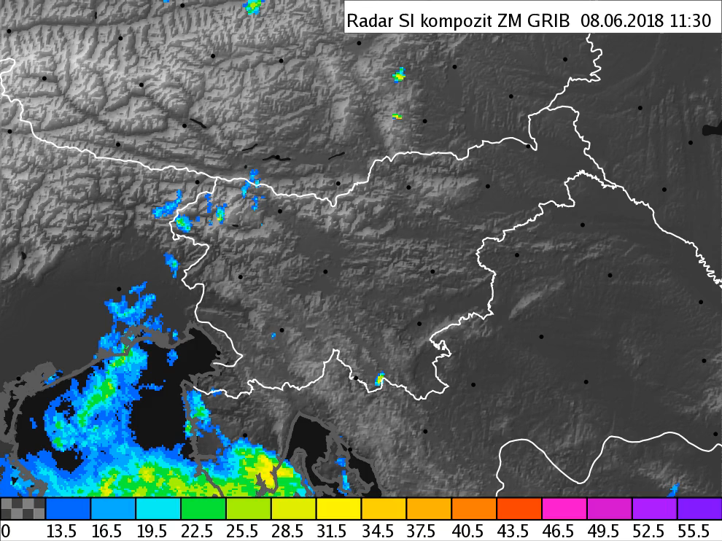
Convective development

Slide 14
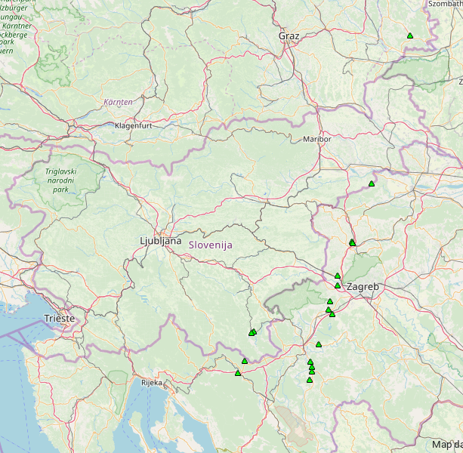
Impact – hail
©ESWD

Slide 15
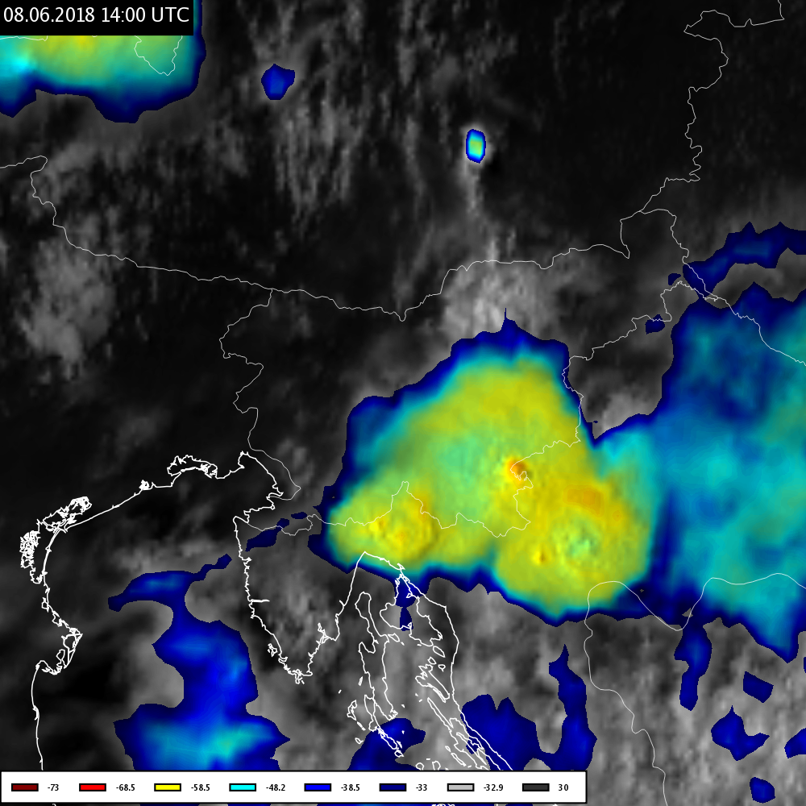
Typical features of severe convective clouds
Overshooting top and cold ring

Slide 16
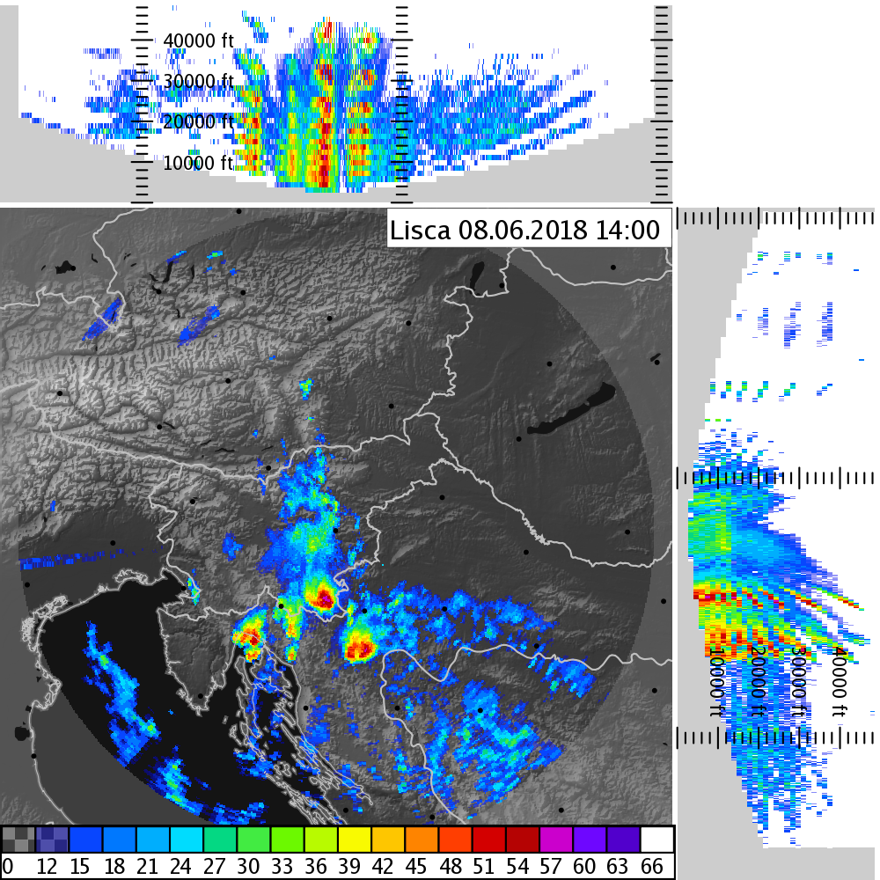
Typical features of severe convective clouds
„Flying eagle“ and very high strong reflectivities

Slide 17
Typical features of severe convective clouds
„Flying eagle“ and very high strong reflectivities

Slide 18
Typical features of severe convective clouds
Split cells

Slide 19
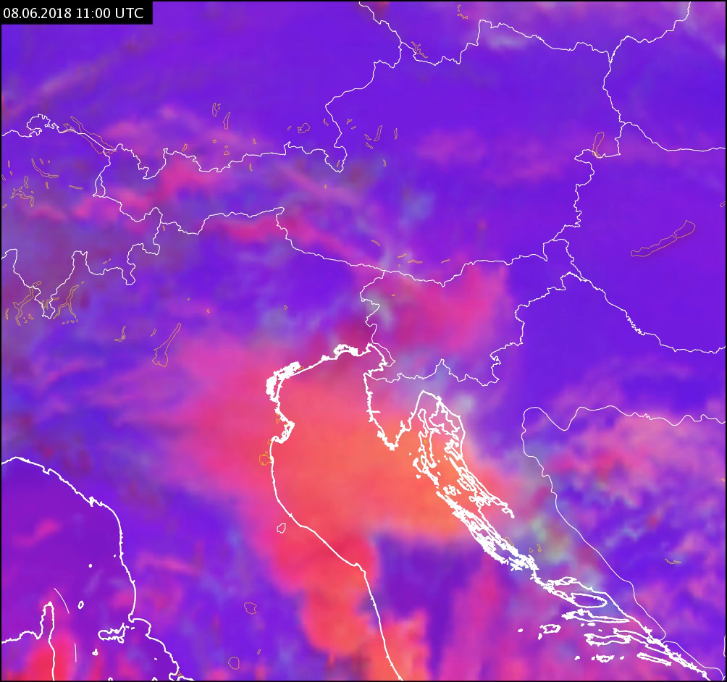
Typical features of severe convective clouds
Small ice crystals at the beginning

Slide 20
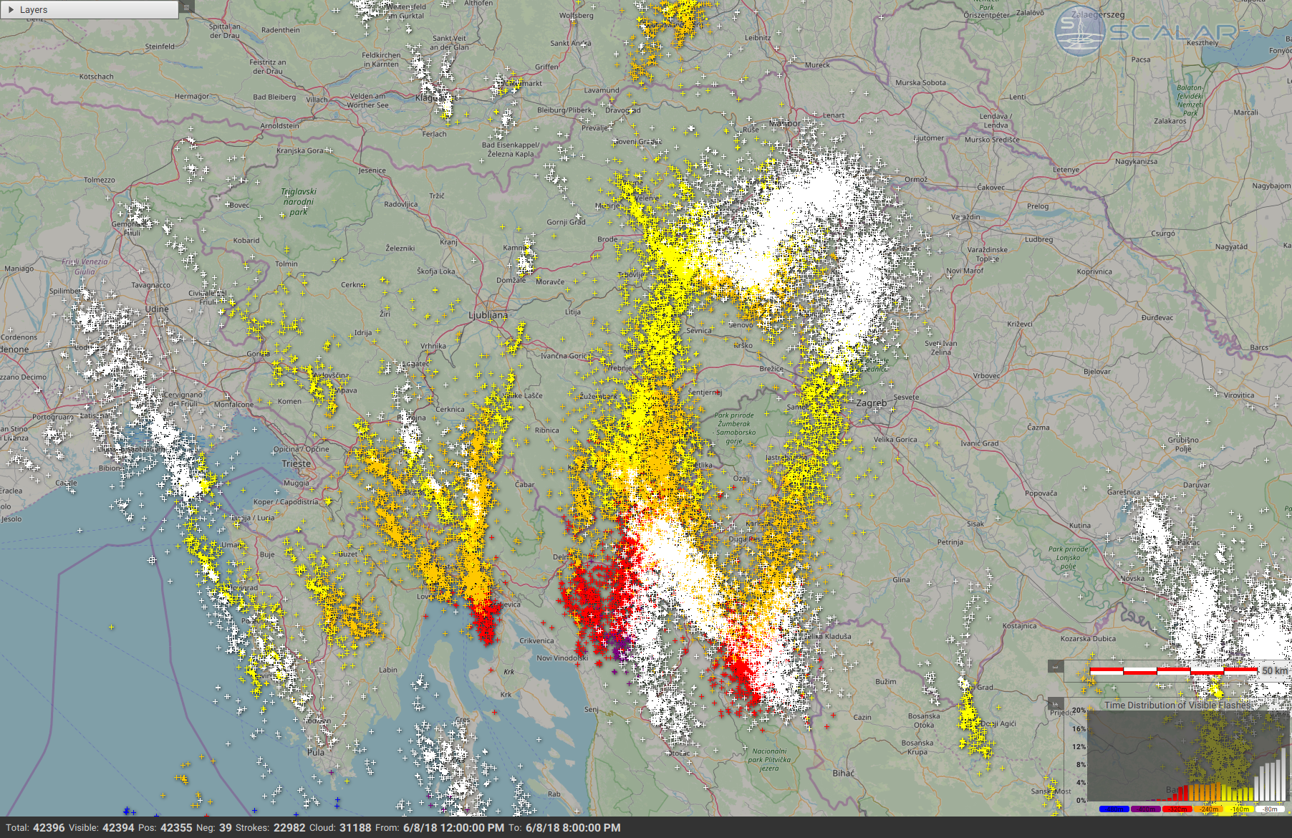
Typical features of severe convective clouds
Lightning jump
No. of flashes along the track of the most severe storm
©EIMV
Hail 4cm
Hail 8cm

Slide 21
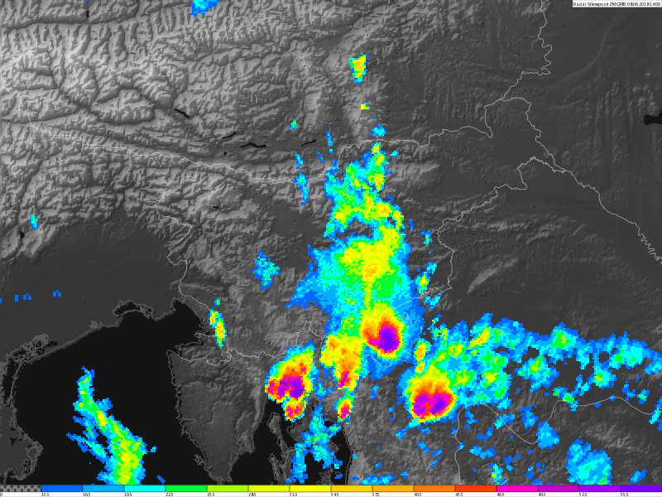
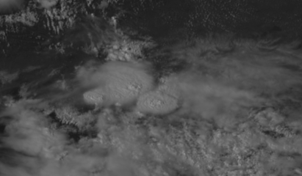
Positive interaction between the two storm cells?
Radar image shows two separate storms, satellite images suggest a possible constructive interaction.

Slide 22
Second phase of convective development
More widespread convection, multicells in late afternoon and evening

Slide 23
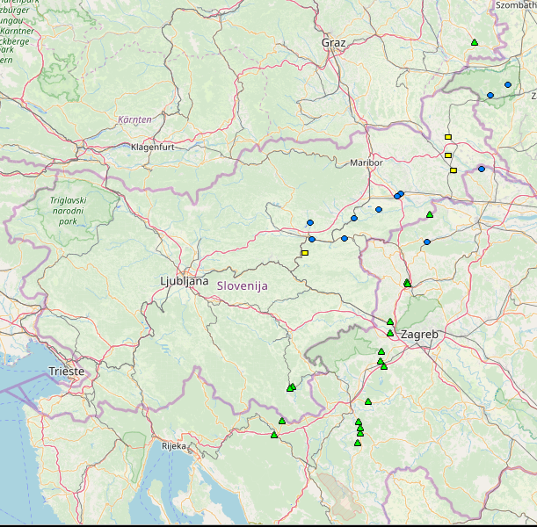
2nd phase of the convectivedevelopment - gusts
Single supercells produced mainly hail, while more organized convective systems produced heavy rain and severe wind gusts.
©ESWD

Slide 24
The ingredients for convective development
Were all ingredients for the development present?
Instability
Moisture
Lift
Goal: Investigation with available satellite data

Slide 25
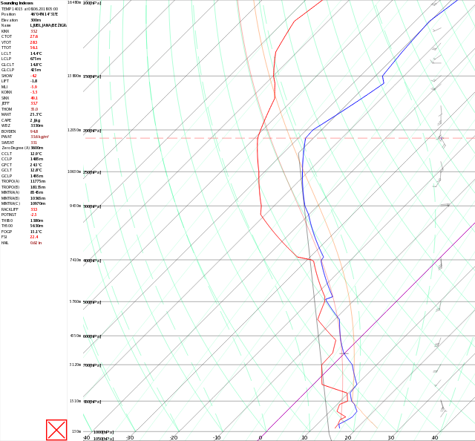
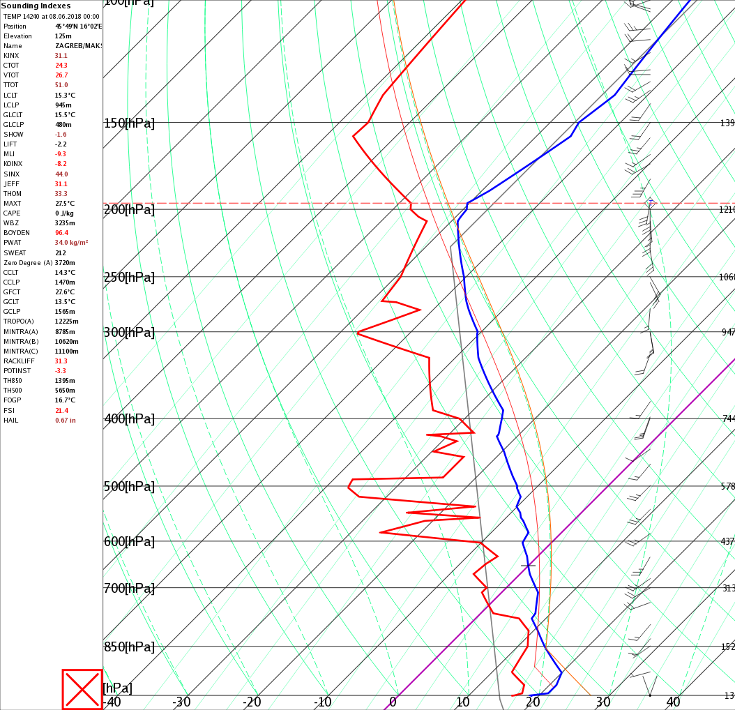
Instability and moisture
TEMP Ljubljana 06 UTC
TEMP Zagreb 00 UTC

Slide 26
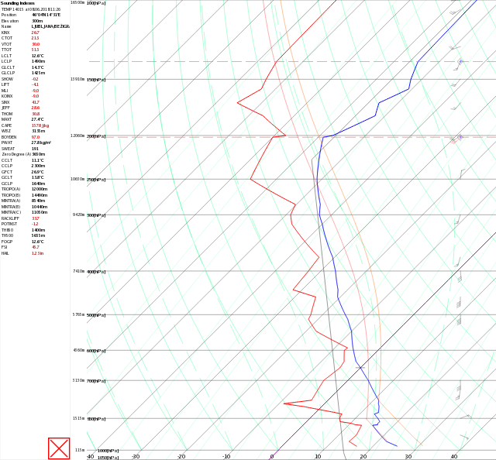
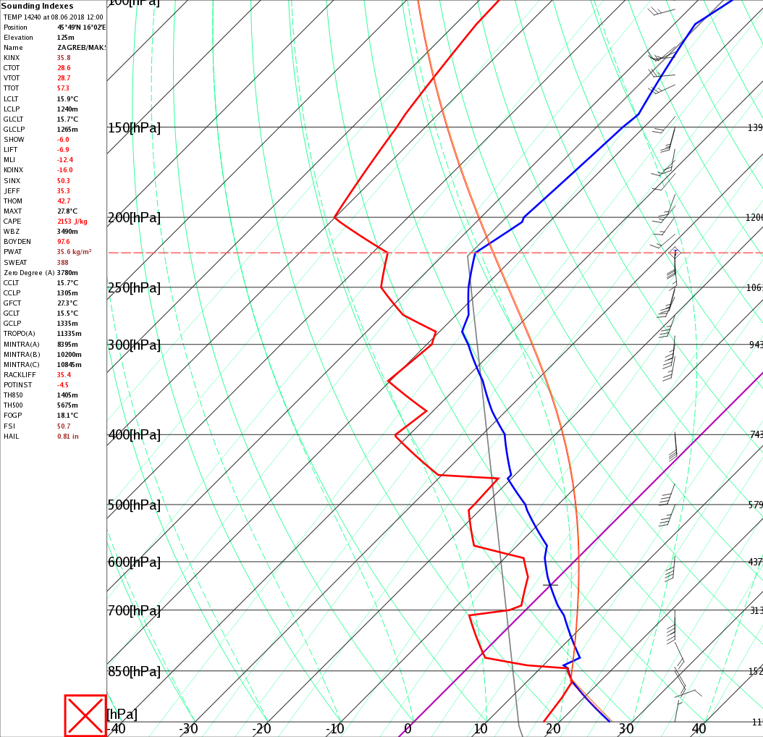
Instability and moisture
TEMP Ljubljana 12 UTC
TEMP Zagreb 12 UTC

Slide 27
IASI level2 temperature and humidity profiles
“All-sky” conditions
Retrieval method: PWLR³ - Piece-wise linear regression (no NWP input!)
Combination of IR (IASI) and collocated MW (AMSU/MHS) measurements
Resolution: 12-39 km, 138 vertical sigma levels
Quality indicators included

Slide 28
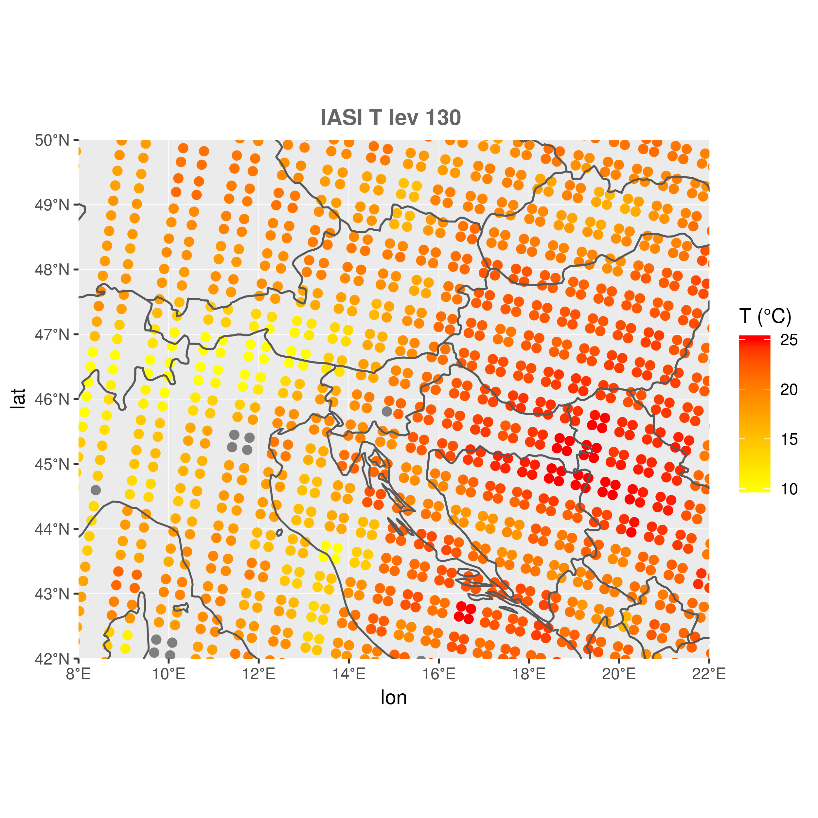
IASI near surface temperature 08:45 UTC

Slide 29
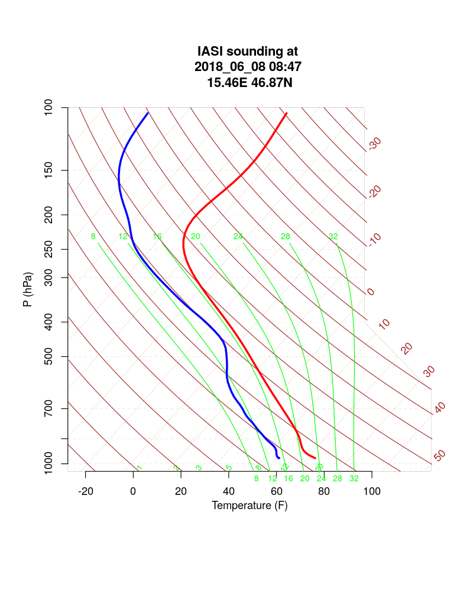
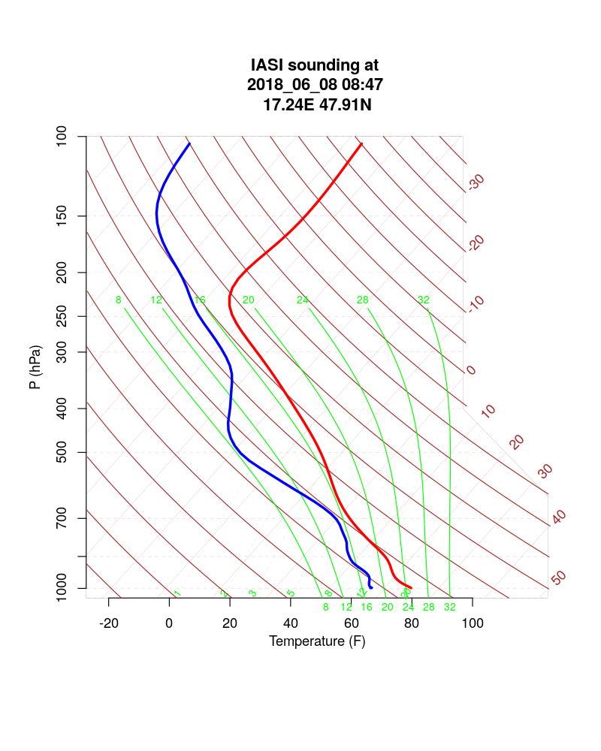
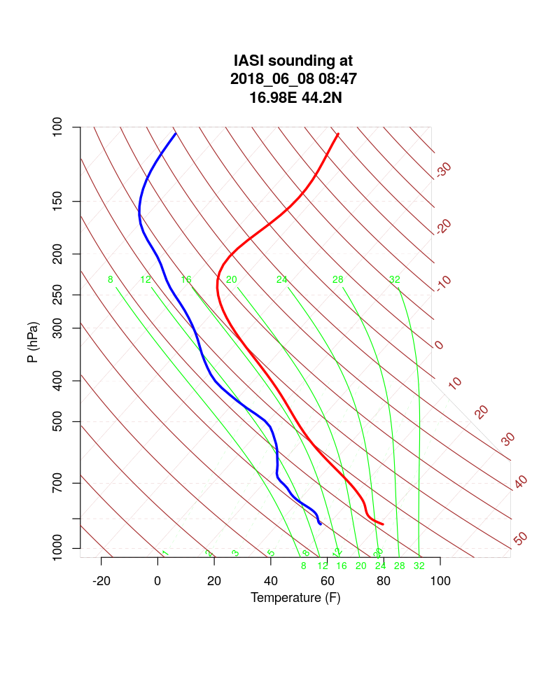
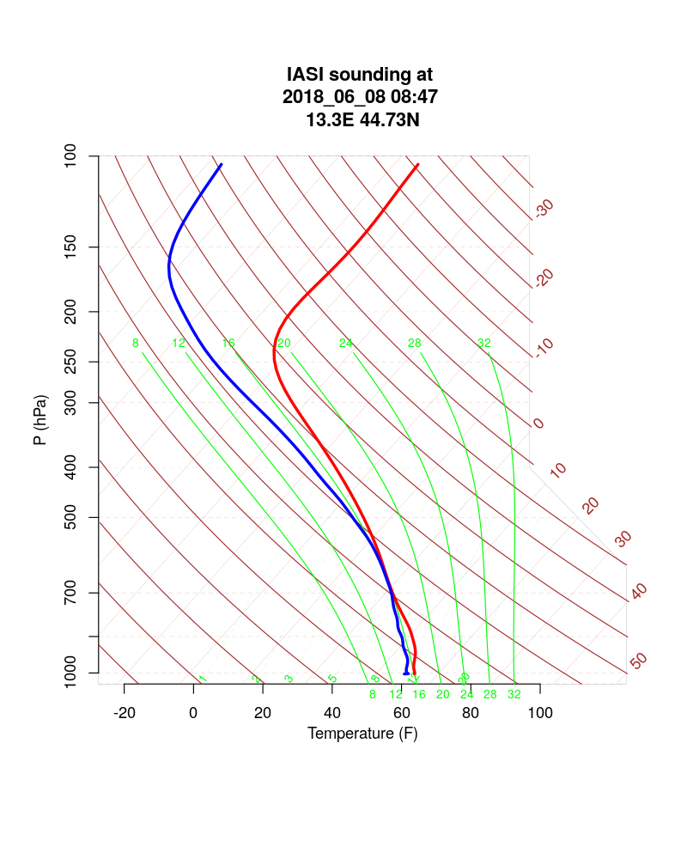
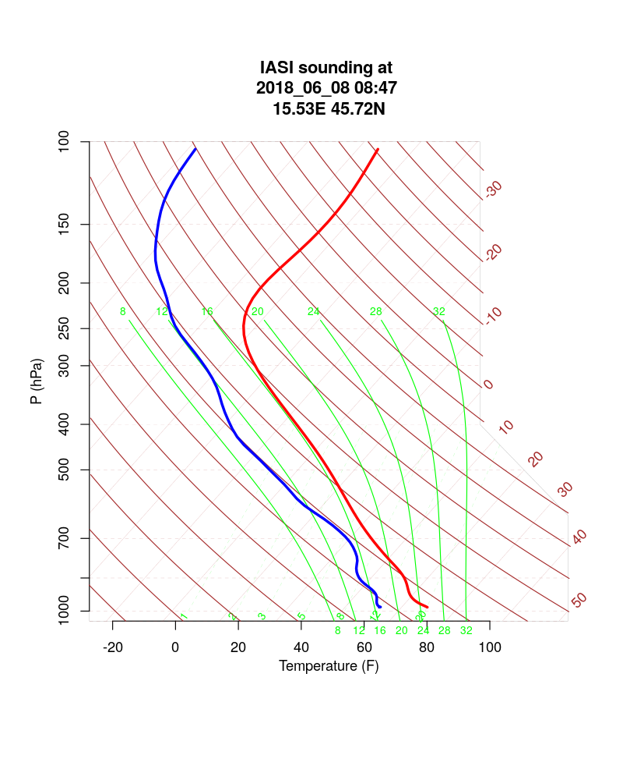

Slide 30
Can we trust these profiles?

Slide 31
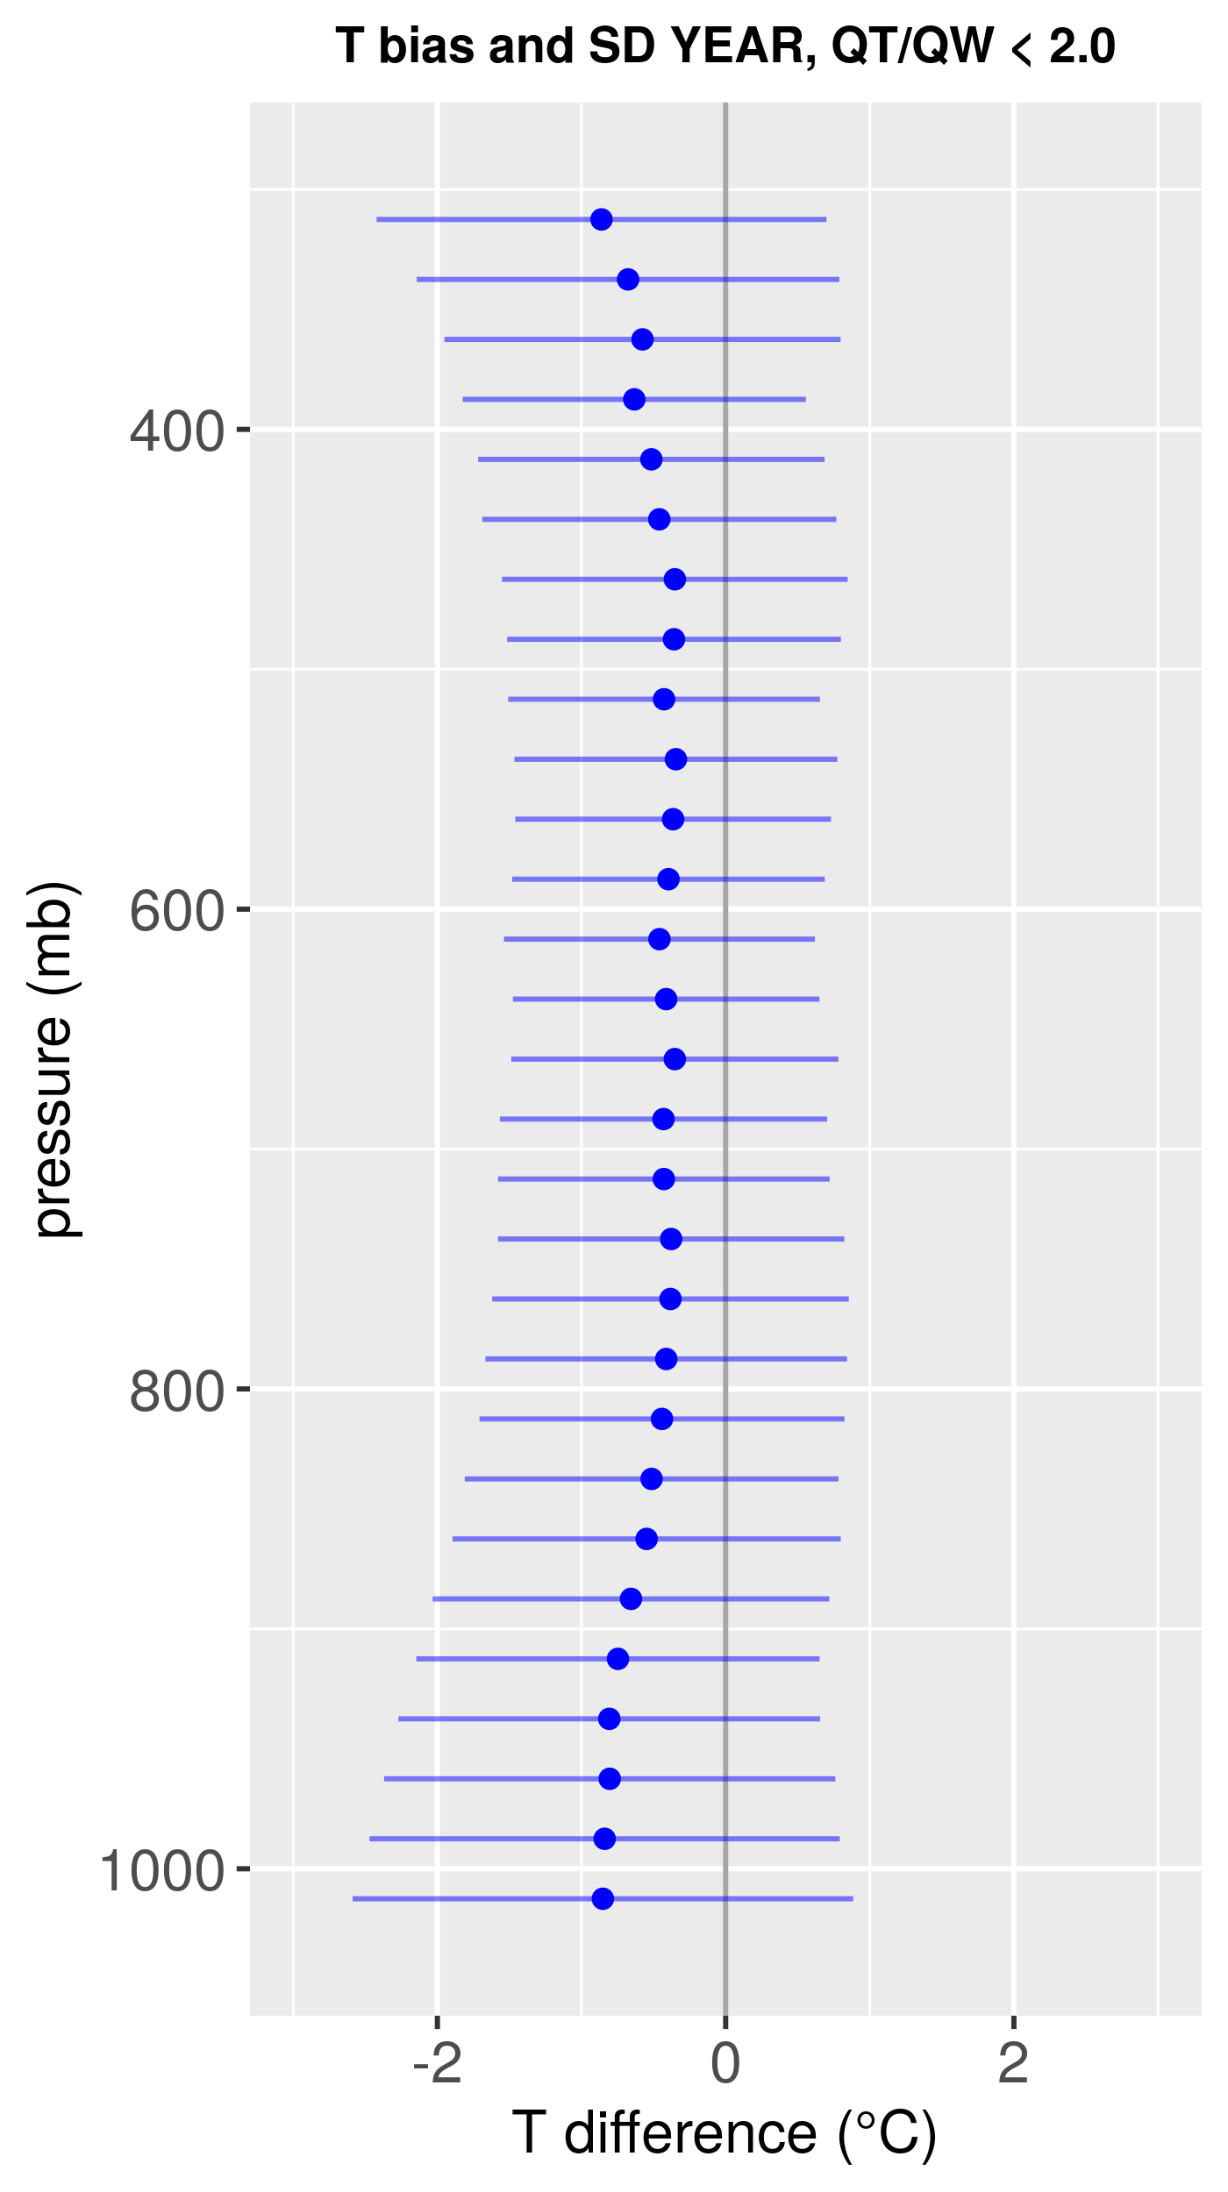
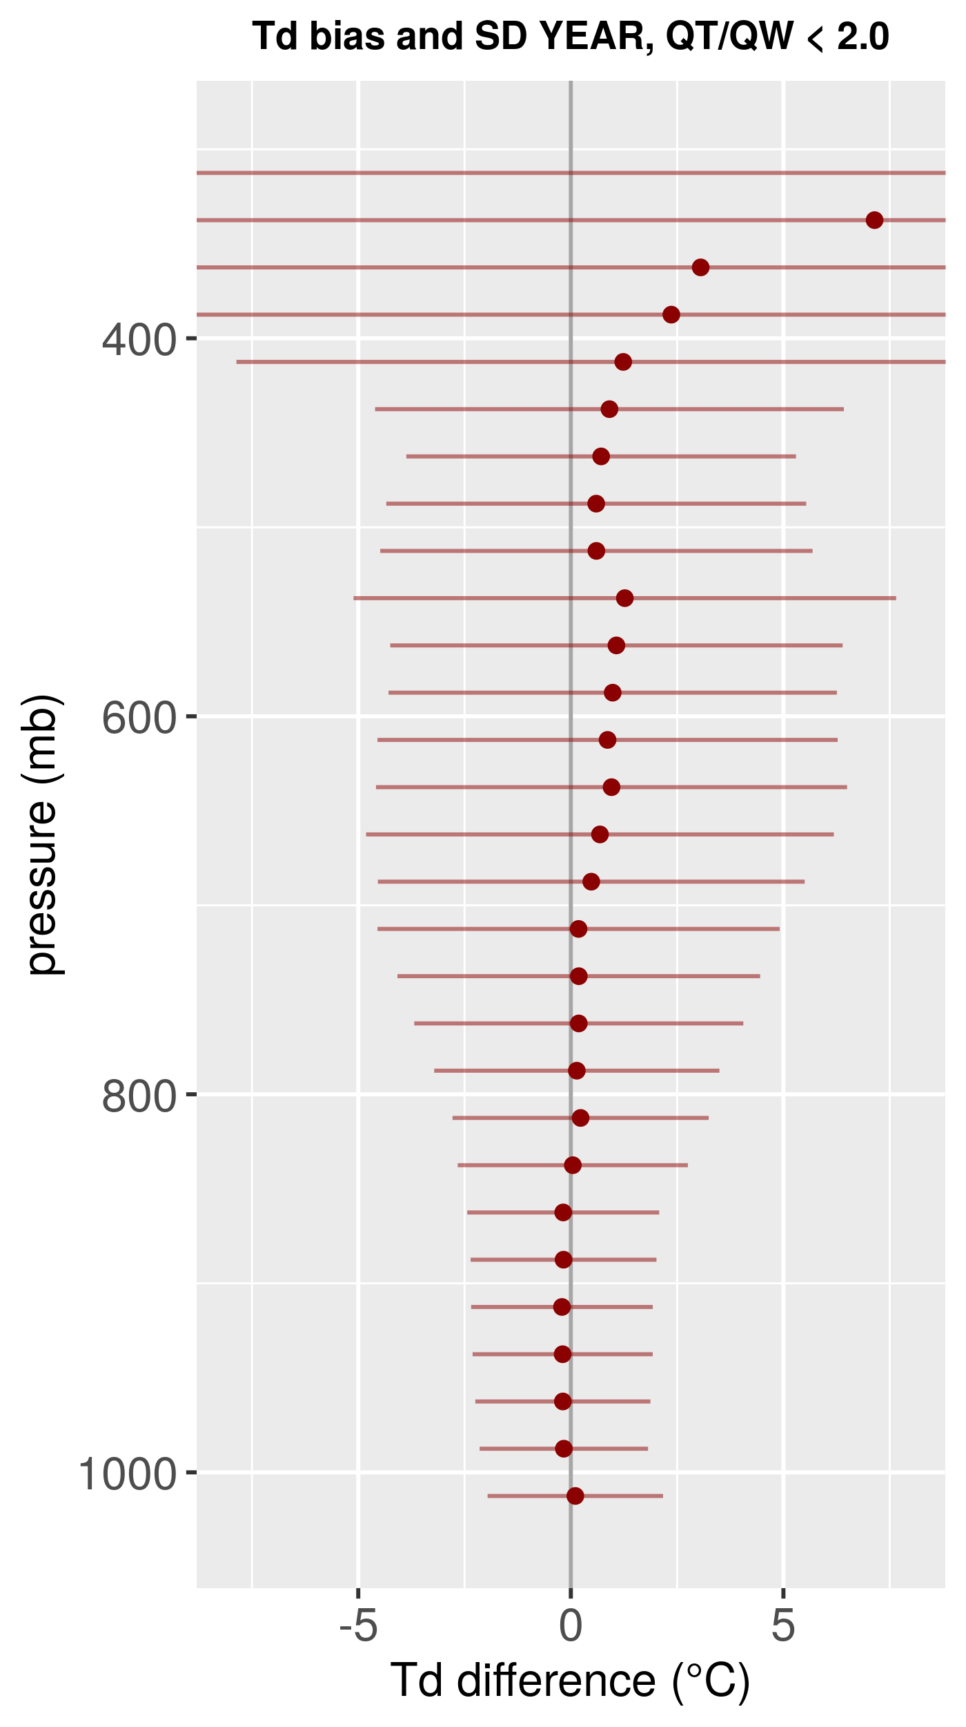
Verification with aircraft (AMDAR) data
Pressure (hPa)
T difference and St dev (°C)
Td difference and St dev (°C)

Slide 32
Stability indices
Convection
K-index:
K = T₈₅₀ + Td₈₅₀ – T₅₀₀ – (T₇₀₀ – Td₇₀₀)
Showalter index:
SWI = T_{env_500} – T_{parcel_500} (lifted from 850 hPa)

Slide 33
Convection IASI vs AMDAR
Slightly adjusted thresholds
SWI < 3 | IASI YES | IASI NO
AMDAR YES | 3327 | 1298
AMDAR NO | 1199 | 3299
POD = 0.72
K > 20 | IASI YES | IASI NO
AMDAR YES | 2327 | 1672
AMDAR NO | 1371 | 3753
POD = 0.58

Slide 34
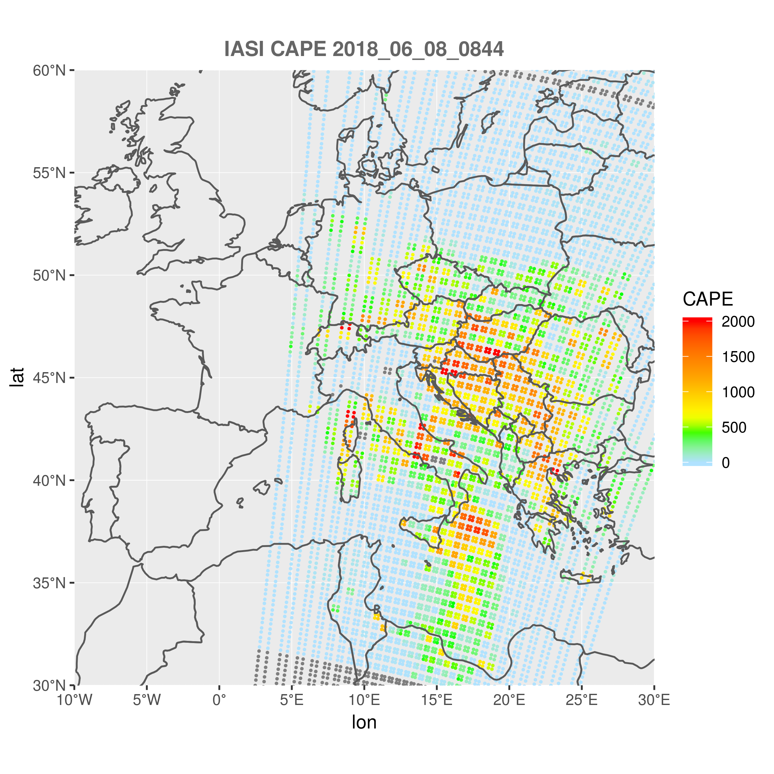
CAPE
Surface based CAPE ~ 8.45 UTC

Slide 35
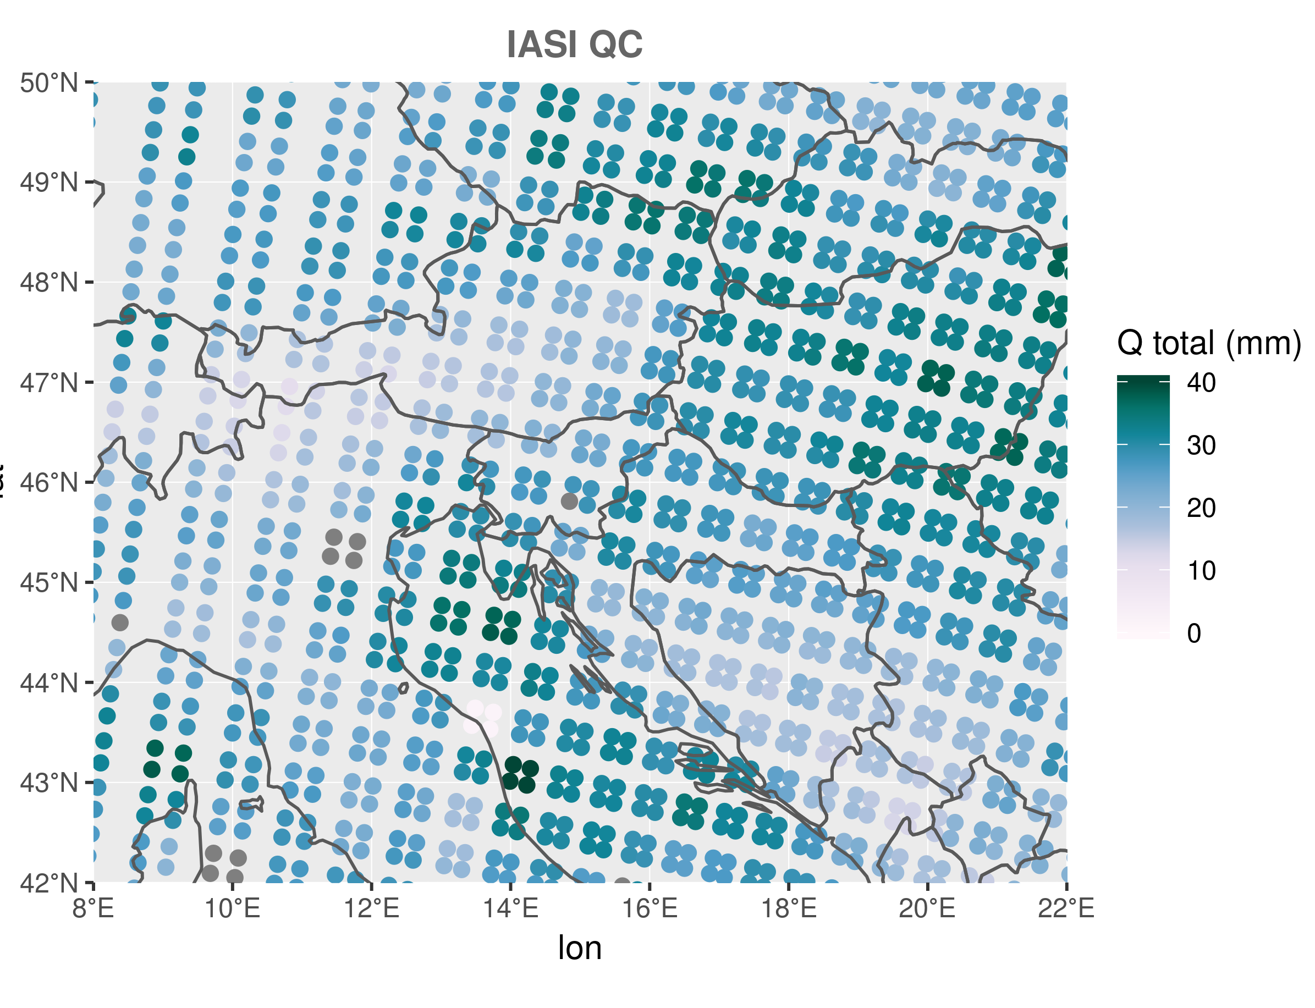
Moisture
Total column water vapour ~ 8.45 UTC

Slide 36
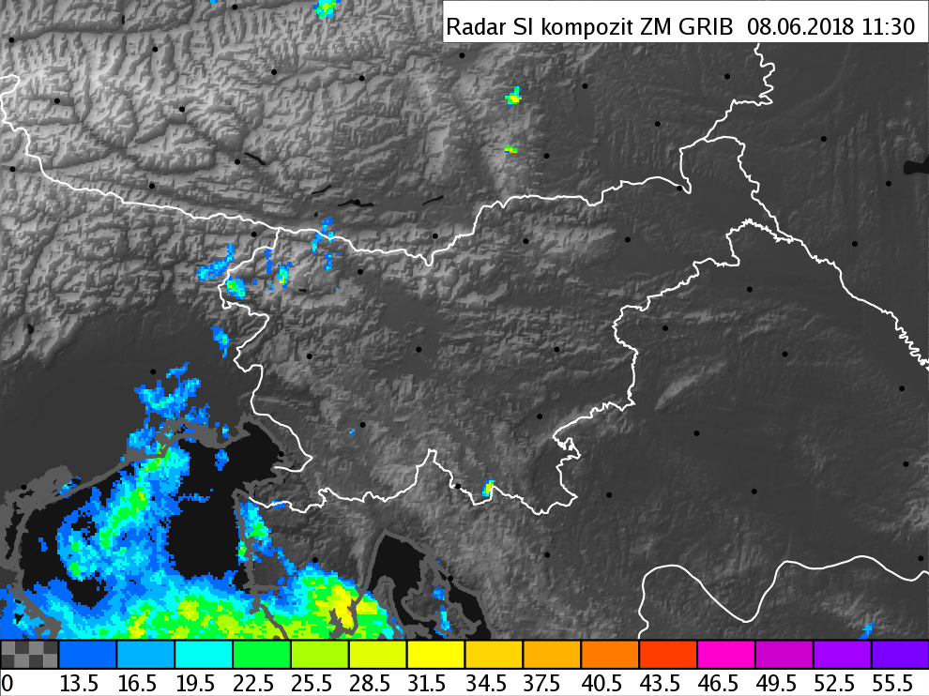
Lifting mechanisms
Orography

Slide 37
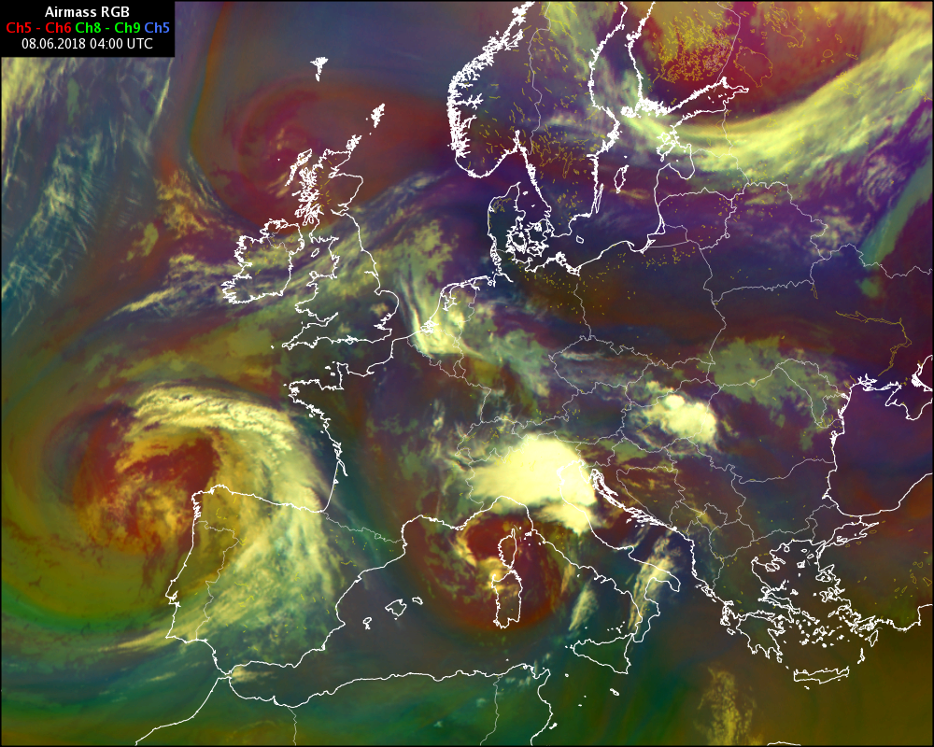
Lifting mechanisms
Synoptic forcing by upper-level PV anomaly

Slide 38
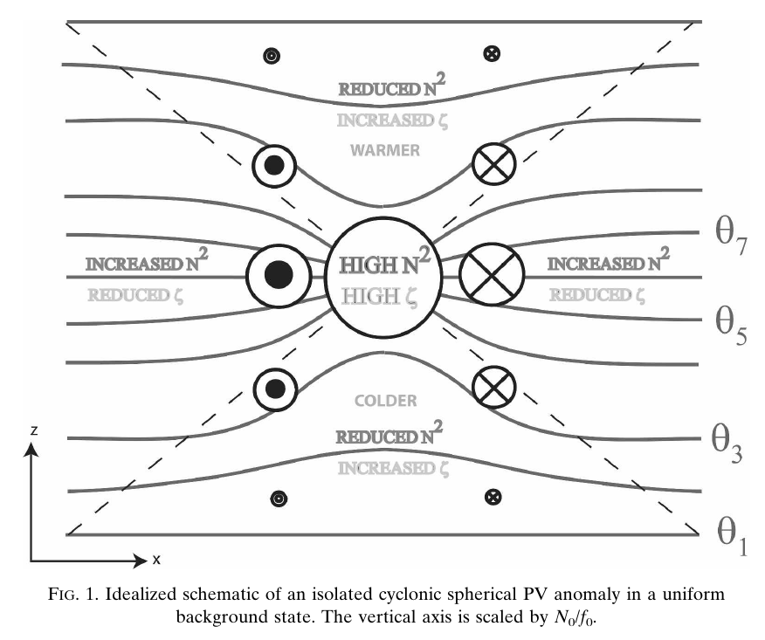
Lifting mechanisms
Synoptic forcing by upper-level PV anomaly
Nielsen-Gammon & Gold 2008

Slide 39
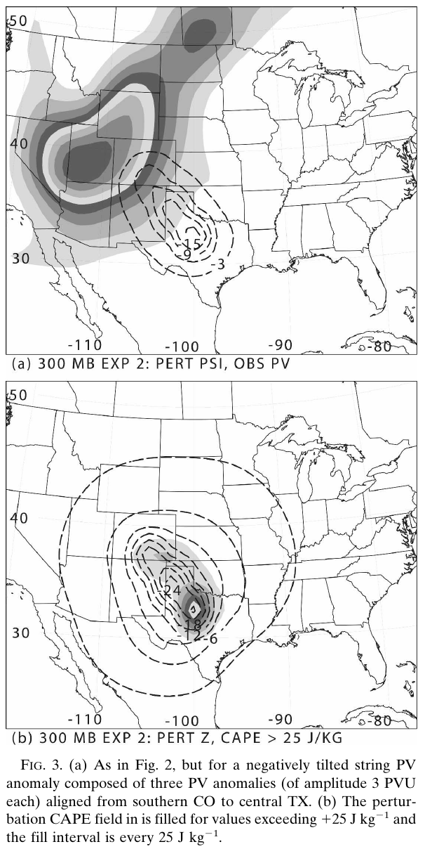
Lifting mechanisms
Synoptic forcing by upper-level PV anomaly
Nielsen-Gammon & Gold 2008

Slide 40
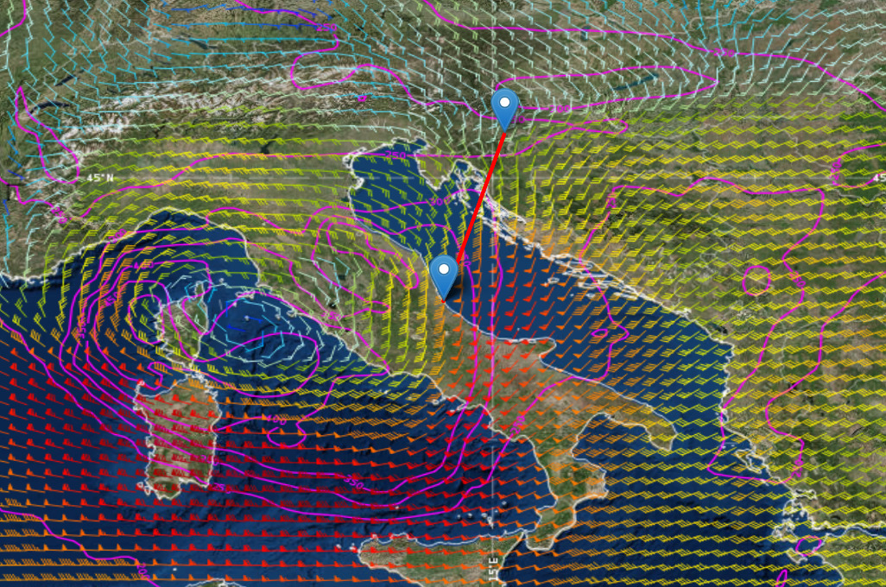
Lifting mechanisms
Height of 1.5 pvu level (pink), 300hPa wind (arrows)
Upper-level divergence

Slide 41
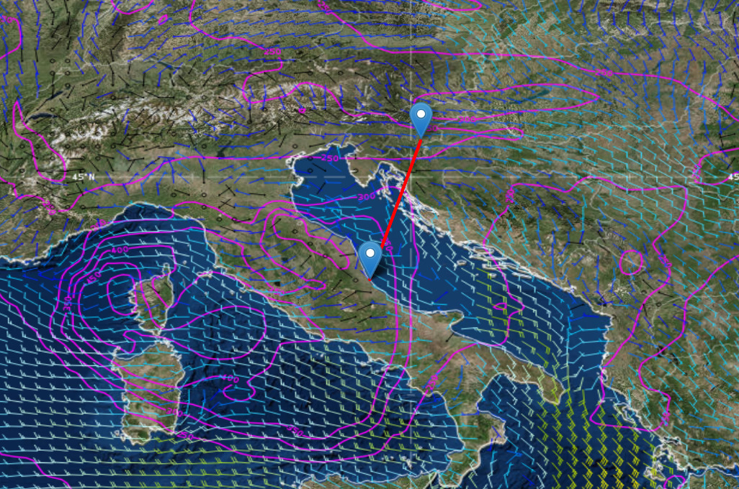
Lifting mechanisms
Height of 1.5 pvu level (pink), 925hPa wind (arrows)

Slide 42
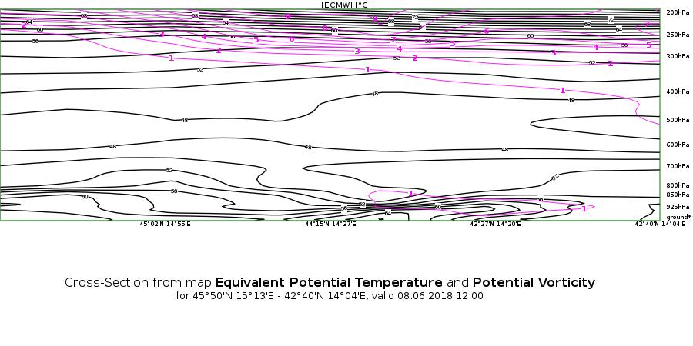
Lifting mechanisms
Crosssection of PV (pink) and pot. temperature (black)
Very unstable atmosphere

Slide 43
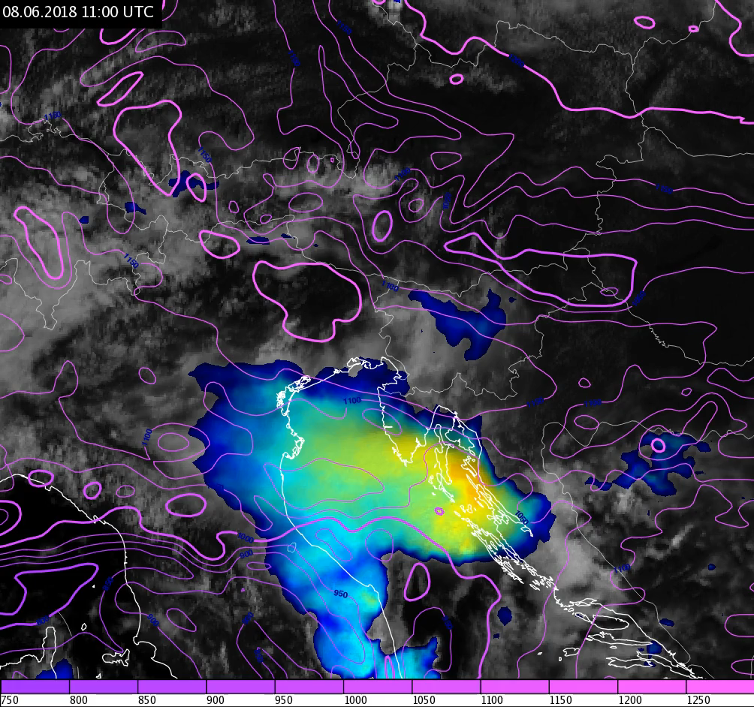
Lifting mechanisms
Upper-level PV anomaly approaches the area of convection initiation

Slide 44
Summary
08.06.2018 was one of the most severe convective days of 2018 convective season.
The storm exhibited several features of severe storms, however the extreme hailstone size was not expected.
Two phases of convective development.
Satellite profiles show abundant moisture and CAPE in the affected region.
In addition to orography, synoptic forcing played an important role.
Possibly interaction between the storms (outflow boundaries) responsible for the extreme hail.

