Slide 1
The influence of soil moisture on convective precipitation in the Eastern Alpine region
Stefan Schneider, Georg Pistotnik
Convection Week 2019
May 23rd, 2019

Slide 2
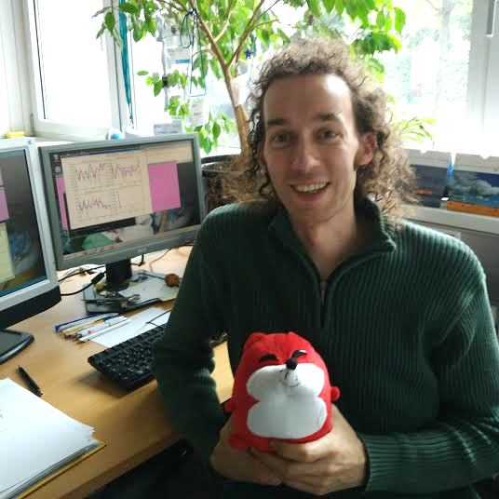
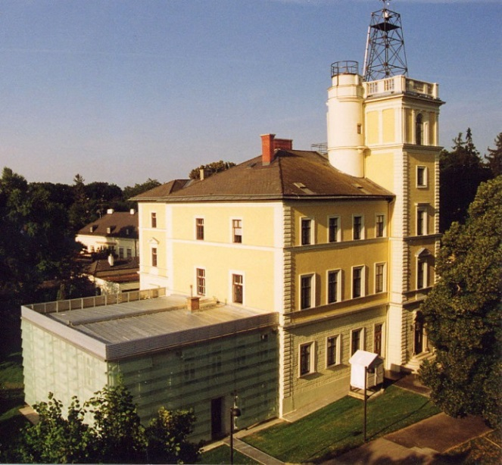
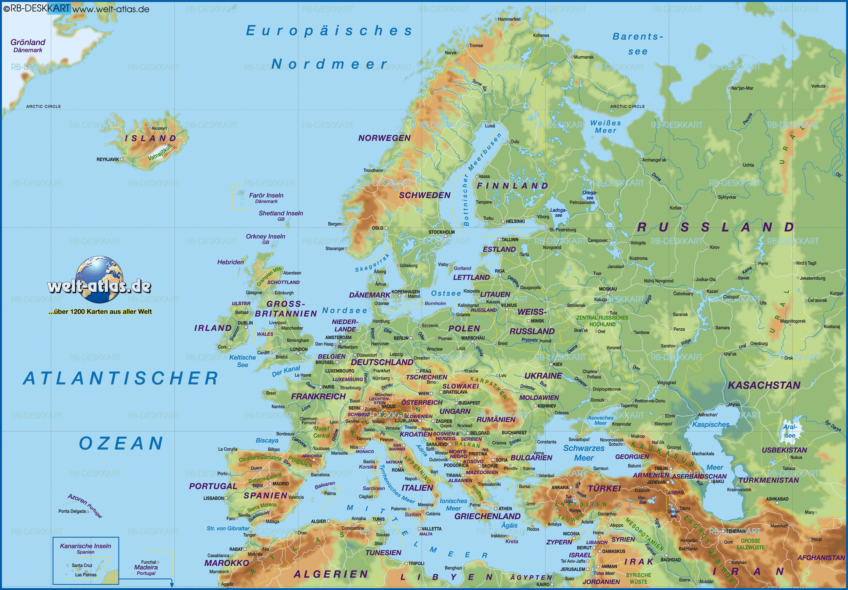
Hello!
Est. 1851
Stefan
Georg

Slide 3
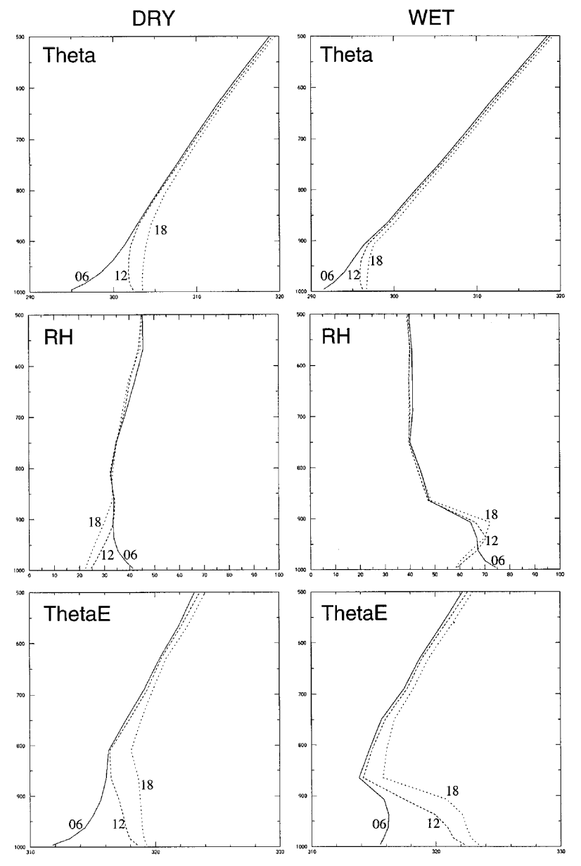
motivation
Theory on the influence of soil moisture
DRY (0.5): solar radiation -> sensible heat
-> pronounced mixing layer
WET (2.0): solar radiation -> latent heat
-> thin mixing layer
WET: moisture is transported into a
thin & cool mixing layer
-> relative humidity increases
(absolute humidity ~ equal, so the additional water,
which is raining out, is mainly advected)
WET: well pronounced mixing layer
warmer near the ground, colder above than DRY
-> higher potential for convective instability
Schär et al., 1999

Slide 4
motivation
Hypothesis
Soil moisture is a prognostic parameter for convection
We know
Numerical weather prediction (NWP) models calculate soil moisture
Several satellites measure soil moisture (e.g. METOP ASCAT, S1)
We want to know
Is there a lower threshold for soil moisture which inhibits convection?
Which soil moisture products can be used for forecasting convection?

Slide 5
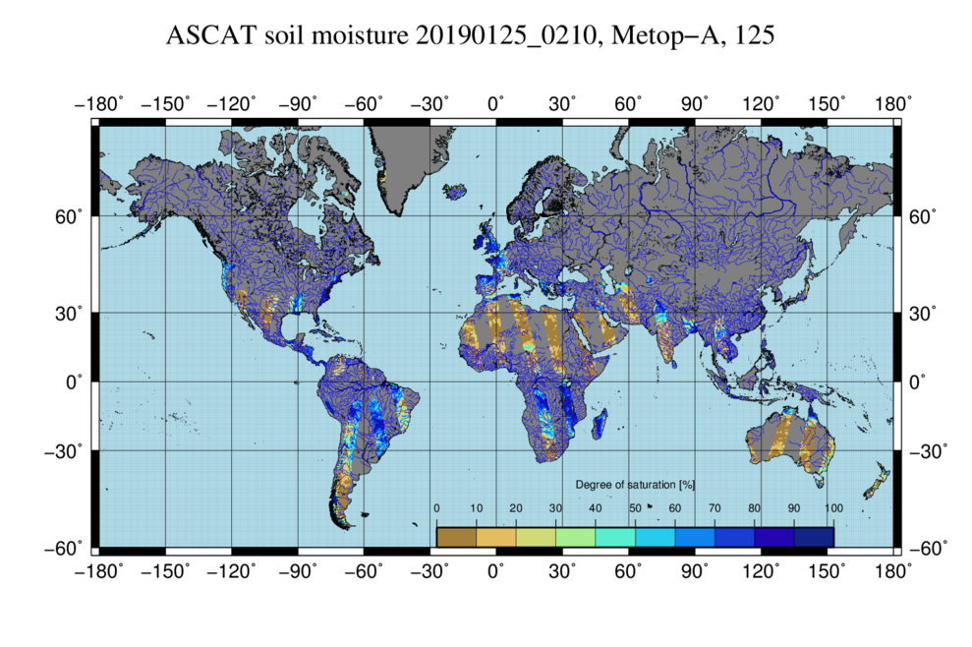
Satellite data
EUMETSAT H-SAF H16 (world) / H08 (Europe)
http://hsaf.meteoam.it/soil-moisture.php?tab=1

Slide 6
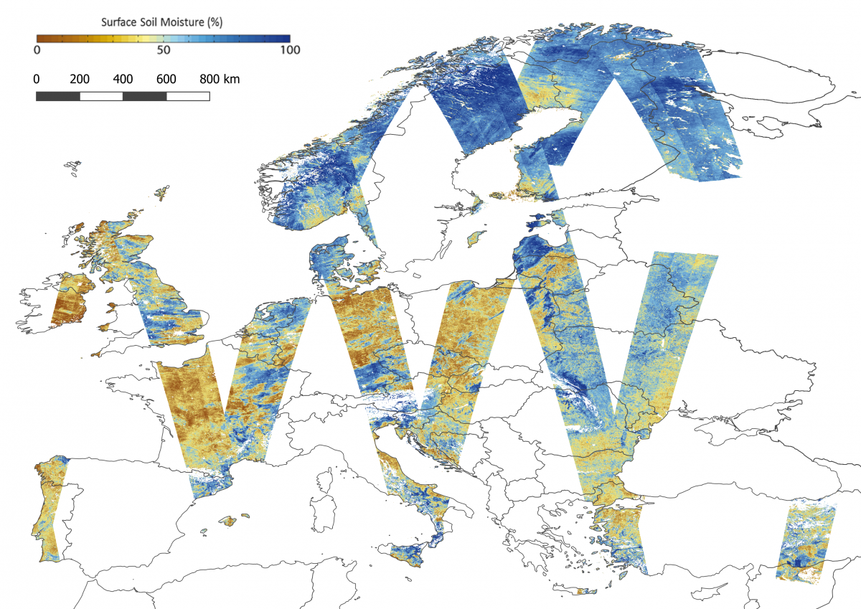
Satellite data
Copernicus Surface Soil Moisture (SSM1km)
https://land.copernicus.eu/global/sites/cgls.vito.be/files/images/products/SSM1km_examples_20180824_Europe.png

Slide 7
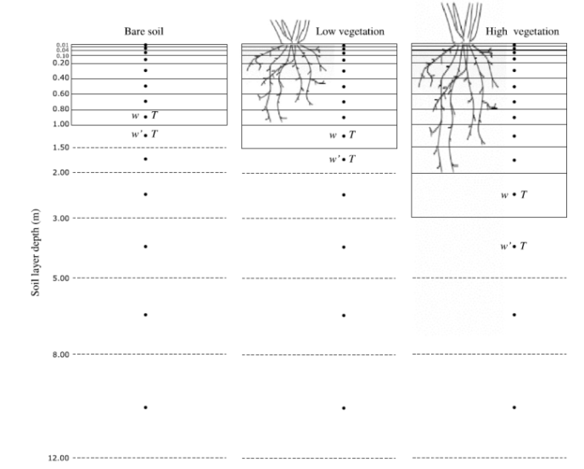
Model setup
Coupled soil-atmosphere NWP model (AROME)
Soil variables can be changed at the beginning of the model run (initialization)
Decharme et al., 2011

Slide 8
Model setup
Soil moisture in layer 1
Reference run (REF)
Dry run (WWILT)
Wet run (WSAT)

Slide 9
Model setup
2 experimental settings:
Case studies I (summer 2016)
days with weak synoptic forcing and thunderstorms
soil manipulated for every case study day separately
mainly to test initiation of convection
Case studies II (summer 2014, 2015)
whole summer season (01.05.-31.08.)
soil manipulated just on the first day (May 1st)
mainly to test feedback processes

Slide 10
Results – case studies I
precipitation 24.06.2016 00UTC -25.06.2016 06UTC
REF
WWILT
WSAT

Slide 11
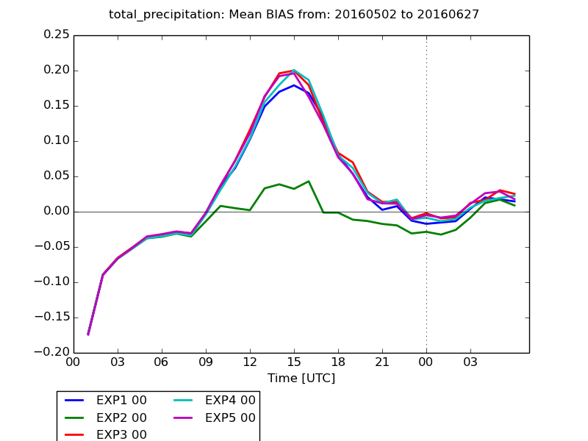
Results – case studies I
Mean Bias (NWP minus stations) of precipitation for 02.05.-27.06.2016 and all available SYNOP stations in Austria
REF WWILT WSAT EXP4 EXP5

Slide 12
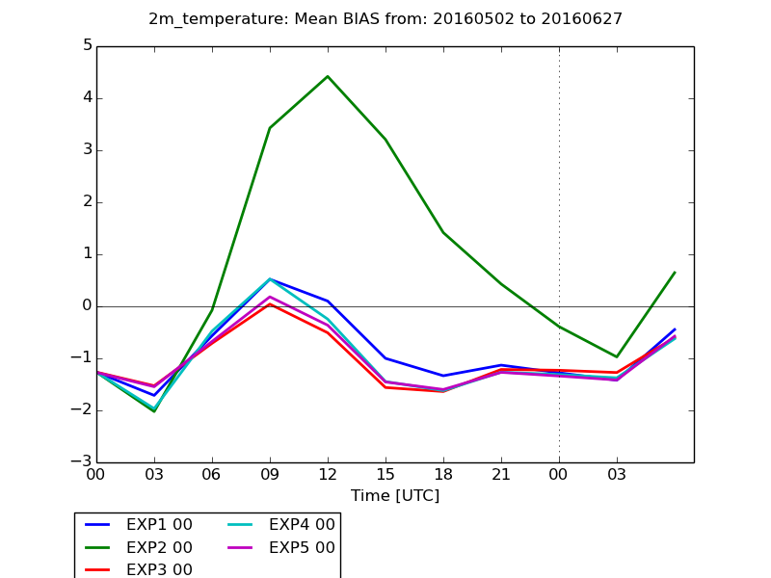
Results – case studies I
Mean Bias (NWP minus stations) for T2m for 02.05.-27.06.2016 and all available SYNOP stations in Austria
REF WWILT WSAT EXP4 EXP5

Slide 13
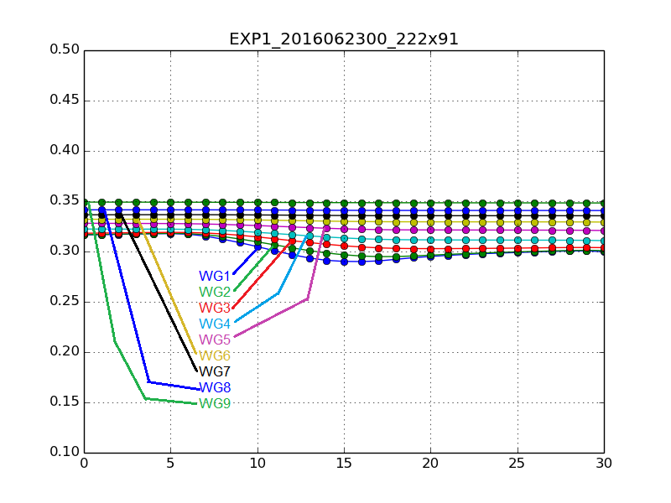
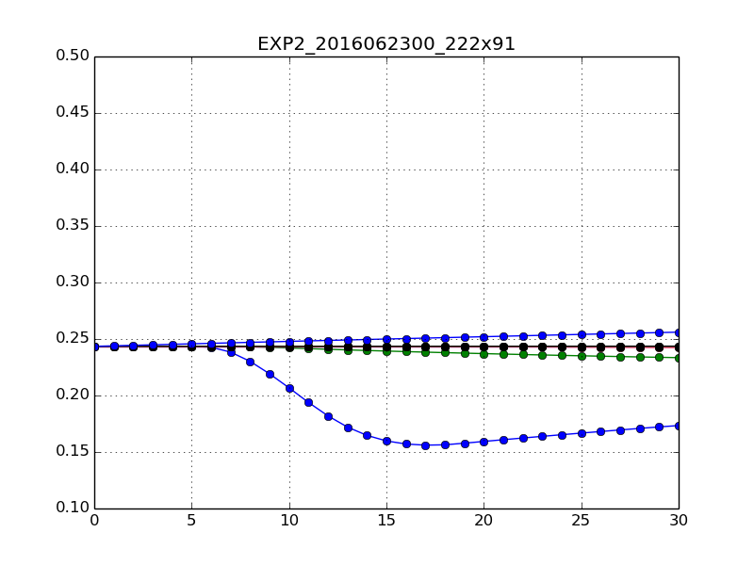
Results – case studies I
soil moisture in a single model grid cell
soil moisture [kg/kg
Forecast range [hours]
REF WWILT

Slide 14
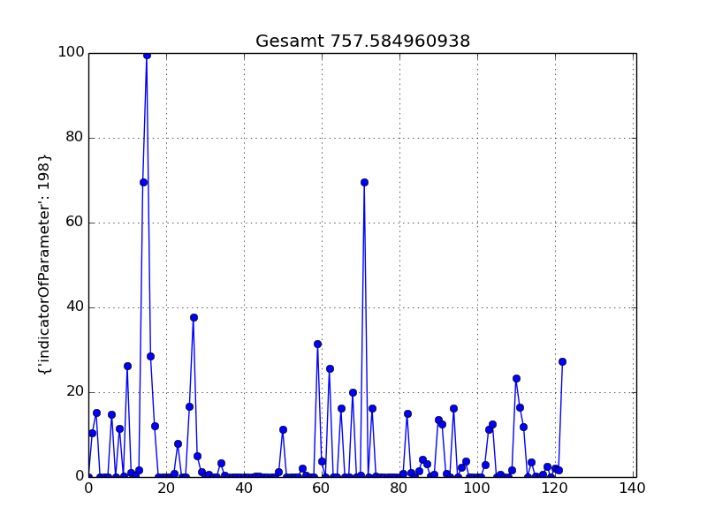
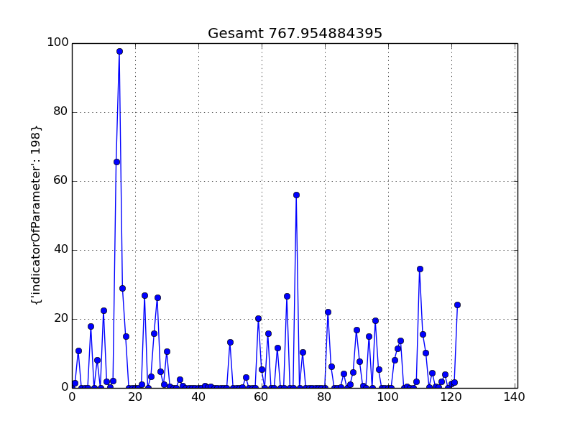
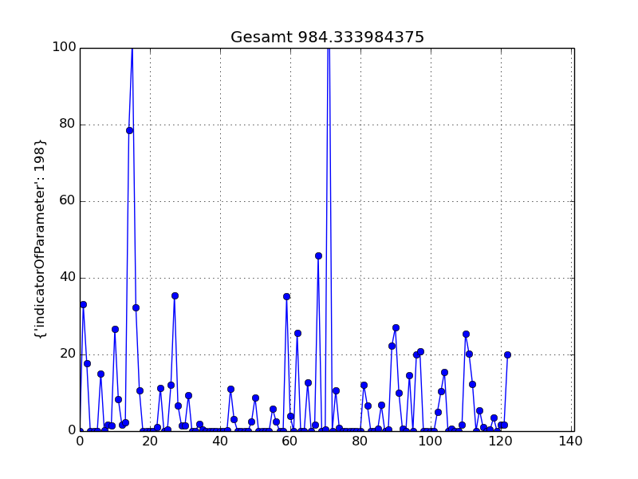
Results – case studies II
Precipitation forecasts 01.05.-31.08.2014 (moist year) for a grid cell in Eastern Austria
May 1st August 31st
REF WWILT WSAT
757mm 767mm 984mm

Slide 15
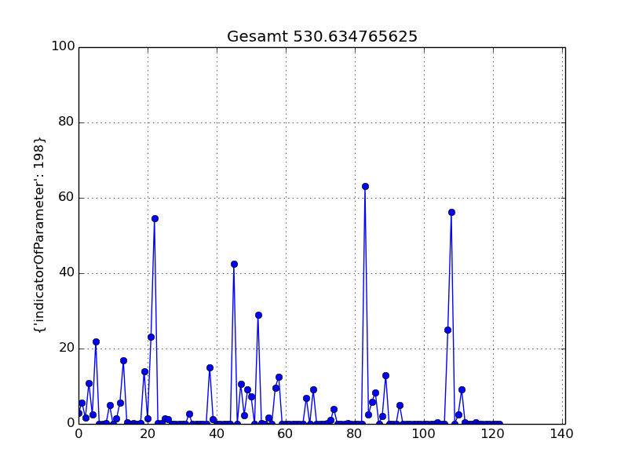
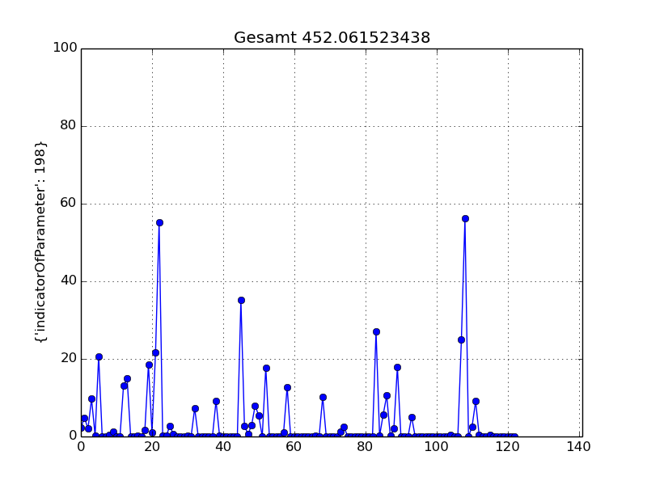
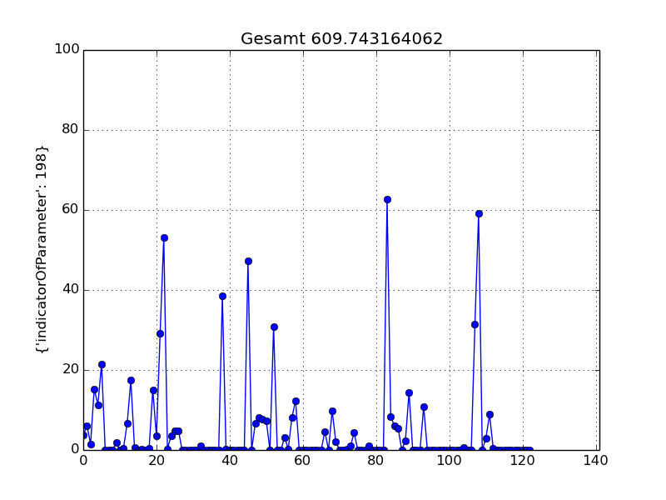
Results – case studies II
Precipitation forecasts 01.05.-31.08.2015 (dry year) for a grid cell in Eastern Austria
REF WWILT WSAT
531mm 452mm 610mm

Slide 16
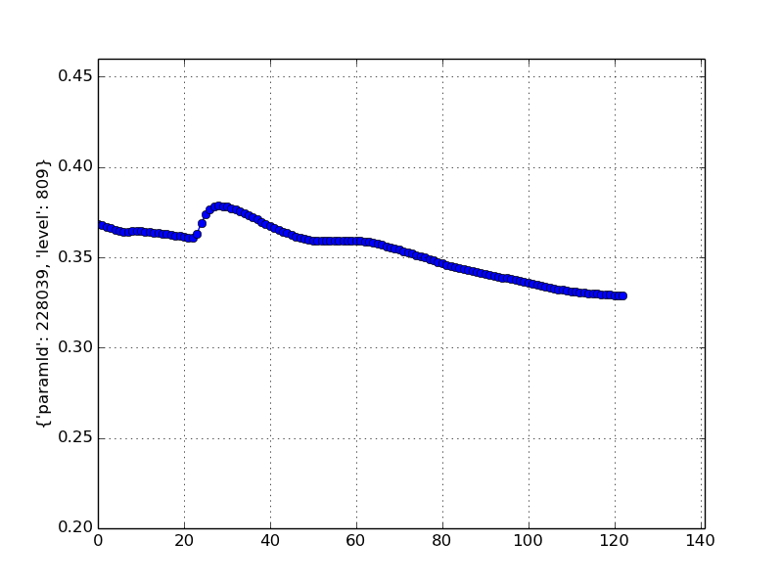
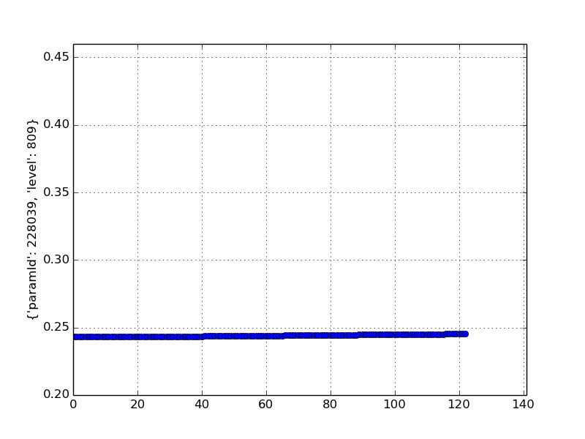
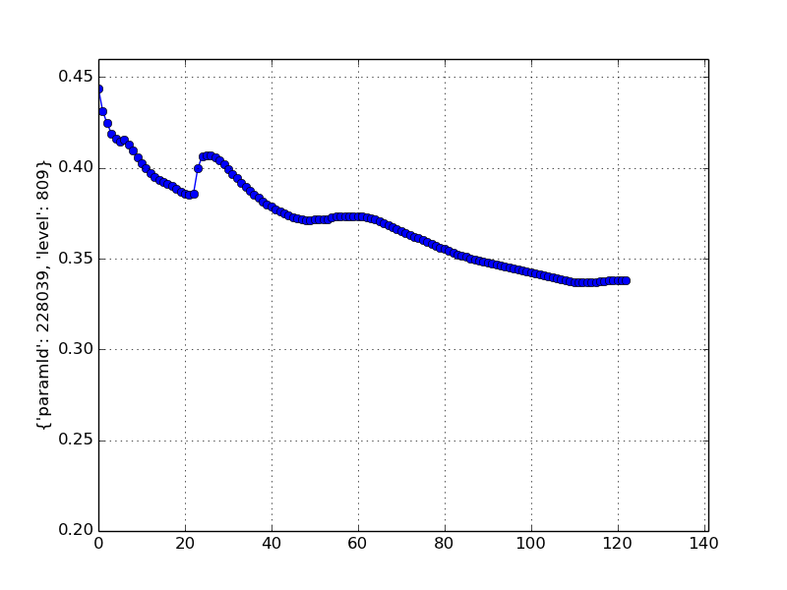
Results – case studies II
Soil moisture in layer 10 (150-200cm) 01.05.-31.08.2015 (dry year) for a grid cell in Eastern Austria
REF WWILT WSAT

Slide 17
Conclusions – part 1
AROME is sensitive to changes in initial soil moisture conditions
convection does not stop
 no lower threshold of soil moisture can be defined
soil moisture of the uppermost layer (0-1cm) is not representative
 SSM satellite data cannot be used directly
severe drought is a long lasting phenomenon, including feedback

Slide 18
Results
Investigated parameters
Parameter | Unit | Measures | Comment
Low-level moisture | [g/kg] | median and p₉₀ | lowest 100 hPa; daily maximum
Vertical temperature gradient | [K/km] | median and p₉₀ | 850 to 500 hPa; daily maximum
CAPE | [J/kg] | median and p₉₀ | based on 100 hPa deep mixed layer; daily maximum
Daily precipitation | [mm/24h] | median and p₉₀ | 06-06 UTC
Accumulated precipitation | [mm] | absolute and relative differences of experiments to reference | 01 May -31 Aug.

Slide 19
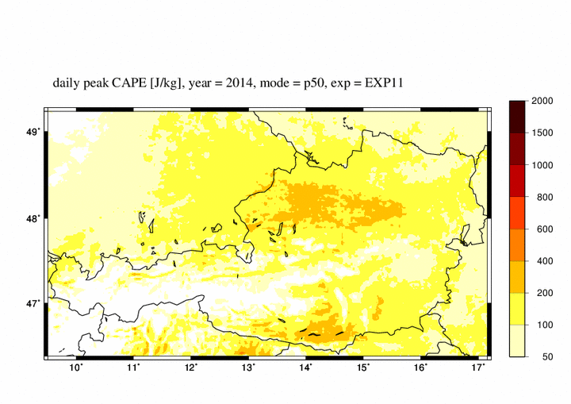
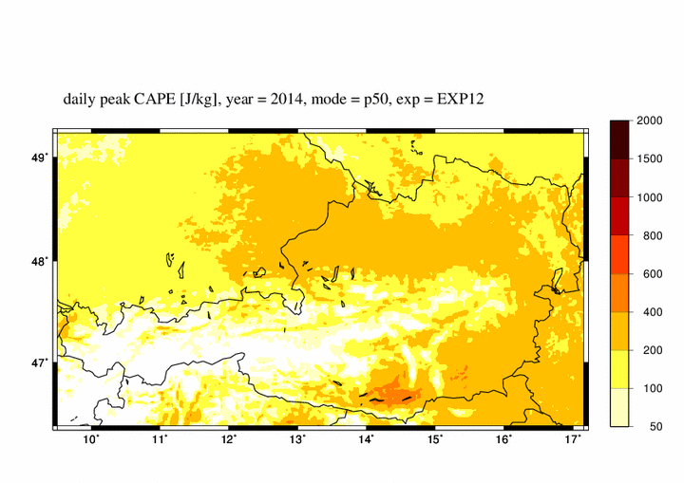
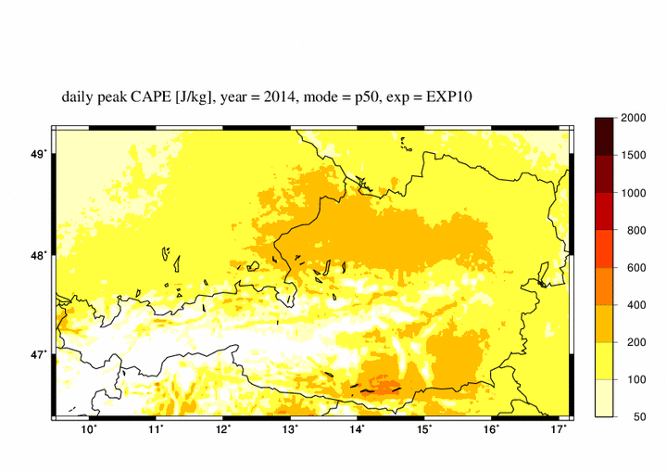
Results
CAPE, year 2014, median
dry experiment
wet experiment
reference

Slide 20
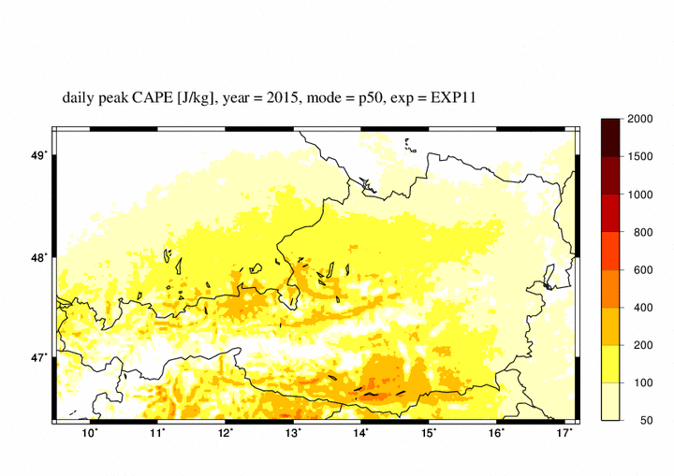
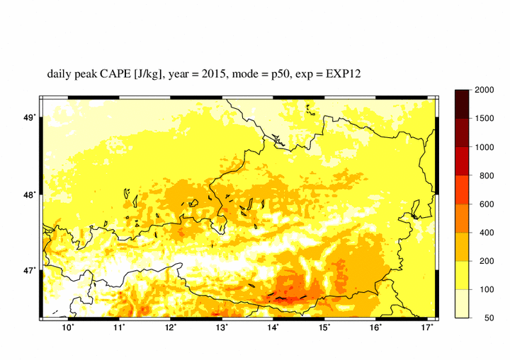
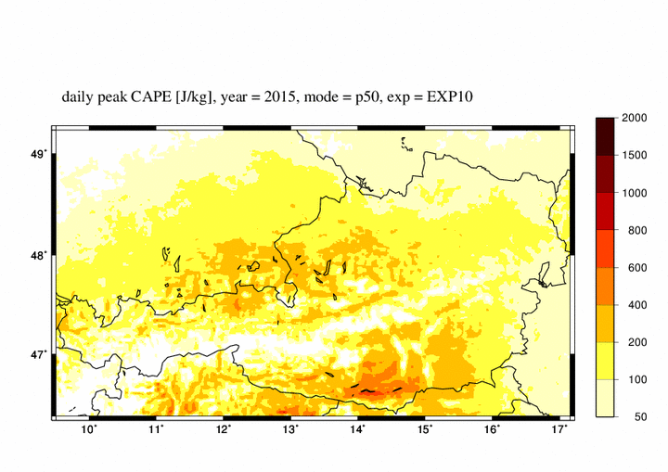
Results
CAPE, year 2015, median
dry experiment
wet experiment
reference

Slide 21
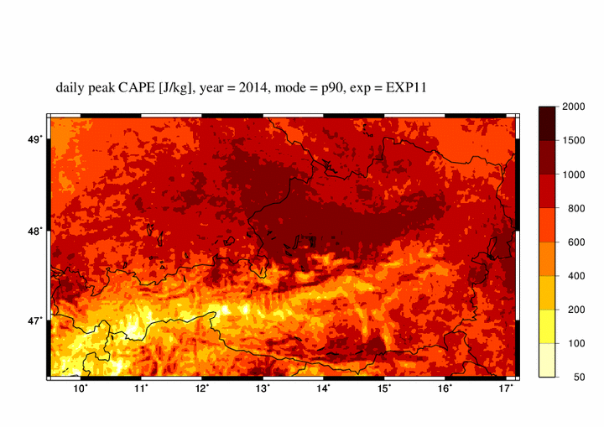
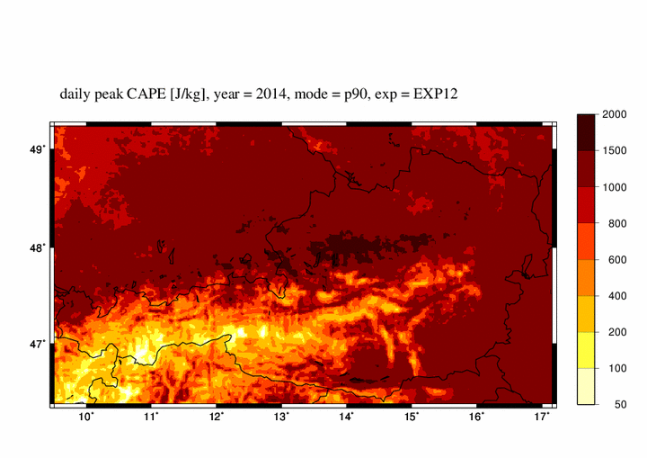
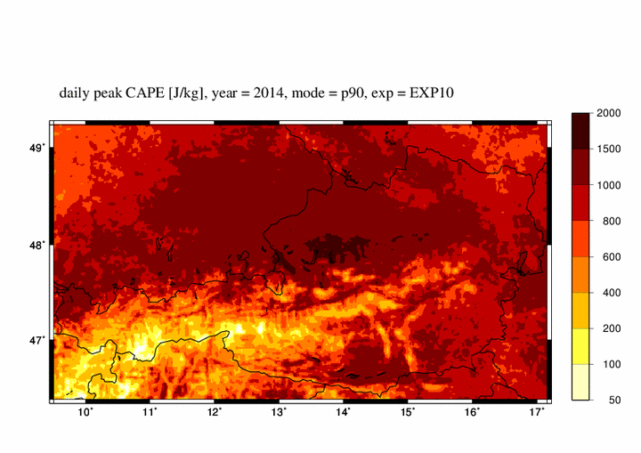
Results
CAPE, year 2014, 90th percentile
dry experiment
wet experiment
reference

Slide 22
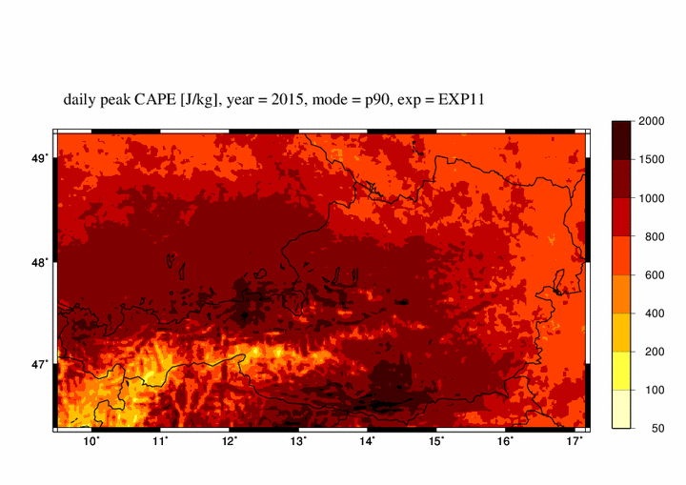
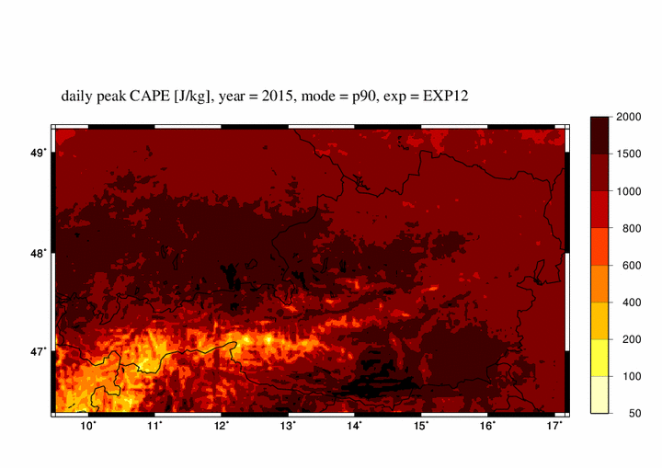
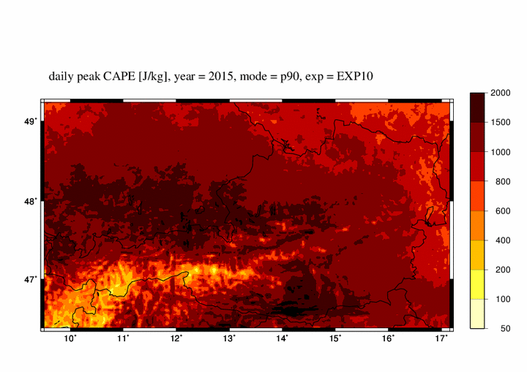
Results
CAPE, year 2015, 90th percentile
dry experiment
wet experiment
reference

Slide 23
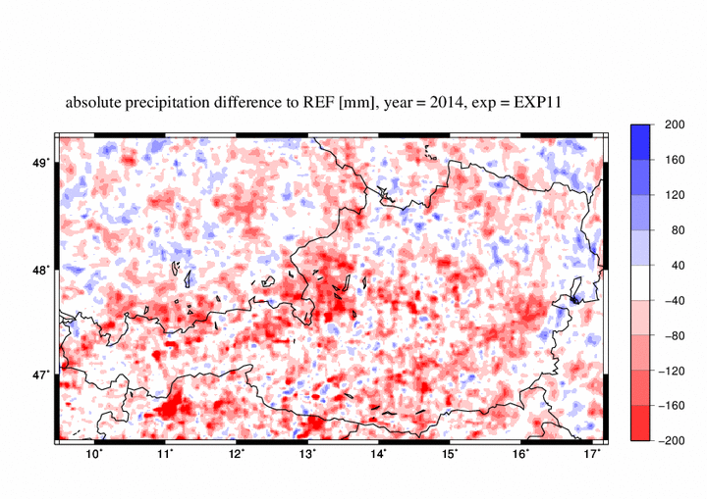
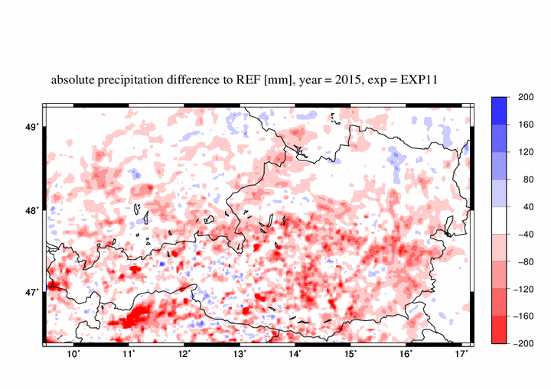
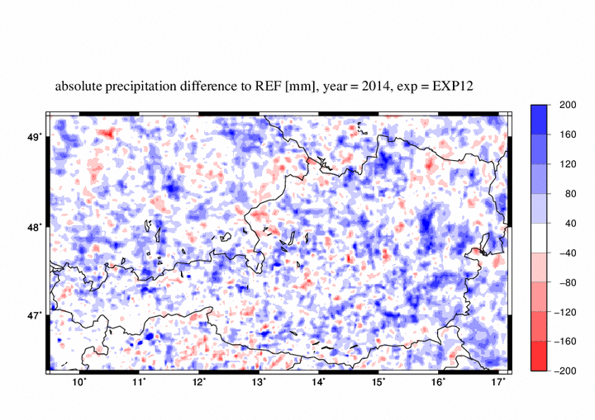
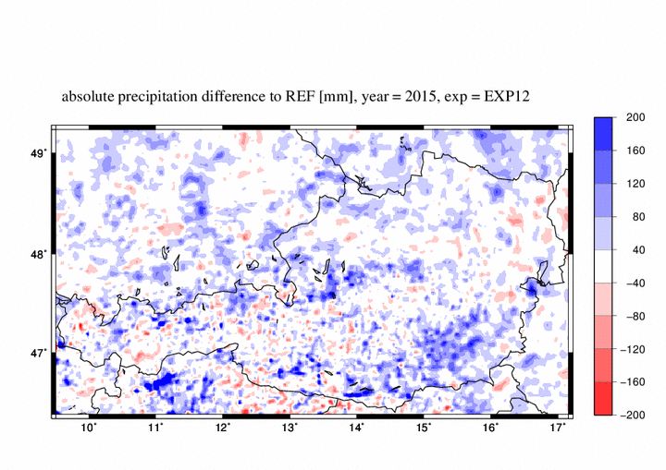
Results
Precipitation sum May – Aug.: absolute differences EXP vs. REF [mm]
dry experiment, 2014
dry experiment, 2015
wet experiment, 2014
wet experiment, 2015

Slide 24
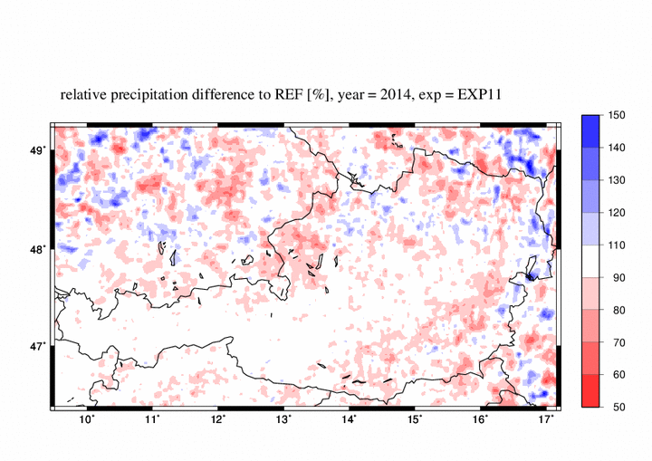
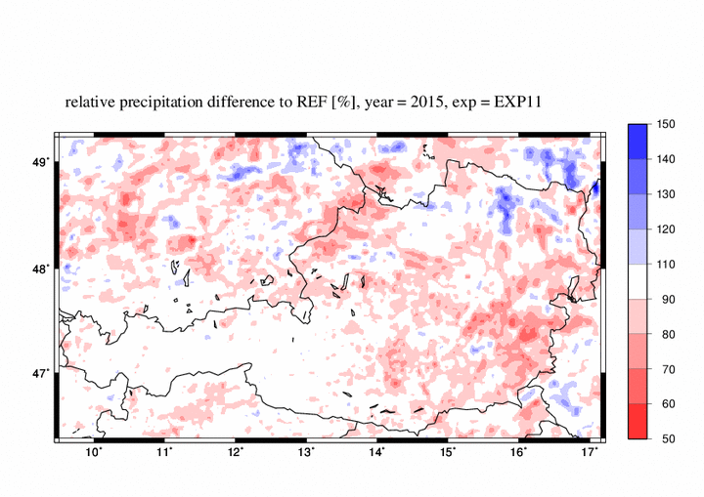
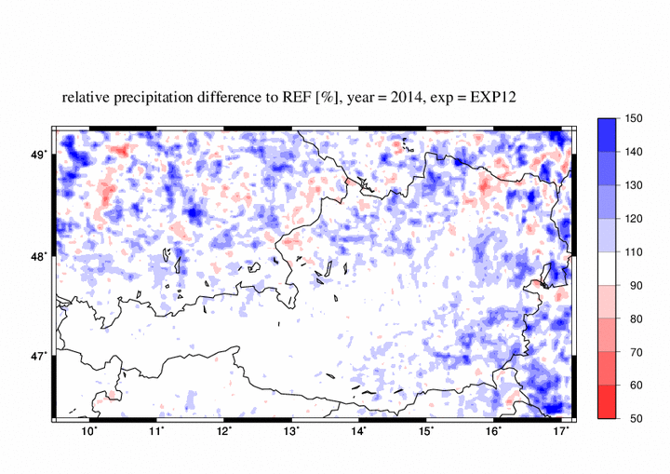
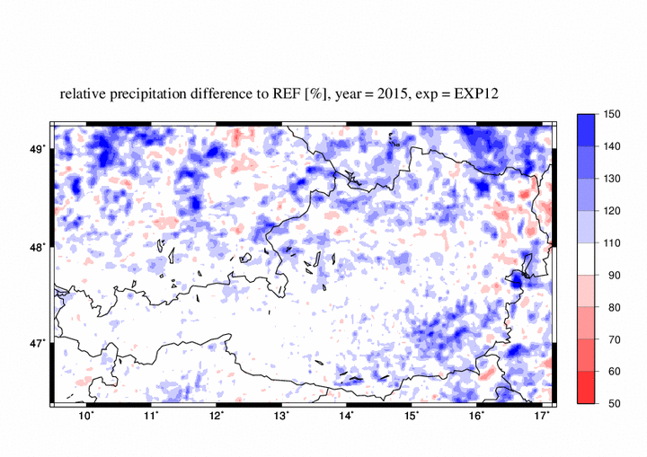
Results
Precipitation sum May – Aug.: relative differences EXP vs. REF [%]
dry experiment, 2014
dry experiment, 2015
wet experiment, 2014
wet experiment, 2015

Slide 25
Results
Influence of soil moisture on convection
 | Dry soil | Wet soil
Daytime heating: | quicker | slower
Onset of thermals and convection: | earlier | later
Vertical mixing: | enhanced | suppressed
Low-level moisture: | lower | higher
Vertical temperature gradient: | stronger | weaker
CAPE buildup: | reduced | enhanced
Precipitation amounts: | lower | higher

Slide 26
Results
Influence of soil moisture on convection
More net precipitation if energy is „bottled up“ in the convective boundary layer!
 | Dry soil | Wet soil
Daytime heating: | quicker | slower
Onset of thermals and convection: | earlier | later
Vertical mixing: | enhanced | suppressed
Low-level moisture: | lower | higher
Vertical temperature gradient: | stronger | weaker
CAPE buildup: | reduced | enhanced
Precipitation amounts: | lower | higher

Slide 27
Results
Sensitivity of convection to soil moisture
Minimum sensitivity | Maximum Sensitivity
mountains | flatlands
primary convection | secondary convection
cyclonic or anticyclonic situations | neutral situations (weak pressure gradients)
cold air advection | warm air advection
no inversion in place | inversion in place
Prototype: | Prototype:
postfrontal shower weather | prefrontal „loaded gun“ situation

Slide 28
Summary
Key points
Local moisture recycling plays crucial role for convection!
„Feed-forward mechanisms“: dry (wet) spells tend to reinforce and extend themselves via reduced (enhanced) convection
Sensinitivity is lowest over mountains, highest over forelands
„Memory“ persists over entire convective season (May to August)!
Engineering options should be discussed (vegetation, irrigation, …)

Slide 29
Goodbye and thanks for your attention!
georg.pistotnik@zamg.ac.at stefan.schneider@zamg.ac.at

