Slide 1
Windstorm and Tornado Damage Assessment
Georg Pistotnik, Rainer Kaltenberger
EUMETSAT Event Week on Convection
21 May 2019

Slide 2
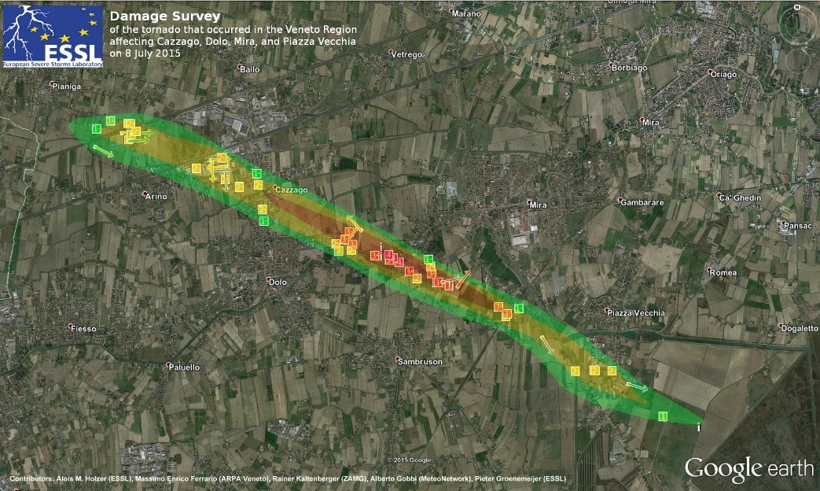
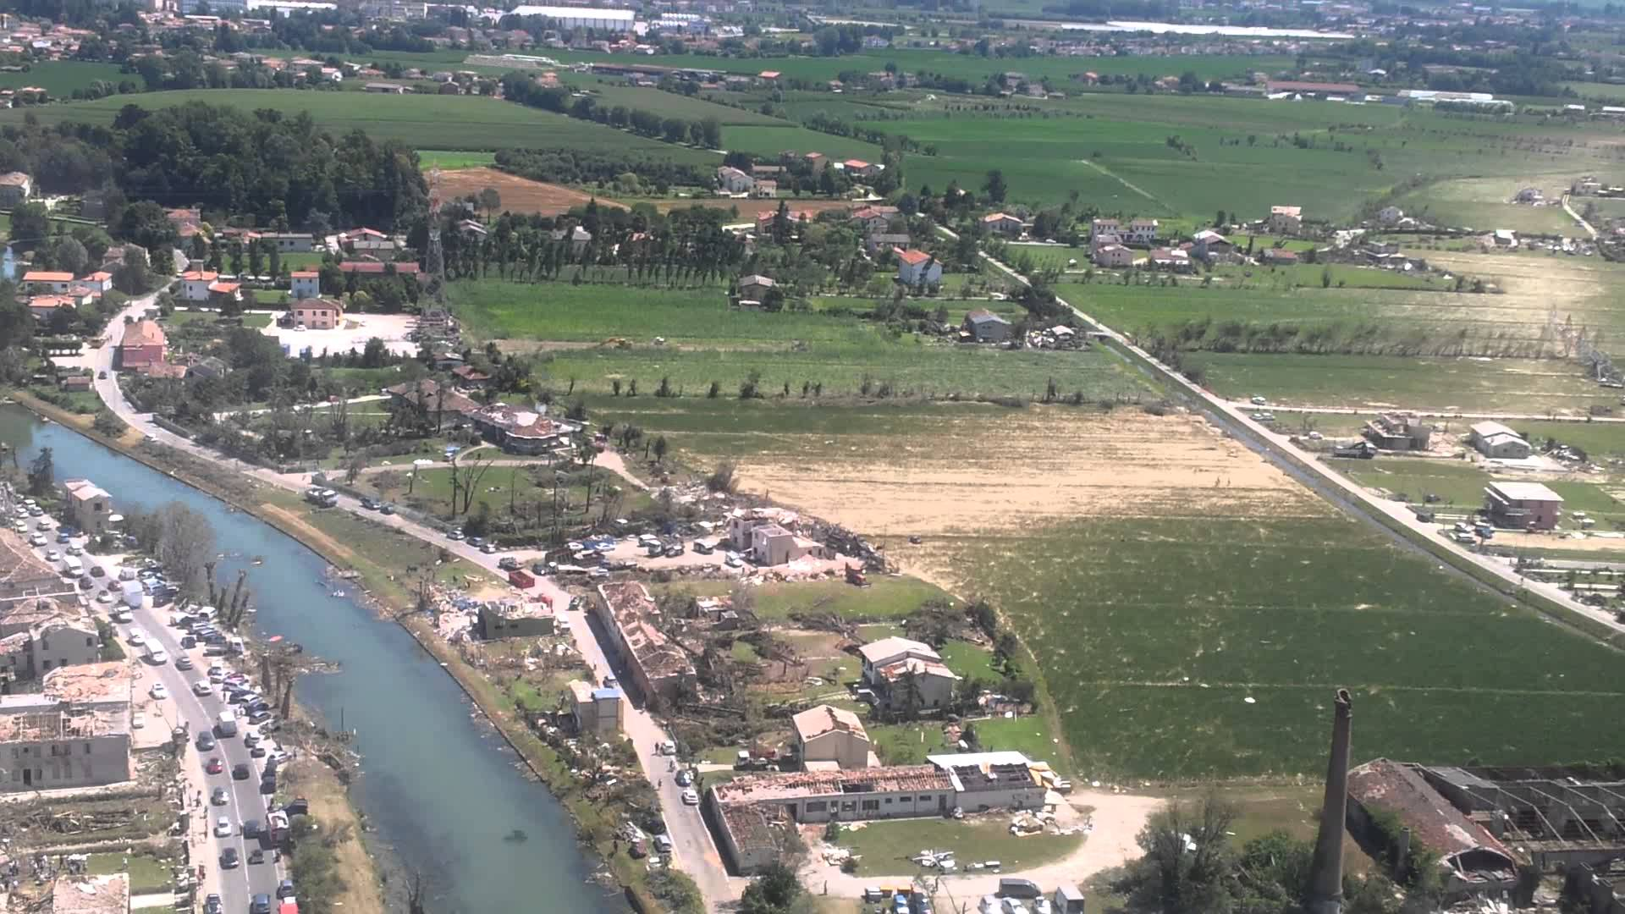
Damage Assessment (1/10)
Tornadoes: Challenges
Rare events, but potentially extreme impact
Small and (usually) short-lived
Forecasts and warnings are very difficult!
Hardly ever direct wind speed measurements => ex post intensity rating via damage assessment
Example: tornado in Dolo (Veneto, IT) on 8 July 2015
© ESSL
© Federico Calzavara

Slide 3
Damage Assessment (2/10)
Motivation: Why damage assessments?
Climatology: knowledge of tornado events is basis for risk assessments
Warnings: identification of weather situations or radar signatures connected with past tornadoes
Process understanding: under which conditions do tornadoes occur?
Expert opinion for insurances, …
Public relations

Slide 4
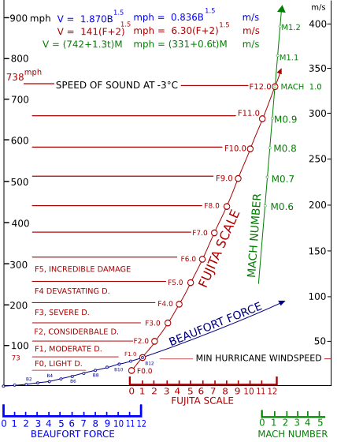
Damage Assessment (3/10)
Fujita Scale (F Scale)
Tetsuya (Ted) Fujita, University of Chicago, USA
Implemented in 1973 in the USA
Upward extension of Beaufort scale
Link from damages to most likely wind speeds
Today in use in Europa except for UK (TORRO scale instead)
© Wikipedia

Slide 5
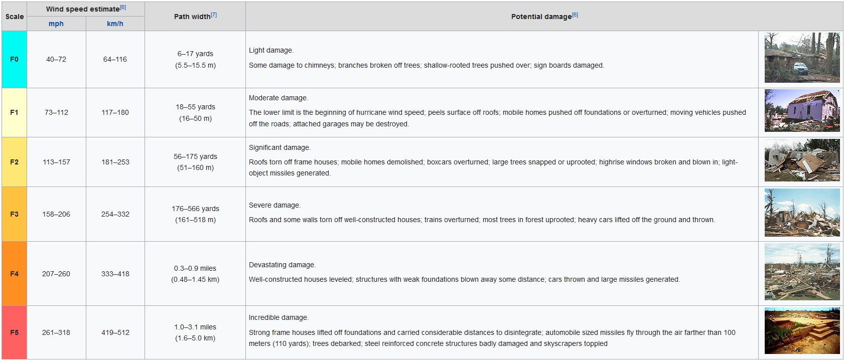
Damage Assessment (4/10)
Fujita Scale (F Scale)
© Wikipedia

Slide 6
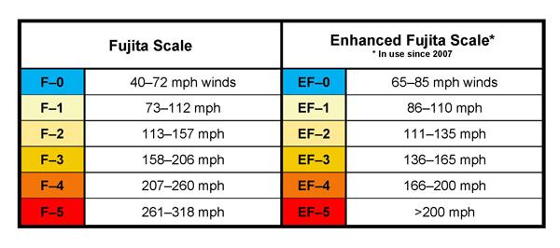
Damage Assessment (5/10)
Enhanced Fujita Scale (EF Scale)
Wind Science and Engineering Research Center, Texas Tech University, 2004
Concept of „Damage indicator“ (DI) and „Degree of Damage“ (DoD) to account for different building standards and include vegetation damages
Correction of wind speeds
EF Scale in use only in USA (since 2007) and Canada (since 2013)
Criticism:
Building standards outside USA still reflected too little
DIs for vegetation only very rudimentary („hardwood“ vs. „softwood“)
Mobile Doppler radar measurements do not always confirm EF Scale
© Texas Geographical Society

Slide 7
Damage Assessment (6/10)
Towards an „International Fujita Scale“
Practice in Europe (ESSL, some National Weather Services):
Concept of DI and DoD adopted
DIs generalized for European building standards and vegetation
But: Rating still in F classes, not EF classes
USA: Working group on redesign of EF Scale (with involvement of ESSL)
Japan: „Japanese Enhanced Fujita Scale“ (JEF Scale)
In the future: „International Fujita Scale“?

Slide 8
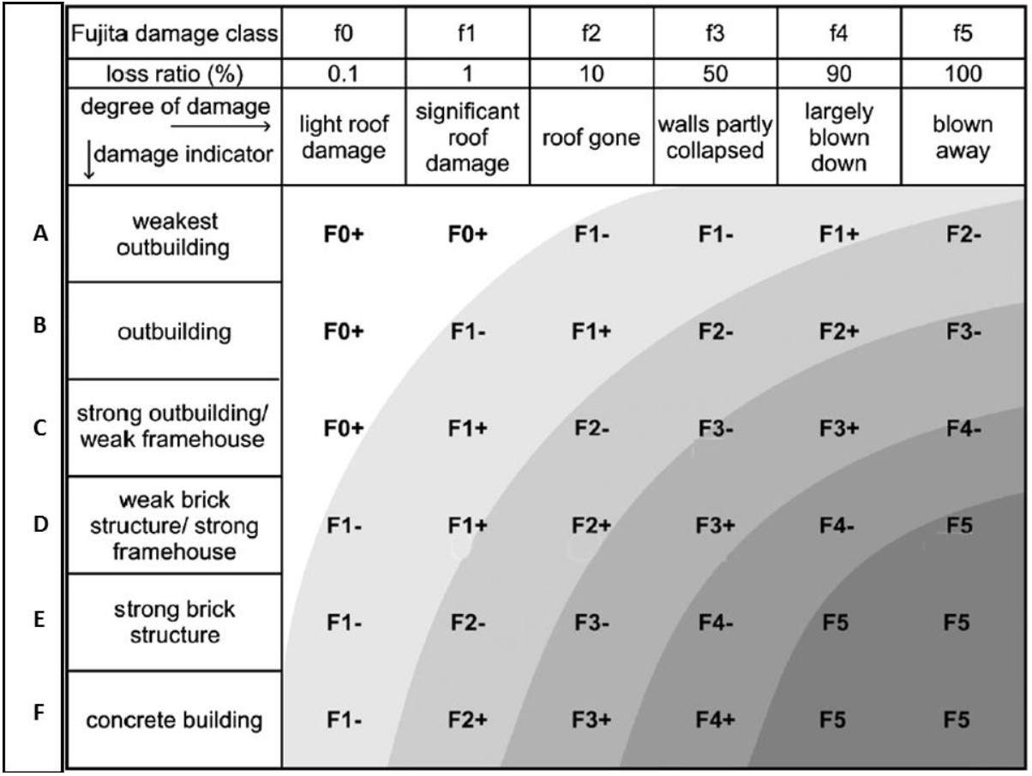
Damage Assessment (7/10)
Adaptation of „Damage Indicators“ for Europe
Part 1: Buildings
© ESSL

Slide 9
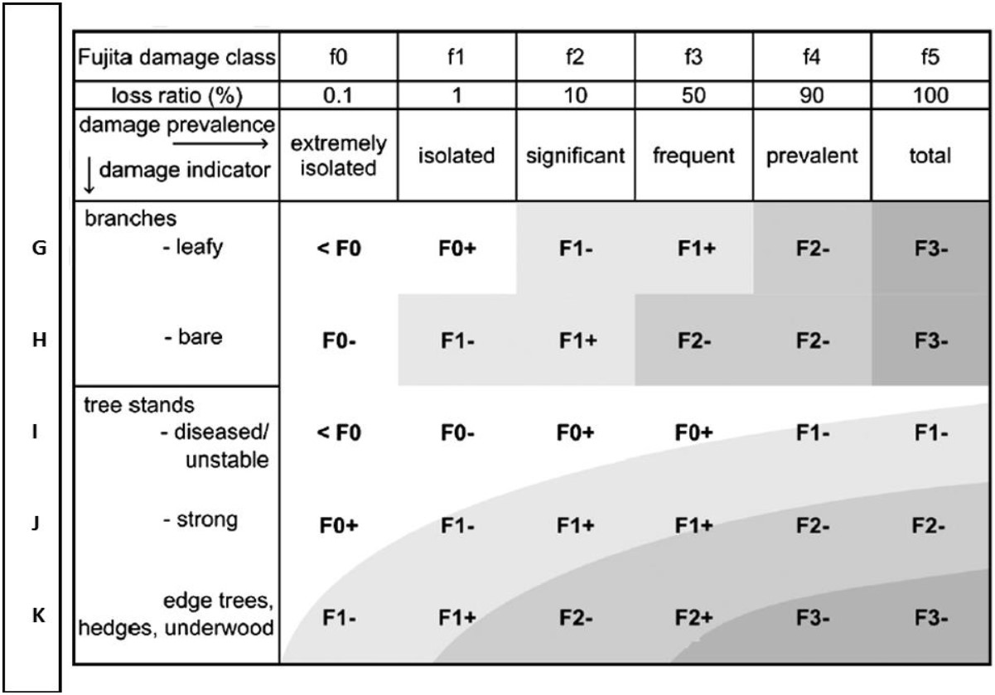
Damage Assessment(8/10)
Adaptation of „Damage Indicators“ for Europe
Part 2: Vegetation
© ESSL

Slide 10
Damage Assessment (9/10)
Tornado or Downburst?
F Scale or EF Scale are likewise applicable to tornadoes and downbursts
Different damage characteristics:
 | Downburst | Tornado
Shape: | length $≳$width | length $≫$ width
Borders: | diffuse | sharp
Fall pattern: | divergent (outward) | convergent (inward)
Fall direction: | rather uniform | often very different
Downburst
Slow-moving tornado
Fast-moving tornado

Slide 11
Damage Assessment (10/10)
Experience and recommendations
As prompt as possible!
Equipment: camera, GPS receiver, compass, maps, paper and pens, …
In a team of at least two persons (division of work, more solid ratings)
Gain overall picture, correct individual outliers if appropriate
A drone can be very useful!
International networking
A pinch of subjectivity remains, but it can be minimized!

Slide 12
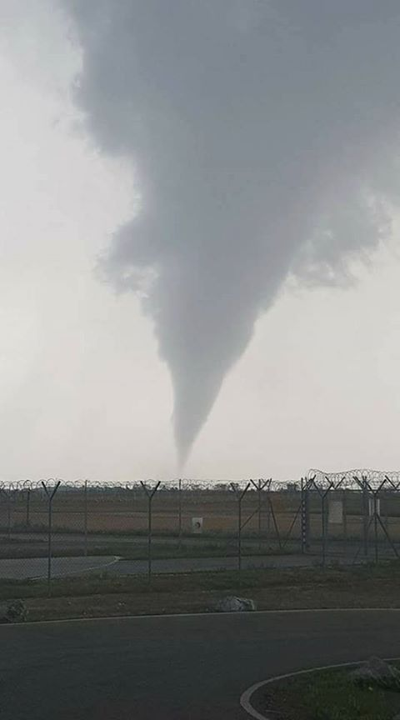
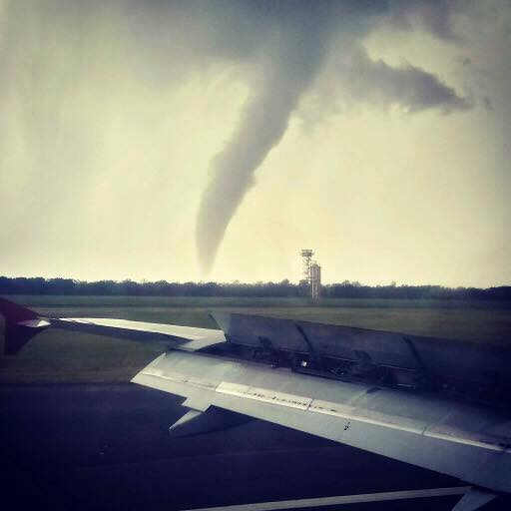
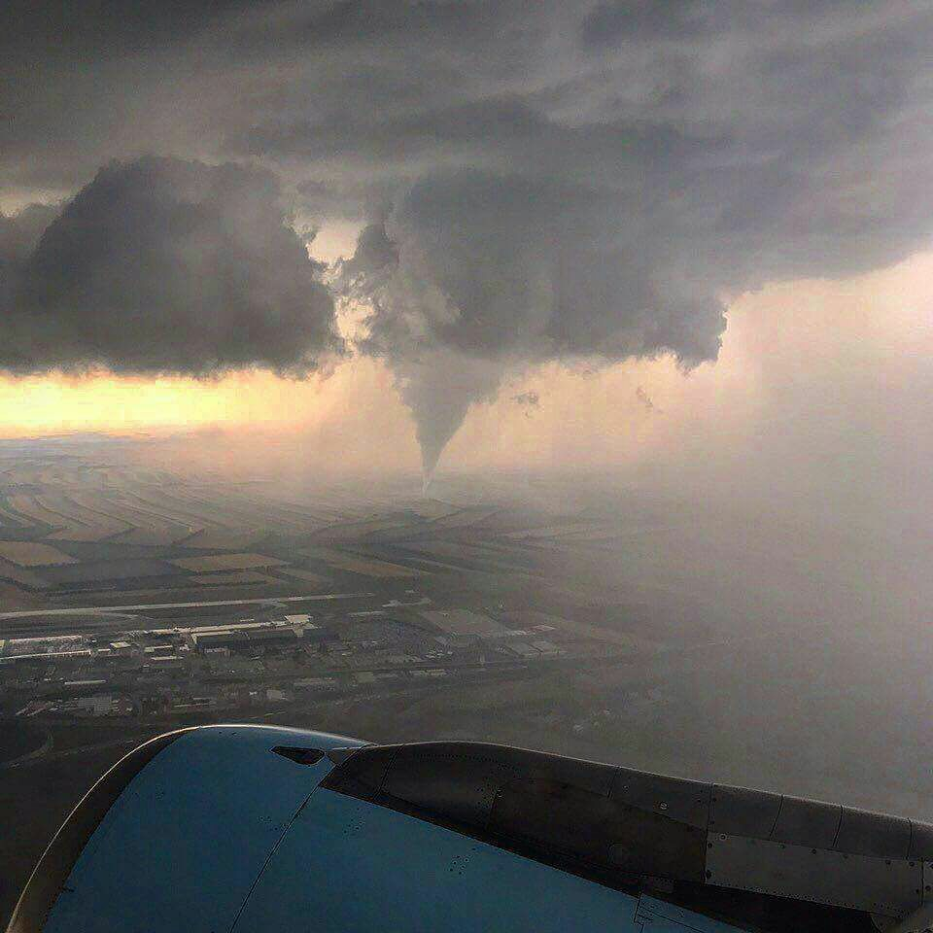
The 10 July 2017 tornado near Vienna Airport (1/11)
Selected pictures from eye-witnesses
© Elisabeth Lobner
© Olga Bystrina
© Christian Weipoltshammer

Slide 13
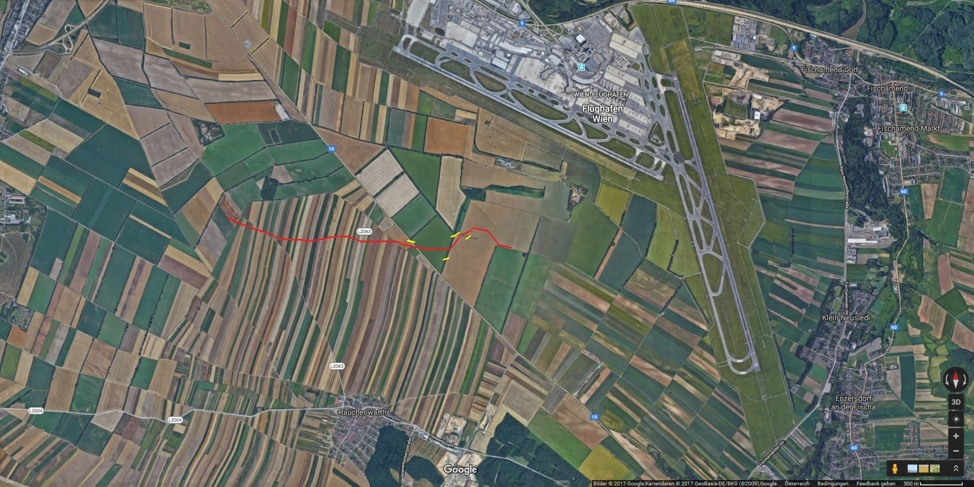
The 10 July 2017 tornado near Vienna Airport (2/11)
Overview of damage track
14:35
report to ZAMG and Austrocontrol
14:44
wall of straw cuboids
14:45
decay
14:29
formation
14:44
windbreaker
14:39
minor road (L2063)
14:42
major road (B10)
1 km
Map © Google
Times in UTC according to eye-witnesses: Mortimer Müller, Mathias Stampfl, Manuel Weber (Skywarn)
Video by Mortimer Müller on Youtube

Slide 14
The 10 July 2017 tornado near Vienna Airport (3/11)
Basic data
Life time: ca. 15 minutes
Track length: a little more than 3 km
Mean displacement speed: 12-15 km/h
Track almost entirely over agricultural areas, hence few classic „Damage Indicators“:
Alley trees next to L2063 road
Alley trees next to B10 road
Windbreaker
(Wall of straw cuboids)

Slide 15
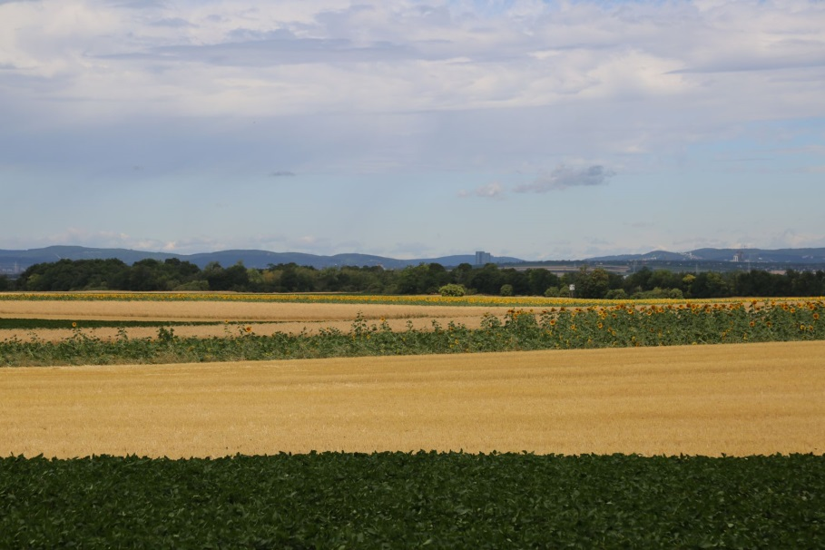
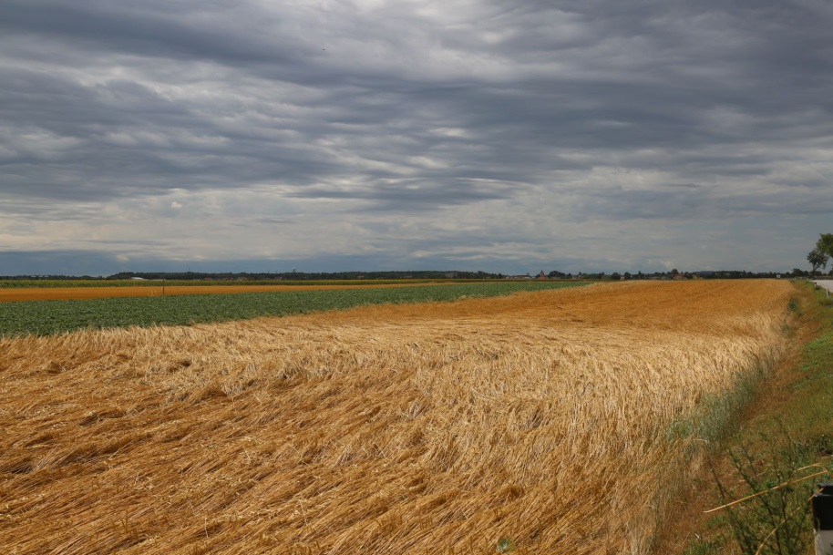
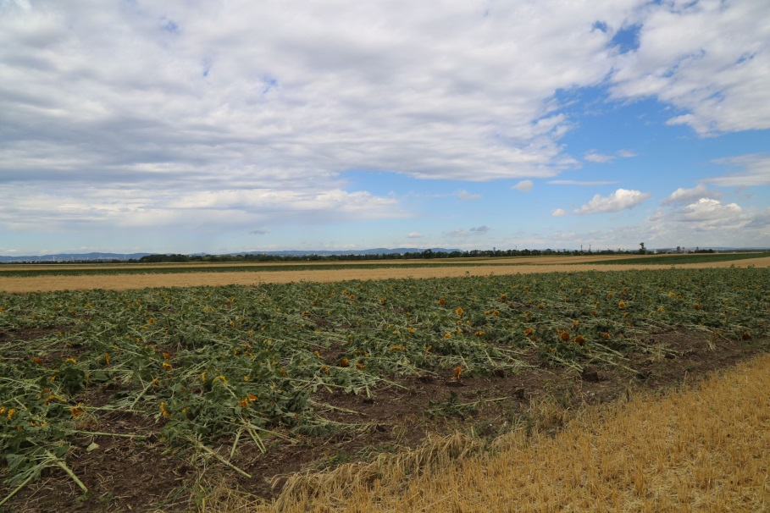
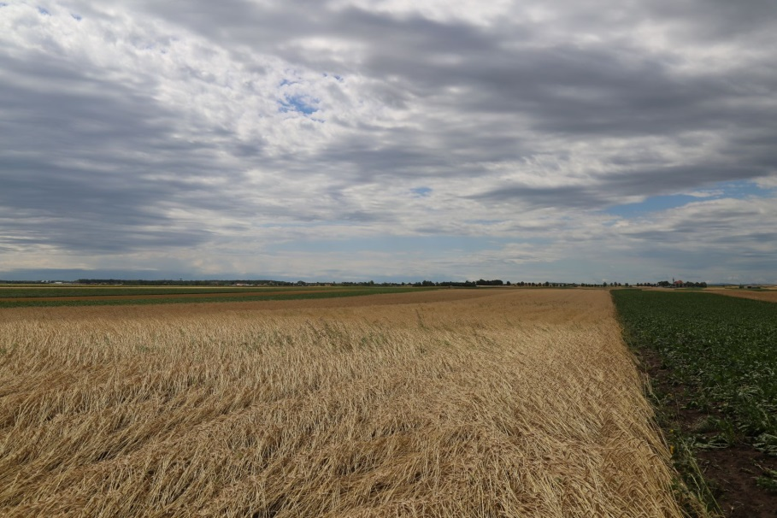
The 10 July 2017 tornado near Vienna Airport (4/11)
Fields ahead of L2063 road (tornado formation)

Slide 16
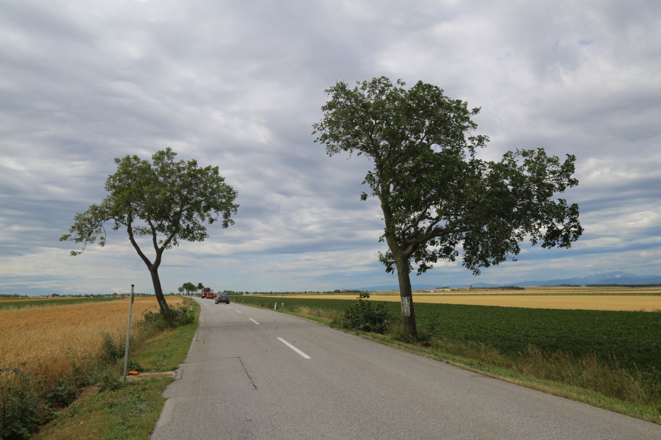
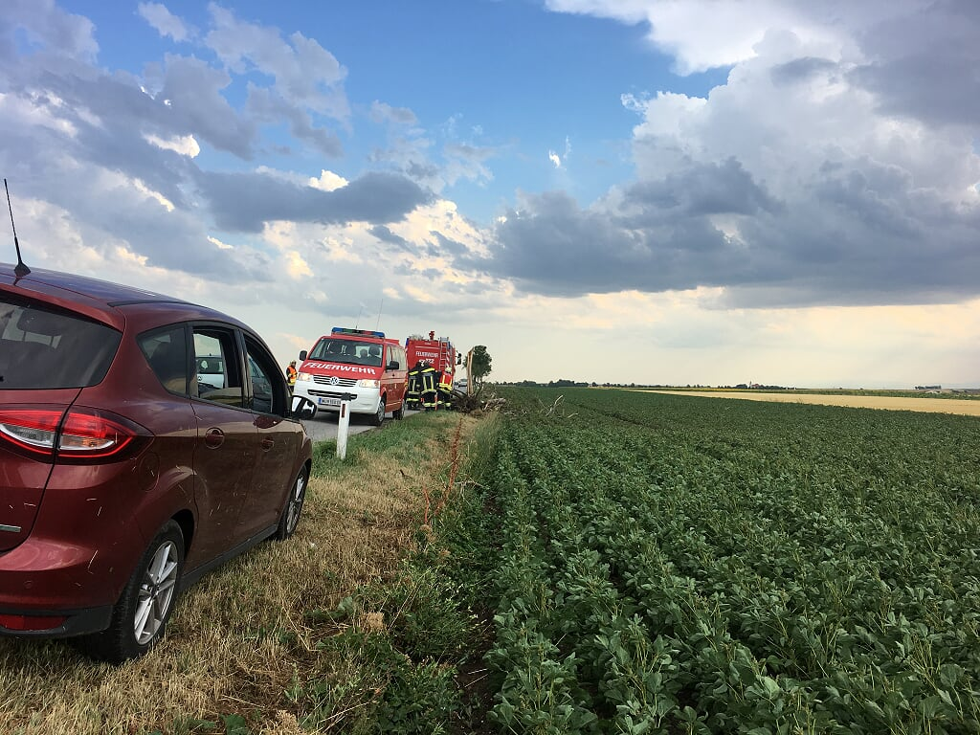
The 10 July 2017 tornado near Vienna Airport (5/11)
Damage Indicator 1: Alley trees next to L2063 road
© Mathias Stampfl
DI: hardwood tree (walnut), strong stand, solitary
DoD: broken / uprooted
F2
© Mortimer Müller & Mathias Stampfl
6m/0.1s $≜$ 216 km/h! (F2)

Slide 17
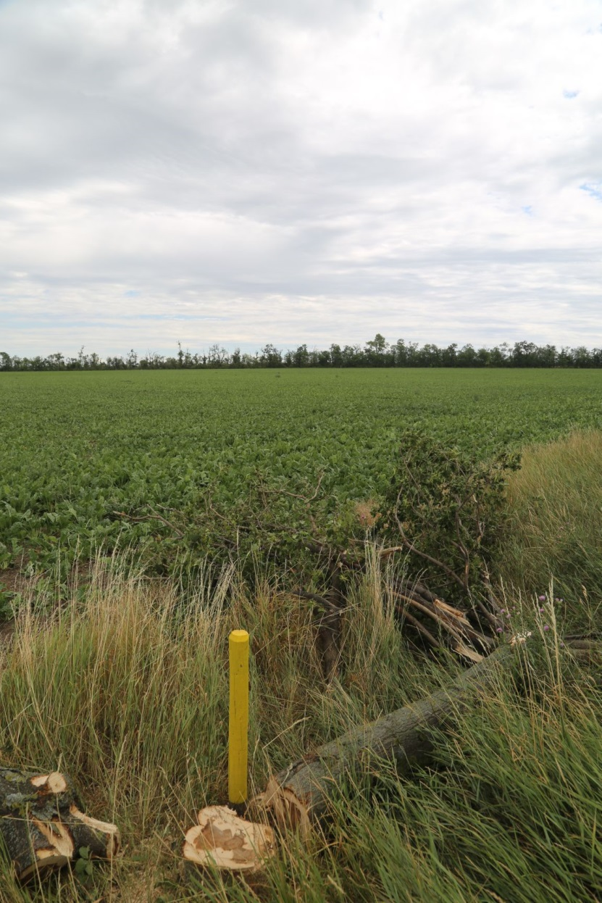
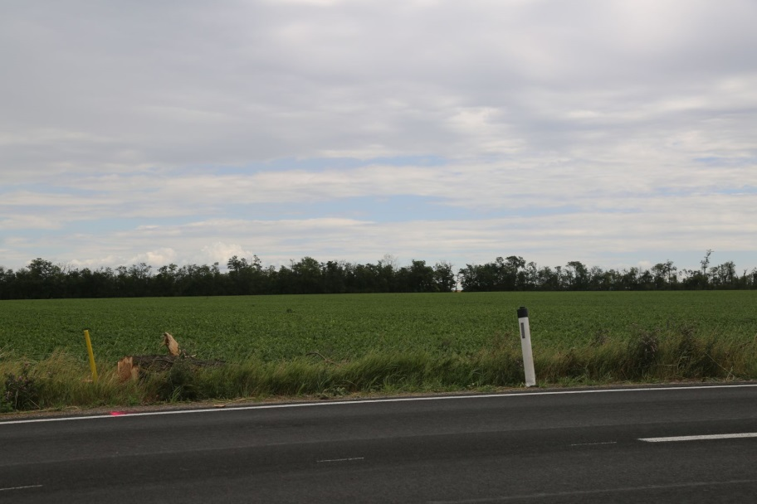
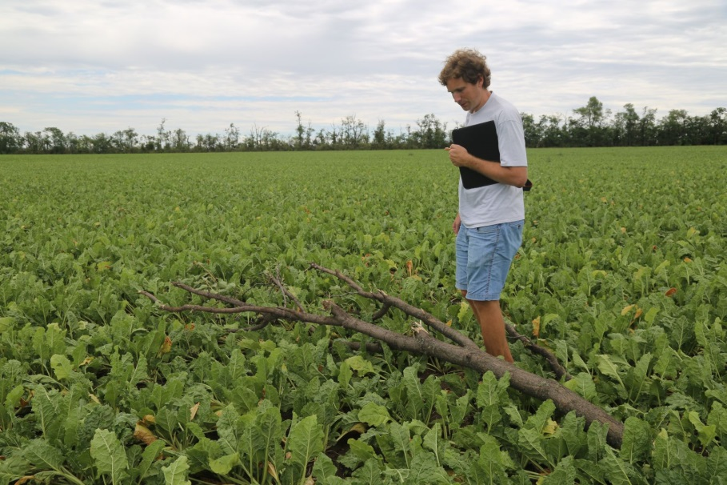
The 10 July 2017 tornado near Vienna Airport (6/11)
Damage Indicator 2: alley trees next to B10 road
DI: softwood tree (poplar), solid ground, solitary
DoD: broken (1x) / largely debranched (2x)
F2

Slide 18
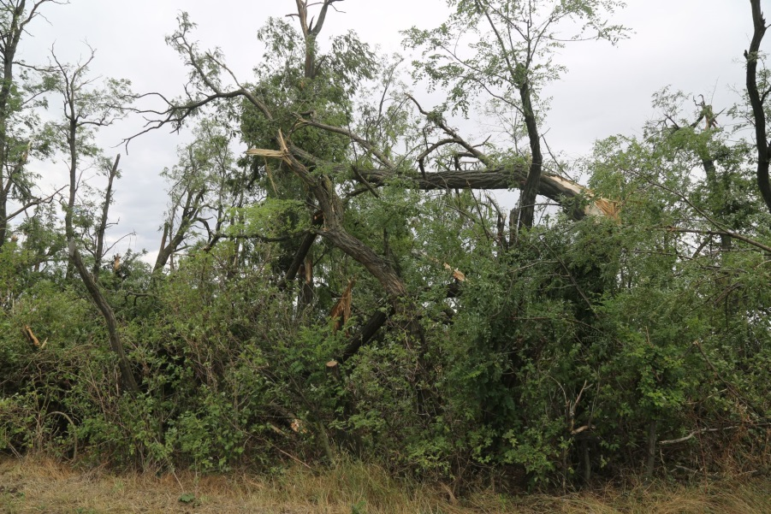
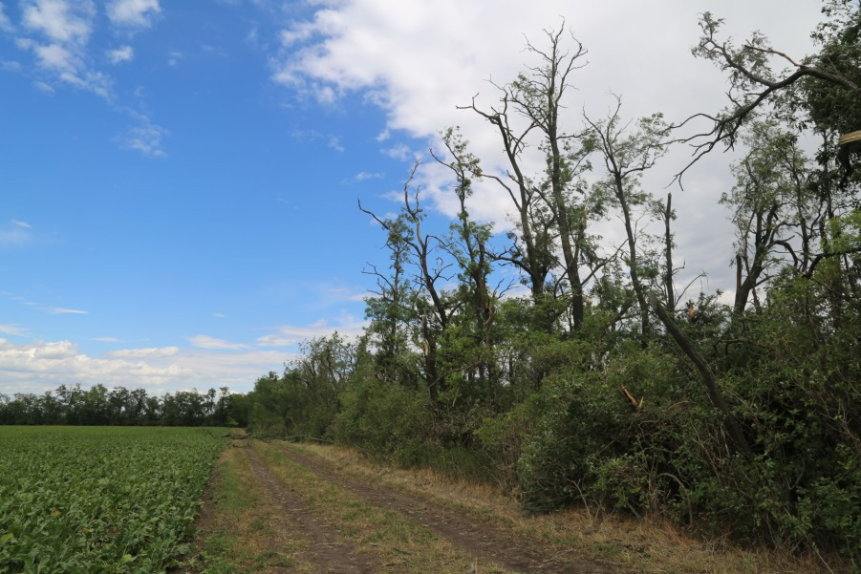
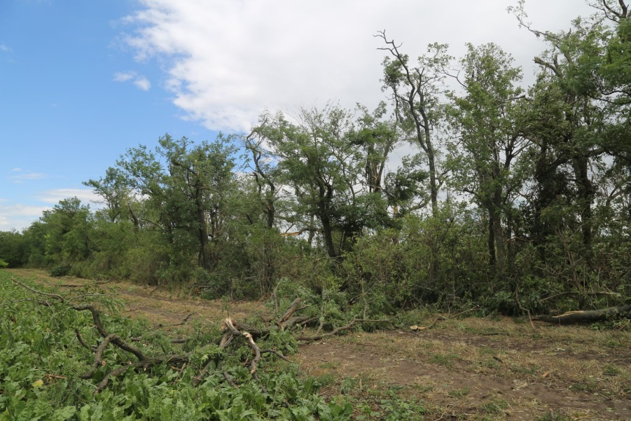
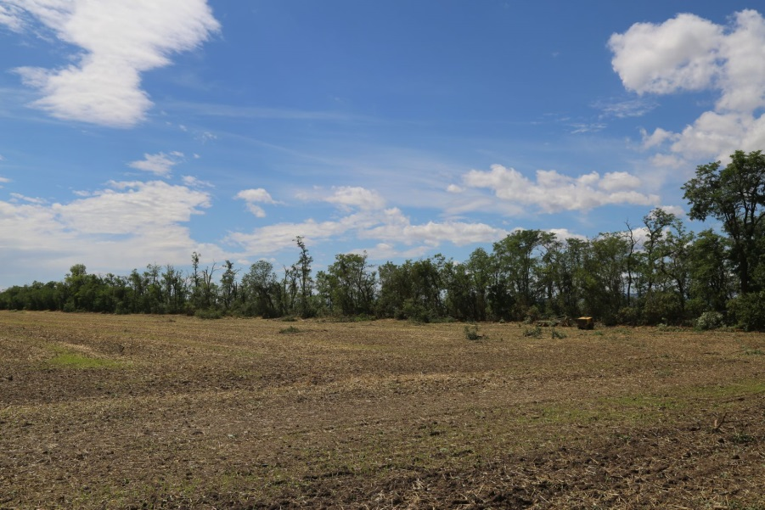
The 10 July 2017 tornado near Vienna Airport (7/11)
Damage Indicator 3: wind breaker
DI: hardwood trees (robinias), solid ground, hedge
DoD: trees broken or uprooted (10% loss ratio) / remaining trees debranched (50-90% loss ratio)
F2

Slide 19
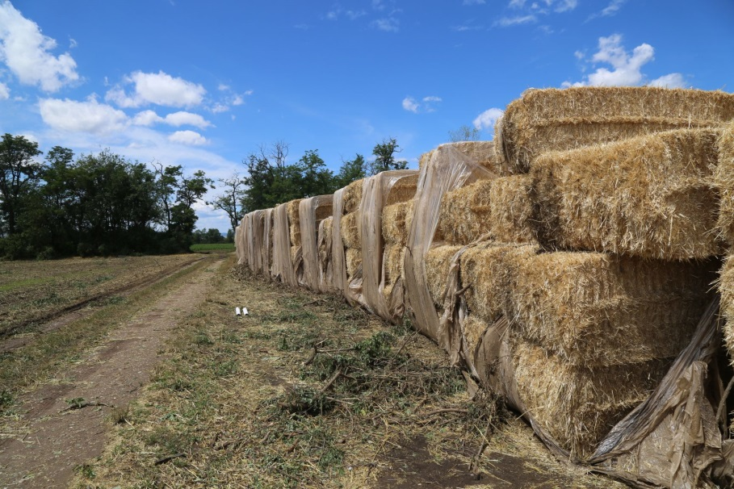
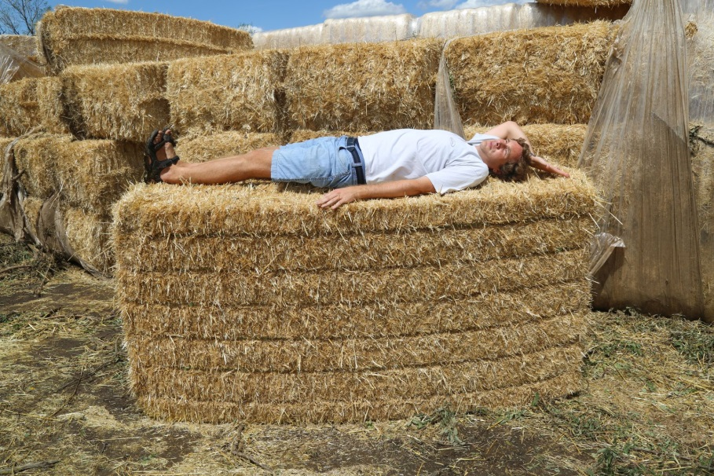
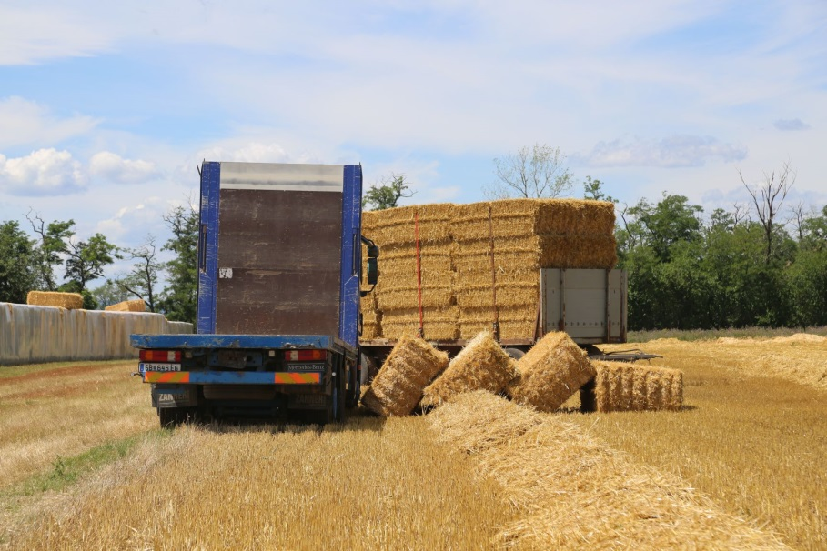
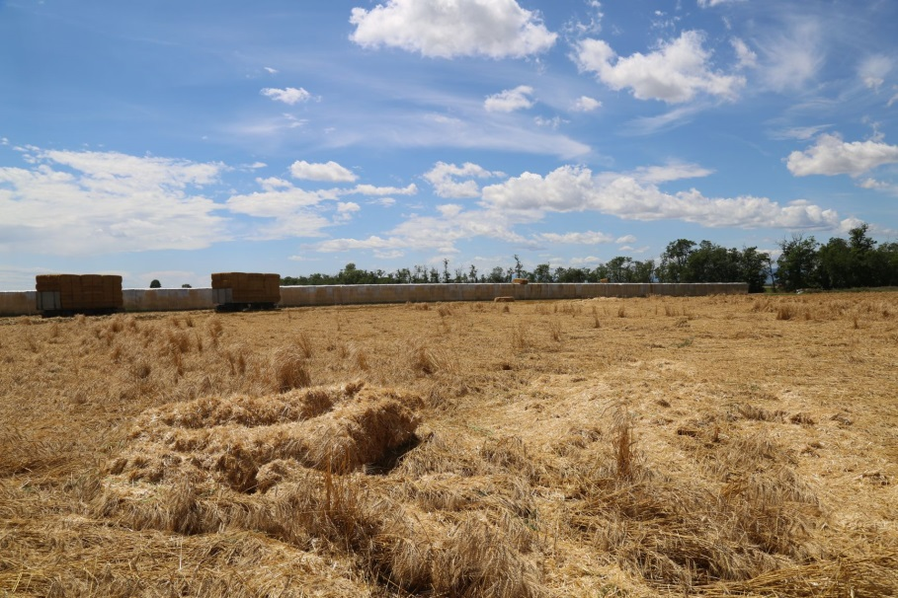
The 10 July 2017 tornado near Vienna Airport (8/11)
Damage Indicator 4: wall of straw cuboids
DI: straw cuboids (220 x 110 x 65 cm; ca. 400 kg each)
DoD: toppled over, a few carried up to 50m away
???
“Forensic Engineering” (Petty, 2013): F2- wind speeds needed to lift cuboids of such dimensions and mass

Slide 20
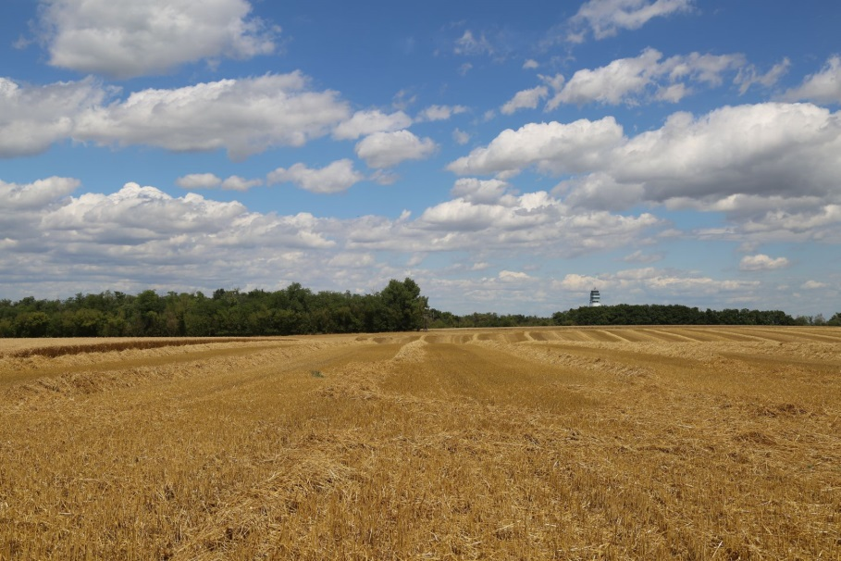
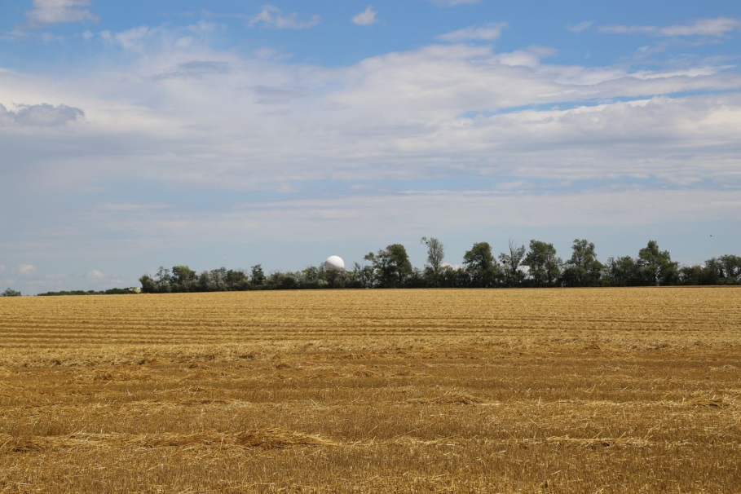
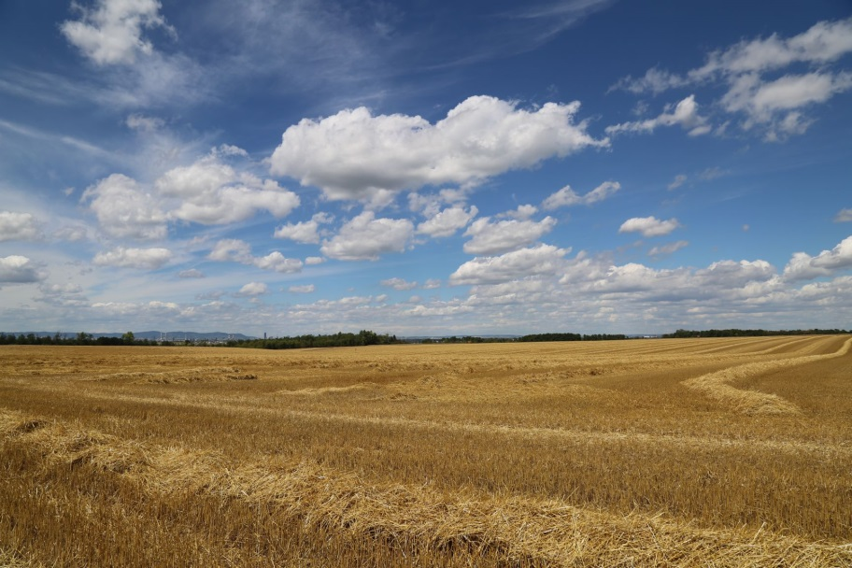
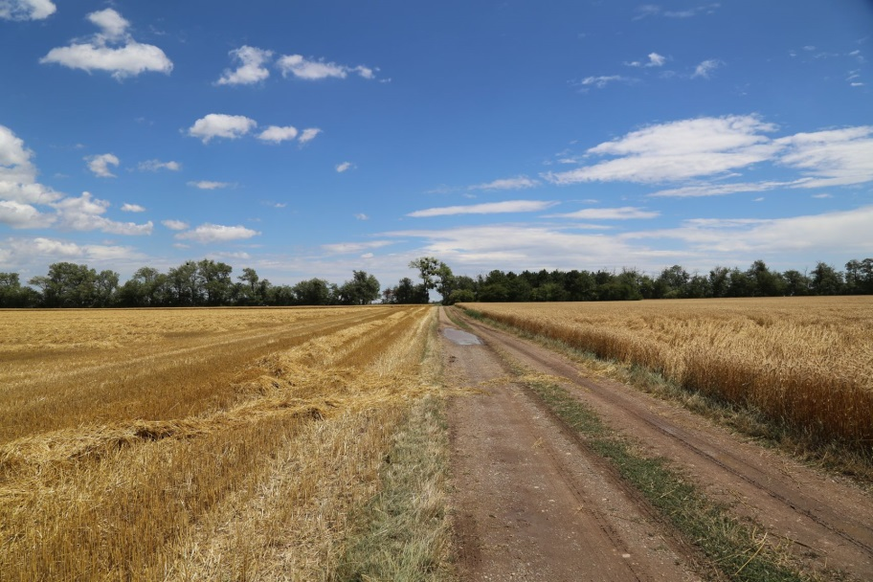
The 10 July 2017 tornado near Vienna Airport (9/11)
Fields behind straw cuboids (tornado dissolution)

Slide 21
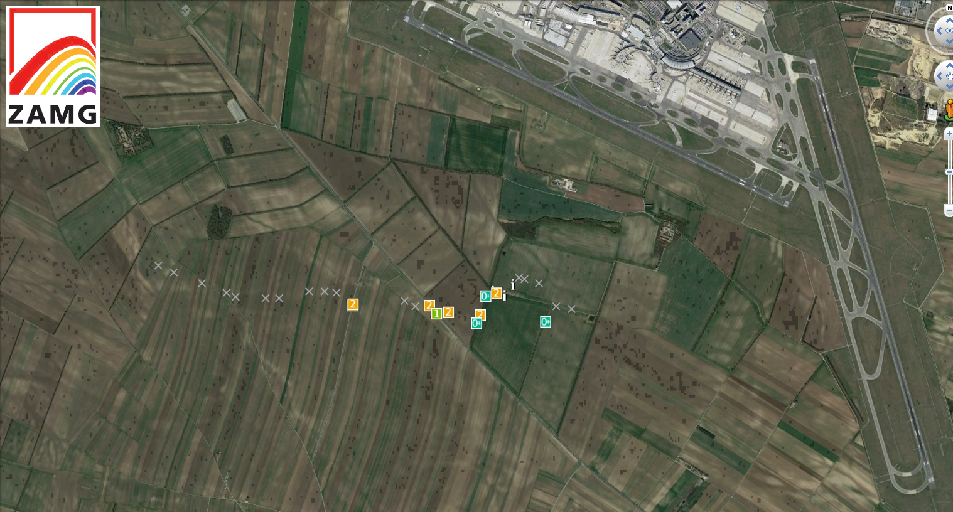
The 10 July 2017 tornado near Vienna Airport (10/11)
Final map after damage assessment
Map © Google

Slide 22
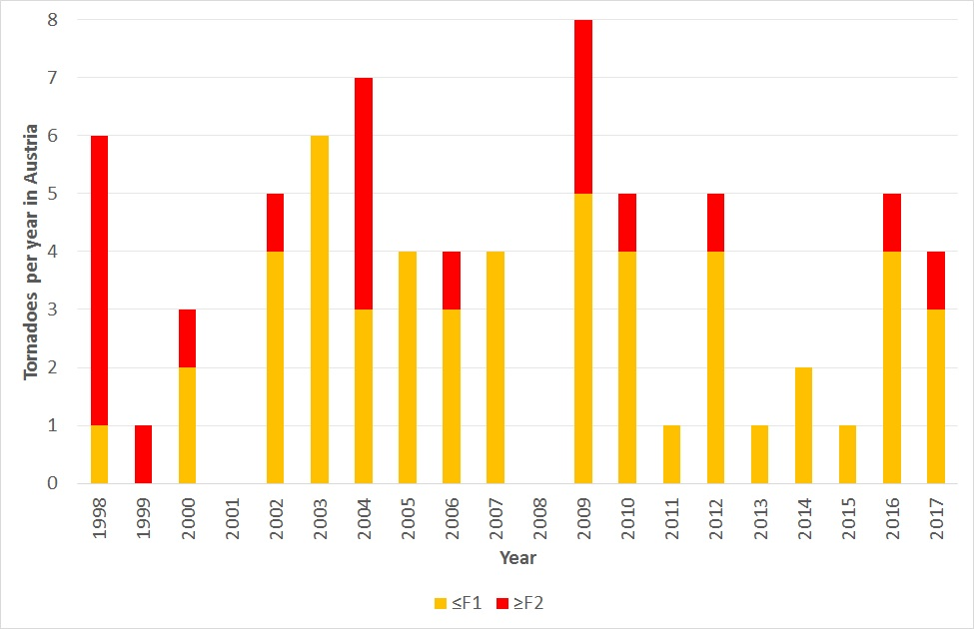
The 10 July 2017 tornado near Vienna Airport (11/11)
Conclusions of site survey
Most likely maximum wind speeds between 180 and 220 km/h (F2-)
Since 1998: 3.6 tornadoes per year in Austria, 1.0 per year with intensity ≥F2
More frequent in Alpine forelands than in Alps
High inter-annual variability
No statements possible (yet) about climatological trends
Data from ESWD
(© ESSL)

Slide 23
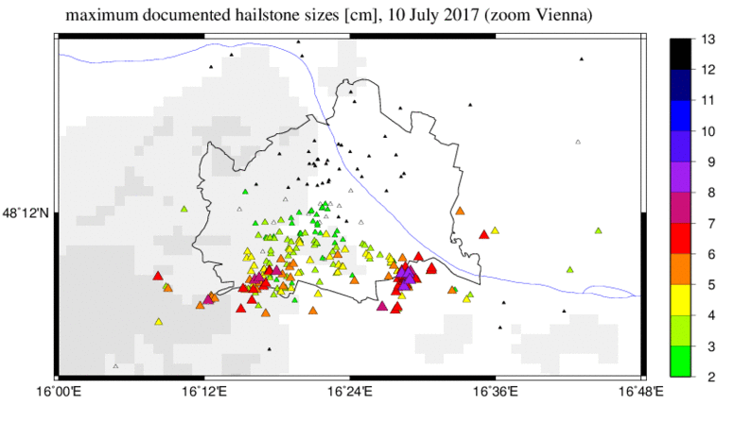
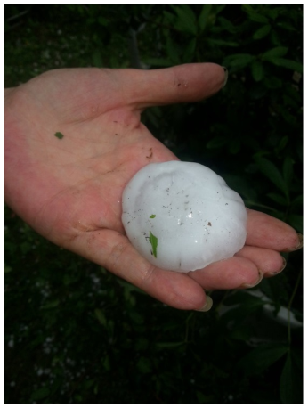
The 10 July 2017 hailfall (1/2)
Map of documented hailstone sizes
302 Eye-witness reports! (Thank you!)
© Karl B. /
meinbezirk
10 km
© Kerstin Palkovits / Facebook

Slide 24
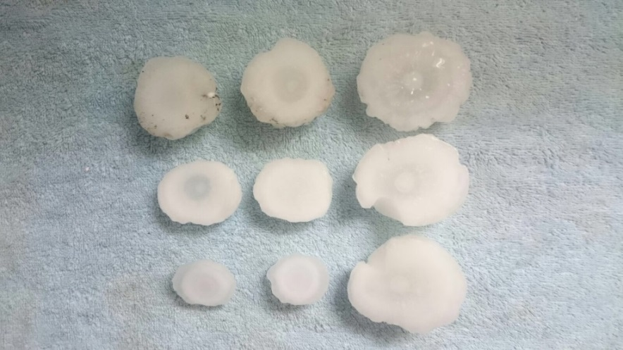
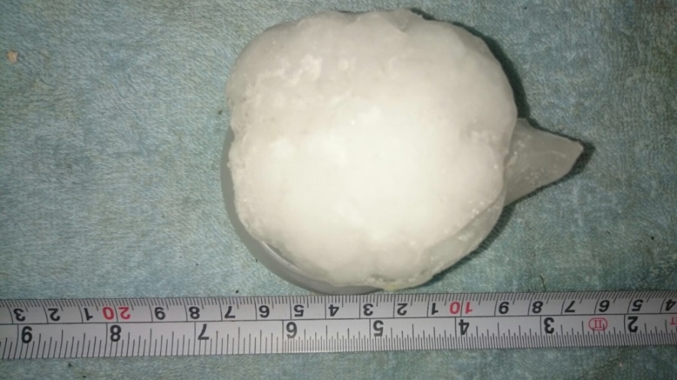
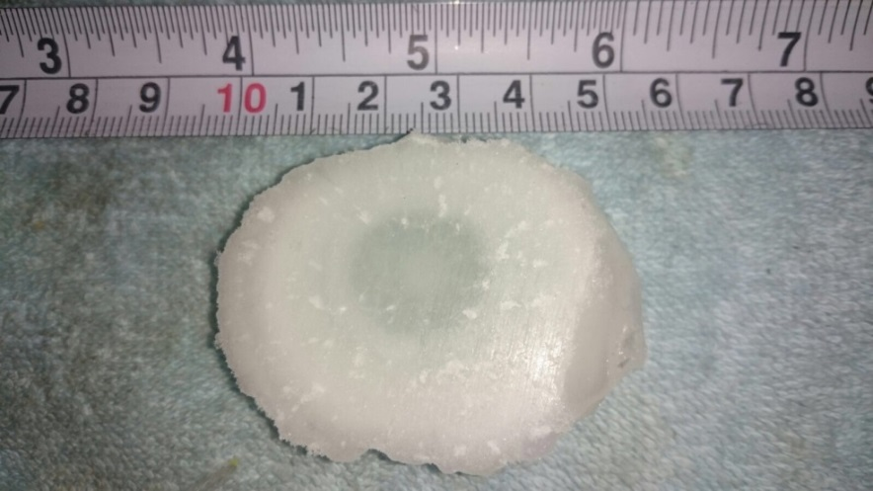
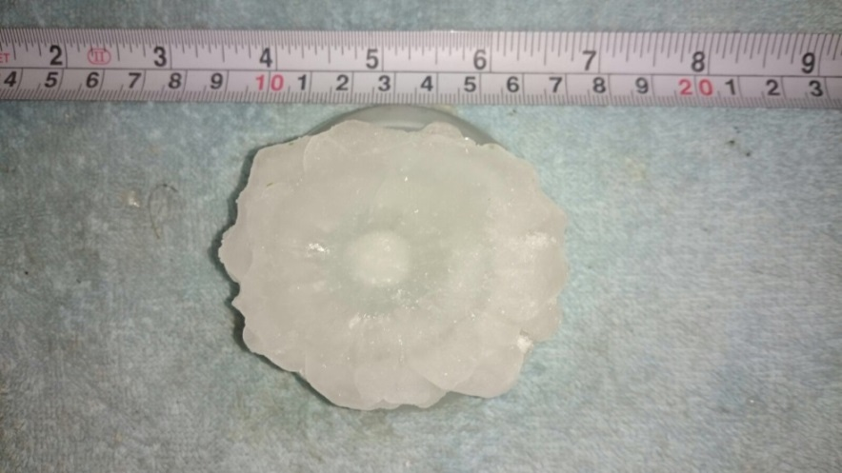
The 10 July 2017 hailfall (2/2)
Cross sections through hailstones
Collected and deep frozen by Gertrude Hauber, Schwechat
Cross sections created in cold store of University of Natural Resources and Life Sciences, Vienna

Slide 25
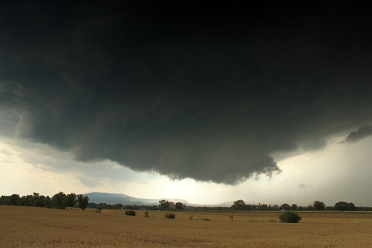
The last slide
Thank you for your attention!
georg.pistotnik@zamg.ac.at
13:49 UTC (40 minutes prior to tornado formation)

