Slide 1
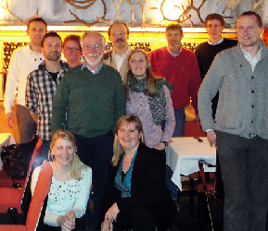
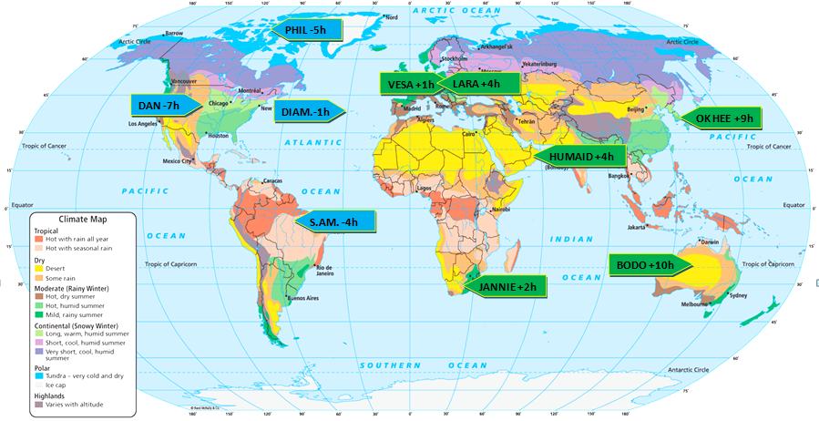
Session 6, 14 UTC Wednesday May 22nd, 2013, Canada
Notes:
Ivan Smiljanic (smiljanic@cirus.dhz.hr)
Add to contacts
02/04/2013
To: Bikos,Daniel, Davison, Michel, matsudo@smn.gov.ar, Phil Chadwick, Vesa Nietosvaara, Humaid AlBadi, Jannie Stander, 김옥희, Bodo Zeschke, LaraNik, diamantino.henriques@ipma.pt, claudiac@cima.fcen.uba.ar
From:Ivan Smiljanic (smiljanic@cirus.dhz.hr)This sender is in your safe list.Sent:April-02-13 5:07:09 AMTo: Bikos,Daniel (Dan.Bikos@colostate.edu); Davison, Michel (michel.davison@noaa.gov); matsudo@smn.gov.ar; Phil Chadwick (philtheforecaster@hotmail.com); Vesa Nietosvaara (vesa.nietosvaara@eumetsat.int); Humaid AlBadi (h.albadi@gmail.com); Jannie Stander (Jannie.Stander@weathersa.co.za); 김옥희 (koh@korea.kr); Bodo Zeschke (B.Zeschke@bom.gov.au); LaraNik (nikfia@mail.ru); diamantino.henriques@ipma.pt; claudiac@cima.fcen.uba.ar
Dear Presenters, Ones again, I would like to welcome you to our incoming event week 'World Wide Weather Briefing'! Thank you for joining and being open to share knowledge and experience to your colleagues around globe. This event week comes closer now and final preparations for it are approaching. For this reason I will ask you to follow my instructions, there are few simple steps for you before we can start our event. And I promise I this will not consume much of your time. As you were able to see already, list of chosen presenters and preliminary agenda are now available on our web page: http://www.eumetrain.org/events/www_briefing_2013.html There you can see that every session has a short description, i.e. area of interest, name of presenter for that region and a short biography about each presenter. So my wish is that each of you, by the end of this week (better jet asap), sends me this short CV or biography, which we will upload to web page for this event. For reference, you can take a look at the biography of your colleague, Dan Bikos (USA), this one is already uploaded. Also, please let me know which special event or weather feature, connected to your region, you will present. - As I already mentioned to you, this should be second (or third) part of your presentation, after short introduction of you and your institute (working place) and 'ordinary' weather brief. Last thing I will ask you (I'm probably lying now J) is to participate test sessions for presenters, where you will be introduced to software for online presentations that we will be using. It is called 'Saba meeting' (or ex 'Centra'). Some of you are familiar with it, but it would be more than useful for all of you to prepare yourself for presentation with no (that means, virtual) audience. - But this step comes only in the beginning of May, so you will be informed about it ones again, week before software testing. Let me know any of you has some issues with this agenda we made. Thank you in advance for these biographies, we will stay in contact! Nice day to All, Ivan p.s.: @Phil: You see that you are chosen to present something about Canada region. I wold just like to ask you to concentrate your presentation on north-most parts of your country, since you are closest to north pole regions (for which, I'm sure, audience will be interested)

Slide 2
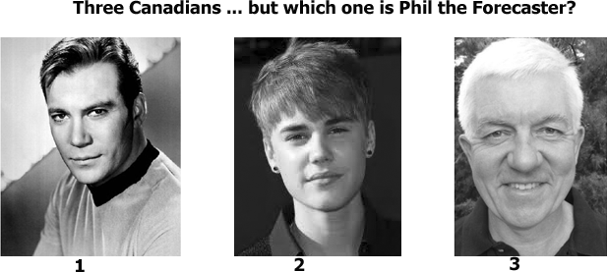
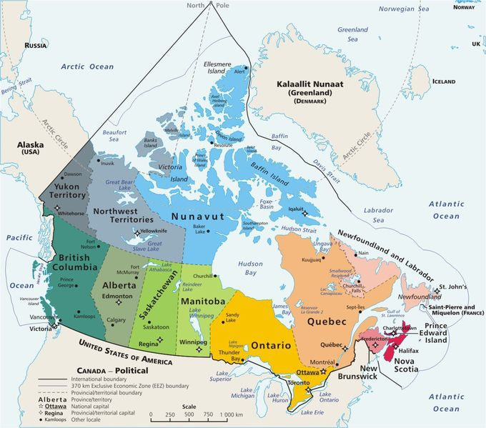
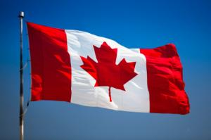
Notes:
My plan here is to start with some humour and the maple leaf flag as the brand Canada. The participants can use “stars” through Samba to indicate their choice or you could turn it into a “clicker” question.
Canada did not have a national flag until February 15, 1965, when its maple leaf flag was adopted by its parliament. Before that, the red ensign, a British maritime flag, was in general use

Slide 3
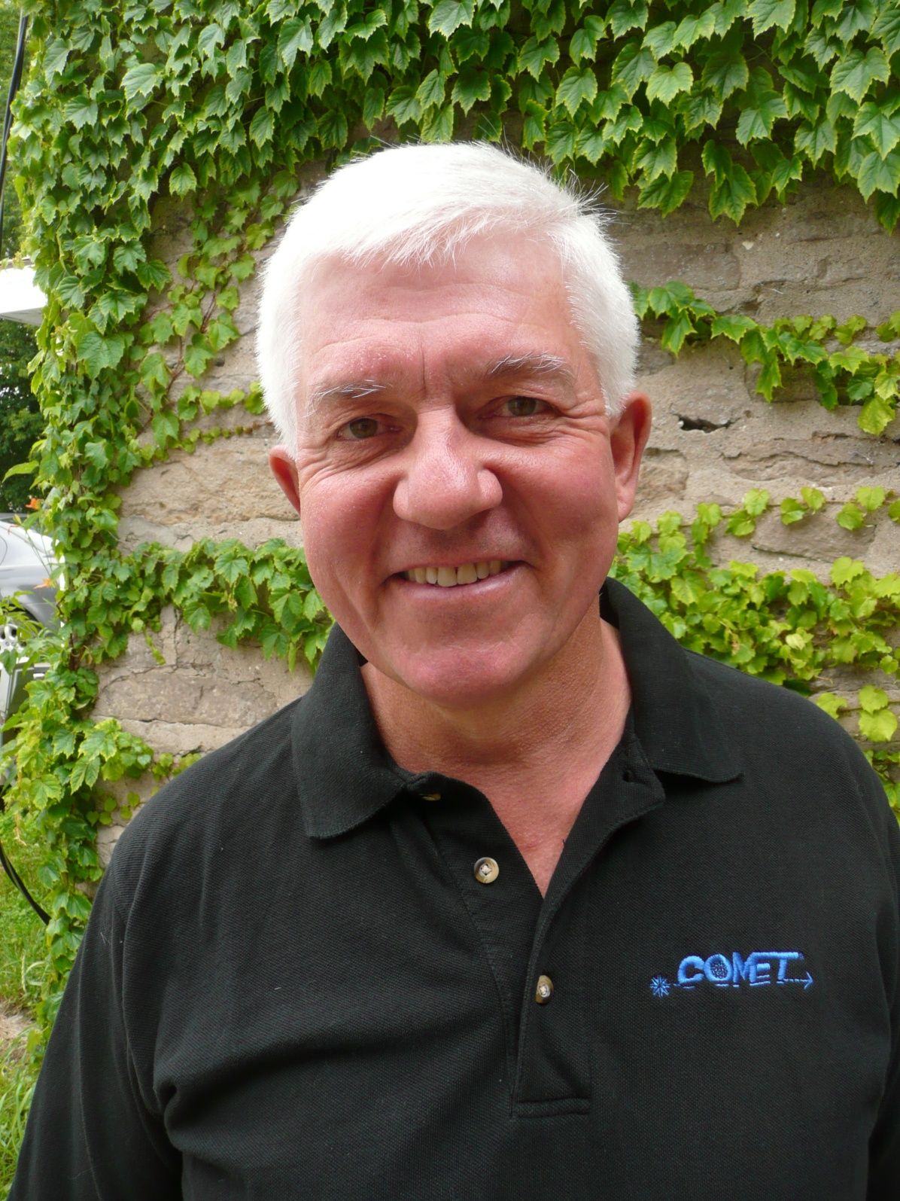
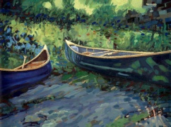
Phil the Forecaster Chadwick
Retired COMET Liaison Meteorologist from the Meteorological Service of Canada
Artist
Philtheforecaster.blogspot.ca
Environmentalist
Notes:
COMET has been serving meteorologists and the atmospheric community since 1989. I have actively been part of COMET since 2000.
I joined MSC in 1976.

Slide 4
Just How Big is Canada?
Which is the largest country in the world?
Russia
Canada
United States
Notes:
This is a clicker question.
Which is the largest country in the world? Here is where they can place “stars” again or you can turn it into a clicker question?
Canada is almost 10 million square kilometres is size. Only Russia is larger with 17 million square kilometres. The United States is third with 9.6 million square kilometres followed closely by China.

Slide 5
Just How Big is Canada?
Which country has the longest shoreline in the world?
Russia
Canada
United States
Notes:
This is a clicker question.
The Canadian motto, A Mari Usque ad Mare, means "From sea to sea.“ It should be “From seas to sea to sea!”
Canada has the world’s longest shoreline at 243,000 km… at 20 km per day it would take you 33 years to go around the Canadian shoreline.
Canada spends 1 billion a year to maintain this shoreline.

Slide 6
Interesting Canada
Canadian motto, A Mari Usque ad Mare, means "From sea to sea”
Canada has 9% of world’s renewable fresh water
Alert northernmost permanent settlement
-63C Feb 3, 1947 Snag
Settled by Vikings in 1000 AD
“Snorri” First Canadian
50% of world’s bitumen
-19C to +22C in one hour, 1962 Why?
21C rise in 4 minutes in 1966
8840 km of undefended border
Notes:
In 1962, Pincher Creek, Alberta experienced the fastest, biggest temperature change ever recorded in Canada as a result of a Chinook (a warm, dry wind that comes off the Rocky Mountains). The temperature rose from -19C to 22C in just one hour!

Slide 7
Just How Big is Canada?
Which country has the lowest population density?
Russia
Canada
United States
Notes:
This is a clicker question.
Canada’s population density is 8.6 people per square mile (3 per square kilometer), making Canada the ninth-most sparsely populated nation in the world. Mongolia has the lowest population density at 5 people per square mile. Population densities soar to 1000 people per square mile to as high as 41k in Monaco. Russia has 22 people per square mile and the United States has 80 people per square mile.
The average life expectancy at birth for a Canadian is 81.16 years, the eighth highest in the world. The United States ranks 46th, at 78.14 years.
The country phone code for Canada is “1” because Alexander Graham Bell who patented the first viable telephone was indeed a Canadian.

Slide 8
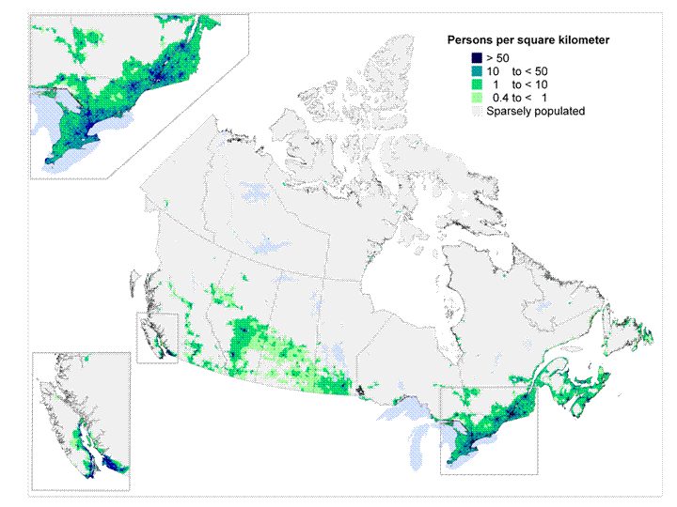
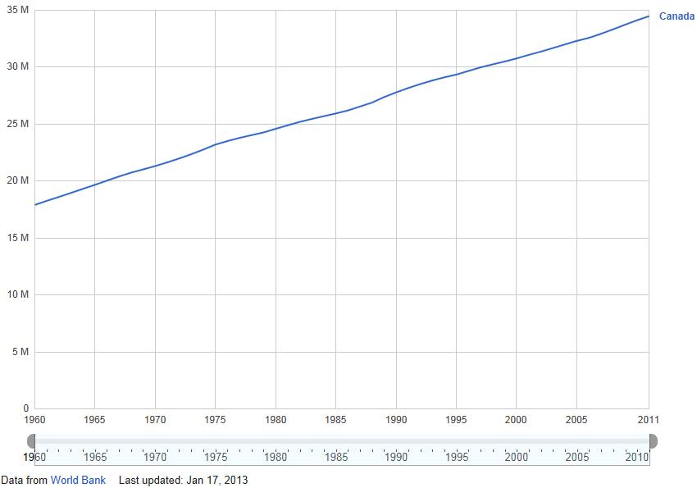
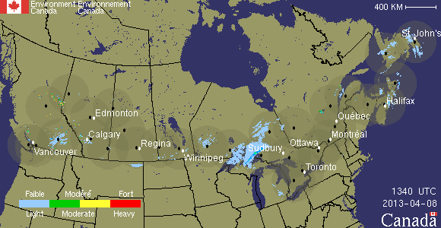
Canadian population increase to 36 million
REMOTE SENSING is your best friend in Canada
Notes:
Constraints faced by Northern Latitude meteorologists
Remote sensing coverage – satellite and radar are important tools.
Animations
Paucity of surface observations and ground truthing of remotely sensed information.
Canadian population trend and population density
Radar coverage is concentrated over the areas with more than 0.5 people per square kilometer.
REMOTE SENSING is your friend in Canada… partly because everything is remote!

Slide 9
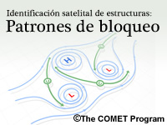
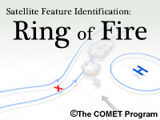
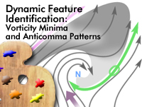
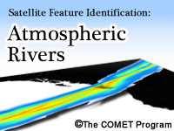
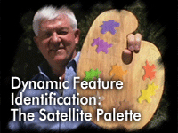
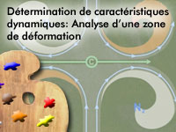
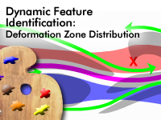
COMET
The Satellite and Radar Palettes
Notes:
COMET through their partnership with MSC gave me the opportunity to publish the science that the atmosphere taught me during my operational career. There are close to twenty modules as part of the Satellite Palette and these have been translated into French and Spanish and maybe even other languages – I really don’t know. These images are just a sampling of the introduction page graphics. There are about another twenty modules to be published but everything takes time.
Nature and the real atmosphere were the best teachers. The atmosphere was never wrong. You may be surprised by this but my interpretation of the atmosphere was often flawed – which impacted on the prediction.
I saw the patterns and shapes in the remote sensing data. I saw it as an art form with physical and scientific meaning.
Some vital lessons.
Moisture patterns are shaped in the atmospheric frame of reference.
Vorticity minima are just as important as vorticity maxima in shaping moisture patterns.
Isentropic flows and conveyor belts are vital to the understanding of any weather situation.
Humans have pattern recognition skills that are far superior to any NWP or computer.
Humans are still the most important piece of the forecast cycle… maybe this idea and thus me are becoming atmospheric dinosaurs.

Slide 10
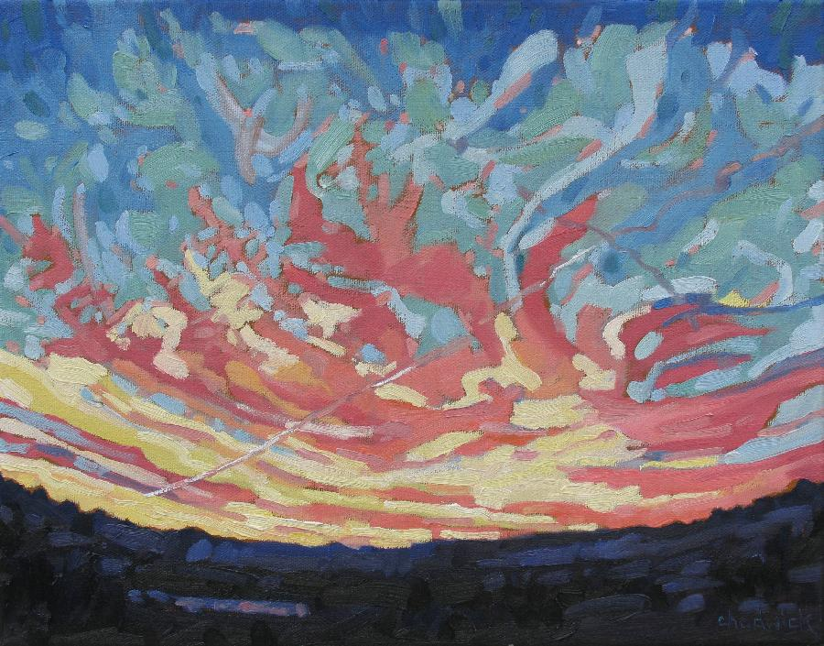
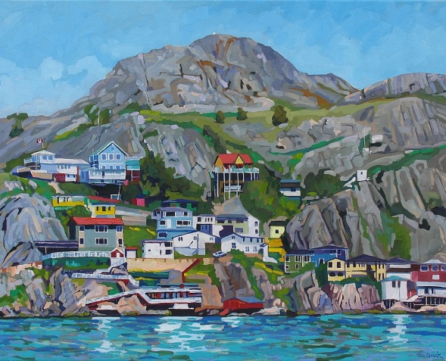
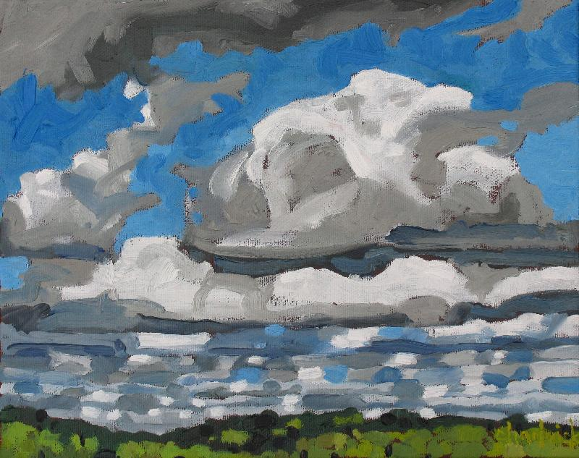
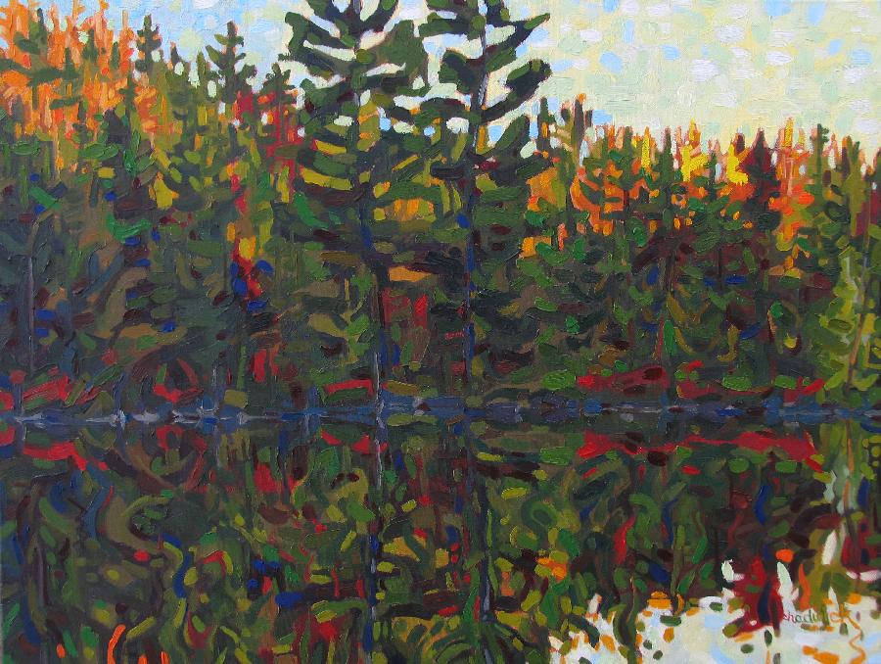
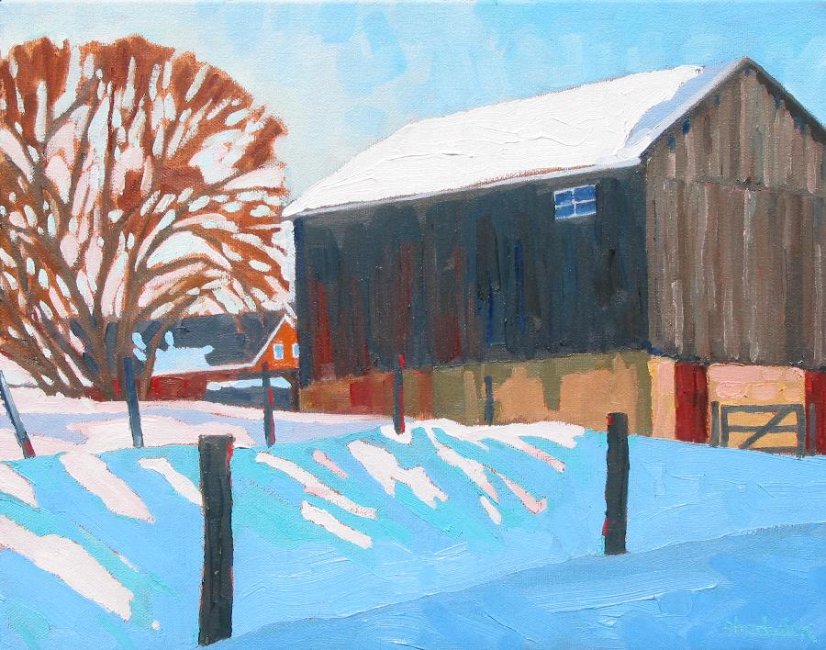
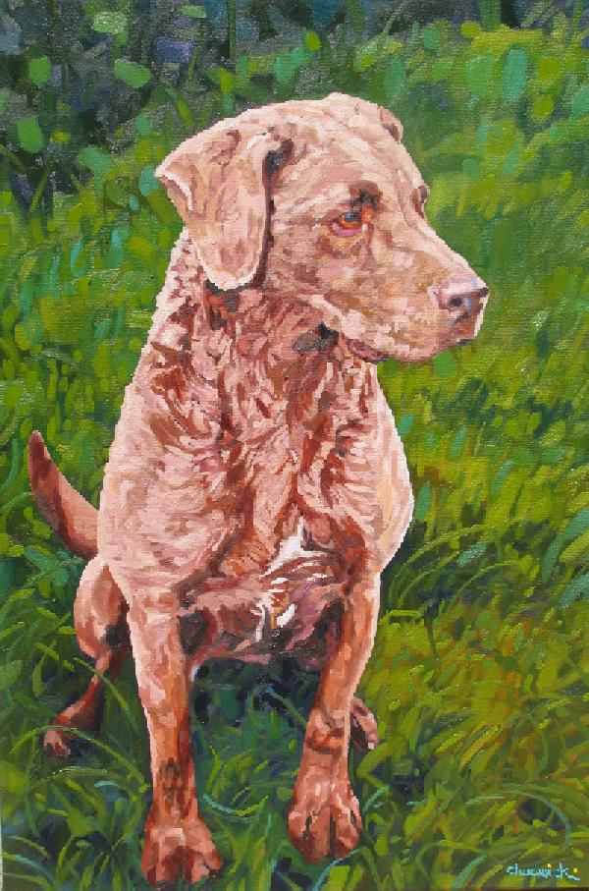
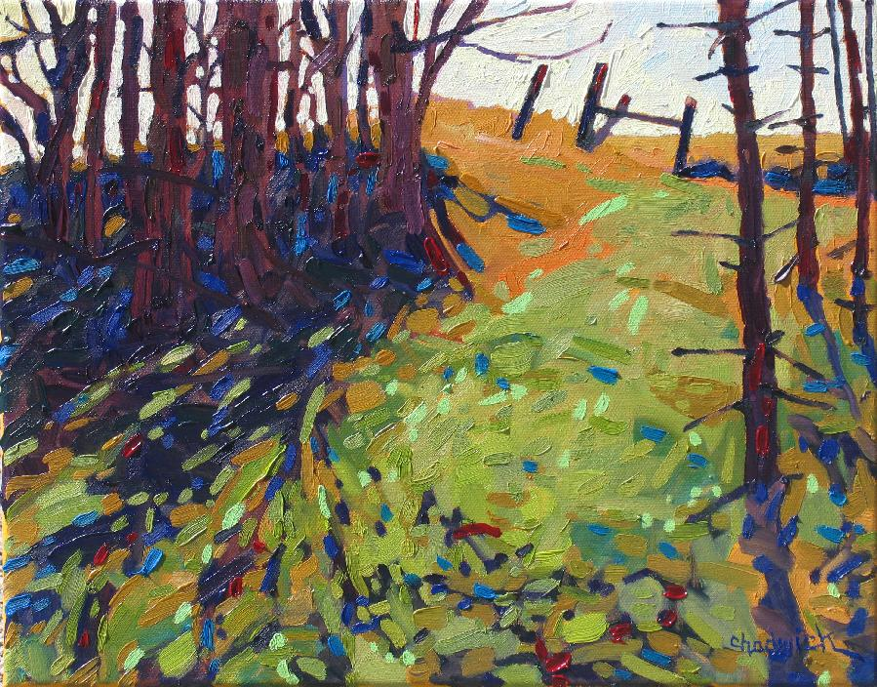
The Art of Phil the Forecaster
The Painting Palette
Place a star on your favourite image.
Notes:
Why add this slide… maybe because science is also an art. Art is science. Science is art.
I have completed almost 1300 paintings and this is just a small sampling of a few of my favourites.

Slide 11
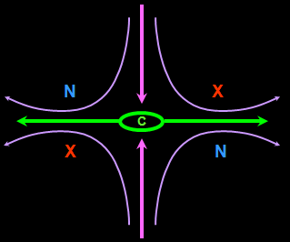
Meteorology
an Art and a Science
A work by Yasuyo Tanaka demonstrating suminagashi – oil and water mixes.
Notes:
… Satellite Meteorology … Creative Satellite Interpretation …an Art and a Science
Turn this into a “clicker” question. Ask the participants to identify the jet stream vector, cyclone, anticyclone and deformation zone.

Slide 12
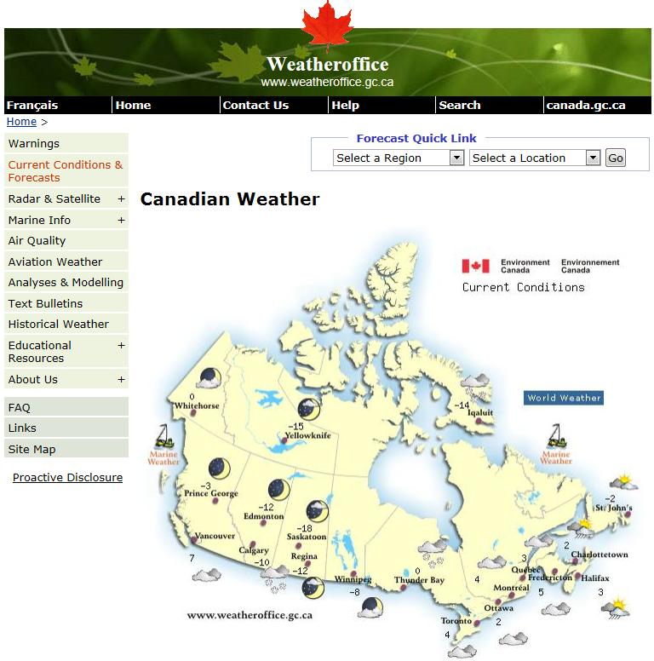
Notes:
'World Wide Weather Briefing'! Thank you for joining and being open to share knowledge and experience to your colleagues around globe. This event week comes closer now and final preparations for it are approaching. For this reason I will ask you to follow my instructions, there are few simple steps for you before we can start our event. And I promise I this will not consume much of your time.
As you were able to see already, list of chosen presenters and preliminary agenda are now available on our web page:
http://www.eumetrain.org/events/www_briefing_2013.html
Also, please let me know which special event or weather feature, connected to your region, you will present. - As I already mentioned to you, this should be second (or third) part of your presentation, after short introduction of you and your institute (working place) and 'ordinary' weather brief.
Last thing I will ask you (I'm probably lying now J) is to participate test sessions for presenters, where you will be introduced to software for online presentations that we will be using. It is called 'Saba meeting' (or ex 'Centra'). Some of you are familiar with it, but it would be more than useful for all of you to prepare yourself for presentation with no (that means, virtual) audience. - But this step comes only in the beginning of May, so you will be informed about it ones again, week before software testing.
Let me know any of you has some issues with this agenda we made. Thank you in advance for these biographies, we will stay in contact!
Ivan Smiljanic (smiljanic@cirus.dhz.hr
Bio
Trained at Queen's University as a nuclear physicist, “Phil the Forecaster" has been a professional meteorologist since 1976. Officially retired in 2011 Phil still continues to advance his research efforts with COMET and the Meteorological Service of Canada (MSC). Satellite and radar meteorology are his forte. Much of this research has been published by COMET under the Satellite Palette banner. Phil has also completed original and extensive research on performance measurement. This large body of work resides in the Case Studies section of Northern Latitude Meteorology (NorLatMet/COMET).
Aside from the above Phil has been painting en plein air forever - Philtheforecaster.blogspot.com - art and science are indeed similar endeavours. A sense of humour bundles all of this together and makes learning and teaching fun.

Slide 13
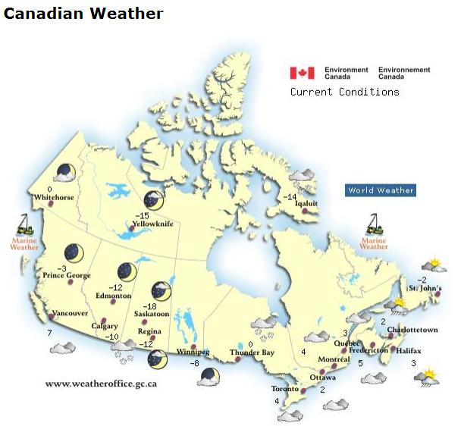
Phil and Family MSC Postings – Travels across Canada
Notes:
The Canadian weather is that of extremes. I was lucky enough to have witnessed some big storms. The best days to work were the nastiest weather days. I would often trade shifts to work the nasty weather. The nasty weather conditions were the best teachers. One can still learn from fair weather days though.

Slide 14
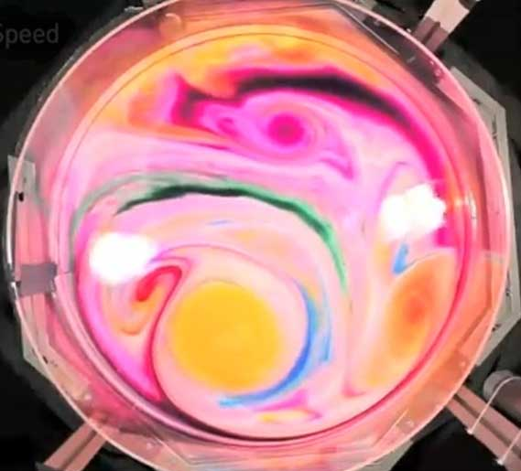
Why remote sensing in northern latitudes?
Large areas with few surface observations
Mechanically Induced Vortices in a Rotating Tank
Requirement to view, analyze and diagnose the entire pattern in order to predict a part of it
Long lived and well defined patterns. Why?
Two dimensional top-down patterns yield 3-D information. How?
Severe weather conditions best viewed safely from a distance…
Numerical weather prediction models face huge challenges…
All of the above
Vortices in a rotating tank: http://www.youtube.com/watch?v=qFIgLbFVo28
Notes:
This could be turned into a “clicker” question or participants could use their stars to indicate which reason resonates with them and their personal experiences.
Dye Circulations in a rotating tank. Mechanically induced vortices in a rotating tank.
The Coriolis force aligns the structures along the shear circulation . The colours do not mix. The circulations are largely two dimensional.
The “North Pole” is the centre of the tank which is the centre of rotation.

Slide 15
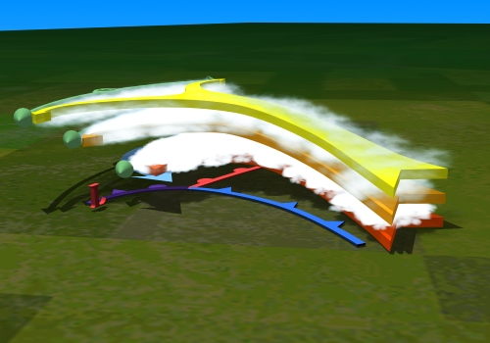
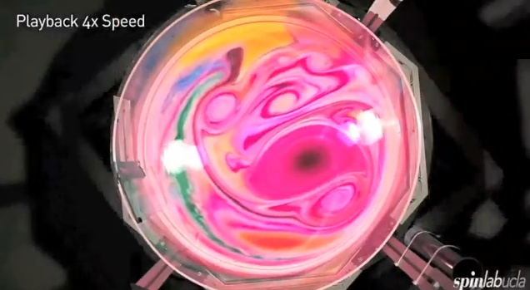
Human Skills of Pattern Recognition combined with conceptual models result in situational awareness and atmospheric understanding.
The Satellite and Radar Palettes are growing libraries of operationally relevant conceptual models. Visit COMET for more details.
Notes:
This slide is intended to empower the participants and suggest that they can better understand the real atmosphere by applying conceptual models to patterns in remote sensing data. Numerical models are useful tools and simulations of atmospheric processes but they are not the solution to the forecast problems of the day.
Think in 3D conceptual models to really understand atmospheric processes.

Slide 16
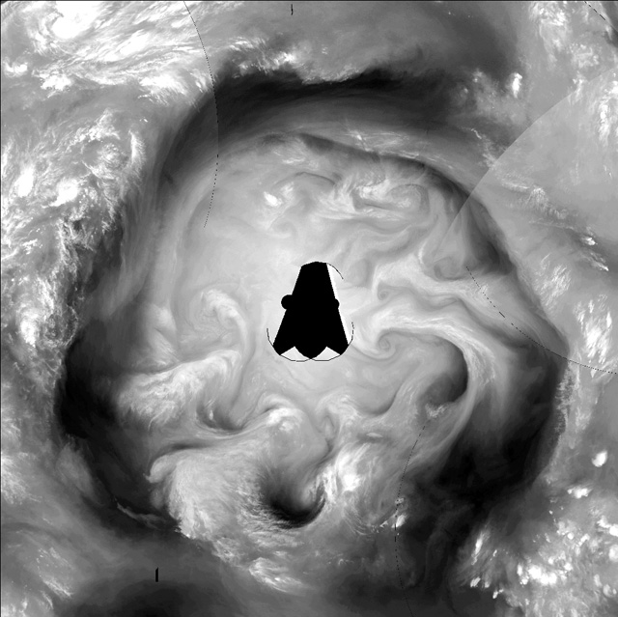
Higher latitude conveyor belts really hang together…
Lower latitude circulations tend to mix into oblivion… more challenging to forecast
Can you find… ?
The North Pole? Santa?
A cyclone… low pressure area
An anticyclone… high pressure area
Vorticity tubes?
A warm conveyor belt
A jet stream
A deformation zone
High and cold moist area – precipitation processes?
Low and dry area – no precipitation processes?
Something interesting?
High time and space resolution
These 3D conceptual models apply at all time and space scales
Notes:
Water vapour satellite imagery as shown here is really showing a three-dimensional isosurface of 1 mm of water vapour as viewed from the satellite.
In atmospheric fluid dynamics, there are 3 basic atmospheric elements: vorticity centres, conveyor belts/jets, and deformation zones. As a system these elements can help us see atmospheric processes. If you can see one element, you can infer the others and further infer three-dimensional structures.
Expert forecasters define this three-dimensional mental model and use it to see their forecasts and better predict the future state of the atmosphere. To them, the atmosphere no longer consists of two-dimensional plan-view maps or cross sections - it is a fully functioning three-dimensional world that they no longer need to slice and dice. Numerical weather prediction (NWP) output is only used where they need more information in their 3D mental model. By limiting the amount of time spent examining model output, forecasters can better focus their efforts on understanding the weather situation.
Full video: http://www.youtube.com/watch?v=S0_-uITuxYQ Creamer Experiment: http://www.youtube.com/watch?v=o-jV5Vf-bcw Vortices in a rotating tank: http://www.youtube.com/watch?v=qFIgLbFVo28
The water vapour isosurface depicted in the imagery is the temperature where the satellite sensor becomes saturated with water vapour (approximately 1 mm of water vapour). This happens in the atmosphere between 250 and 700 mb.
Indicate on the imagery where the lowest 3 areas of water vapour are by dragging the numbers 1 (lowest), 2 (low but not as low as 1), and 3 (low but not as low as 2) onto the image. Also indicate the highest 3 areas of water vapour by dragging the numbers 8 (high but not as high as 9), 9 (high but not as high as 10), and 10 (highest) onto the imagery.
You do not need to be able to do this accurately in a forecast situation. Understand that the brighter colours are colder and thus higher and the darker colours are warmer and thus lower in the atmosphere should be sufficient.
A conveyor belt can be envisioned as an ensemble of air parcels, originating from a common source region. Conveyor belts are slanted along isentropic surfaces (planes of constant potential temperature) with warm conveyor belts ascending up an isentropic surface and dry conveyor belts descending down isentropic surfaces. Cold conveyor belts are a mishmash of rising and sinking motion but change in height by only a little. Trajectories of each of the conveyor belts are shown below.

Slide 17
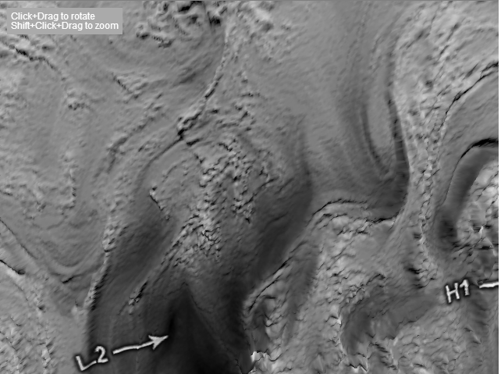
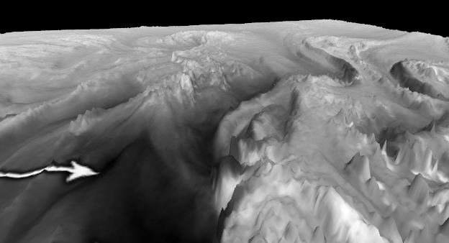
3D Water Vapour
Weather does not recognize geopolitical boundaries. Canadian weather is the same as Russian weather…
Create your own 3D conceptual model of the real atmosphere … new COMET Module coming very soon.
Notes:
3D-WV – mention that I typically remove geopolitical lines.
In this image, the grayscale colours have been assigned heights relative to the entire brightness temperature scale. So in the image, every pixel of the same colour will have exactly the same height. But we know that even though pixels may have the same colour on this image, they may be at different altitudes due to the atmospheric characteristics in the profile beneath that pixel. Yet, it offers a three-dimensional representation that aids us in interpreting water vapour in 3D and creating our own three-dimensional model. Remember to only compare heights within a given system.
Vorticity can be cyclonic or anticyclonic. Cyclonic vorticity, in either hemisphere, is considered a maximum (vorticity maximum or vort max for short) while anticyclonic vorticity is considered a minimum (vorticity minimum or vort min for short). Cyclonic vorticity centres are typically easier to find than anticyclonic vorticity centres on water vapour imagery.

Slide 18
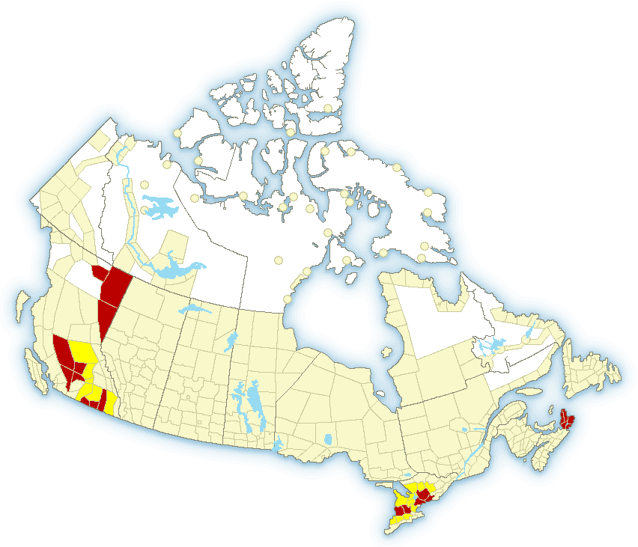
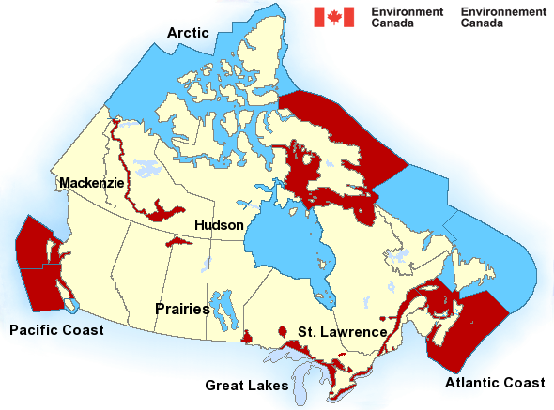
Public
Warnings from May 21st, 2013
Heavy snow
Heavy rain
Frost
Marine
Severe thunderstorms
Lightning Danger within 10 minutes
Did Phil shut his computer down? Yes No
Notes:
Warnings are in effect for somewhere and some reason all of the time.
Was I in lightning danger within 10 minutes?

Slide 19
Current Weather Related Concerns Spring 2013
Freezing Rain and Ice storms
Heavy Snow
Heavy Rain
Flooding
Wild fires
Spring Convection
Frost
Ice storm from late April 2013 – at my home
Notes:
Almost 50% of the disasters in Canada are weather related.
Weather is not only important… it is one of the main topics of conversation.

Slide 20
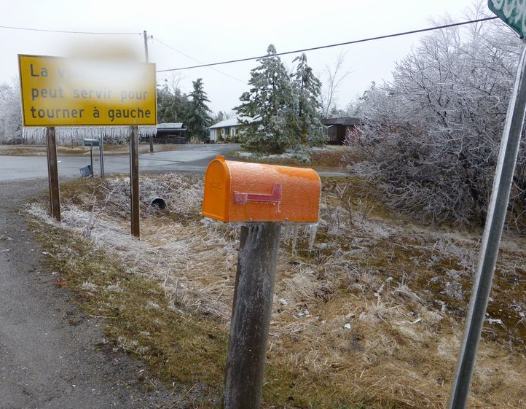
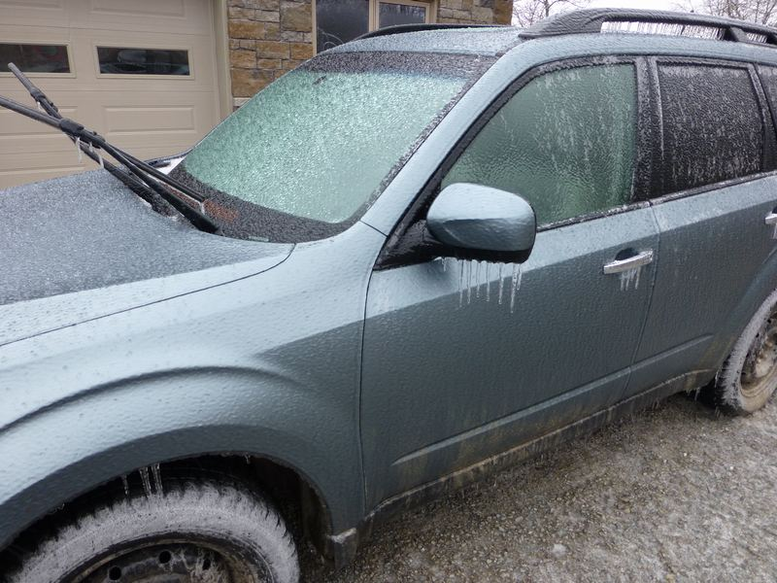
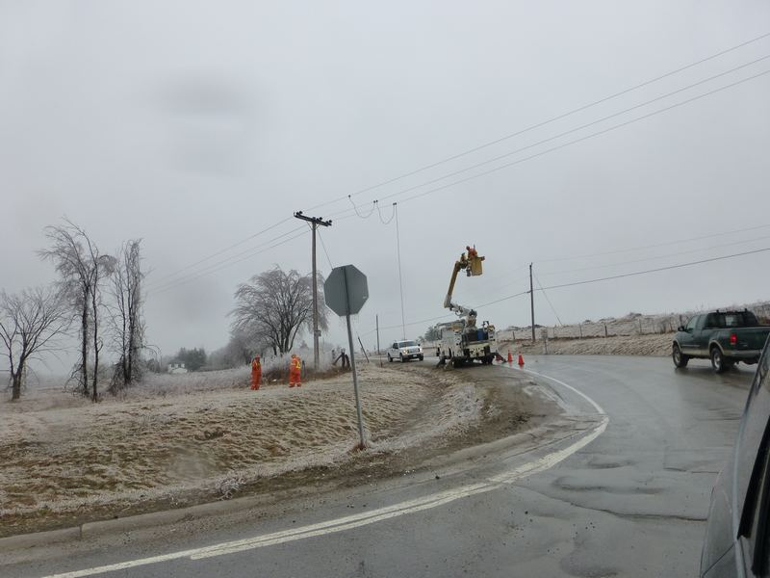
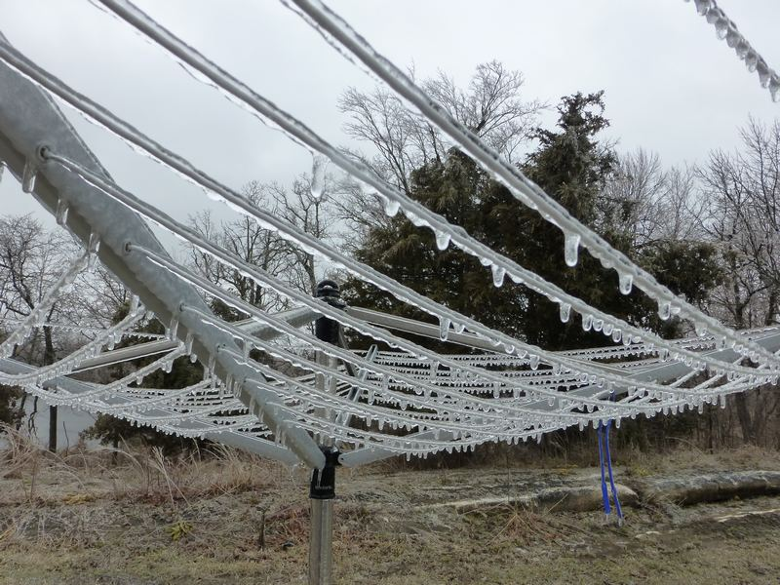
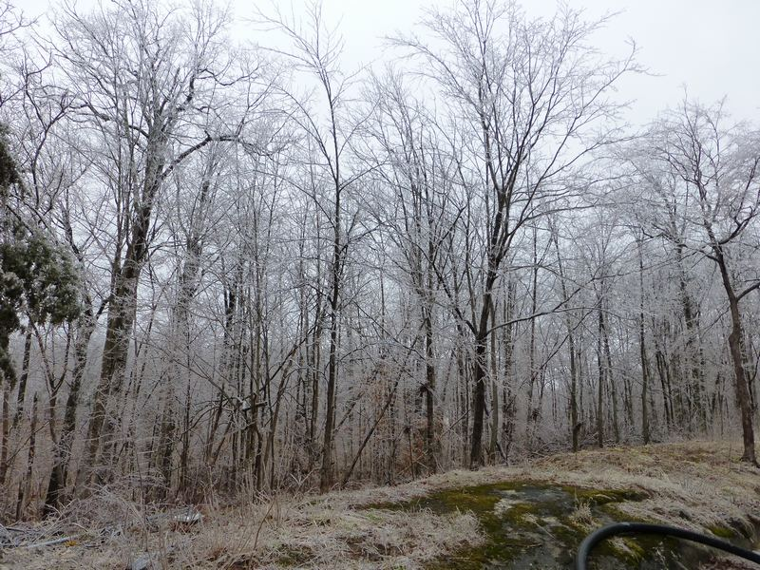
Place a star on your favourite image.

Slide 21
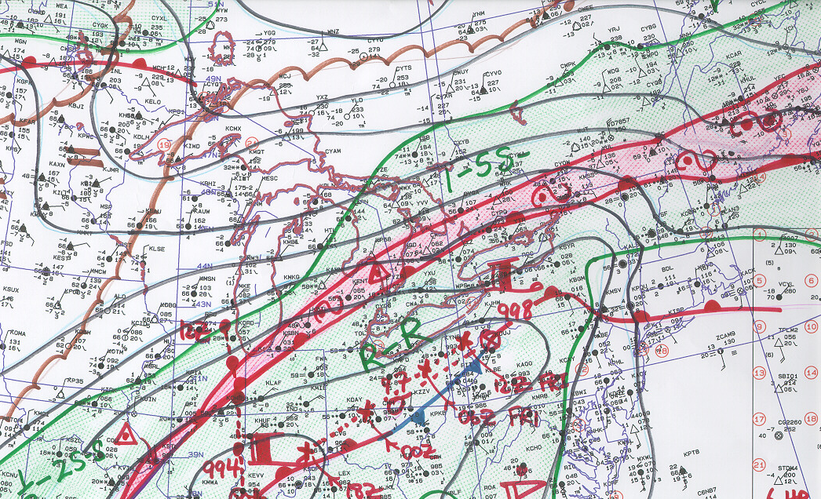
My hand analysis for Ice Storm 1998
Do you do hand analysis of maps? Place a star…
Yes
Sometimes
No

Slide 22
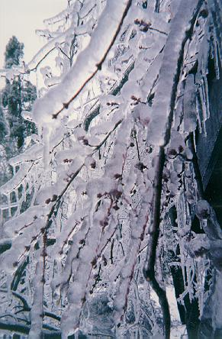
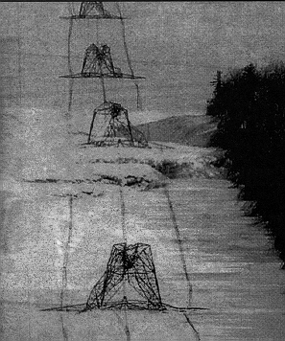
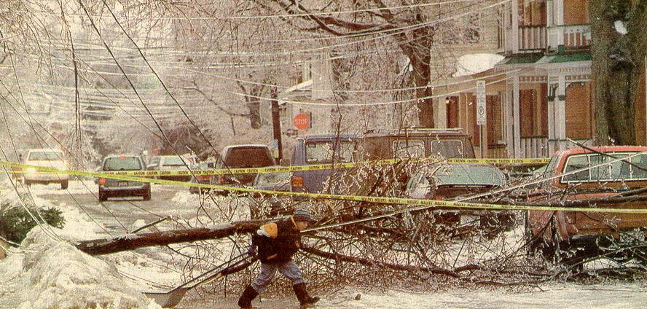
2 inches of ice accretion on surfaces
Happens once or twice a century

Slide 23
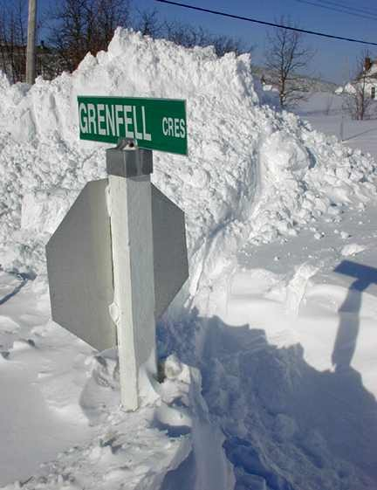
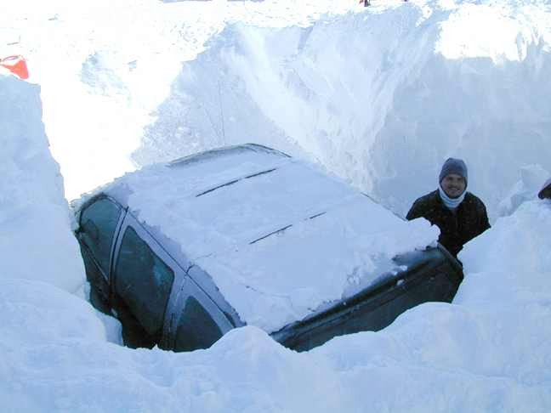
Current Weather Related Concerns Spring 2013
Place a star on your favourite image.
Freezing Rain and Ice storms
Heavy Snow
Heavy Rain
Flooding
Wild fires
Spring Convection
Frost
Notes:
Almost 50% of the disasters in Canada are weather related.
Weather is not only important… it is one of the main topics of conversation.

Slide 24
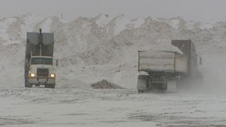
Regina's 196 cm (over 6 feet) of snow - a new record for 2013
Record Values of
Snow on Ground, May 2013
Which leads to spring flooding…
Notes:
Background to the World Wide Weather Briefing
Show creamer experiment.
Show animation of rotating fluid and dye.
The effects of the Coriolis Force
Minimal mixing of conveyor belts
Long surviving and complex circulations that contain abundant information on the processes that created them in the past
Why I prefer to predict northern latitudes than equatorial regions
Conceptual Models that help to
Interpret the meanings of current pattern
Predict the evolution of the patterns in the future
Remember that moisture shapes are generates in the atmospheric frame of reference and that vorticity minima are as important as the more exciting vorticity maxima.

Slide 25
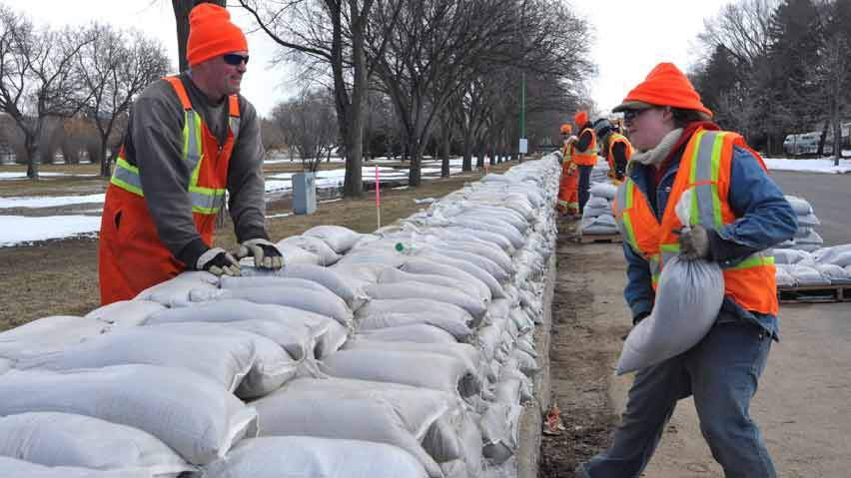
Preparing for Spring in Canada 2013
Not all Canadians were blaze orange toques… just a majority. I have 4 of them.

Slide 26
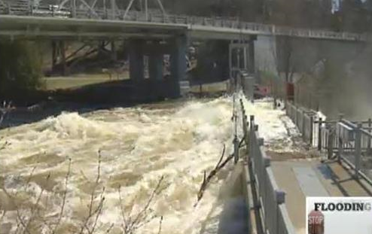
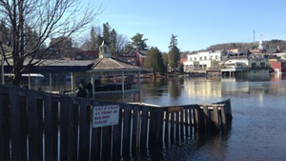
Current Weather Related Concerns Spring 2013
Hudson’s Bay is the world’s 2nd largest bay and drains 4 million square kilometres – northward following rivers prone to spring floods.
Freezing Rain and Ice storms
Heavy Snow
Heavy Rain
Flooding
Wild fires
Spring Convection
Frost
Notes:
Almost 50% of the disasters in Canada are weather related.
Weather is not only important… it is one of the main topics of conversation.

Slide 27
Place a star on your favourite image.
Notes:
Manitoba forecasters now fear the Red River valley area could face one of the worst floods in history because of recent record snowfalls in the U.S.
“Based on the wetter conditions that we’ve seen in North Dakota, particularly the Fargo area, we are upgrading potential flood risk in the Red River valley,” Emergency Measures Minister Steve Ashton said Thursday. “The current unfavourable scenario (in the U.S.) indicates that we could be looking at a level in the Red River Valley up to one foot higher than the level in 2009 (23 feet), but not at 1997 levels.”
Those were two of the three worst floods ever experienced in Manitoba.
The level of the Red River between Emerson and Winnipeg will rise a half-foot to one foot higher than 2009, depending on the weather.

Slide 28
Current Weather Related Concerns Spring 2013
Freezing Rain and Ice storms
Heavy Snow
Heavy Rain
Flooding
Wild fires
Spring Convection
Frost
Notes:
Almost 50% of the disasters in Canada are weather related.
Weather is not only important… it is one of the main topics of conversation.

Slide 29
Current Weather Related Concerns Spring 2013
Where would you rather be?
In the path of the storm.
Freezing Rain and Ice storms
Heavy Snow
Heavy Rain
Flooding
Wild fires
Spring Convection
Frost
In the remote sensing room.
F5 Tornado in Elie, Manitoba on June 22nd, 2007
Vortices of a different scale
Remote sensing is the best way to view severe convection.
Notes:
Almost 50% of the disasters in Canada are weather related.
Weather is not only important… it is one of the main topics of conversation.

Slide 30
Weather is important to everyone Meteorologists are the most important part of the forecast cycle I love my profession and going to work!
My personal views only…
Place a star on those you agree with…
Humans have a skill set not duplicated by any computer
Pattern Recognition and conceptual models are great tools that I use
Remotely sensed data has terrific time and space resolution… and is getting even better!
I just look at NWP…

Slide 31
Thank you to EUMETRAIN !
Thank You from Canada !
Questions?
Meteorology: an Art and a Science
A work by Yasuyo Tanaka demonstrating suminagashi.
Notes:
… Satellite Meteorology … Creative Satellite Interpretation …an Art and a Science

