Slide 1
LSA-SAF Event Week 2011
Session 5
FIRE RISK
Carlos C. DaCamara
Associate Professor
IDL – University of Lisbon
Email: cdcamara@fc.ul.pt

Slide 2
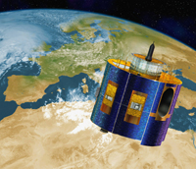
BACKGROUND
Fire-related processes have long been identified as applications with great potential to be derived from Meteosat/SEVIRI.

Slide 3
BACKGROUND
The growing number of users of Meteosat information for agricultural and forestry applications, together with the growing demands for environmental monitoring and risk management has led EUMETSAT’s LSA SAF to commit to the development of a new line of research aiming to explore the capability of Meteosat/SEVIRI to detect and monitor active fires over Africa and Europe.

Slide 4
BACKGROUND
As a result, the LSA SAF is currently disseminating on an operational basis the following products:

Slide 5
BACKGROUND
As a result, the LSA SAF is currently disseminating on an operational basis the following products:
the Fire Risk Mapping (FRM) product, that provides daily maps of meteorological fire risk over Mediterranean Europe;

Slide 6
BACKGROUND
As a result, the LSA SAF is currently disseminating on an operational basis the following products:
the Fire Risk Mapping (FRM) product, that provides daily maps of meteorological fire risk over Mediterranean Europe;
the Fire Detection and Monitoring (FD&M) product, that provides a continuous monitoring of fire activity over Africa and Europe;

Slide 7
BACKGROUND
As a result, the LSA SAF is currently disseminating on an operational basis the following products:
the Fire Risk Mapping (FRM) product, that provides daily maps of meteorological fire risk over Mediterranean Europe;
the Fire Detection and Monitoring (FD&M) product, that provides a continuous monitoring of fire activity over Africa and Europe;
The Fire Radiative Power (FRP) product that allows the estimation of carbon emissions from the vegetation fires.

Slide 8
LSA-SAF Event Week 2011
Session 5
Part 1
PRE-FIRE CONDITIONS
Carlos C. DaCamara
Associate Professor
IDL – University of Lisbon
Email: cdcamara@fc.ul.pt

Slide 9
INTRODUCTION
Rural fires are common events on ecosystems characterized by alternating rainy and drought periods, which inevitably lead to high levels of vegetation stress and to the accumulation of fuels during the dry phase .

Slide 10
INTRODUCTION
Rural fires are common events on ecosystems characterized by alternating rainy and drought periods, which inevitably lead to high levels of vegetation stress and to the accumulation of fuels during the dry phase .
QUESTION: In what part of Europe is this particularly true?

Slide 11
INTRODUCTION
This is particularly true in Mediterranean Europe, where the rainy and mild winters followed by warm and dry summers make the region especially prone to the occurrence of a large number of fire events.

Slide 12
INTRODUCTION
This is particularly true in Mediterranean Europe, where the rainy and mild winters followed by warm and dry summers make the region especially prone to the occurrence of a large number of fire events.
QUESTION: In what time of the year do the most severe fire episodes take place?

Slide 13
FIRES IN PORTUGAL
PORTUGAL has been strongly affected by wildfires.
According to the most recent inventory provided by the National Forest Authority (Autoridade Florestal Nacional, AFN), over 5 million hectares have burned during 1980-2006, of which the impressive amount of 1 million ha concentrates in the 3-year period of 2003-2005.

Slide 14
FIRES IN PORTUGAL

Slide 15
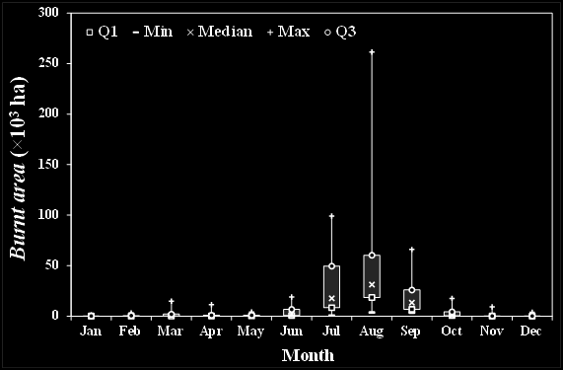
FIRES IN PORTUGAL

Slide 16
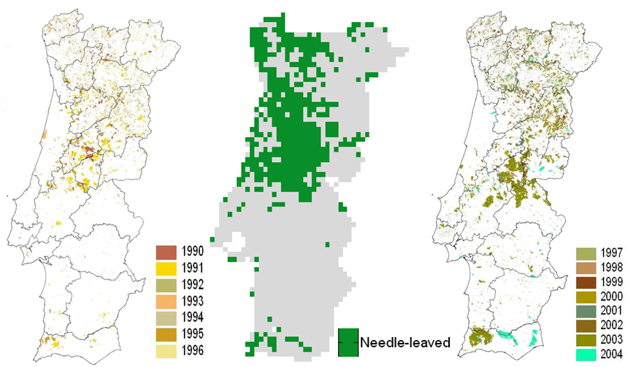
FIRES IN PORTUGAL

Slide 17
CLIMATE & WEATHER ANOMALIES
The aim of this lesson is to demonstrate that the extent of burnt area in Portugal is mainly controlled by two different types of meteorological factors associated to two different temporal scales:

Slide 18
CLIMATE & WEATHER ANOMALIES
The aim of this lesson is to demonstrate that the extent of burnt area in Portugal is mainly controlled by two different types of meteorological factors associated to two different temporal scales:
the climate anomaly which relates to the existence of long dry periods with absence of precipitation in late spring and early summer;

Slide 19
CLIMATE & WEATHER ANOMALIES
We begin by demonstrating that the extent of burnt area in Portugal is mainly controlled by two different types of meteorological factors associated to two different temporal scales:
the climate anomaly which relates to the existence of long dry periods with absence of precipitation in late spring and early summer;
the weather anomaly which relates to the occurrence of very intense dryspells in days of extreme synoptic situations.

Slide 20
WHAT IS NDVI?
Red light is strongly absorbed by photosynthetic pigments found in green leaves, whereas near-infrared is highly reflected by live leaf tissues, regardless of their color.
Areas of bare soil on the contrary tend to appear similar in both the red and near-infrared wavelengths.

Slide 21
WHAT IS NDVI?
QUESTION
What are the values of NDVI to be expected for vegetation and bare soil surfaces?

Slide 22
WHAT IS NDVI?
QUESTION
What are the values of NDVI to be expected for vegetation and bare soil surfaces?
Answer: The typical range of actual values of NDVI is about 0.1 for bare soils to 0.9 for dense vegetation.

Slide 23
EXTREME YEARS

Slide 24
EXTREME YEARS
SEVERE YEARS
WEAK YEARS

Slide 25
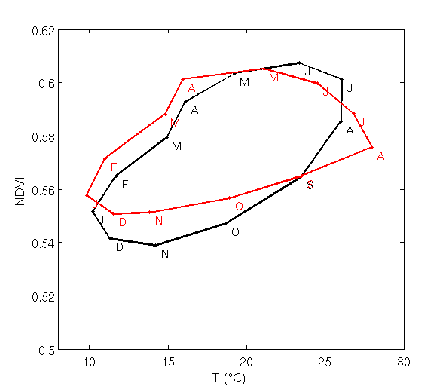
EXTREME YEARS
SEVERE YEARS

Slide 26
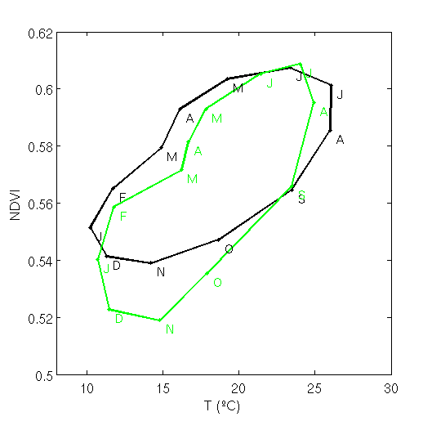
EXTREME YEARS
SEVERE YEARS
WEAK YEARS

Slide 27
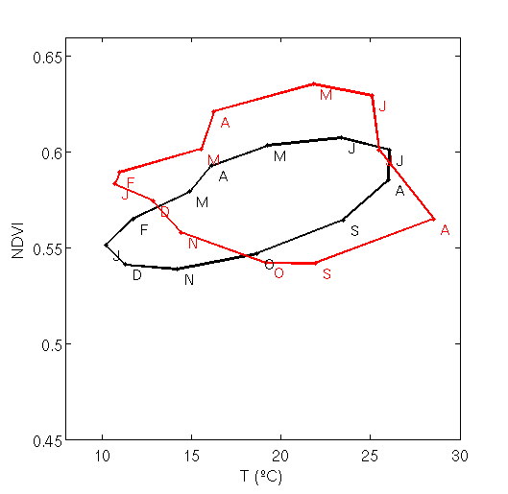
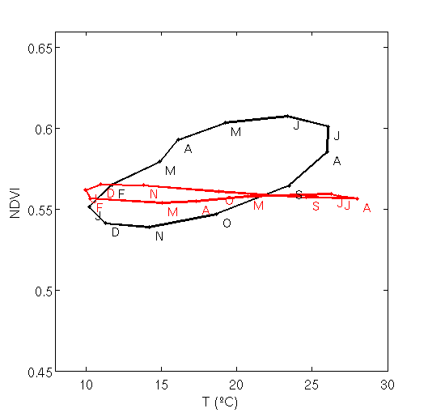
2003 versus 2005
2003
2005

Slide 28
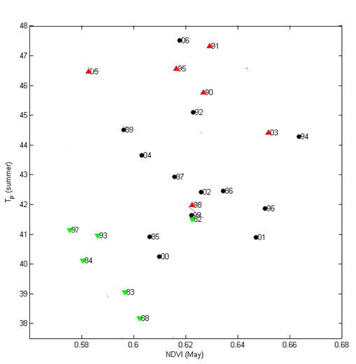
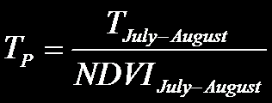
CLIMATE vs. WEATHER ANOMALIES
T_{P} (summer) is the “pyrogenic” temperature defined by:

Slide 29
CLIMATE vs. WEATHER ANOMALIES

Slide 30
CLIMATE vs. WEATHER ANOMALIES
Climate anomaly

Slide 31
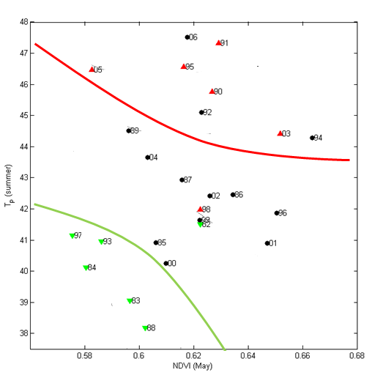
CLIMATE vs. WEATHER ANOMALIES
Meteorological anomaly
Climate anomaly

Slide 32
LSA-SAF Event Week 2011
Session 5
Part 2
THE FRM PRODUCT
Carlos C. DaCamara
Associate Professor
IDL – University of Lisbon
Email: cdcamara@fc.ul.pt

Slide 33
The Fire Risk Mapping product
The FRM product is based on:

Slide 34
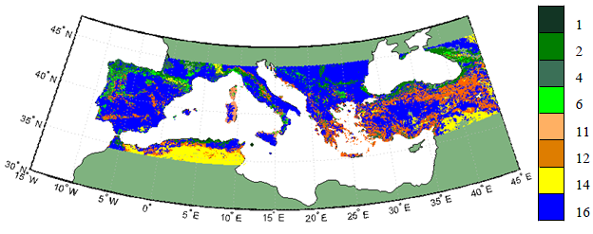
The Fire Risk Mapping product
The FRM product is based on:
Information about vegetation type from GLC200. Vegetation type provides an indication about available fuel and flammabiltiy;

Slide 35
The Fire Risk Mapping product
The FRM product is based on:
Information about vegetation type from GLC200. Vegetation type provides an indication about available fuel and flammabiltiy;
Information about location and duration of fire events as obtained from the Fire Detection & Monitoring product (details will be provided in Session 6);

Slide 36
The Fire Risk Mapping product
The FRM product is based on:
Information about vegetation type from GLC200. Vegetation type provides an indication about available fuel and flammabiltiy;
Information about location and duration of fire events as obtained from the Fire Detection & Monitoring product (details will be provided in Session 6);
The Fire Weather Index, that uses meteorological data to empirically estimate the available fuel and fire spread rate. Data used to calculate FWI are derived from daily meteorological fields of ECMWF analyses.

Slide 37
The Fire Weather Index

Slide 38
The Generalized Pareto distribution
Active fire duration is defined by the number of consecutive MSG slots (1 MSG slot = 15 minutes) where an active fire is identified in a given pixel.

Slide 39
The Generalized Pareto distribution
Active fire duration is defined by the number of consecutive MSG slots (1 MSG slot = 15 minutes) where an active fire is identified in a given pixel.
It was found that the decimal logarithm of active fire duration tends to follow a Generalized Pareto (GP) distribution.

Slide 40
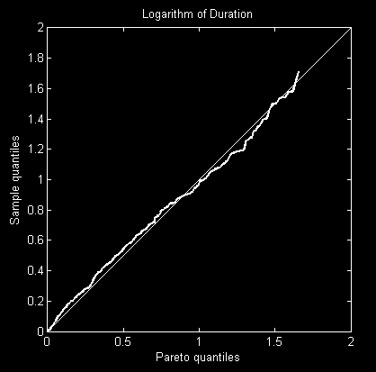
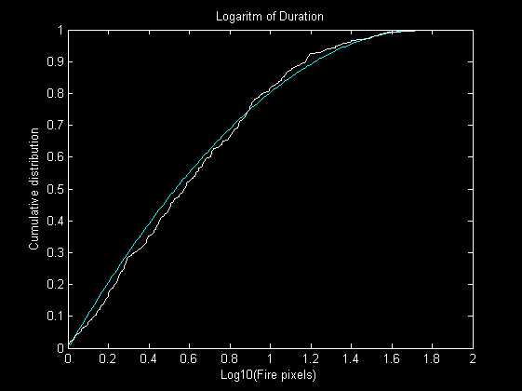
The Generalized Pareto distribution

Slide 41
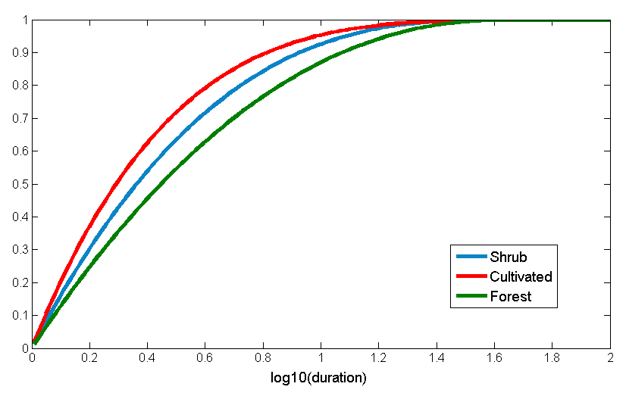
Active fire duration distribution
The background model
Forest
Shrub
Cultivated areas
QUESTION: Witch curve corresponds to each vegetation type?

Slide 42
Active fire duration distribution
The background model
Forest
Shrub
Cultivated areas

Slide 43
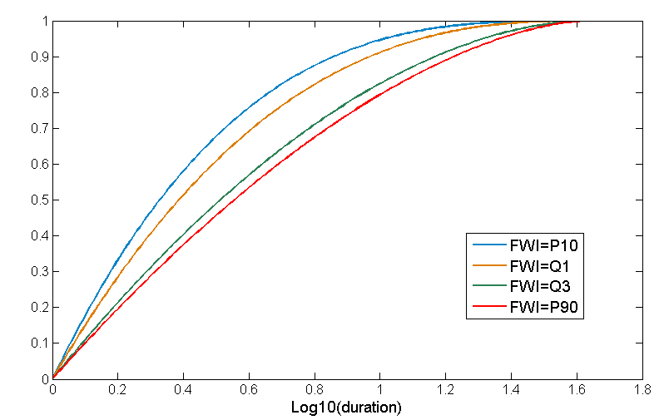
Active fire duration distribution
The FWI model
QUESTION: Which curve corresponds to highest FWI?

Slide 44
Active fire duration distribution
The FWI model

Slide 45
Mapping fire risk (background model)
Risk of occurrence of active fires with a duration exceeding pre-defined threshold (150 minutes)

Slide 46
Mapping fire risk (background model)
Risk of occurrence of active fires with a duration exceeding pre-defined threshold (150 minutes)
Active fire duration (in minutes) associated to a risk of occurrence of fire (25%)

Slide 47
Mapping fire risk (FWI model)
Risk of occurrence of active fires with a duration exceeding pre-defined threshold (150 minutes)
24/07/07
25/08/07
31/08/09

Slide 48
Fire risk
Background model
FWI model – 24/07/07
QUESTION: Can you tell where it is likely to have a fire event?

Slide 49
Risk anomaly
Combining the static maps of the background model (which depends on vegetation only) with the daily maps of the FWI model (which also uses FWI as a covariate) provides better indication on whether meteorological conditions are aggravating or mitigating fire risk.
Risk anomaly – 24/07/07
Background risk
Background GP model
Active fire duration
GP model with FWI
Fire risk
Maps of risk anomaly

Slide 50
Classes of fire risk
15% | 5% | 0% | -10%
Very high | High | Moderate | Low | Very low

Slide 51
An “happy” ending!
]0-0.5]
]0.5-2.5]
]2.5-5]
] 5-7.5]
>7.5 h

