Slide 1
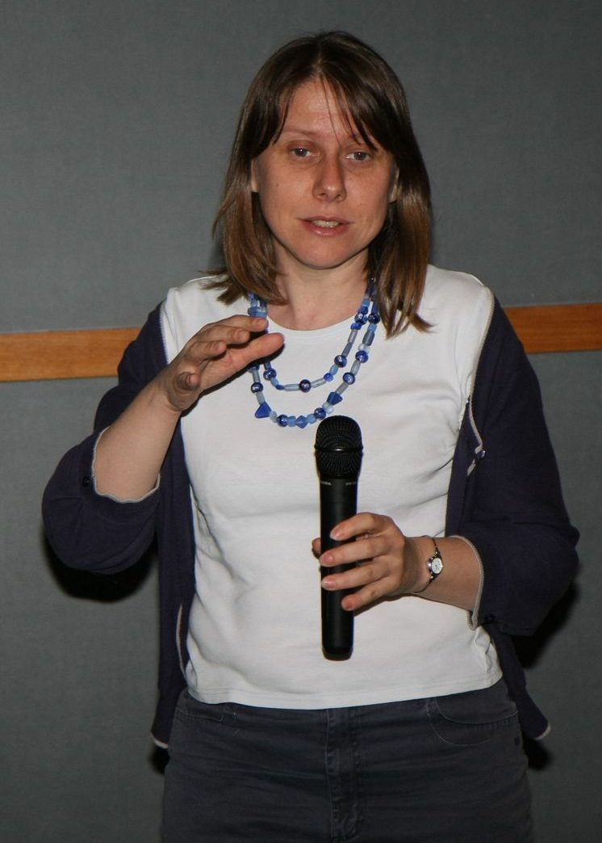
Waves from radar altimetry satellites: measurements and uses
Vinca Rosmorduc, CLS / Aviso

Slide 2
Aviso?
Archiving, Validation and Interpretation of Satellite Oceanographic data French Distributing and Archiving center for satellite altimetry data since 1992 (Topex/Poseidon launch)
Distribution of Altimetry data & Doris precise location system data
User Helpdesk
Information about Altimetry & Doris,
Promotion of users’ work
Outreach
http://www.aviso.oceanobs.com aviso@oceanobs.com

Slide 3
Altimetry applications
Geodesy & geophysics
Bathymetry
Geodesy
Tsunami
Ocean
Large-scale circulation
Ocean currents and eddies
Operational oceanography
Tides
Mean Sea Level rise
Ice
Ice sheets
Sea ice
Climate
ENSO
NAO
Decadal oscillations
Atmosphere, wind & waves
Wind & waves
Cyclones
Rain
Hydrology & land
Lake level
Land
River level
Coastal

Slide 4
Altimetry applications
Geodesy & geophysics
Bathymetry
Geodesy
Tsunami
Ocean
Large-scale circulation
Ocean currents and eddies
Operational oceanography
Tides
Mean Sea Level rise
Ice
Ice sheets
Sea ice
Climate
ENSO
NAO
Decadal oscillations
Atmosphere, wind & waves
Wind & waves
Cyclones
Rain
Hydrology & land
Lake level
Land
River level
Coastal

Slide 5
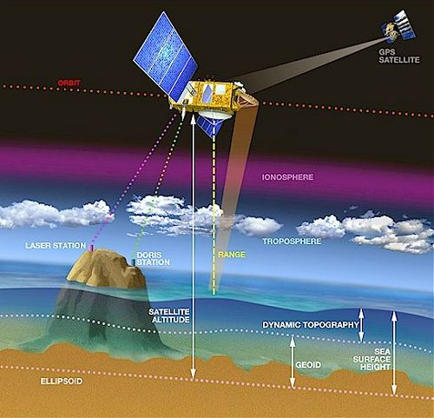
The principle of Altimetry
Altimetry is meant to retrieve “Sea Surface Height” This is the difference between the satellite-to-ocean range (calculated by measuring the signal’s round-trip time) and the satellite’s position on orbit with respect to an arbitrary reference surface (a raw approximation of the Earth’s surface, called the reference ellipsoid)
OK, BUT: what about WAVES??
Animation

Slide 6
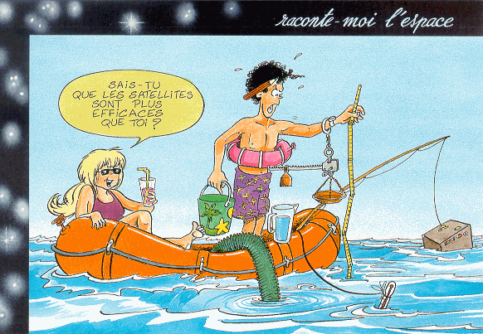
Wave retrieval?

Slide 7
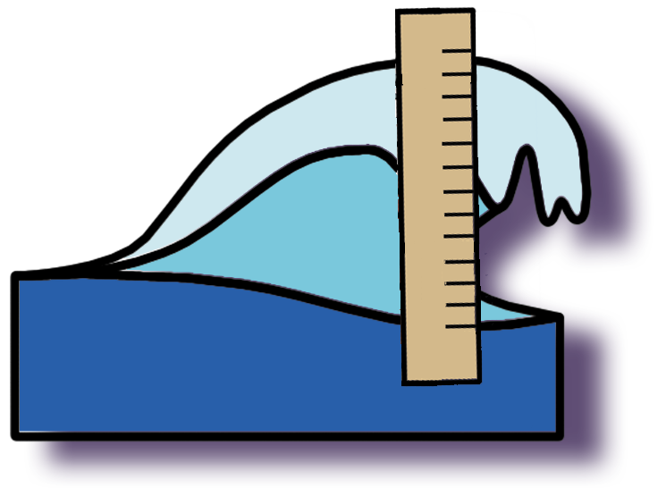
Wave retrieval?

Slide 8
Wave retrieval?

Slide 9
No…
Because :
The satellite is taking an image?
The satellite beam is not a thin thread?
The satellite accuracy is not good enough?
The wave would be too distorted by the water droplets in the air
Measurements are averaged anyway, individual measurements are never used

Slide 10
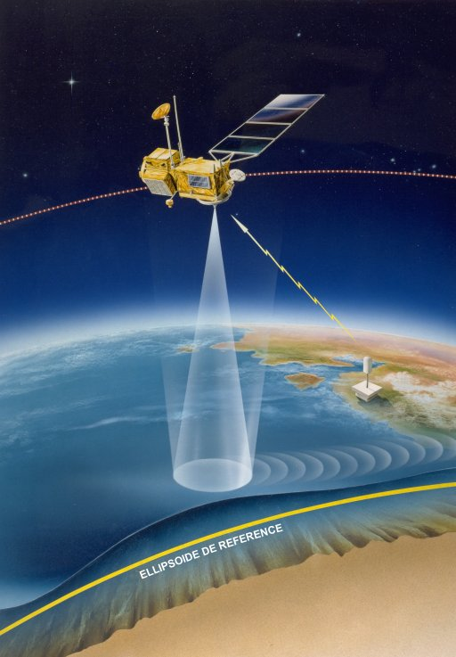
No…
Because :
Satellite beam is not a thin line… (its footprint is about 1-2 km minimum in diameter)
Measurements are averaged anyway (over 1s, i.e. 7 km along the track), to remove noise. Individual measurements are never used
Anyway, it would be too anecdotic (one wave measured over a lot)
So, how?: the way the radar wave reflects on the ocean surface is largely shaped by wave (and wind) at the footprint level

Slide 11
Radar return echo: calm sea
Satellite
Radar wave
Radar wave as seen from above the surface
Shape of the power as received back by the onboard radar with respect to time

Slide 12
Radar return echo: rough sea
Satellite
Radar wave
Radar wave as seen from above the surface
Shape of the power as received back by the onboard radar with respect to time

Slide 13
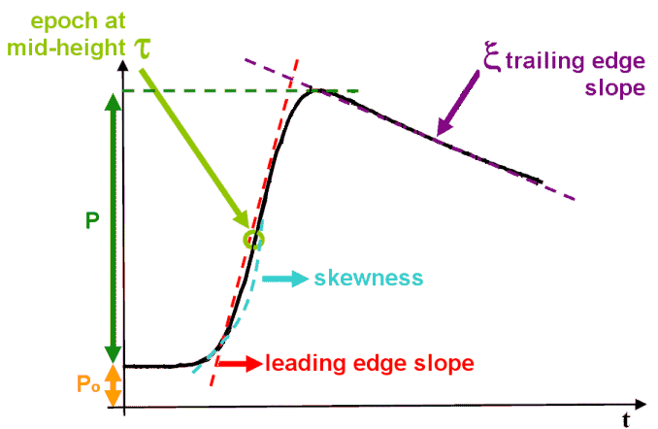
Radar echo over ocean
Theoretical echo over ocean (“Brown model”). Significant wave height is computed from the leading edge slope.

Slide 14
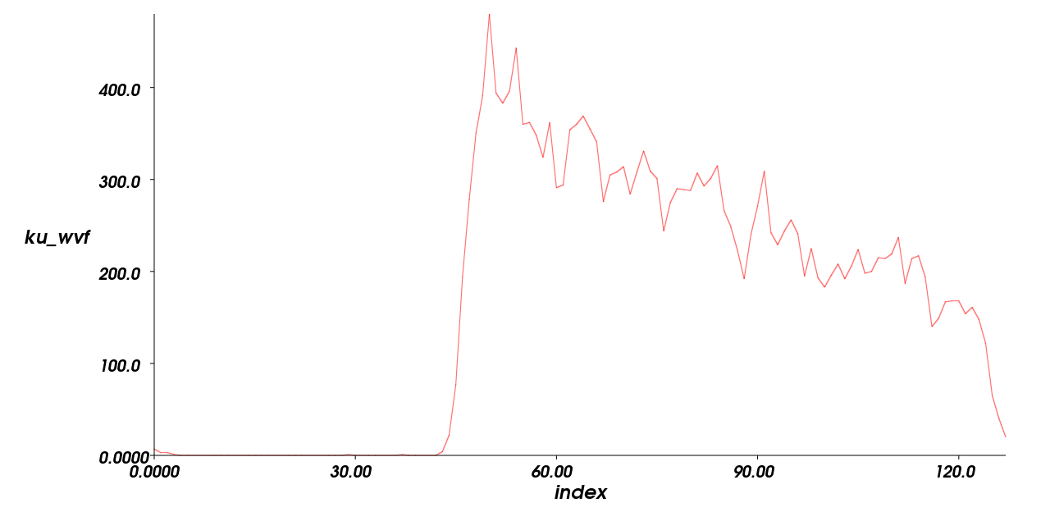
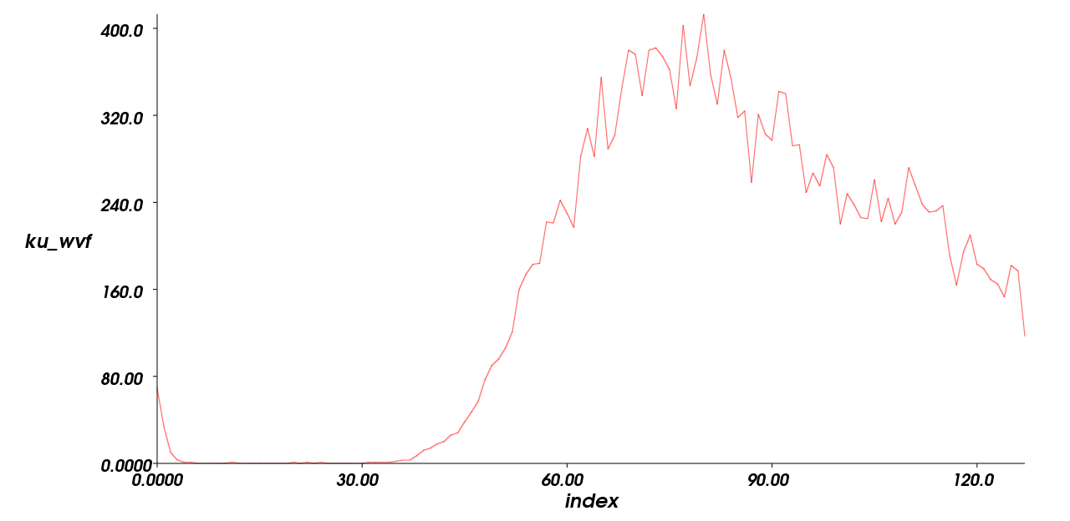
A “real” case
“normal” sea
18-m SWH sea
Two “waveforms” (radar echoes) taken on December 9, 2007 by Envisat. Left outside the storm, right over the worst of the storm over North-East Atlantic

Slide 15
A “real” case
“normal” sea
18-m SWH sea
Two “waveforms” (radar echoes) taken on December 9, 2007 by Envisat. Left outside the storm, right over the worst of the storm over North-East Atlantic

Slide 16
A “real” case
“normal” sea
18-m SWH sea
Two “waveforms” (radar echoes) taken on December 9, 2007 by Envisat. Left outside the storm, right over the worst of the storm over North-East Atlantic

Slide 17
Wind speed: how do we get it from altimetry?
Wind create ripples on the ocean surface. The stronger the wind, the more there are.
Wind speed MODULUS (not direction) is estimated from the backscatter coefficient (or sigma0, σ0, sigma naught)
satellite
The radar wave is reflected in every direction (not especially in the satellite’s)
Less power gets back to the radar, thus the measurement of the power received / emitted enable to estimate wind speed.
Wind

Slide 18
Accuracy
Accuracy of SWH depends on the wave height; the higher the wave, the larger the error on the measurement
Typically
for SWH: 5% or 0.25 m (whichever is greater)
for wind speed: 1.5 m/s (note that some algorithms for some satellites may have threshold effects, so that winds saturate over a certain limit)

Slide 19
What can we do with this?

Slide 20
Applications of Significant wave height measurements from altimetry
Operational measurement of waves? Yes □ No □

Slide 21
Applications of Significant wave height measurements from altimetry
Operational measurement of waves? Well, yes and no:
No: the satellite goes over the same point “only” every cycle (10 days at least, up to 35 days depending on the satellite), so not all the surface of the ocean is covered at all time

Slide 22
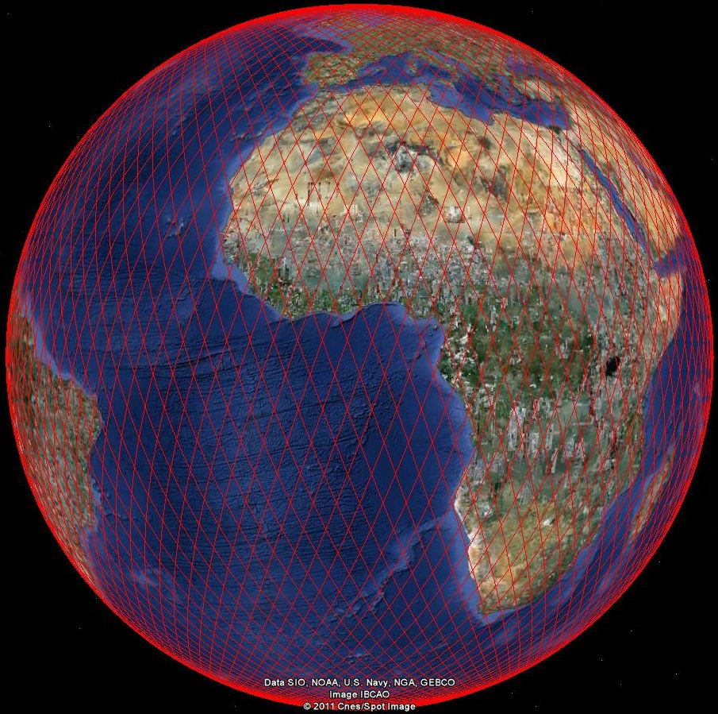
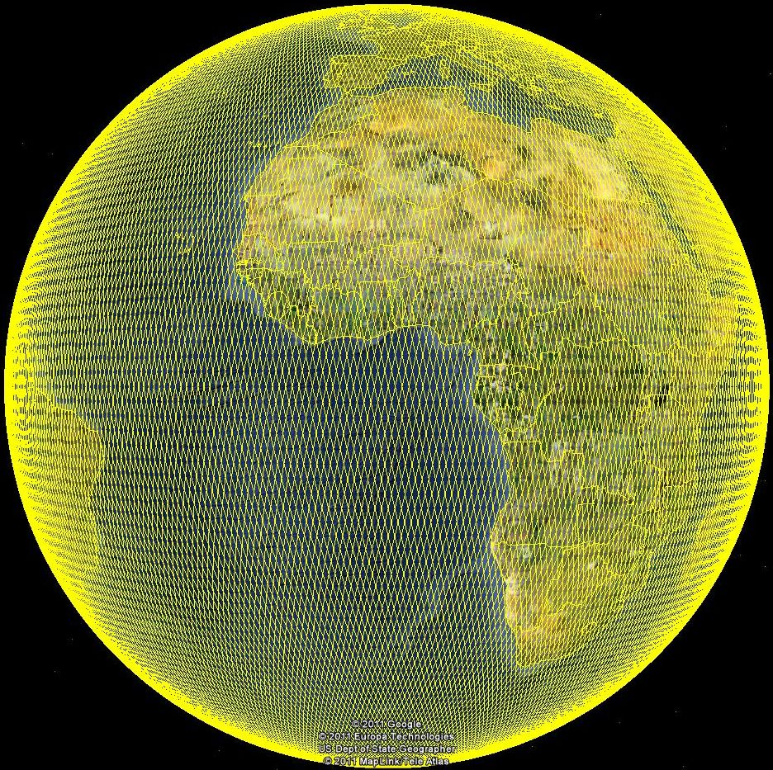
Satellite coverages
T/P and Jason-1 & 2 orbits:
Priority for temporal coverage.
10-day revisit capability (cycle).
Observe large-scale signals.
ERS and Envisat orbits:
Priority for spatial coverage.
35-day revisit capability (cycle).
Observe small-scale signals: eddies.
Jason-2 coverage (for merly Topex/Poseidon and Jason-1) left, Envisat (formerly ERS-1 and 2) right
Notes:
Alternative to previous slide (T/P-Jason orbit through Google Earth).
Cf http://www.aviso.oceanobs.com/en/data/tools/pass-locator/ for Google Earth files

Slide 23
Coverage
One day of measurements taken by 3 satellites (Jason-1, Jason-2, Envisat)

Slide 24
Applications of Significant wave height measurements from altimetry
Operational measurement of waves? Well, yes and no:
No: the satellite goes over the same point “only” every cycle (10 days at least, up to 35 days depending on the satellite), so not all the surface of the ocean is covered at all time
Yes: SWH from altimetry can be assimilated within ocean wave models…
And if a satellite goes over your region of interest in the right time frame, you can have data 2 hours after measurements

Slide 25
Applications of Significant wave height measurements from altimetry
Operational measurement of waves? Well, yes and no:
No: the satellite goes over the same point “only” every cycle (10 days at least, up to 35 days depending on the satellite), so not all the surface of the ocean is covered at all time
The data are available 2 hours after measurements
Yes: SWH from altimetry can be assimilated within ocean wave models…

Slide 26
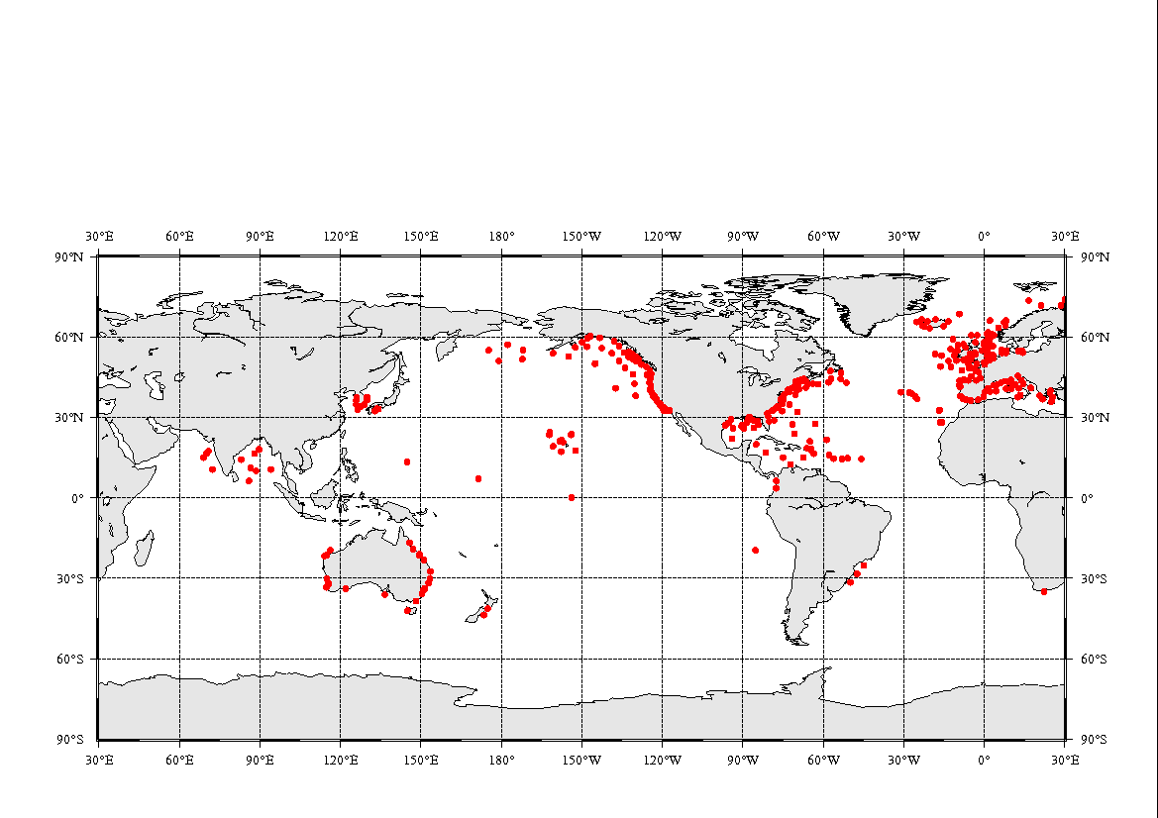
Operational application: wave forecast during a storm
Wave-measuring buoys not present everywhere
while satellites are going all over the globe, continuously, homogeneously (if not measuring the same point at any given time)
Courtesy JM Lefèvre, Météo France

Slide 27
Operational application: wave forecast during a storm
Wave measuring buoys not everywhere on the other hand, satellites measure everywhere
SWH data from altimetry are assimilated in real time in wave models. And those data are also used as validation of wave models, especially where there are no other data
Example: In December 2007, a strong storm hit North-East Atlantic, breaking records – 18 m SWH was forecasted, and measured, by both altimetry and in situ buoys

Slide 28
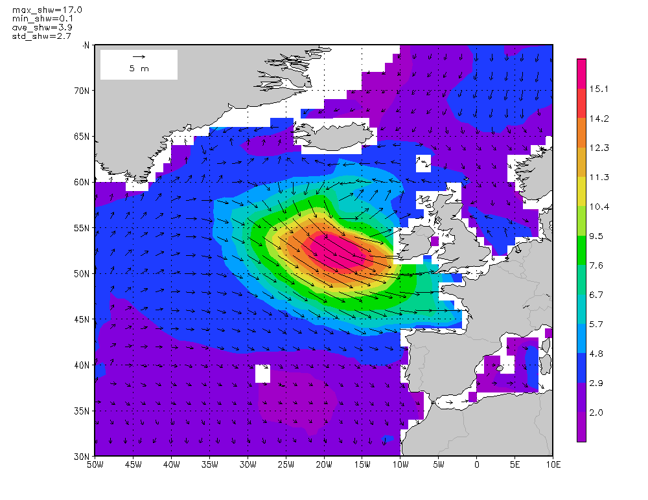
Meteo-France global wave model forecast +72H for 09 Dec 2007 00:00 UTC; Wave direction and Significant Wave Height [m]
Courtesy JM Lefèvre, Météo France

Slide 29
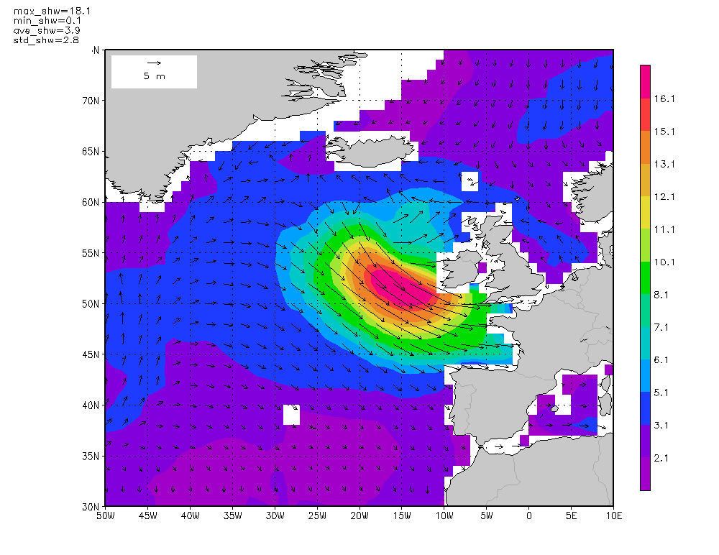
Meteo-France global wave model forecast +78H for 09 Dec 2007 06:00 UTC; Wave direction and Significant Wave Height [m]
Courtesy JM Lefèvre, Météo France

Slide 30
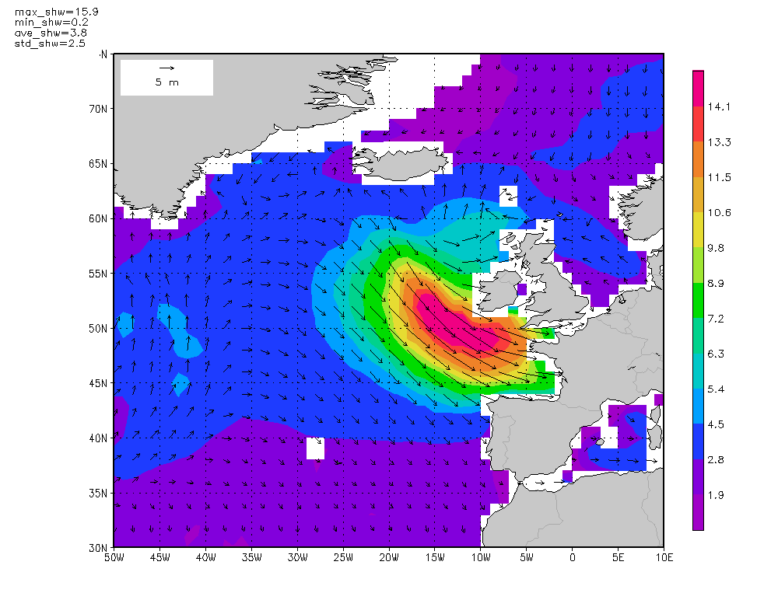
Meteo-France global wave model forecast +84H for 09 Dec 2007 12:00 UTC; Wave direction and Significant Wave Height [m]
Courtesy JM Lefèvre, Météo France

Slide 31
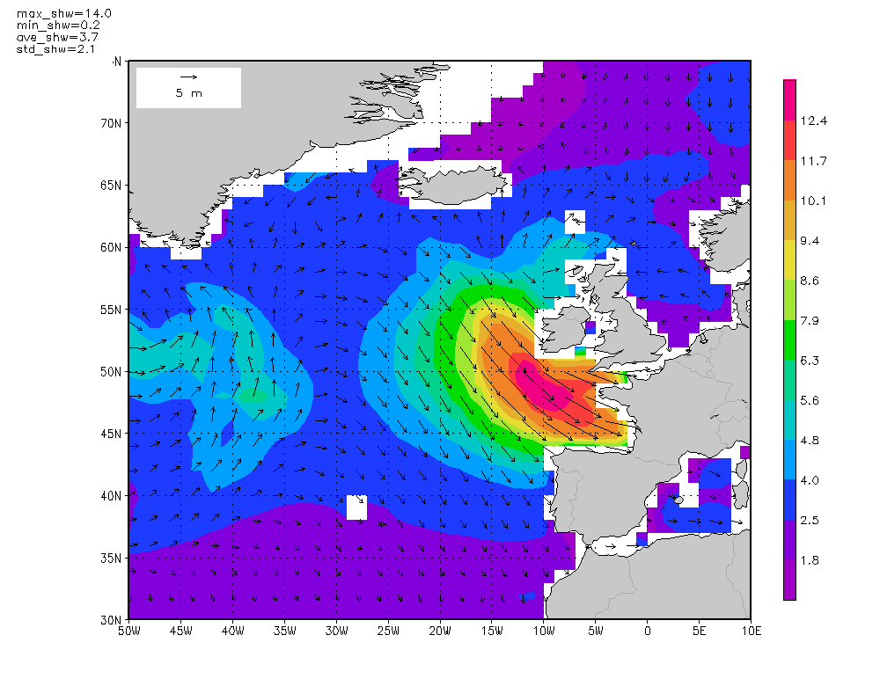
Meteo-France global wave model forecast +90H for 09 Dec 2007 18:00 UTC; Wave direction and Significant Wave Height [m]
Courtesy JM Lefèvre, Météo France

Slide 32
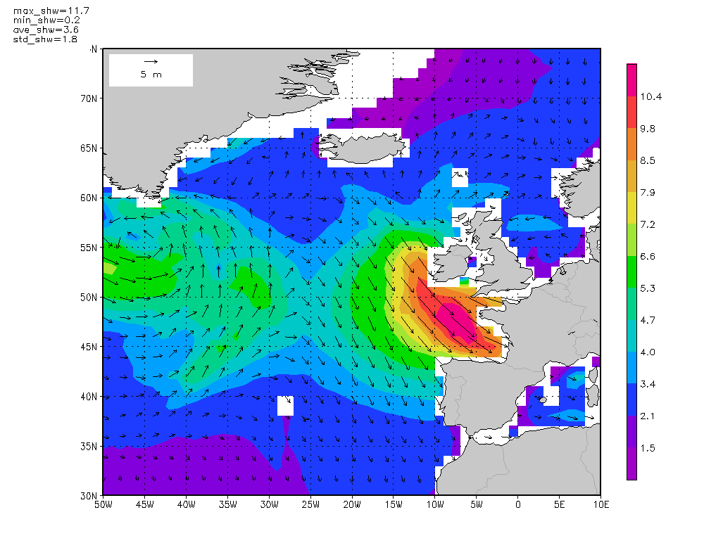
Meteo-France global wave model forecast +96H for 10 Dec 2007 00:00 UTC; Wave direction and Significant Wave Height [m]
Courtesy JM Lefèvre, Météo France

Slide 33
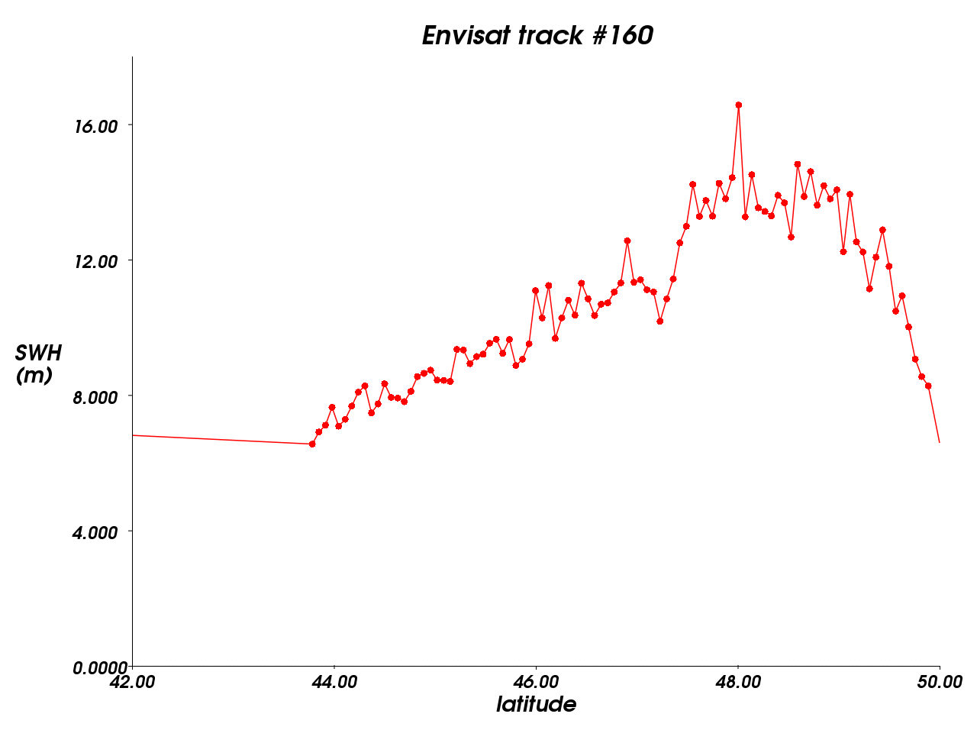
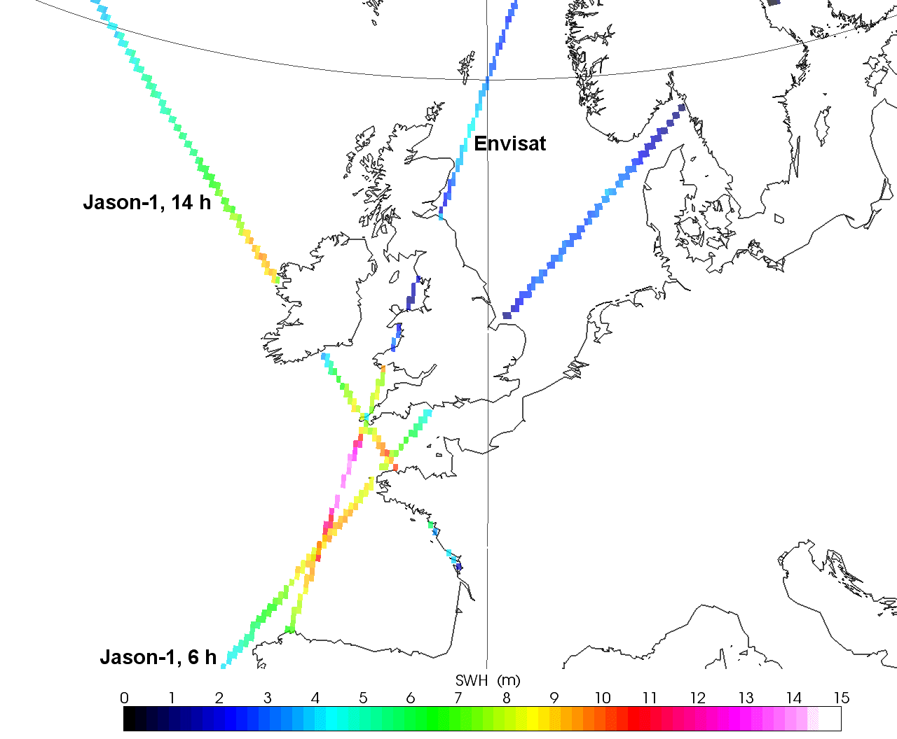
SWH measured by altimeters
09/12 at about 12hTU
http://www.aviso.oceanobs.com
Credits CNES/CLS

Slide 34
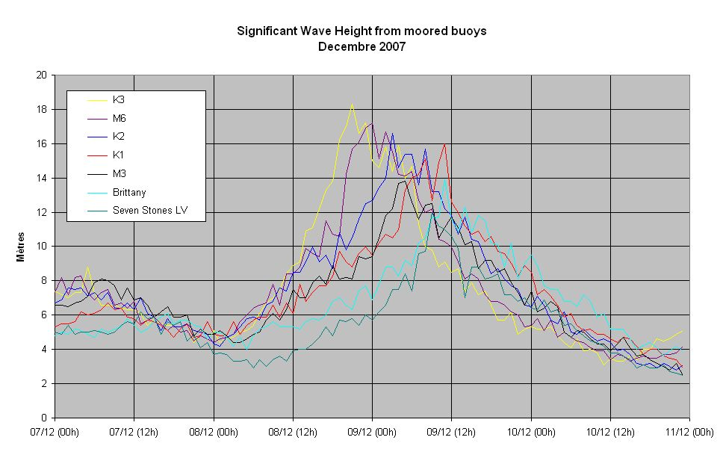

Slide 35
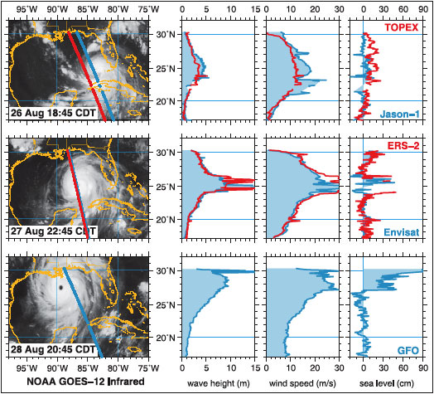
Measurements during a hurricane (Katrina)
10 days for global SWH
Courtesy R. Scharroo, Altimetrics

Slide 36
Climatology
Twenty years of continuous, intercalibrated measurements now available
With synoptics, systematic and global capabilities
Can be used
Research
Knowledge of extreme,
Open ocean conditions to coastal model for infrastructure planning
etc.

Slide 37
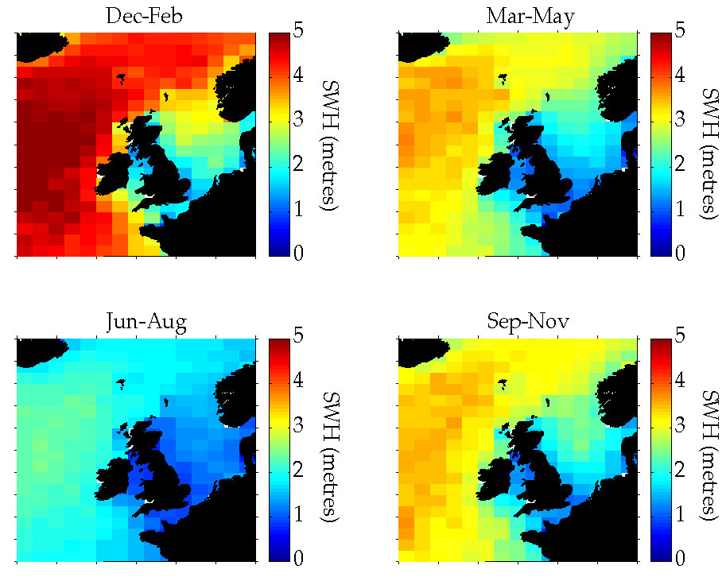
Seasonal means
1993-97 SWH means for different seasons around the British Islands.
Credits NOC

Slide 38
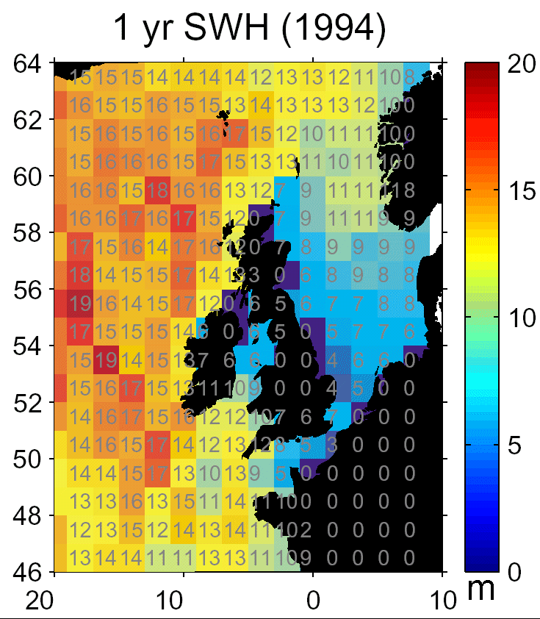
Annual maxima
Maximum wave heights measured by altimetry in 1994
Credits NOC

Slide 39
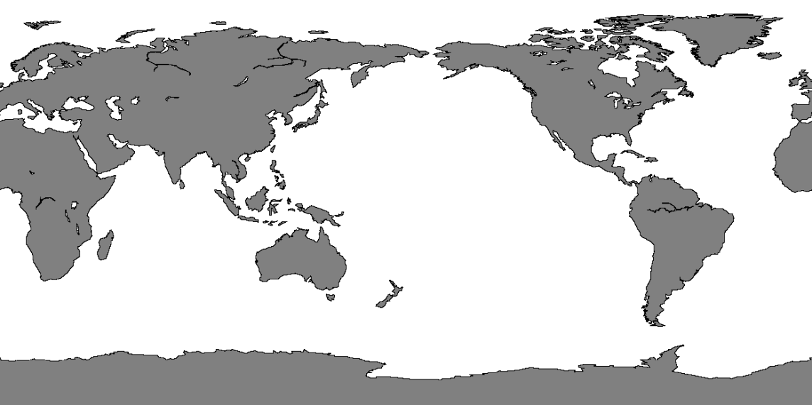
Where can we find the highest waves?

Slide 40
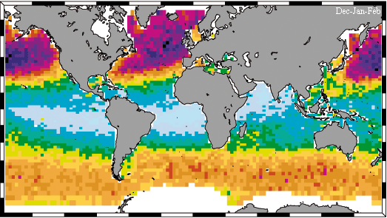
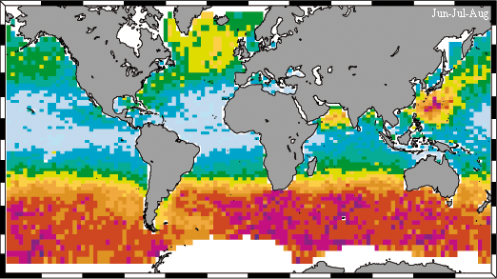
Extreme waves climatology
Extreme wave height statistics for a 20-year return time depending on the season.
Top, Northern hemisphere winter, with the highest waves at about 17 m at high latitude;
in the Southern hemisphere winter (bottom), the equivalent latitudes also show high waves, even if slightly less so.
(Credits IH Cantabria - Universidad de Cantabria)

Slide 41
More information www.aviso.oceanobs.com

