Slide 1
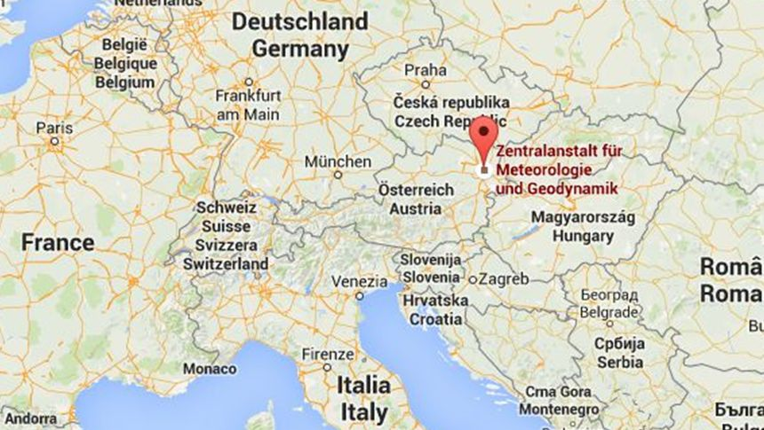
Towards the Standardization of European Weather and Impact Observations
Thomas Krennert, Rainer Kaltenberger, Andreas Schaffhauser
ZAMG Vienna, Austria (t.krennert@zamg.ac.at)

Slide 2
Thunderstorm Forecasting and Warning @ ZAMG
Krennert, Kaltenberger and Schaffhauser, Standardization of Weather- and Impact- Observations
6/3/2019
Ingredients Based
Approach
RADAR
NWP
Satellite
data
IbW
and
Public Perception
Lightning detection
Probabilistic
Forecasts
Radiosondes
Weather Stations
RUC, Blending: INCA
TS Forecast and Warning
Convective Predictors,
Sweet-Spot Estimate
Weather Maps
Frontal Analysis
Verification
Medium and Short Range Forecasts
3 days – 1 day – 12 hrs
Nowcasting and Monitoring
6 h – 1 h – 10 min
North- or South Side of Alps, Provinces and Regions
Advisory
Regions and Communes
Alert

Slide 3
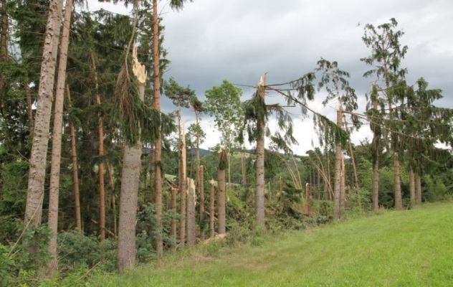
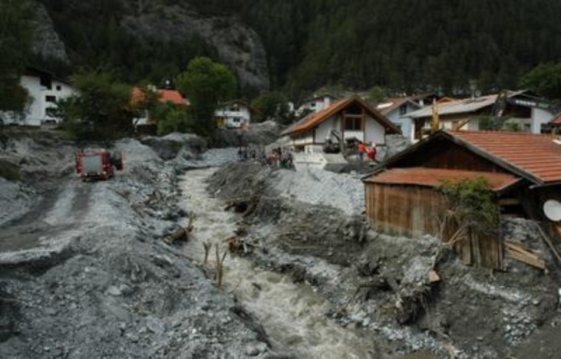
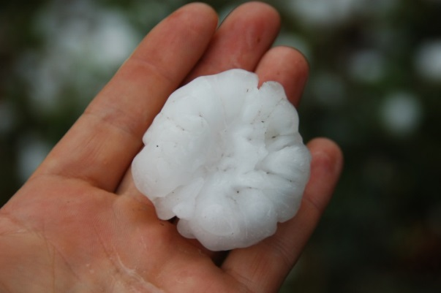
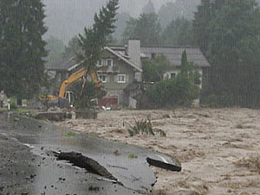
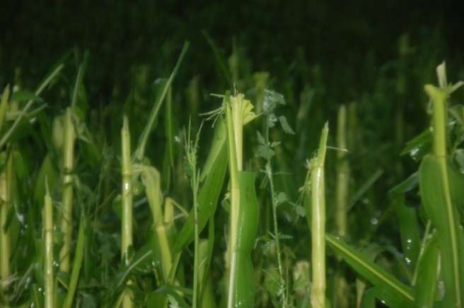
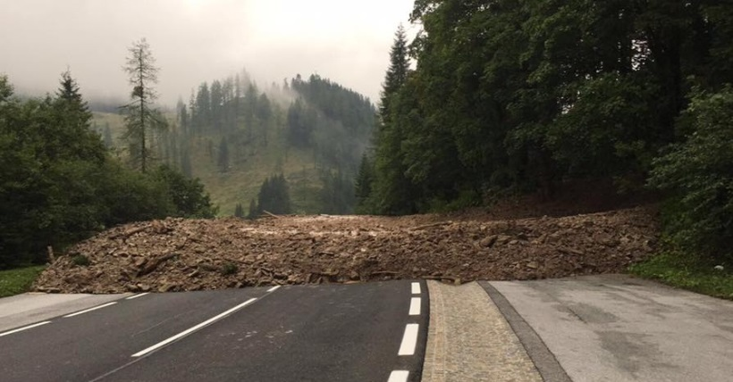
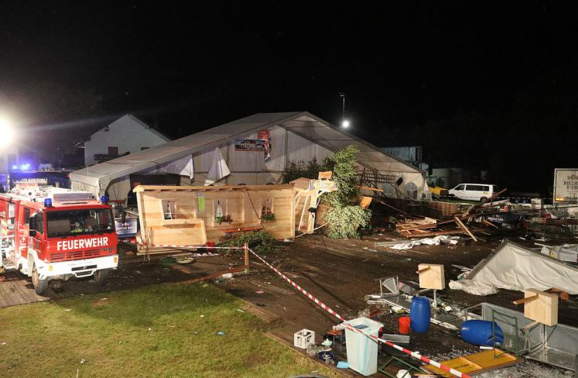
Krennert, Kaltenberger and Schaffhauser, Standardization of Weather- and Impact- Observations
6/3/2019
Reliable Information about Weather Impacts

Slide 4
Krennert, Kaltenberger and Schaffhauser, Standardization of Weather- and Impact- Observations
6/3/2019
Focusing on Human Observations in Crowdsourcing
Crowd-sourced Measurements
Private Stations
Mobile Sensors
IOT - Internet of Things
Data Mining in Social Media
Information Retrieval
Word Crawling
Image Pattern Recognition
Crowd-sourced Human Observations
Reporting tools/apps
Targeted Human Assessment
Standardizations
Collaborations (e.g. spotter groups)
Krennert, T., et al.: Crowdsourcing of weather observations at national meteorological and hydrological services in Europe, Adv. Sci. Res., 15, 71–76, https://doi.org/10.5194/asr-15-71-2018, 2018.

Slide 5
Krennert, Kaltenberger and Schaffhauser, Standardization of Weather- and Impact- Observations
6/3/2019
Standardization of Weather- and Impact Observations
Standardization of human weather and impact observations is obligatory:
Standardized real time observations enable instantaneous feedback loop
Forecasters to see „what‘s happening out there“ (ground truth)
Instantaneous verification and adaptation of impact based warnings
Further applications
Impact modeling
Input data for severe weather- and damage databases (e.g. ESWD)
Climatological analysis
NWP assimilation
Reporting Parameters
Training
Quality Control
Data Exchange Protocolls

Slide 6
Krennert, Kaltenberger and Schaffhauser, Standardization of Weather- and Impact- Observations
6/3/2019
Survey among European NMHSs Forecast Offices 2018
Carried out in EUMETNET EMMA/Meteoalarm program in autumn 2018
Response (up to date): 29/37 (78%), full results to be published 2019
Excerpt:
“I see crowdsourced weather- and impact observations as (multiple answers possible)”:
· Important, because they have the potential to close the gap of “ground truth”: 90%
· Important due to the decreasing number of weather observations: 45%
· Important for the verification of impact-oriented-/impact-based warnings: 76%
· Important for forecasters to have them available in real-time
“to see what’s actually happening out there”: 97%
Kaltenberger, R., Schaffhauser, A., Staudinger, M.:
Status of Implementation of Impact-oriented Warnings in Europe.
Oral presentation at EMS-ECAC conference on 3rd September 2018.

Slide 7
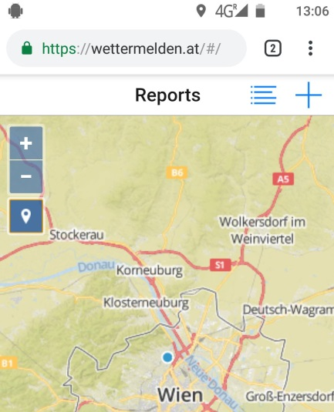
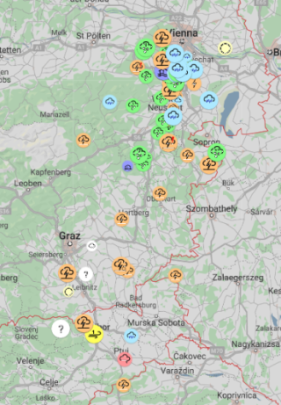
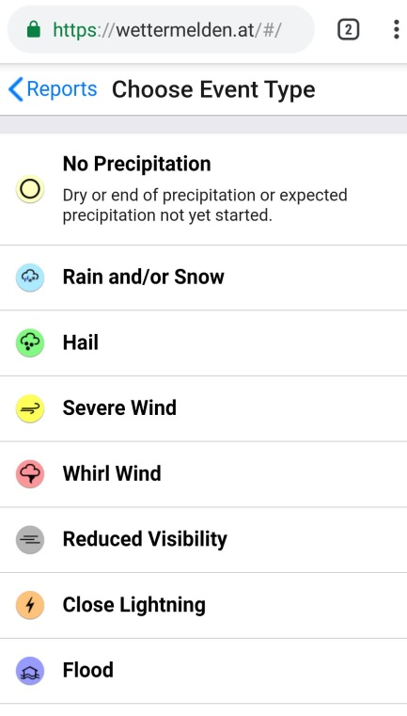
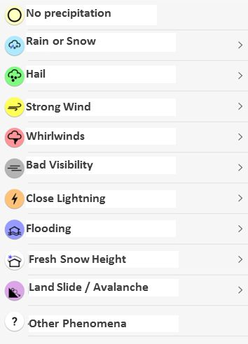
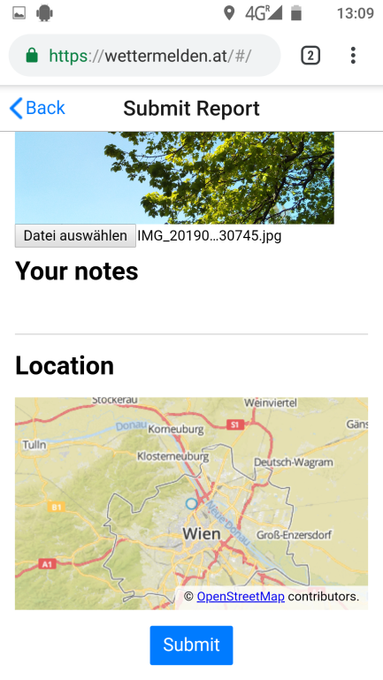
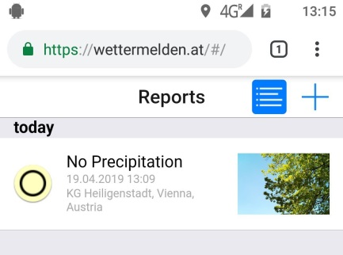
Krennert, Kaltenberger and Schaffhauser, Standardization of Weather- and Impact- Observations
6/3/2019
Reporting Parameters of “wettermelden.at”
Reporting parameters are equivalent to European EWOB native app from ESSL
Austrian “WOB” operational from second half of 2019 as Web App
Screenshot from ESSL EWOB native App, 2 May 2018

Slide 8
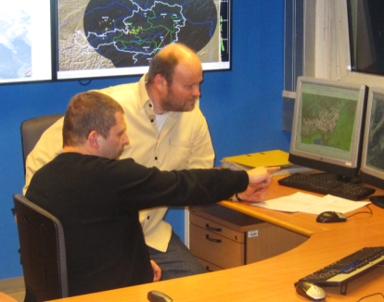
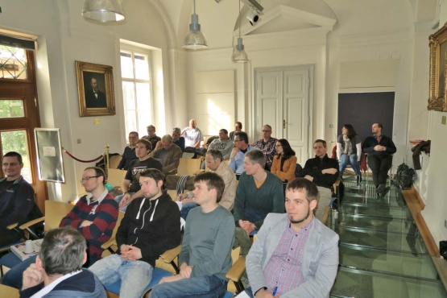
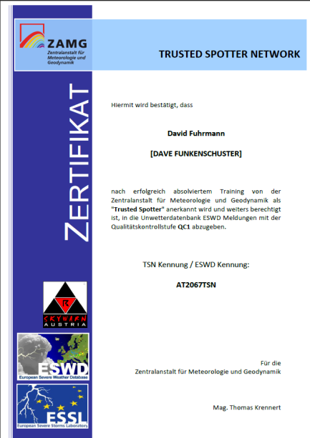
Krennert, Kaltenberger and Schaffhauser, Standardization of Weather- and Impact- Observations
6/3/2019
Training and Quality Management
Training
Quality Management
Without Training
Reliability Level 0
Basic online Training
Reliability Level 1
certified
Advanced Training
Reliability Level 2
certified
Automated image quality scan by
Neuronal Network
Rated best practice by the EMS

Slide 9
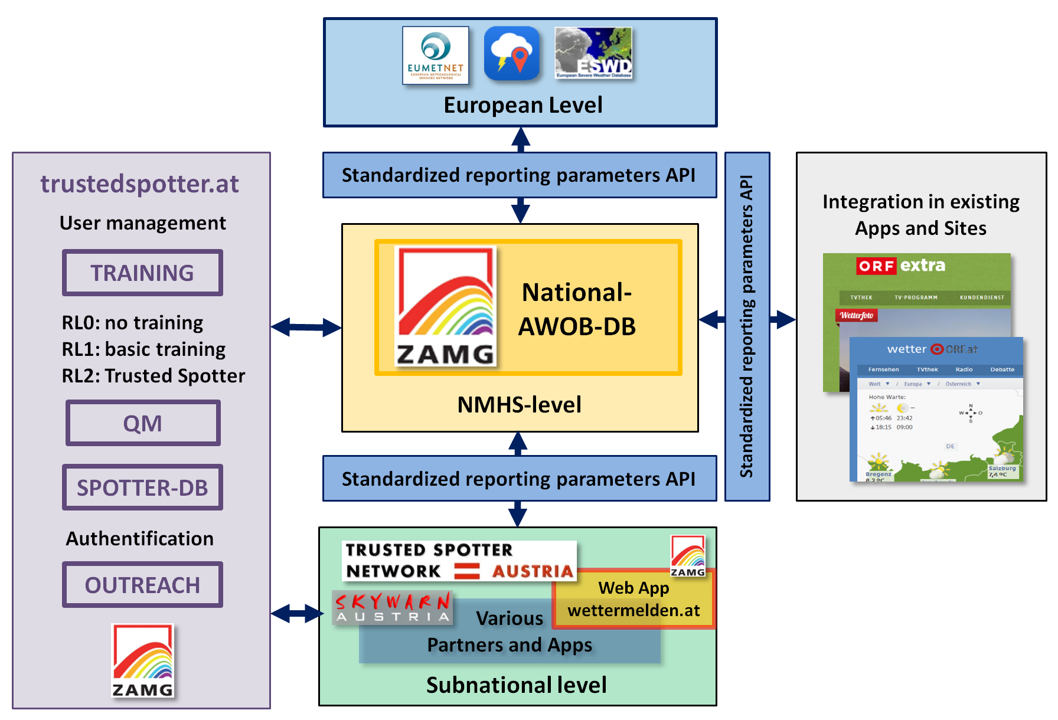
Krennert, Kaltenberger and Schaffhauser, Standardization of Weather- and Impact- Observations
6/3/2019
National Level: The Austrian Weather OBserver AWOB
IbW / IbF
Feedback Loop
Notes:
Explaining schematic of the Austrian Weather and Impact Observation System AWOB

Slide 10
Krennert, Kaltenberger and Schaffhauser, Standardization of Weather- and Impact- Observations
6/3/2019
Scalability: Standardized Data Exchange on all levels
European level
Standardized reporting parameters API
NMHS-level
…
Other National-
EWOB-DB
National-
EWOB-DB
National-
EWOB-DB
National-
EWOB-DB
Standardized reporting parameters API
Subnational level
Standardized API between all partners
NMHSs provide API to subnational collaborators
API can be easily implemented in existing web pages and apps

Slide 11
Krennert, Kaltenberger and Schaffhauser, Standardization of Weather- and Impact- Observations
6/3/2019
Real Time Data Exchange via MQTT Protocol
European level
Standardized reporting parameters API
NMHS-level
Other National-
EWOB-DB
National-
EWOB-DB
National-
EWOB-DB
National-
EWOB-DB
Push
and
Pull
Standardized reporting parameters API
Subnational level
Real time data exchange via usage of MQTT protocol
Exchange of weather and impact observations between European Level and NMHSs
Cross-border high impact events!

Slide 12
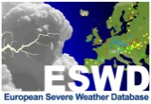
Krennert, Kaltenberger and Schaffhauser, Standardization of Weather- and Impact- Observations
6/3/2019
Activities at the European Level
ESWD-DB
Scientific community
EU - EWOB-DB
Standardized reporting parameters API
NMHS-level
Subnational level
Definition of new set of reporting parameters (version 1807) by DHMZ, FMI, KNMI, ESSL and ZAMG and other ESSL collaborators (i.e. European spotter groups)
Efforts to form an European WOB – consortium (proposal)
Ongoing activities within the framework of EUMETNET Crowdsourcing Community
to standardize human weather- and impact observations

Slide 13
Krennert, Kaltenberger and Schaffhauser, Standardization of Weather- and Impact- Observations
6/3/2019
Highlights
Establishing standardization of human assessed weather- and impact observations
European NMHSs operate national databases of observations
Participating NMHSs join a “WOB” consortium (proposal)
Consortium meetings on scientific and technical standards
(e.g. parameter list, API specifications)
Real time data exchange as prerequisite for instantaneous feedback loop (IbW / IbF)
Standardized APIs between all levels, integration in existing apps
Due to scalability of software ZAMG is able to offer web services for:
National user management and training
National observations databases and QC/QM
Maintenance of APIs
No competition to existing crowdsourcing consortia
--> Invitation to join “WOB” consortium!

