Slide 1
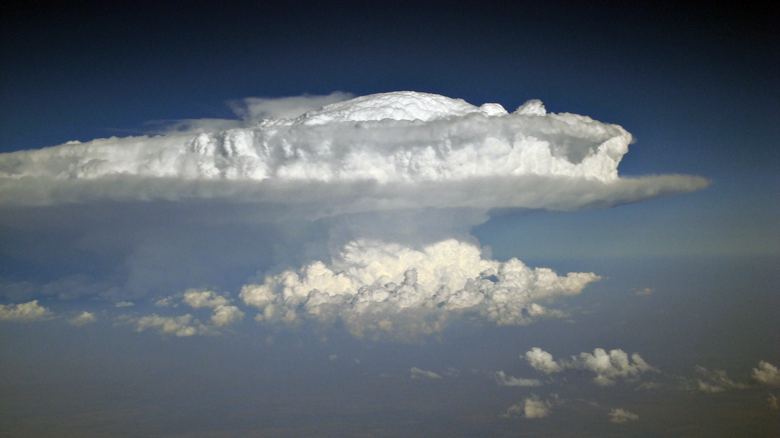
Above Anvil Cirrus Plumes atop major European hailstorms of 2018
SW Germany
28 July 2013
Tomáš Púčik, European Severe Storms Laboratory, tomas.pucik@essl.org
photo: Dejan Primorac
photo: Daniel Eggert

Slide 2

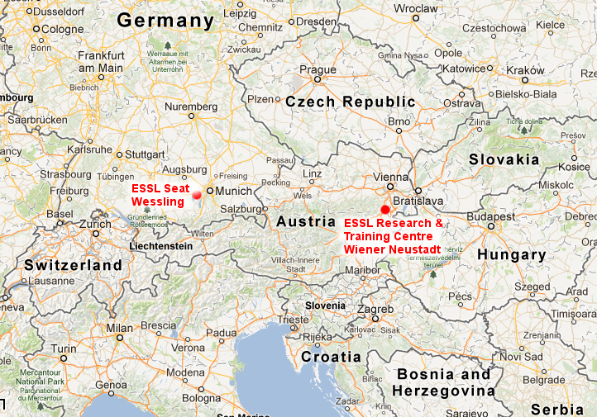
A little bit about me
PhD in Physical Geography
Forecaster at CHMI and SHMI
Researcher and trainer at the ESSL
SW Germany
28 July 2013
photo: Dejan Primorac
photo: Daniel Eggert

Slide 3
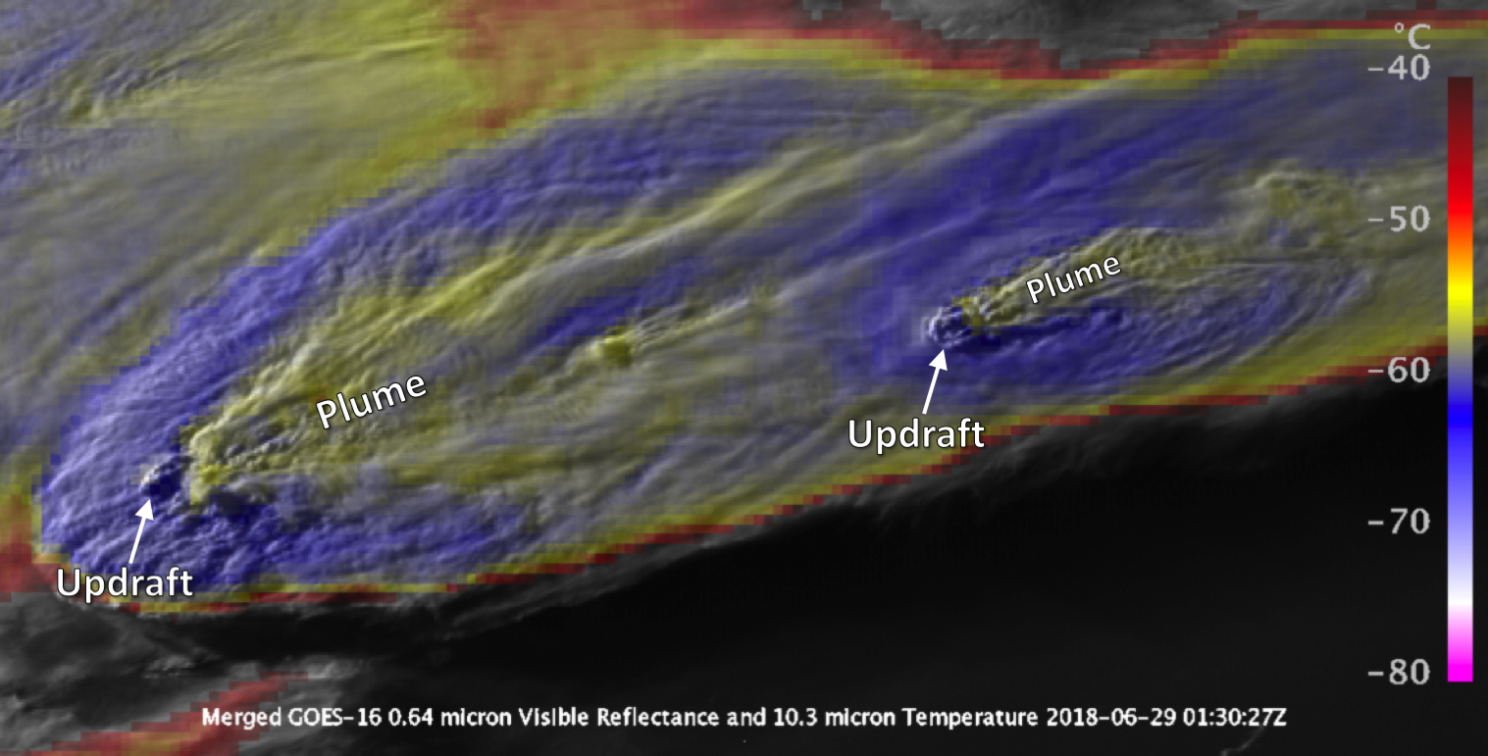
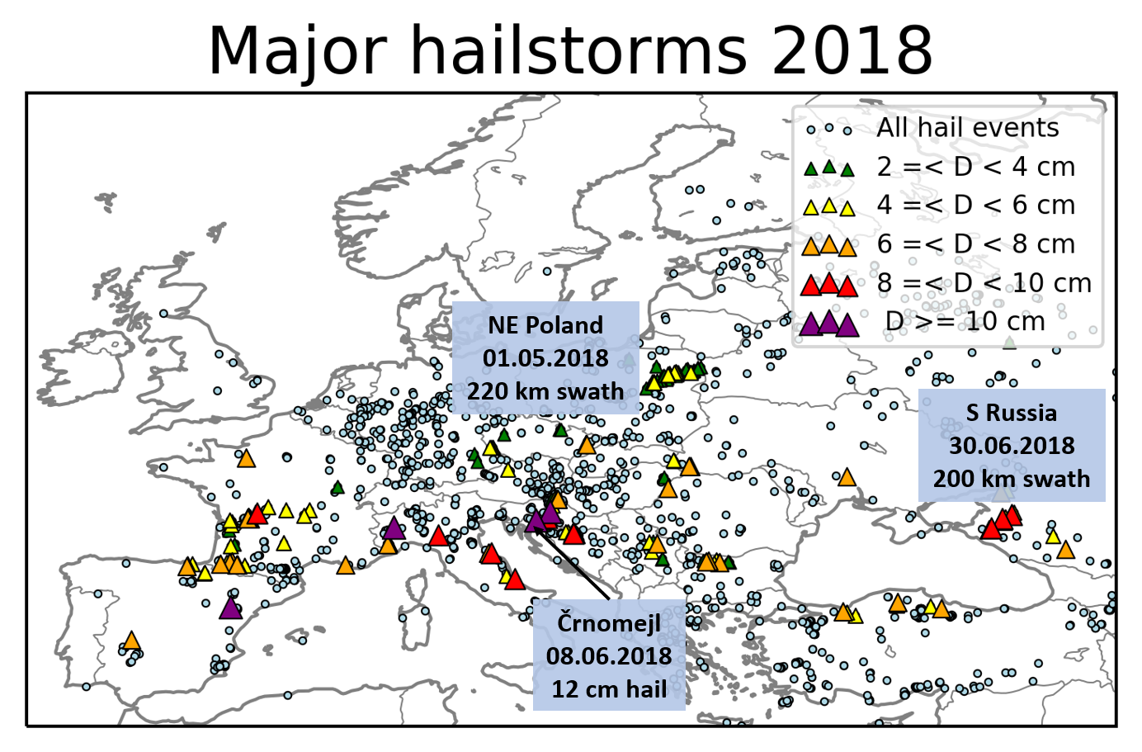
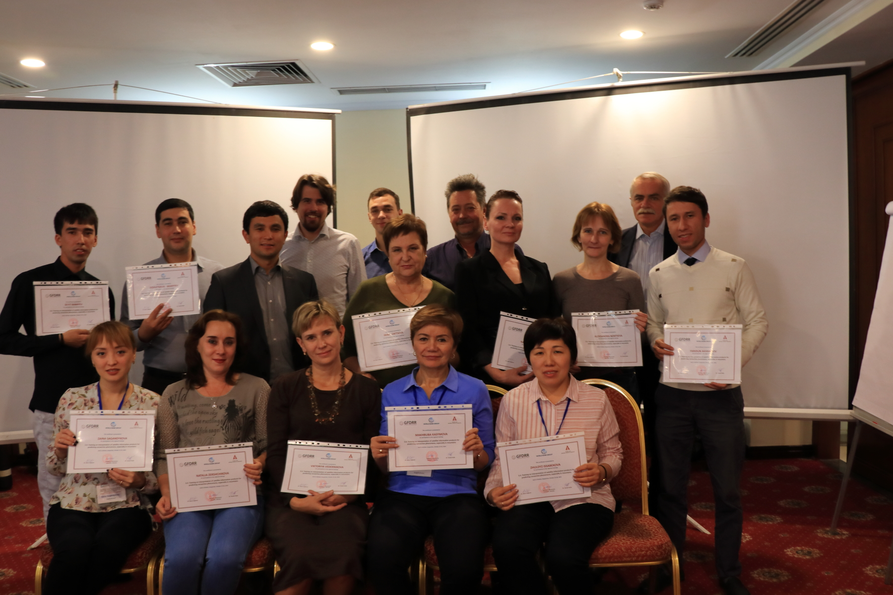
Motivation behind this presentation
SW Germany
28 July 2013
photo: Dejan Primorac
photo: Daniel Eggert

Slide 4
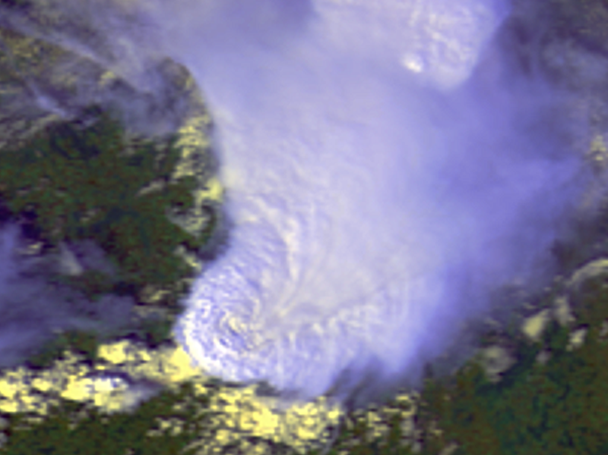
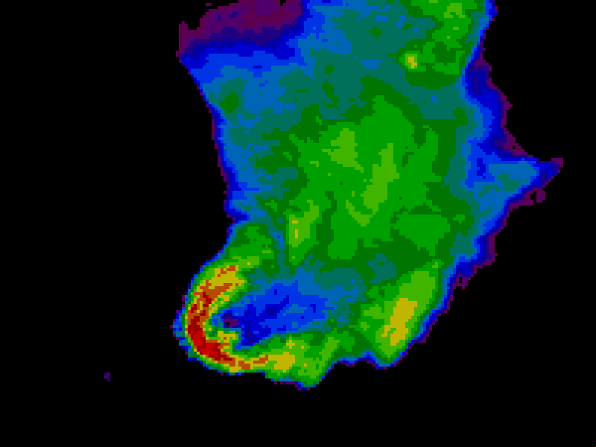
Above Anvil Cirrus Plumes
Research began in 1980s with the advances in the satellite meteorology
Courtesy of Martin Setvak
photo: Dejan Primorac
photo: Daniel Eggert

Slide 5
Above Anvil Cirrus Plumes
18 August 1986: Hailstorm over the Czech Republic with hail up to 12 cm in diameter
Plume
Cold-U/V with embedded warm area
Courtesy of Martin Setvak
photo: Dejan Primorac
photo: Daniel Eggert

Slide 6
Above Anvil Cirrus Plumes
Plume corresponds to the warm area downwind of the overshooting top
https://www.dropbox.com/s/g4njbren1ahgvep/Poster.pdf?dl=0
photo: Dejan Primorac
photo: Daniel Eggert

Slide 7
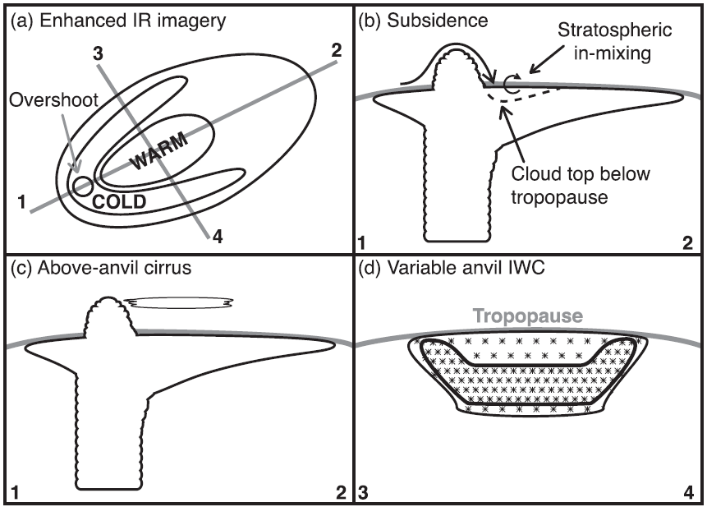
Above Anvil Cirrus Plumes versus Cold-U/V
Homeyer
(2014)

Slide 8
Spot the plume!

Slide 9
Spot the plume!
Above Anvil Cirrus Plume

Slide 10
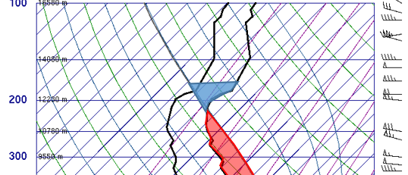
Reason for embedded warm area
Above Anvil Cirrus Plume
temperature of the OT
temperature of the Plume

Slide 11
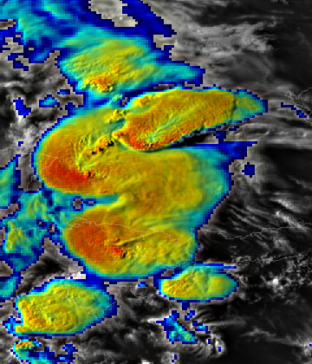
Spot the plume!
Courtesy of Martin Setvak

Slide 12
Spot the plume!
Plume 1
Plume 2
Plume 3
Courtesy of Martin Setvak

Slide 13
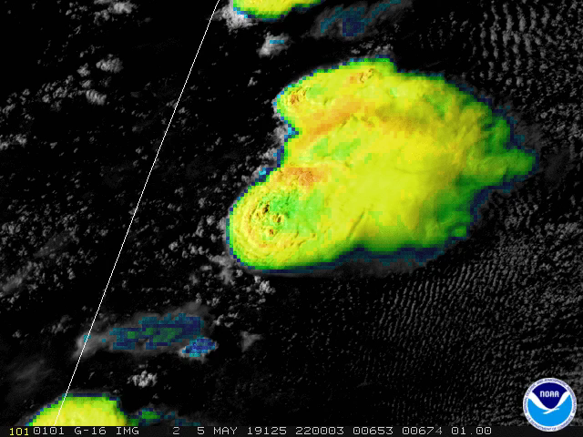
Spot the plume!
Animation source: Dan Lindsey

Slide 14
What matters most for plume production?
Temperature stratification above the tropopause
Relative humidity at the tropopause
Strength of storm-relative winds at the anvil level
Duration of the overshooting into the stratosphere

Slide 15
What matters most for plume production?
Temperature stratification above the tropopause
Relative humidity at the tropopause
Strength of storm-relative winds at the anvil level
Duration of the overshooting into the stratosphere

Slide 16
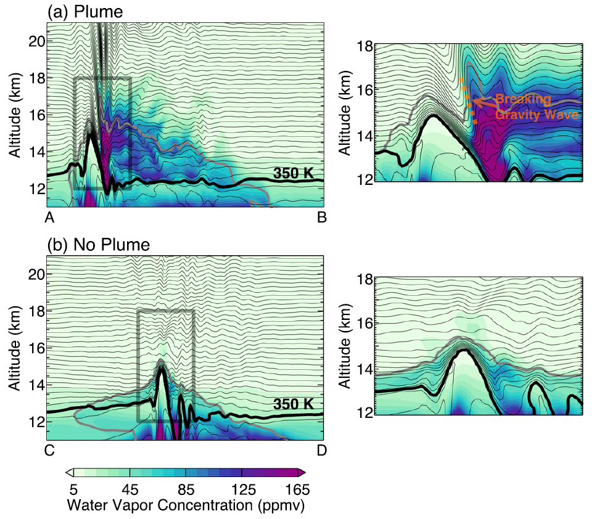
What matters most for plume production?
Strong relative
wind
Weak relative
wind
Homeyer et al. (2017)

Slide 17
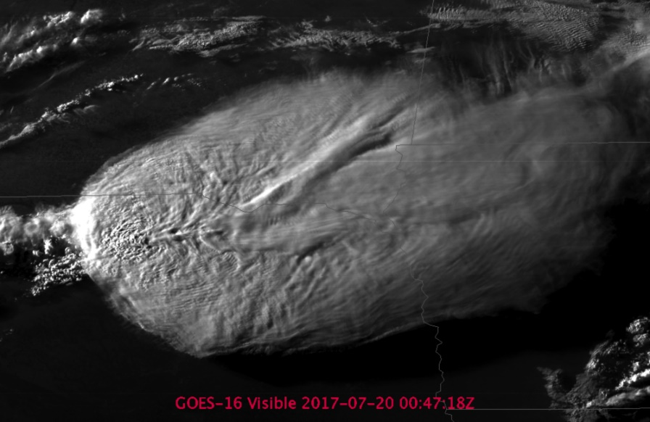
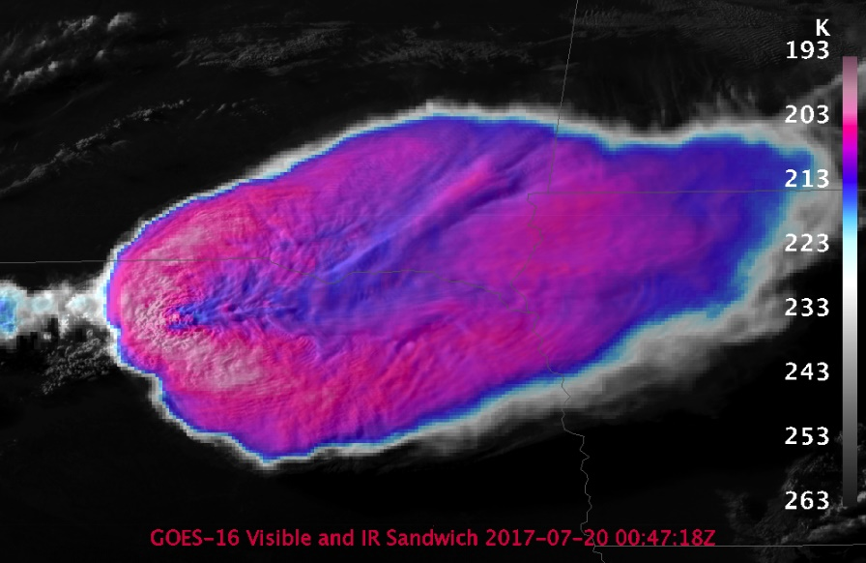
Plumes in action
Bedka et al. (2018): „Plume“ producing storms produce 14 times more severe weather than storms without plumes
59% of storms with plumes were severe
75% of supercells produced plumes

Slide 18
Plumes in action
Bedka et al. (2018): Relation between plumes and severe weather is strongest for large hail.
The first indication of the plume precede the severe weather by 30 minutes.

Slide 19
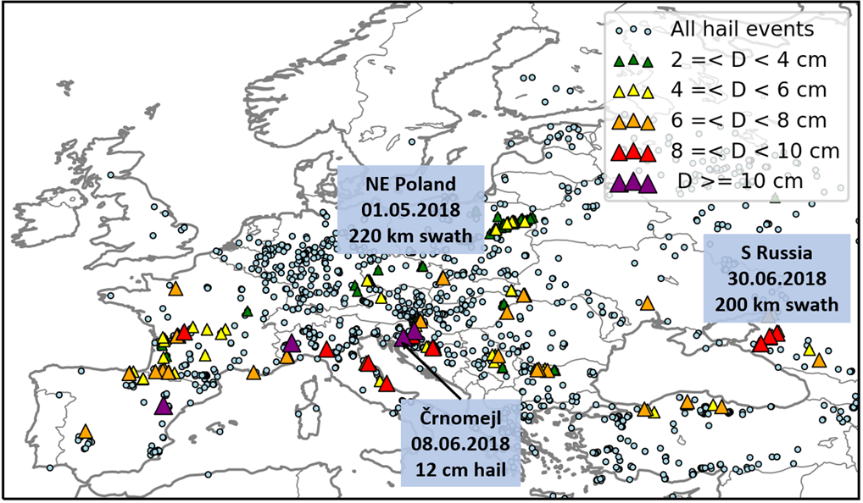
Major hailstorms of 2018
26 days with very large, 5+ cm, hail
https://www.essl.org/cms/major-hailstorms-of-2018-across-europe/

Slide 20
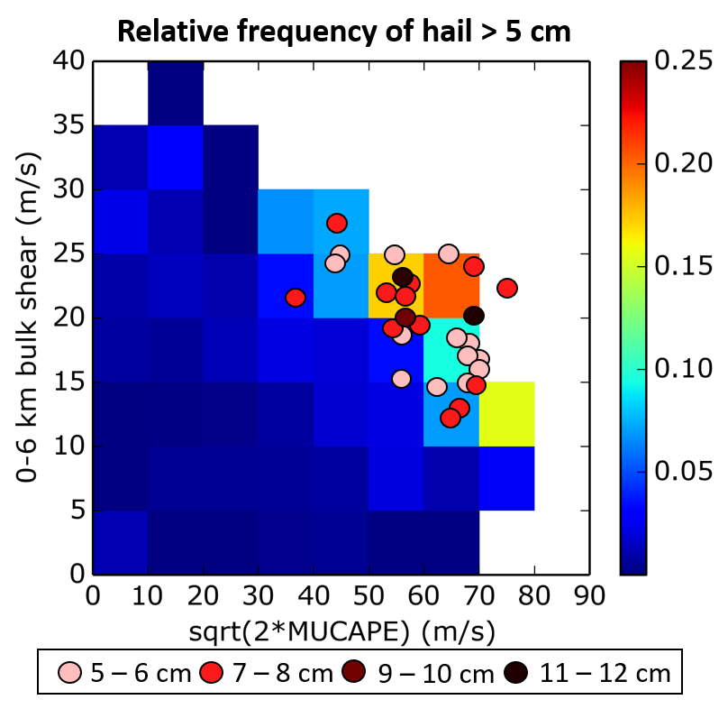
Major hailstorms of 2018
Prevalence of high CAPE and strong vertical wind shear
Based on Púčik et al. (2015)
https://www.essl.org/cms/major-hailstorms-of-2018-across-europe/

Slide 21
Research questions
1. Did the investigated hailstorms produce plumes?
2. If yes, how much lead time was there between the plume and the first hail report?

Slide 22
Data used
Visible and infrared imagery from Meteosat 10, Rapid Scan mode
Hail reports based on the European Severe Weather Database

Slide 23
Hailstorms studied in total
29
storms

Slide 24
Plumes identified in
25/29
86.2% of hailstorms

Slide 25
Plumes identified using visible imagery in
12/25
48% of hailstorms with plumes

Slide 26
Plumes identified using infrared imagery in
25/25
100% of hailstorms with plumes

Slide 27
On average, plume in infrared imagery occurred sooner than in the visible imagery by
37
minutes

Slide 28
Only in
2
cases
was the plume apparent sooner in the visible imagery

Slide 29
On average, the lead time of the plume to the first 2 cm hail report was
-6.4
minutes

Slide 30
On average, the lead time of the plume to the first 5 cm hail report was
8
minutes

Slide 31
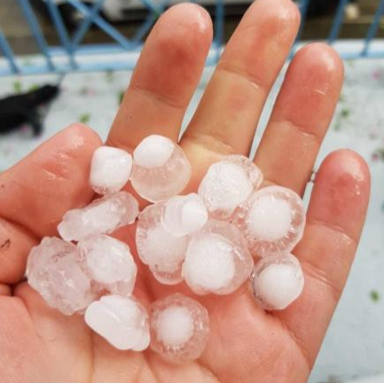
Lead time to the first 2+ cm hail report
-180
-120
-60
0 (min)
60
120
180
Plume occuring later than the hail report
13/25 = 52% of cases
Plume occuring earlier than the hail report
12/25 = 48% of cases

Slide 32
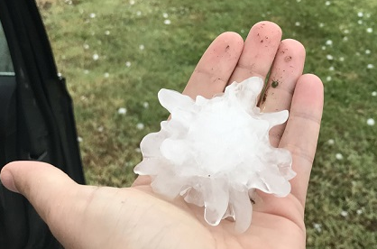
Lead time to the first 5+ cm hail report
-180
-120
-60
0 (min)
60
120
180
Plume occuring later than the hail report
11/25 = 44% of cases
Plume occuring earlier than the hail report
14/25 = 56% of cases

Slide 33
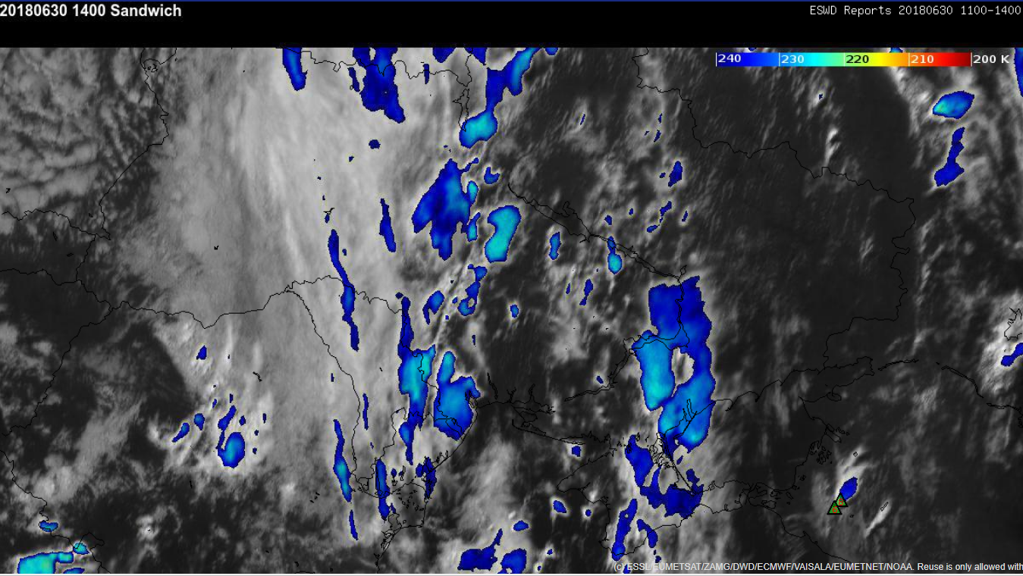
A tale of one russian hailstorm…

Slide 34
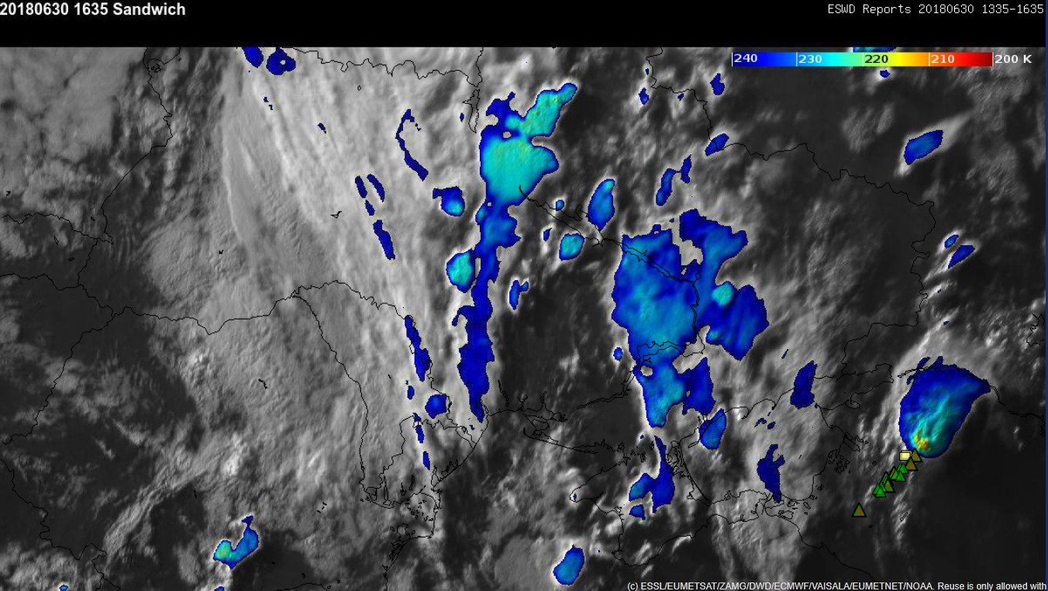
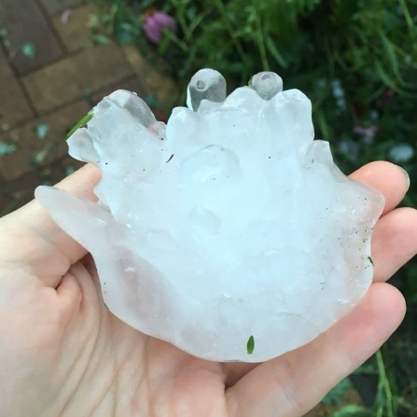
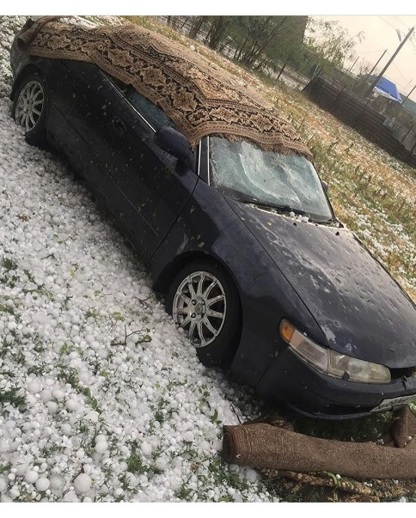
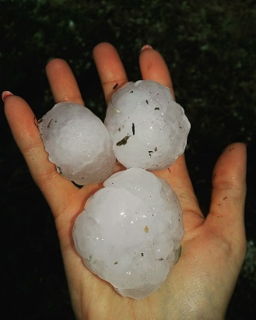
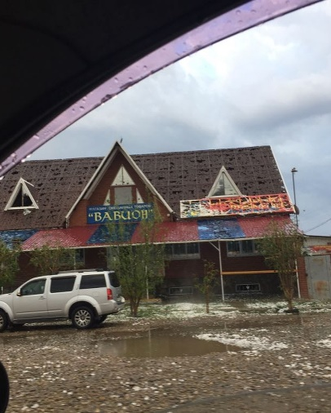
A tale of one russian hailstorm…

Slide 35
Limitations
Small sample of storms
ESWD accurracy
Spatial and temporal resolution of satellite data
Considerable subjectivity in plume detection

Slide 36
Answers to research questions
Did the investigated hailstorms produce plumes?
Most of them (86.2%) did, detectable mostly in the infrared imagery.
2. If yes, how much lead time was there between the plume and the first hail report?
Lead time was very variable, on average negative for the first 2 cm and positive for the first 5 cm hail report.

Slide 37
Further questions to ask
How would plumes compare to other types of severe weather?
Given that plume is detected, what is the probability of severe weather?

Slide 38
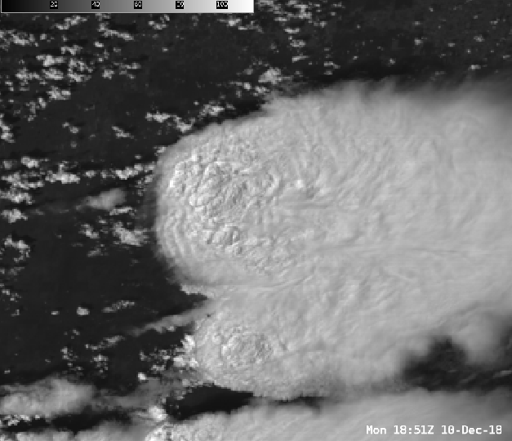
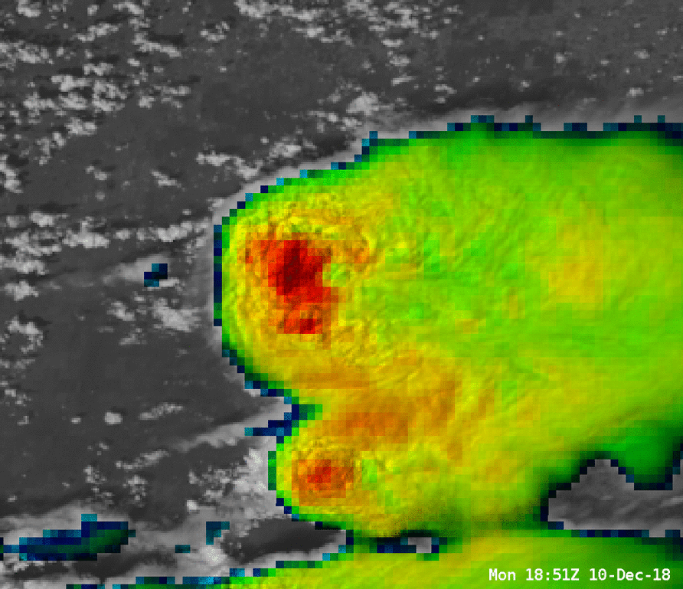
What future holds for plume detection?
https://satelliteliaisonblog.com

