Slide 1
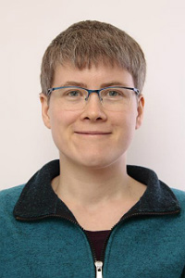
PPSv2018 introduction and scientific updates.
Nina Håkansson, Sara Hörnquist, Anke Thoss, Ronald Scheirer, Adam Dybbroe, Karl-Göran Karlsson

Slide 2
Content
About the software
Introduction to the products
Scientific news in v2018
I use PPS
I do not use PPS yet

Slide 3
PPS v2018
I have used PPS v2014
Software for cloud and precipitation products
Developed by NWCSAF
Polar orbiting satellites
Instruments (v2018)
AVHRR
VIIRS
MODIS

Slide 4
Products
Cloud mask
Cloud Probability (new)
Cloud Type
CTTH
Cloud Top Temperature, Pressure and Height
Precipitating clouds
Cloud Physical Properties

Slide 5
Cloud Mask (CMA)
Cloud mask
Binary cloud mask
Extended product:
Cloud filled
Cloud contaminated
Cloud free snow/ice
Cloud free
Uses Thresholding:
If features are not within what is reasonable for clear conditions it is a cloud. (simplified)
I will be using the cloud mask

Slide 6
Cloud Mask (CMA)
Separate quality png
Indicating pixels with low quality
In product (nc) file quality information is in flag cma_quality flag
Allows users to filter data.

Slide 7
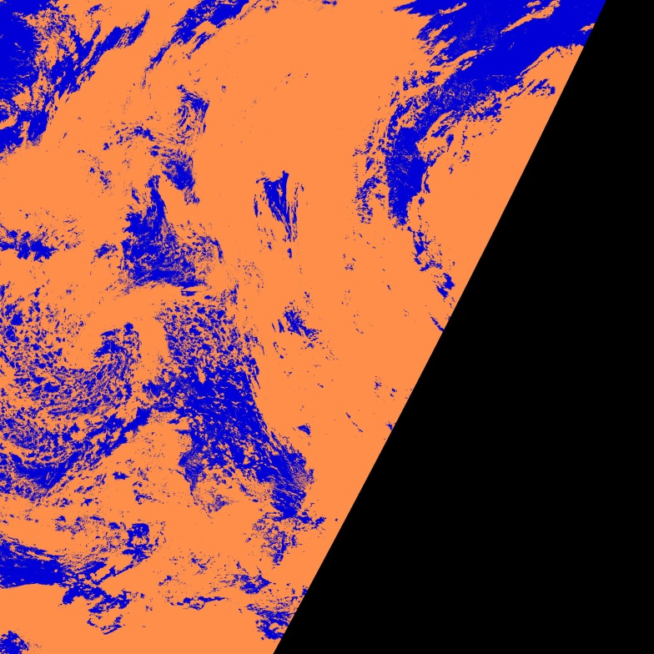
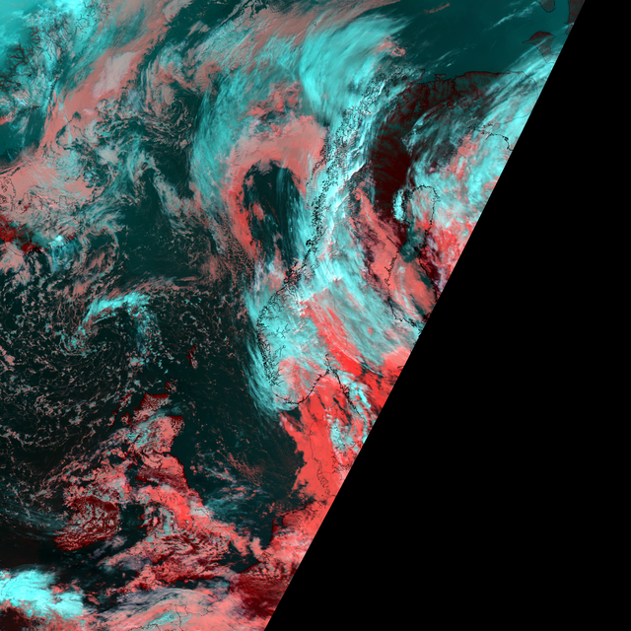
CMA News v2018
Thresholds updated to RTTOV12
Harmonized:
Test order
Cloudfilled / cloud contaminated
Increased POD cloudy
Slightly increased FAR
Slightly better Hitrate
Similar Kuipers Skill Score
V2018
RGB

Slide 8
Cloud probabilities
Developed by CMSAF
Gives probability of cloud for each pixel.
Can be used as input to CTTH and CPP
Minimum cloudy probability limit is configurable.
SM_CMAPROB_CLOUD_THRESHOLD

Slide 9
Original CMaprob slides from: Karl-Göran Karlsson
CMaprob in PPS 2018: Probabilistic cloud masks - Motivation
Goal:
Complement CMA with a cloud mask expressed as cloud probabilities
Reason:
Provide uncertainty in cloud masking
Flexible use of the cloud mask
Examples of applications:
Clear-conservative (SST/LST retrievals),
climate-optimised (CM SAF Climate Data Records)
cloud-conservative (cloud property retrievals)

Slide 10
Cmaprob method
Simplified Bayesian theory (Naïve Bayesian)
The equation gives the probability that it is cloudy given an image feature vector F. The result is calculated as a product of the probabilities given by individual image features.
Individual feature probabilities are calculated from 10 years of collocated global AVHRR and CALIPSO-CALIOP observations

Slide 11
Special features of the CMaprob method
Cloud probabilities can never be the same over surfaces with very different characteristics (e.g. bright vs dark, cold vs warm, day vs night, etc.) ➔ Probabilities are calculated differently for several surface categories and for day and night!
To account for viewing angle dependencies and atmospheric conditions, several image features are constructed as differences from PPS pre-calculated thresholds (already accounting for these dependencies)

Slide 12
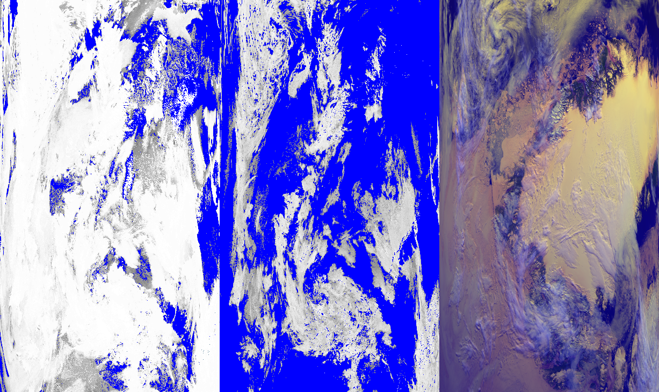
Demonstration of the use of different training statistics (from filtered CALIOP cloud masks) over different surfaces
Clear water training
Snow cover land training
RGB
(0.6, 0.9, 11 µm)
Merged final product

Slide 13
The meaning of resulting probabilities
The default version of CMaprob is tuned so that a 50 % threshold gives a globally optimized cloud mask.
Which clouds are detected varies with surface. Very thin cirrus is not possible to detect over very cold or very bright surfaces.
Best conditions are found over High Latitude Ocean surfaces where clouds with optical thicknesses down to 0.05 can be detected at the 50 % probability level

Slide 14
Cloud probabilities validation
15 orbits NPP-data is used.
 | POD cloudy | POD clear
CMA | 88 | 83
CMAPROB-10 | 91 | 73
CMAPROB-50 | 82 | 89
CMAPROB-90 | 80 | 91

Slide 15
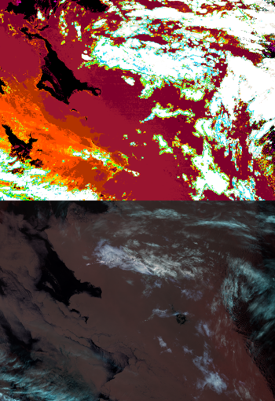
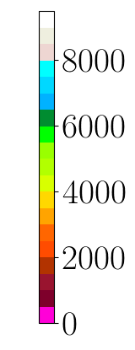
Cloud Top Temperatur and Height
Temperature
Height
Pressure
Input one of:
CMA
Cloud Probability
Uses NWP-data
Height

Slide 16
CTTH major development in last releases
RGB
v2012
v2014
v2018

Slide 17
CTTH news in v2018
Algorithm replaced with neural network trained approach.
Significantly improved results!
Mean absolute error is reduced ~40%.
I note results look good also compared to MODIS-C6

Slide 18
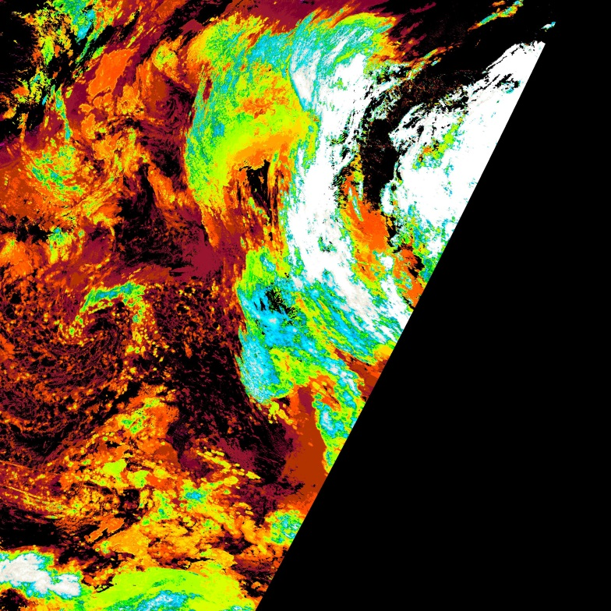
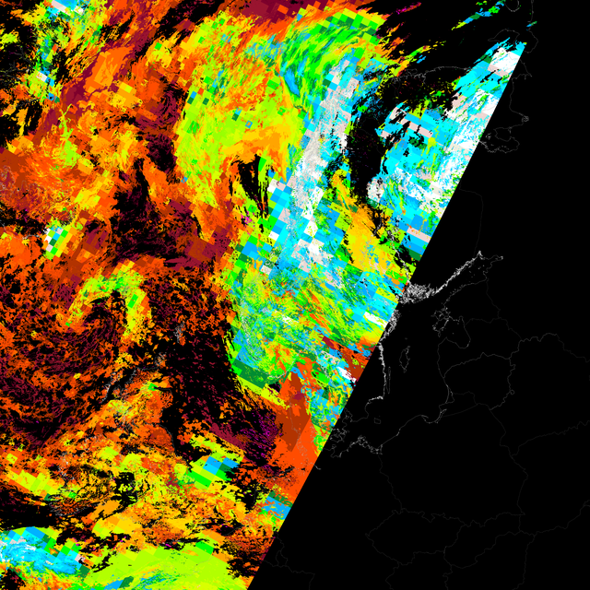
CTTH news in v2018
High clouds is placed higher.
Height of cloud edges/subpixel cloudiness improved
V2018
V2014

Slide 19
NPP example 1
v2018
RGB
v2014
In the upper right corner I see that low and high clouds are better separated in version 2018.

Slide 20
Example NPP 2
v2018
RGB
v2014
In version 2018 low clouds are placed lower.
In version 2018 the larger segment size for semi-transparent clouds is no longer needed.
Less large squares with same height.

Slide 21
CTTH method documented in article
http://www.atmos-meas-tech.net/11/3177/2018/amt-11-3177-2018.html
I will check this out

Slide 22
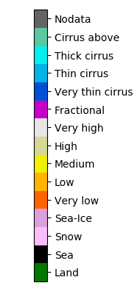
Cloud Type (CT)
Gives cloud type in 14 classes
I will be using the CT product

Slide 23
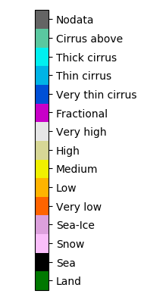
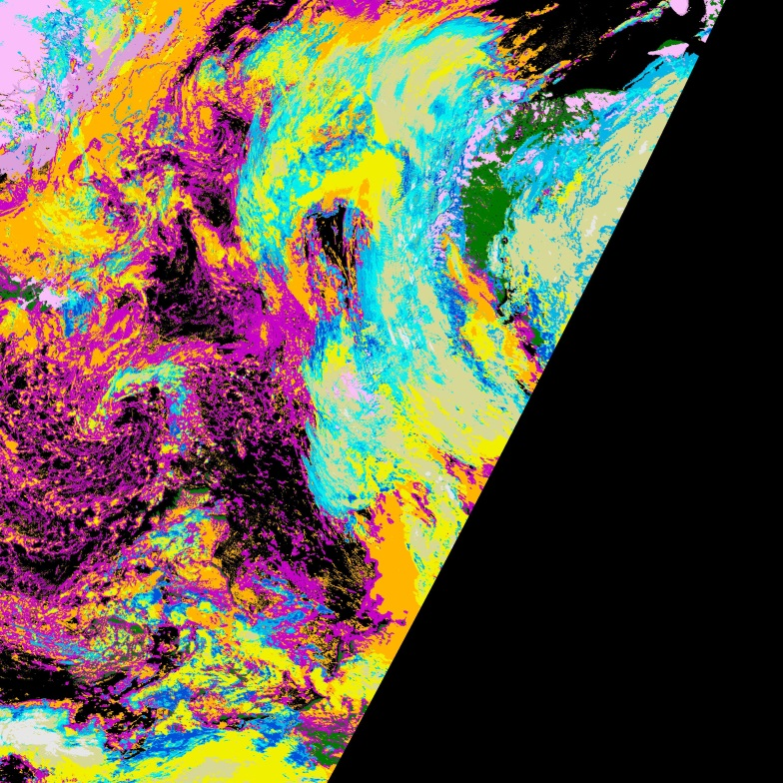
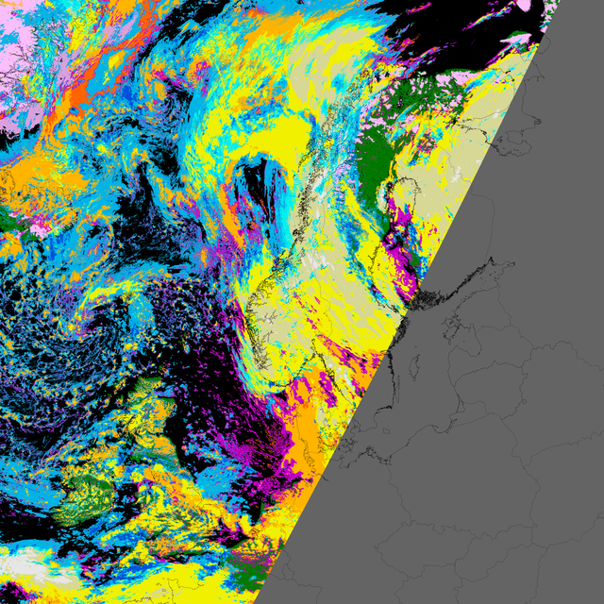
CT news in v2018
Uses CTTH as input
Very Low clouds defined as:
Clouds within 500m from ground
Better separates fractional from cirrus.
V2018
I notice large areas with fractional clouds (purple) in v2018 that was classed cirrus (blue) in v2014.
V2014

Slide 24
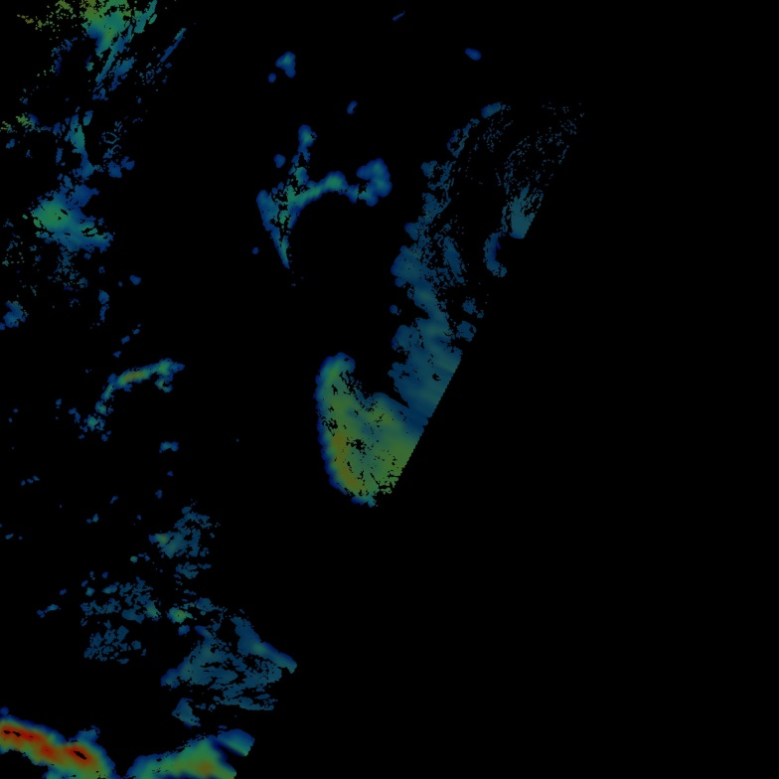
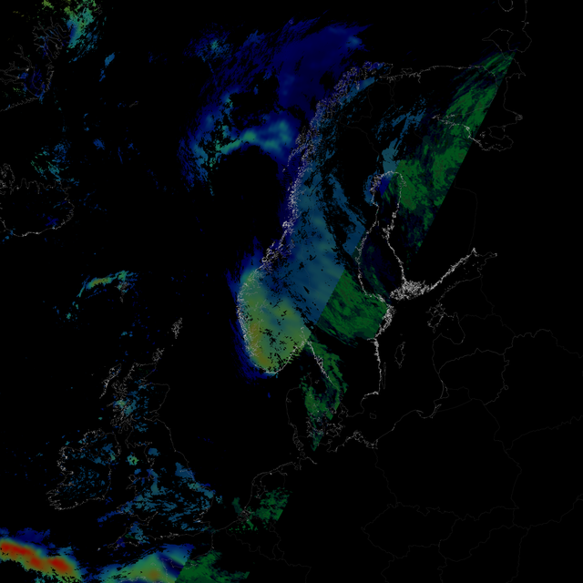
Precipitating clouds
Only technical updates from v2014 and forward
In version 2018 nodata if no AMSU-data.
Largest difference between the two versions.
Some differences due to updates in CT (CTTH as input)
V2018
V2014

Slide 25
Cloud microphysical properties (CPP)
Developed by KNMI
Validated products:
Cloud Phase
Liquid water path
Extra products:
Effective Radius
Ice water path
Cloud water path
Cloud optical thickness
Cloud water Paths

Slide 26
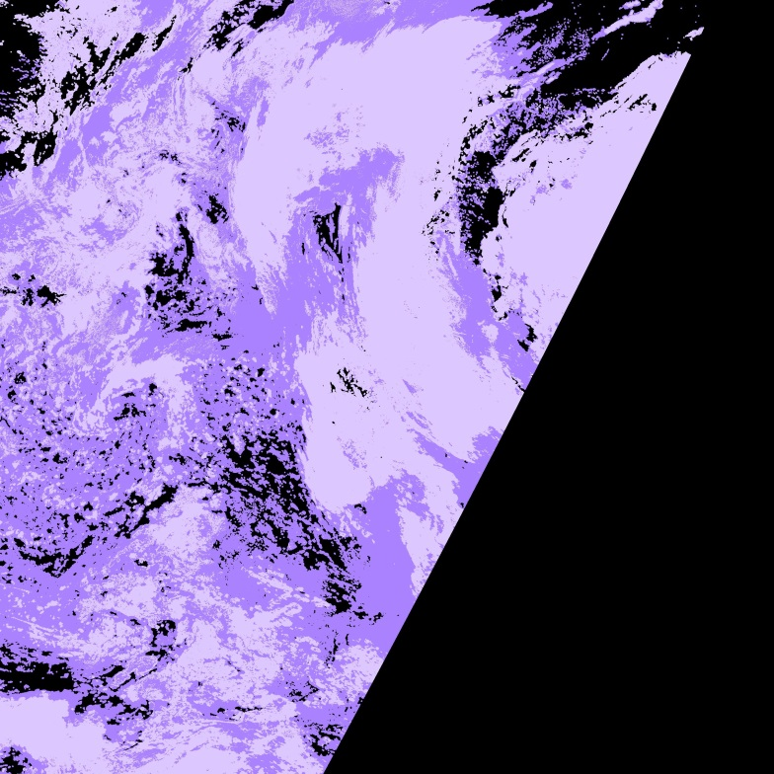
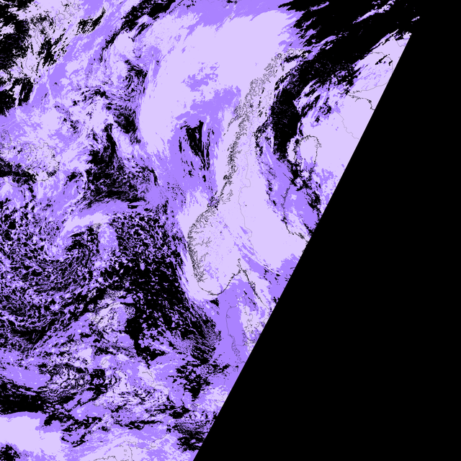
CPP news v2018
Also benefits from improved CTTH
If configured to use CTTH as input!
Most changes visible is due to changed CMA.
V2018
V2014

Slide 27
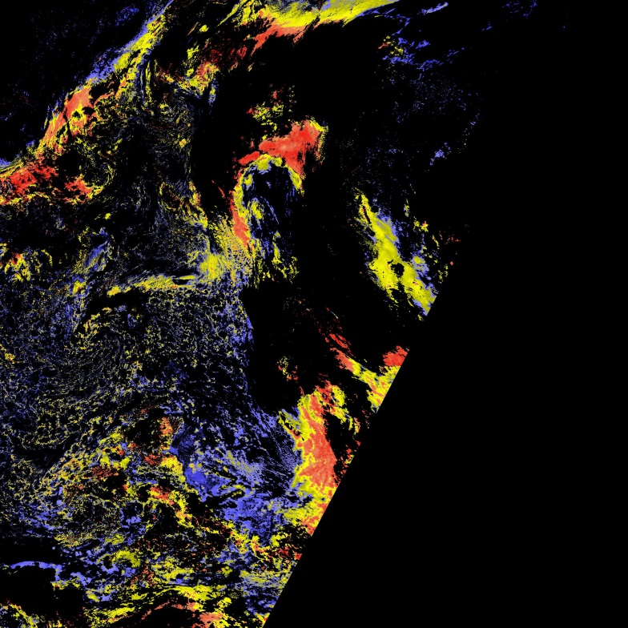
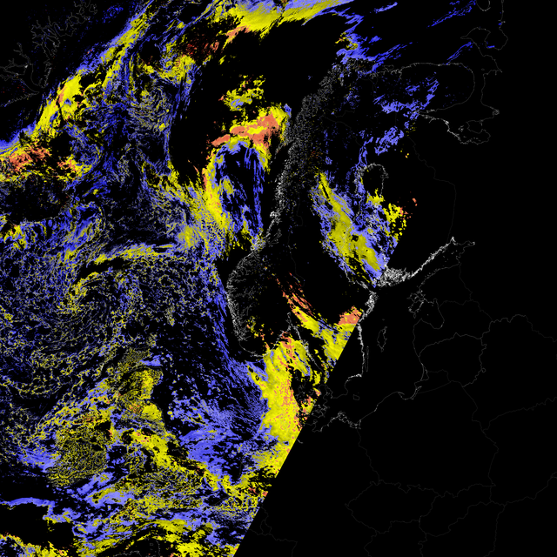
CPP news v2018
LWP
Changed to use 3.7 instead of 1.6 when both are available.
Patch 2:
10-30% faster processing of CPP
(Not for GAC)
V2018
LWP
I look forward to faster CPP!
V2014

Slide 28
Real time product demonstration
http://nwcsaf.smhi.se/pps_v2018_product_demonstration.php
I will check this out

Slide 29
Thanks for listening!
I need a break!

