Slide 1

Weather in
The Sultanate of Oman
By Meteorologist:
Mahmood Al-Khayari

Slide 2
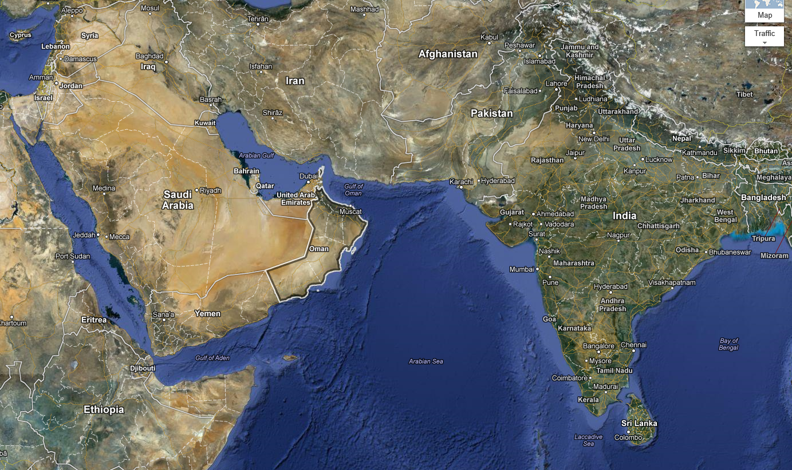
Location of Oman
South eastern part of the Arabian Peninsula

Slide 3
Direcorate of Metorology and Air Navigation (DGMAN)
DGMAN
Air Navigation Affairs
Meteorology Affairs
Operation and Tech.
Dept.
Forecasting and Obs.
Dept.
Sec. of systems and
Data processing
General Forecasting
Outside Obs. Stations.
Aviation and Marine Fcst.
Communication & net.
Remote sensing & studies
NWP
Media services.

Slide 4
Oman Climate
Main center in Muscat:
50 forecaster, observers and programmers.
Backup center in Salalah

Slide 5
Oman Climate
Winter (December to February)
Spring ( March & April)
Summer ( May to September)
Fall ( October & November)

Slide 6
Seasons in Oman
2 Main seasons: summer & winter
Fall & Spring are barely noticeable
locally called (transition periods)

Slide 7
Winter season
Cold and Dry (due to winter monsoon)
Main feature: Westerly disturbances (Troughs) coming from Mediterranean sea.

Slide 8
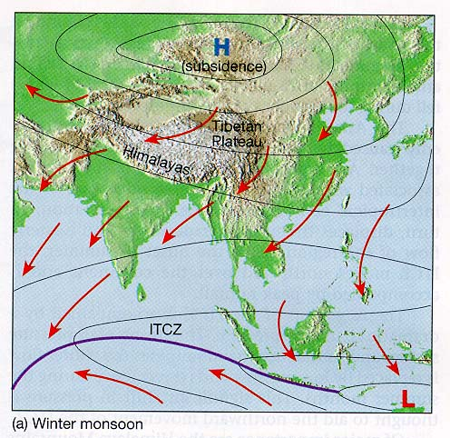
Winter season
Mainly dry air due to winter monsoon.

Slide 9
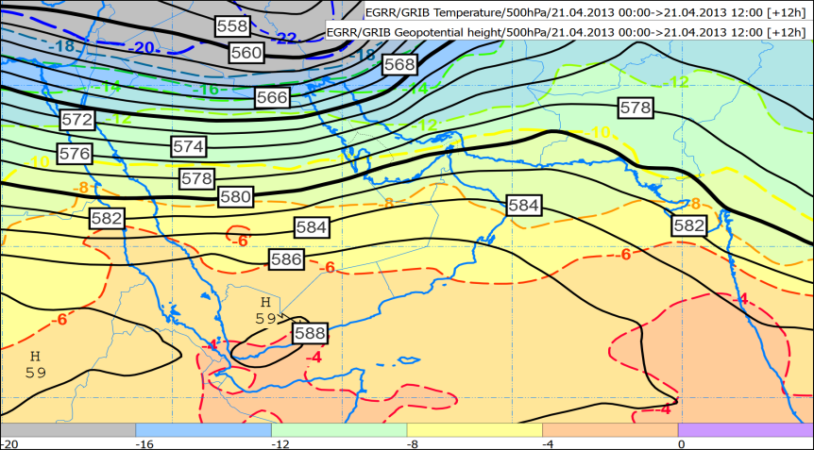
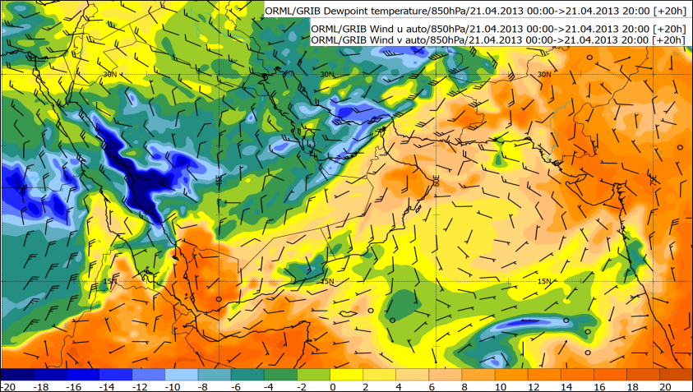
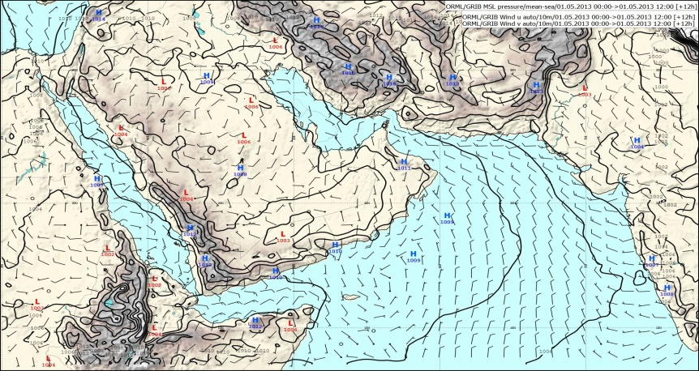
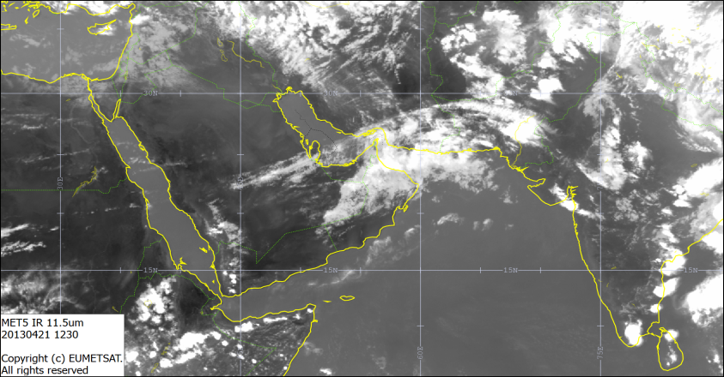
Winter season
Example of westerly disturbances coming from Mediterranean sea (21 April-03 May):

Slide 10
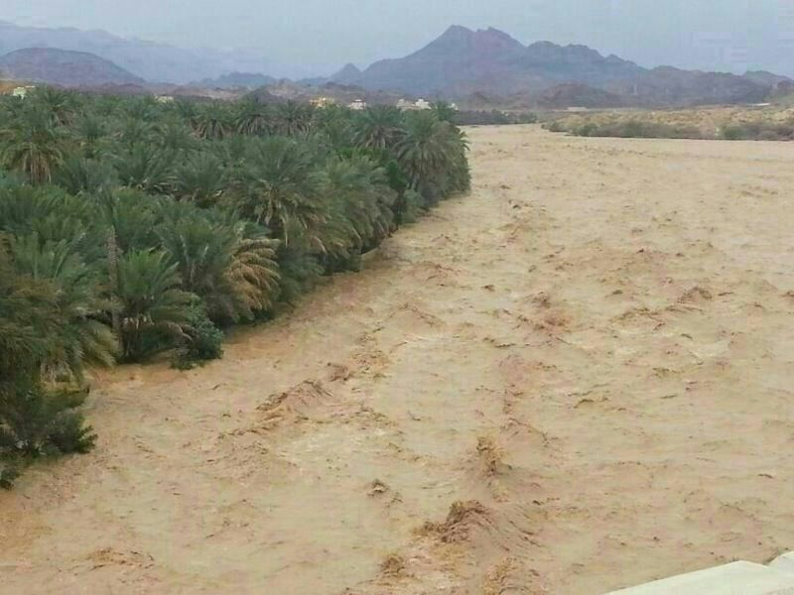
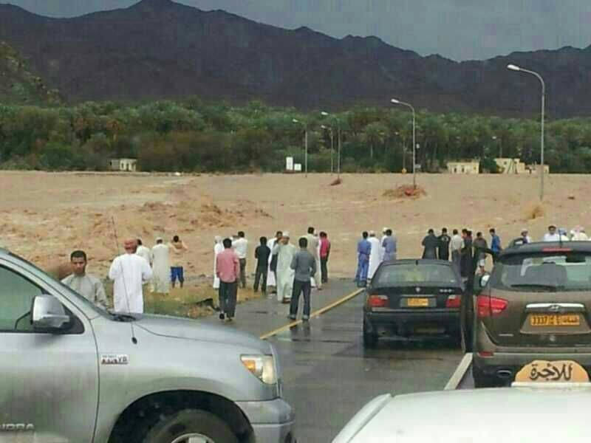
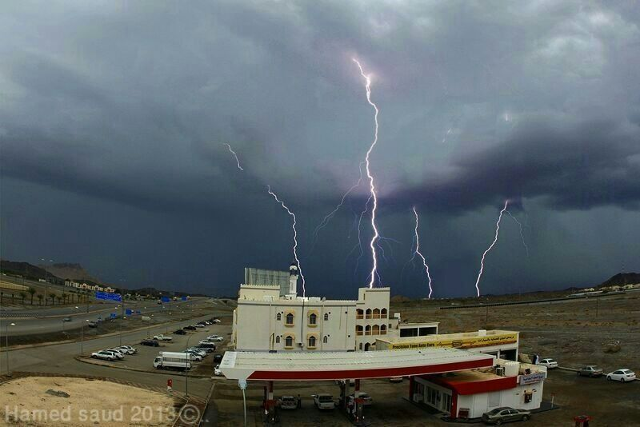
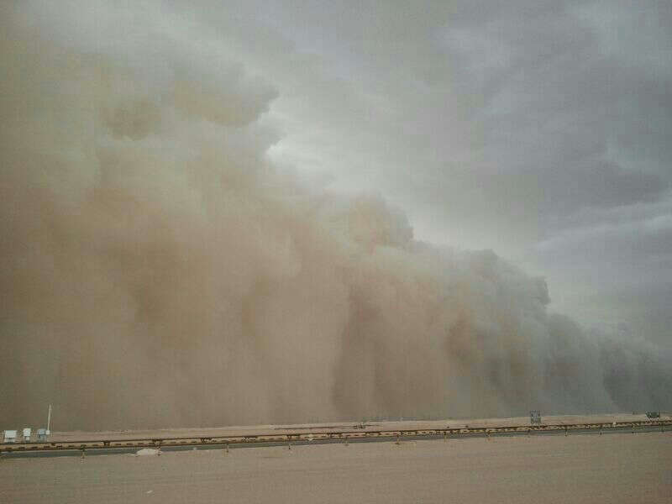
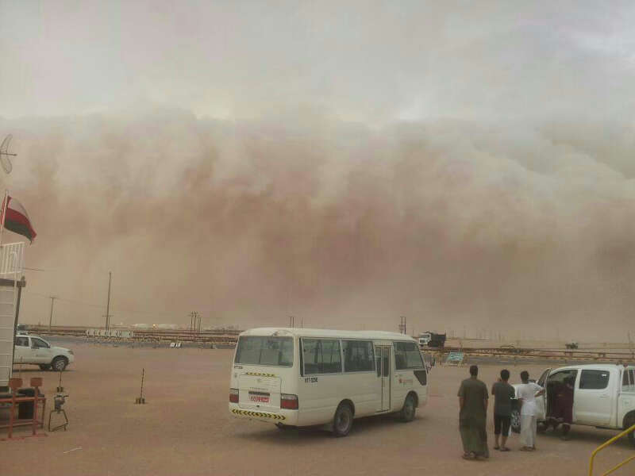
The system caused a lot of flash floods/dust storms

Slide 11
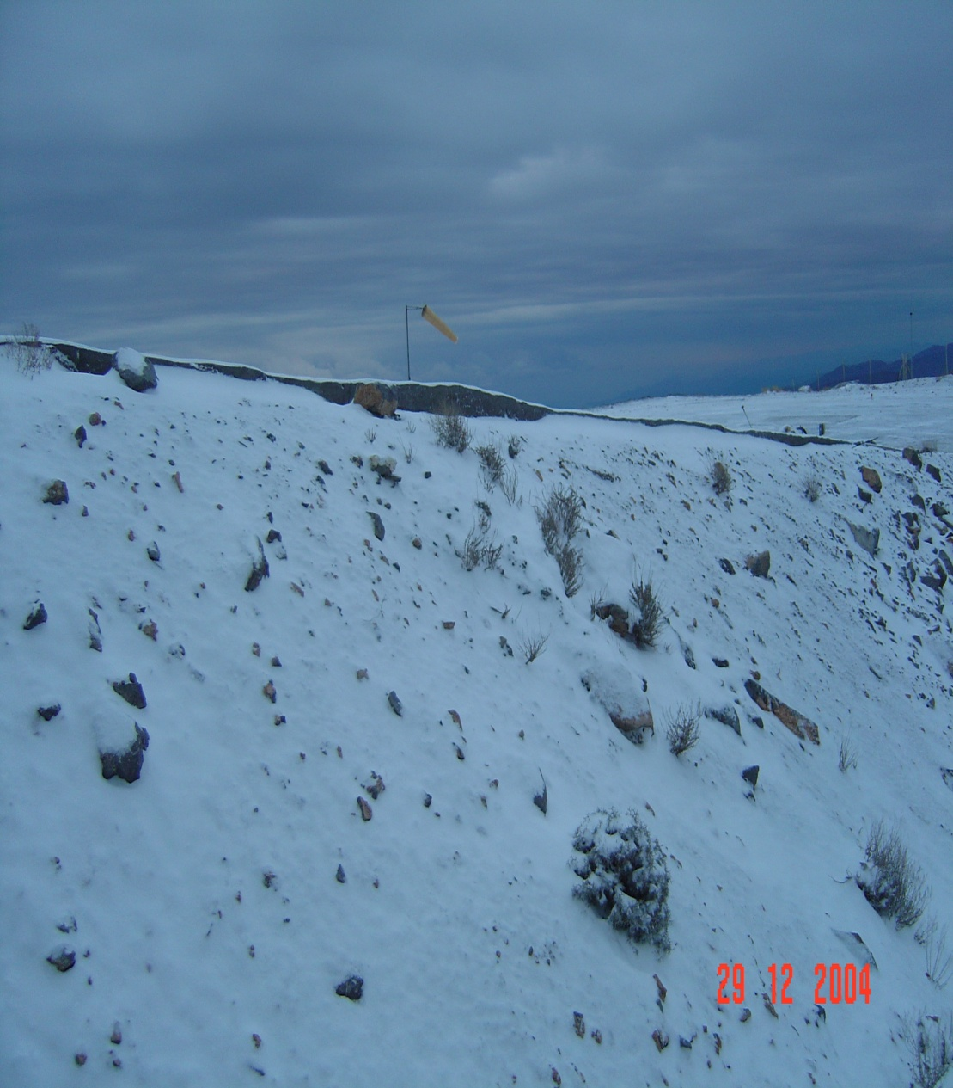
Snow over Musandam mountains, Dec2004

Slide 12
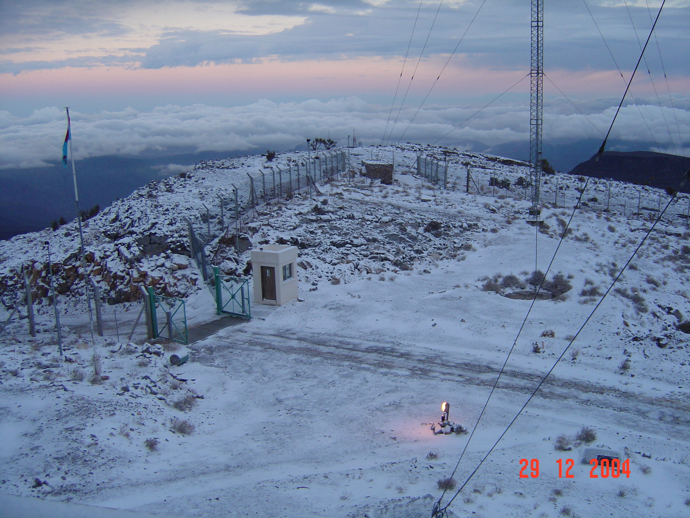

Slide 13
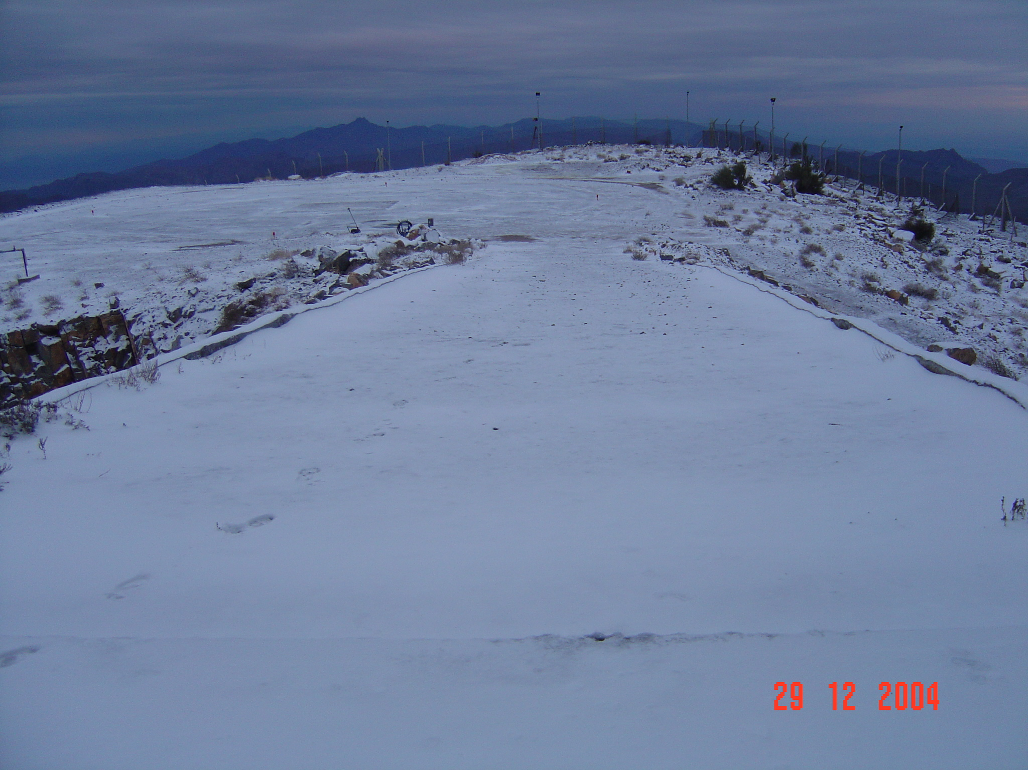
ثلوج على محافظة مسندم (29ديسمبر2004)

Slide 14
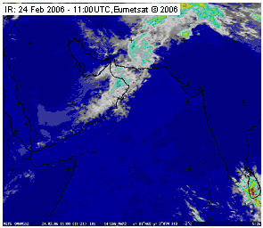
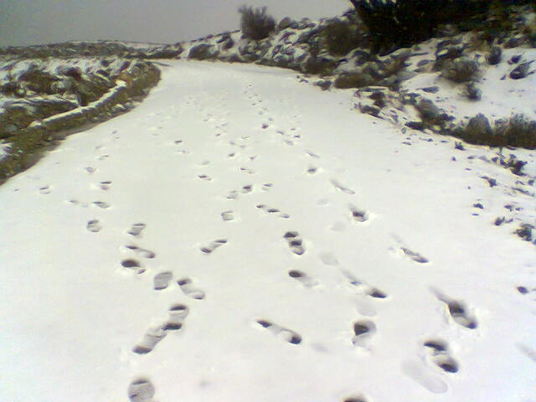
Snow over Shams mountains, Feb, 2006

Slide 15
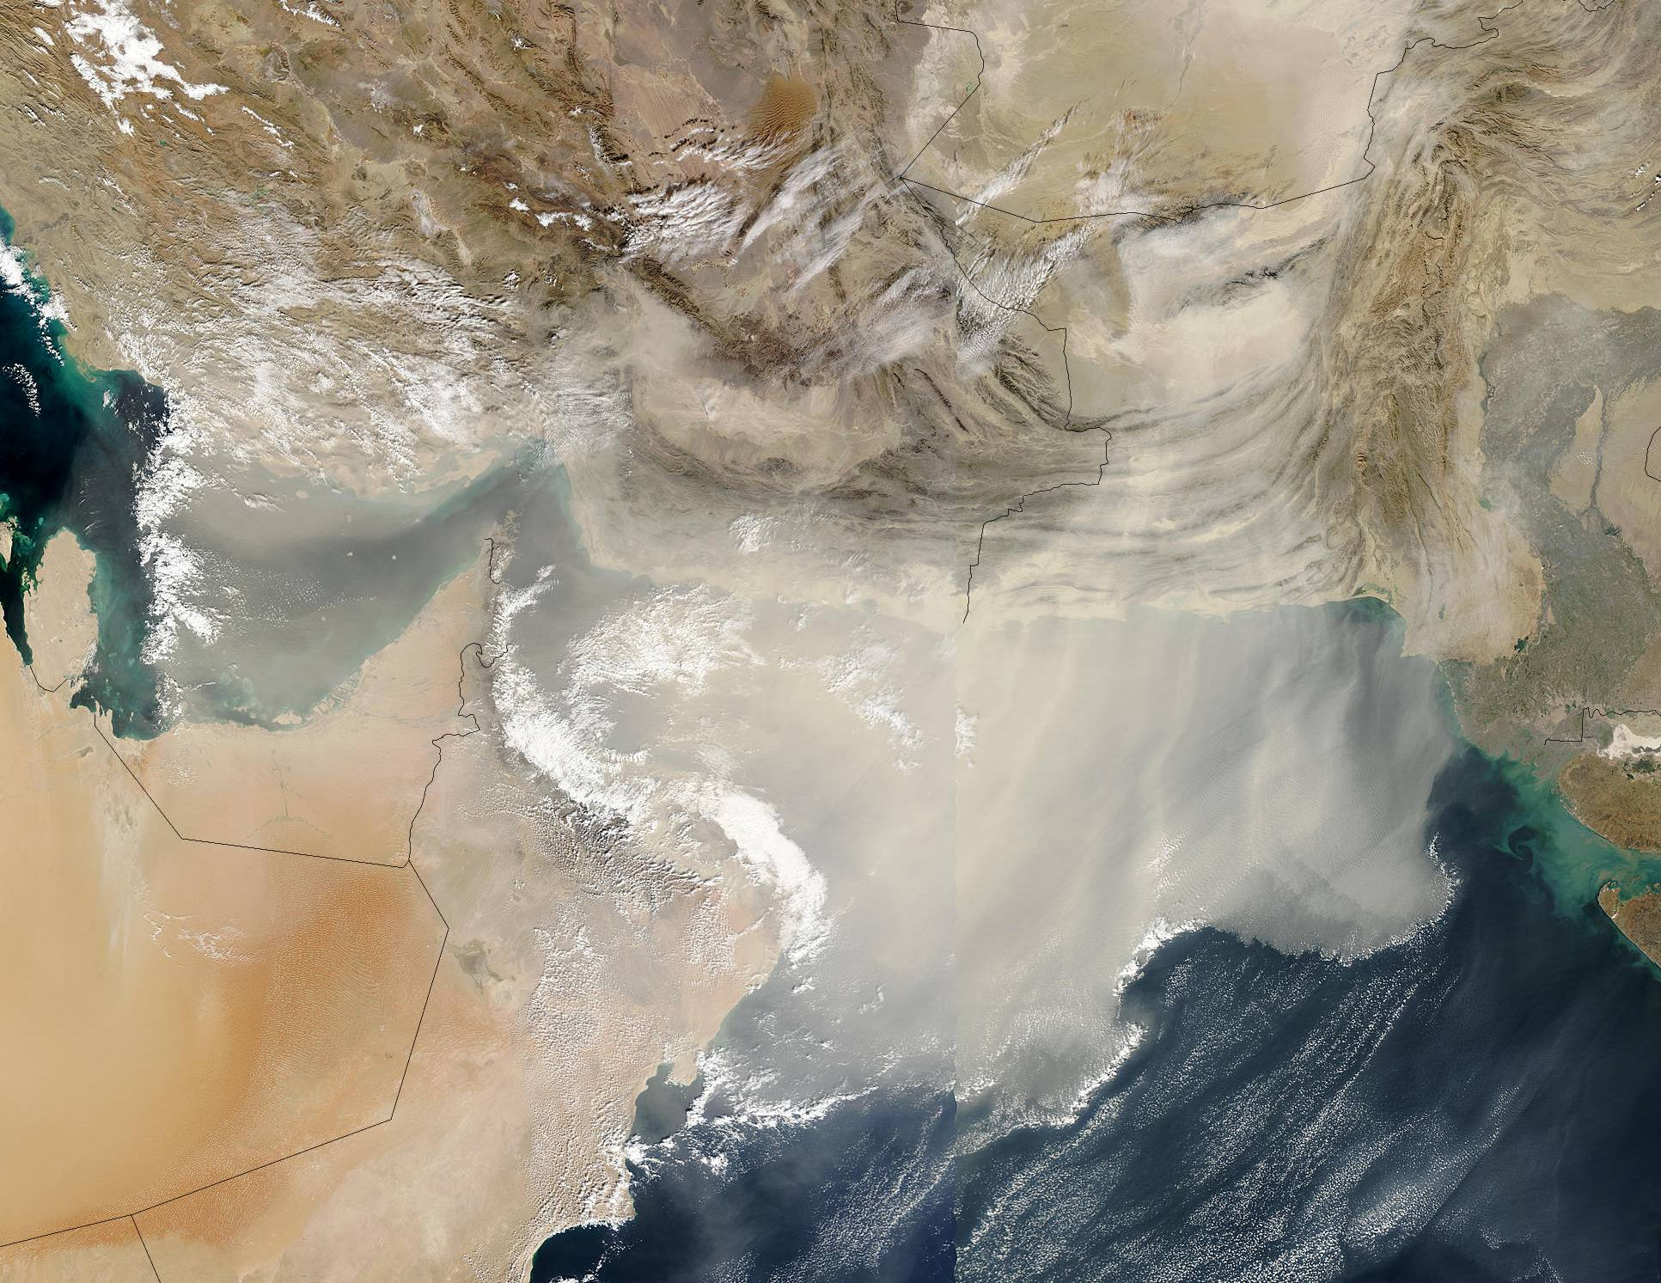
Dust storms
(December 2002) strong continuous surface to 850 northeasterly winds from Iranian and Pakistani desert.

Slide 16
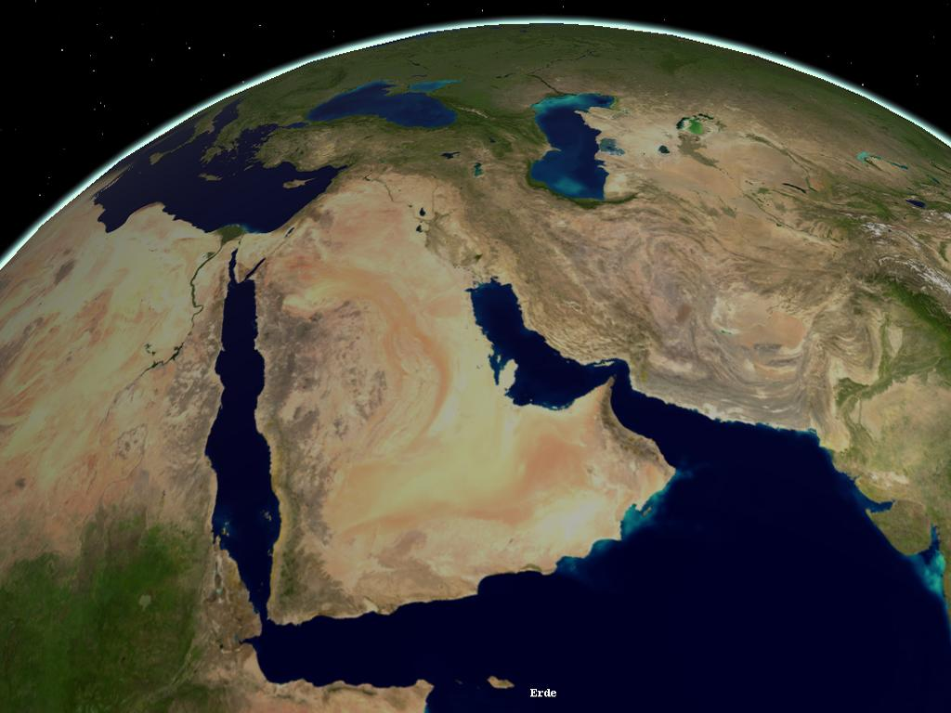
Main dust storm sources
Local dust storms.
Tigris and Euphrates rivers basin.
Sistan Basin & Baloushistan.

Slide 17
Summer season
Weather is characterized by:
Hot and humid along coastal areas.
Hot and dry over the interior and desert areas.
Local Activity (along Al-Hajar mountains).
Khariaf (low clouds along Dhofar coasts)

Slide 18
Sources of moisture
Arabian Sea (maritime tropical air mass):
During summer, High pressure dominates over Arabian sea resulting in SW/SE wind and pumping moisture inland, (summer monsoon).

Slide 19
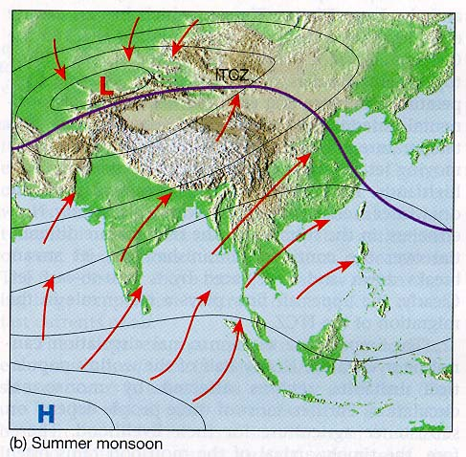
Summer
Southwest monsoon
©1998 Prentice-Hall, Inc.

Slide 20
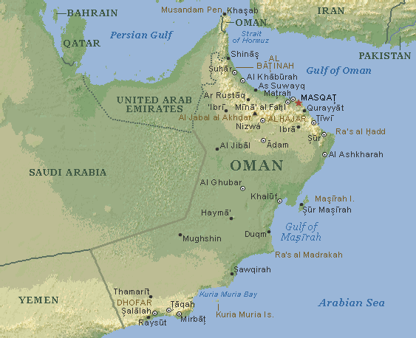
During summer
Continental tropical
Sea brease
Thermal Low
pressure
Early morning fog
Low clouds
High pressure

Slide 21
Local Activities (Orographic Convection)
Necessary elements to happene:
- heating
- convergence
- moisture

Slide 22
Convergence
MT or CT
MT or CT
MT

Slide 23
Time and place
Limited place : Only over Alhejer mountains and adjoining areas.
Limited time: starts during afternoon and ends by early night.

Slide 24


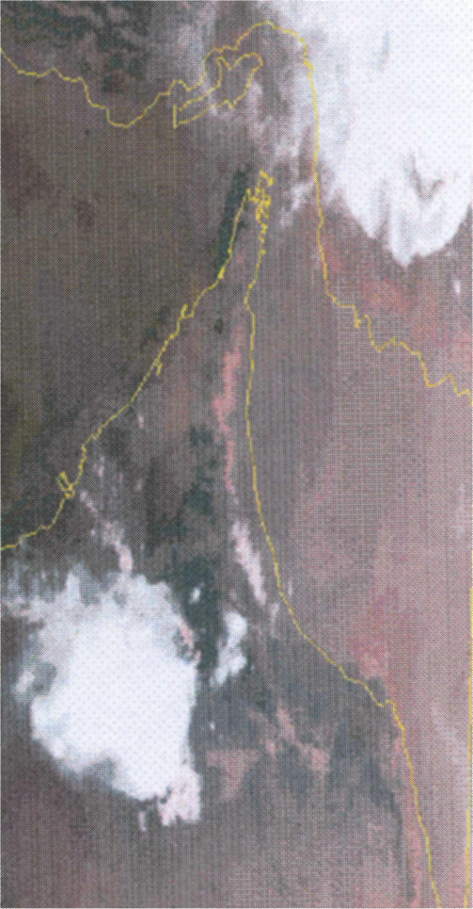
Local thunderstorm

Slide 25
Kharif
Place : Over coastal areas of Governorate of Dhofar and adjoining mountains.
Continuous southwesterly winds over the coastal areas brings a lot of moisture that is encountered by mountains forming low clouds giving continuous drizzle/light rain.
Time : Lasts for almost 3 months.

Slide 26
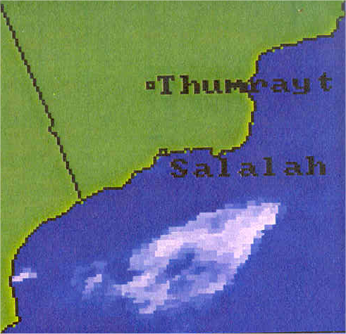
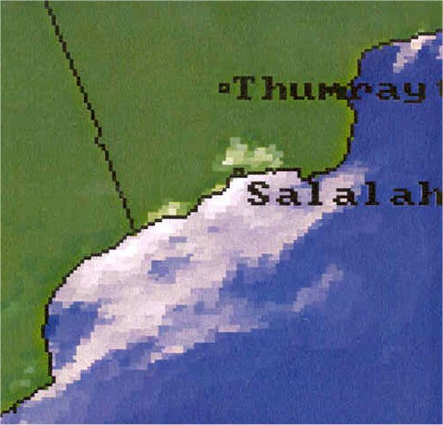
Monsoon Outbreak
27.07.2000
28.07.2000
Notes:
- Meteosat7 vis channels show the monsoon low clouds coverage over south-eastern Oman in an outbreak day (to the left) and in normal day (to the right).

Slide 27
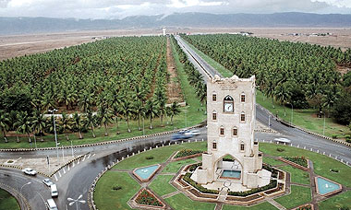
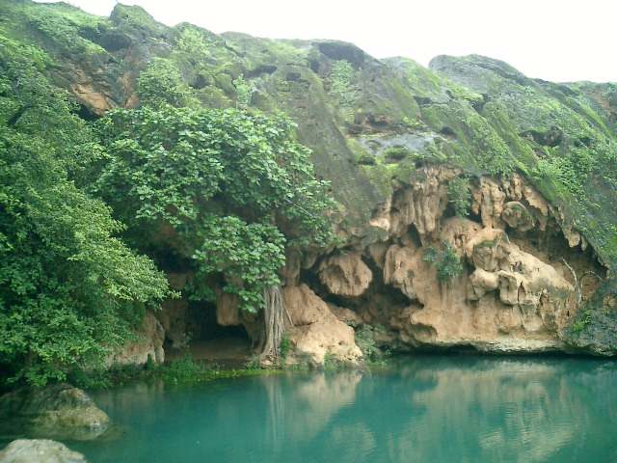
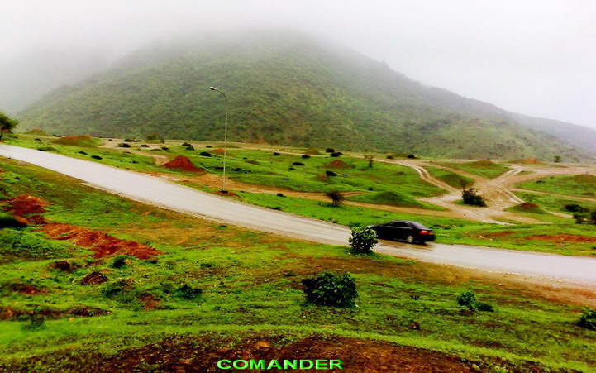
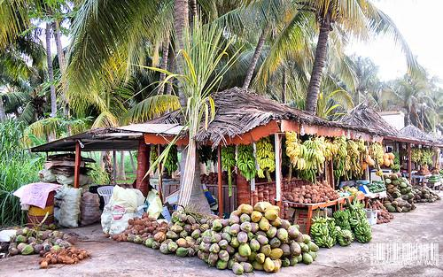
Salalah During Khareef

Slide 28
Spring and Fall
The atmosphere is very sensitive for any changes.
Weak trough may result in heavy thundershowers since it will by enhanced by heat and local activity.

Slide 29
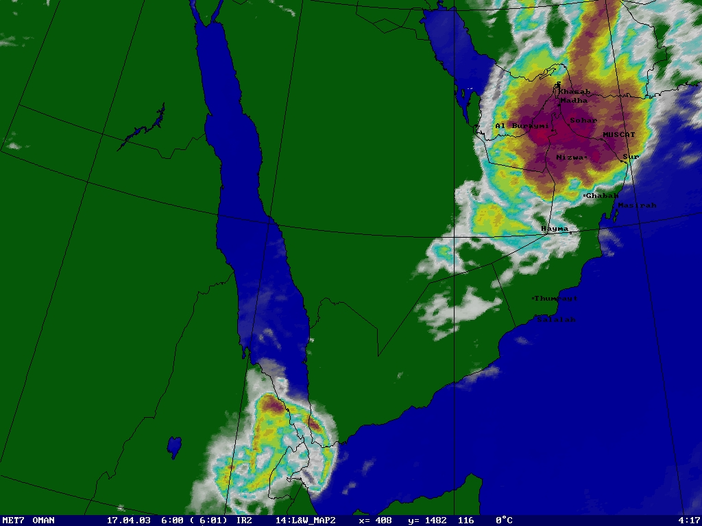
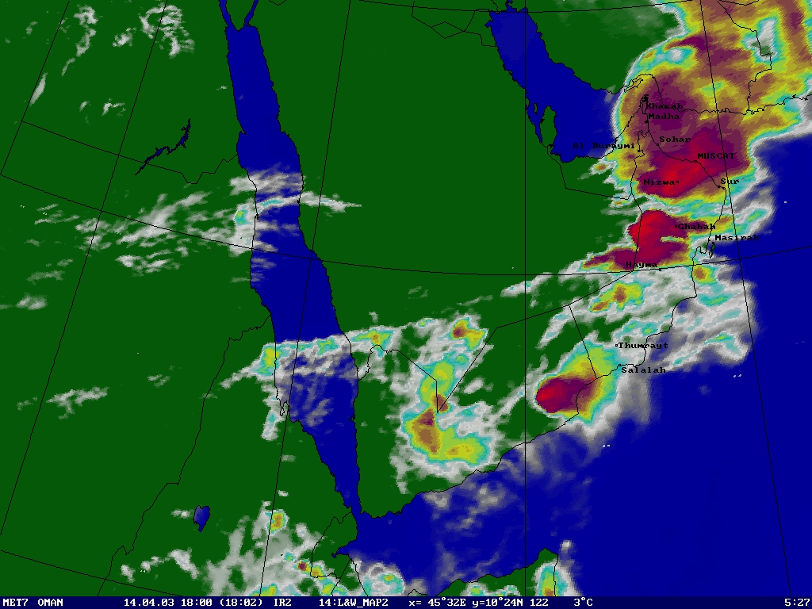
Trough (April)

Slide 30
Tropical Cyclones
Due to its location, Oman is at risk of Tropical cyclones.
Spring (Pre-monsoon) and fall (post monsoon) are tropical cyclone's seasons.
Roughly, most of TCs that hit Oman occurred during pre-monsoon seasons.
.

Slide 31
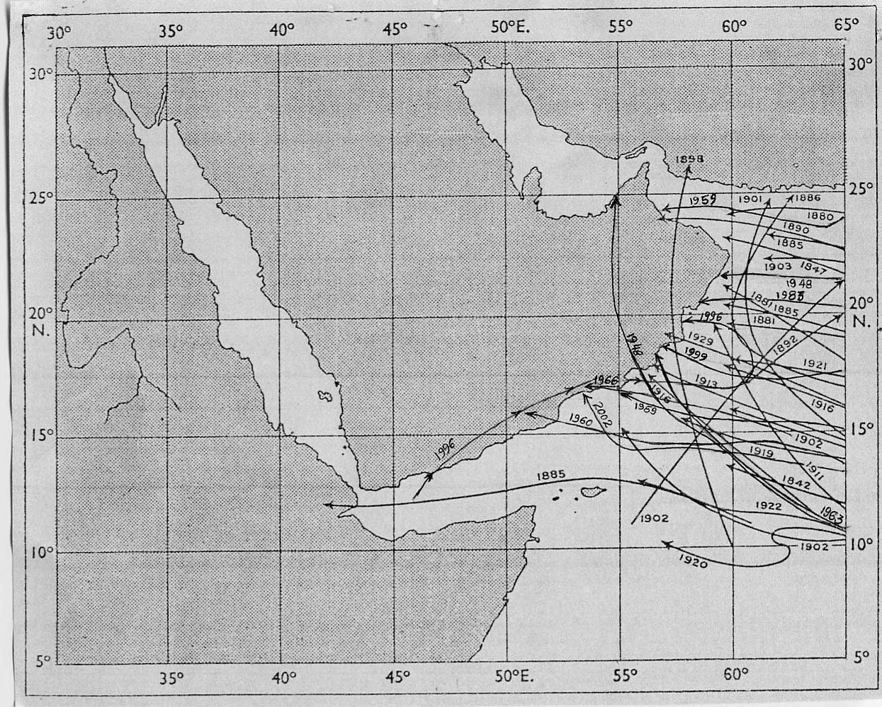
History of TCs hit Oman since 1891 to 2002

Slide 32
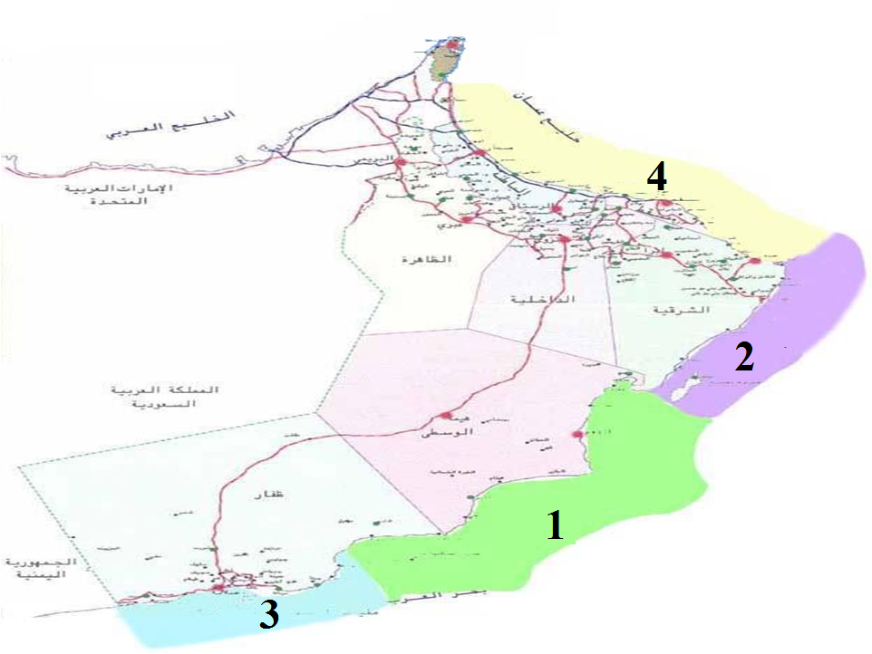

Slide 33
Examples of Tropical cyclones that hit Oman

Slide 34
Tropical Cyclone
June 1996

Slide 35
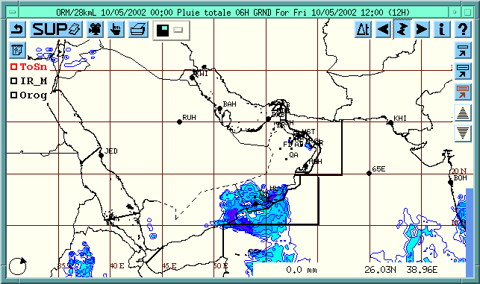
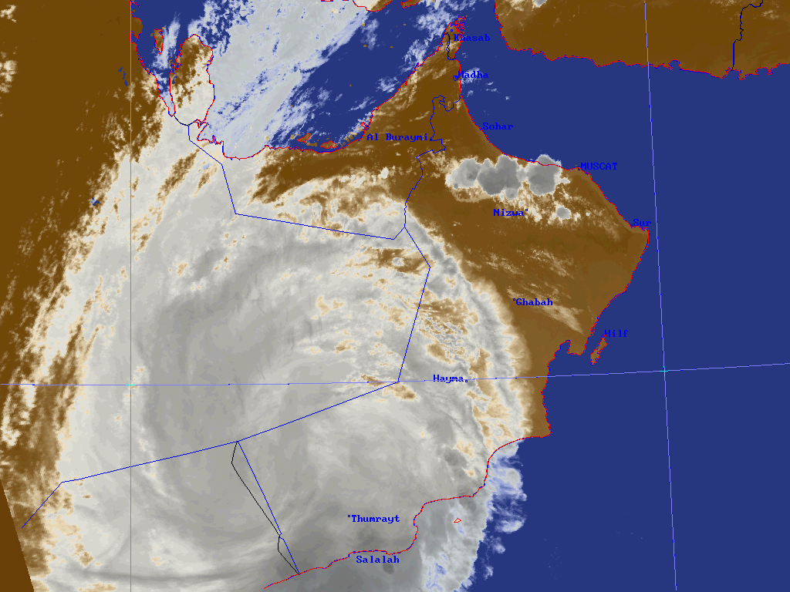
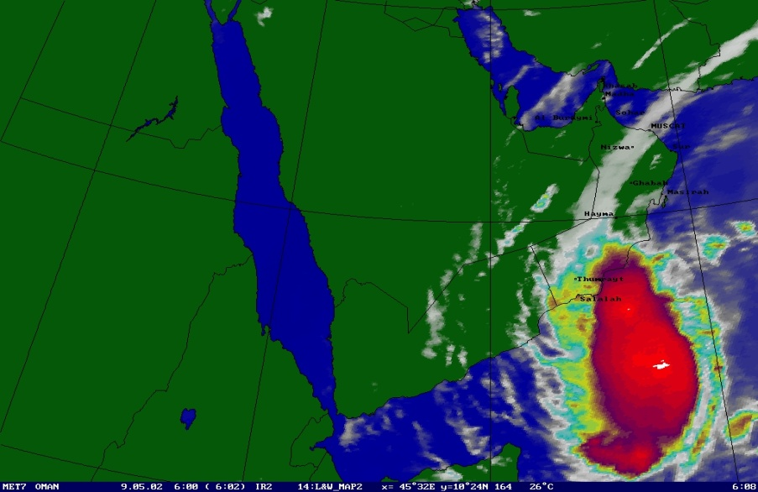
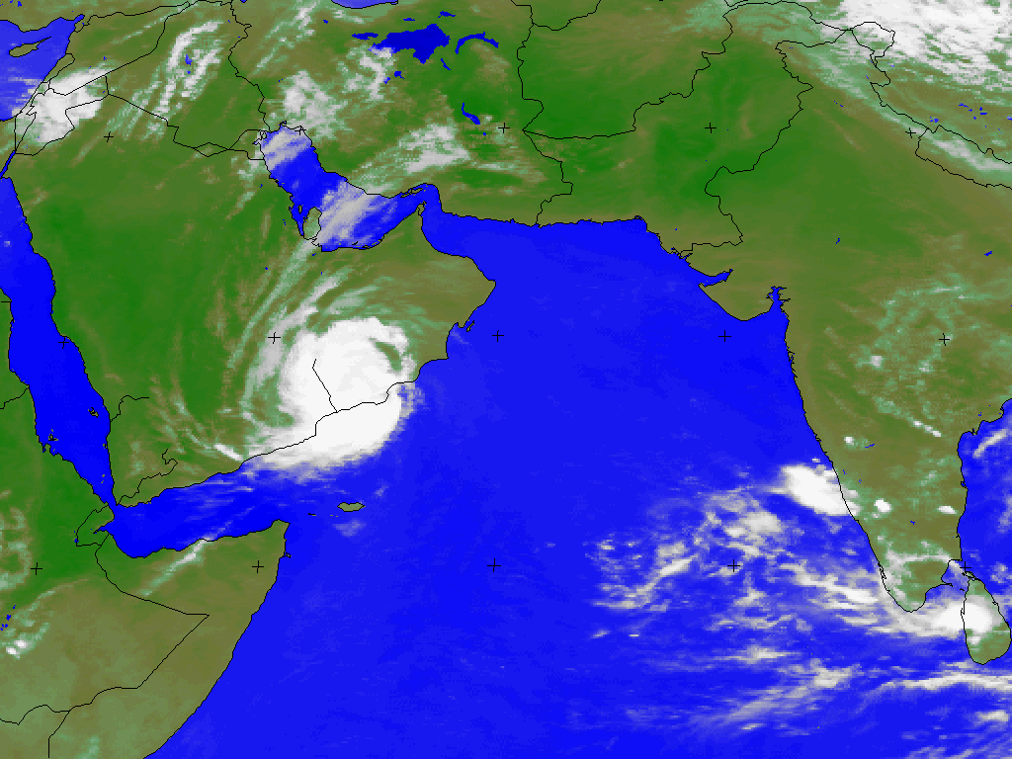

Slide 36
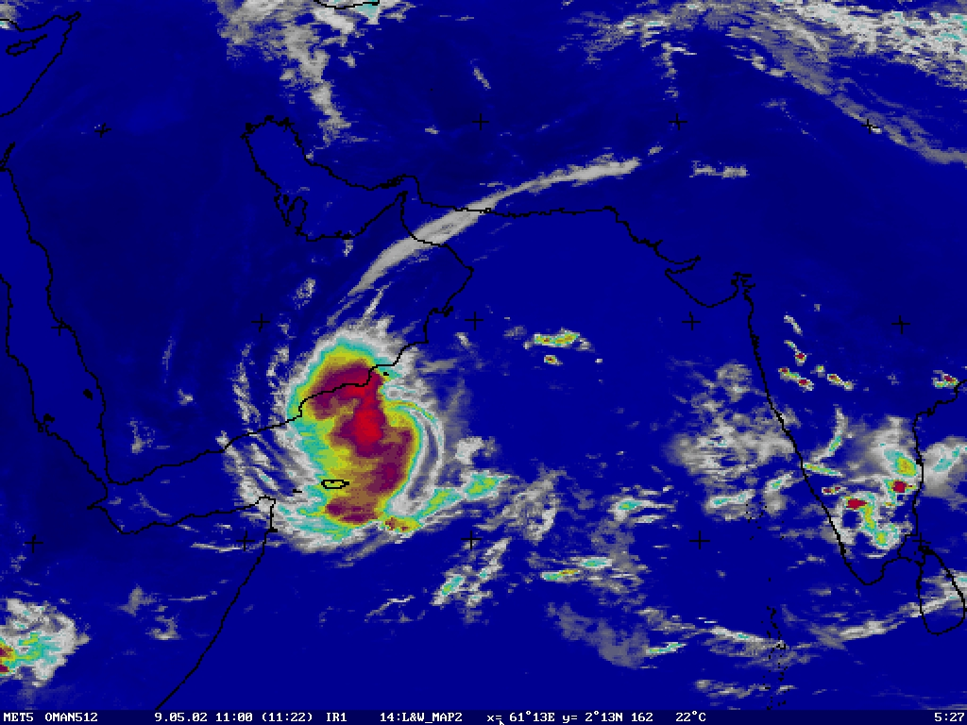
Tropical Cyclone
May 2002

Slide 37
Tropical cyclone hit Alsharqia coast in November 1993

Slide 40
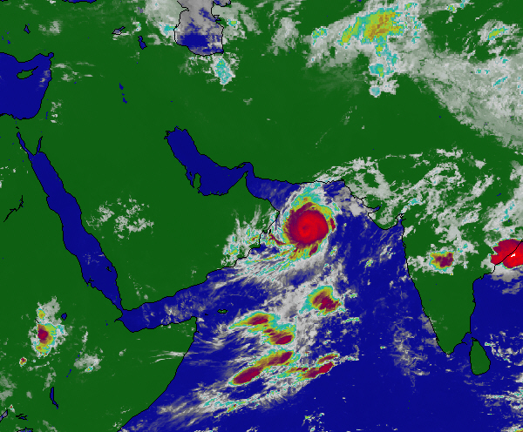
Tropical Cyclone “Guno”
June 2006
Most destructive Tc hit Oman in recent History

Slide 41
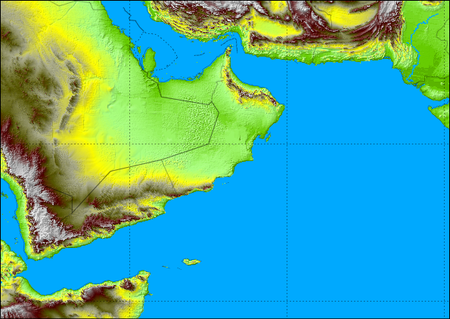
0400/07
1600/06
1900/05
1000/05
2200/04
1600/04
1000/04
2200/03
1600/03
0700/03
مسار الإعصار جونو

Slide 42
Qalhat recorded wind speed of 94 knots
Al-Jabal ALAbiath recorded rain fall of about 1000 ml

Slide 43
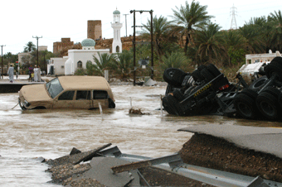
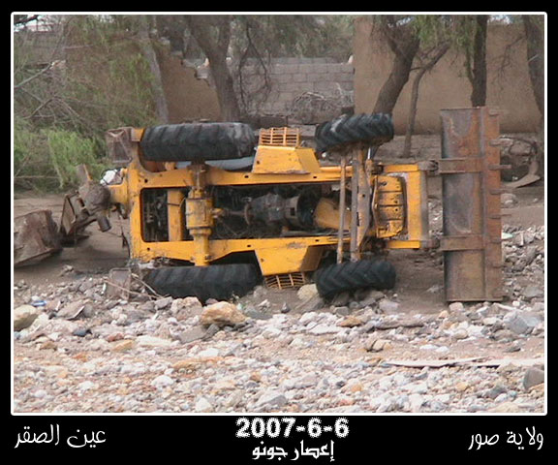

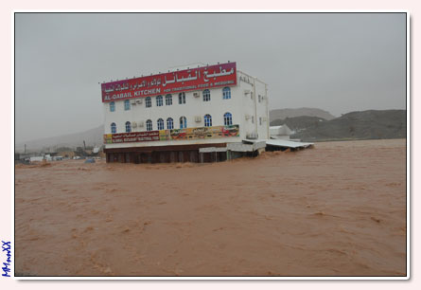

Slide 44
Thank You…

