Slide 1
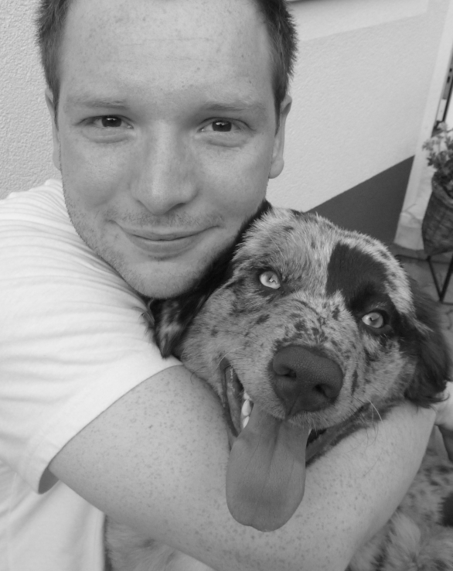
Soil Moisture from Remote Sensing: METOP ASCAT Soil Moisture Retrieval
Sebastian Hahn
shahn@ipf.tuwien.ac.at
Research Group Photogrammetry and Remote Sensing
Department of Geodesy and Geoinformation Vienna University of Technology www.ipf.tuwien.ac.at/radar

Slide 2
Outline
Introduction to Soil Moisture
Microwave properties
Remote Sensing of soil moisture
SMOS
SMAP
METOP ASCAT
TU Wien Soil Moisture Retrieval
Assumption
Processing steps
Limitations
Conclusion

Slide 3
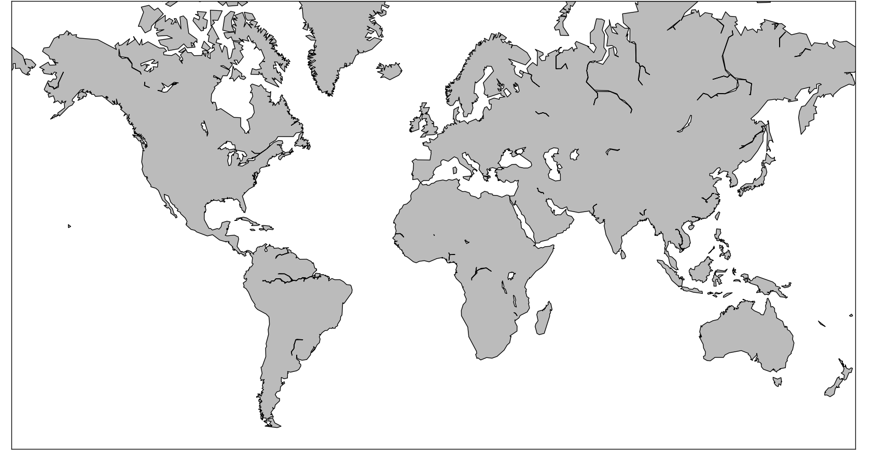
Land
Ice
Atmosphere
Ocean
Other

Slide 4
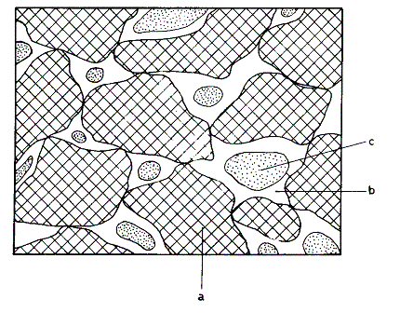
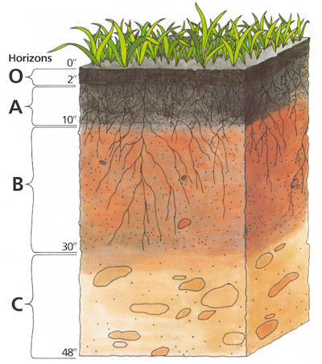
Soil Moisture
Source: Koorevaar et al., 1983
Definition, e.g.
Average
Cross-section of a soil
Air
Water
Solid Particles
Thin, remotely sensed soil layer
Root zone: layer of interest for most applications
Soil profile

Slide 5
Microwaves
Microwaves: 1 mm – 1m
Band designations
Advantages compared to optical/IR range
penetrate the atmosphere (to some extent clouds and rain)
independent of the sun as source of illumination
penetration depth into vegetation and soil
Source: Ulaby et al., 1981

Slide 6
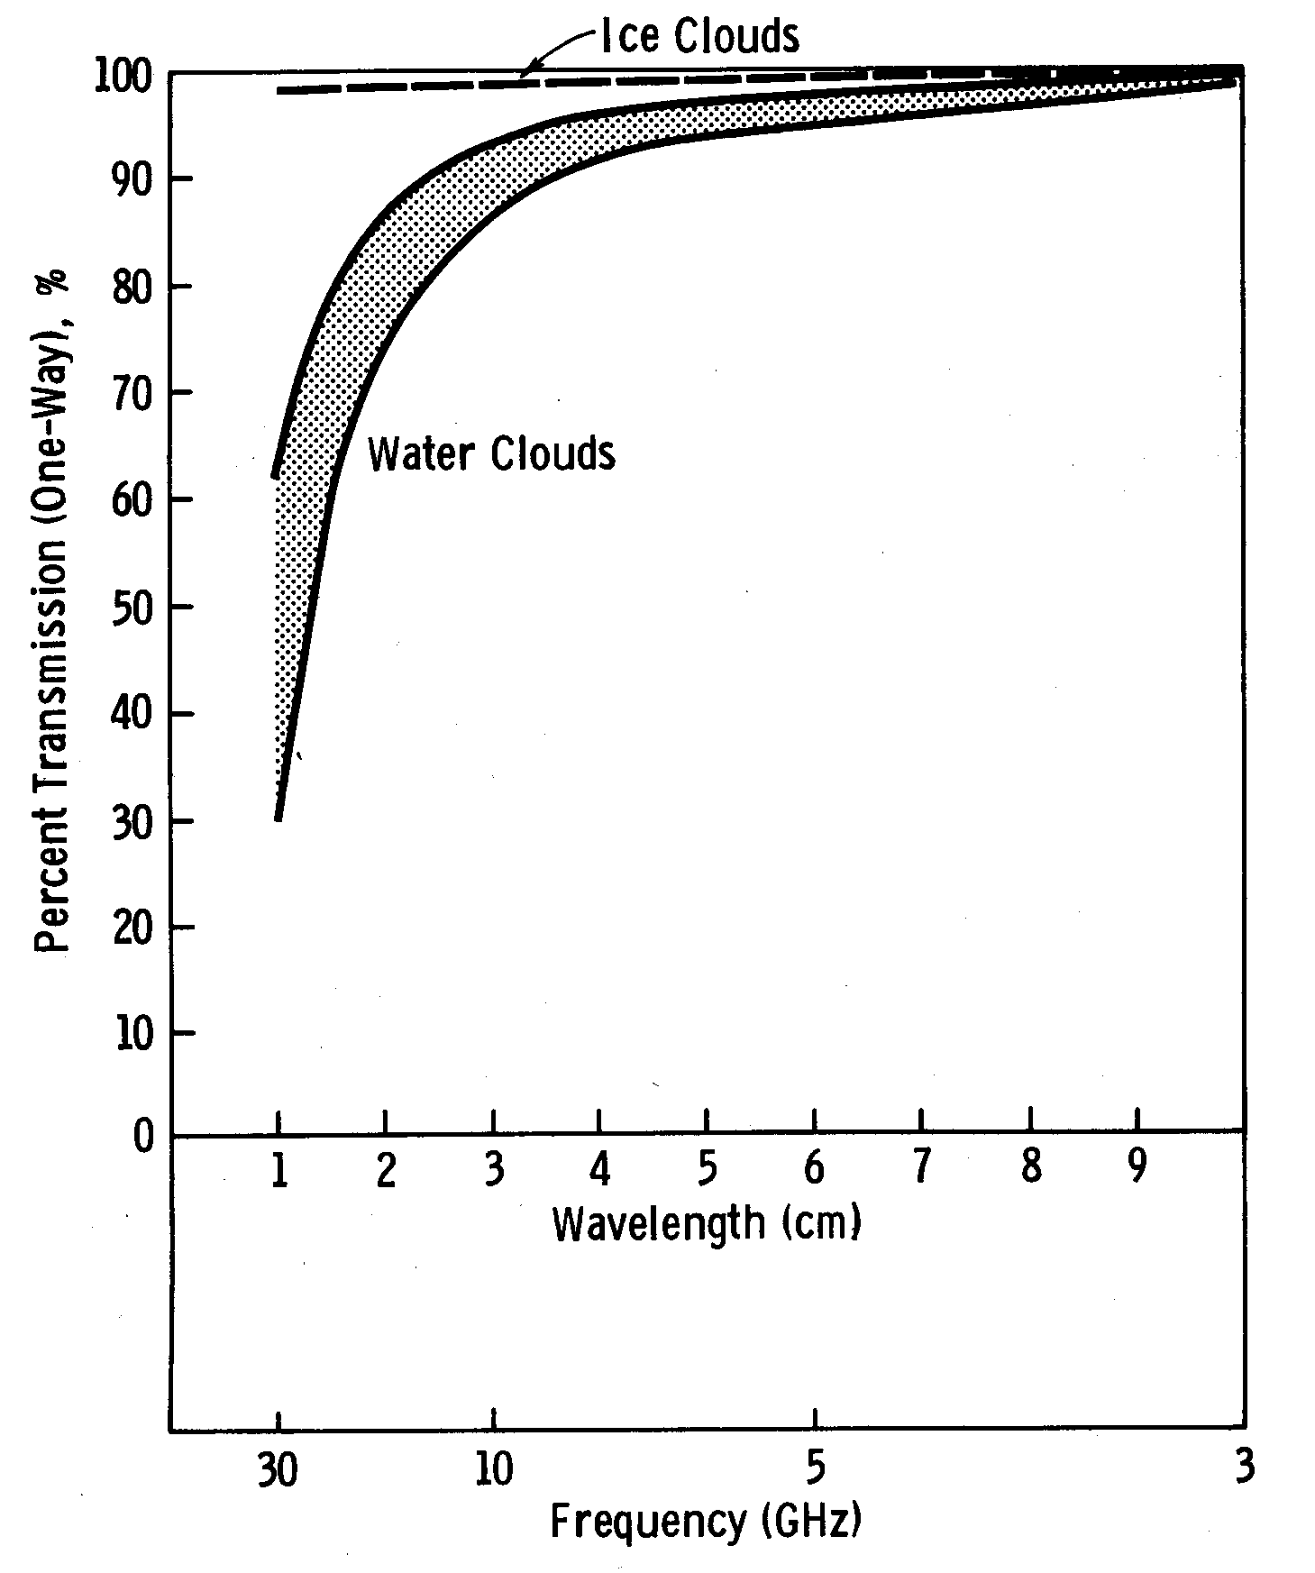
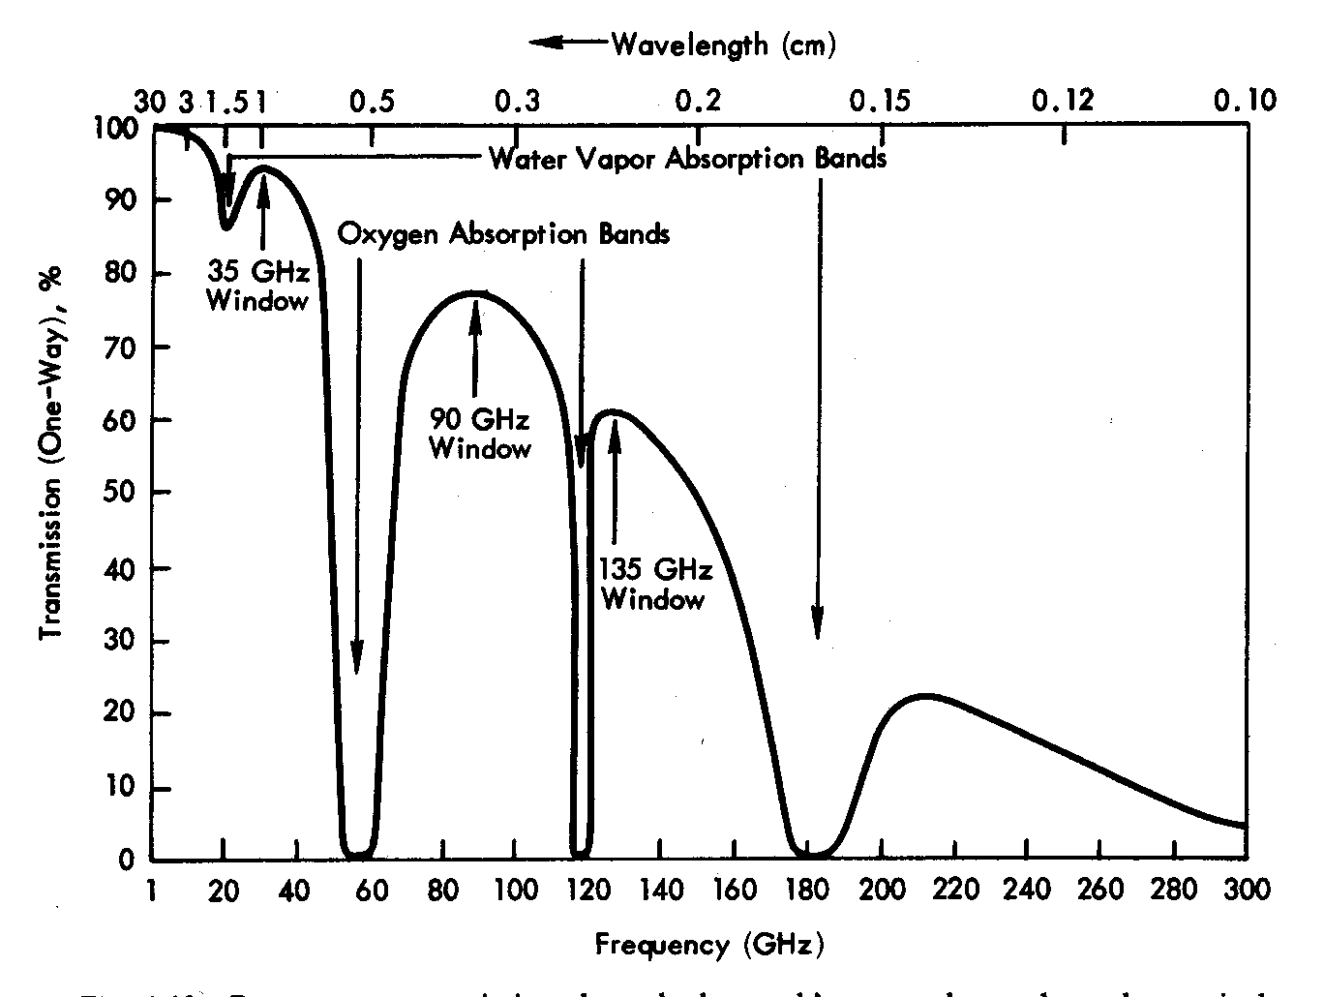
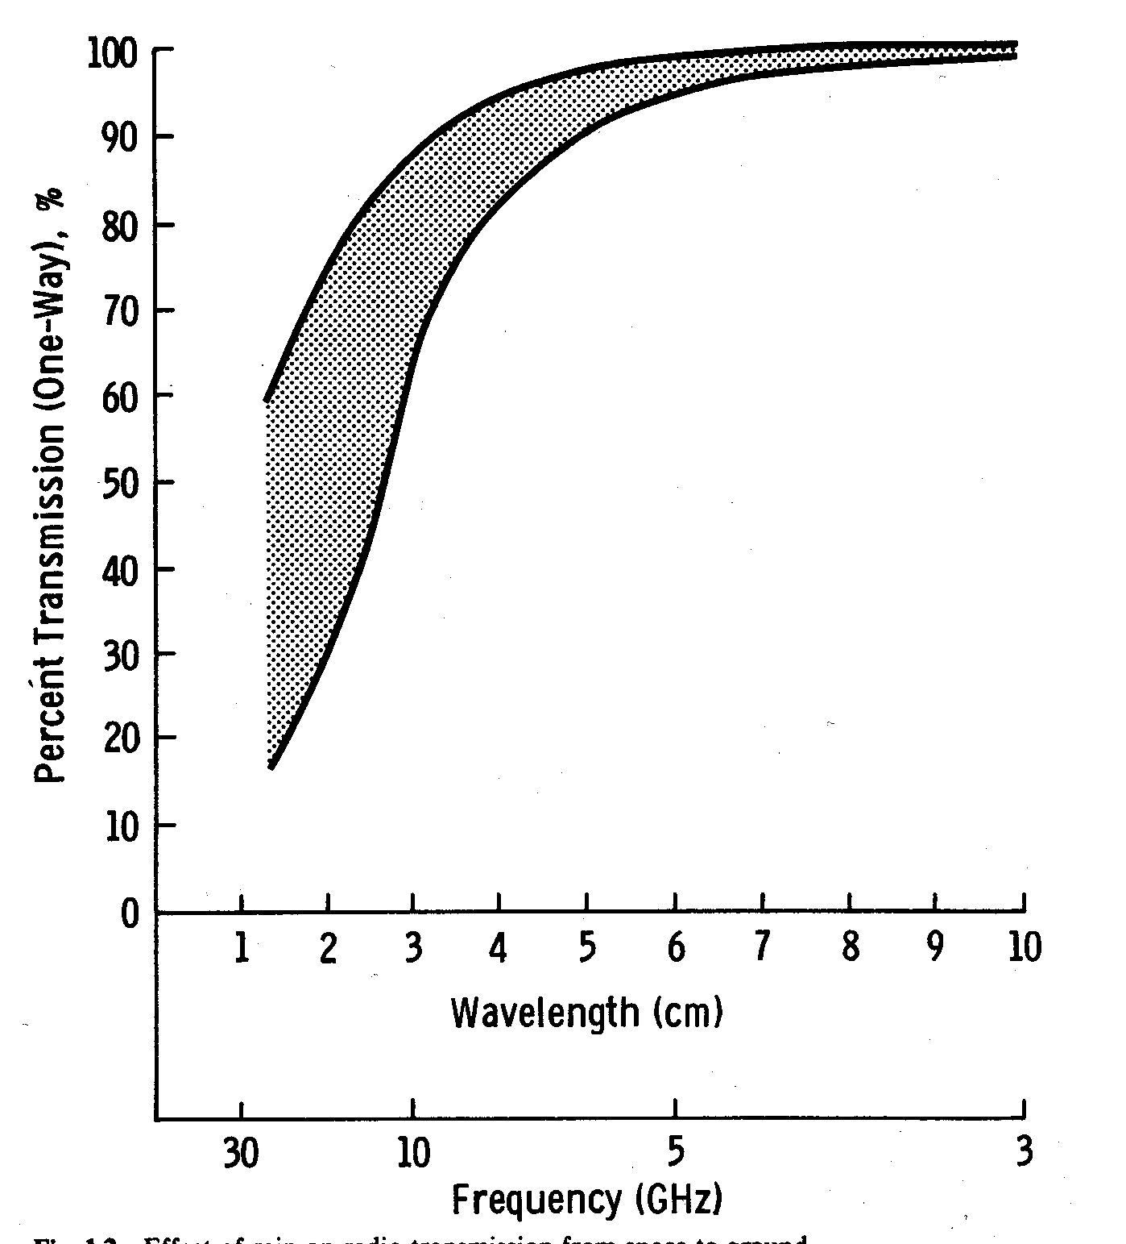
Transmission through Atmosphere, Clouds and Rain
Atmosphere
Clouds
Rain
Source: Ulaby et al., 1981

Slide 7
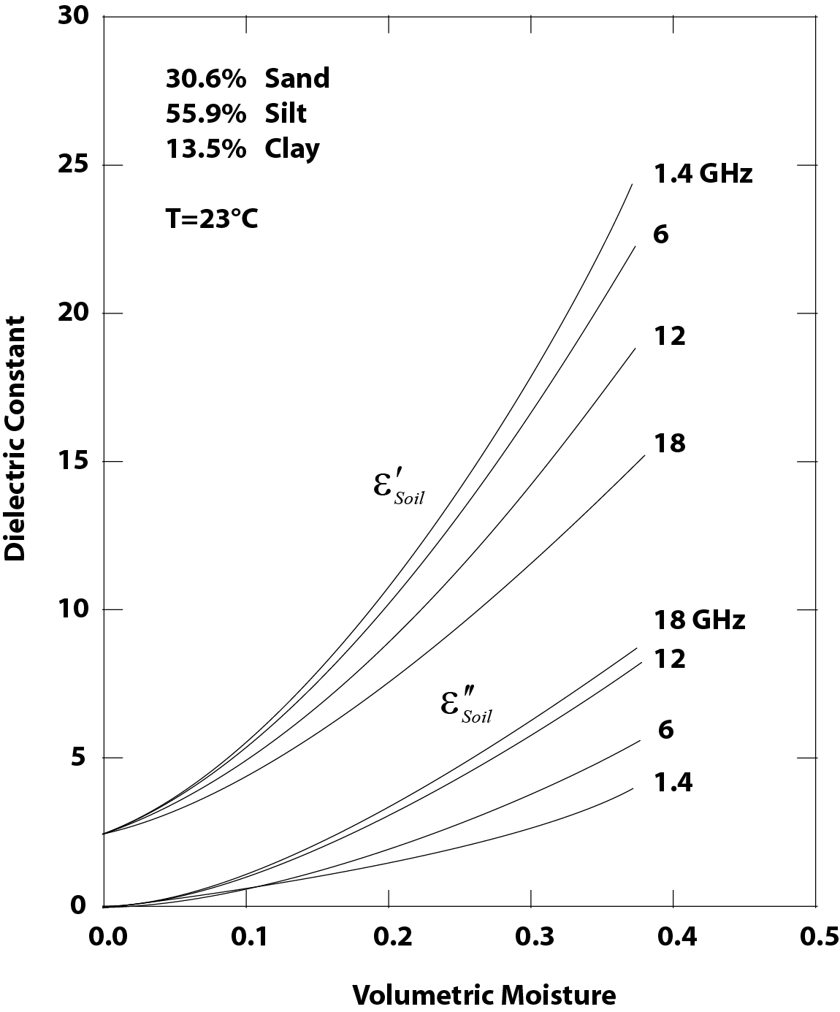
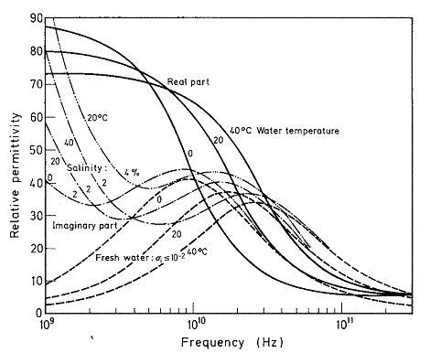
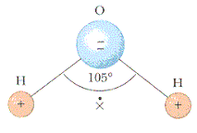
Microwaves and Water
Microwaves
All-weather, day-round measurement capability
Very sensitive to soil water content below relaxation frequency of water (< 10 GHz)
Penetrate vegetation and soil to some extent
Penetration depth increases with wavelength
Dielectric constant of water
Source: Schanda, 1986
The dipole moment of water molecules causes “orientational polarisation”, i.e. a high dielectric constant
Relationship between soil moisture
and dielectric constant
Source: after Ulaby et al., 1986

Slide 8
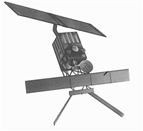
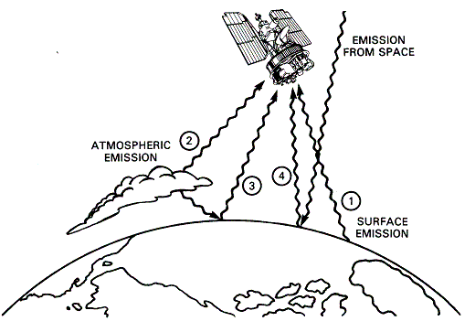
Active and Passive Microwave Sensors
Active
Active remote sensors create their own electromagnetic energy
Sensors
Altimeters
Side-looking real aperture radar
Scatterometer (SCAT)
Synthetic Aperture Radar (SAR)
Passive
Passive remote sensing systems record electromagnetic energy that is reflected or emitted from the surface of the Earth
Sensors
Microwave radiometers
Source: Gloersen et al., 1992

Slide 9
Observed quantities
Radars
Backscattering coefficient s⁰; a measure of the reflectivity of the Earth surface
Radiometers
Brightness temperature T_{B} = e × T_{s} where e is the emissivity and T_{s} is the surface temperature
Passive and active methods are interrelated through Kirchhoff’s law:
e = 1 – r where r is the reflectivity
Example: increase in soil moisture content
Backscatter ↑
Emissivity ↓

Slide 10
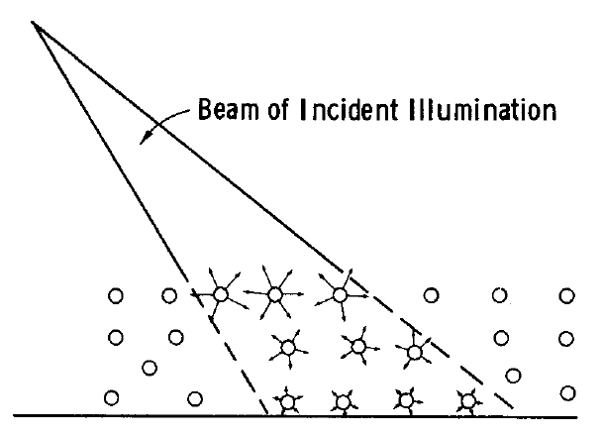
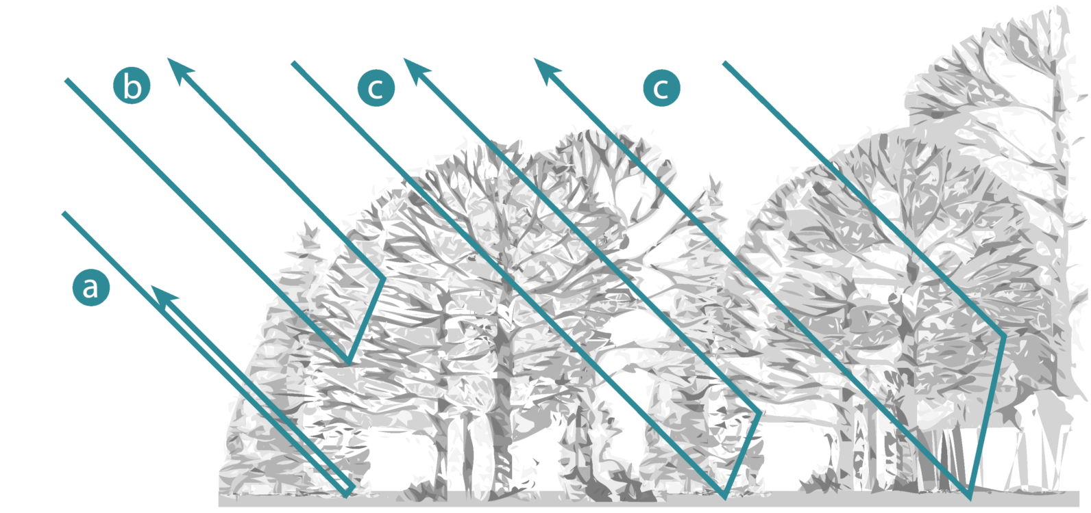
Scattering Mechanisms
Surface Scattering
Source: Ulaby et al., 1982
Volume Scattering
Backscatter from Vegetation
Surface-volume interaction
Volume scattering
Surface scattering
(attenuated by vegetation canopy)
Source: Ulaby et al., 1982
Source: Bartalis, 2009

Slide 11
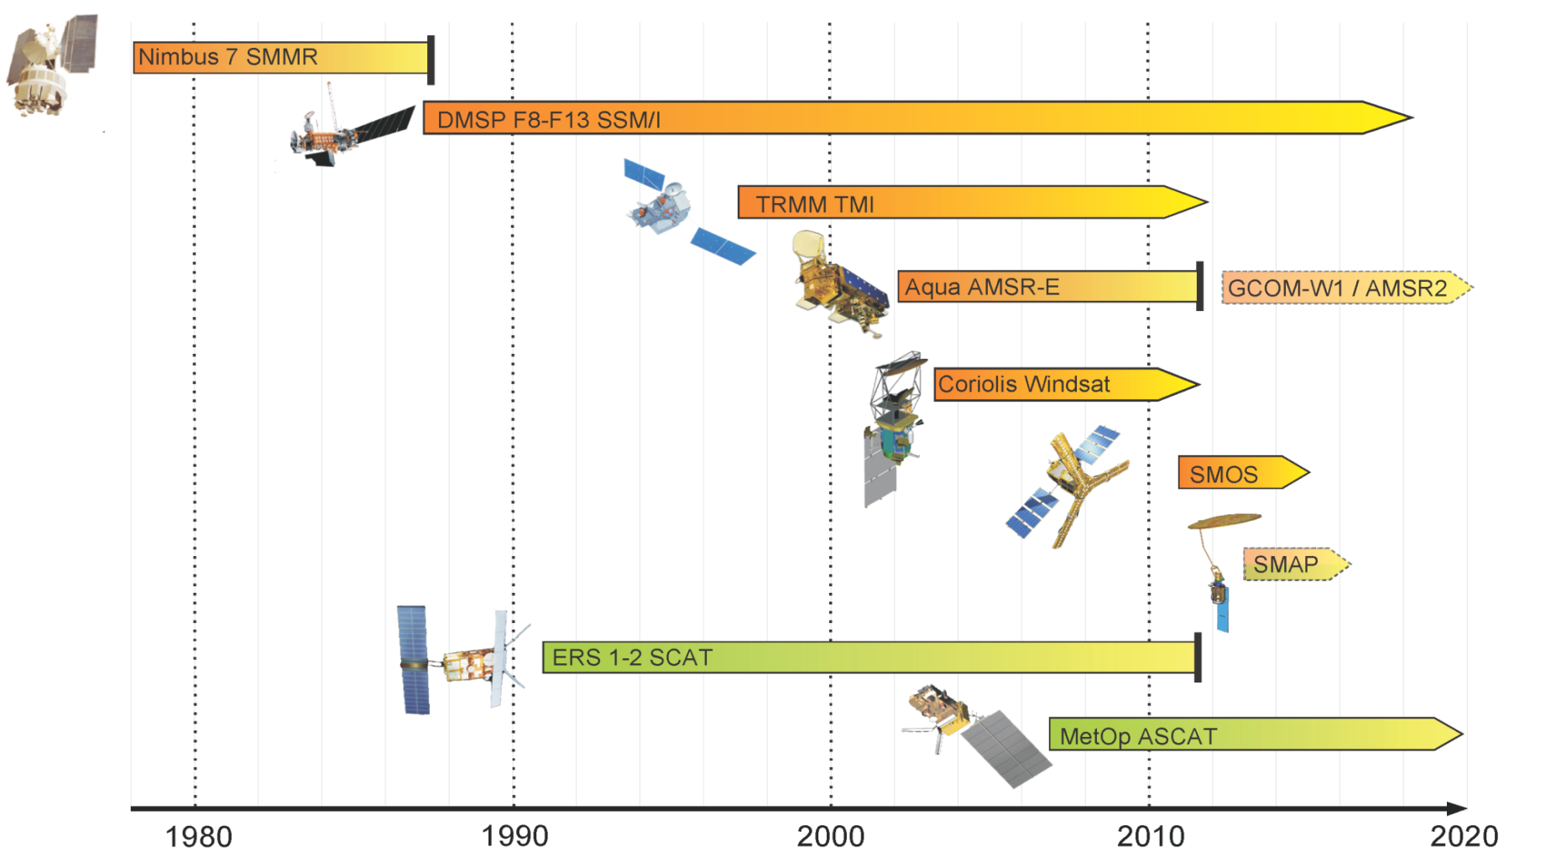
Microwave missions for soil moisture
33 years of passive and active satellite microwave observations for soil moisture

Slide 12
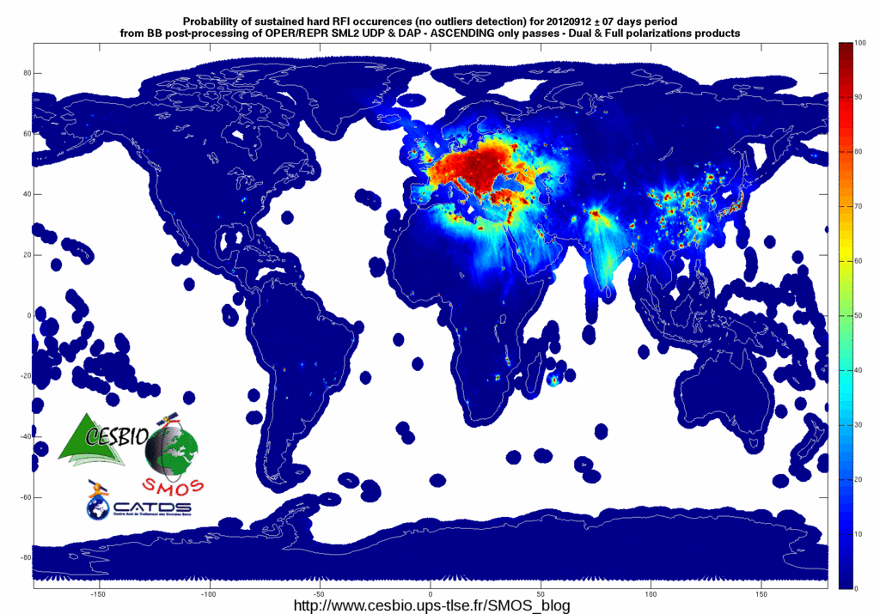
SMOS – Soil Moisture and Ocean Salinity
Launched: Nov. 2009
Passive, L-band, 1.41 GHz, 21.3 cm
V and H polarisation
Spatial Resolution: 30 – 50 km
Swath: 1000 km
Daily global coverage: 82 %
Multi-angular: 30 – 55°
Synthetic Antenna
Several (quasi) instantaneous independent measurements
SMOS
Source: ESA
MIRAS, the Microwave Imaging Radiometer using Aperture Synthesis instrument, is a passive microwave 2-D interferometric radiometer measuring in L-Band; 69 antennas are equally distributed over the 3 arms and the central structure.
Source: http://www.cesbio.ups-tlse.fr/SMOS_blog/
Notes:
SMOS has demonstrated the concept of Aperture Synthesis Radiometry in Two Dimensions from space, end-to-end, only 3 months after launch.
It is a completely new observation technique, that will likely extend in the future to other applications, other frequency bands and other orbits.
New retrieval algorithms have been developed for multi-incidence angle wide-field of view observations.
The concept is fully scalable and allows to achieve very fine spatial resolution without moving parts.
SMOS has also provided science a step forward through the Corbella equation, a real breakthrough in the fundamental theory of radio-astronomy, established in the 60’s.
Our major concern, the electromagnetic cleanness of MIRAS itself, vanished after the first tests with the complete instrument, where we achieved unbiased high quality measurements.
SMOS will be the first ESA mission flying a complete optical harness, which has contributed to the electromagnetic cleanness of the measurements (optical fibres do not generate electrical noise).
In summary, SMOS is a milestone mission in remote sensing.

Slide 13
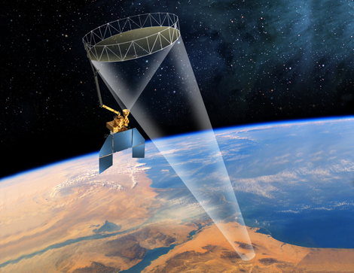
SMAP – Soil Moisture Active Passive
Active
Frequency: 1.26 GHz
Polarizations: VV, HH, HV (not fully polarimetric)
Relative accuracy (3 km grid): 1 dB (HH and VV), 1.5 dB (HV)
Passive
Frequency: 1.41 GHz
Polarizations: H, V, 3rd & 4th Stokes
Relative accuracy (30 km grid): 1.3 K
Spatial Resolution:
Radiometer (IFOV): 39 km x 47 km
SAR: 1-3 km (over outer 70% of swath)
Swath width: 1000 km
Orbit: Polar, Sun-Synchronous
SMAP
Source: NASA
Conically-scanning deployable mesh reflector shared by radar and radiometer (Diameter: 6 m, Rotation rate: 14.6 RPM)
Launch: Nov. 2014

Slide 14
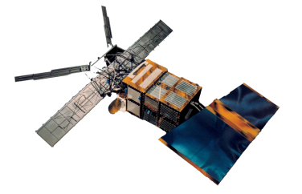
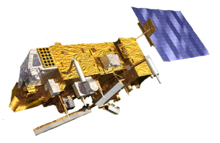
European C-Band Scatterometer
ERS Scatterometers
λ = 5.7 cm / 5.3 GHz
VV Polarization
Resolution: (25) / 50 km
Daily global coverage: 41%
Multi-incidence: 18-59°
3 Antennas
Data availability
ERS-1: 1991-2000
ERS-2: 1995-2011
gaps due to loss of gyros (2001) and on-board tape recorder (2003)
METOP Advanced Scatterometer
λ = 5.7 cm / 5.3 GHz
VV Polarization
Resolution: 25 / 50 km
Daily global coverage: 82 %
Multi-incidence: 25-65°
6 Antennas
Data availability
At least 15 years
METOP-A: since 2006

Slide 15
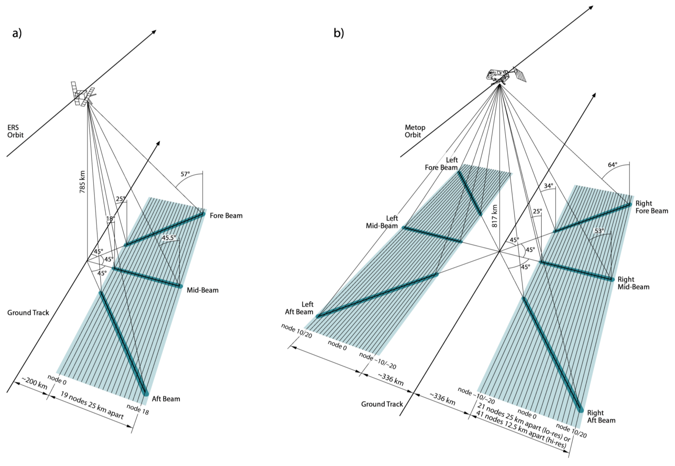
ERS-1/2
METOP ASCAT
Source: Bartalis, 2009

Slide 16
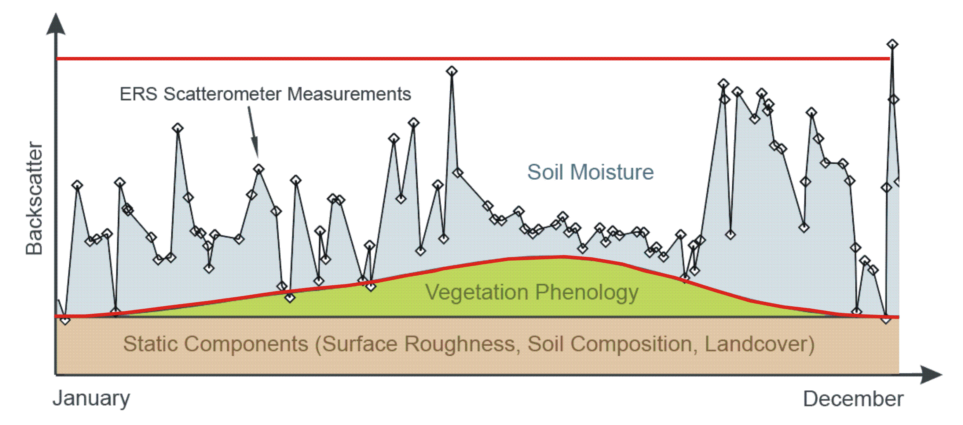
TU Wien Change Detection Approach
SCAT Measurement

Slide 17
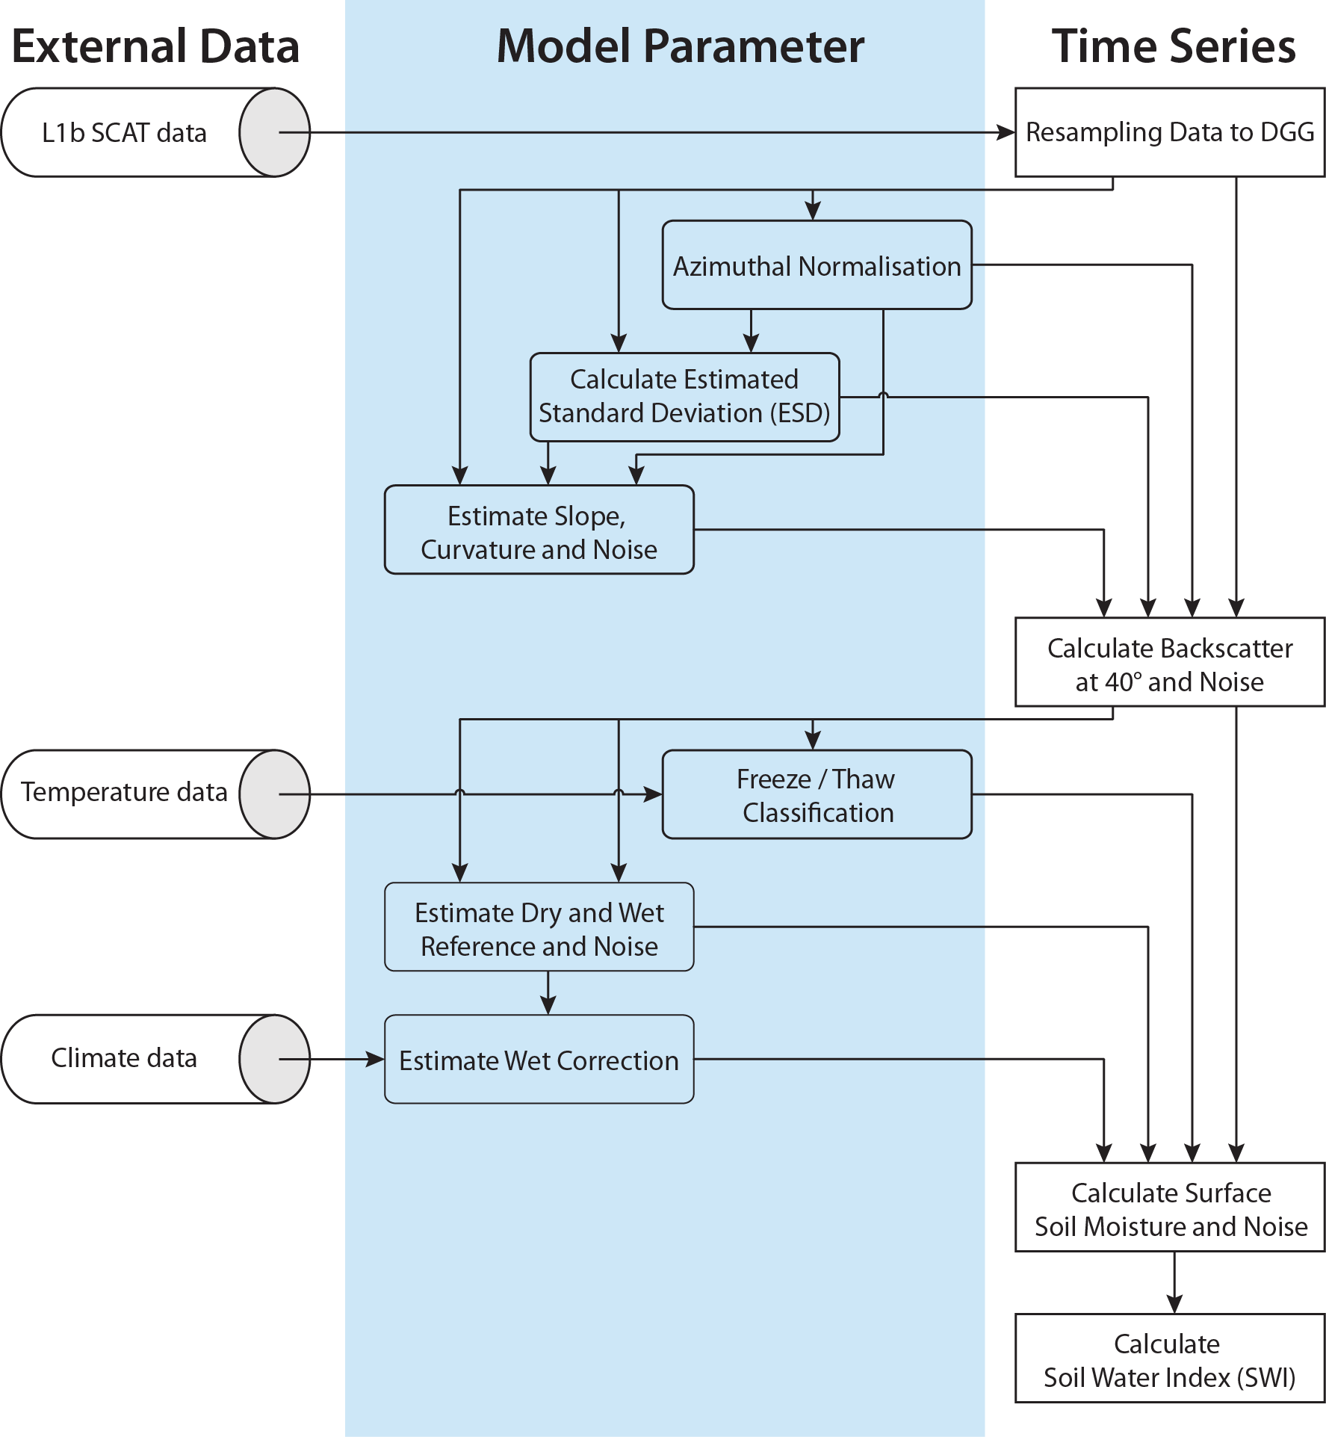
TU Wien Model – Assumptions
Linear relationship between backscatter (in dB) and soil moisture
Empirical description of incidence angle behaviour
Land cover patterns do not change over time
Roughness at a 25/50 km scale is constant in time
Vegetation cycle basically unchanged from year to year
Seasonal vegetation effects cancel each other out at the "cross-over angles"
dependent on soil moisture

Slide 18
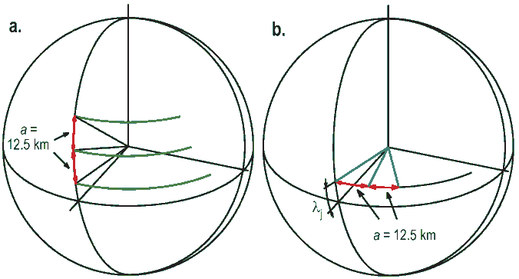
TU Wien Model – Processing steps
Resampling
Constructing the Discrete Global Grid (DGG)
Adapted sinusoidal grid
Ellipsoid: GEM6
Discontinuity at 180° meridian
Azimuthal Normalisation
ESD
Calculate Slope
and Curvature
Incidence angle
Normalisation
Freeze/Thaw detection
Estimation of dry/wet reference
Wet correction
Surface Soil Moisture
Soil Water Index
(SWI)

Slide 19
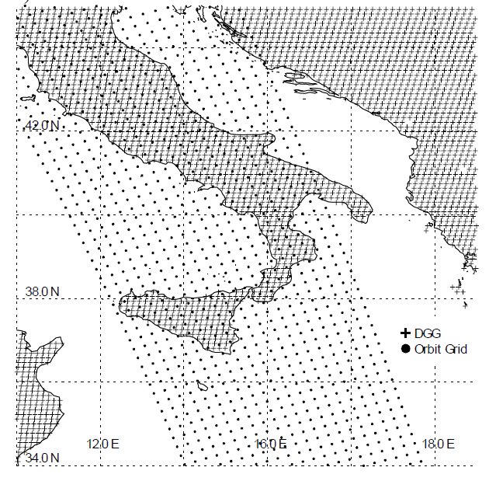
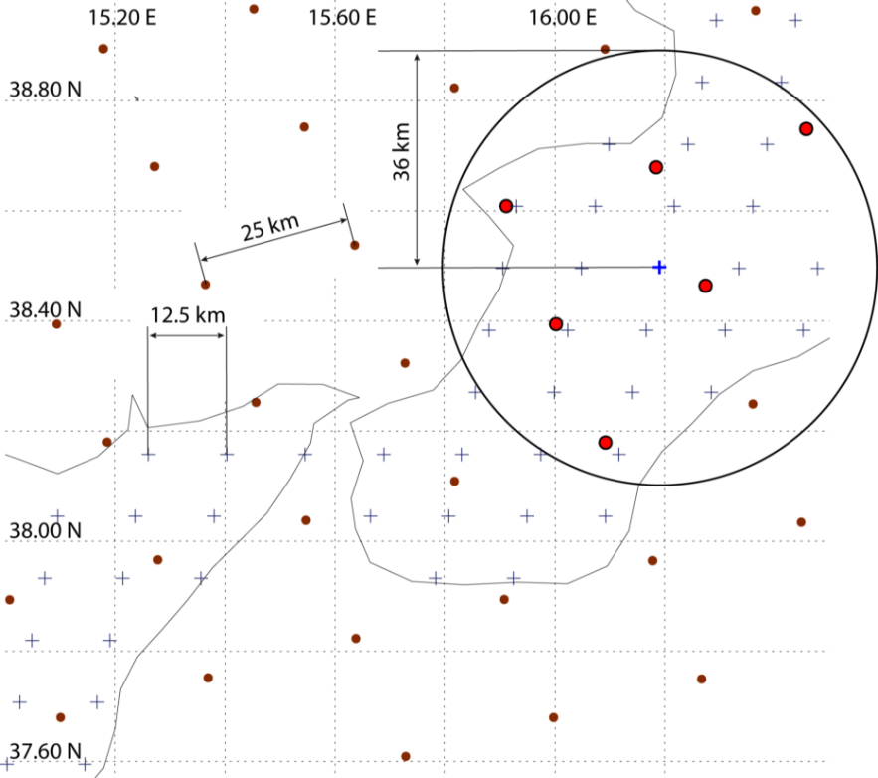
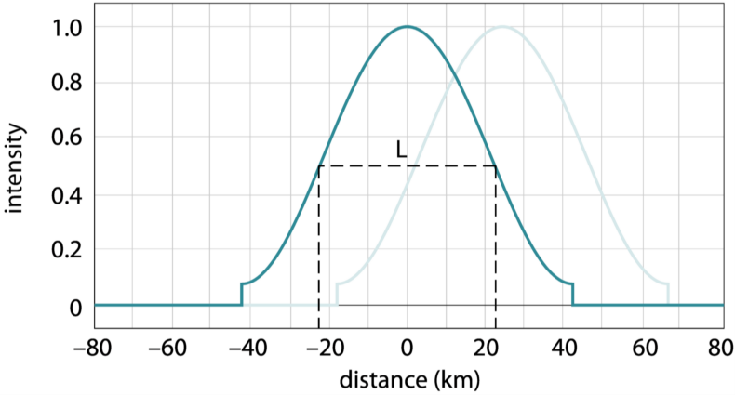
TU Wien Model – Processing steps
Resampling
Azimuthal Normalisation
ESD
Calculate Slope
and Curvature
time
Orbit geometry
Incidence angle
Normalisation
Freeze/Thaw detection
Estimation of dry/wet reference
Wet correction
Surface Soil Moisture
Soil Water Index
(SWI)
Source: Naeimi, 2009 and Bartalis, 2009
Hamming window

Slide 20
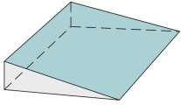
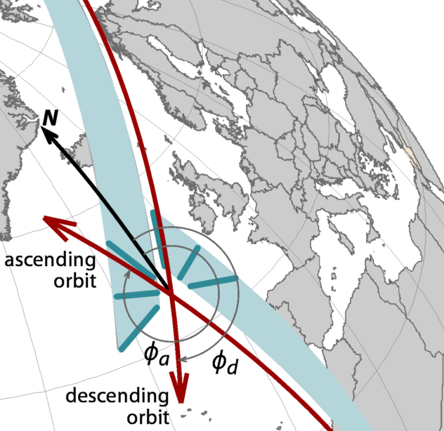
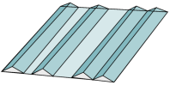
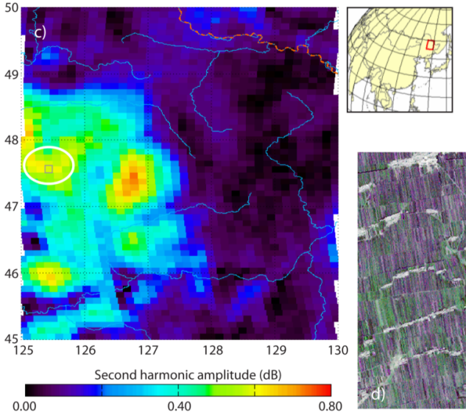
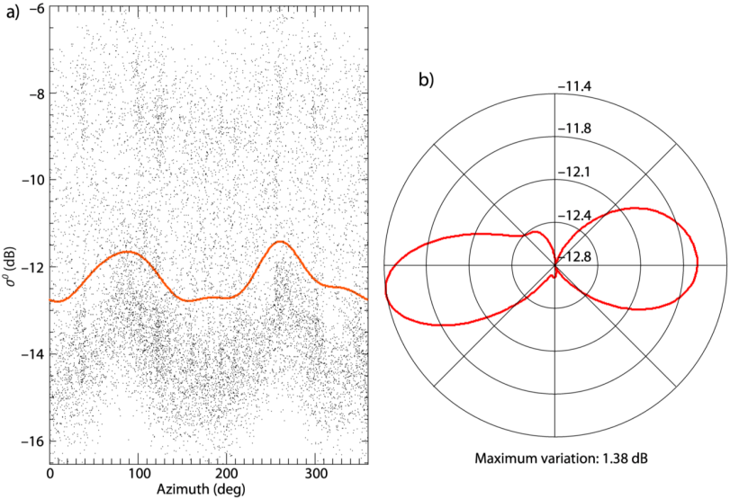
TU Wien Model – Processing steps
Resampling
Azimuthal Normalisation
ESD
Calculate Slope
and Curvature
Incidence angle
Normalisation
Freeze/Thaw detection
Source: Bartalis, 2006 and Bartalis, 2009
Estimation of dry/wet reference
Wet correction
Surface Soil Moisture
Soil Water Index
(SWI)

Slide 21
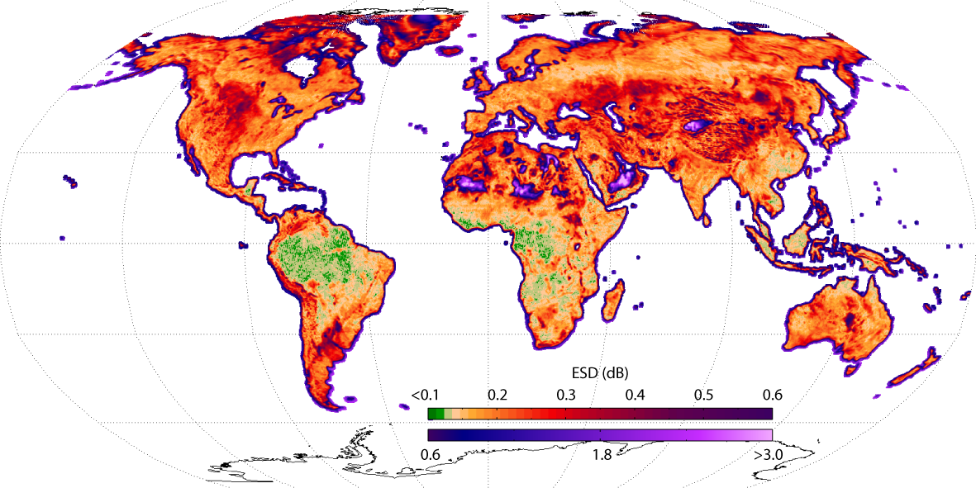
TU Wien Model – Processing steps
Resampling
Estimated Standard Deviation (ESD)
Azimuthal Normalisation
ESD
Calculate Slope
and Curvature
Incidence angle
Normalisation
Freeze/Thaw detection
Estimation of dry/wet reference
Wet correction
Surface Soil Moisture
Soil Water Index
(SWI)
Source: Naeimi 2009

Slide 22
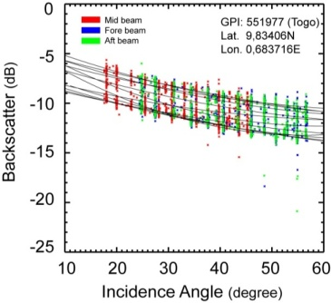
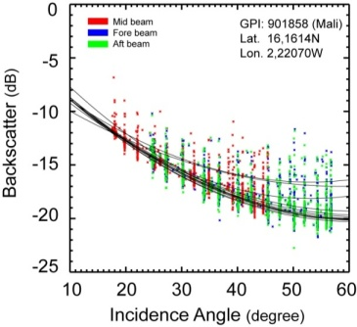
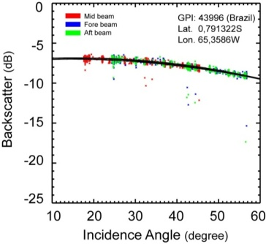
TU Wien Model – Processing steps
Resampling
Incidence angle – backscatter behaviour Source: Naeimi, 2009
Azimuthal Normalisation
ESD
Calculate Slope
and Curvature
Incidence angle
Normalisation
Taylor series (degree 2), expansion point:
Freeze/Thaw detection
measure
slope
curvature
Estimation of dry/wet reference
Wet correction
Surface Soil Moisture
Soil Water Index
(SWI)

Slide 23
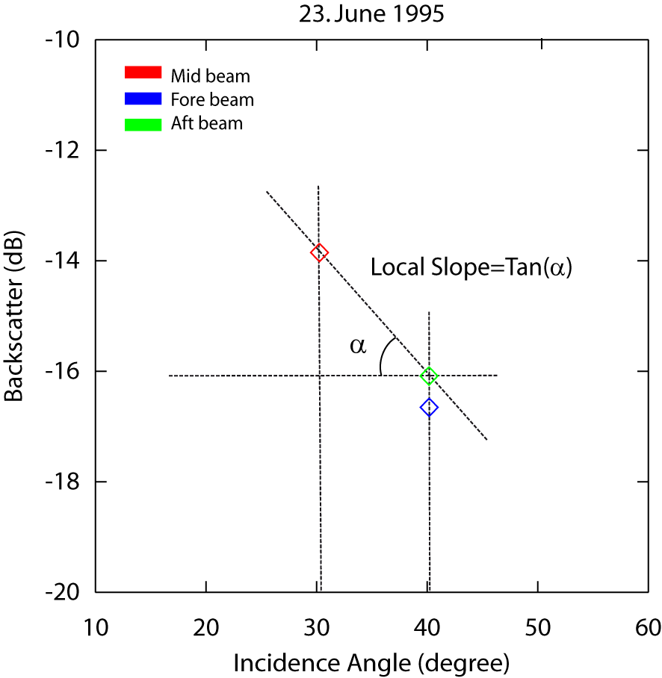
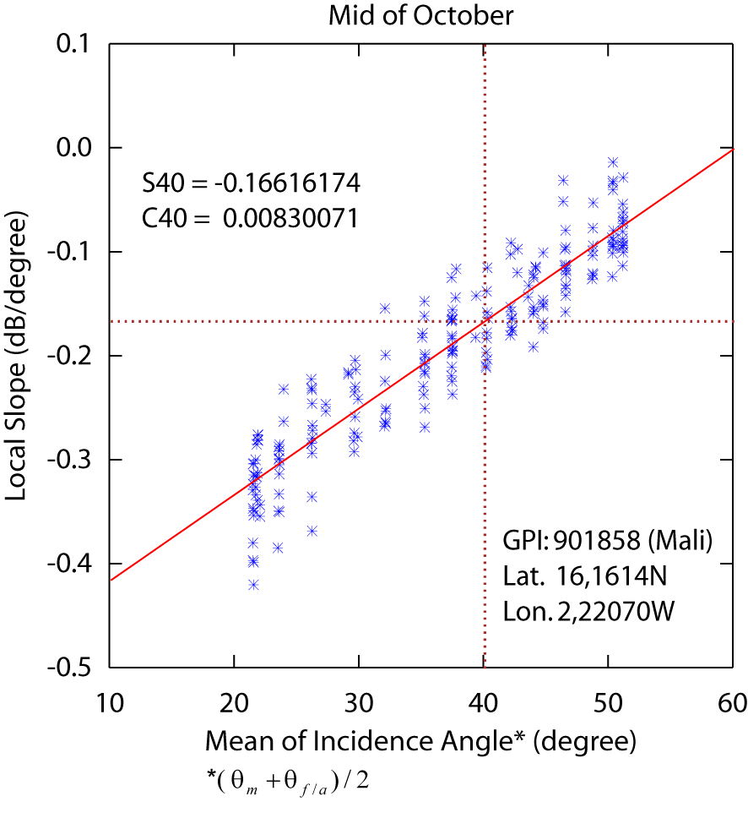
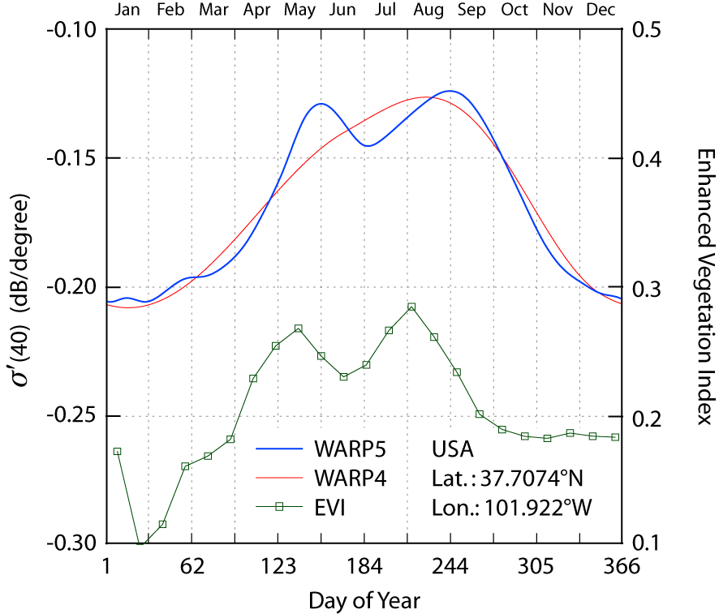
TU Wien Model – Processing steps
Resampling
Azimuthal Normalisation
ESD
Calculate Slope
and Curvature
Incidence angle
Normalisation
Freeze/Thaw detection
Estimation of dry/wet reference
Wet correction
Surface Soil Moisture
Soil Water Index
(SWI)
Source: Naeimi, 2009

Slide 24
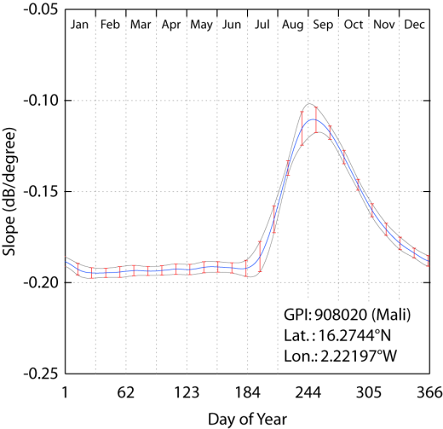
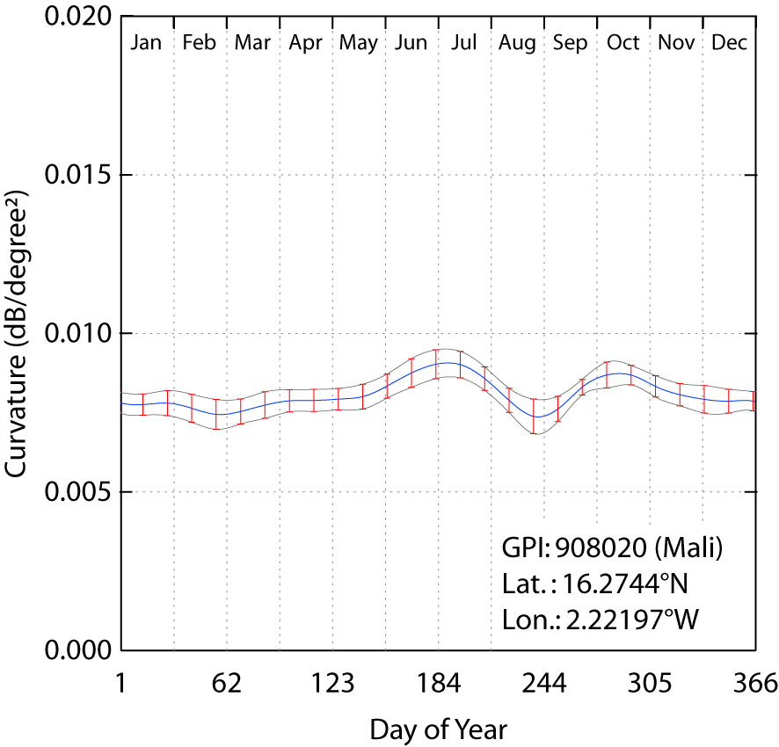
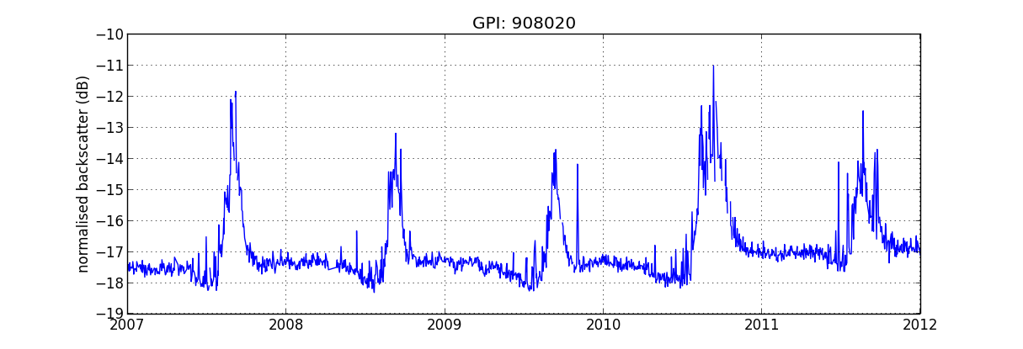
TU Wien Model – Processing steps
Resampling
Source: Naeimi, 2009
Azimuthal Normalisation
ESD
Calculate Slope
and Curvature
Incidence angle
Normalisation
Freeze/Thaw detection
measure
slope
curvature
Estimation of dry/wet reference
Wet correction
Surface Soil Moisture
Soil Water Index
(SWI)

Slide 25
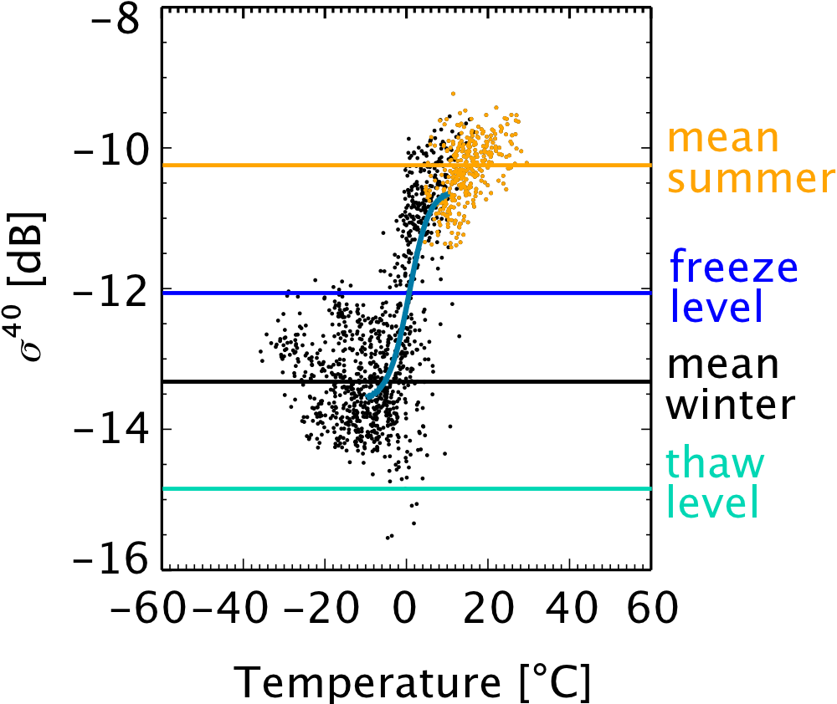
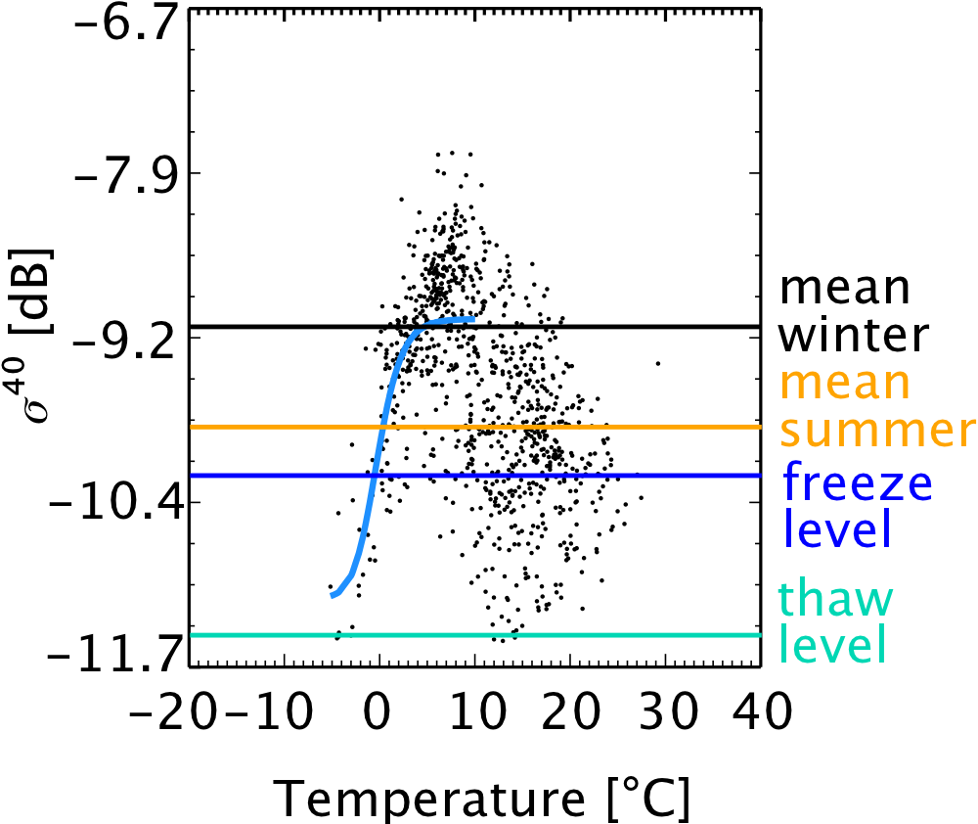
TU Wien Model – Processing steps
Resampling
Surface State Flag (SSF)
Azimuthal Normalisation
ESD
Calculate Slope
and Curvature
Incidence angle
Normalisation
Freeze/Thaw detection
Estimation of dry/wet reference
Wet correction
Surface Soil Moisture
Naeimi, V., Paulik, C., Bartsch, A., Wagner, W., Member, S., Kidd, R., Park, S., et al. (2012). ASCAT Surface State Flag (SSF): Extracting Information on Surface Freeze/Thaw Conditions From Backscatter Data Using an Empirical Threshold-Analysis Algorithm. IEEE Transactions on Geoscience and Remote Sensing.
Soil Water Index
(SWI)

Slide 26
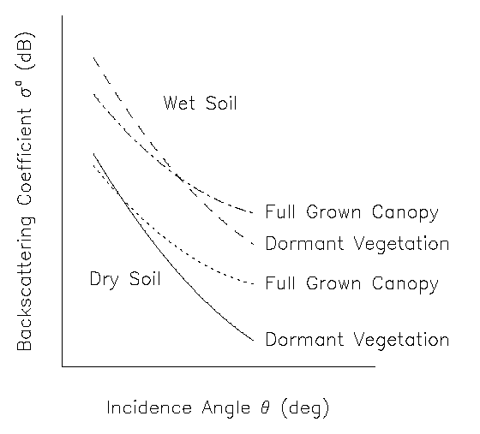
TU Wien Model – Processing steps
Resampling
Source: Wagner, 1998
Cross-over angle concept
Azimuthal Normalisation
ESD
Calculate Slope
and Curvature
Incidence angle
Normalisation
Freeze/Thaw detection
Estimation of dry/wet ref.
Wet correction
Surface Soil Moisture
Soil Water Index
(SWI)
Source: Naeimi, 2009

Slide 27
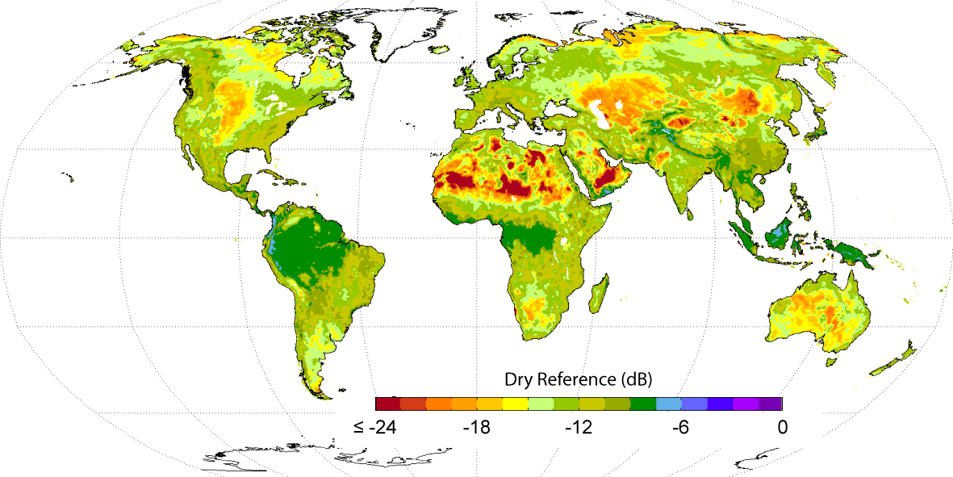
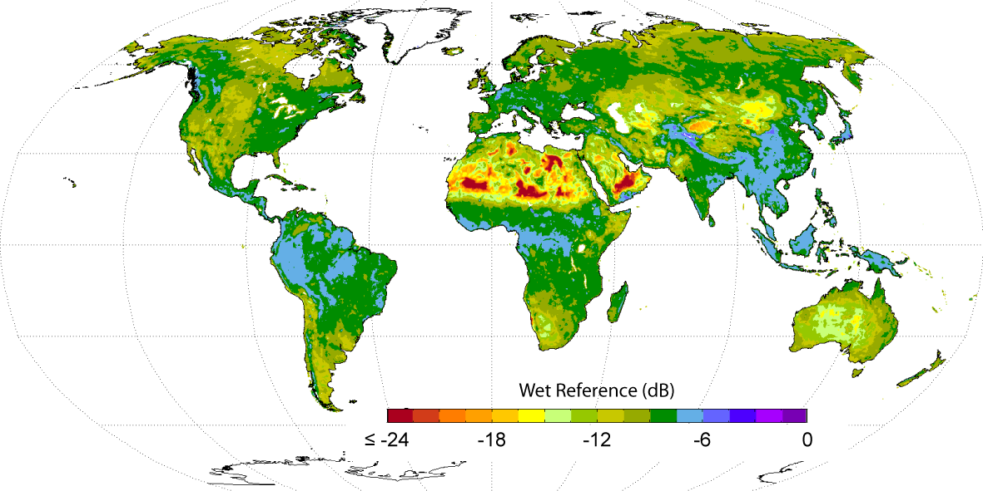
TU Wien Model – Processing steps
Resampling
Azimuthal Normalisation
Dry reference
ESD
Calculate Slope
and Curvature
Incidence angle
Normalisation
Freeze/Thaw detection
Estimation of dry/wet ref.
Wet correction
Wet reference
Surface Soil Moisture
Soil Water Index
(SWI)
Source: Naeimi, 2009

Slide 28
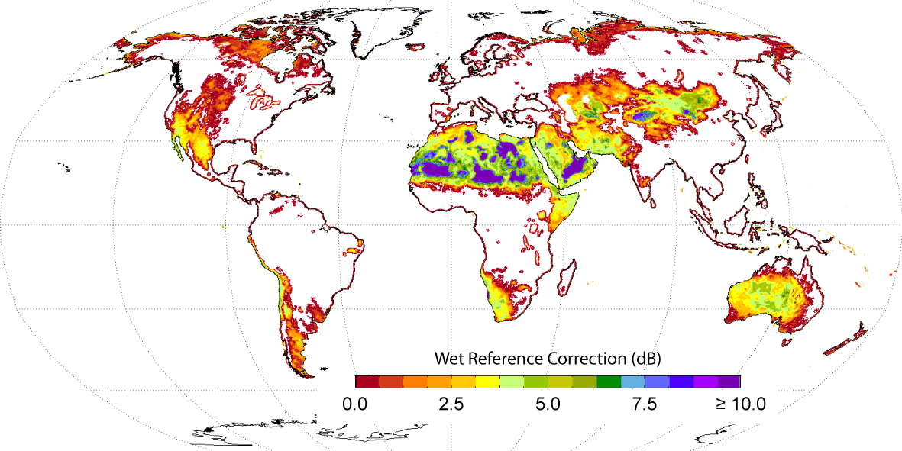
TU Wien Model – Processing steps
Resampling
Problem
In very dry climates the soil wetness does not ever reach to the saturation point
Azimuthal Normalisation
ESD
Calculate Slope
and Curvature
Incidence angle
Normalisation
Freeze/Thaw detection
Estimation of dry/wet reference
Wet correction
Surface Soil Moisture
Soil Water Index
(SWI)
Source: Naeimi, 2009

Slide 29
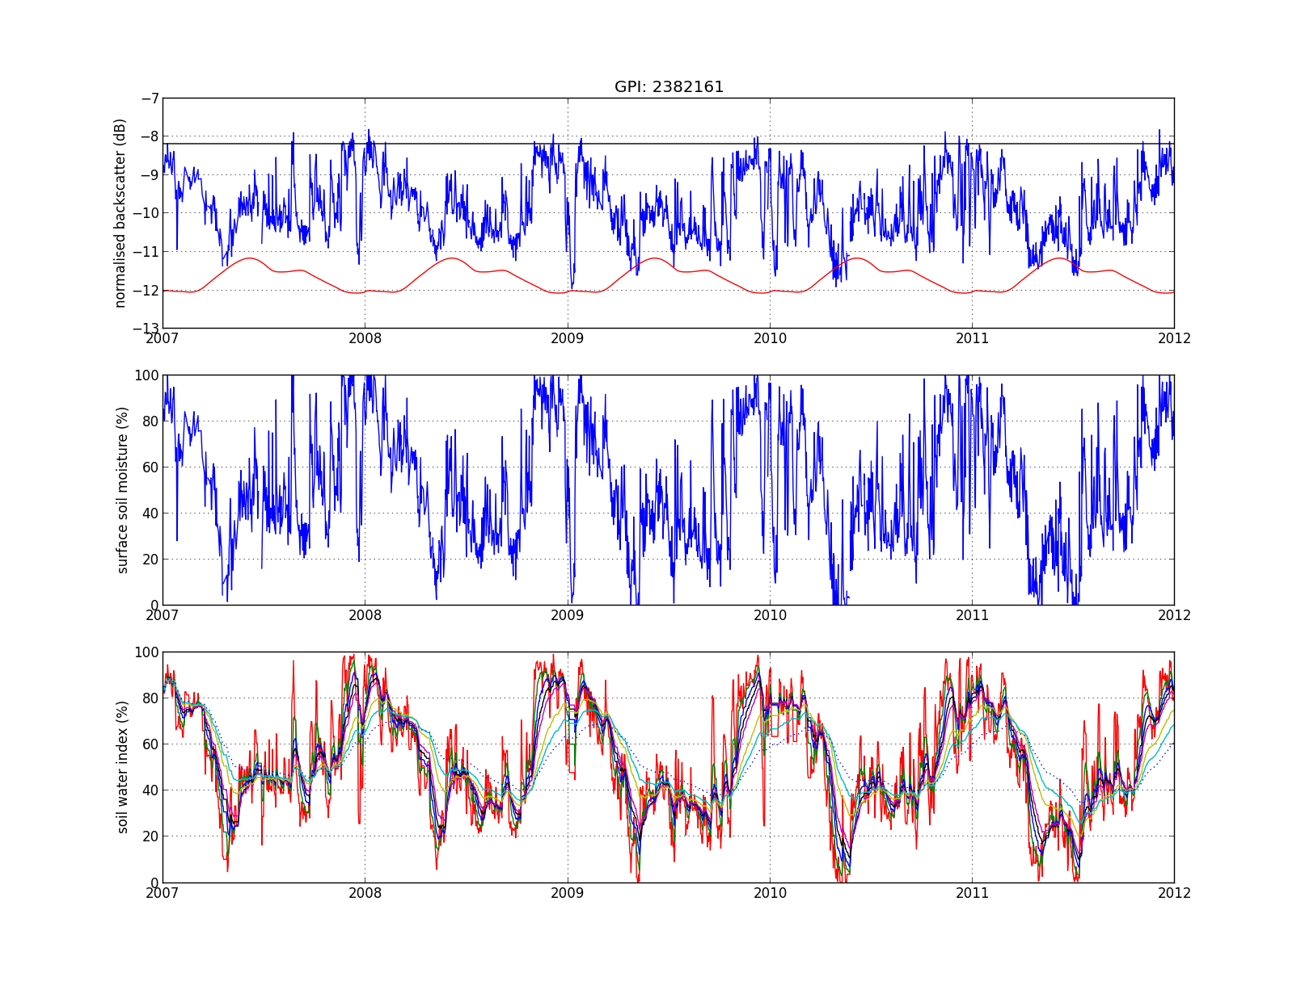
TU Wien Model – Processing steps
Resampling
Soil moisture calculated relative to historically driest and wettest conditions (Degree of Saturation)
Azimuthal Normalisation
ESD
Calculate Slope
and Curvature
Incidence angle
Normalisation
Freeze/Thaw detection
σ
Estimation of dry/wet reference
Wet correction
Surface Soil Moisture
SSM
Soil Water Index
(SWI)

Slide 30
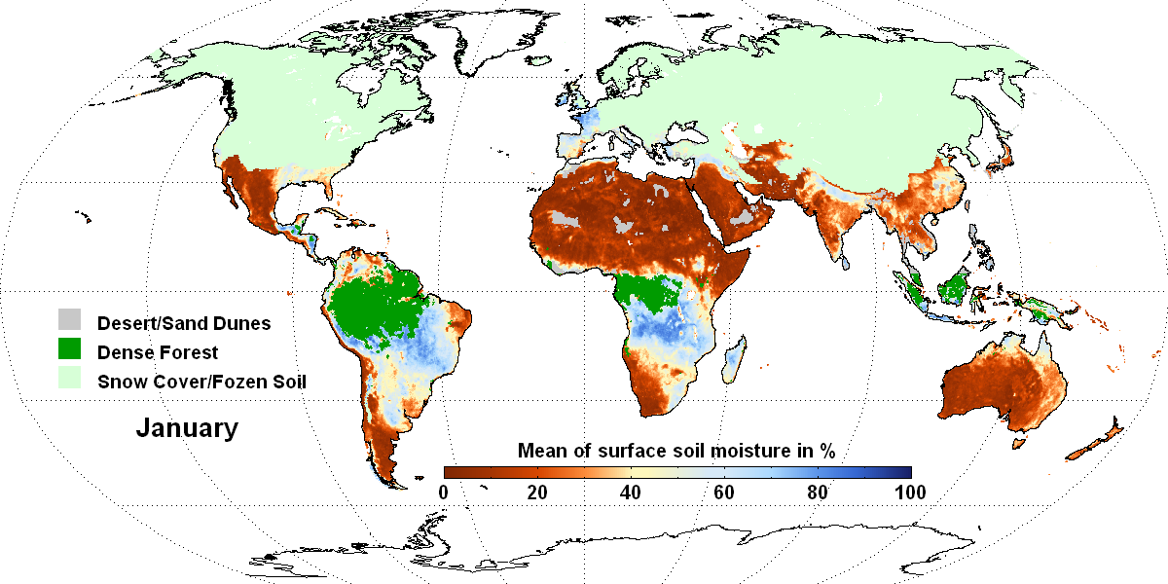
TU Wien Model – Processing steps
Resampling
Mean ERS Scatterometer Surface Soil Moisture
(1991-2007)
Azimuthal Normalisation
ESD
Calculate Slope
and Curvature
Incidence angle
Normalisation
Freeze/Thaw detection
Estimation of dry/wet reference
Wet correction
Surface Soil Moisture
Soil Water Index
(SWI)

Slide 31
TU Wien Model – Processing steps
Resampling
Using the latest x number of surface soil moisture values, calculate the profile soil moisture values using an infiltration model
T...characteristic time length (days)
1, 5, 10, 15, 20, 40, 60, 100 days
Azimuthal Normalisation
ESD
Calculate Slope
and Curvature
Incidence angle
Normalisation
Freeze/Thaw detection
Estimation of dry/wet reference
Wet correction
SSM
Surface Soil Moisture
Soil Water Index
(SWI)
SWI

Slide 32
Resumé of the retrieval
Soil moisture retrieval method is a data-based approach
Starts from the observations, not from theoretical model considerations
Nevertheless, the TU Wien method has a solid physical foundation
Exploits multiple viewing capabilities
Important for modelling the effect of seasonal vegetation growth and decay (phenology)
Exploits the availability of long-term data series
Change Detection Approach: Accounts for heterogeneous land cover and spatial surface roughness patterns
No external/auxiliary datasets are used for the retrieval
Soil texture, soil type, land cover, biomass, evapotranspiration, brightness temperature…
But raw backscattering signatures in different incidence (viewing) angles

Slide 33
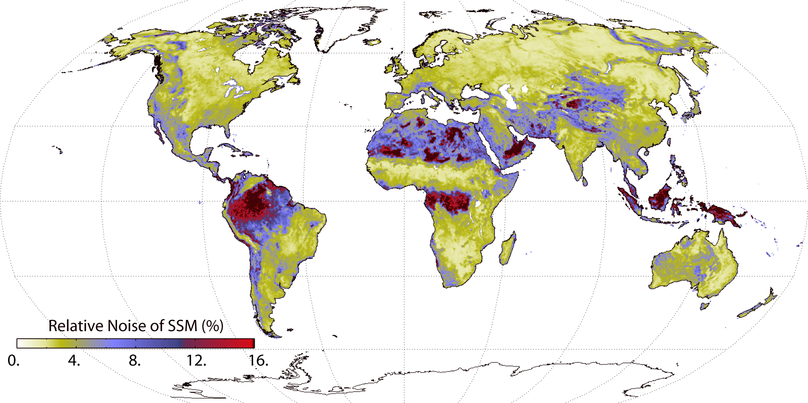
Where does the retrieval go wrong?
Low signal-to-noise ratio (known from error propagation)
Vegetation
Mountainous regions
Urban areas
Where does the model fail?
Frozen ground
(Wet) Snow
Water surfaces
Dry soil scattering
Known calibration issues
Wet correction in arid environments
Differences in sensor calibration
Long-term changes in land cover
Relative Soil Moisture Noise (%)
Source: Naeimi, 2009

Slide 34
ASCAT Soil Moisture Product Families
Surface (< 2 cm) soil moisture (SSM)
25 km / 50 km in near-real-time (~135 min) in orbit geometry (EUMETSAT)
25 km irregularly updated off-line time series at a fixed discrete global grid (H-SAF/TU Wien)
Profile (~2-100 cm) soil moisture = Soil Water Index (SWI)
25 km off-line (TU Wien)
50 km assimilated soil moisture at fixed grid for Europe (H-SAF/ECMWF)
Downscaled ASCAT-ASAR soil moisture
1 km near real-time on fixed grid for Europe (H-SAF/ZAMG/TU Wien)
http://www.eumetsat.int
http://hsaf.meteoam.it
http://www.zamg.at

Slide 35
ASCAT Dataviewer
www.ipf.tuwien.ac.at/radar/dv/ascat/

Slide 36
Conclusion
Soil moisture is currently topic of international agendas
Large and diverse user community
ASCAT offers the first operational soil moisture product distributed by EUMETSAT over EUMETCast
Many positive validation and application studies
Still, product quality can much improved by further developing and improving the algorithms & software
Validation, Intercomparisons and Merging
International Soil Moisture Network
http://www.ipf.tuwien.ac.at/insitu/
Intercomparisons with SMOS, AMSR-E, SMAP, GLDAS, ERA-Interim, ...
Combined soil moisture products
http://www.esa-soilmoisture-cci.org/

Slide 37
Further Reading
Publications
Wagner, W., Lemoine, G., Rott, H. (1999): A Method for Estimating Soil Moisture from ERS Scatterometer and Soil Data. Rem. Sens. Environ. 70: 191-207.
Wagner, W., Naeimi, V., Scipal, K., de Jeu, R., and Martínez-Fernández, J. (2007): Soil moisture from operational meteorological satellites, Hydrogeology Journal, vol. 15, no. 1, pp. 121–131.
Naeimi, V., K. Scipal, Z. Bartalis, S. Hasenauer and W. Wagner (2009), An improved soil moisture retrieval algorithm for ERS and METOP scatterometer observations, IEEE Transactions on Geoscience and Remote Sensing, Vol. 47, pp. 555-563.
Naeimi, V., Z. Bartalis, and W. Wagner, (2009) ASCAT soil moisture: An assessment of the data quality and consistency with the ERS scatterometer heritage, Journal of Hydrometeorology, Vol. 10, pp. 555-563, DOI: 10.1175/2008JHM1051.1.
Technical Reports (www.ipf.tuwien.ac.at/radar)
ASCAT Soil Moisture Product Handbook (Z. Bartalis, V. Naeimi, S. Hasenauer and W. Wagner, 2008)
WARP NRT Reference Manual (Z. Bartalis, S. Hasenauer, V. Naeimi and W. Wagner, 2007)
Definition of Quality Flags (K. Scipal, V. Naeimi and S. Hasenauer, 2005)

