Slide 1
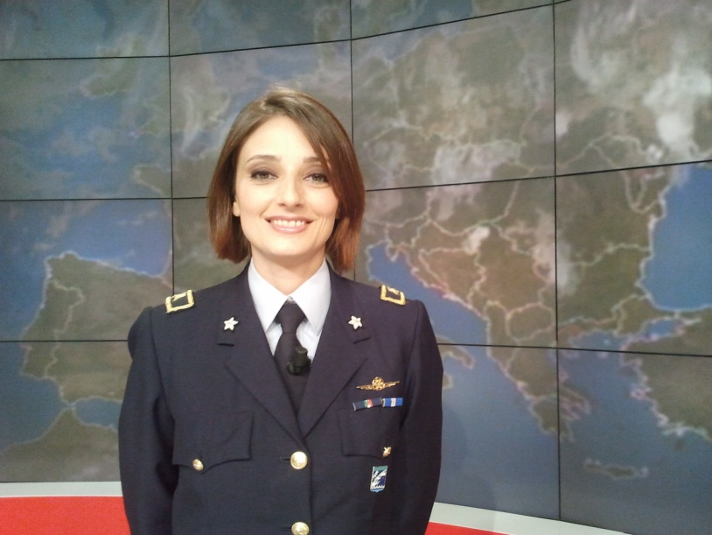
EUMETSAT
Satellite Application Facility on Support to Operational Hydrology and Water Management
Ten Gars Stefania De Angelis

Slide 2
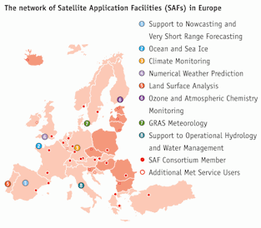
was established by the EUMETSAT Council on 3 July 2005 as part of the
EUMETSAT SAF Network
In March 2012 the Program entered its Second Continuous Development and Operation Phase, which will last until February 2017.

Slide 3
The H-SAF objectives are:
to provide new satellite-derived products, by mean of the following identified products:
precipitation (liquid, solid, rate, accumulated);
soil moisture (at large-scale, at local-scale, at surface, in the roots region);
snow parameters (detection, cover, melting conditions, water equivalent);
to perform independent validation of the usefulness of the new products.

Slide 5
H-SAF Precipitation Products – current status
All precipitation products are generated routinely at the CNMCA, Italy
[Note: CNMCA also manages the Data service for all H-SAF products].

Slide 6
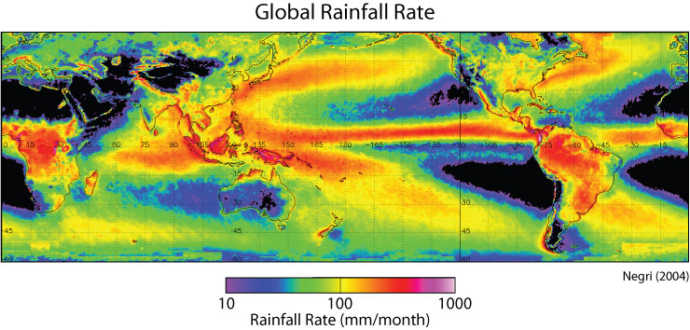
Meteorological satellite provide a unique opportunity for monitoring the precipitation for regions where ground measurement is limited and consistent with the accuracy required by hydrologists.

Slide 7
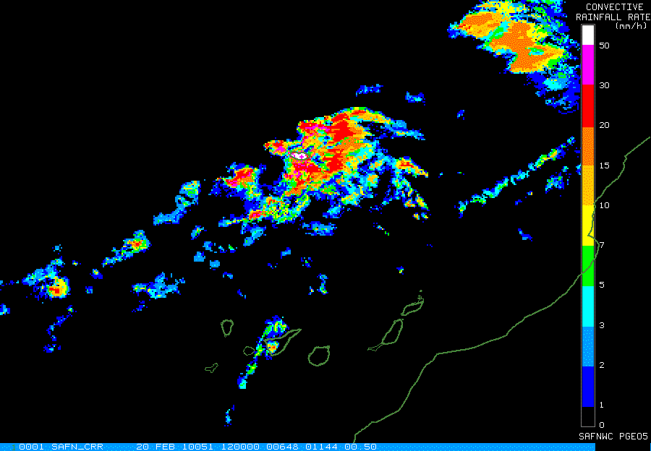
Satellite Rainfall Estimation from infrared and/or visible channels
Rainfall rates are generally derived from cloud-top infrared (IR) brightness temperature, which is related to cloud-top height for optically thick clouds below the tropopause.
Visible cloud albedos are generally used, as supplemental information to discriminate cold clouds which are optically thin and presumably non-precipitating from those which are optically thick and therefore possibly precipitating
NWCSAF Convective Rainfall Rate

Slide 8
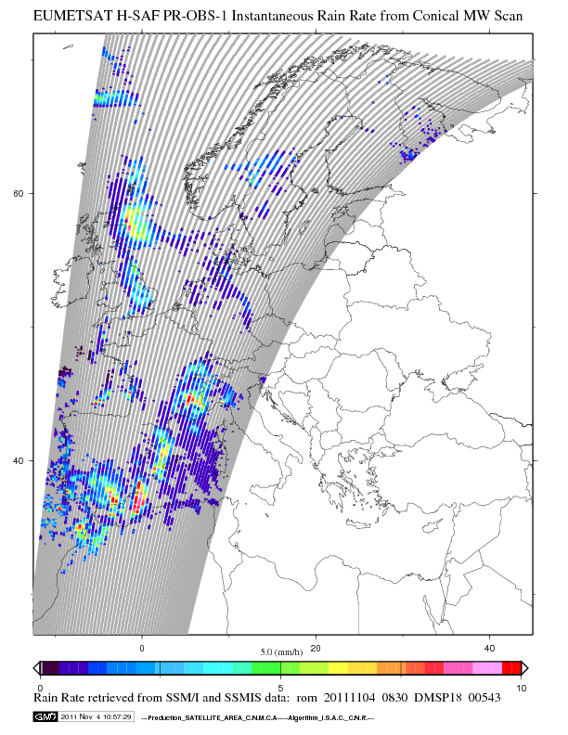
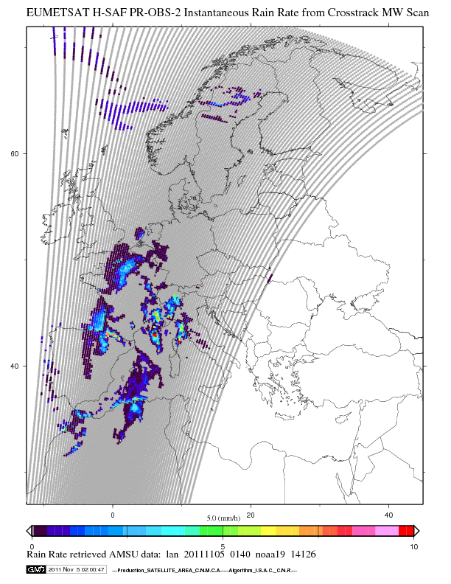
Satellite Rainfall Estimation from MicroWave instruments
Microwave instruments give more reliable information concerning instantaneous precipitation rates on account of their ability to "see" through cloud tops and detect directly the presence of actual precipitation particles within and below the clouds
CNR-ISAC Italy, 2010: Algorithm Theoretical Basic Document for “PR-OBS1 Precipitation rate at ground by MW conical scanners” .
CNR-ISAC Italy, 2010: Algorithm Theoretical Basic Document for “PR-OBS2 Precipitation rate at ground by MW cross-track scanners
Notes:
Advanced Microwave Sounding Unit (AMSU A)
Microwave Humidity Sounder (MHS)
Special Sensor Microwave/Imager (SSM/I) and Special Sensor Microwave Imager Sounder (SSMIS)

Slide 9
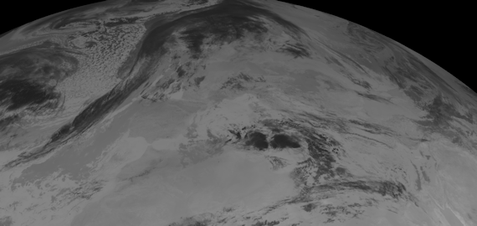
Satellite Rainfall Estimation multi-platform algorithm
So the most common approach is to combine geostationary and low orbital satellite imagery and sounder. This kind of multi-platform algorithm provides global precipitation estimation merging high-quality, sparsely sampled data from METOP, NOAA and DMSP low altitude polar-orbital satellites with the more physically direct detection with continuously sampled data from geostationary satellites

Slide 10
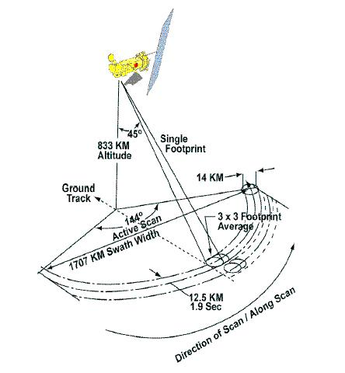
PR-OBS-1
Precipitation rate at ground by MW conical scanners (with indication of phase)
SSMIS is a microwave multispectral, passive radiometer, scanning with conical geometry
PR-OBS-1 uses the data of microwave radiometers of DMSP (Defense Meteorological Satellites Program) satellites.
The DMSP satellites are managed by the US Department of Defence (DoD).
They were all put into sun-synchronous near-polar circular orbits, altitude ~800 Km, inclination ~ 99 degrees, period 102 min.

Slide 11
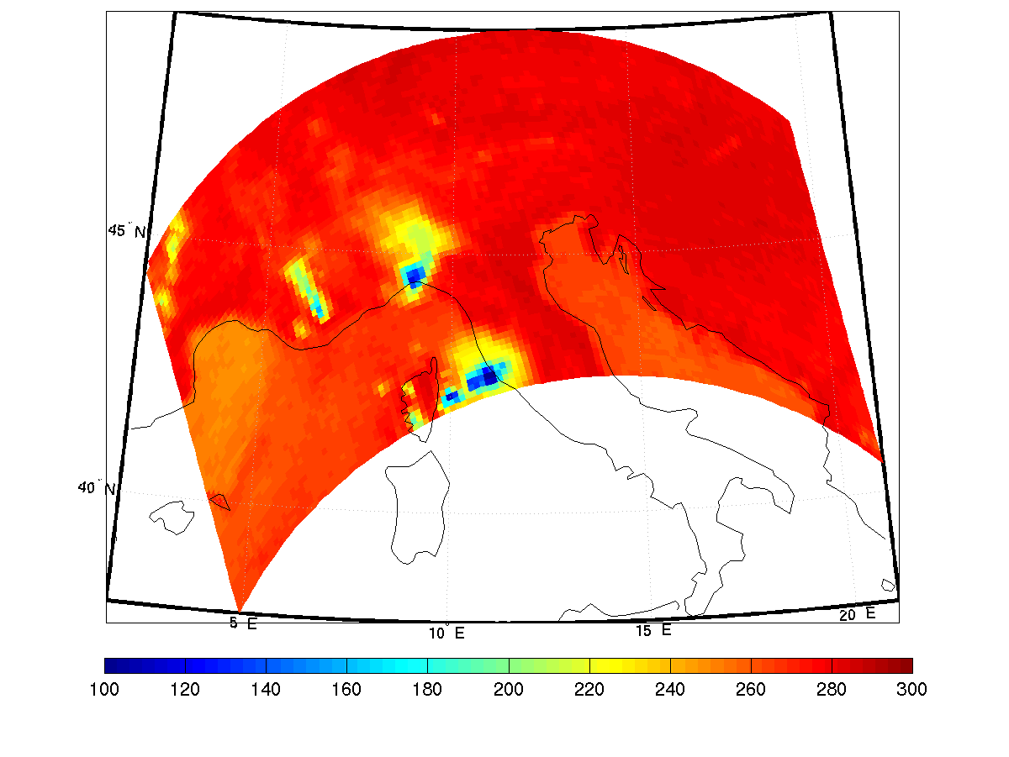
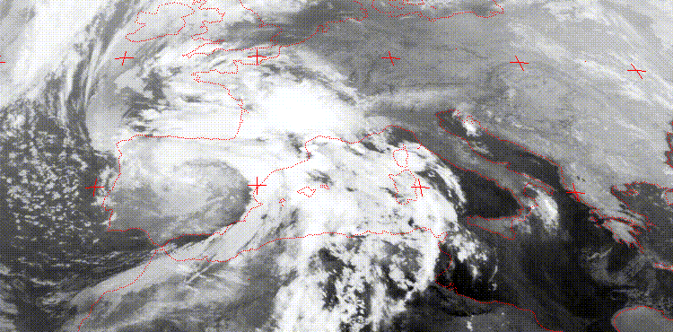
Meteosat IR image –
September 27, 1992
Corresponding microwave (SSM/I) observations @ 85 GHz - September 27, 1992 @ 16:51 UTC
MW radiation interacts with all the cloud layers. The signal is more sensible to precipitation. Convective cells can be recognized.
IR or VIS signal is emitted from the cloud top.
Notes:
This slide shows why we use mw radiometer

Slide 12
PR-OBS-1
Measurements of brightness temperature (TB) are made by radiometers on Low Earth Orbit (LEO) satellites of the Defence Meteorological Satellites Program (DMPS).
The relationship that links the brightness temperature to precipitation has a variable degree of complexity (from minimum at the lower frequencies over the sea to maximum at higher frequencies over land), and in addition invariably refers to columnar contents of liquid or ice water.
The vertical structure necessary for the retrieval is input through the use of a database of radiative cloud/precipitation models previously built by means of simulations carried out over real events. The accuracy of the product depends on the representativeness of the database.
Precipitation rates are estimated by means of Bayesian technique using the passive microwave measurements (brightness temperatures) and a probabilistic (Bayesian) analysis of a Cloud Radiation Database (CRD).

Slide 13
How is PR-OBS-1 obtained?
Raw data
Satellite
Precipitation rate at ground (mm/hr)
Bayesian variance
Quality index
Precipitation phase
Latitude, Longitude
Surface type (land, ocean, coast)
Data
output
input
Bayesian Retrieval
Final data for
the users
Post-processing
Satellite:
Defense Meteorological Satellites Program (low earth orbit (LEO)).
PR-OBS-1 production:
Data acquisition and PR-OBS-1 production is on Italian Air Force Meteorological Service (C.N.M.C.A.)
responsibility.
Radiometric system:
SSM/I is a 7 channel, 4 frequencies, linearly polarized, passive microwave radiometer.
SSMIS is a 24 channel, 21 frequencies, passive microwave radiometer.
Bayesian Retrieval:
Bayesian technique estimates precipitation rates using the passive microwave measurements
(brightness temperatures) and a probabilistic (Bayesian) analysis of a Cloud Radiation Database (CRD). The development of the Bayesian retrieval algorithm is on CNR-ISAC (Rome) responsibility
Notes:
CNMCA acquires the data from UK Met Office via ftp. The delay from the end of acquisition of one orbit is in the range of 90 min.
About 2.5 hours
Operationl chain that produces pr-obs-1
The product is generated in two steps
The first step consists in the processing of satellite data using a bayesian retrieval algorithm
The second step consists in a post processing procedure that converts the output of the bayesian alg. to the final format for the user
We will see this tachnique in detail in the following slides
Aboard this satellite
noaa->metoffice->cnmca

Slide 14
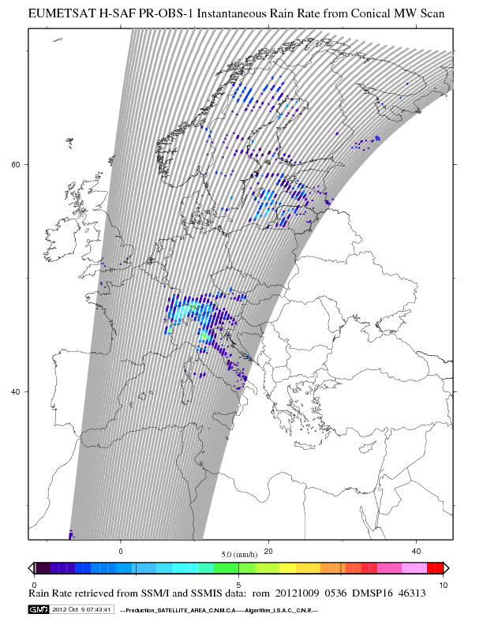
PR-OBS 1 – Map examples

Slide 15
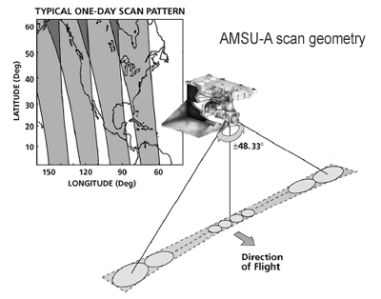
PR-OBS-2
Precipitation at ground by MW cross-track scanners
Surface precipitation rate in mm/hr (in ASCII, BUFR, MAPS format) is generated from MW images taken by cross-track scanners on operational satellites in sunsynchronous orbits.
In absorption bands exploited for temperature sounding
(the 54 GHz band of AMSU-A) or for water vapour sounding
(the 183 GHz band of AMSU-B and MHS) the effect
of surface emissivity is minimised. Precipitation
represents a “disturb” for these instruments,
is retrieved by exploiting the differential effect
of liquid drops or ice particles at different frequencies
associated to weighting functions peaking in different
atmospheric layers.
It is a highly indirect principle that implies that only part of the retrieval process is physically-based, whereas substantial part of the retrieval is currently relying on the use of neural networks
Notes:
The AMSU is a multi-channel microwave radiometer installed on meteorological satellites. The instrument examines several bands of microwave radiation from the atmosphere to perform atmospheric sounding of temperature and moisture levels.
The Advanced Microwave Sounding Unit (AMSU) instruments scan continuously in a "whisk broom" mode. During about 6 seconds of each 8-second observation cycle, AMSU-A makes 30 observations at 3.3° steps from −48° to +48°. It then makes observations of a warm calibration target and of cold space before it returns to its original position for the start of the next scan. In these 8 seconds the subsatellite point moves about 48 km, so the next scan will be 48 km further along the track. AMSU-B meanwhile makes 3 scans of 90 observations each, with a spacing of 1.1°.
During any given 24-hour period there are approximately 16 orbits. Almost the entire globe is observed in either daylight or nighttime mode, many in both. Polar regions are observed nearly every 100 minutes.
The AMSU has two sub-instruments, AMSU-A and AMSU-B. AMSU-A has 15 channels between 23.8 and 89 GHz, and is used primarily for measuring atmospheric temperatures (known as "temperature sounding"). It has a ground resolution near nadir of 48 km. AMSU-B/MHS, with five channels between 89 and 183.3 GHz, has a spatial resolution near nadir of 16 km and is primarily intended for moisture sounding. Spot size of both sub-instruments becomes larger and more elongated toward the edges of the swath.
When the two instruments are used together, there are roughly 9 AMSU-B fields-of-view in a 3x3 array corresponding to each AMSU-A field-of-view. This reflects the higher spatial variability of water vapor compared to temperature.

Slide 16
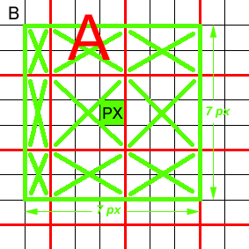
AMSU RR – Potentially precipitating mask (H02)
To screen potentially precipitating pixels the altitude and following TB are used: AMSU-A ch.5, (53.6 GHz), AMSU-B (MHS) ch.4, (183.31+3.00)GHz and ch.5 (183.31+7.00) GHz.
AMSU-A ch.5 -TB 53.6 GHz (T53.6) is the spatially filtered limb-corrected and resampled obtained by selecting the warmest brightness temperature (9 AMSU-A values) within a 7×7 array of AMSU-B pixels.
Black color: AMSU-B grid
Red color: AMSU-A grid
Green color: 7x7 array of AMSU-B grid

Slide 17
AMSU RR – Potentially precipitating mask (H02)
The (183.31±7.00) GHz channel is reasonably good for detecting precipitation also because the angle-dependent variation of precipitation-free brightness temperatures is small when compared to the variation due to precipitation.
To realize a potentially precipitation mask T threshold values are determined empirically.
All 16-km pixels with brightness temperatures at (183.31±7.00) GHz that are below a threshold T₇ are flagged as potentially precipitating, where:
However, the (183.31±7.00) GHz channel can become sensitive to surface variations in very cold, dry atmospheric conditions.

Slide 18
AMSU RR – Potentially precipitating mask (H02)
If T 53.6 < 248 K the atmosphere is cold and dry and in this case the (183.31±3.00) GHz TB is compared to a threshold T3 defined below:
The thresholds T₇ and T₃ are slightly colder than a saturated atmosphere would be, implying the presence of a microwave-absorbing or scattering cloud.
Potentially precipitation mask
If (T53.6 >248) K and TB (183.31±7.00) GHz <T7 → potentially precipitating
If (242<T53.6 <248) K and TB (183.31±3.00) GHz <T3 → potentially precipitating
If (T53.6<242) K → no precipitating (Atmosphere cold and dry)
If altitude > A(θlat) → no precipitating

Slide 19
AMSU RR - Neural Net Algorithm (H02)
Since the relationship between precipitation and satellite brightness temperatures is nonlinear and imperfectly known, the rain rate retrievals value here employ neural networks trained with tested physical models.
The estimates for surface precipitation rates were trained using a mesoscale numerical weather prediction (NWP) model (MM5), a two-stream radiative transfer model (TBSCAT), and electromagnetic models for icy hydrometeors (F(λ)).
The MM5 model has been initialized with National Center for Atmospheric Research (NCEP) for 122 representative storms and their corresponding brightness temperatures simulated at AMSU frequencies.
Only storms with simulated morphologies that match simultaneous AMSU observations near 183±7 GHz were used. The global nature of these storms used for training addresses the principal weakness in statistical methods trained with radar or other non-global data.
The validity of these simulated storms is supported by their general agreement with histograms of concurrent AMSU observations

Slide 20
AMSU RR - Neural Net Algorithm (PR-OBS-02)
.
Neural networks were trained to retrieve 15-minutes average surface precipitation rates for rain and snow at 15-km resolution for land and sea at all viewing angles.
Different algorithms were used for land and sea, where principal component analysis was used to attenuate unwanted noises, such as surface effects and angle dependence.
All neural networks have three layers with 10, 5, and 1 neuron, respectively, where the first two layers employ tangent sigmoid operators, and the final layer is linear.
The Levenberg-Marquardt training algorithm was used and the net weights were initialized using the Nguyen-Widrow method.
C. Surussavadee and D. H. Staelin, “Global Millimeter-Wave Precipitation Retrievals Trained with a Cloud-Resolving Numerical Weather Prediction Model, Part I: Retrieval Design,” IEEE Transactions on Geoscience and Remote Sensing, vol. 46, no. 1, pp. 99-108, Jan. 2008.
C. Surussavadee and D. H. Staelin, “Global Millimeter-Wave Precipitation Retrievals Trained with a Cloud-Resolving Numerical Weather Prediction Model, Part II: Performance Evaluation,” IEEE Transactions on Geoscience and Remote Sensing, vol. 46, no. 1, pp. 109-118, Jan. 2008.

Slide 21
AMSU RR - Neural Net Algorithm (PR-OBS-02)
NOAA-15 – 10 Oct 2009, 04:10 UTC

Slide 22
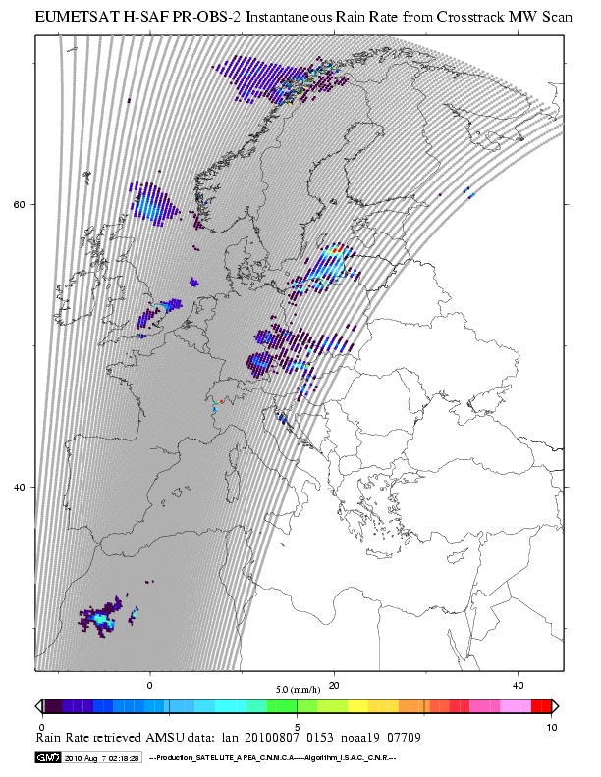
PR-OBS 2 – Map example

Slide 23
PR-OBS-3
Tracking a rain system by means of the Rapid Update algorithm
The Naval Research Laboratory MW-IR blended technique - Rapid Update (RU)
DEF: It derives groundfall rain intensity at the SEVIRI time (15’) and space resolution (~4 km, depending on lat and long) by means of statistical relationships between Channel 9 brightness temperature (10.8 μm) and rain maps from MW sensors/algortihms (Turk et al. 2000, Torricella et al. 2007).

Slide 24
The Rapid Update algorithm (OBS-03)
It is based on a blended MW-IR technique that correlates, by means of the statistical probability matching, brightness temperatures measured by the geostationary sensors and precipitation rates at ground derived from PMW data.
Main inputs to the RU procedure
geolocated IR brightness temperatures at 10.8 μm from the MSG-SEVIRI;
rain intensities from PMW algorithms.
Required information for both input data sets
detailed information about the observation acquisition time;
data geolocation
spatial resolution
observation geometry (satellite zenith angle).

Slide 25
Combining two different types of observation of the rain field
Rain probability distributions from LEO platforms and BT probability distributions from GEO IR observations are matched to derive statistical BT vs rain intensity relationships via Probability matching method
time
t₋₂
t₋₁
t₀
t₊₁
…etc
time “window”
MSG SEVIRI BT measurements each 15’
Non-equally spaced MW observation

Slide 26
First step: Compute (or ingest) RR from PMW and BT from IR
AMSU overpass (NOAA15)
19 October 2006 ~ 0520 UTC
SEVIRI CHANNEL 9 10.8 0542 UTC

Slide 27
Second step: Extract space and time coincident locations from IR and MW data
GEO IR
LEO MW

Slide 28
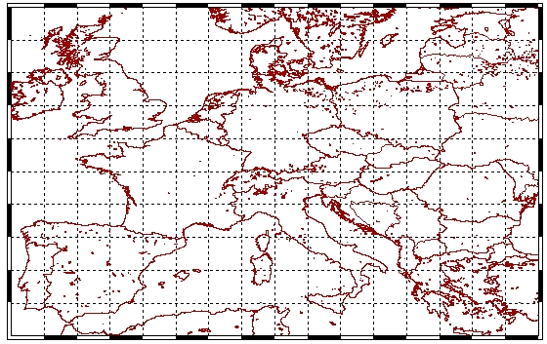
Third step: Accumulate coincident points are for NHOURS = 24 h in each grid point (i, j) of the mesh (2.5° x 2.5°) covering the area. To reach a certain coverage (75%) or minimum number of points (400) to get geo-located BT vs rain rate relationships
2.5°
2.5°

Slide 29
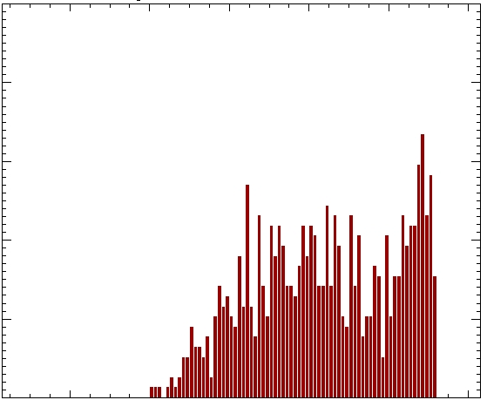
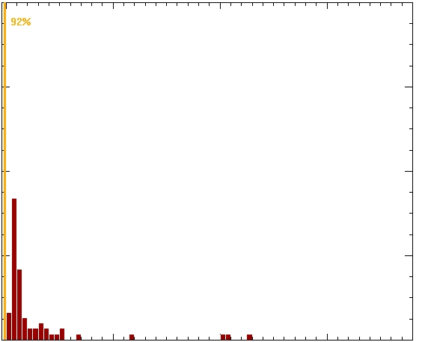
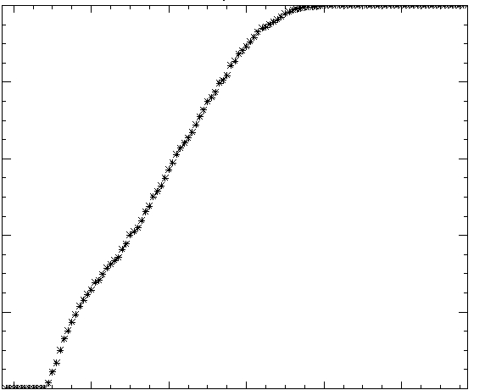
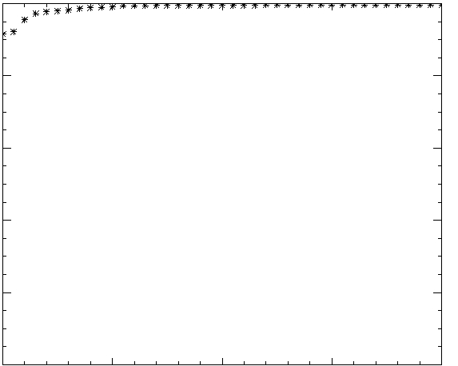
Fourth step: Apply the Probability Matching Method (PMM)
5
TB histogram
8
RR histogram
4
6
3
4
zero rain bin
2
1
2
0
0
200
220
240
260
280
300
0.01
10
20
30
40
100
cdf
100
cdf
80
80
60
60
40
40
20
20
0
0
300
280
260
240
220
200
0
5
10
15
20

Slide 30
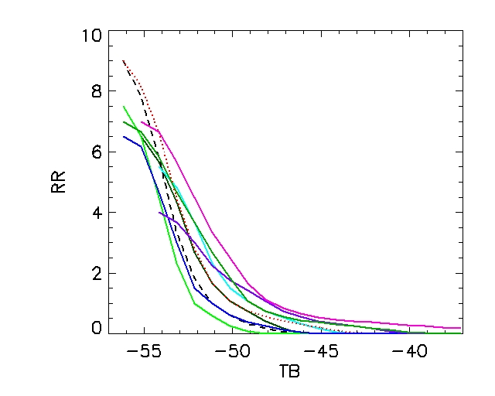
Fifth step: Compute the statistical relationships for each grid box

Slide 31
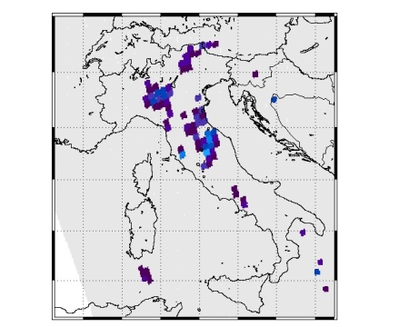
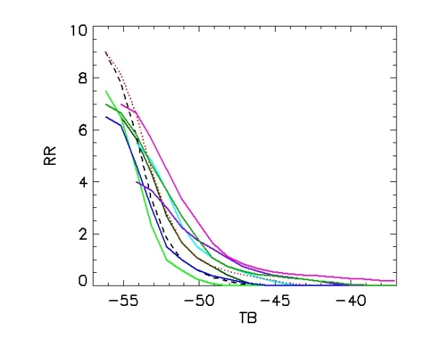
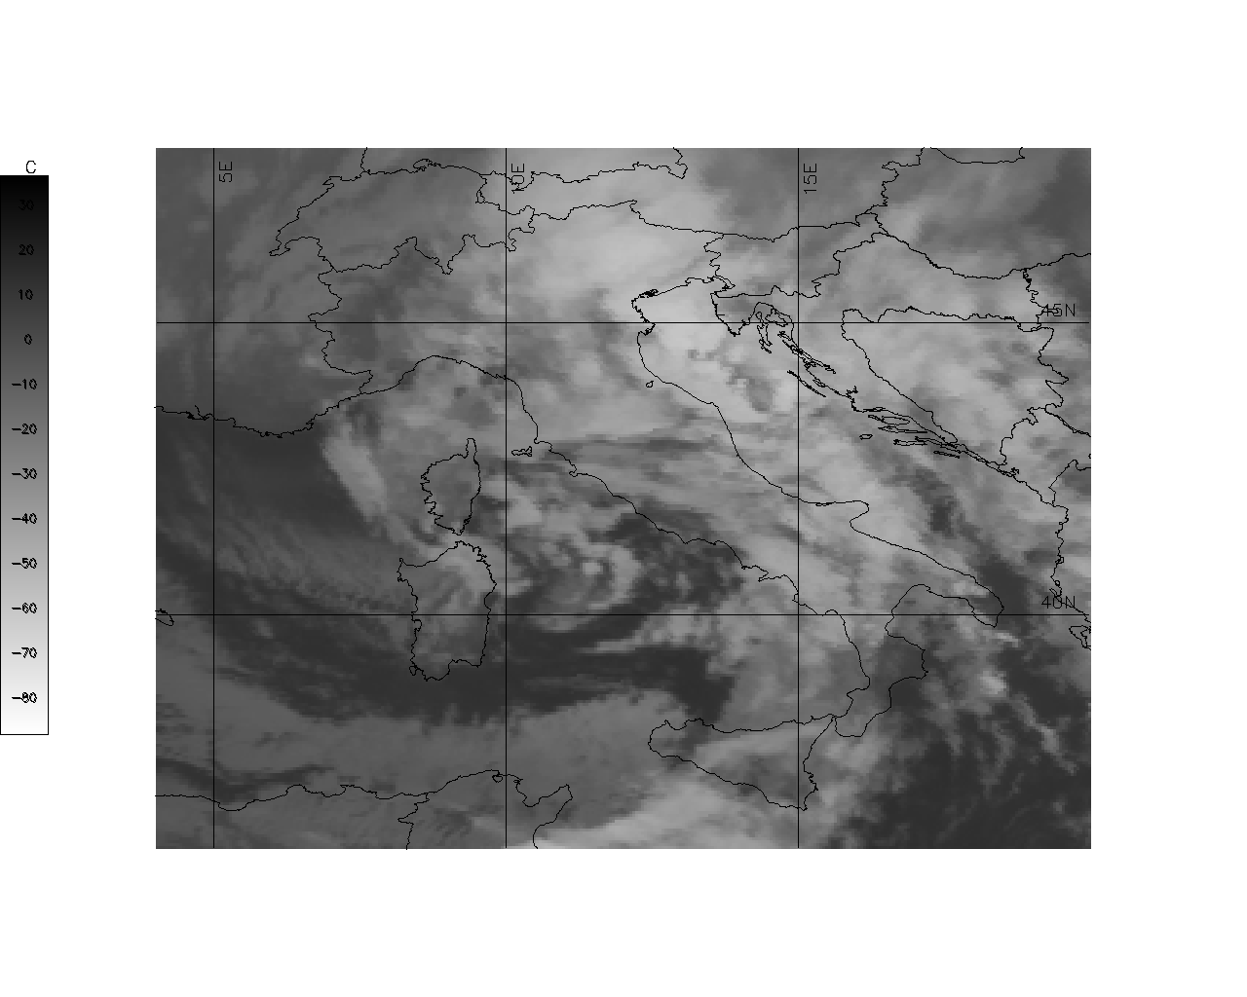
Rain intensity maps from PMW data
RU complete operative scheme
Extract space and time coincident locations from IR and MW data for each grid box
Create geolocated statistical relationships RR-T_{b}
AT TIME t…
MSG- SEVIRI IR brightness temperatures at 10.8 μm
Assign RR at
every IR pixel
Produce instantaneous rain intensity maps at the geostationary time/space resolution
The process is restarted for each IR slot in the study period

Slide 32
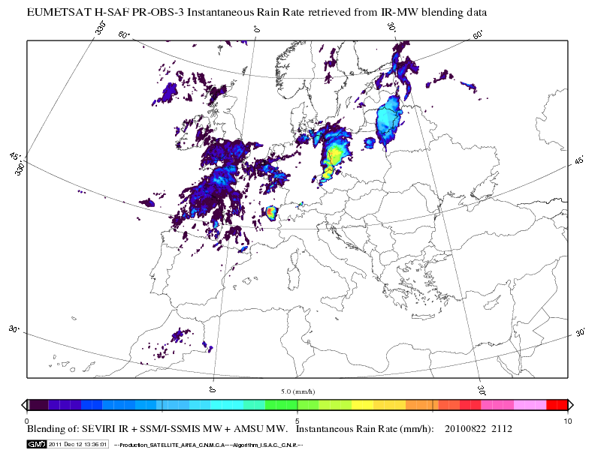
Satellite Rainfall Estimation multi-platform algorithm
HSAF PR-OBS3: BLENDING Technique
The PR-OBS3 algorithm is based on a collection of time and space overlapping SEVIRI IR images and Low Earth Orbit (LEO) MW radiometers. As a new MW swath is available, the MW-derived pixels are paired with the time and space coincident geostationary (GEO) TB at 10.8 mm. Coincident data are subsequently located in a geographical latitude-longitude grid (2.5° x 2.5°), and for each grid box the histogram of the IR TBs and that of the corresponding MW rain rates is built.
Notes:
Allow to derive groundfall rain intensity at the SEVIRI time (15’) and space resolution (~4 km, depending on lat and long) by means of statistical relationships between Channel 9 brightness temperature (10.8 μm) and rain maps from MW sensors/algortihms (Turk et al. 2000, Torricella et al. 2007).

Slide 33
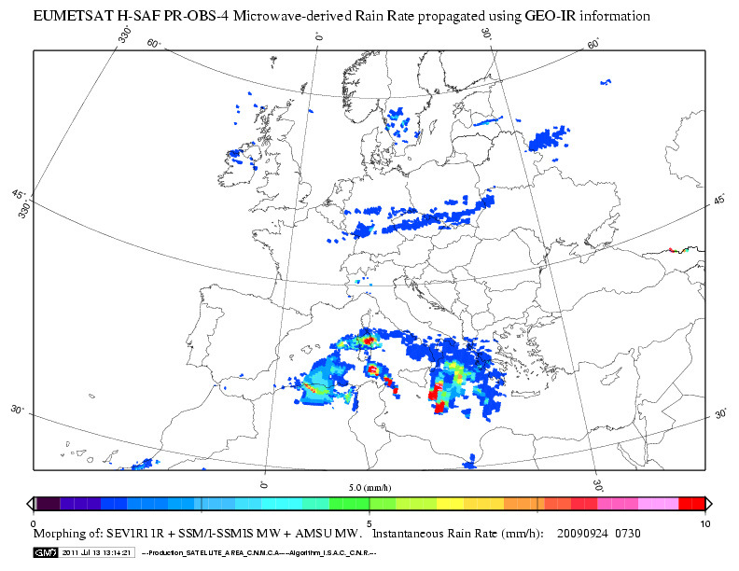
Satellite Rainfall Estimation multi-platform algorithm
HSAF PR-OBS4: MORPHING Technique
Propagation vector matrices are produced by computing spatial lag correlations over successive images of GEO/IR and then used to propagate the MW-derived precipitation estimates in time and space when updated MW data are unavailable.

Slide 34
PR-OBS-5 Accumulated precipitation at ground by blended MW and IR

Slide 35
(OBS-05) - Products description
Products are derived from precipitation maps generated by merging MW images from operational sun-synchronous satellites and IR images from geostationary satellites (at present time PR-OBS-3 products).
Products are derived by time integration of product PR-OBS-3 (96 samples/day at 15-min intervals) over 3, 6, 12 and 24 hours.
At each product is associated a Quality Index (QI).

Slide 36
(OBS-05) - Products generation

Slide 37
(OBS-05) - Time integration of instantaneous precipitation
The aim is to obtain a value of accumulated precipitation starting from satellite estimation of instantaneous precipitation.
R_{S_acc}=∫_{T} R_{S} (t) dt
The evaluation of the accumulated precipitation achieved by the integration of any interpolation function (linear, cubic, spline, etc..) is very similar.

Slide 38
(OBS-05) - Integration of H03 products
Assumption: rain rate does not change during the 15 minutes intervals.
The accumulated precipitation for each time step is obtained with the rain rate value multiplied by the same time step.
Total accumulated precipitation in 3, 6, 12 and 24 hours is a sum up of each contribution.
Notes:
38

Slide 40
(OBS-05) - Products outliers control
Search of outliers every 15 minutes and on the different accumulation periods, using climatological data (different thresholds by season and geographic position) got basically from “Climate Atlas of Europe” led by Meteo France inside the project ECSN (European Climate Support Network) of EUMETNET
A superior limit is established
If Obs-05_value is > Outlier_value the last is used

Slide 41
(OBS-05) - Quality index
QI index (from 0 to 100 %) is obtained evaluating the number of slots (15 minutes) available at the different time steps.
3 hours – from 0 to12 slots
6 hours – from 0 to 24 slots
12 hours – from 0 to 48 slots
24 hours – from 0 to 96 slots

Slide 42
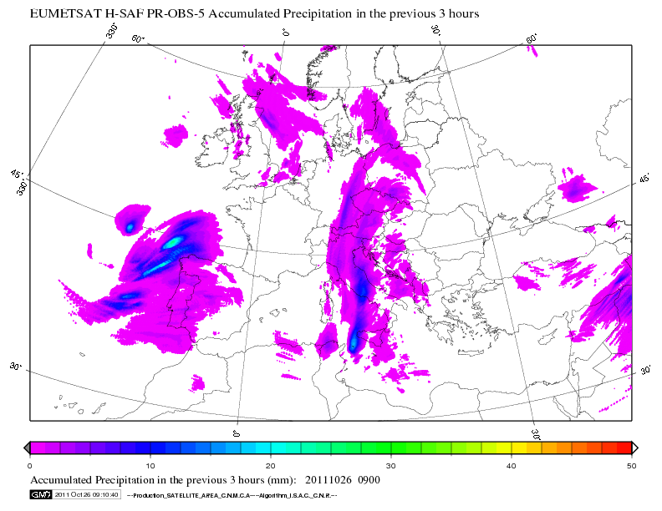
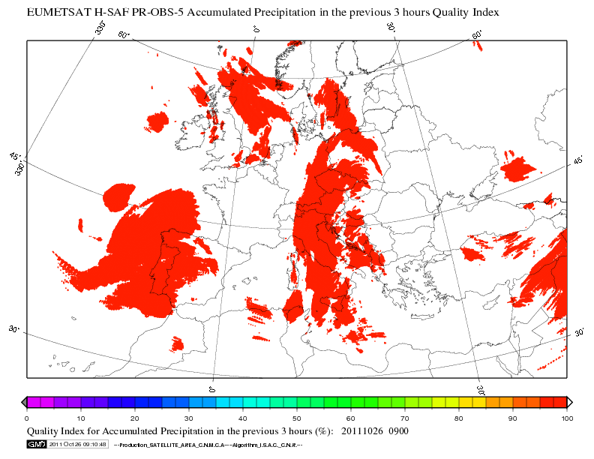
OBS-05 - Products
26 October 2011
3 hours accumulated precipitation at ground - (starting time - 06 UTC)

Slide 43
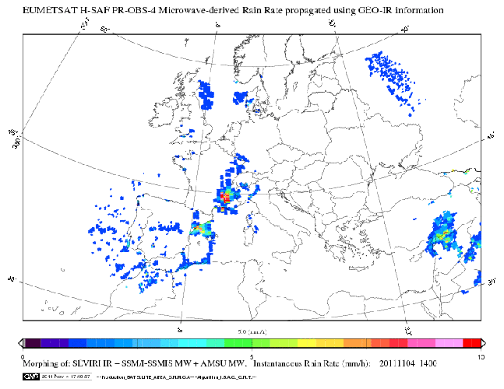
FUTURE ASPECTS
Coming soon
PROBS04: Precipitation rate at ground by LEO/MW supported by GEO/IR

Slide 44
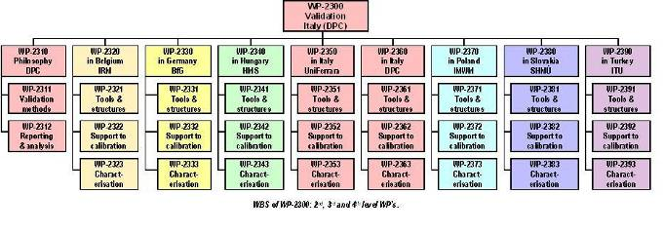
Introduction to the H-SAF Products Validation
Precipitation validation is a not a trivial task not only because the remote sensing from space is in general indirect, but also because of the natural space-time variability of the precipitation field (fractal or close-to-fractal), which represents severe sampling problems. In addition, because of ground system uncertainties (essentially rain gauges and radar), a reliable ground truth does not exist. The performance of the algorithm used for precipitation retrieval changes with the climatic situation and the type of precipitation. For these reasons a European Precipitation Products Validation (PPV) programme has been developed within the H-SAF project.
The Partecipants to the H-SAF PPV Group
The H-SAF PPV group is composed of experts from the National Meteorological and Hydrological Institutes of Belgium, Germany, Hungary, Italy, Poland, Slovakia and Turkey . Hydrologists, meteorologists and radar and rain gauge experts are involved in this activity.
HOMEPAGE 1/3

Slide 45
Ten Stefania De Angelis
Italian Air Force
CNMCA
TEL. +39 06 91292664
Email: deangelis@meteoam.it

