Slide 1
Meteosat MVIRI surface radiation dataset
Rebekka Posselt (MeteoSwiss)
With support from
J. Trentmann, R. Müller, R. Stöckli
Contact me at: rebekka.posselt@meteoswiss.ch

Slide 2
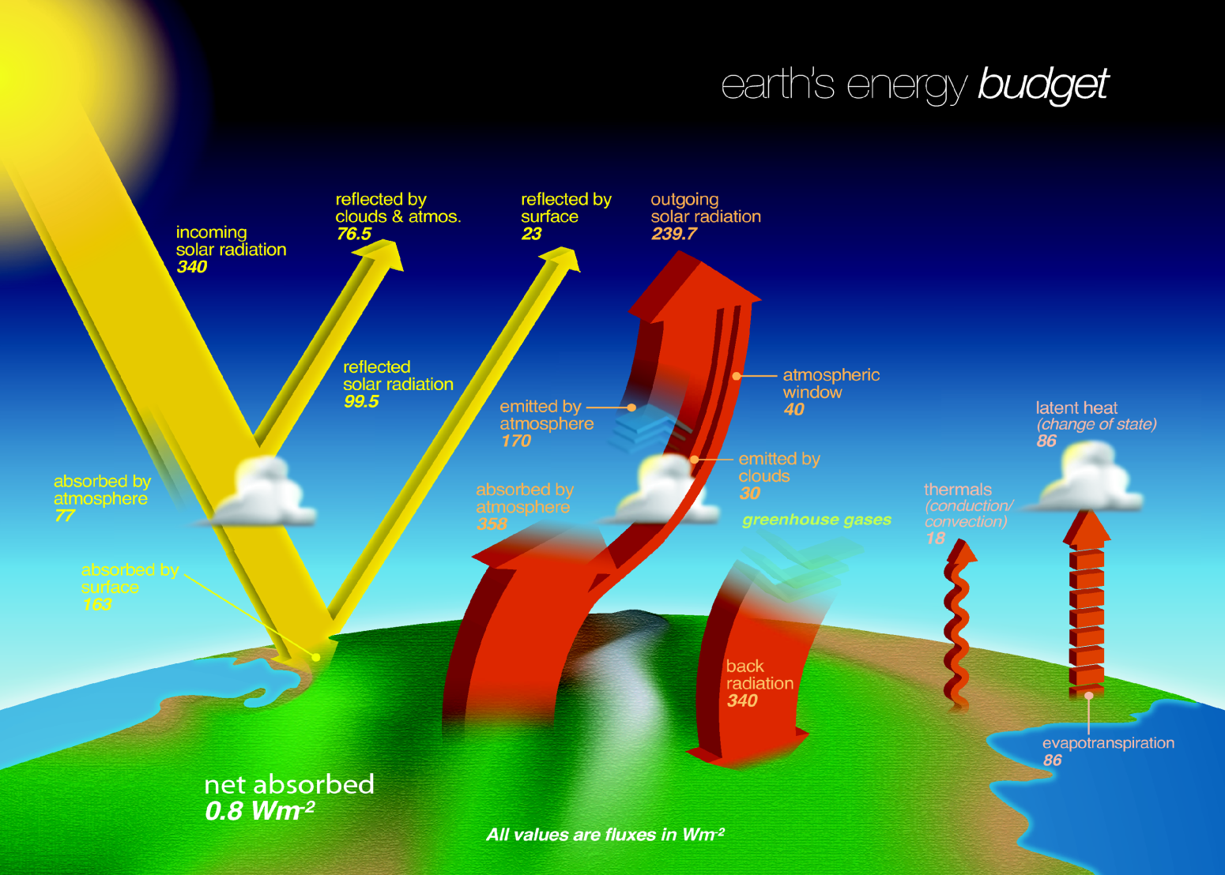
Motivation
Radiation is the driving force for all atmospheric processes.
→ Radiation budget is an essential climate variable (GCOS)
Planning and monitoring of solar energy systems

Slide 3
Motivation
Radiation is the driving force for all atmospheric processes.
→ Radiation budget is an essential climate variable (GCOS)
Planning and monitoring of solar energy systems

Slide 4
Outline
Motivation and Introduction
Algorithm repetition
Meteosat MVIRI surface radiation dataset
Validation
Homogeneity
Known Issues
Applications
Extension with SEVIRI data?

Slide 5
Outline
Motivation and Introduction
Algorithm repetition
Meteosat MVIRI surface radiation dataset
Validation
Homogeneity
Known Issues
Applications
Extension with SEVIRI data?

Slide 6
Available operational Products and Datasets
Clouds Macrophysics Microphysics
Time range: 2005 – now Coverage: MSG full disk; Arctic & Europe (from AVHRR)
Clouds
Cloudalbedo
MAGICSOL
(Surf.Rad.Dataset)
Meteosat
full disk
1983 - 2005
Surface Radiation
Solar incoming & reflected
CM SAF
Data
Surface Radiation
Solar incoming & reflected
Thermal outgoing & netto
Radiation Budget
Time range: 2005 - now
Coverage: MSG full disk
Clouds
Macrophysics
Microphysics
AVHRR-CLARA
Global
Coverage
1982 - 2009
Climate
Datasets
Operational
Products
Surface Radiation
Solar incoming & reflected
Thermal outgoing & netto
Radiation Budget
Top-of-Atmosphere Radiation
Solar & Thermal Time range: 2004 – now Coverage: MSG full disk & Arctic
HOAPS
Globally over
ice free ocean
1987 - 2006
Watervapour and
Energyfluxes
Watervapour
and temperature
Profiles Time range: 2004 – now
Coverage: Global

Slide 7
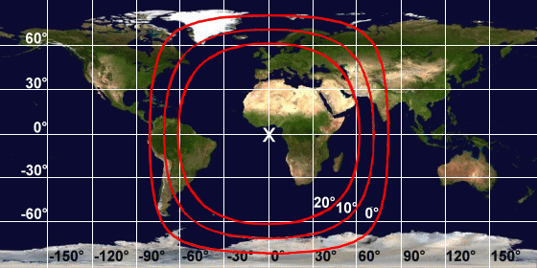
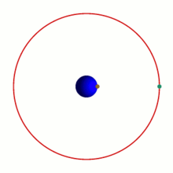
Meteosat MVIRI
MVIRI = Meteosat Visible and Infrared Imager
Instrument on Meteosat First Generation (or Meteosat Transition Period) Satellites
1977-2005 = Meteosat 1-7
Covers Africa and Europe (positioned at 0°)
© http://www.eumetsat.int
Graphics from: http://de.wikipedia.org/wiki/Geosynchrone_Umlaufbahn

Slide 8
Meteosat MVIRI
Where are you on the Meteosat disc? (use the )
Graphics from: http://de.wikipedia.org/wiki/Geosynchrone_Umlaufbahn

Slide 9
Outline
Motivation and Introduction
Algorithm repetition
Meteosat MVIRI surface radiation dataset
Validation
Homogeneity
Known Issues
Applications
Extension with SEVIRI data?

Slide 10
MagicSol Retrieval for historical radiation datasets
For more details refer to the previous “Surface Radiation Retrieval” session

Slide 11
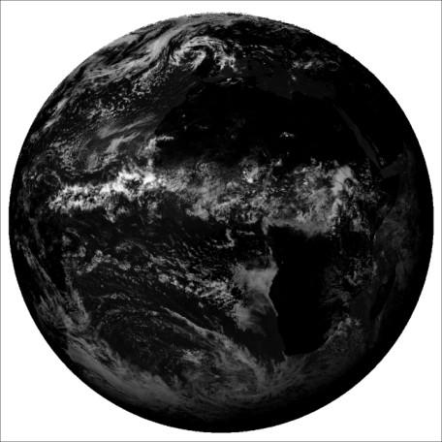
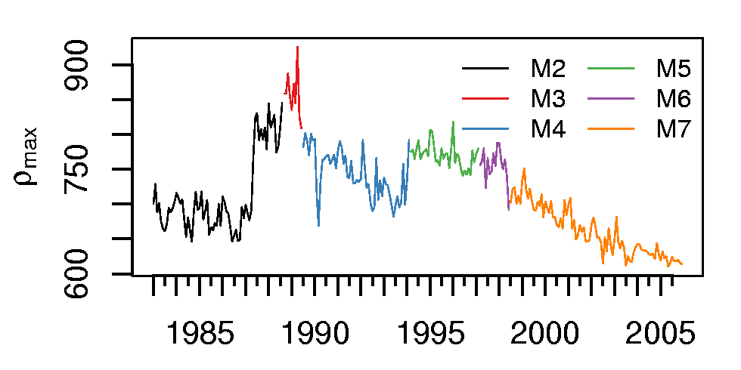
MagicSol Retrieval for historical radiation datasets
Cloud image
~ Maximum range of pixel brightnesses

Slide 12
MagicSol Retrieval for historical radiation datasets
Get clear sky radiation (clear sky gnu-magic)
LookUpTables
Fast
Obtained from a Radiative Transfer Model
Atmospheric State
Aerosols (climatology)
Water vapour (reanalysis)
Ozone
LookUpTable
Surface Albedo
climatology
Interpolation
Rad_{cs}
Müller et al. (2009)
http://sourceforge.net/projects/gnu-magic

Slide 13
Outline
Motivation and Introduction
Algorithm repetition
Meteosat MVIRI surface radiation dataset
Validation
Homogeneity
Known Issues
Applications
Extension with SEVIRI data?

Slide 14
MVIRI Surface Radiation CDR
Available variables:
SIS – global radiation
SID – direct radiation
CAL – cloud albedo (also Cl – Cloud index)
Available coverage
1982 – 2005 (= Meteosat 2 – 7)
Meteosat Full Disc
Available resolutions:
hourly, daily and monthly means
0.03° regular lon-lat-grid

Slide 15
MVIRI Surface Radiation CDR

Slide 16
Validation Dataset
Quality of dataset is validated using Baseline Surface Radiation Network (BSRN) data
BSRN is a project of the GEWEX Radiation Panel under the World Climate Research Programme (WCRP).
Currently about 40 stations in contrasting climatic zones
Support of the validation and confirmation of satellite and computer model estimates

Slide 17
Validation Dataset
Quality of dataset is validated using Baseline Surface Radiation Network (BSRN) data
BSRN is a project of the GEWEX Radiation Panel under the World Climate Research Programme (WCRP).
Currently about 40 stations in contrasting climatic zones
Support of the validation and confirmation of satellite and computer model estimates
Accuracy requirements | SIS [W/m²] | SID [W/m²] | CAL
Monthly | 15 | 20 | 0.15
Hourly/Daily | 25 | 30 | 0.2

Slide 18
Intercomparison datasets
ERAinterim (ECMWF Re-Analysis Project)
6-hourly means, 1989 - present
Global coverage on a 1° x 1° global grid
GEWEX (Global Energy and Water-cycle Experiment) Surface Radiation Budget dataset
3-hourly/daily/monthly means, July 1983 - Dec. 2007
Global coverage on a 1° x 1° global grid
ISCCP (International Satellite Cloud Climatology Project) Flux dataset
3-hourly means, July 1983 - Dec 2007
Global coverage on a 280 km equal-area global grid

Slide 19
Validation Monthly mean SIS

Slide 20
Validation Monthly mean SIS
SIS | N_{mon} | Bias [W/m²] | MAB [W/m²] | SD [W/m²] | AC | Frac_{mon} > 15 W/m² [%]
CM SAF | 878 | 4.24 | 7.76 | 8.23 | 0.89 | 10.71
ERAinterim | 878 | 5.48 | 10.41 | 12.15 | 0.8 | 24.6
GEWEX | 878 | -2.42 | 12.03 | 11.03 | 0.82 | 31.89
ISCCP | 878 | -0.02 | 11.56 | 11.25 | 0.78 | 29.16

Slide 21
Intercomparison
CM SAF
ERA interim
Summer mean (1983-2005)
Find the differences! (use the )

Slide 22
Intercomparison
Overall pattern are in good agreement, but significant regional differences are visible
→ especially Tropics and Southern and Northern Atlantic

Slide 23
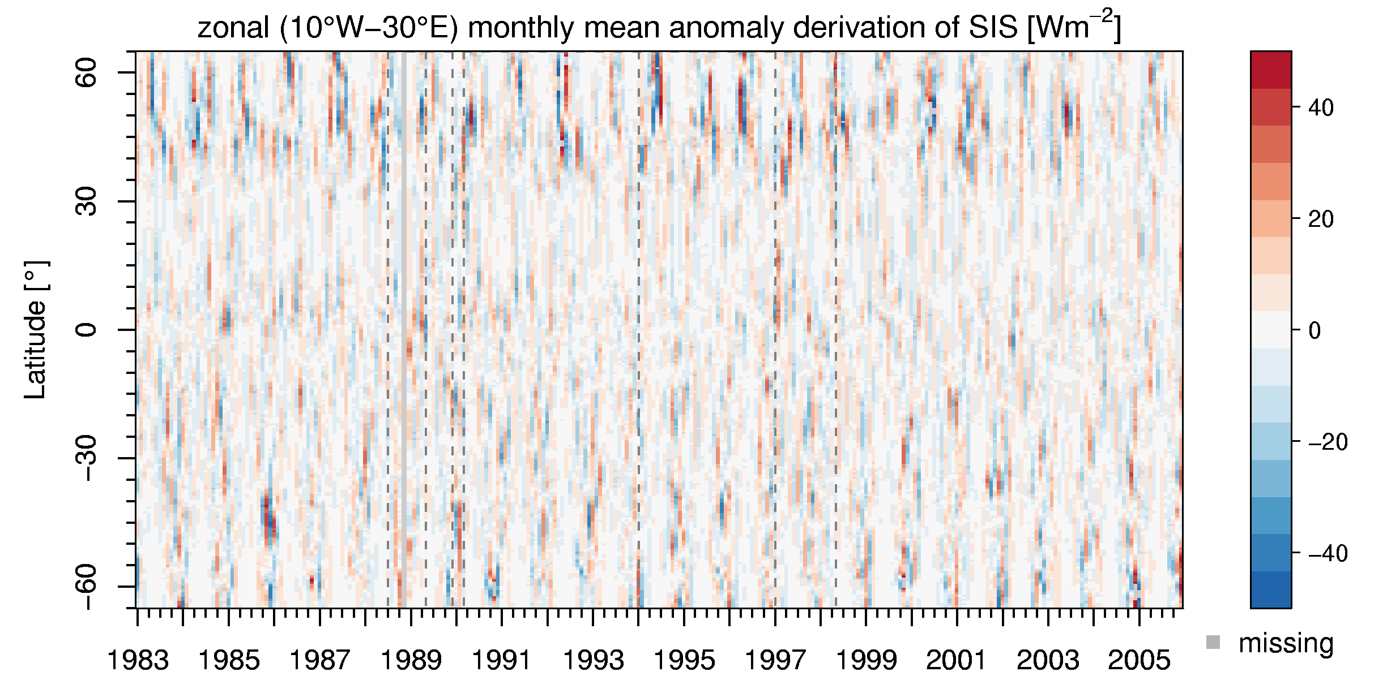
Homogeneity

Slide 24
Homogeneity

Slide 25
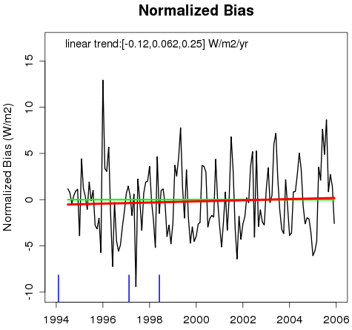
Homogeneity

Slide 26
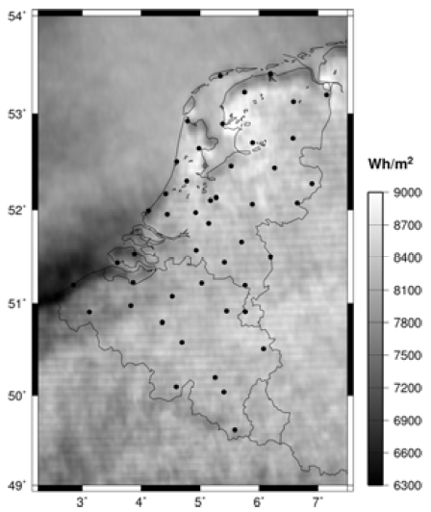
Known Issues
Stripping pattern in Meteosat 2 and 3 data (1982 – 1989; partly up to 1994, if Meteosat 3 was used as backup)
Due to uncorrected missing lines during night
Consequence: means are too low (order of 5 Wm⁻² for daily means)
Cannot be corrected at the moment, wait for next dataset release (CDOP2)
Courtesy of M. Journée (RMIB)
Radiation over bright surfaces (e.g., snow and deserts)
ρ_{min} retrieval complicated and, thus, unreliable
Consequence: Handle radiation fields in this areas with care!

Slide 27
Outline
Motivation and Introduction
Algorithm repetition
Meteosat MVIRI surface radiation dataset
Validation
Homogeneity
Known Issues
Applications
Extension with SEVIRI data?

Slide 28
Applications
“Brainstorming”
→ “What applications can you imagine for the MVIRI surface radiation Dataset?”
Notes:
Whiteboard for Brainstorming!
(time permitting!)

Slide 29
Applications
Solar Energy potential
PVGIS (http://re.jrc.ec.europa.eu/pvgis/)
Geographical Assessment of Solar Resource and Performance of Photovoltaic Technology

Slide 30
Applications Trend Analysis

Slide 31
Outline
Motivation and Introduction
Algorithm repetition
Meteosat MVIRI surface radiation dataset
Validation
Homogeneity
Known Issues
Applications
Extension with SEVIRI data?

Slide 32
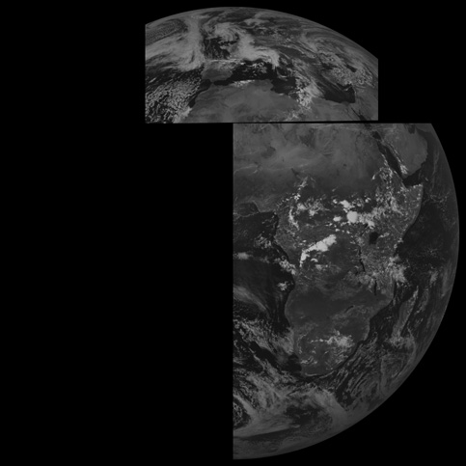
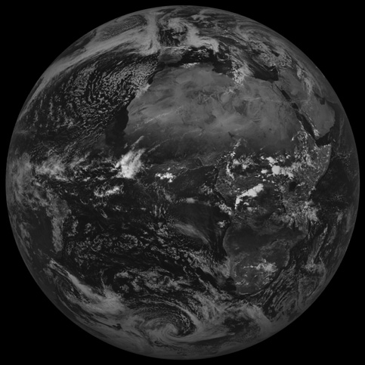
Extension with SEVIRI data?
SEVIRI = Spinning Enhanced Visible and InfraRed Imager
Onboard Meteosat Second Generation satellites (Meteosat 8-10 → 2004-now)
HRV
High resolution visible (HRV) channel:
Differences in spatial coverage
Only useful for subsets (e.g., Europe, Africa)
Similar spectral properties
VIS

Slide 33
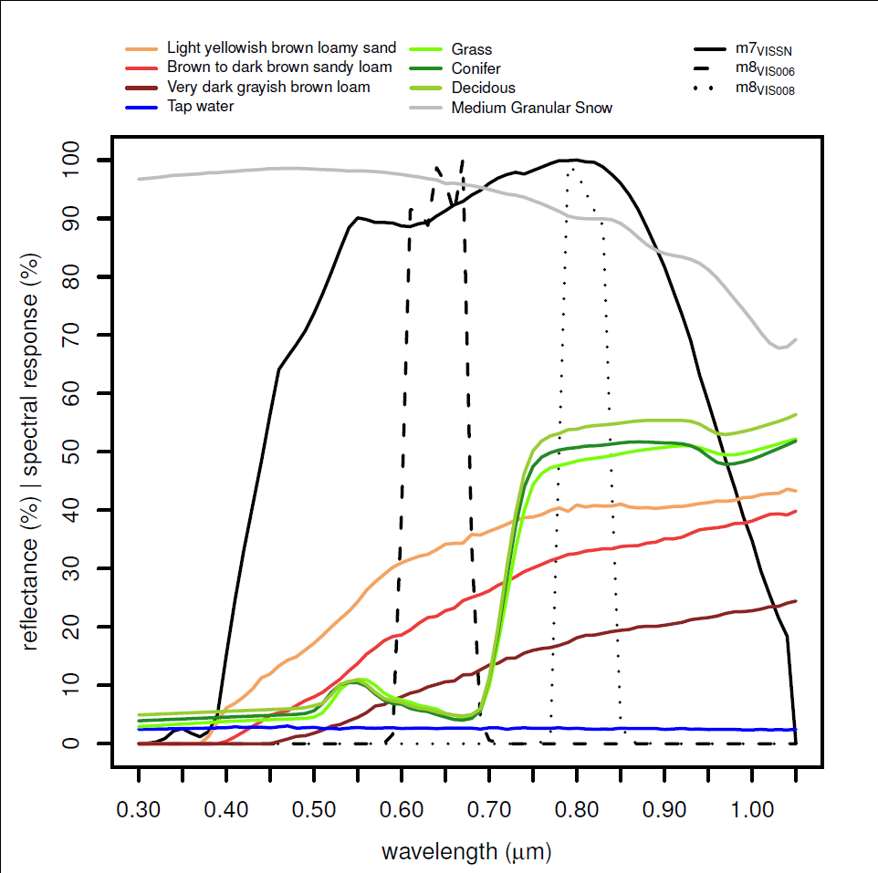
Extension with SEVIRI data?
SEVIRI = Spinning Enhanced Visible and InfraRed Imager
Onboard Meteosat Second Generation satellites (Meteosat 8-10 → 2004-now)
Narrowband VIS channels
Differences in spectral characteristics (broadband vs. narrowband)
Large differences especially for vegetation
Similar spatial coverage
MVIRI
SEVIRI

Slide 34
Extension with SEVIRI data?
How to solve? (use the )
Combination of the SEVIRI VIS channels to generate a broadband channel similar to MVIRI
Average SIS of the SEVIRI VIS channels to even out the differences
Winter
Summer

Slide 35
Extension with SEVIRI data?

Slide 36
Outline
Motivation and Introduction
Algorithm repetition
Meteosat MVIRI surface radiation dataset
Validation
Homogeneity
Known Issues
Applications
Extension with SEVIRI data?

