Slide 1
This presentation
Descending into the maelstrom:
Cyclone "Emma" on 1 March 2008
is primarily about the ESSL Testbed
will start with some motivation for the Testbed
will then explain the concept
and finally show the current state of implementation
Georg Pistotnik
European Severe Storms Laboratory
georg.pistotnik@essl.org
EUMETSAT Cyclone Week
04 June 2012

Slide 2
|| introduction || synoptic scale || mesoscale || small scale || conclusions ||
Contents:
Introduction
Synoptic-scale developments
Mesoscale developments
Small-scale developments
Conclusions

Slide 3
|| introduction || synoptic scale || mesoscale || small scale || conclusions ||
Cyclone „Emma“ on 01 March 2008 in Europe:
Exceptionally strong winter storm
14 people killed
Damage estimated to 0.75 … 1.3 billion Euro
Countries most affected: Netherlands, Germany, Czech Republic, Austria, Slovakia, Hungary, Serbia
Convection along cold front played a significant role in gust enhancement
Near Braunau (AT): F3/T6 downburst => one of the strongest recorded worldwide!

Slide 4
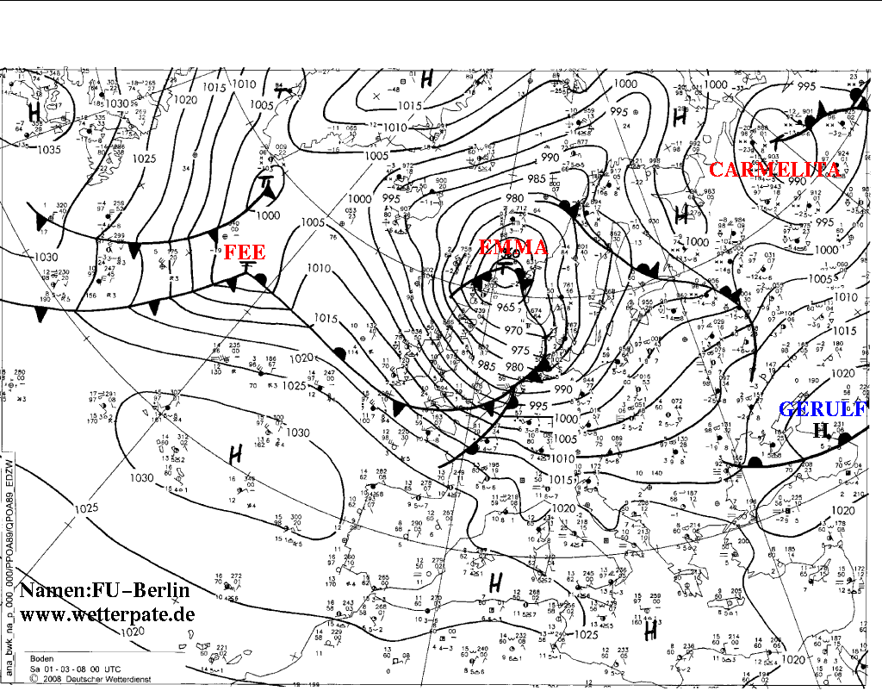
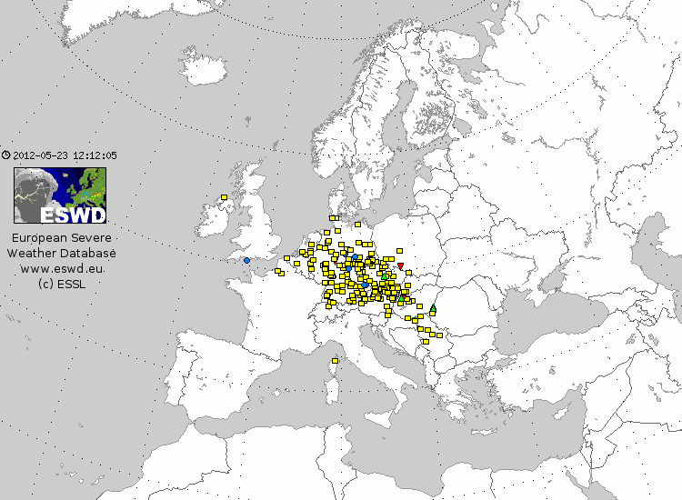
Synopsis (1)
|| introduction || synoptic scale || mesoscale || small scale || conclusions ||
ESWD 01 March 2008:
184x severe wind (yellow)
9x heavy rain (blue)
8x large hail (green)
3x tornado (red)
1x gustnado (orange)
(source: ESSL)
surface analysis
00 UTC 01 March 2008
(source: FU Berlin)

Slide 5
Synopsis (1)
|| introduction || synoptic scale || mesoscale || small scale || conclusions ||
Temporal course of lightning strokes and severe weather reports:
Peak intensity in the late morning => diurnal course was of minor importance
(data sources: EUCLID, ESSL)

Slide 6
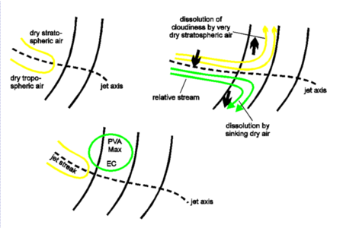
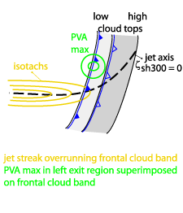
|| introduction || synoptic scale || mesoscale || small scale || conclusions ||
Only one slide about conceptual models – the „split front“:
If dry intrusion overruns a cold front => partition into upper-level cloud shield and low-level cold front
Dry (stratospheric) air over humid air mass creates potential instability => may be released in case of forced ascent due to positive vorticity advection
(source: ZAMG Sat Manual)

Slide 7
|| introduction || synoptic scale || mesoscale || small scale || conclusions ||
00 UTC 29 Feb 2008
Development stage of „Emma“ over North Atlantic
Central pressure < 975 hPa, rapidly dropping

Slide 8
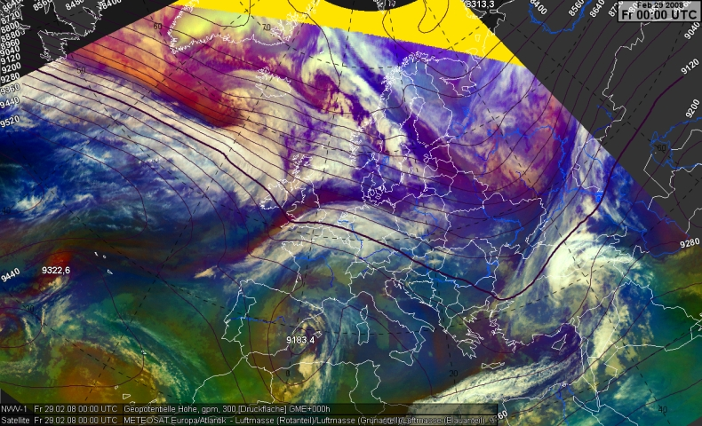
|| introduction || synoptic scale || mesoscale || small scale || conclusions ||
Strong zonal flow
Pink: dry intrusion
Blue (and cloudy): warm conveyor belt
Meteosat RGB product & 300 hPa geopotential
00 UTC 29 Feb 2008
(source: EUMeTrain)

Slide 9
|| introduction || synoptic scale || mesoscale || small scale || conclusions ||
Jet maximum > 200 kt
„Emma“ favourably placed in left exit region
Trailing cold front aligned with jet axis
Meteosat RGB product & 300 hPa wind speed
00 UTC 29 Feb 2008
(source: EUMeTrain)

Slide 10
|| introduction || synoptic scale || mesoscale || small scale || conclusions ||
06 UTC 29 Feb 2008
Rapid cyclogenesis in full swing
Central pressure ~965 hPa, pressure drop slowing down
Main dynamic support starts to shift from low pressure center to cold front

Slide 11
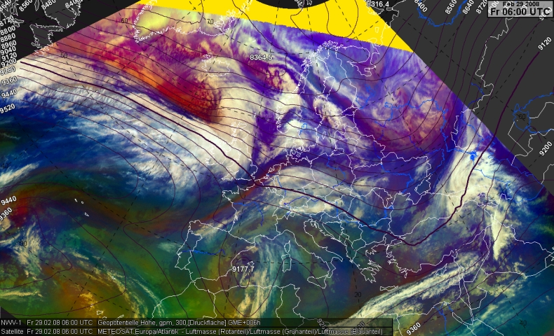
|| introduction || synoptic scale || mesoscale || small scale || conclusions ||
First hint of a short wave trough
Meteosat RGB product & 300 hPa geopotential
06 UTC 29 Feb 2008
(source: EUMeTrain)

Slide 12
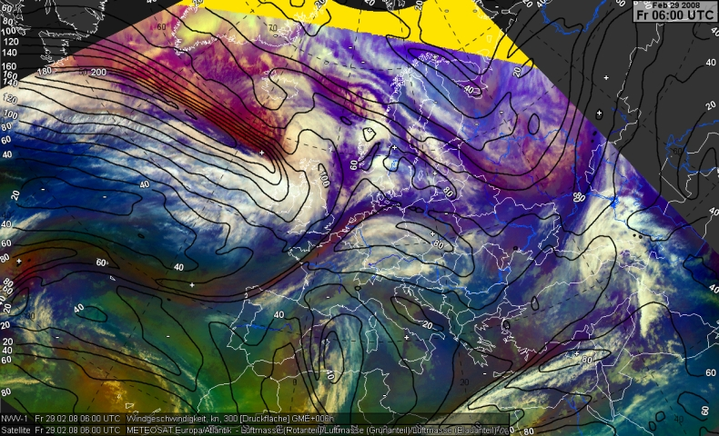
|| introduction || synoptic scale || mesoscale || small scale || conclusions ||
Meteosat RGB product & 300 hPa wind speed
06 UTC 29 Feb 2008
(source: EUMeTrain)

Slide 13
|| introduction || synoptic scale || mesoscale || small scale || conclusions ||
12 UTC 29 Feb 2008
Rapid cyclogenesis almost completed
Central pressure < 965 hPa
First signs of favourable interaction between dry intrusion and cold front

Slide 14
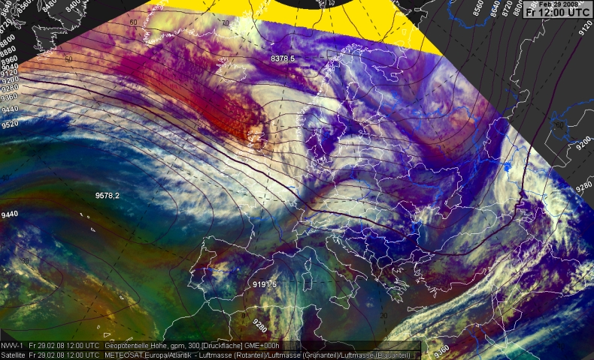
|| introduction || synoptic scale || mesoscale || small scale || conclusions ||
Short wave trough gets more pronounced
Meteosat RGB product & 300 hPa geopotential
12 UTC 29 Feb 2008
(source: EUMeTrain)

Slide 15
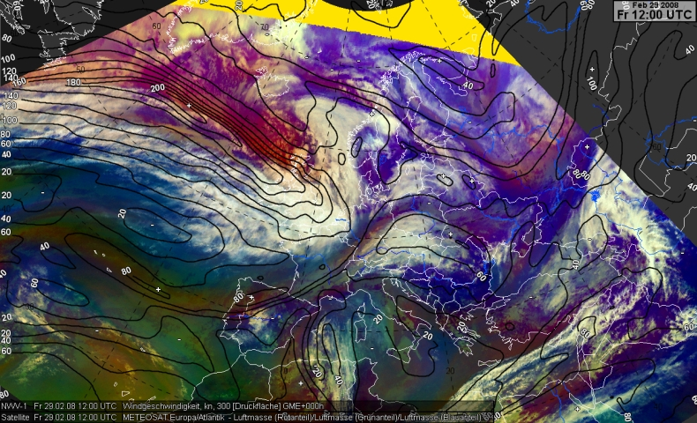
|| introduction || synoptic scale || mesoscale || small scale || conclusions ||
Low pressure center slips away from left exit region of jet streak
Cold front crosses Scotland, no severe weather yet
Meteosat RGB product & 300 hPa wind speed
12 UTC 29 Feb 2008
(source: EUMeTrain)

Slide 16
|| introduction || synoptic scale || mesoscale || small scale || conclusions ||
18 UTC 29 Feb 2008
„Emma“ reaches mature stage
Minimum central pressure < 960 hPa
Favourable interaction between dry intrusion and cold front intensifies

Slide 17
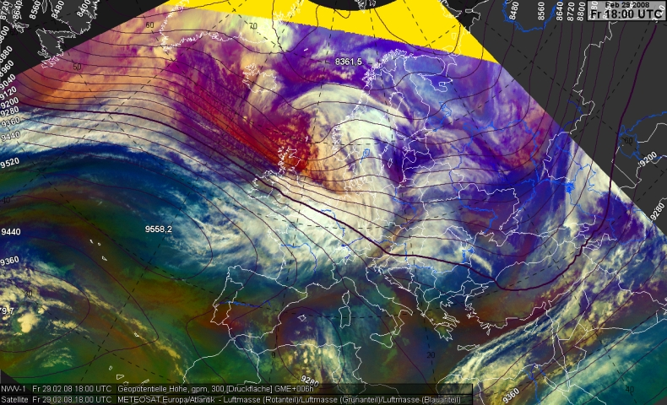
|| introduction || synoptic scale || mesoscale || small scale || conclusions ||
Short wave trough
First signs of a split front over North Sea
Meteosat RGB product & 300 hPa geopotential
18 UTC 29 Feb 2008
(source: EUMeTrain)

Slide 18
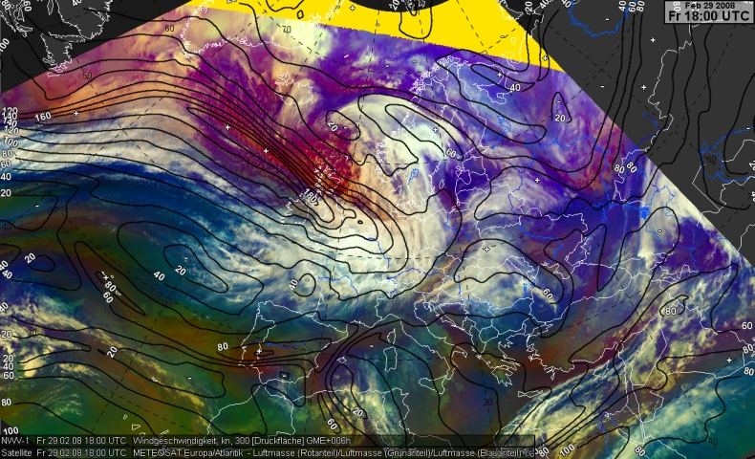
|| introduction || synoptic scale || mesoscale || small scale || conclusions ||
Jet streak starts to cross cold front
Left exit region spreads over cold front
Trailing cold front crosses British Isles, still no severe weather
Meteosat RGB product & 300 hPa wind speed
18 UTC 29 Feb 2008
(source: EUMeTrain)

Slide 19
|| introduction || synoptic scale || mesoscale || small scale || conclusions ||
00 UTC 01 March 2008
Well-advanced stage of rapid cyclogenesis
Central pressure constantly at ~960 hPa
First signs of favourable interaction between dry intrusion and cold front

Slide 20
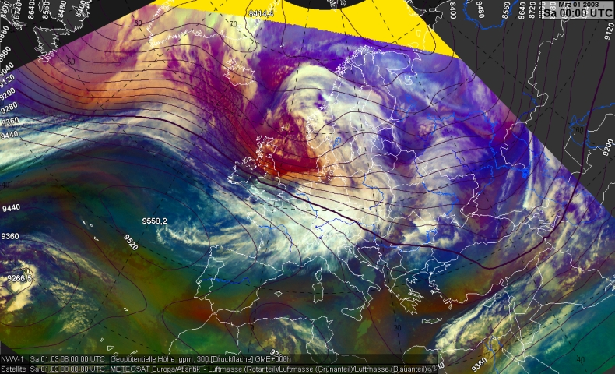
|| introduction || synoptic scale || mesoscale || small scale || conclusions ||
Short wave trough
Flow turns increasingly to the Northwest
Split front approaches shore of North Sea
Meteosat RGB product & 300 hPa geopotential
00 UTC 01 March 2008
(source: EUMeTrain)

Slide 21
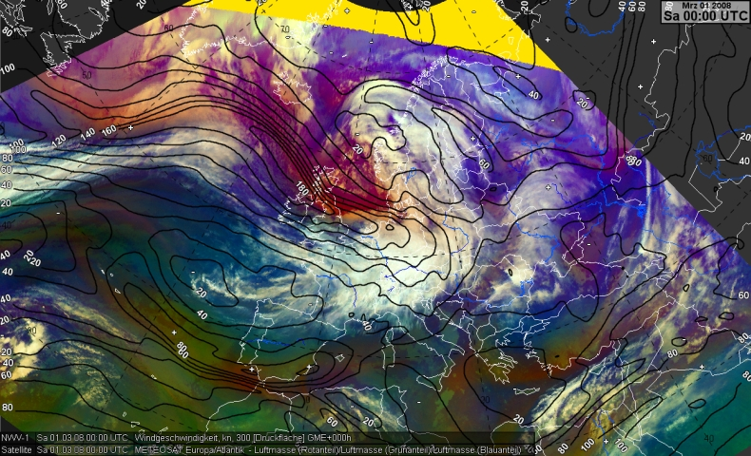
|| introduction || synoptic scale || mesoscale || small scale || conclusions ||
Left exit of jet streak
First isolated lightning along cold front, first severe wind gusts
Meteosat RGB product & 300 hPa wind speed
00 UTC 01 March 2008
(source: EUMeTrain)

Slide 22
|| introduction || synoptic scale || mesoscale || small scale || conclusions ||
06 UTC 01 March 2008
Center of „Emma“ is located over Norwegian Sea, central pressure starts to rise again
Secondary center forms further South (Skagerrak cyclogenesis)
Fully developed split front invades Central Europe
Episode of extremely severe weather along cold front begins
Extraordinary lightning activity for a wintertime storm

Slide 23
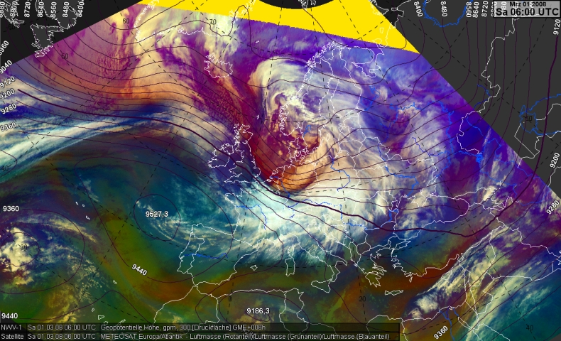
|| introduction || synoptic scale || mesoscale || small scale || conclusions ||
Highly amplified short wave trough
Fully developed split front
Meteosat RGB product & 300 hPa geopotential
06 UTC 01 March 2008
(source: EUMeTrain)

Slide 24
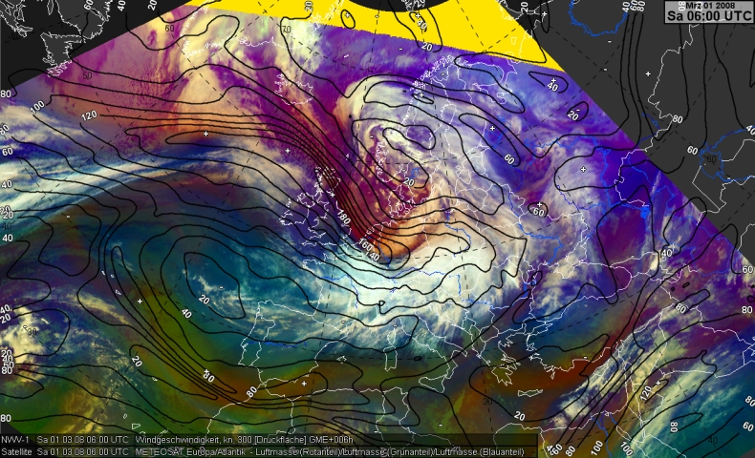
|| introduction || synoptic scale || mesoscale || small scale || conclusions ||
Left exit of jet streak
Deep convective line with lots of lightning and widespread severe gusts evolves
Meteosat RGB product & 300 hPa wind speed
06 UTC 01 March 2008
(source: EUMeTrain)

Slide 25
|| introduction || synoptic scale || mesoscale || small scale || conclusions ||
12 UTC 01 March 2008
Secondary low pressure center over Southern Sweden outstrips primary center
Split front has crossed most of Central Europe
Convective line starts to weaken, lightning activity declines
Still widespread severe gusts

Slide 26
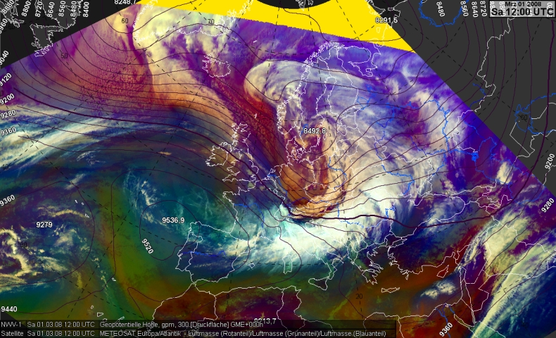
|| introduction || synoptic scale || mesoscale || small scale || conclusions ||
Highly amplified short wave trough
Fully developed split front
Meteosat RGB product & 300 hPa geopotential
12 UTC 01 March 2008
(source: EUMeTrain)

Slide 27
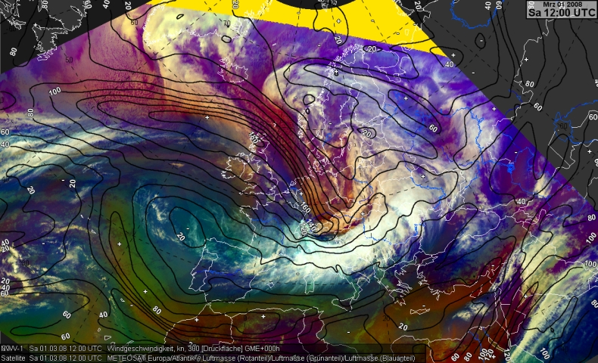
|| introduction || synoptic scale || mesoscale || small scale || conclusions ||
Left exit of jet streak
Still considerable lightning activity and widespread severe gusts
Meteosat RGB product & 300 hPa wind speed
12 UTC 01 March 2008
(source: EUMeTrain)

Slide 28
|| introduction || synoptic scale || mesoscale || small scale || conclusions ||
18 UTC 01 March 2008
Secondary low pressure center over Southern Sweden outstrips primary center
Split front has crossed most of Central Europe
Convective line starts to weaken, lightning activity declines
Still widespread severe gusts

Slide 29
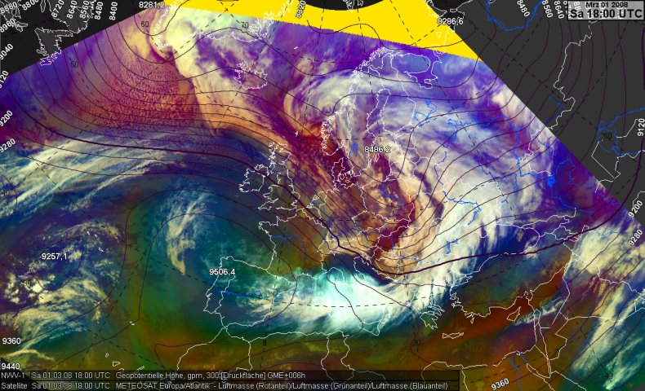
|| introduction || synoptic scale || mesoscale || small scale || conclusions ||
Short wave trough decelerates
Decaying split front
Meteosat RGB product & 300 hPa geopotential
18 UTC 01 March 2008
(source: EUMeTrain)

Slide 30
|| introduction || synoptic scale || mesoscale || small scale || conclusions ||
Jet streak curving away from cold front
Support of left exit region decreases
Hardly any severe weather any more
Meteosat RGB product & 300 hPa wind speed
18 UTC 01 March 2008
(source: EUMeTrain)

Slide 31
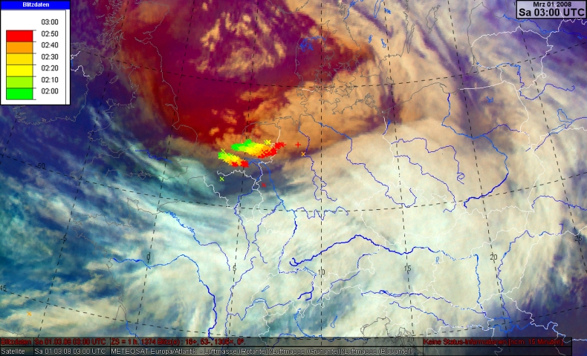
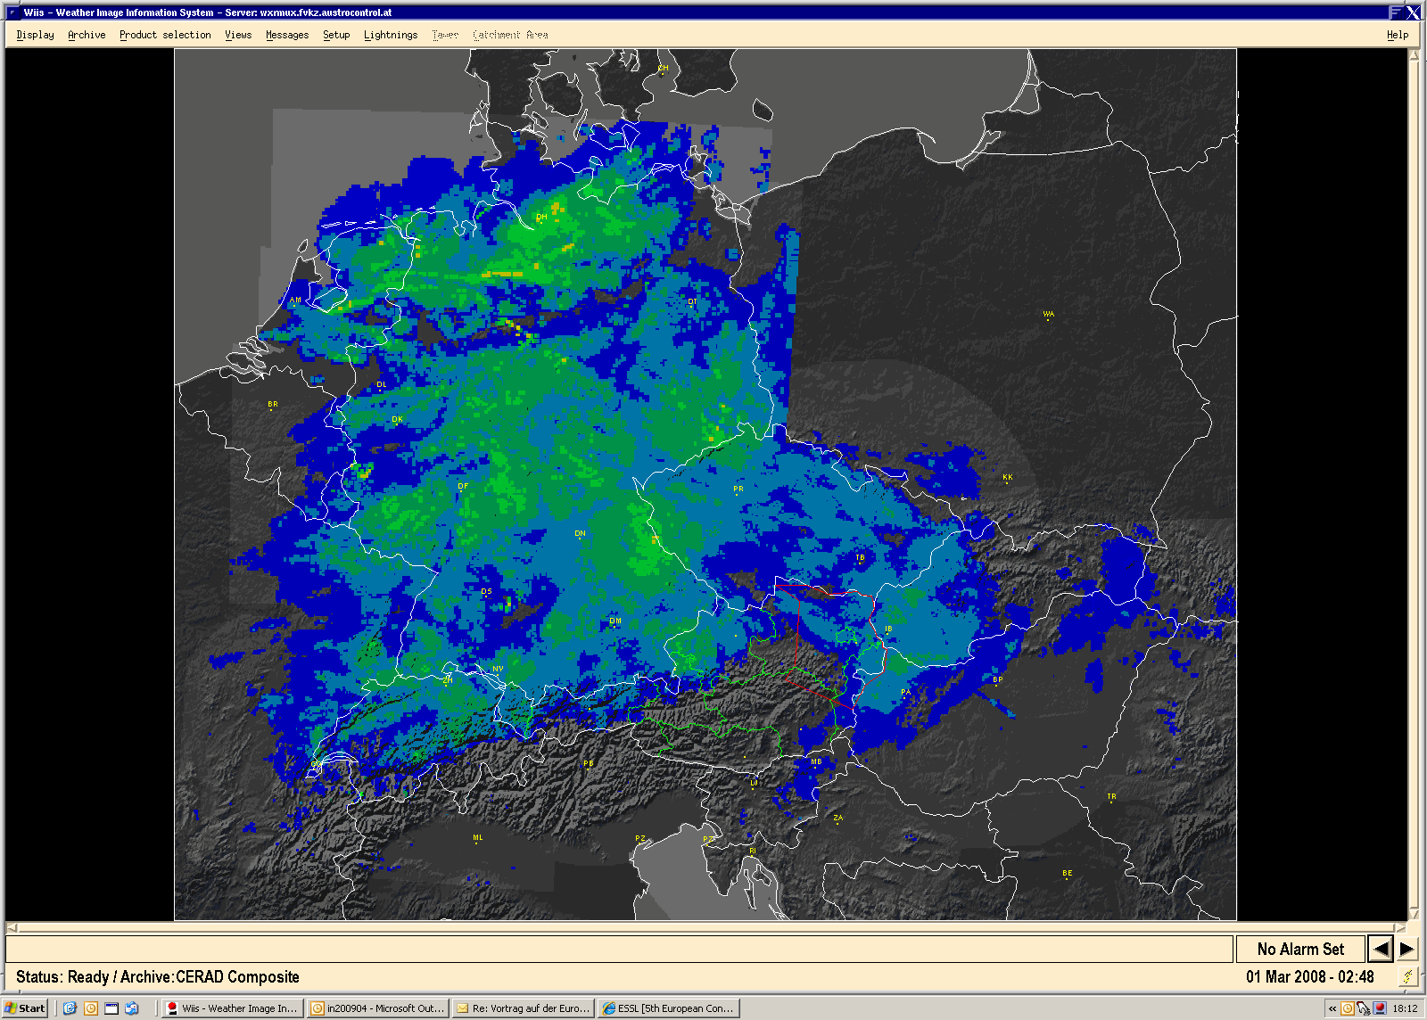
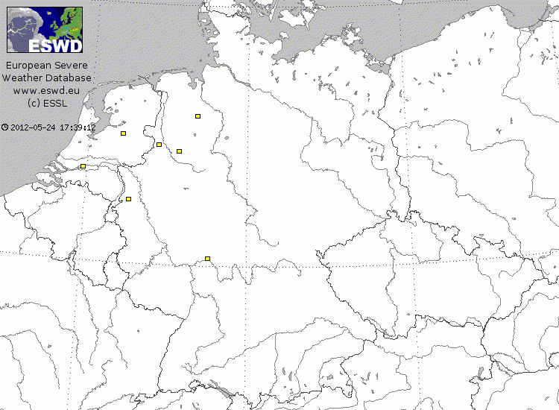
|| introduction || synoptic scale || mesoscale || small scale || conclusions ||
03 UTC 01 March 2008
Upper left: Meteosat RGB product & lightning strokes
Upper right: CERAD radar composite
Lower right: ESWD entries
(sources: EUMeTrain, AustroControl, ESSL)

Slide 32
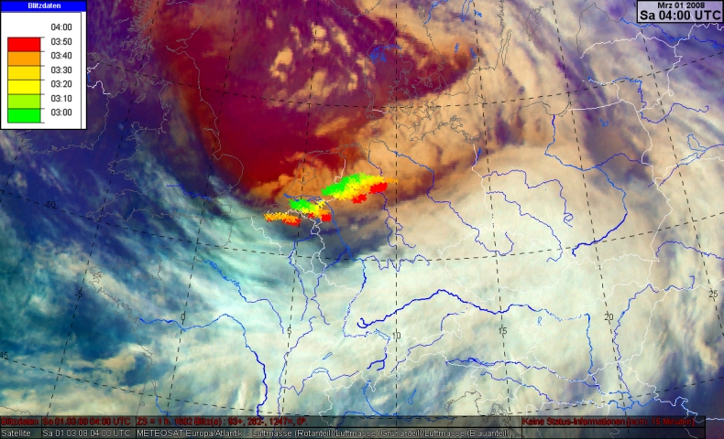
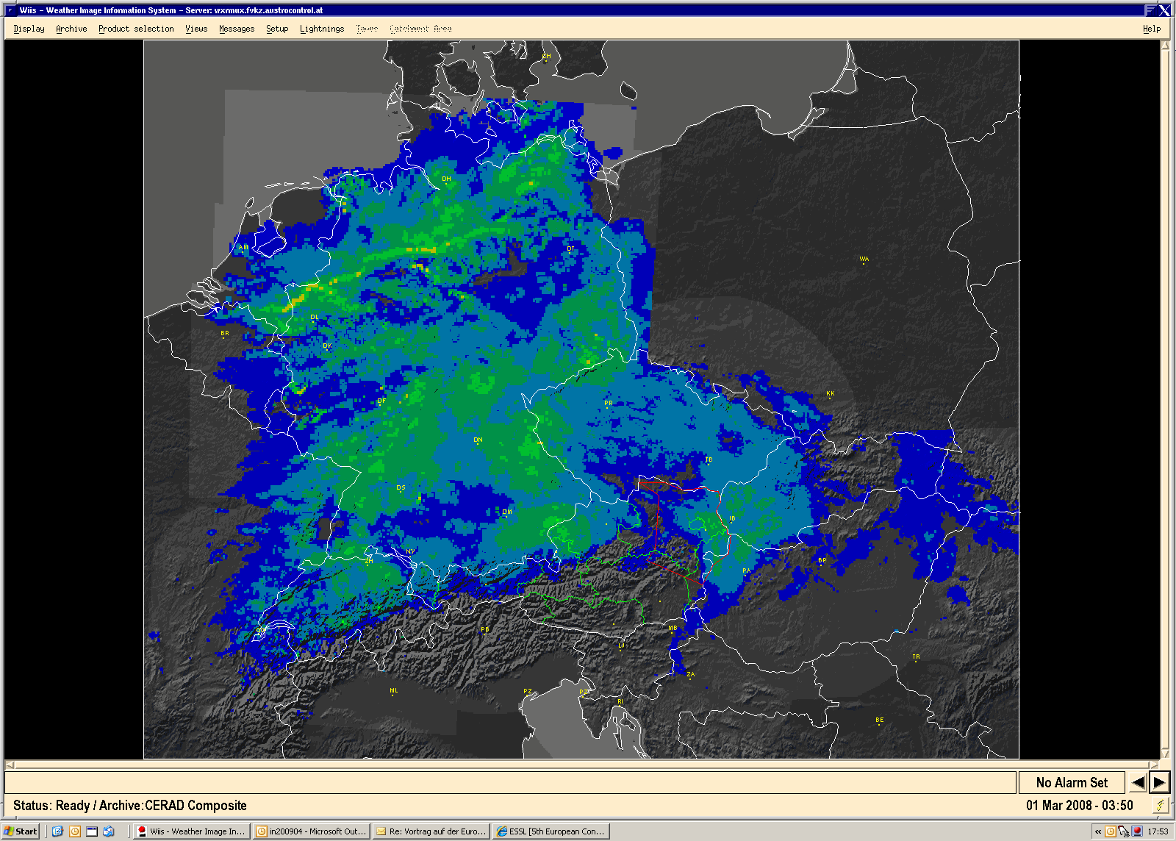
|| introduction || synoptic scale || mesoscale || small scale || conclusions ||
04 UTC 01 March 2008
Upper left: Meteosat RGB product & lightning strokes
Upper right: CERAD radar composite
Lower right: ESWD entries
(sources: EUMeTrain, AustroControl, ESSL)

Slide 33
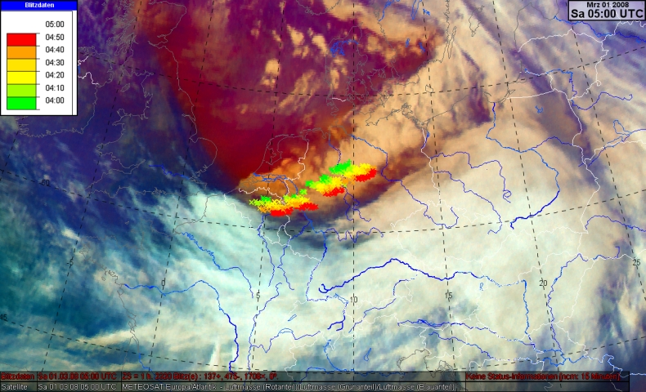
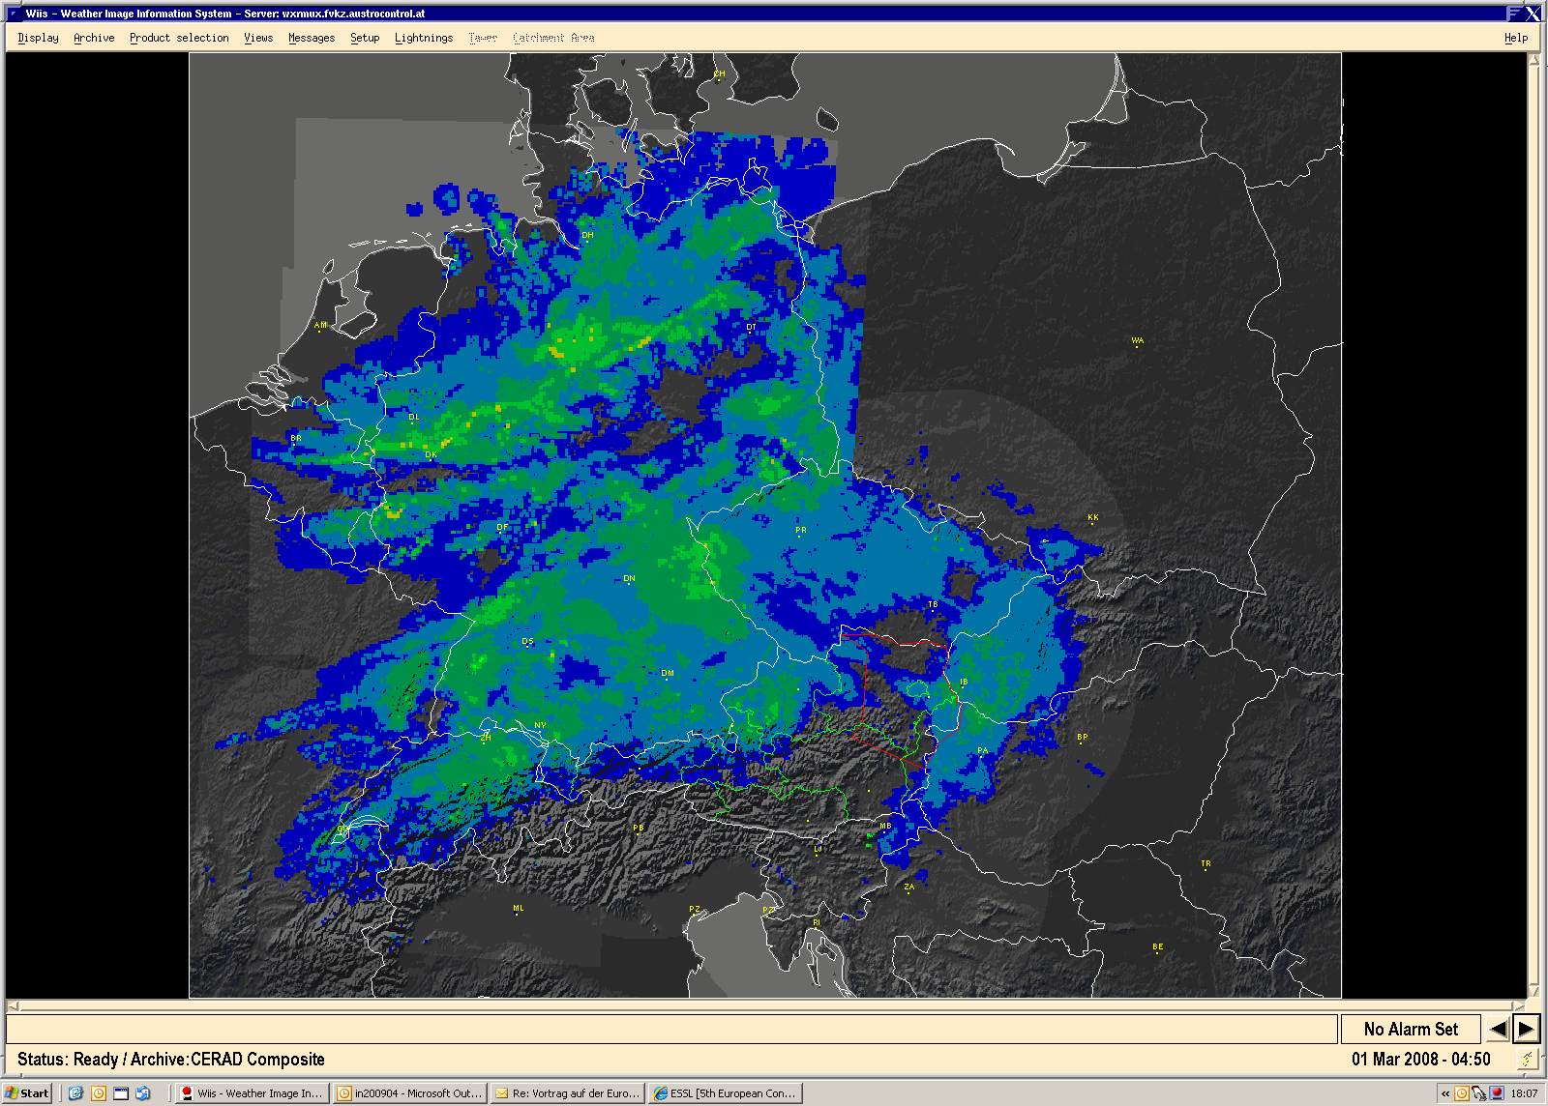
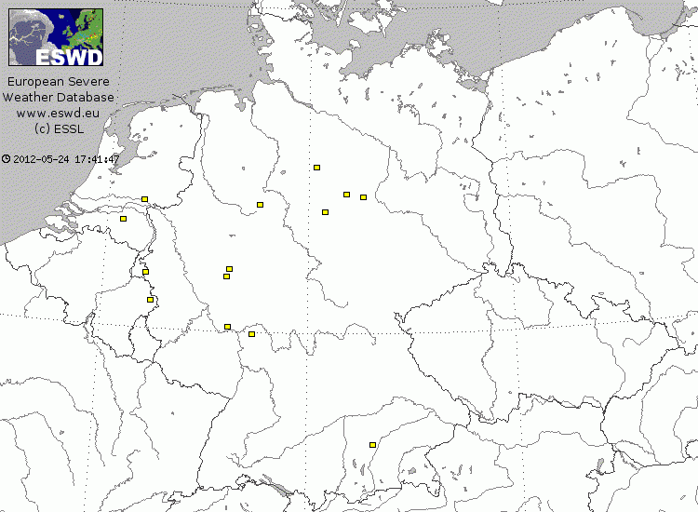
|| introduction || synoptic scale || mesoscale || small scale || conclusions ||
05 UTC 01 March 2008
Upper left: Meteosat RGB product & lightning strokes
Upper right: CERAD radar composite
Lower right: ESWD entries
(sources: EUMeTrain, AustroControl, ESSL)

Slide 34
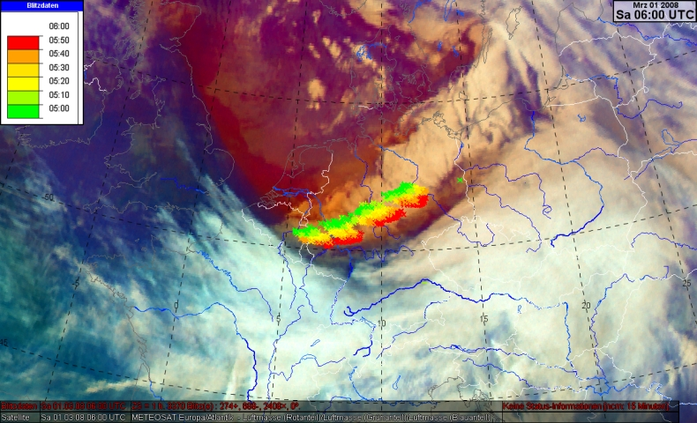
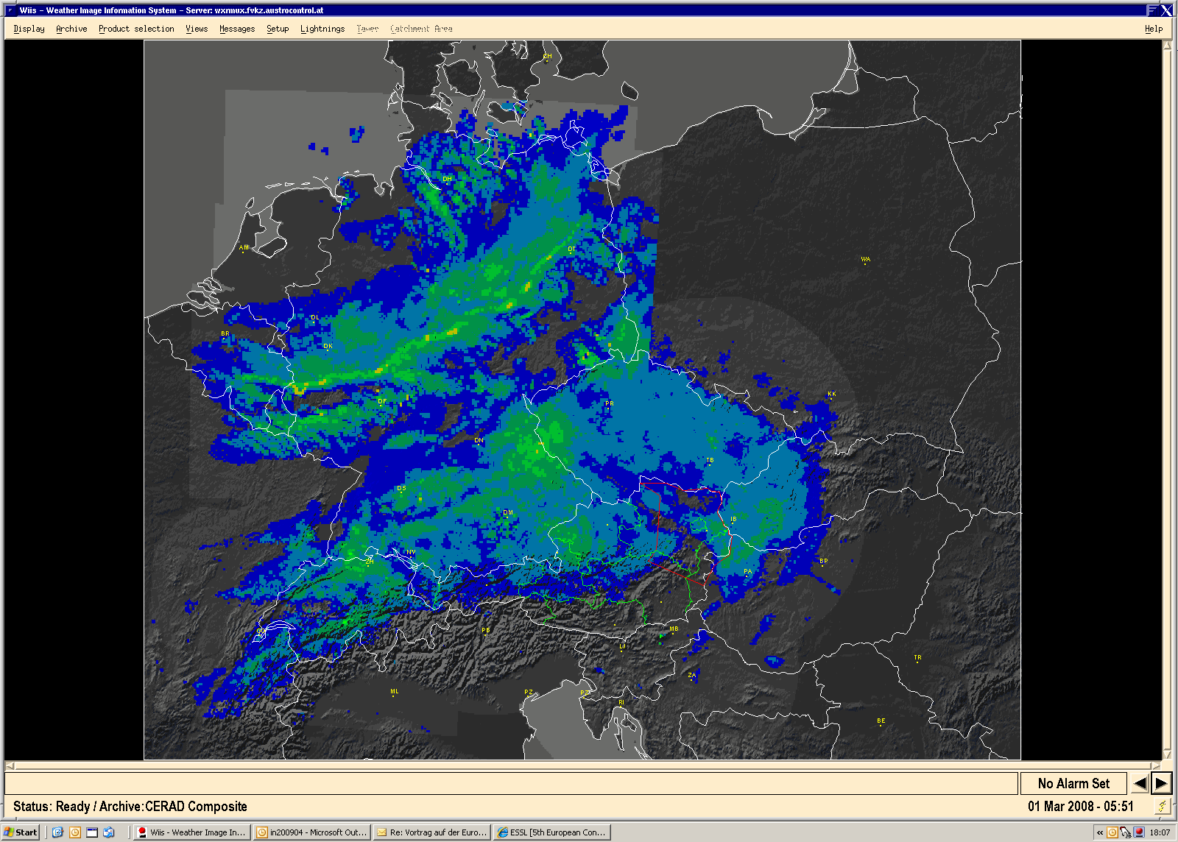
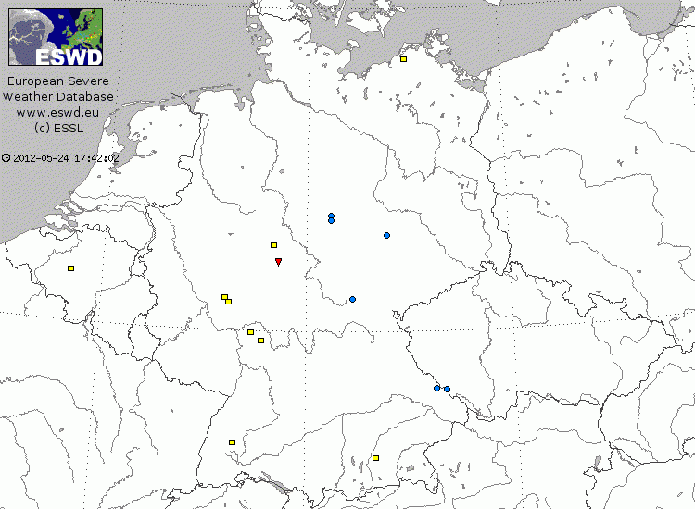
|| introduction || synoptic scale || mesoscale || small scale || conclusions ||
06 UTC 01 March 2008
Upper left: Meteosat RGB product & lightning strokes
Upper right: CERAD radar composite
Lower right: ESWD entries
(sources: EUMeTrain, AustroControl, ESSL)

Slide 35
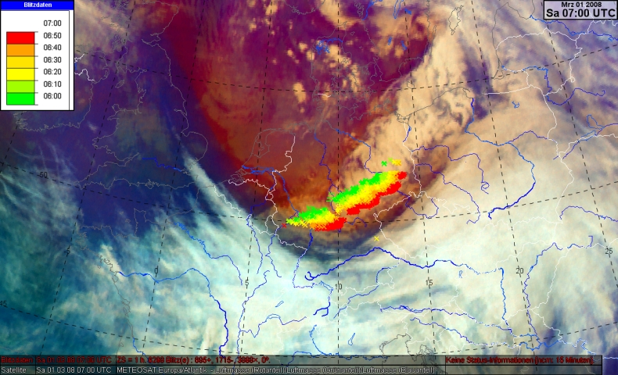
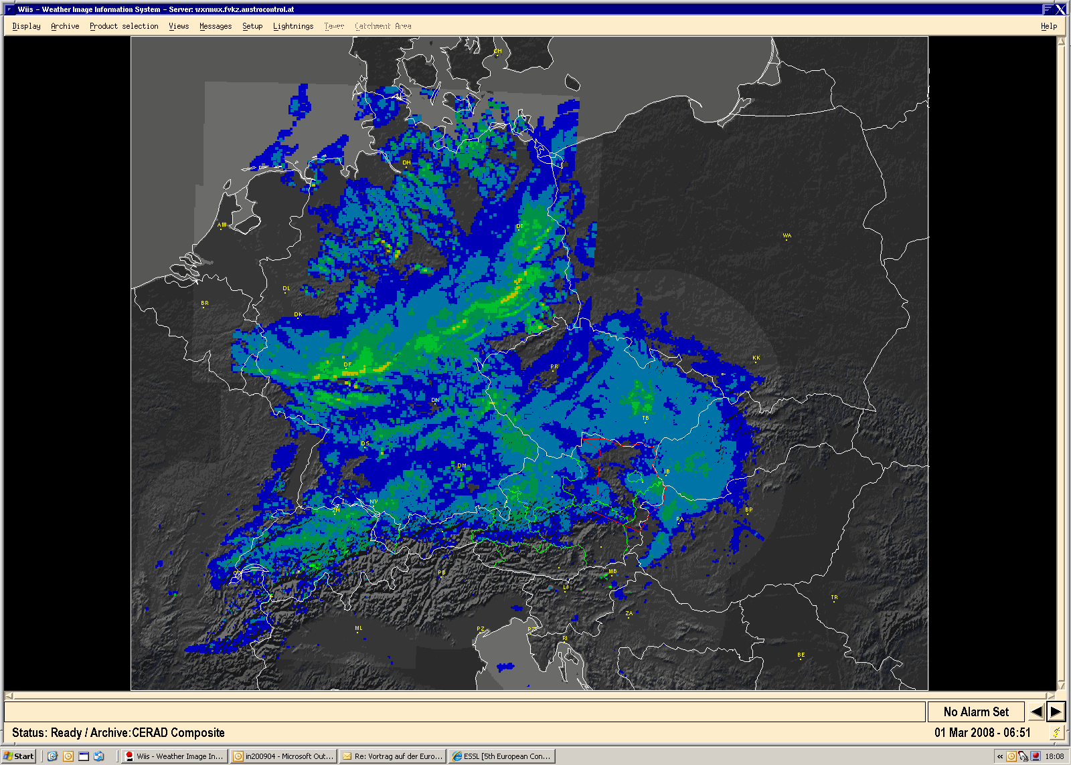
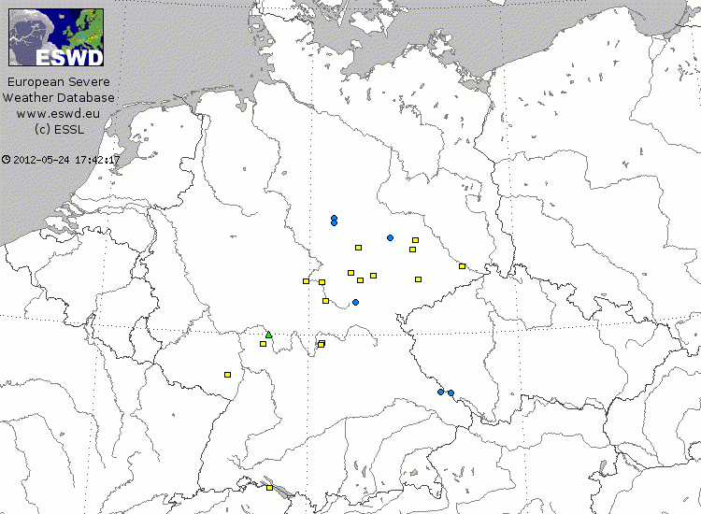
|| introduction || synoptic scale || mesoscale || small scale || conclusions ||
Severe wind reports along cold front increase
07 UTC 01 March 2008
Upper left: Meteosat RGB product & lightning strokes
Upper right: CERAD radar composite
Lower right: ESWD entries
(sources: EUMeTrain, AustroControl, ESSL)

Slide 36
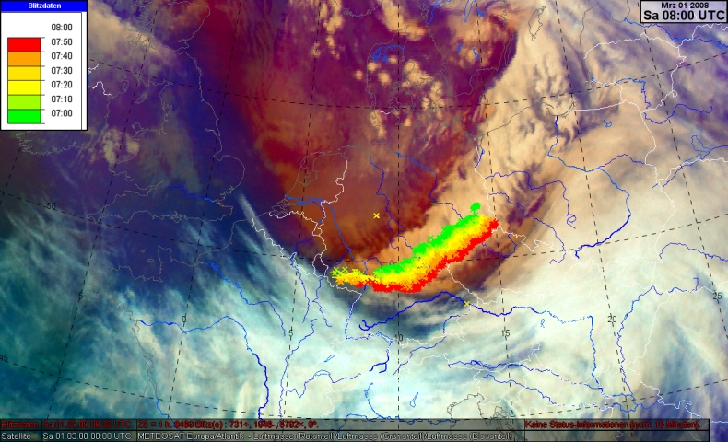
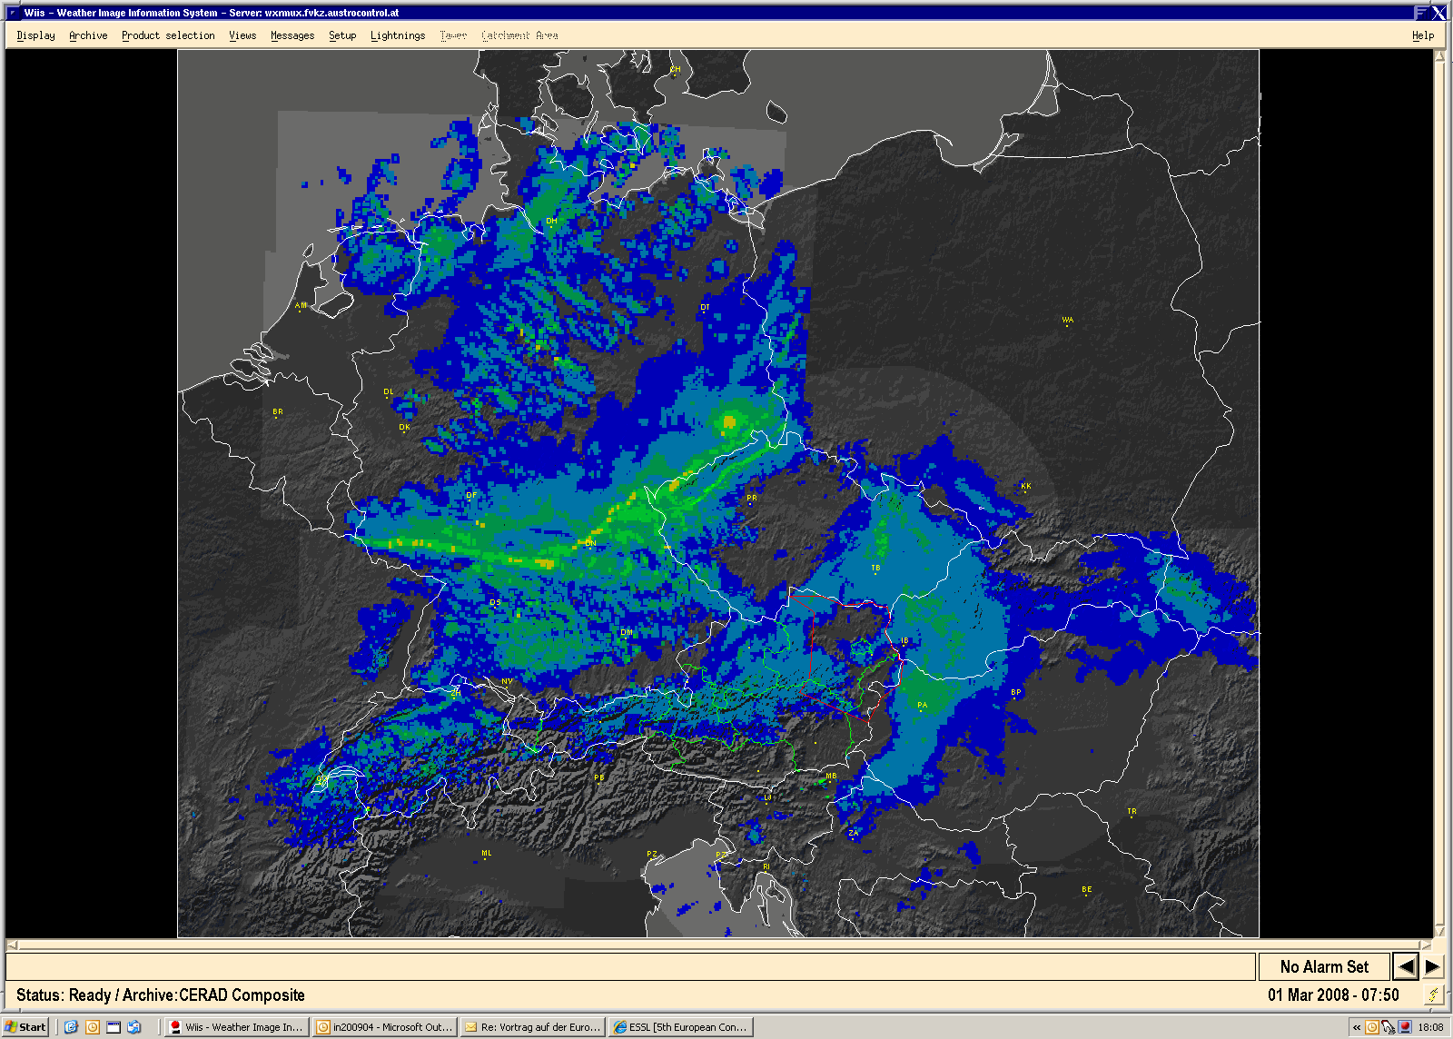
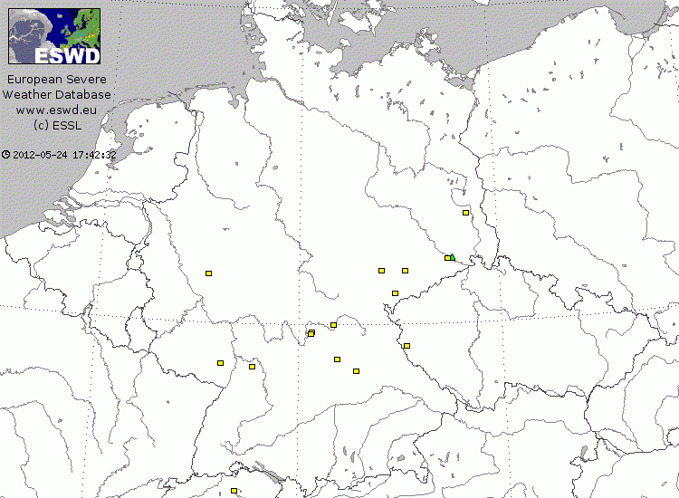
|| introduction || synoptic scale || mesoscale || small scale || conclusions ||
08 UTC 01 March 2008
Upper left: Meteosat RGB product & lightning strokes
Upper right: CERAD radar composite
Lower right: ESWD entries
(sources: EUMeTrain, AustroControl, ESSL)

Slide 37
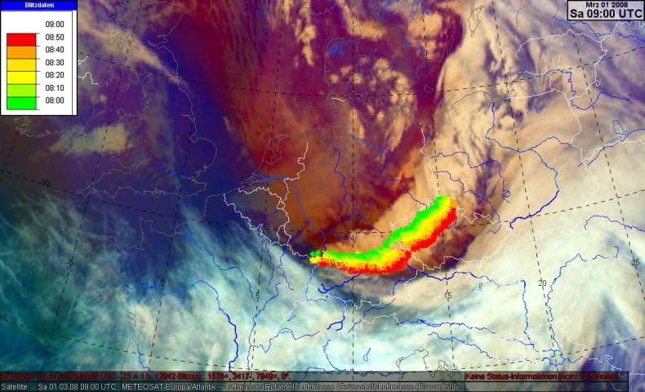
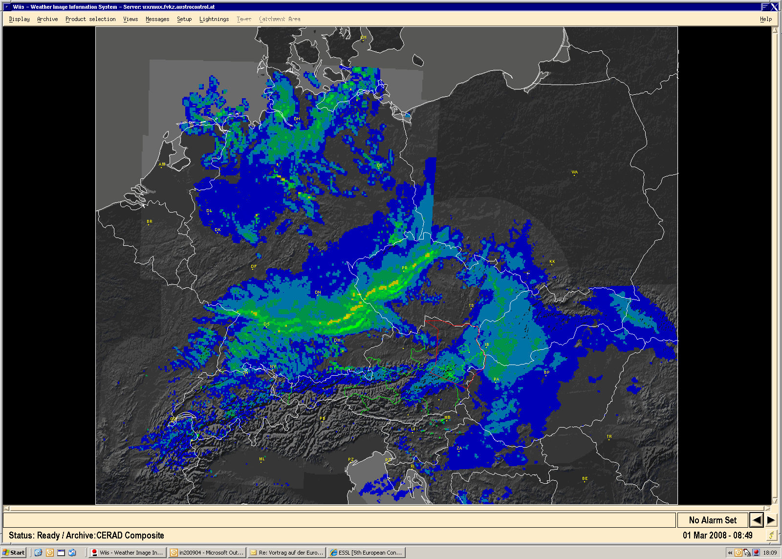
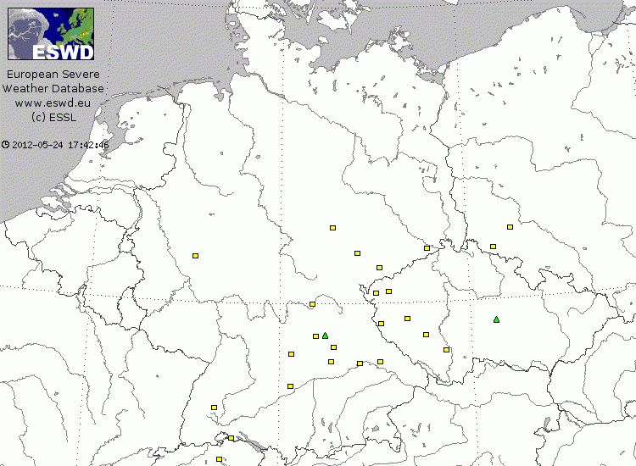
|| introduction || synoptic scale || mesoscale || small scale || conclusions ||
Bavarian Forest seems to slow down and divide convective line
Maximum of lightning activity!
Increased clearing ahead of front
09 UTC 01 March 2008
Upper left: Meteosat RGB product & lightning strokes
Upper right: CERAD radar composite
Lower right: ESWD entries
(sources: EUMeTrain, AustroControl, ESSL)

Slide 38
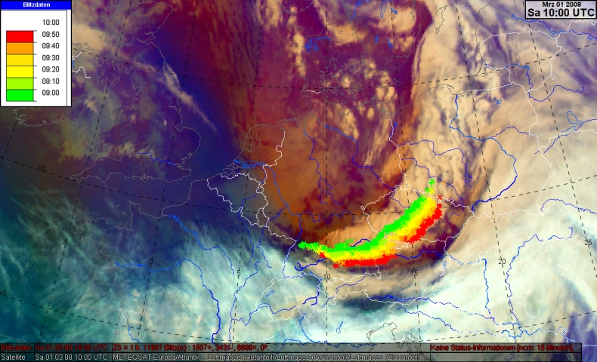
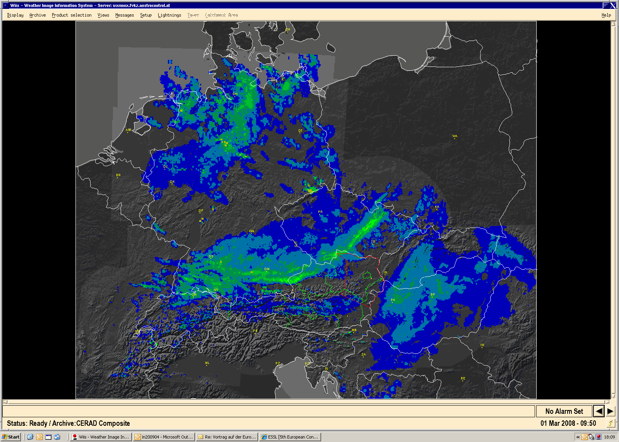
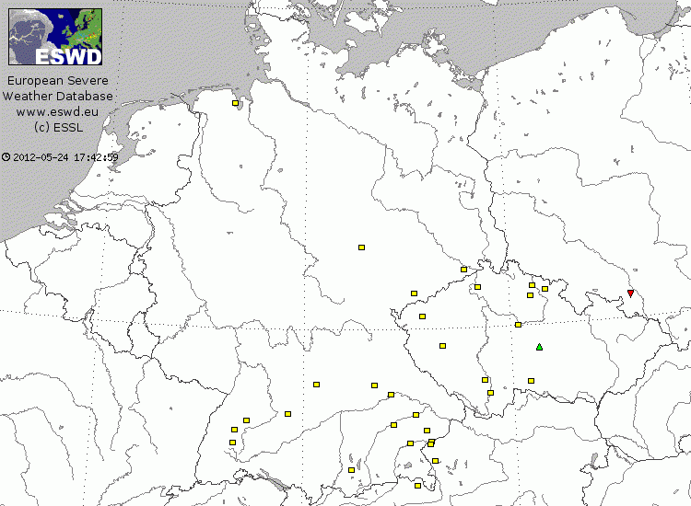
|| introduction || synoptic scale || mesoscale || small scale || conclusions ||
Foehn effects along Northern and Eastern Alpine rim
10 UTC 01 March 2008
Upper left: Meteosat RGB product & lightning strokes
Upper right: CERAD radar composite
Lower right: ESWD entries
(sources: EUMeTrain, AustroControl, ESSL)

Slide 39
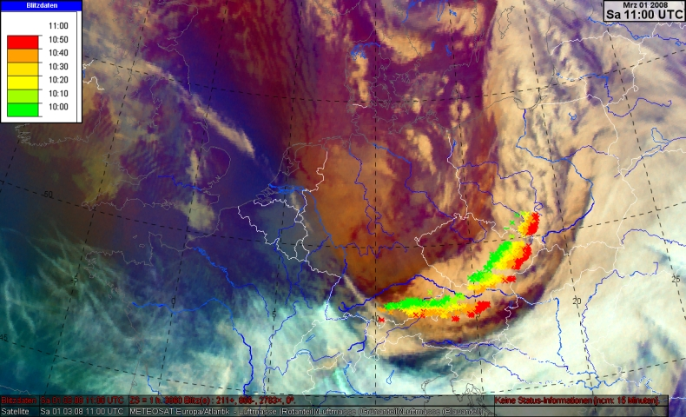
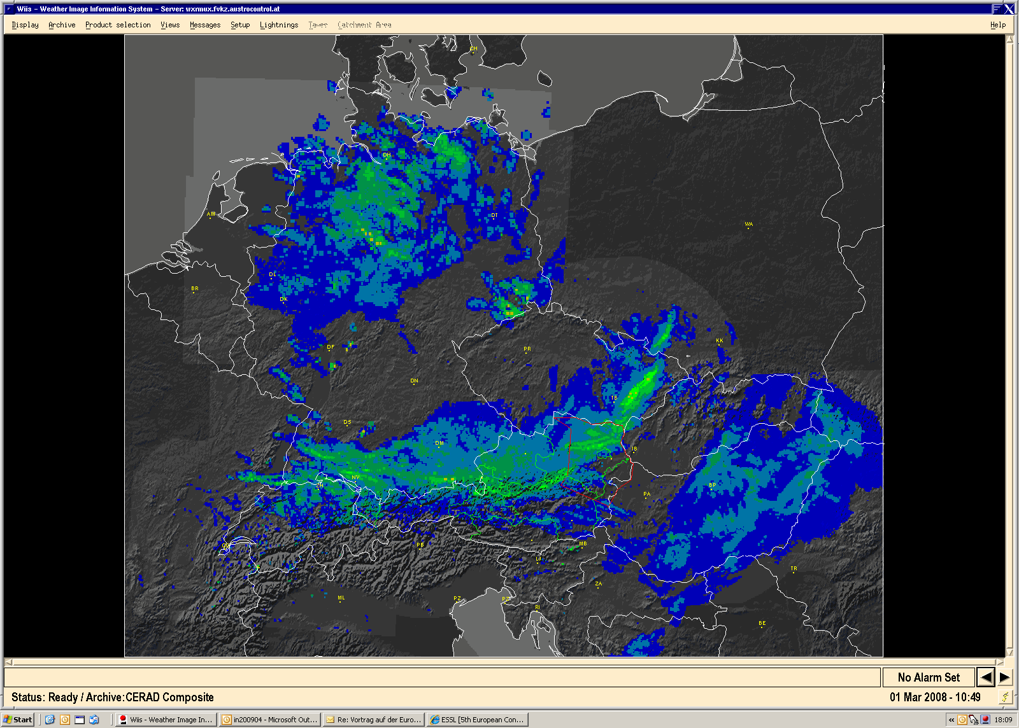
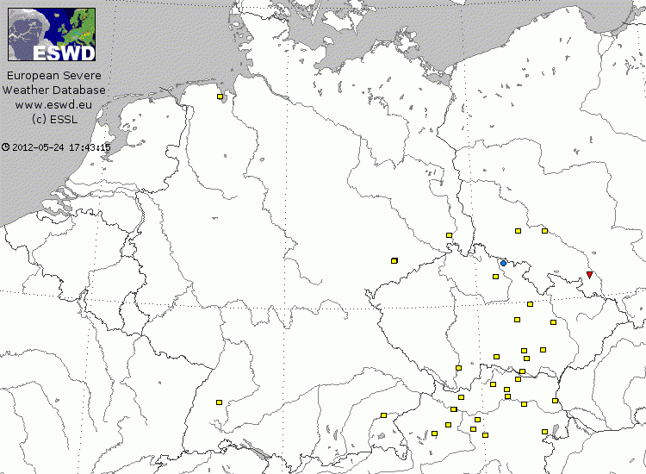
|| introduction || synoptic scale || mesoscale || small scale || conclusions ||
Maximum of severe weather reports!
11 UTC 01 March 2008
Upper left: Meteosat RGB product & lightning strokes
Upper right: CERAD radar composite
Lower right: ESWD entries
(sources: EUMeTrain, AustroControl, ESSL)

Slide 40
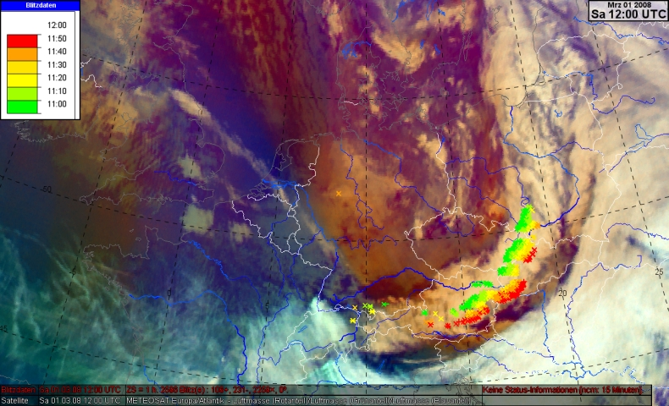
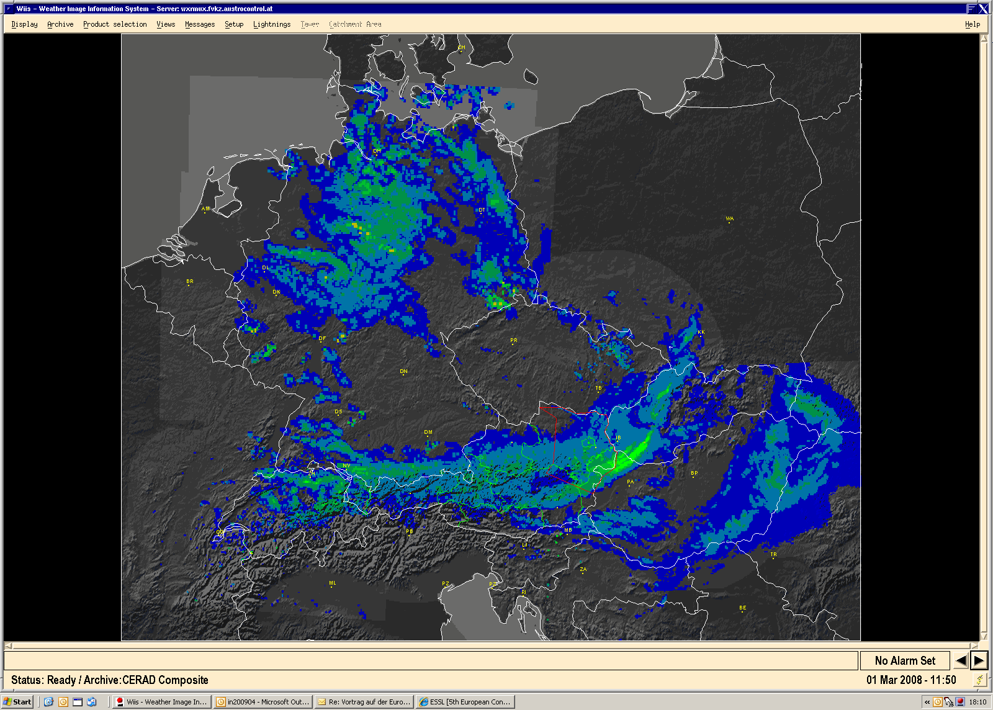
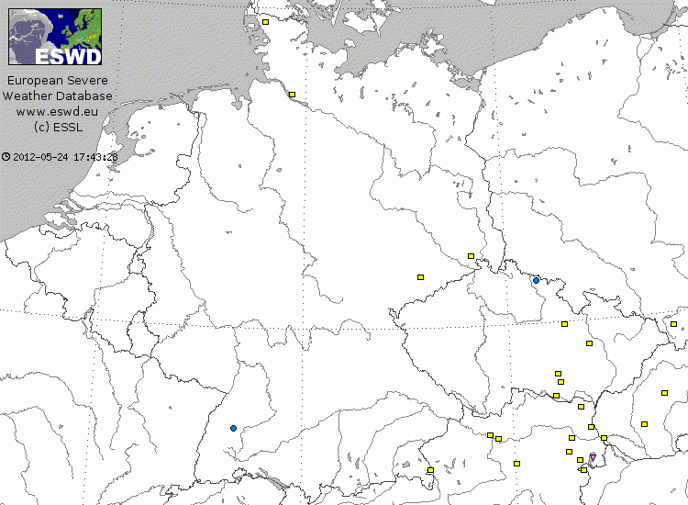
|| introduction || synoptic scale || mesoscale || small scale || conclusions ||
12 UTC 01 March 2008
Upper left: Meteosat RGB product & lightning strokes
Upper right: CERAD radar composite
Lower right: ESWD entries
(sources: EUMeTrain, AustroControl, ESSL)

Slide 41
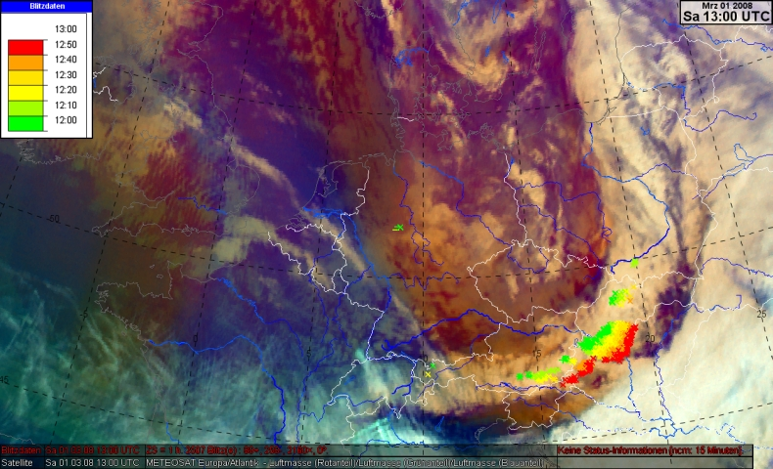
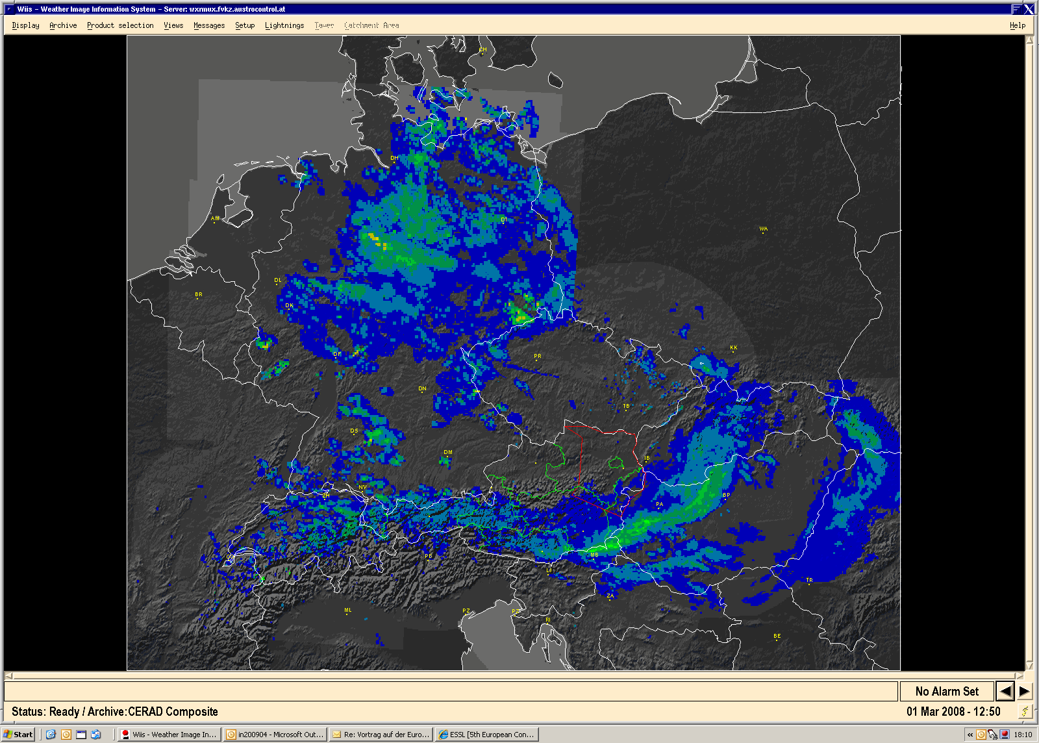
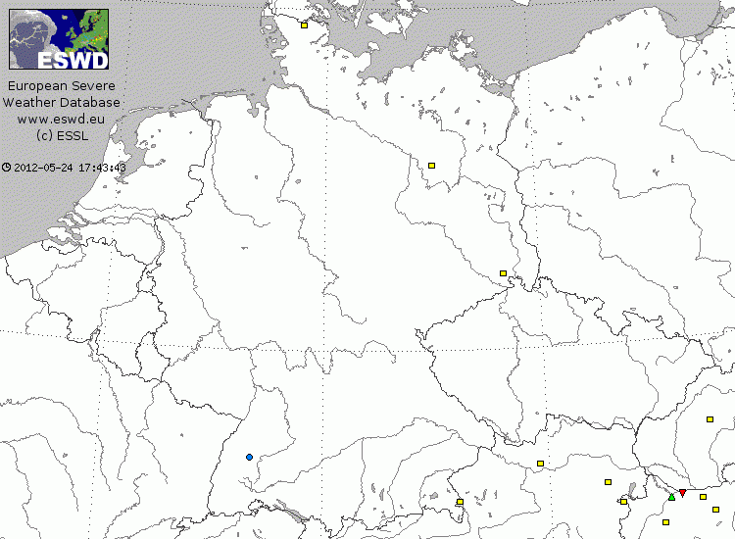
|| introduction || synoptic scale || mesoscale || small scale || conclusions ||
13 UTC 01 March 2008
Upper left: Meteosat RGB product & lightning strokes
Upper right: CERAD radar composite
Lower right: ESWD entries
(sources: EUMeTrain, AustroControl, ESSL)

Slide 42
|| introduction || synoptic scale || mesoscale || small scale || conclusions ||
14 UTC 01 March 2008
Upper left: Meteosat RGB product & lightning strokes
Upper right: CERAD radar composite
Lower right: ESWD entries
(sources: EUMeTrain, AustroControl, ESSL)

Slide 43
|| introduction || synoptic scale || mesoscale || small scale || conclusions ||
Extreme measurements:
Place | Hour [UTC] | Maximum Gust [km/h] | Comment
Melpitz near Leipzig (DE) | 07 | 165 | LIDAR measurement (10s mean at 12m height)
Chemnitz (DE) | 08 | 151 | SYNOP report
St. Peter/Hart near Braunau (AT) | 10 | ~240 | Site survey
Salzburg airport (AT) | 10 | 140 | SYNOP report
Oberleis (AT) | 11 | 166 | SYNOP report
Vienna airport (AT) | 11 | 140 | SYNOP report
Vienna airport (AT) | 11 | 163 | Runway anemometer
Salzburg airport (AT)
© APA
Ebensee (AT)
© APA

Slide 44
|| introduction || synoptic scale || mesoscale || small scale || conclusions ||
Wrap-up of events (measurements, media reports, …):
Widespread severe wind gusts in the upper F0 and lower F1 range (i.e., 90 to 130 km/h)
A few stronger events in the solid F1 range (i.e., 130 to 170 km/h) can mainly be explained by special exposure of sites
No explanation for the extreme Braunau downburst => what caused this singularity?

Slide 45
|| introduction || synoptic scale || mesoscale || small scale || conclusions ||
INCA maximum windgust analysis 01 March 2008 (Austria):
X … sites of deadly incidents
S … Salzburg
O … Oberleis
V … Vienna
B … Braunau
(data source: ZAMG)

Slide 46
Site survey (3)
|| introduction || synoptic scale || mesoscale || small scale || conclusions ||
Pictures © A.M. Holzer

Slide 47
Site survey (3)
|| introduction || synoptic scale || mesoscale || small scale || conclusions ||
Pictures © A.M. Holzer

Slide 48
Site survey (3)
|| introduction || synoptic scale || mesoscale || small scale || conclusions ||
Pictures © A.M. Holzer

Slide 49
Site survey (3)
|| introduction || synoptic scale || mesoscale || small scale || conclusions ||
Pictures © A.M. Holzer

Slide 50
Site survey (7)
|| introduction || synoptic scale || mesoscale || small scale || conclusions ||
Ranshofen weather station

Slide 51
Site survey (7)
|| introduction || synoptic scale || mesoscale || small scale || conclusions ||
T6: 256 – 295 km/h F3: 256 – 335 km/h EF3: 219 – 266 km/h

Slide 52
Synopsis (8)
|| introduction || synoptic scale || mesoscale || small scale || conclusions ||
Ranshofen automatic station (close to begin of damage swath):
cold air pool
cold air pool
Pressure signal:
+6 hPa / 10 min
+10 hPa / h
Maximum wind gust:
103 km/h
Temperature signal:
-8 K / 10 min
-12 K / h
(data source: ZAMG)

Slide 53
|| introduction || synoptic scale || mesoscale || small scale || conclusions ||
X
Austrian radar composite
0900 UTC 01 March 2008
(source: AustroControl)

Slide 54
|| introduction || synoptic scale || mesoscale || small scale || conclusions ||
X
Austrian radar composite
0915 UTC 01 March 2008
(source: AustroControl)

Slide 55
|| introduction || synoptic scale || mesoscale || small scale || conclusions ||
X
Austrian radar composite
0930 UTC 01 March 2008
(source: AustroControl)

Slide 56
|| introduction || synoptic scale || mesoscale || small scale || conclusions ||
X
Austrian radar composite
0945 UTC 01 March 2008
(source: AustroControl)

Slide 57
|| introduction || synoptic scale || mesoscale || small scale || conclusions ||
X
Austrian radar composite
1000 UTC 01 March 2008
(source: AustroControl)

Slide 58
|| introduction || synoptic scale || mesoscale || small scale || conclusions ||
X
Austrian radar composite
1015 UTC 01 March 2008
(source: AustroControl)

Slide 59
Synopsis (9)
|| introduction || synoptic scale || mesoscale || small scale || conclusions ||
Maximum of radar reflectivity
Well-marked overhang (artifact due to fast movement?)
Salzburg radar: MAXCAPPI & cross sections
0945 UTC 01 March 2008
(source: AustroControl)

Slide 60
|| introduction || synoptic scale || mesoscale || small scale || conclusions ||
INCA temperature analysis 10 UTC 01 March 2008 (Austria):
Boundaries:
Cold front
Dryline (?)
No Foehn:
Ranshofen
T = 14°C
Td = 5°C
Foehn:
Salzburg
T = 16°C
Td = -1°C
(data source: ZAMG)

Slide 61
Conclusions (2)
|| introduction || synoptic scale || mesoscale || small scale || conclusions ||
Guiding theme:
Interaction of supporting factors over a wide range of scales managed to create this extraordinary storm!
Developments on the synoptic scale set the stage for a pronounced cyclone development
Developments on the mesoscale created the convective line which enhanced and concentrated the severe weather threat
Developments on small scales governed the final position and strength of outstanding donwburst event(s)

Slide 62
Conclusions (2)
|| introduction || synoptic scale || mesoscale || small scale || conclusions ||
Supporting factors on the synoptic scale:
Presence of a strong frontal zone
Favorable interaction between dry intrusion and low pressure system
Optimum interaction and feedback processes between low-level cyclogenesis and formation of upper-level short wave trough
Resulting rapid cyclogenesis

Slide 63
Conclusions (2)
|| introduction || synoptic scale || mesoscale || small scale || conclusions ||
Supporting factors on the mesoscale:
Favorable interaction between dry intrusion and cold front
Release of potential instability by forced ascent along short-wave trough
Formation of a persistent convective line with a pronounced cold air pool in its wake
Balanced state between front inflow and „rear inflow jet“

Slide 64
Conclusions (2)
|| introduction || synoptic scale || mesoscale || small scale || conclusions ||
Supporting factors on small scales:
Probable presence of a pre-frontal „dryline“, a boundary perpendicular to the cold front which may have enhanced rising motions
?
Largely unknown!

Slide 65
|| introduction || synoptic scale || mesoscale || small scale || conclusions ||
Epilogue: the storm in Vienna
Thank you for your attention!

